Slide 1

Oracle JET Talent Launch April 2018 Jeroen Rijnboutt & Laura Broekstra

Slide 2
Oracle JET

Slide 3

Facts
Oracle JET announced on OOW 2015
Open Source Release (v2.0.0) February 2016
Version 3 - March 2017
Version 4 - September 2017
Version 5 - April 2018

Slide 4
What is JET?
JET is an JavaScript Extensible Toolkit.
Not to be confused with a framework.
Oracle chooses open-source modularity over a framework with possible deprecation.
What is a toolkit?
Collection of proven (adult) libraries.
Together they provide all needed functionality.

Slide 5
Advantages toolkit
Easier to add libraries.
Easier to throw out libraries and choose different solution.
Easy for Oracle to change configuration of toolkit in later versions.
Good documentation for separate libraries

Slide 6
Disadvantages toolkit
Not the most modern. (No TypeScript, ES5 source code)
Possible faster EOL for older versions
No concise documentation

Slide 7

What is in the toolkit?
RequireJS – Lazy-loading of modules
KnockoutJS – Databinding
jQuery
Cordova – Mobile applications

Slide 8

Oracle JET and AMIS
Darling - begin 2017 (POC)
Follow-up Darling – october 2017
IHC – summer 2017 (2 small portals)
Follow-up IHC – november 2017 (1 big portal)
Grown to 5 developers (+2 architects)

Slide 9
Agenda – Day 1
General JET
First installation
Refreshing our JavaScript
RequireJS
KnockoutJS
Lunch
JET Cookbook
Working with REST
JET Common Model

Slide 10
Agenda – Day 2
Finish assignments day 1
Visualization components
Layout
Lunch
JET architecture
Composite Components

Slide 11
Installing JET
JET current version 4.2.0
Get Started page: http://www.oracle.com/webfolder/technetwork/jet/globalGetStarted.html
Install Oracle JET CLI from NPM
npm -g install @oracle/ojet-cli
ojet create <applicationName>
Optional: Use a template:
ojet create <applicationName> --template=navdrawer

Slide 12
JET templates
http://www.oracle.com/webfolder/technetwork/jet/globalExamples.html
Basic Starter – no navigation
Nav Bar Starter – a navigation bar
Nav Drawer Starter – a navigation drawer

Slide 13
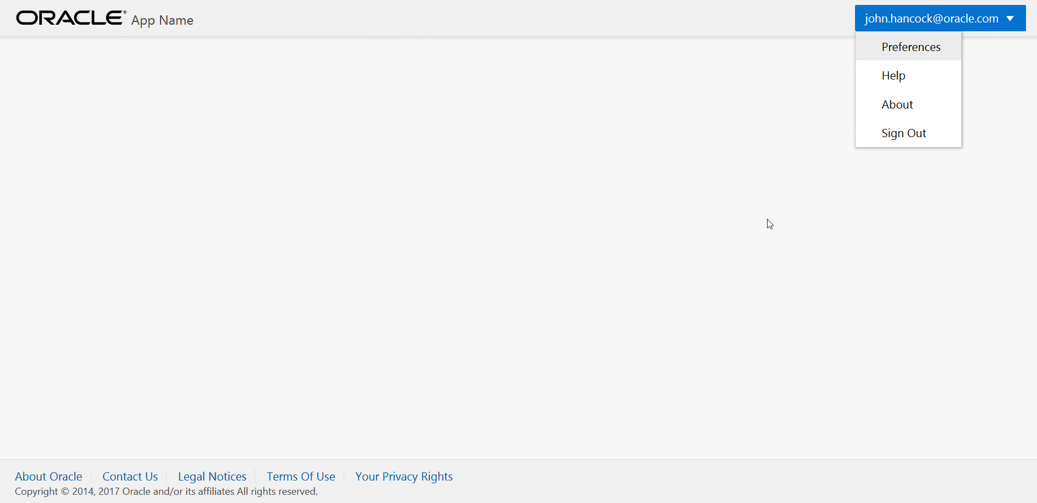
Basic starter

Slide 14
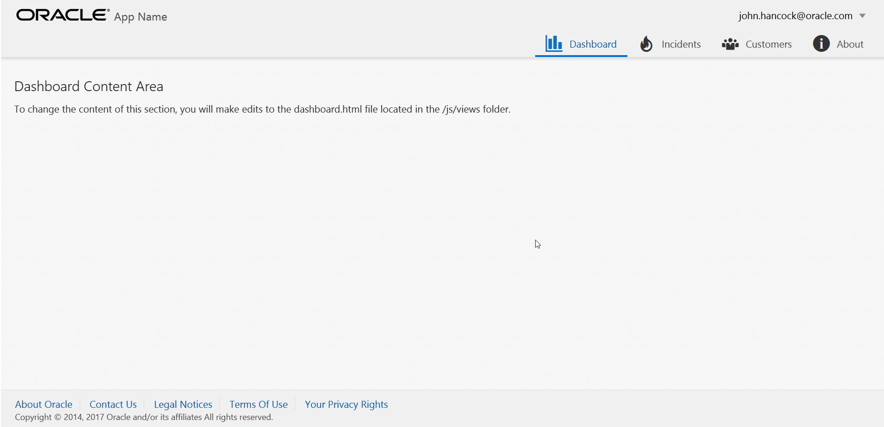
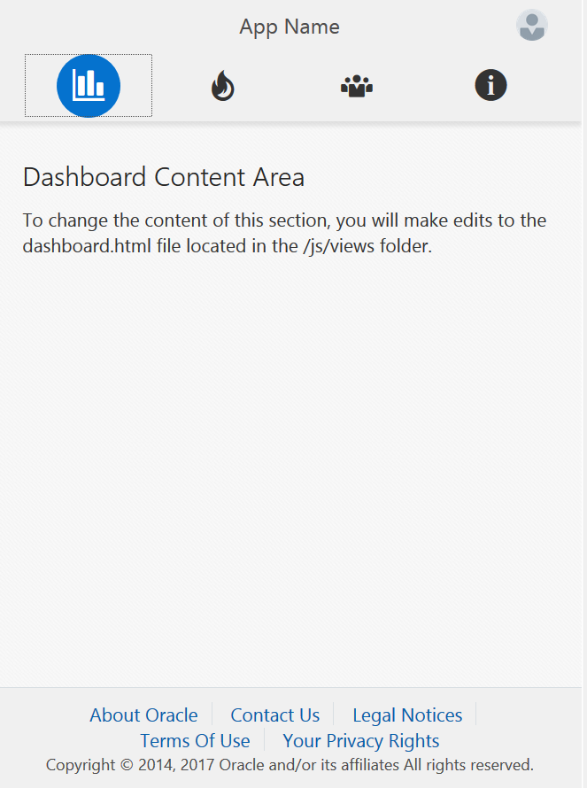
Navbar

Slide 15
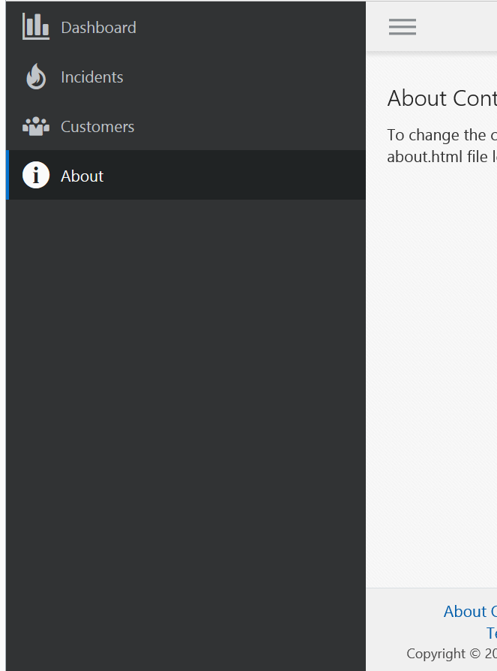
Navdrawer

Slide 16
Assignment - First application

Slide 17
JavaScript Refresher

Slide 18
JavaScript refresh
Presentation JavaScript
Differences / Similarities Java
Notes:
Because half of the learners in the training know little JavaScript but do know Java. Can be skipped.

Slide 19
STATEMENTS, COMMENTS AND VARIABLES
Statements: Can be separated by new line or semicolon.
Comments: 2 types.
Single line: // Author: Joe
Multi line: /* Perhaps some lengthy license. */

Slide 20
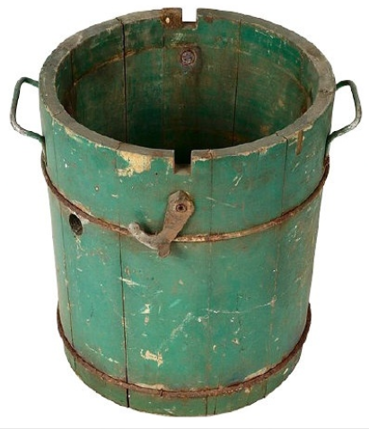
VARIABLES (i,e, buckets)
Overwrites when redefined. 2 types.
Local: Declared using var keyword.
Global: Declared without var keyword
Assignment operator (=) to assign values.
var something = “value”;

Slide 21
VARIABLE DATA TYPES (i.e. stuff that goes in buckets)
The latest ECMAScript standard defines seven data types:
Six data types that are primitives:
Boolean
Number
String
Null
Undefined
Symbol (new in ECMAScript 6)
and Object
The typeof operator can help you to find the type of your variable.
var something = “value”;
Typeof something // string

Slide 22
NUMBERS
3, -3, 3.33, -3.33. These all are numbers in JS, whether it’s some integer or floating point number.
Operations: addition (+), subtraction (-), division (/), multiplication (*), modulo division (%)
Result is always promoted to float whenever possible.
5 / 3, 3 / 5, 0.5 * 5, 0.5 + 5
Assignment operators: +=, -=, /=, *=, %=
Special operators: increment (++), decrement (--)
var one = 2 – 1;
var two = 1 + 1;
var three = 9 / 3;
var four = 2 * 2,
var five = three + two;
var inc = five;
inc++; // inc = inc + 1
var total = four;
total += five; // 9

Slide 23
STRINGS
Strings: Series/sequence of characters from zero to infinity. Can contain any character. Can be created using single or double quotes.
Use backslash (\) to escape special characters.
“Hi this is \“special\” word here.”
“Hi this is \ttab\t here.“
Operations: Concatenation.
var name = “Some ” + “string.”
var name = “Some ” + someVar + “.”
var name = “John ”; name = name + “Doe”;
var name = “John ”; name += “Doe”;

Slide 24
BOOLEANS
Booleans: Are you saying true or false.
Cases for true
“<1 space here>”, “string”, “undefined”, 1, 2, 3, -3, -2, -1, true;
all represents true value.
Cases for false
“<empty string>”, undefined, null, 0, false;
all represents false value.
var yes = true;
var no = false;

Slide 25
ARRAYS
Arrays: To hold a collection of items together. Can store any data types together in single array.
var array = [1, {“k”: “v”}, 2.3, [“another”, “array”]];
2 types: Single dimensional and Multi dimensional (array of array(s)).
var array = [“1st”, “2nd”, “3rd”];
var arrayM = [[“1st”], [“2nd”], [“3rd”]];
Accessing values stored in array: We use what is called index which is some integer ranges from 0 to array’s length - 1.

Slide 26
ACCESSING ARRAYS
Accessing Single dimensional array:
array[0]; // 1st
array[1]; // 2nd
array[2]; // You guess here.
Accessing Multi dimensional array:
arrayM[0]; // [“1st”]
arrayM[0][0]; // 1st.

Slide 27
WRITING TO ARRAYS
Writing to Single dimensional array:
array[0] = “1st”;
array[1] = “2nd”;
array[2] = “3rd”;
Writing to Multi dimensional array:
arrayM[0] = [“1st”];
arrayM[0][0] = “1st”;

Slide 28
CONTROLLING PROGRAM FLOW
Conditions: Making decisions.
Flow statements: Expects a boolean expression.
Expression is a combination of values, variable references, function calls and operators that evaluates to some value.
Some comparison operators that we can use are:
less than (<), greater than (>),
less than equal to (<=), greater than equal to (>=), equals to (==),
not equals to (!=), not (!)
Multiple conditions operators:
and (&&),
or (||)

Slide 29
CONDITION: COMPARISON
var my_var = 1;
my_var > 2; // false
my_var < 2; // true
my_var == 2; // false
my_var >= 2; // false
my_var <= 2; // true
my_var != 2; // true
my_var === 2; // false
my_var !== 2; // true
Data type check
my_var === 1; // true
my_var === “1”; // false
my_var === 1; // true
my_var === “1”; // false
Logical checks
my_var > 2 && my_var < 10 // false
my_var > 2 || my_var < 10 // true

Slide 30
IF STATEMENTS
if-else statement: if condition is false then execute the else block.
else-if statements: It’s not reverse of the if-else. It just says if condition false then check this (else-if) condition.
if (condition) { // condition = someVar < 2
// Some true code
} else if (condition) { // condition = someVar > 4
// Some 2nd true code
} else {
// Some false code
}

Slide 31
SWITCH STATEMENT
The switch statement is used to perform different actions based on different conditions.
switch(expression) {
case “F”:
// code block
break;
case “M”:
// code block
break;
default:
// code block
}

Slide 32
LOOPS
Loops: Minimizing repetition
while loop: Simplest loop. While condition is true run the code. Condition can be any expression.
do-while loop: Runs at least once, as condition is evaluated after running the loop body. As always condition can be any expression.
for loop: Succinct all the above!
All the loops must consist three things:
Incrementer,
conditional expression,
logic to increase the incrementer – so that condition eventually turns to false.

Slide 33
LOOPS
while loop:
while (condition) {
// Run the code
}
do-while loop:
do {
// Run the code
} while (condition)
for loop:
for (declaration; condition; action) {
// Run the code
}

Slide 34
FOR LOOPS
for (var i = 0; i < 10; i++) {
console.log( i );
}
// 0,1,2,3,4,5,6,7,8,9
var cars = ["BMW", "Volvo", "Saab", "Ford"];
var text = ""; for (var i = 0; i < cars.length; i++) { text += cars[i] + “, "; }

Slide 35
FUNCTIONS: WRITING CODE FOR LATER
If we want to re-run some code again and again from different places, then put that code in a function and call this function.
Functions are like little packages of JavaScript code waiting to be called into action.
Some predefined functions are alert(), prompt() and confirm().
Functions can return values.
Values returned by functions are:
undefined or null
user input string “I have enterered this with my keyboard”
empty string “”
true or false

Slide 36
MY FUNCTIONS
Writing your own functions:
function sayHi() {
alert(“Hi”);
}
Calling functions:
sayHi();
Parentheses are needed to call the functions.

Slide 37
ARGUMENTS: PASSING DATA TO FUNCTIONS
Arguments or parameters: When a function expects something then it’s called a parameter. While we pass the expected data to a function then it’s called arguments.
Declaring parameters:
function sayHi(name) {
alert(“Hi ” + name);
}
Calling function with arguments:
sayHi(“Joe”);
Functions can contain any number of parameters/arguments.
addAllNumbers(3,6,9,4,7);

Slide 38
FUNCTIONS: RETURN
Returning: As we know functions can return the values. We use return statement to return something.
function sayHi(name) {
return “Hi ” + name;
}
var greeting = sayHi(“Joe”); // “Hi Joe”

Slide 39
OBJECTS
Objects exist as a way of organizing variables and functions into logical groups. If we create objects to organize some variables and functions then the terminology changes slightly, now they are called properties and methods respectively.
Array is an object of JavaScript. An array can be created as follows:
var array = new Array(1, 2, 3); // [1, 2, 3];
This is called instantiation of an object using the new keyword.
Built-in objects: String, Date, Math, Boolean, Number, RegExp, Object, Array

Slide 40
EVERYTHING IS AN OBJECT: STRING
var str_a = '1 2 3 4 5‘;
var str_b = '6 7 8 9';
str_a.length; // 9
str_a.concat( ' ', str_b ); // '1 2 3 4 5 6 7 8 9'
str_a.indexOf( '1' ); // 0
str_a.lastIndexOf( ' ' ); // 7

Slide 41
EVERYTHING IS AN OBJECT: ARRAY
var arr = [ 1, 2, 3, 4, 5 ];
arr.length; // 5
arr.join( ' ' ); // '1 2 3 4 5'
arr.pop(); // [ 1, 2, 3, 4 ]
arr.push( 6 ); // [ 1, 2, 3, 4, 6 ]
arr.reverse(); // [ 6, 4, 3, 2, 1 ]
arr.shift(); // 6 removed from the array
arr.unshift( 5 ); // 5 added to the beginning
arr; // [ 5, 4, 3, 2, 1 ]

Slide 42
jQuery
JavaScript library
Simplifies common tasks
Helps with AJAX calls, DOM manipulation.
Widely used and supported

Slide 43
jQuery syntax
$
$(“#button”).click(); -id
$(“.button”).click(); -class
$(“button”).click(); -tag
$(selector).action() = DOM manipulation
Actions: click, hide, show, toggle, fade etc.

Slide 44
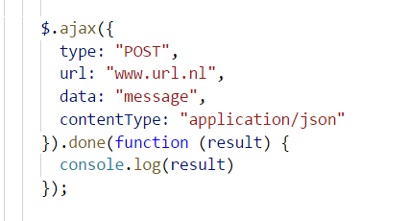
jQuery AJAX
GET
$.get(URL,callback);
$.get("https://swapi.co/api/people/1", function(data){ alert("Data: " + data); });
POST
$.post(URL,data,callback);
More options available (headers, contentType, succes, fail)

Slide 45
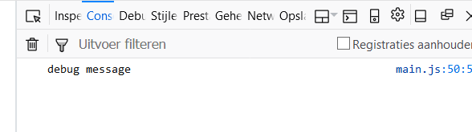
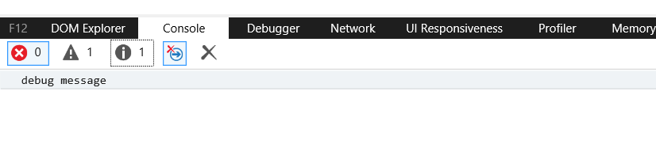
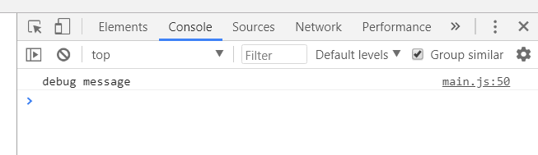
JavaScript debugging
Console.log
console.log(‘debug message’);
Also Objects, Arrays, etc.
Debugging / developer tools available in all browsers (F12)

Slide 46
JET logging
Standard JET logger: ojLogger
Different default log levels: ERROR, WARN, LOG, INFO, NONE
Write a logline:
oj.Logger.warn("Beware of bugs in the above code");
By default only log errors and higher will show in the console
Change the loglevel manually in code or console
oj.Logger.option("level", oj.Logger.LEVEL_WARN);
ERROR
WARN
LOG
INFO
NONE

Slide 47
Require & Knockout

Slide 48
RequireJS
Week 1 - part 2: https://www.youtube.com/watch?v=yznhGmE9VEg
Week 1 - part 3: https://www.youtube.com/watch?v=it9EvsNEPMw

Slide 49
KnockoutJS
Library for databinding
Good tutorials: http://knockoutjs.com/
Start with: Introduction & Working with Lists and collections

Slide 50
Observables
Declare an emtpy observable:
var dynamicValue = ko.observable();
Declare and instantiate an observable:
var dynamicValue = ko.observable(“option1”);
Instantiate an existing observable:
dynamicValue(“option2”);
Retrieve the value of an observable:
var value2 = dynamicValue();
Subscribe to an observable:
dynamicValue.subscribe(function(newValue){
console.log(“Value changed to: ” + newValue);
}

Slide 51
Observable Arrays
Declare the array:
var niceArray = new ObservableArray([“String1”, “String2”]);
Add a new item:
niceArray.push(“String3”);
Remove last item:
niceArray.pop();
Remove specific item:
niceArray.remove(“String2”);
Read more in documentation: http://knockoutjs.com/documentation/observableArrays.html

Slide 52
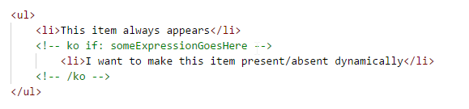
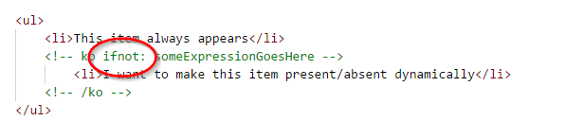
Ko if and if not
Easy way to dynamically show and hide divs in your view
Use comment syntax:

Slide 53
New databinding syntax since JET 4.0
Oracle takes a small step towards Angular
<span data-bind="text: id"></span>
<span data-bind="text: name"></span>
Becomes:
<p>{{id}} {{name}}</p>
This is two-way databinding (write changes back to observable)
One-way binding (no write-back) goes like this:
<p>[[id]] [[name]]</p>

Slide 54
Assignment - Knockout

Slide 55
JET Cookbook

Slide 56

JET Cookbook
JET Components
Shows all available JET components
Code examples
Adjust and test code in browser
JS Doc
Notes:
Short demo of JET Cookbook, show different categories
Short demo of how to include component in code

Slide 57
JET Cookbook
Checklist
Use HTML
Use JavaScript
Include component in define-block
Notes:
Checklist to remember when using components from cookbook

Slide 58
Assignment - JET Cookbook

Slide 59
REST

Slide 60
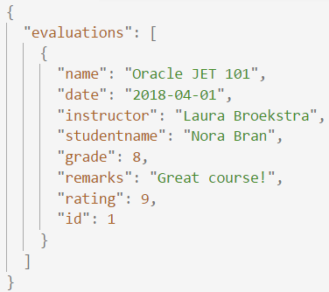
REST
REST
JSON
REpresentational State Transfer
Acces web services
HTTP calls (GET / POST / DELETE / ..)
Call with URL
Response code
JSON output
JavaScript Object Notation
Easy to use for humans and computers
Name/value pairs
List of values
Notes:
Explain the different types of requests in short
Further explain the JSON-format: what are the pairs?

Slide 61
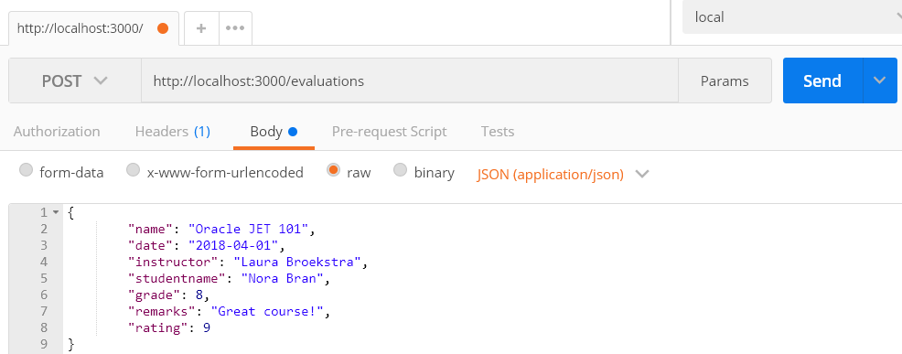
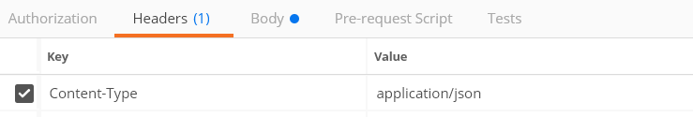
REST
POST(man)
POST-request to save data
Test requests with Postman
Notes:
Showing Postman here as it is a good tool to have in your toolbox.
It is enough to know the basics of request and request body.
But also possible to add headers (in case of this request necessary)
Authorization added
Testing.

Slide 62
REST
JSON-(mock)server
JSON-file
localhost:
3000
App
Exposes data
Request
Notes:
For the assignments in this course we will use json-server as an easy way to get and post data

Slide 63
Assignment - JSON Server & POST

Slide 64
Common Model

Slide 65
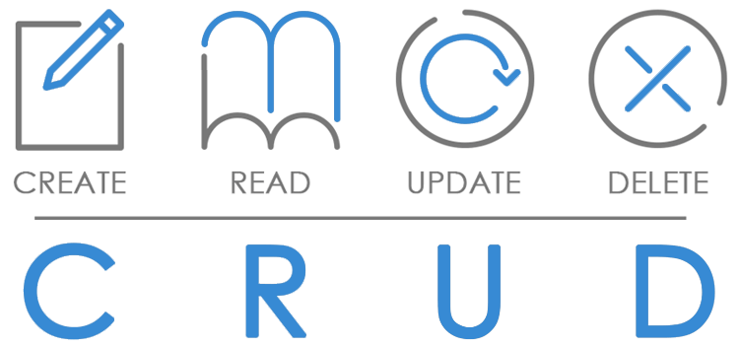
Common Model
Framework
Perform operations on data in backend
Add headers and customize request-URL
Format data for JET collection components
Standard methods to apply to data (get, filter, metadata, transform)
Notes:
Methods to apply: get a specific record, filter the data, get indexnumbers and fetchsizes, transform data to JSON

Slide 66
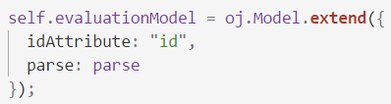
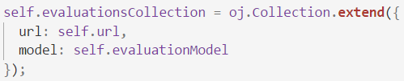
Common Model
Model
Collection
Tabel
Record
Record
Record
Record

Slide 67
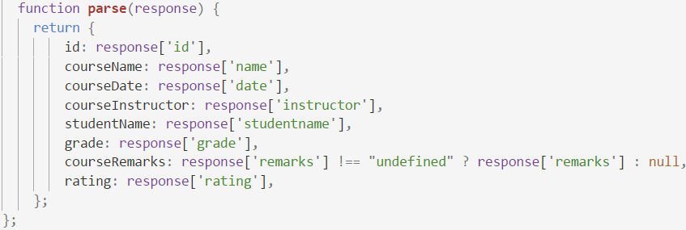
Common Model
REST
GET
JSON
Parse to easy to use object

Slide 68
Common Model
Datasource
Representation of data usable by components
CollectionTableDataSource can be used by Table
Notes:
Can depend on representation of data (collection or array) and the jet component

Slide 69
Assignment - Collection & Table

Slide 70
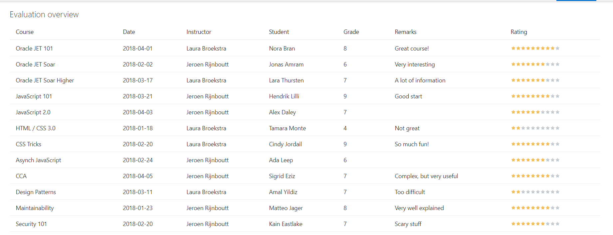
End of Oracle JET Day 1

Slide 71
Recap Day 1

Slide 72
Recap day 1
What is JET?
First application
JavaScript refresher
RequireJS
KnockoutJS
Cookbook
REST
Common Model

Slide 73
Program day 2
Finish excercises day 1
Visualization components
Layout
Application architecture
Composite Component
Create your own Component!
Wrap-up

Slide 74
Visualisations

Slide 75
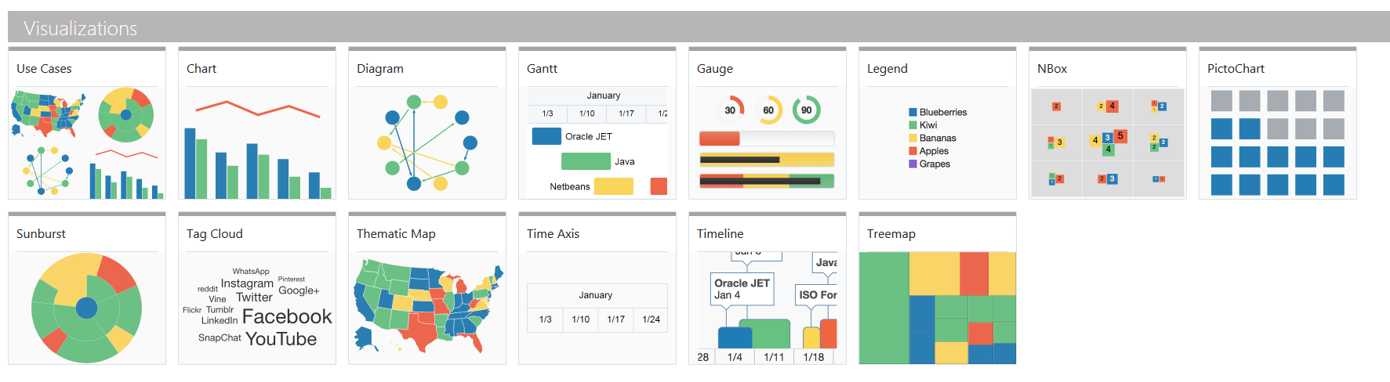
Visualization Components
JET provides numerous nice components in the Cookbook
One of the key features of Oracle JET

Slide 76
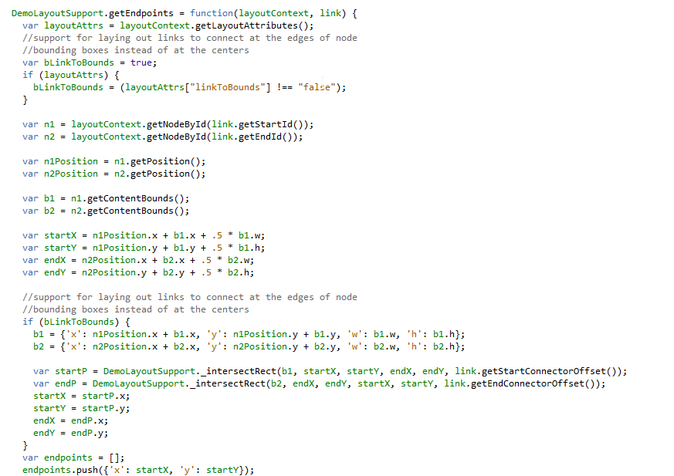
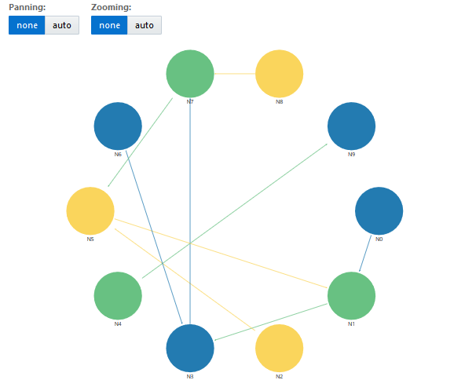
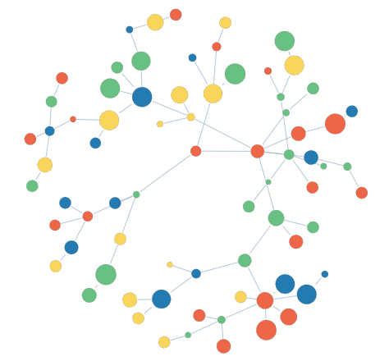
Cookbook caution
Required data structure can be complex

Slide 77
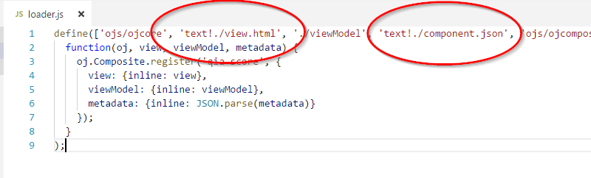
RequireJS text plugin
Standard part of JET
Used for inserting non-JavaScript files
Used in all Composite Components:

Slide 78
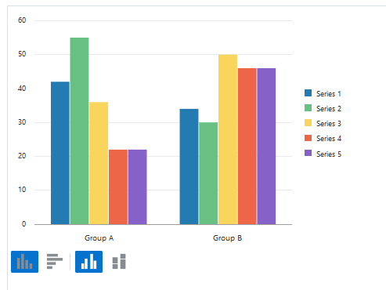
Assignment - Chart
We start easy: Bar Chart
Extra excercises for more complexity
Use the JSdocs! Some options are not used in the cookbook

Slide 79
Layout

Slide 80
Layout
Flexbox
Responsive
flex-container (oj-flex)
(oj-)flex-item
(oj-)flex-item
(oj-)flex-item

Slide 81
Layout
Flex-direction: row (default)
Flex-direction: column
Main Axis
Cross Axis
Cross Axis
Flexcontainer
Main Axis
Flexcontainer

Slide 82
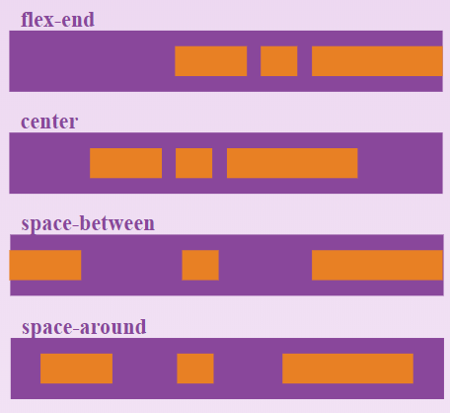
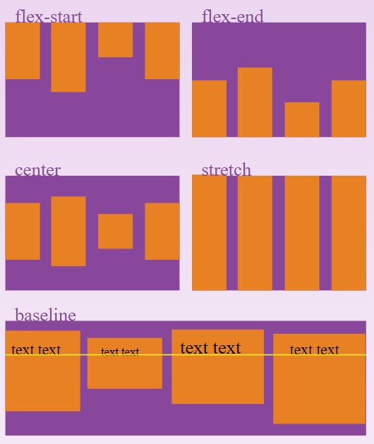
Layout
Alignment
Justify-content: align items along Main Axis
Flex-end
Center
Space-around
Space-between
Align-items: align items along Cross Axis
Center
Flex-start
Flex-end
Baseline

Slide 83
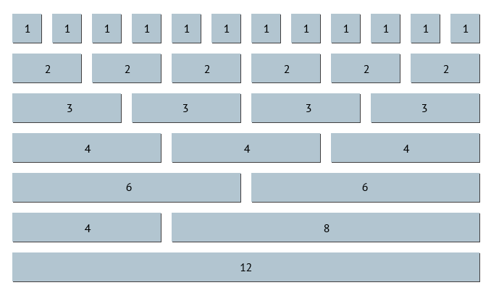
Layout
12 column Grid
Notes:
JET also uses the 12 column Grid layout where the parent element is divided in 12 equal columns.
You can set a child element to be a certain amount (width) of columns in order to make sure some elements are shown on the same row (or not).

Slide 84
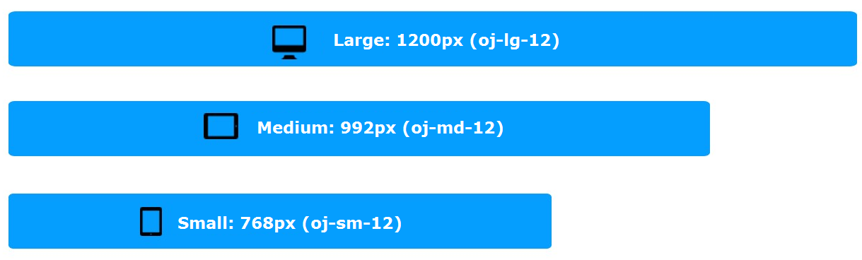
Layout
Responsive sizing

Slide 85
Assignment - Flex Layout

Slide 86
Architecture

Slide 87
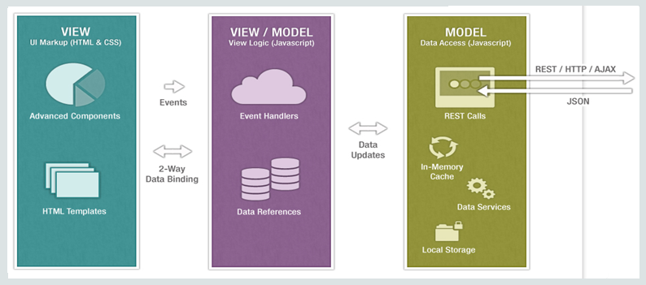
Architecture
MVVM

Slide 88
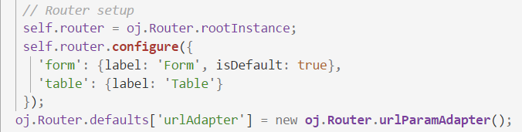
Architecture
Routing
SPA
Module navigation
Router state

Slide 89

Architecture
Routing
Store information

Slide 90
Architecture
ojModule
Composite Component
“Manages content replacement”
Used by router for navigation
“Reusable piece of UI”
Has own html / JS / CSS
Works on it’s own or with input from parent-application

Slide 91
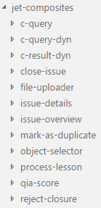
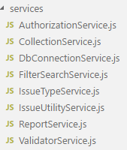
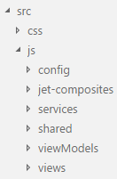
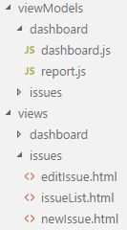
Architecture
Clean codebase

Slide 92
Composite Component

Slide 93
Composite Components
What is it?
Encapsulated piece of functionality
Why use it?
Decreases size of files
Ready to distribute
Ready for re-use

Slide 94
Structure
HTML file (view)
JavaScript file (viewModel)
Loader file (starting point)
JSON configuration file (parameters)
CSS file (styling)

Slide 95
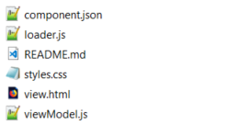
Creating your component
ojet create component <component-name>
ojet create component first-component

Slide 96
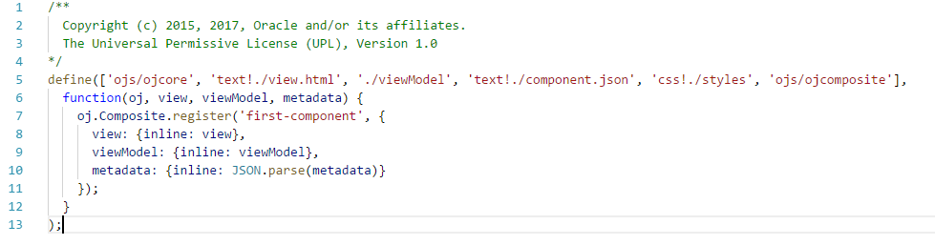
Loader.js

Slide 97
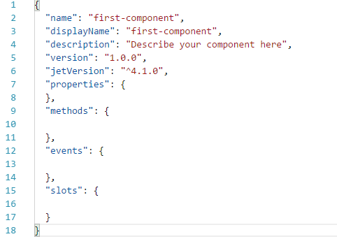
Component.json

Slide 98
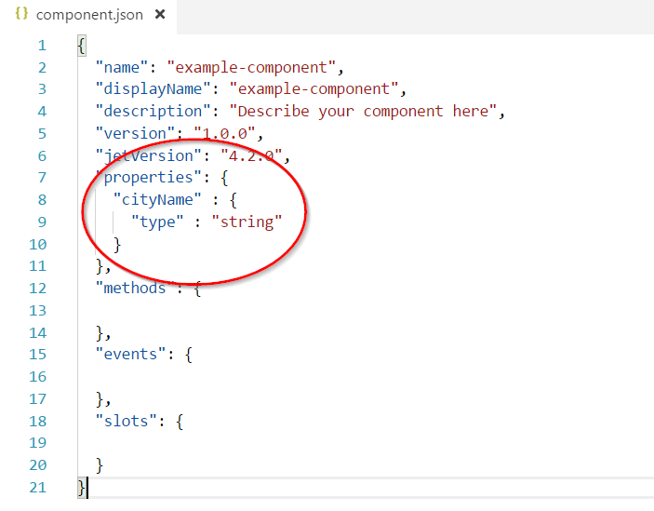
Example

Slide 99
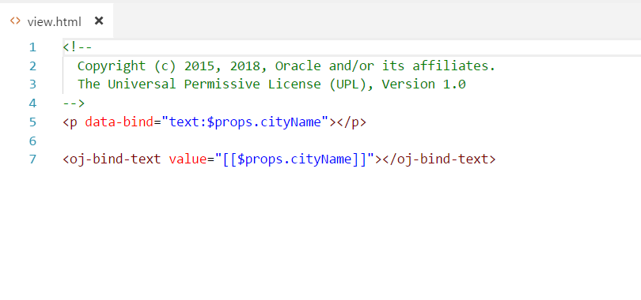
Example

Slide 100
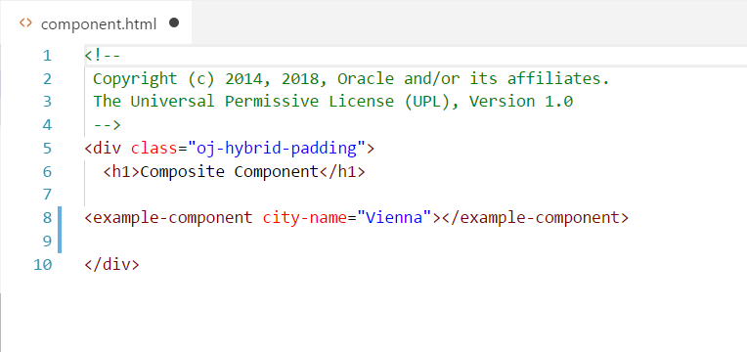
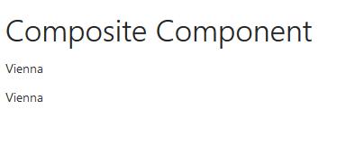
Example
Camel-case property names are converted into case-insensitive HTML element attributes with hyphens at the camel-case break point of the original name.

Slide 101
Assignment - Composite Component
Simple component for use in VBCS training
Expand on this with extra assignments

Slide 102
Recap

Slide 103




Wrap-up
Thank you!
What have we done?
Oracle JET and the UI Practice

Slide 104
Sources and further reading
http://www.oracle.com
http://knockoutjs.com
https://github.com/nklasens/amis-course-2018.git (Nico Klasens, Lucas Jellema)
Duncan Mills blogs: https://blogs.oracle.com/groundside/cca
http://blog.iangilman.com/2015/02/self-this.html

Slide 105

Feedback

Slide 106
DIY Extra
SIG Lucas Jellema JET and OpenLayers
https://github.com/lucasjellema/sig-meetup-jet-openlayers-composite-components.git
Other Knockout tutorials
http://knockoutjs.com
jQuery tutorials
https://www.w3schools.com/jquery/default.asp
http://jqfundamentals.com/chapter/jquery-basics
JET MOOC

Slide 107
End of Oracle JET Day 2

