Slide 1
Exercise physical environment
Global IP address (wireless/DHCP?)
GW/
uRA
Agg.
NSA
uPA-1
uPA-2
…
uPA-n
QA
Viewer
(RRM)
Switch for Service Plane
Ping
PC-1
Service Plane: 192.168.1.0/24
Ping
PC-2
Net-A
(SW-A)
Net-B
(SW-B)
Net-C
(SW-C)
Net-D
(SW-D)
Data Plane: 192.168.2.0/24, VLAN: 1780-1799

Slide 2
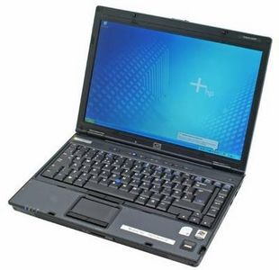
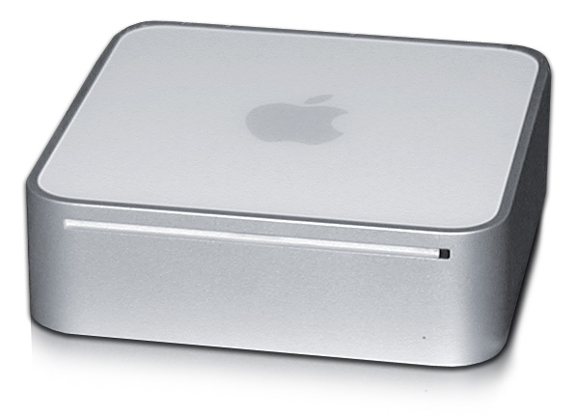
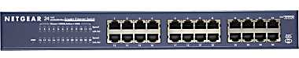

Exercise #1 Installation and use
Objective: Download, install, and use a NSI client to create a connection across a network
Download OpenNSA – any NSI software package will do, but OpenNSA is relatively light weight for this exercise.
Given the map below, use the cli commands to establish a connection
uRA
C2A-[80..81]
NSA-C
uPA
C2D-[80..81]
eth-sw3
curacao.ets
c1-[80..81]
c1-[82..83]

Slide 3
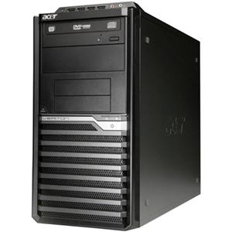
Four (4) uPAs for exercise #1 (!)
uRA₂
port7-[80..83]
uRA₁
NSA-B
uPA₂
NSA-A
port15-[80..83]
port22-[80..83]
uPA₁
eth-sw1
eth-sw2
bonaire.ets
aruba.ets
port10-[80..83]
uRA₃
NSA-D
NSA-C
uPA₄
uPA₃
eth-sw3
eth-sw4
dominica.ets
curacao.ets
port17-[80..83]
port18-[80..83]
port20-[80..83]
port7-[80..83]
uRA₄

Slide 4
Exercise #1
Follow instructions on:
https://github.com/jeroenh/NSI-Tutorial-Topologies/wiki/OpenNSA-installation
Transform the command there to use the right domain and port

Slide 5
NSI: A Basic Overview:
Network Services Agent (NSA)
NSA
Requesting
Agent (RA)
Application NSA
Network Services Interface
Protocol(s)
Provider
Agent (PA)
NSI protocol(s)
NSA
Network Resource Manager
A
B
C
NRM
NSI “Network Service”
Domain A
Domain B
Domain C
NSI Topology

Slide 6
Exercise #2 multi-Domain Connections
Objective: Set up the indicated SDPs and establish a multi-domain connection:
port7-[80..99]
uRA
uPA₂
NSA-B
AG
NSA-A
port15-[80-99]
port22-[80..99]
eth-sw1
eth-sw2
bonaire.ets
aruba.ets
SDP
port10-[80..81]
port10-[80..81]
SDP
SDP
port10-[80..81]
port10-[80..81]
NSA-D
NSA-C
uPA₄
uPA₃
eth-sw3
SDP
eth-sw4
dominica.ets
curacao.ets
port20-[80..99]
port7-[80..99]
port4-[80..99]
https://github.com/jeroenh/NSI-Tutorial-Topologies/wiki/Exercise2

Slide 7
Exercise #2
Procedure

Slide 8
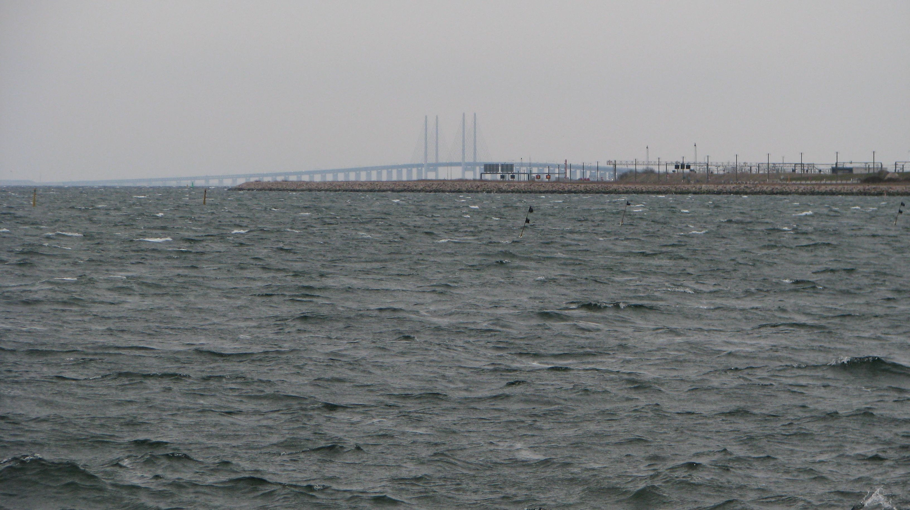
Exercise #3 Building a Topology
Objective: Define your own network service and construct the corresponding N3 topology file suitable for advertising to the world.
aruba.ets
bonaire.ets
C2A-[80..81]
SDP
SDP
D2B-[80..81]
NSA-D
NSA-C
eth-sw3
SDP
eth-sw4
dominica.ets
curacao.ets
c1-[80..81]
d1-[80..83]
c1-[82..83]
??
eth-sw5

Slide 9
Exercise #3:
Procedure:
Diagram the plan
Choose the NSA software and install it (pre-installed for TIP)
Create the topology file from your diagram
N3 NML – editor of your choice
Place/update the topo file in the current github repository
Physically construct the network
Place and configure the switches
Connect the SDPs and verify
Connect the STPs and configure end systems
Fire up the NSA
And test
a) intra-domain (ala exercise 1)
b) inter-domain (ala exercise 2)

Slide 10
Exercise #3: Procedure
Diagramatically…
First, decide what type of service you want to offer..
suggest an ethernet transport service: “ets”
Choose a name for the network service – e.g. “aloha”,”maui”, …
Suggest a name that will fit your registered DNS domain stucture
Make sure your network name is globally unique … and/or
Work out your local URN structure for naming NSI topological objects
Define the csProviderEndpoint that will be the PA
Decide who your external adjacent networks will be: aruba? Bonaire?...
Name the STPs you will use in the SDPs with each network
Coordinate with the peer network to define the interface characteristics of the SDPs
Define the internal n-tuple infrastructure map for STPs in the SDPs
Define the NML mapping
Decide who/where your local client end systems will be
Decide for each end system how many terminals you will provide
This will be a function of your service capabilities and your local policy
“ets” typically provides four terminals per test site, but can define as many as you like
Name these STPs
Define the specific n-tuple infrastructure map
Define the NML mapping

