Slide 1
Introduction NML Topology for NSI
What is OGF NML
What is “N3” and how does NML fit ?
Topologies, Nodes, Ports, Links.
Bi-dir vs Uni-dir…
Jeroen van der Ham - editor of OGF NML and research scientist at UvA

Slide 2
Network Markup Language
OGF Standardisation group since 2007
Based on PerfSONAR, NDL, AutoBAHN,…
Allows for multi-layer multi-domain network topology description
Syntax is XML or RDF

Slide 5
RDF and N3
RDF: Resource Description Framework
Way of describing semantic graphs:

Slide 6
Identifiers
Topology descriptions need globally unique identifiers
OGF & GLIF recommend:
urn:ogf:network:<DNSName>:<YYYY>:<localID>
urn:ogf:network:ets.aruba.ex:2013:port10

Slide 7
Notation3
A way of describing the graph:
aruba:topology a nml:Topology;
nml:hasOutboundPort
aruba:port10,
aruba:port14;
nsi:managedBy aruba:nsa .
aruba:port10 a nml:PortGroup;
nmleth:vlans "1780-1799” ;
nml:isAlias
<urn:ogf:network:ets.bonaire.ex:2013:port11> .

Slide 8
Topology Syntax
NML for basic topology components
NSI for additional constructs:
NSA
managedBy
csProviderEndpoint
peersWith

Slide 9
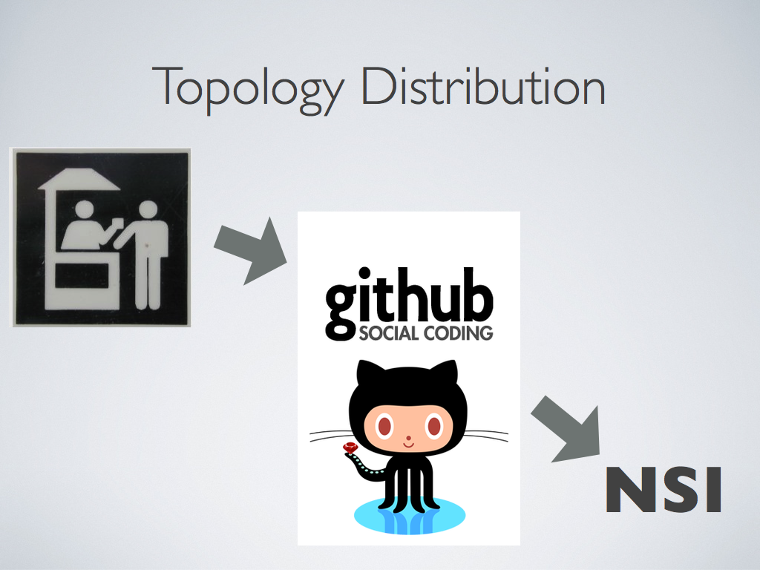
Topology Distribution
Topology Distribution is required for pathfinding
Distribution methods:

