Slide 1
C++ versus Ruby
Jeroen Heymans
Rolnr. 90055
jeheyman@vub.ac.be

Slide 2
The compared languages
C++
  Static typing
  Multi-paradigm
Ruby
  Dynamic typing
  Duck typing
  Object oriented

Slide 3
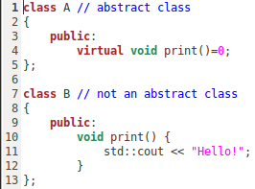
Abstract class
C++
  Virtual method
  All virtuals?
Ruby
  Private constructor

Slide 4
Friend class
Extra access privilege
  A is friend of B? A gets access to everything from B
Only in C++
Special Ruby libraries
Friendships
  Not corresponded
  Not transitive
  Not inherited
A
B
C
D

Slide 5
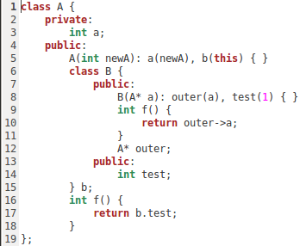
Inner class
Inner class defined in outer
C++
  Keep instance to inner and outer class
  Inner class can access privates from outer class
Ruby
  Keep instance to inner and outer class
  Act is if they are separate classes

Slide 6

Meta class
Only in Ruby
1 class has 1 meta class
Class methods versus instance methods
Class members versus instance members

Slide 7
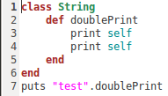
Partial classes
C++
  Only splitting codefiles
Ruby
  Dynamic addition of members and methods
  Open classes
  Can be frozen

Slide 8
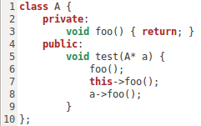
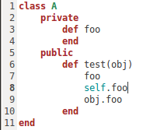
Access control
Public, protected, private
Difference in private
  C++
    Only accessible via class
    Other objects of same class
  Ruby
    Subclasses can access privates
    Implicit versus explicit receiver

Slide 9
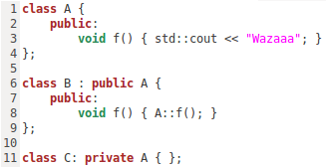
Access control derived classes
C++ feature
Derive as:
  Public
    Public and protected stay public and protected
  Protected
    Public and protected
    become protected
  Private
    Public and protected
    become private

Slide 10
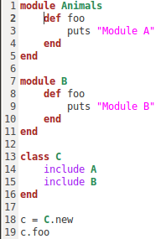
Inheritance
C++
  Multiple
  Explicit super
Ruby
  Single
  Mixins
    Modules
    Include

Slide 11
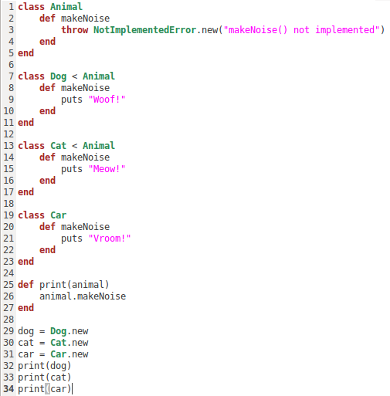
Polymorphism
Different response to same message
Static typing versus duck typing

Slide 12
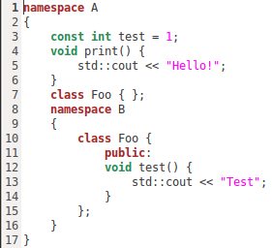
Namespaces or modules
C++: namespaces
  Hierarchical
Ruby: modules
  Modules in classes possible

Slide 13
Reflection
Only in Ruby
Instance variables
  Get, set, remove
Class variables
  Get, set, remove
Methods
  Define, undefine, alias

Slide 14
Everything is an object?
Ruby
C++
  Primitives not

Slide 15
Conclusion
Ruby
  Lots of OO features possible
  Extra OO features can be implemented
C++
  Good basis for OO development
  Less dynamic

