Slide 1




Download the data for the latest month
Save the data as
an excel file
Split the data
into the imports
and exports
Process imports
data:
Format date columns
Extract HS sub-codes
Extract SITC sub-codes
Process exports
data:
Format date columns
Extract HS sub-codes
Extract SITC sub-codes
Report issues to customs
Quality checks for missing
data and common input
errors
Quality checks for missing
data and common input
errors
Quality checks for missing
data and common input
errors
Quality checks for missing
data and common input
errors
Link trade statistics data
with classification tables
Link trade statistics data
with classification tables
Generate key
statistics and
plots for
monthly report
Generate 14
summary tables
of key statistics

Slide 2




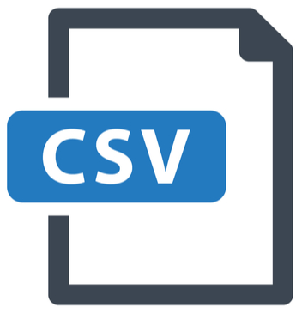
Download the data for the latest month
Save the data as
an excel file
Process and clean data:
Format date columns
Examine missing data
Extract HS and SITC sub-codes
Merge classification tables
Check for missing classification codes
Check for outliers
Flag issues to report to customs
Update
local data
store
Generate key
statistics, plots,
and monthly
report
Generate 14
summary tables
of key statistics
Interactive
dashboard
Public data
repository

