Slide 1
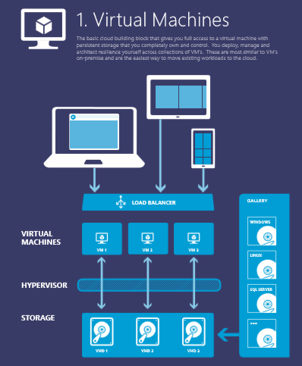
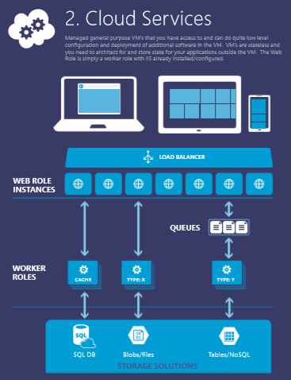
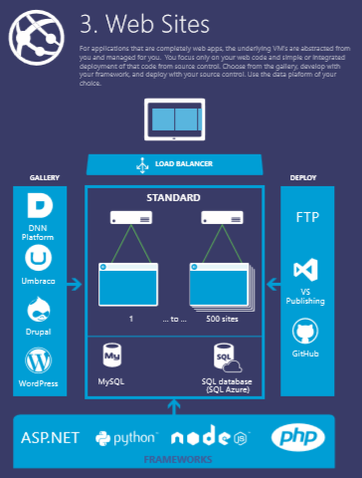
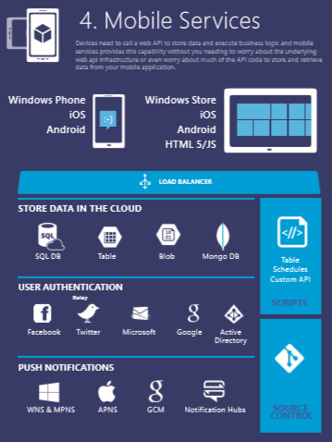
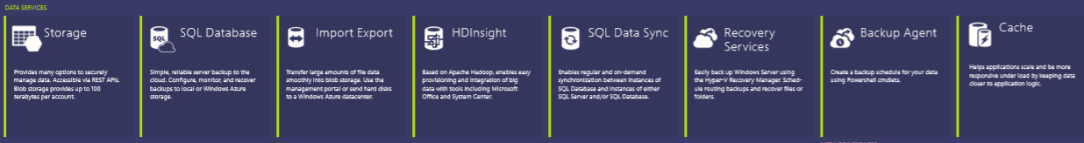




Notes:
You can use this to explain all the Azure building blocks – the compute services at the top and then the other blocks of services – data, networking, Apps…. OR you can go with the next set of slides… YOUR CHOICE…

