Slide 1
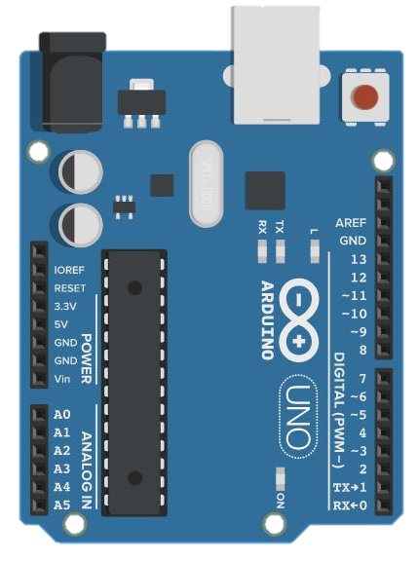
5V
GND
GND
NC
Ecran 128xRGBx128
NC
Led Photo
LED
Led +
SCL
Led -
SDA
RS
RST
CS
Relais 1
NO
GND
Commun
IN1
NC
IN2
Relais 2
NO
VCC
Commun
NC
+
Alim 5V 2A
-
Alim +
Bande 120 leds RGB
Alim -
commun
Data
Alim +
Anneau 24 leds RGB
Alim -
commun
Data
Led 12V +
Bouton
Led 12V -
Contact B
Contact A
+
5V 2A (carte)
-
Alim 12V 2A
+
-

