Slide 1
Non-Rigid Image Registration with MRF
The motivation of this project comes from the registration of 3D faces. Using
Discrete Ricci Flow and conformal mapping, we can map a 3D face onto a 2D
image. Registration work is done on this 2D image. Our project focuses on the
second step. We use MRF energy to represent the matching problem and minimize
the energy to achieve our goal. This work has been specified in Efficient mrf deformation model for
non-rigid image matching. Computer Vision and Image Understanding 112(1):91–99, 2008

Slide 2
Outline
MRF Energy Funciton
Minimize Energy Function
Summary and Future Work

Slide 3

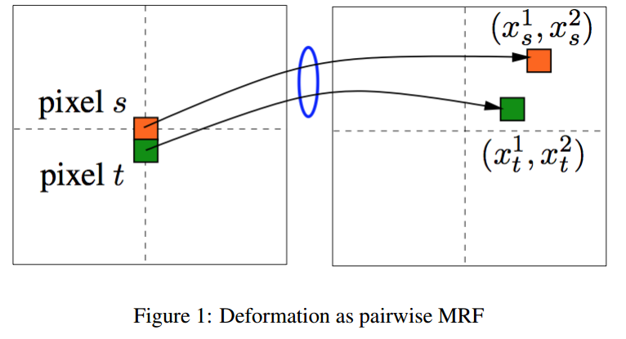
MRF Energy Function
MRF Energy Function constrains

Slide 4
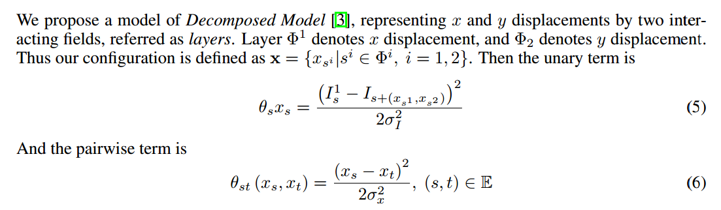
MRF Energy Function
MRF Unary and Pairwise Term

Slide 5
Minimize Energy Function
MRF block term

Slide 6
Summary and Future Work

