Slide 1
ICCV 2007 tutorial
Part III
Message-passing algorithms
for energy minimization
Vladimir Kolmogorov
University College London

Slide 2
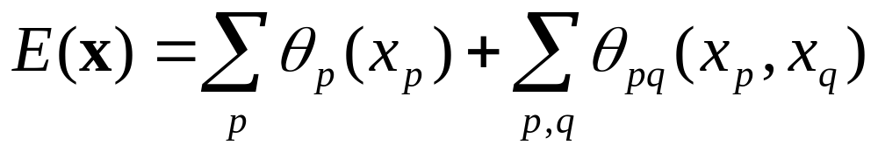
Message passing
p
q
Iteratively pass messages between nodes...
Message update rule?
  Belief propagation (BP)
  Tree-reweighted belief propagation (TRW)
  max-product (minimizing an energy function, or MAP estimation)
  sum-product (computing marginal probabilities)
Schedule?
  Parallel, sequential, ...

Slide 3
Outline
Belief propagation
  BP on a tree
    Min-marginals
  BP in a general graph
  Distance transforms
Reparameterization
Tree-reweighted message passing
  Lower bound via combination of trees
  Message passing
  Sequential TRW

Slide 4
Belief propagation
(BP)

Slide 5
BP on a tree [Pearl’88]
leaf
p
q
r
leaf
root
Dynamic programming: global minimum in linear time
BP:
  Inward pass (dynamic programming)
  Outward pass
  Gives min-marginals

Slide 6
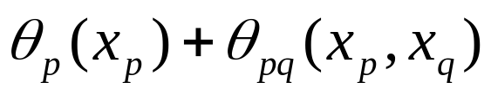

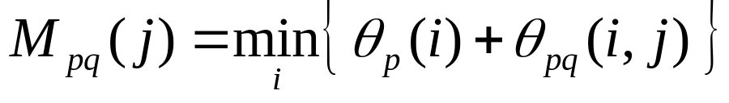
Inward pass (dynamic programming)
p
q
r

Slide 7
Inward pass (dynamic programming)
p
q
r

Slide 8
Inward pass (dynamic programming)
p
q
r

Slide 9
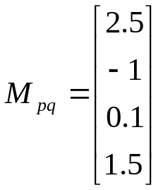
Inward pass (dynamic programming)
p
q
r

Slide 10
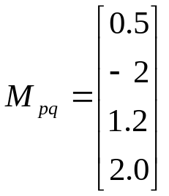

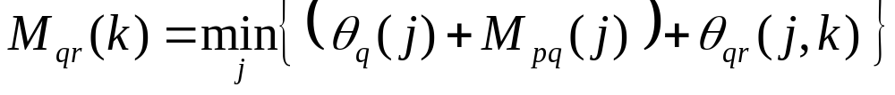
Inward pass (dynamic programming)
p
q
r

Slide 11
Inward pass (dynamic programming)
p
q
r

Slide 12
Inward pass (dynamic programming)
p
q
r

Slide 13
Outward pass
p
q
r

Slide 14
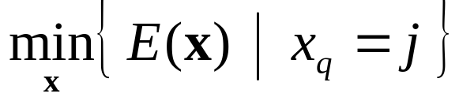
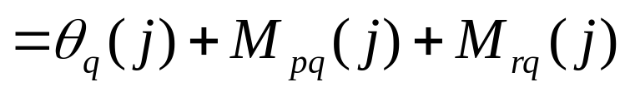
BP on a tree: min-marginals
p
q
r
Min-marginal
for node q and label j:

Slide 15
BP in a general graph
Pass messages using same rules
  Empirically often works quite well
May not converge
“Pseudo” min-marginals
Gives local minimum in the “tree neighborhood” [Weiss&Freeman’01],[Wainwright et al.’04]
  Assumptions:
    BP has converged
    no ties in pseudo min-marginals

Slide 16

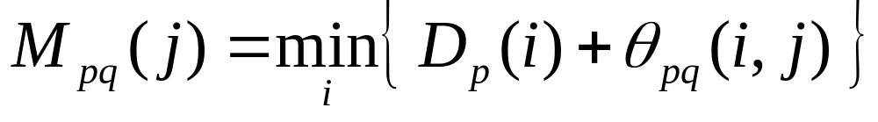
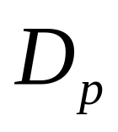
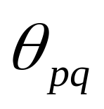
Distance transforms
[Felzenszwalb & Huttenlocher’04]
Naïve implementation: O(K²)
Often can be improved to O(K)
  Potts interactions, truncated linear, truncated quadratic, ...

Slide 17
Reparameterization

Slide 18
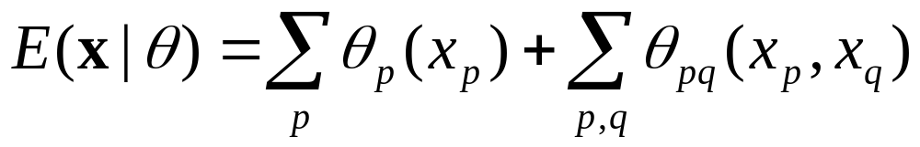
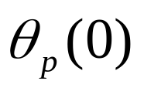
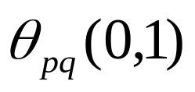

Energy function - visualization
0
0
3
label 0
4
5
vector of
all parameters
label 1
2
1
0
node p edge (p,q) node q

Slide 19
Energy function - visualization
0
0
3
label 0
4
5
vector of
all parameters
label 1
2
1
0
node p edge (p,q) node q

Slide 20
Reparameterization
0
0
3
4
5
2
1
0

Slide 21
Reparameterization
0
0
3
4
5
̶ δ
̶ δ
2
1
+δ
0

Slide 22


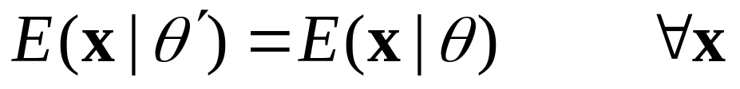
Reparameterization
0
0
3
4-δ
5
2
1-δ
δ
Definition. is a reparameterization of
if they define the same energy:
Maxflow, BP and TRW perform reparameterisations

Slide 23
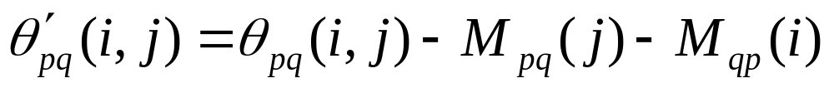
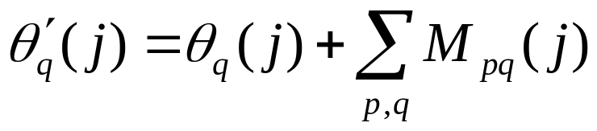
BP as reparameterization
[Wainwright et al. 04]
Messages define reparameterization:
M_{pq}
min-marginals (for trees)
j
̶ δ
+δ
δ = M_{pq}( j )
BP on a tree: reparameterize energy so that unary potentials become min-marginals

Slide 24
Tree-reweighted
message passing
(TRW)

Slide 25
Linear Programming relaxation
Energy minimization: NP-hard problem
Relax integrality constraint: x_{p}∈{0,1} ⇒ x_{p}∈[0,1]
  LP relaxation [Schlesinger’76,Koster et al.’98,Chekuri et al.’00,Wainwright et al.’03]
Try to solve dual problem:
  Formulate lower bound on the function
  Maximize the bound
E
E
E
Energy function
with discrete variables
LP relaxation
Lower bound on
the energy function

Slide 26
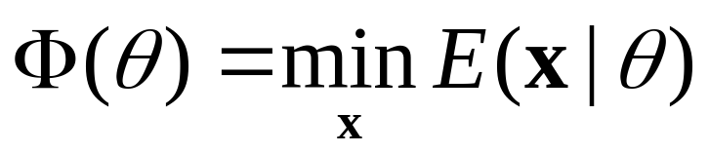
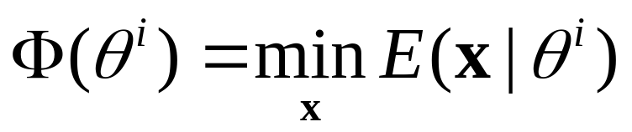
Convex combination of trees [Wainwright, Jaakkola, Willsky ’02]
Goal: compute minimum of the energy for θ :
Obtaining lower bound:
  Split θ into several components: θ = θ¹ + θ ² + ...
  Compute minimum for each component:
  Combine Φ(θ¹), Φ(θ ²), ... to get a bound on Φ(θ)
Use trees!

Slide 27
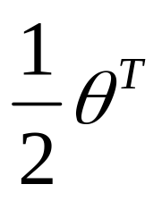
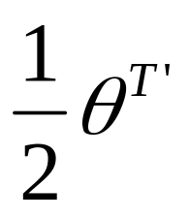



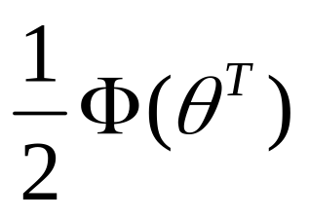
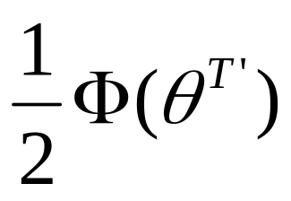
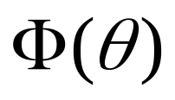

Convex combination of trees
(cont’d)
graph
tree T
tree T’
maximize
lower bound on the energy

Slide 28
Maximizing lower bound
Subgradient methods
  [Schlesinger&Giginyak’07], [Komodakis et al.’07]
Tree-reweighted message passing (TRW)
  [Wainwright et al.’02], [Kolmogorov’05]

Slide 29
TRW algorithms
Two reparameterization operations:
  Ordinary BP on trees
  Node averaging

Slide 30
TRW algorithms
Two reparameterization operations:
  Ordinary BP on trees
  Node averaging
0
4
1
0

Slide 31
TRW algorithms
Two reparameterization operations:
  Ordinary BP on trees
  Node averaging
2
2
0.5
0.5

Slide 32
TRW algorithms
Order of operations?
  Affects performance dramatically
Algorithms:
  [Wainwright et al. ’02]: parallel schedule (TRW-E, TRW-T)
    May not converge
  [Kolmogorov’05]: specific sequential schedule (TRW-S)
    Lower bound does not decrease, convergence guarantees
    Needs half the memory

Slide 33
TRW algorithm of Wainwright et al. with tree-based updates (TRW-T)
Run BP on all trees
“Average” all nodes
If converges, gives (local) maximum of lower bound
Not guaranteed to converge.
Lower bound may go down.

Slide 34
Sequential TRW algorithm (TRW-S)
[Kolmogorov’05]
Pick node p
Run BP on all trees containing p
“Average” node p

Slide 35
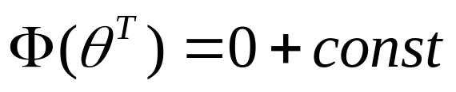
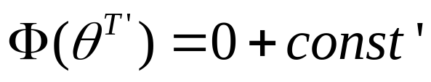
Main property of TRW-S
Theorem: lower bound never decreases.
Proof sketch:
0
4
1
0

Slide 36
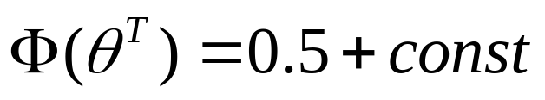
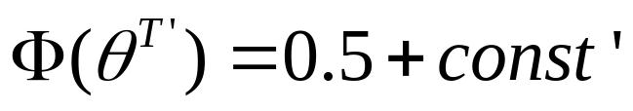
Main property of TRW-S
Theorem: lower bound never decreases.
Proof sketch:
2
2
0.5
0.5

Slide 37
TRW-S algorithm
Particular order of averaging and BP operations
Lower bound guaranteed not to decrease
There exists limit point that satisfies weak tree agreement condition
Efficiency?

Slide 38
Efficient implementation
Pick node p
Run BP on all trees containing p
“Average” node p
inefficient?

Slide 39
Efficient implementation
Key observation: Node averaging operation preserves messages oriented towards this node
Reuse previously passed messages!
Need a special choice of trees:
  Pick an ordering of nodes
  Trees: monotonic chains
1
2
3
4
5
6
7
8
9

Slide 40
Efficient implementation
Algorithm:
  Forward pass:
    process nodes in the increasing order
    pass messages from lower neighbours
  Backward pass:
    do the same in reverse order
Linear running time of one iteration
1
2
3
4
5
6
7
8
9

Slide 41
Efficient implementation
Algorithm:
  Forward pass:
    process nodes in the increasing order
    pass messages from lower neighbours
  Backward pass:
    do the same in reverse order
Linear running time of one iteration
1
2
3
4
5
6
7
8
9

Slide 42
Memory requirements
Standard message passing: 2 messages per edge
TRW-S: 1 message per edge
  Similar observation for bipartite graphs and parallel schedule in [Felzenszwalb&Huttenlocher’04]
standard message passing
TRW-S

Slide 43
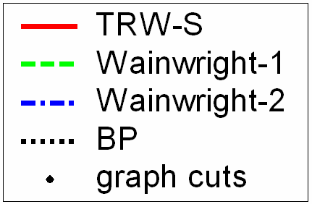


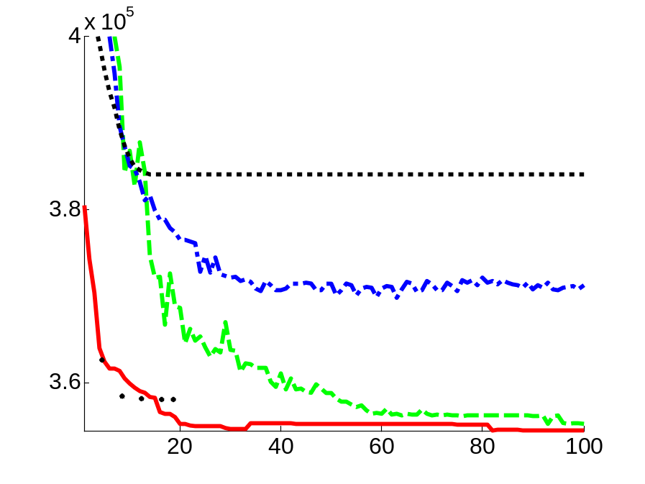


Experimental results: stereo
TRW-E
TRW-T
left image
ground truth
BP
TRW-S
Global minima for some instances with TRW [Meltzer,Yanover,Weiss’05]
See evaluation of MRF algorithms [Szeliski et al.’07]

Slide 44
Conclusions
BP
  Exact on trees
    Gives min-marginals (unlike dynamic programming)
  If there are cycles, heuristic
  Can be viewed as reparameterization
TRW
  Tries to maximize a lower bound
  TRW-S:
    lower bound never decreases
    limit point - weak tree agreement
    efficient with monotonic chains
  Not guaranteed to find an optimal bound!
    See subgradient techniques [Schlesinger&Giginyak’07], [Komodakis et al.’07]

