Slide 1


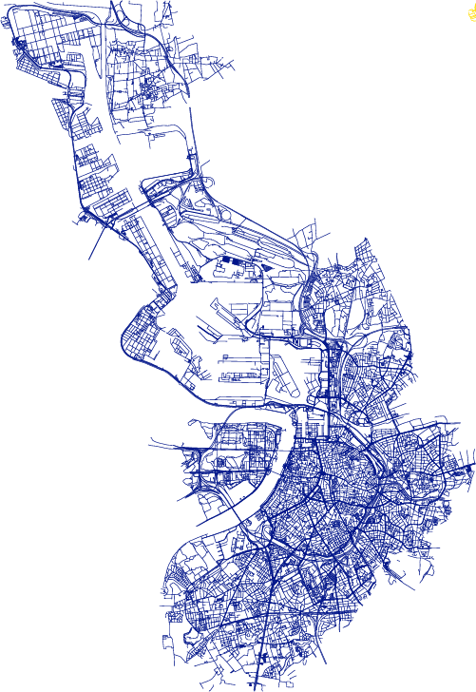
How to put an entire country in a container:
transportable OpenStreetMap data integration into Postgis using docker
By: Benjamin DESWYSEN

Slide 2

About me
Geomatician @GeoPostcodes (Belgium)
OpenStreetMap contributor: beginner level
OpenStreetMap user: every day!
I love coffee, feel free to join me for one after the session!

Slide 3
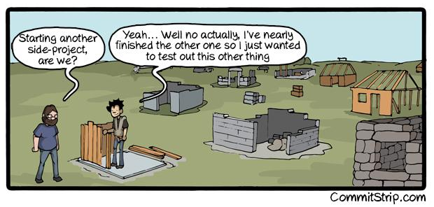
Once upon a time… Another dev side-project!
Source: https://www.commitstrip.com/wp-content/uploads/2014/11/Strip-Side-project-650-finalenglish.jpg

Slide 4



Once upon a time… Another dev side-project! (2)

Slide 5

Imposm?
Postgis?
Docker?

Slide 6
https://bdeswysen.gitlab.io/sotm_workshop

Slide 7
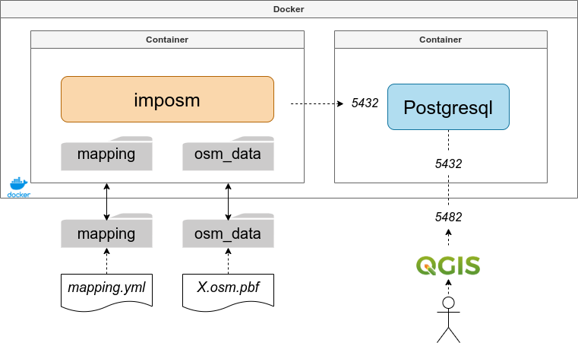
Infrastructure

