Slide 1

CREATE AN S3 BUCKET ON AWS AND SETUP STATIC WEBSITE USING TERRAFORM
TEAM MEMBERS
AIMAN MARYAM
FLERIN MATHEW
JOSHUA JACKLEMON
JEROME WILSON

Slide 2
Agenda
Abstract
Objective
Block Diagram
Proposed setup
Hardware & Software Tools
Implementation
References

Slide 3

Abstract
The integration of Amazon Web Services (AWS) S3 and Terraform provides a powerful method for deploying static websites in a scalable, efficient, and automated manner. This document outlines the step-by-step process of creating an S3 bucket and configuring it to host a static website using Terraform, an infrastructure-as-code tool. By leveraging Terraform, users can define and manage their AWS resources in a consistent and reproducible way. The guide covers essential tasks such as installing Terraform, configuring AWS credentials, and writing the necessary Terraform configuration files to create an S3 bucket, upload HTML files, and set bucket policies for public access. This approach not only simplifies the deployment process but also ensures infrastructure changes are version-controlled and auditable, enhancing both productivity and security in web development workflows.

Slide 4
Objective
The objective of this project is to deploy a static website on AWS S3 using Terraform for automation. This involves creating an S3 bucket, configuring it for static website hosting, and automating the setup using Terraform. By leveraging Terraform's infrastructure-as-code capabilities, we aim to ensure a consistent and reproducible deployment process, enhancing both productivity and security. This project guides through installing Terraform, configuring AWS credentials, writing necessary configuration files, uploading HTML files, and setting bucket policies for public access. The goal is to streamline the deployment process and maintain a robust, secure static website using modern cloud technologies and infrastructure management practices.

Slide 5
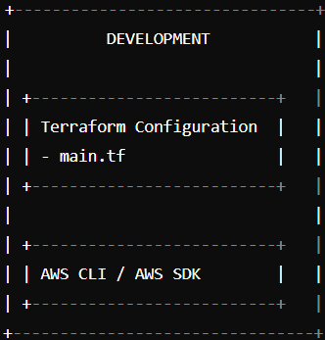
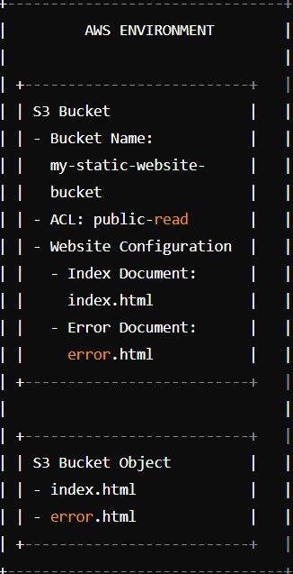
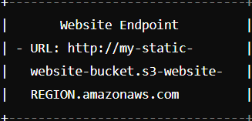
Block Diagram
→
DEPLOYS
OUTPUT
→

Slide 6
Proposed Setup
Step 1: Install and Configure Terraform :
Install Terraform: Download and install Terraform from the official Terraform website.
AWS CLI Configuration: Ensure the AWS CLI is installed and configured with your AWS credentials. Run aws configure and provide your access key, secret key, region, and output format.
Step 2: Create Terraform Configuration File :
Create a Directory: Create a new directory for your Terraform project.
Main Configuration File: Inside this directory, create a file named main.tf. This file will contain the Terraform configuration code to create the S3 bucket and set it up for static website hosting.

Slide 7
Proposed Setup
Step 3: Initialize Terraform :
Initialize Terraform: In your project directory, run the following command to initialize Terraform. This will download the necessary provider plugins.
Step 4: Apply the Terraform Configuration :
Apply Configuration: Run the following command to apply the Terraform configuration. Terraform will create the S3 bucket, configure it for static website hosting, and upload the index.html and error.html files.

Slide 8
Proposed Setup
Step 5: Upload Website Files :
Upload HTML Files: Ensure that index.html and error.html are in the paths specified in the Terraform configuration. These files will be uploaded to the S3 bucket as part of the Terraform apply process.
Step 6: Access the Static Website :
Website Endpoint: After the Terraform apply process completes, Terraform will output the S3 bucket website endpoint URL. You can use this URL to access your static website.

Slide 9
Hardware & Software Tools
System Specifications :
Operating System : Windows 11
Processor : Intel i5 or equivalent
RAM : 8 GB (minimum)
Storage : 256 GB SSD (minimum)
Software Used :
Terraform
AWS CLI
AWS SDKs:
Code Editor/IDE:
Version Control System (VCS):
Web Browser

Slide 10
Implementation
Step 1: Install Terraform
1. Download and Install Terraform:
* Linux/macOS
curl -LO
https://releases.hashicorp.com/terraform/{VERSION}/terraform_{VERSION}_linux_amd64.zip
unzip terraform_{VERSION}_linux_amd64.zip
sudo mv terraform /usr/local/bin/
Windows
Download the appropriate Terraform binary from Terraform's official site.
Extract the binary and add it to your PATH environment variable.

Slide 11
2: Verify Installation:
terraform –v
Step 2: Set Up AWS Credentials
Configure AWS CLI (if not already configured)
aws configure
Enter your AWS Access Key, Secret Key, region, and desired output format.
Step 3: Create Terraform Configuration
1: Create a Directory for Your Terraform Configuration:
mkdir my-s3-website
cd my-s3-website

Slide 12
2: Create a Terraform Configuration File:
Main.tf
provider "aws" {
region = "ap-south-1"
}
resource "aws_s3_bucket" "example" {
bucket = "my-unique-bucket-name-for-cloud-internship"
}
resource "aws_s3_bucket_website_configuration" "example" {
bucket = aws_s3_bucket.example.id
index_document {
suffix = "index.html"
}
error_document {
key = "error.html"
}
}

Slide 13
resource "aws_s3_object" "index" {
bucket = aws_s3_bucket.example.bucket
key = "index.html"
source = "index.html"
content_type = "text/html"
}
resource "aws_s3_object" "error" {
bucket = aws_s3_bucket.example.bucket
key = "error.html"
source = "error.html"
content_type = "text/html"
}
resource "aws_s3_bucket_policy" "example" {
bucket = aws_s3_bucket.example.id
policy = jsonencode({
Version = "2012-10-17"
Statement = [

Slide 14
{
Effect = "Allow"
Principal = "*"
Action = "s3:GetObject"
Resource = "${aws_s3_bucket.example.arn}/*"
}
]
})
}
output "website_url" {
value = "http://${aws_s3_bucket.example.bucket}.s3-website-ap-south-1.amazonaws.com"
}

Slide 15
Provider.tf
terraform {
required_providers {
aws = {
source = "hashicorp/aws"
version = "5.60.0"
}
}
}

Slide 16
Create a Simple Static HTML File:
Index.html
<html>
<head><title>My Static Website</title></head>
<body>
<h1>Hello, world!</h1>
</body>
</html>

Slide 17
Error.html
<html>
<head><title>Page Not Found</title></head>
<body>
<h1>Oops! Page not found.</h1>
</body>
</html>

Slide 18
Step 4: Initialize Terraform
Run Terraform Initialization
terraform init
Step 5: Apply the Terraform Configuration
Run Terraform Plan (optional, but recommended):
terraform plan
• This will show you what resources will be created.
2: Apply the Configuration:
terraform apply
Confirm by typing yes when prompted.

Slide 19
Step 6: Access Your Static Website
Retrieve the Website Endpoint:
After applying the configuration, Terraform will output the S3 bucket website endpoint.
Open Your Web Browser:
Enter the website endpoint URL to view your static website.
Optional: Configure a Custom Domain
Set Up a Route 53 Hosted Zone:
You can create a hosted zone in AWS Route 53 and set up DNS records to point your custom domain to your S3 bucket.
Update the S3 Bucket Policy:
Update the bucket policy to allow access from the domain. You can add a policy like this

Slide 20
{ "Version": "2012-10-17",
"Statement": [
{
"Effect": "Allow",
"Principal": "*",
"Action": "s3:GetObject",
"Resource": "arn:aws:s3:::my-unique-bucket-name-for-cloud-internship/*"
}
]
}

Slide 21
Summary
Terraform Configuration:
Set up AWS provider and S3 bucket.
Configure static website hosting on S3.
Deploy a simple index.html file.
Initialize and Apply Terraform:
Initialize and apply to create and configure the S3 bucket.
Access and Test:
Access the website using the provided endpoint URL.
Feel free to adjust the configuration and resource settings as needed for your specific use case

Slide 22
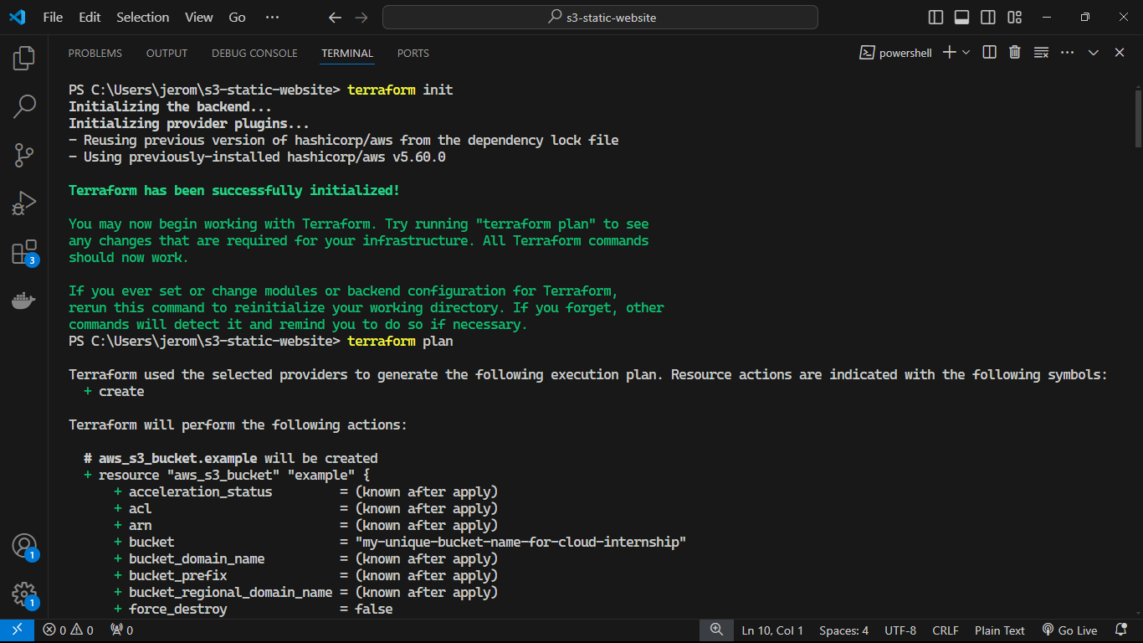

Slide 23
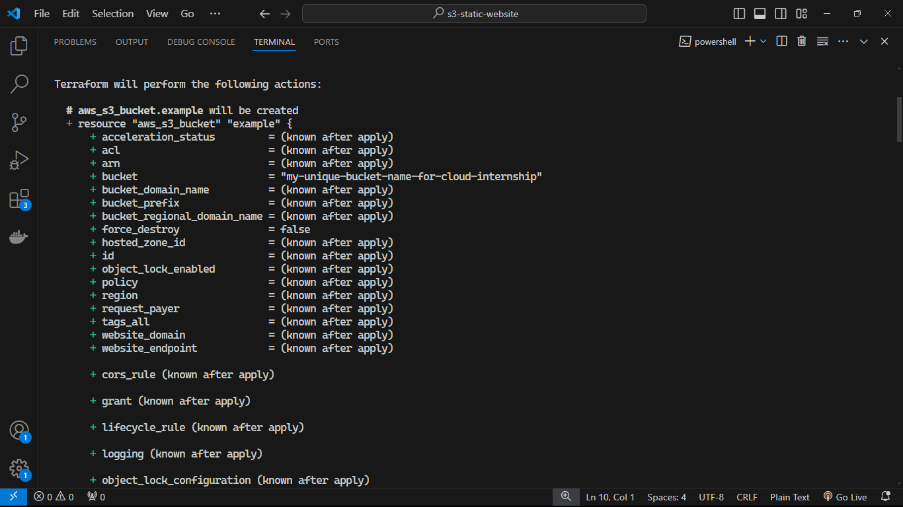

Slide 24
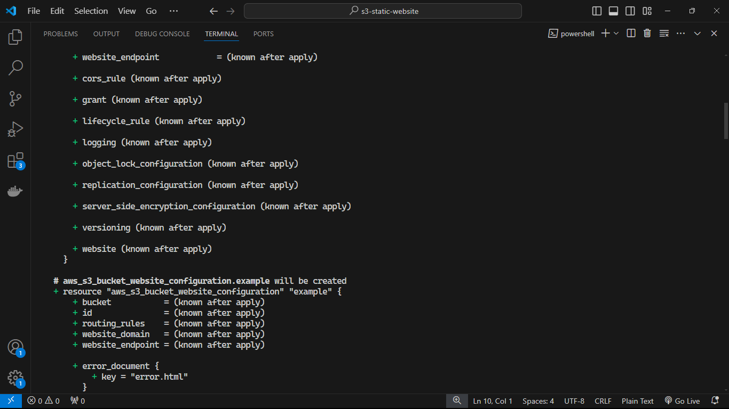

Slide 25
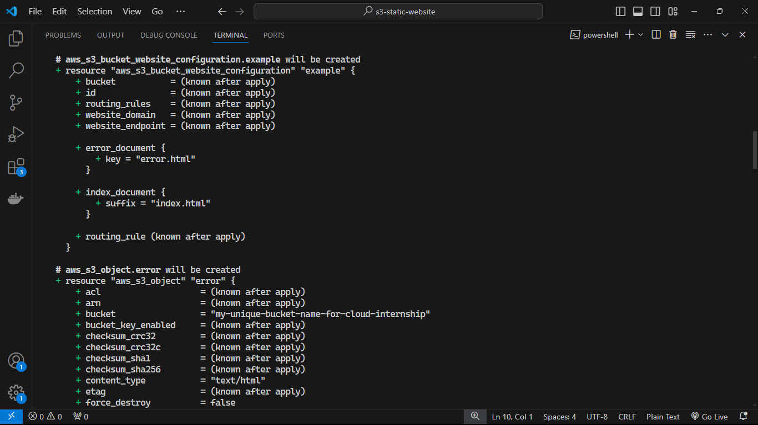

Slide 26
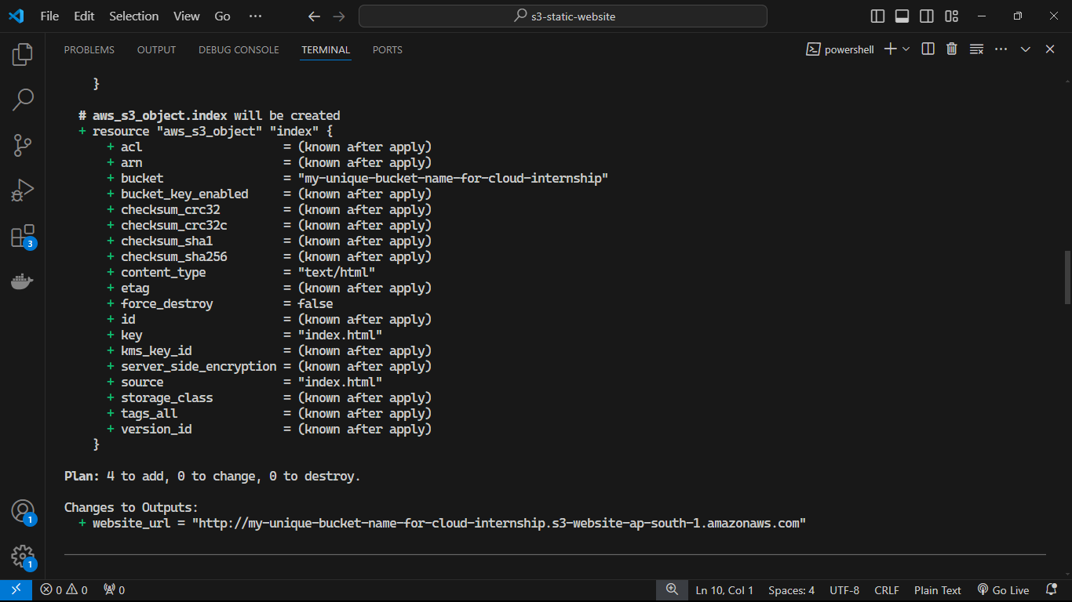

Slide 27
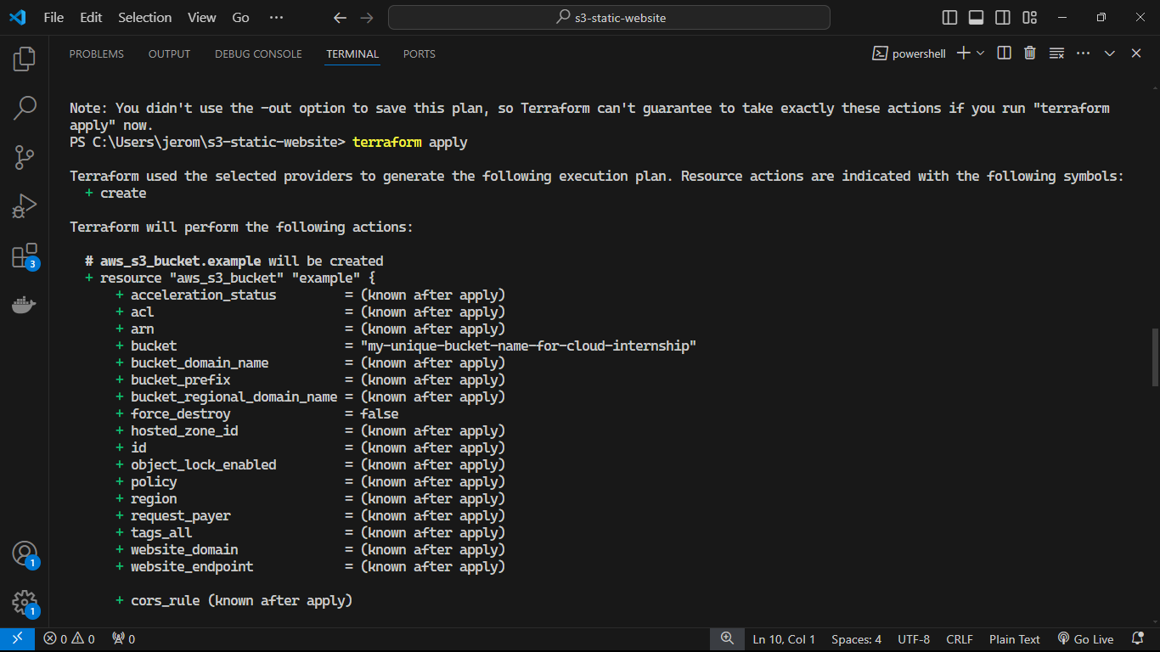

Slide 28


Slide 29
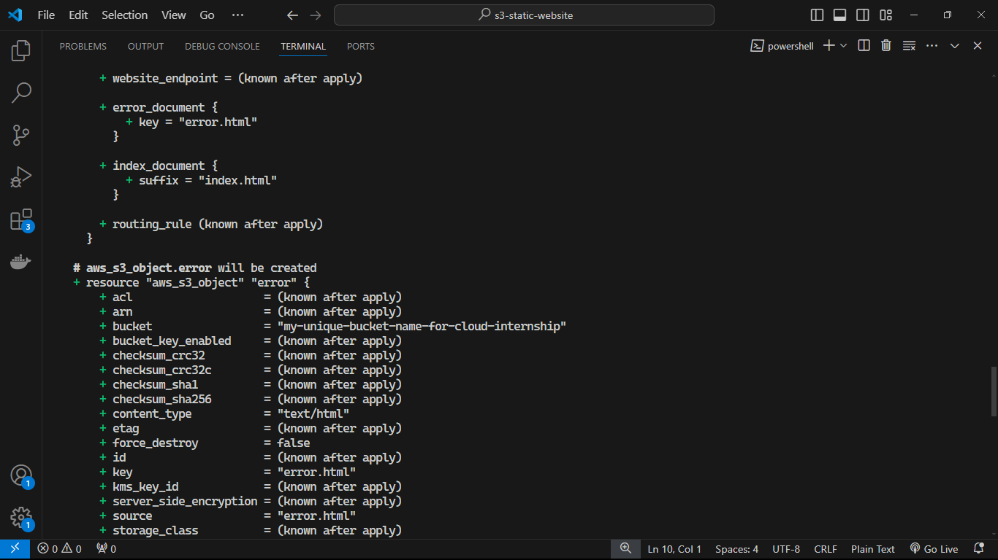

Slide 30
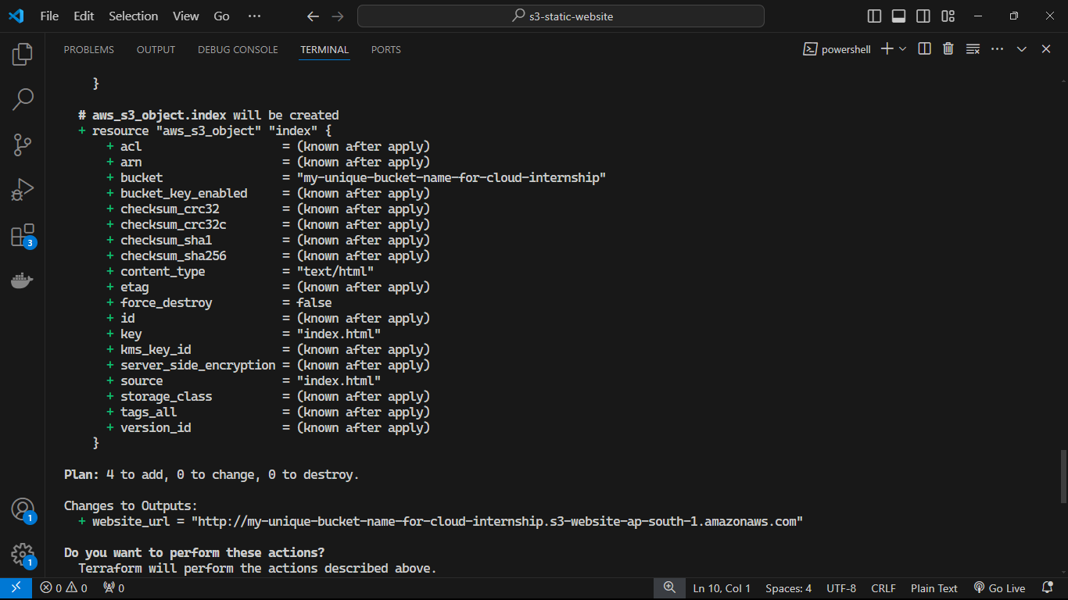

Slide 31
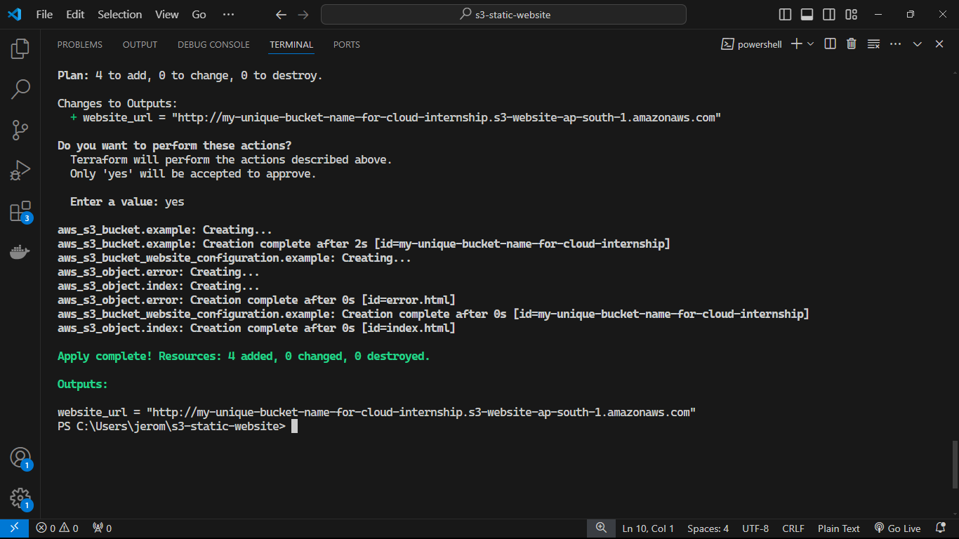

Slide 32
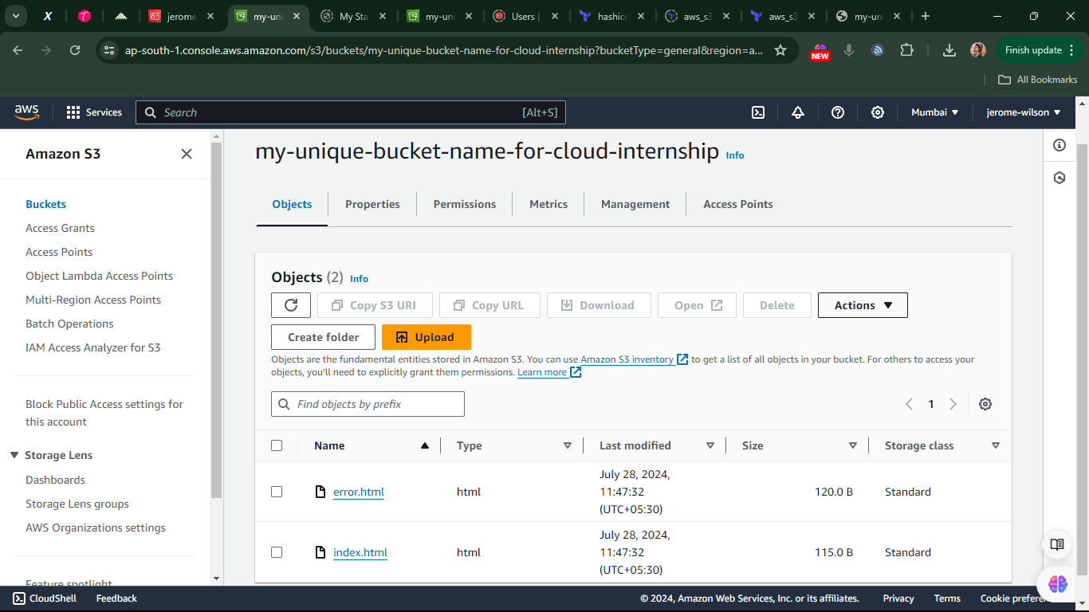

Slide 33
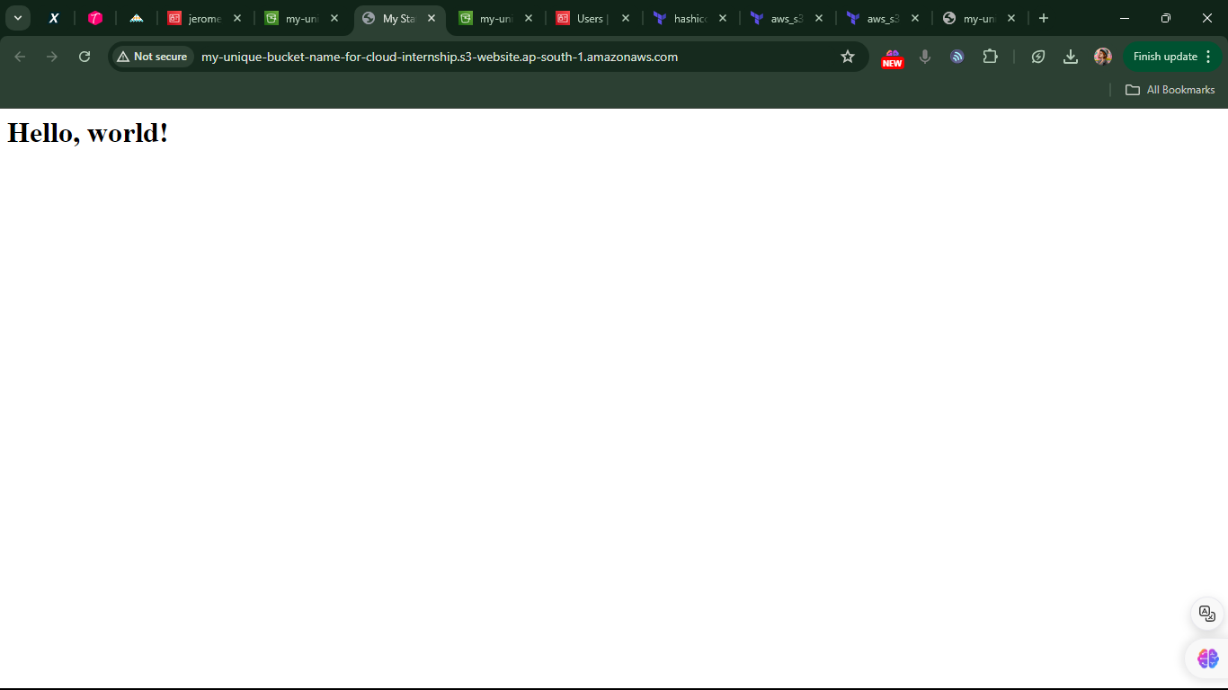

Slide 34
References
Resource: aws_s3_bucket on Terraform
https://registry.terraform.io/providers/hashicorp/aws/latest/docs/resources/s3_bucket
s3-static-website: Terraform:
https://registry.terraform.io/modules/cn-terraform/s3-static-website/aws/latest

Slide 35
THANK YOU

