Slide 1
Analysis of Algorithms
Understanding the Core Concepts and Implementations
Theoneste Murangira

Slide 2
Objectives
Describe
Analyze
Implement
Explore basic data structures: Stack, Queue, Linked List, Tree, Hash table, Graph.
Applications of Data Structures and Algorithms
Common Algorithms and Algorithmic Techniques

Slide 3

References
T. H. Cormen, C. E. Leiserson, R. L. Rivest, and C. Stein, Introduction to Algorithms, 3rd ed. Cambridge, MA, USA: MIT Press, 2009.
R. Sedgewick and K. Wayne, Algorithms, 4th ed. Upper Saddle River, NJ, USA: Addison-Wesley Professional, 2011.
R. Tamassia, M. T. Goodrich, and M. H. Goldwasser, Data Structures and Algorithms in Java, 7th ed. Hoboken, NJ, USA: John Wiley & Sons, 2019.
S. S. Skiena, The Algorithm Design Manual, 3rd ed. London, UK: Springer, 2020.
J. Kleinberg and É. Tardos, Algorithm Design, New York, NY, USA: Pearson, 2006.
T. Roughgarden, Algorithms Illuminated, Part 1: The Basics, 1st ed. Palo Alto, CA, USA: Soundlikeyourself Publishing, LLC, 2017.

Slide 4

Online resources
https://ocw.mit.edu/courses/6-006-introduction-to-algorithms-spring-2020/
https://sp21.datastructur.es/
https://algs4.cs.princeton.edu/home/

Slide 5

Introduction and Definitions
Linear Data Structures
Sorting Algorithms
Analysis of Algorithms
Divide and Conquer Algorithms
Non-Linear Data Structures (Graphs and Trees)
Greedy Algorithms
Dynamic Programming
Hashing and Hash Functions

Slide 6
ASSESSMENT
4 Assignments( 15%)
2 Closed books Tests (25%)
4 Quizzes (10%)
Final Exam (50%)

Slide 7
In this course we explore some of the most common Algorithms and Data Structures used in Computer Science
Data Structure : A Way of organizing and storing information for efficient retrieval and processing.
Algorithm: A procedure (recipe, step –by-step instructions to solve an algorithmic problem)

Slide 8
Why Study Algorithms?
Computer Science is about problem solving => Algorithms and Data Structures are at the heart of Computer Science
A new way of modeling and solving scientific problems
Algorithms can be entertaining and fun

Slide 9
What people have said about Data Structures and Algorithms
"Algorithms are the poetry of computation. Just like verse, they can be beautiful and elegant, expressing complex ideas in a concise and powerful way." - Jeanette Wing
"An algorithm must be seen to be believed, and the best way to learn what an algorithm is all about is to try it." - Donald E. Knuth
"Behind every screen on your phone, there is a simple instruction that started it all. That's the power of algorithms: to start from a simple command and create infinitely complex worlds." - Kevin Slavin
"Bad programmers worry about the code. Good programmers worry about data structures and their relationships.“ Linus Torvalds
"Algorithms + Data Structures = Programs" - Niklaus Wirth
"Data structures are the core of programming. If you don't understand data structures, then you can't code." - Juhi Kumari

Slide 10
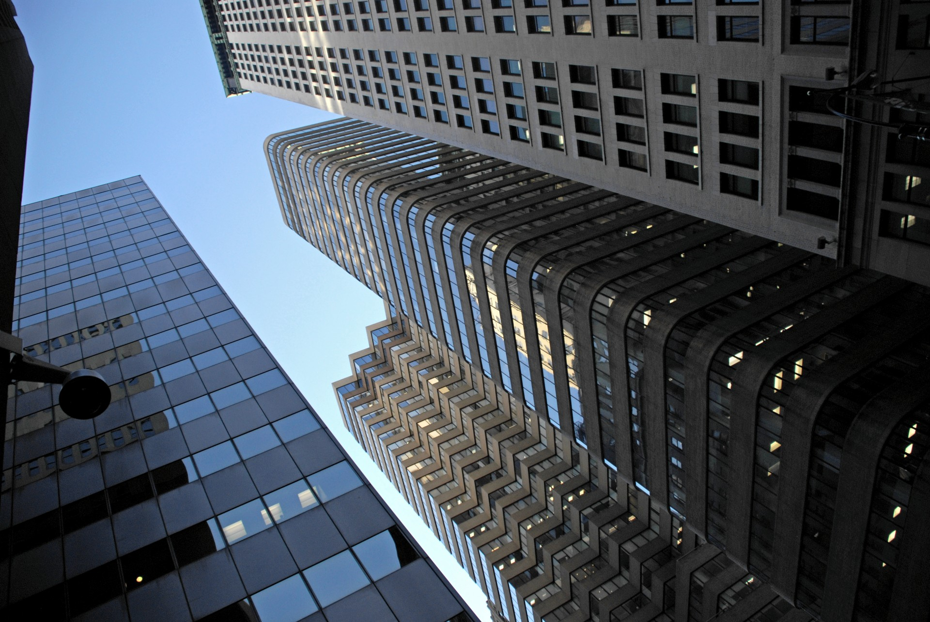
ALGORITHMS ARE ABOUT PROBLEM SOLVING
PROBLEM
PROCEDURE
PROGRAM
PROCESS

Slide 11


Name three common Data Structures
ⓘ Start presenting to display the poll results on this slide.

Slide 12

Given an array containing n elements, find the majority element. The majority element appears more than n/2 times in the array.

Slide 13

How many majority elements can there be in an array?
ⓘ Start presenting to display the poll results on this slide.

Slide 14
BRUTE FORCE APPROACH
For each element num in nums:
Set count to 0
For each element elem in nums:
If elem is equal to num:
Increment count by 1
If count is greater than n / 2:
Return num

Slide 15
Create a hash map to store counts of each element
For each element num in nums:
If num is in the hash map:
Increment its count
Else:
Add num to the hash map with count 1
For each entry in the hash map:
If the entry's value is greater than n / 2:
Return the entry's key

Slide 16
Sort the array nums
Return the element at index n / 2
Initialize candidate to None and count to 0
For each element num in nums:
If count is 0:
Set candidate to num
If num is equal to candidate:
Increment count by 1
Else:
Decrement count by 1
Return candidate

Slide 17
An Abstract Data Type (ADT) is a conceptual model or blueprint that defines a set of data values and the operations that can be performed on those values.
It specifies what the data type can do without concerning itself with how it will be implemented.
ADTs provide an abstraction layer that separates the logical behavior of data structures from their physical implementation details.

Slide 18
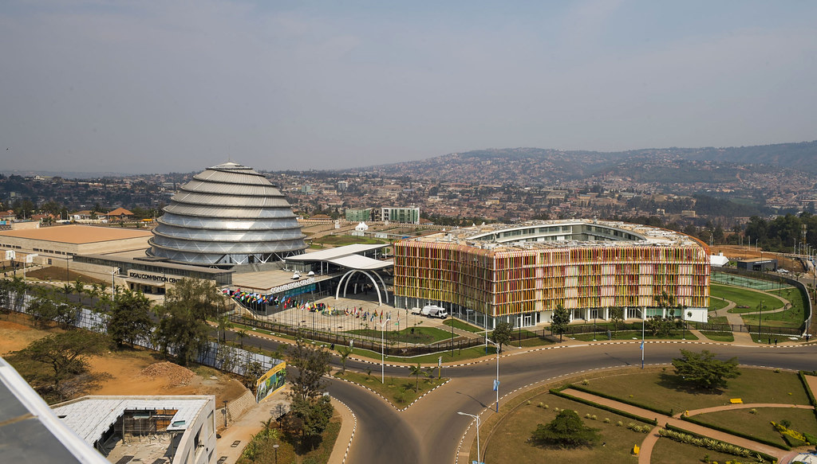
Array ADT:
Data: A collection of elements of the same type, stored in contiguous memory locations.
Operations: insert(value, index), delete(index), get(index), set(index, value), size().

Slide 19
List ADT:
Data: A collection of nodes, where each node contains a data value and a reference (link) to the next node in the sequence.
Operations: insertAtHead(value), insertAtTail(value), deleteFromHead(), deleteFromTail(), get(index), size().

Slide 20
Stack ADT:
Data: A collection of elements with a Last-In-First-Out (LIFO) access policy.
Operations: push(value) (insert an element at the top), pop() (remove and return the top element), peek() (return the top element without removing it), isEmpty(), size().

Slide 21
Queue ADT:
Data: A collection of elements with a First-In-First-Out (FIFO) access policy.
Operations: enqueue(value) (insert an element at the rear), dequeue() (remove and return the front element), peek() (return the front element without removing it), isEmpty(), size().

Slide 22
Implementing Stack in C++
template<typename T>
struct Node {
T data;
Node* next;
Node(T data, Node* next = nullptr) : data(data), next(next) {}
};

Slide 23
Implementing Stack in C++
template<typename T>
class LinkedListStack {
public:
LinkedListStack() : top(nullptr), _size(0) {} // Constructor
~LinkedListStack(); // Destructor
void push(T data); // Push data on stack
T pop(); // Pop data from stack
T peek() const; // Get the top element
bool isEmpty() const { return top == nullptr; } // Check if stack is empty
int size() const { return _size; } // Get the size of the stack
private:
Node<T>* top; // Top of the stack
int _size; // Size of the stack
};

Slide 24
Implementing Stack in C++
template<typename T>
LinkedListStack<T>::~LinkedListStack() {
while (!isEmpty()) {
pop();
}
}
template<typename T>
void LinkedListStack<T>::push(T data) {
Node<T>* newNode = new Node<T>(data, top);
top = newNode;
_size++;
}

Slide 25
Implementing Stack in C++
template<typename T>
T LinkedListStack<T>::pop() {
assert(!isEmpty() && "Stack is empty. Cannot pop.");
Node<T>* temp = top;
T data = top->data;
top = top->next;
delete temp;
_size--;
return data;
}
template<typename T>
T LinkedListStack<T>::peek() const {
assert(!isEmpty() && "Stack is empty. Cannot peek.");
return top->data;
}

Slide 26
Applications of Stack Data Structure
Expression Evaluation and Syntax Parsing:
Stacks are widely used in compilers and interpreters to evaluate expressions and parse programming language syntax.
The operators and operands are pushed and popped from the stack based on their precedence and associativity rules, allowing for proper evaluation and parsing.
Function Call Stack:
In most programming languages, function calls are handled using a stack data structure known as the "call stack" or "execution stack".
When a function is called, its arguments, local variables, and return address are pushed onto the stack.
When the function returns, its stack frame is popped off the stack, and execution resumes where it left off in the calling function.

Slide 27
Applications of Stack Data Structure
Undo/Redo Operations:
Many applications, such as text editors, image editors, and web browsers, implement undo and redo functionality using stacks.
Each action (e.g., typing a character, deleting text, or modifying an image) is pushed onto an undo stack.
When the user undoes an action, the top item is popped from the undo stack and the corresponding reverse operation is performed.
The redo functionality works similarly, using a separate stack to store the undone actions.
Backtracking Algorithms:
Stacks are essential in backtracking algorithms, which are used to solve problems by exploring all possible combinations of solutions.
Examples include solving mazes, parsing expressions with parentheses, and finding solutions to combinatorial problems like the N-Queens problem or the Sudoku puzzle.

Slide 28
Applications of Stack Data Structure
Browser History:
Web browsers maintain a history of visited URLs using a stack data structure. When a new page is visited, its URL is pushed onto the history stack.
The back and forward buttons in the browser navigate through the history stack, popping and pushing URLs accordingly.
Memory Management:
In programming languages with manual memory management, such as C and C++, stacks are used to allocate and deallocate memory for local variables and function call frames.
The stack is a region of memory that grows and shrinks as functions are called and returned from, ensuring efficient memory management and preventing issues like memory leaks.

Slide 29
Implementing Queue in C++
template<typename T>
class CircularQueue {
private:
std::vector<T> queue;
int head; // Points to the front of the queue
int tail; // Points to the end of the queue
int count; // Number of elements in the queue
int capacity; // Maximum number of elements in the queue
public:
CircularQueue(int size) : queue(size), head(0), tail(-1), count(0), capacity(size) {}
};

Slide 30
Template<typename T>
void CircularQueue::enqueue(T value) {
// Check if the queue is full
assert(!isFull() && "Queue is full. Cannot enqueue.");
tail = (tail + 1) % capacity; // Move tail to the next position circularly
queue[tail] = value;
count++;
}
Template<typename T>
T CircularQueue::dequeue() {
// Check if the queue is empty
assert(!isEmpty() && "Queue is empty. Cannot dequeue.");
T frontValue = queue[head];
head = (head + 1) % capacity; // Move head to the next position circularly
count--;
return frontValue;
}

Slide 31
bool isFull() const {
return count == capacity;
}
bool isEmpty() const {
return count == 0;
}
T front() const {
// Check if the queue is empty
assert(!isEmpty() && "Queue is empty. Cannot access front.");
return queue[head];
}

Slide 32
Applications of Queue Data Structure
Network Traffic Management:
In computer networks, queues are employed to manage and buffer incoming network packets or requests.
For example, when a router or server receives more traffic than it can handle immediately, the incoming packets or requests are placed in a queue.
The router or server then processes the elements from the front of the queue in a timely manner, ensuring that no data is lost and that the traffic is managed efficiently.
Operating System Process Scheduling:
In operating systems, queues are often used to manage the scheduling of processes or threads.
When a process or thread needs to be executed, it is added to the back of a queue.
The operating system then follows a specific scheduling algorithm (e.g., First-Come, First-Served, Round-Robin) to remove processes or threads from the front of the queue and allocate CPU time to them.

Slide 33
Applications of Queue Data Structure
Breadth-First Search (BFS) in Graphs:
In graph theory and algorithms, the Breadth-First Search (BFS) algorithm is used to traverse or search a graph in a level-by-level order. BFS uses a queue to keep track of the vertices that need to be visited.
The algorithm starts by adding the starting vertex to the queue, and then it iteratively removes a vertex from the front of the queue, visits it, and adds its unvisited neighbors to the back of the queue.
Printer Spooling:
In computer systems, when multiple users send print jobs to a shared printer, the print jobs are typically added to a queue. The print spooler (a program that manages print jobs) removes the print jobs from the front of the queue one by one and sends them to the printer for processing.
This ensures that print jobs are processed in the correct order and that the printer is utilized efficiently.

Slide 34
Applications of the Queue Data Structure
Asynchronous Event Handling:
In event-driven programming, queues are often used to handle asynchronous events or tasks. When an event occurs (e.g., user input, network request), it is added to the back of a queue.
A separate thread or process continuously removes events from the front of the queue and processes them.
This approach helps ensure that events are processed in the correct order and that the application remains responsive, as events are not processed immediately but rather queued for later processing.

