Slide 1


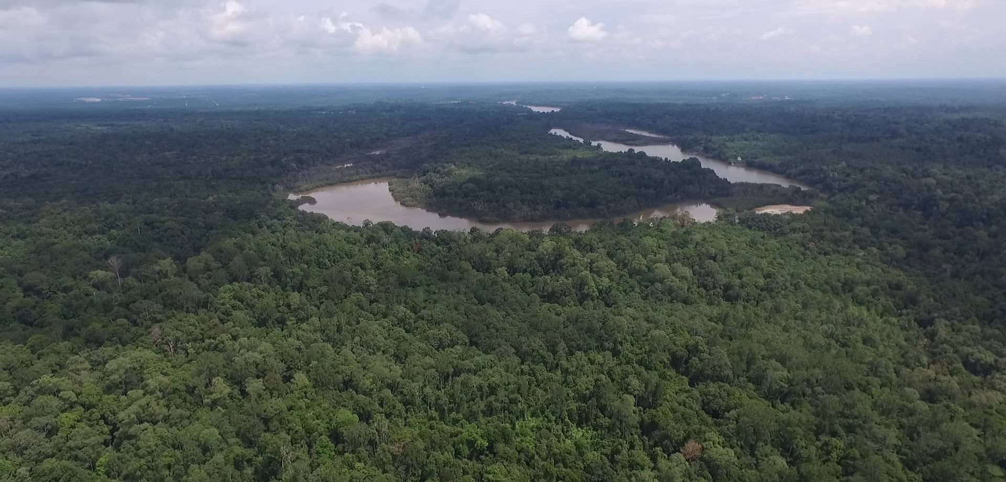

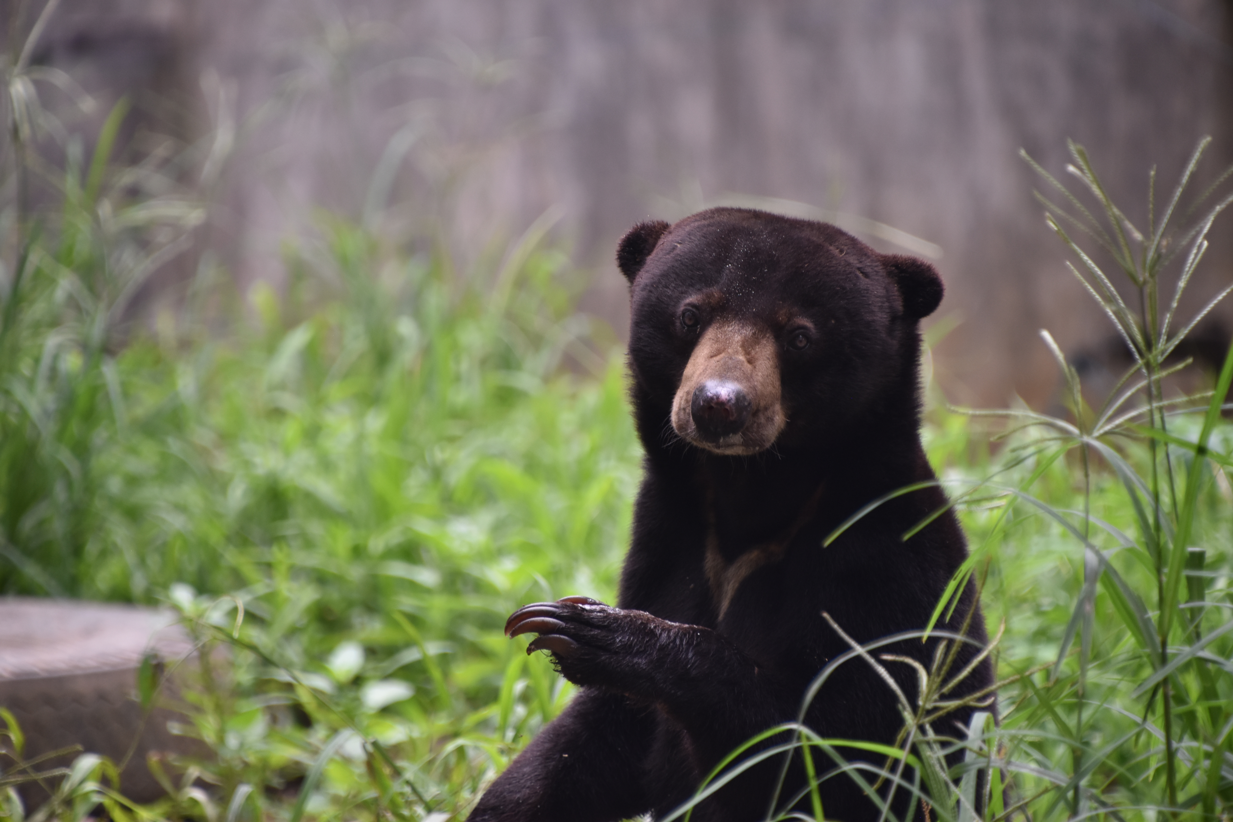
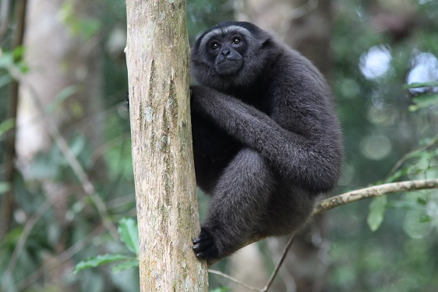
ACKNOWLEDGEMENT OF SUPPORT
Issued to
[certificate.cert_fullname]
Funding of an area of [certificate.cert_data1;frm= 0 000.] [certificate.cert_unit_unit] of forest to help Yayasan Kalaweit Indonesia to protect wildlife habitat on Borneo and Sumatra (Indonesia).
[onshow;block=begin;when [certificate.cert_display_mnt]=1]
Land value : [certificate.cert_input_mnt;frm=0 000.00] [certificate.mon] (or [certificate.cert_output_mnt;frm=0 000.] Indonesian RP)[onshow;block=end;]
In Paris, [certificate.cert_ts]
Chanee
Founder and president

