Slide 1
Game Theory: introduction
and applications to computer networks
Lecture 3: two-person non zero-sum games
Giovanni Neglia
INRIA – EPI Maestro
6 January 2010
Slides are based on a previous course
with D. Figueiredo (UFRJ) and H. Zhang (Suffolk University)

Slide 2
Outline
Two-person zero-sum games
  Matrix games
    Pure strategy equilibria (dominance and saddle points), ch 2
    Mixed strategy equilibria, ch 3
  Game trees, ch 7
  About utility, ch 9
Two-person non-zero-sum games
  Nash equilibria…
    …And its limits (equivalence, interchangeability, Prisoner’s dilemma), ch. 11 and 12
  Strategic games, ch. 14
  Subgame Perfect Nash Equilibria (not in the book)
  Repeated Games, partially in ch. 12
  Evolutionary games, ch. 15
N-persons games

Slide 3
Strategic moves: preliminary
Is it better to play first or after?
  what about zero-sum games with saddle points?
  and about zero-sum games without saddle points?
  Answers: 1. no difference, 2. the first player makes worse

Slide 4
Strategic moves: preliminary
Is it better to play first or after?
  and for non zero-sum games?
Colin
 | swerve | stay
swerve | 0, 0 | -1, 5
stay | 5, -1 | -10, -10
Rose makes better
Colin
Rose
 | A | B
A | 2, 3 | 4, 2
B | 1, 0 | 3, 5
Colin
Rose
 | A | B
A | 1, 2 | 2, 0
B | 2, 0 | 0, 2
Both players would like
Rose to play first!
Rose
Rose makes worse

Slide 5
Strategic moves
Even if both players play at the same time, similar effects can be obtained if players can communicate
  commitment, Rose: “I will always play X”
  how to convince Colin
    communicate and block any form of communications
    reduce its own payoffs (public commitment, contract,…)
    gain credibility in a repeated game
Colin
Colin
 | A | B
A | 2, 3 | 4, 2
B | 1, 0 | 3, 5
 | A | B
A | 0, 3 | 2, 2
B | 1, 0 | 3, 5
Rose
Rose

Slide 6
Strategic moves
Even if both players play at the same time, similar effects can be obtained if players can communicate
  commitment, Rose: “I will always play X”
2 other basic forms of communications in sequential games
  threat, Rose “If you play X, I will play Y”
    Y is harmful to Colin, but also to Rose!
  promise: “If you play X, I will play Y”
    Y is beneficial to Colin, but harmful to Rose.

Slide 7

Possible conflicting commitments
2
2
Game of Chicken (aka. Hawk-Dove Game)
  driver who swerves looses
Driver 2
 | swerve | stay
swerve | 0, 0 | -1, 5
stay | 5, -1 | -10, -10
Drivers want to do opposite of one another
Driver 1
Will prior communication help?

Slide 8
Game Trees Revisited
Microsoft and Mozilla are deciding on adopting new browser technology (.net or java)
  Microsoft moves first, then Mozilla makes its move
Microsoft
.net
java
Mozilla
Mozilla
.net
java
.net
java
3, 1
1, 0
0, 0
2, 2
Non-zero sum game
  what are the NEs?
  remember: a (pure) strategy has to specify the action at each information set

Slide 9
NE and Threats
.net
java
Convert the game to normal form
.net
java
.net
java
Mozilla
3, 1
1, 0
0, 0
2, 2
 | NN | NJ | JN | JJ
.net | 3,1 | 3,1 | 1,0 | 1,0
java | 0,0 | 2,2 | 0,0 | 2,2
Microsoft
NE
Mozilla’s JJ is a threat to Microsoft
  I will play Java, no matter what you do
  harmful to Microsoft, but also to Mozilla if Microsoft plays .net

Slide 10
NE and Threats
.net
java
Convert the game to normal form
.net
java
.net
java
Mozilla
3, 1
1, 0
0, 0
2, 2
 | NN | NJ | JN | JJ
.net | 3,-1 | 3,-1 | 1,0 | 1,0
java | 0,-2 | 2,2 | 0,-2 | 2,2
Microsoft
NE
Mozilla’s JJ is a threat to Microsoft
Mozilla may declare that it will never adopt .net (loss of image when adopting .net equal to -2)

Slide 11
NE and Incredible Threats
.net
java
Convert the game to normal form
.net
java
.net
java
Mozilla
3, 1
1, 0
0, 0
2, 2
 | NN | NJ | JN | JJ
.net | 3,1 | 3,1 | 1,0 | 1,0
java | 0,0 | 2,2 | 0,0 | 2,2
Microsoft
NE
Mozilla’s JJ is a threat to Microsoft
If loss of image is negligible, the threat is incredible
Even if the threat is incredible, (java,JJ) is still a NE
  How to get rid of this unconvincing NE?

Slide 12
Removing Incredible Threats and other poor NE
.net
java
Apply backward induction to game tree
.net
java
.net
java
3, 1
1, 0
0, 0
2, 2
Single NE remains
  .net for Microsoft,
  .net, java for Mozilla
.net
java
3, 1
2, 2
In general, multiple NEs are possible after backward induction
  cases with no strict preference over payoffs
Corollary: be careful with reduction to normal form, when the game is not zero-sum!

Slide 13
Subgame Perfect Nash Equilibrium
Def: a subgame is any subtree of the original game that also defines a proper game
  only it makes sense in games with perfect information
Def: a NE is subgame perfect if its restriction to every subgame is also a NE of the subgame
The one deviation property: s* is a Subgame Perfect Nash Equilibrium (SPNE) if and only if no player can gain by deviating from s* in a single stage.
Kuhn’s Thr: every finite extensive form game with complete information has one SPNE
  based on backward induction
Notes:
Kuhn’s theorem does not hold for extensive games with simultaneous moves, see Osborne section 6.3 exercise 103.3

Slide 14

NE and Incredible Threats
.net
java
.net
java
.net
java
Mozilla
3, 1
1, 0
0, 0
2, 2
 | NN | NJ | JN | JJ
.net | 3,1 | 3,1 | 1,0 | 1,0
java | 0,0 | 2,2 | 0,0 | 2,2
Microsoft
NE
SPNE
JJ is an incredible threat and java-JJ is not an SPNE
NN is not really a threat (it motivates more Microsoft to play net), but net-NN is not an SPNE

Slide 15
Weakness of SPNE
(or when GT does not predict people’s behaviour)
Centipede Game
  two players alternate decision to continue or stop for k rounds
  stopping gives better payoff than next player stopping in next round (but not if next player continues)
C
C
C
C
C
C
C
C
8, 7
S
S
S
S
S
S
S
S
1, 0
0, 2
3, 1
2, 4
5, 3
4, 6
7, 5
6, 8
Backward induction leads to unique SPNE
  both players choose S in every turn
How would you play this game with a stranger?
  empirical evidence suggests people continue for many rounds

Slide 16
Stackelberg Game
A particular game tree
Two moves, leader then follower(s)
  can be modeled by a game tree
Stackelberg equilibrium
  Leader chooses strategy knowing that follower(s) will apply best response
  It is a SPNE for this particular game tree

Slide 17
Stackelberg Game and
Computer Networking
"Achieving Network Optima Using Stackelberg Routing Strategies."
Yannis A. Korilis, Aurel A. Lazar, Ariel Orda. IEEE/ACM Transactions on Networking, 1997.
"Stackelberg scheduling strategies".
Tim Roughgarden. STOC 2001.

Slide 18
Promises
Example: in a sequential prisoner’s dilemma “I will not confess, if you not confess”.
Similar issues about credibility as for threats
Suspect 2
 | NC | C
NC | 2, 2 | 10, 1
C | 1, 10 | 5, 5
Suspect 1

Slide 19
Outline
Two-person zero-sum games
  Matrix games
    Pure strategy equilibria (dominance and saddle points), ch 2
    Mixed strategy equilibria, ch 3
  Game trees, ch 7
  About utility, ch 9
Two-person non-zero-sum games
  Nash equilibria…
    …And its limits (equivalence, interchangeability, Prisoner’s dilemma), ch. 11 and 12
  Strategic games, ch. 14
  Subgame Perfect Nash Equilibria (not in the book)
  Repeated Games, partially in ch. 12
  Evolutionary games, ch. 15
N-persons games

Slide 20
Repeated games
players face the same “stage game” in every period, and the player’s payoff is a weighted average of the payoffs in each stage.
moves are simultaneous in each stage game.
finitely repeated (finite-horizon) and infinitely repeated (infinite-horizon) games
in this talk, we assume:
  players perfectly observed the actions that had been played.

Slide 21
Repeated games are game trees
P2
left
right
normal form simultaneous game
  transform it in a game tree
L
3,1 | 1,0
0,0 | 2,2
P1
R
P1
stage 1
L
R
P2
left
right
left
right
(3,1)
(1,0)
(0,0)
(2,2)

Slide 22
Repeated games are game trees
P2
P1
left
right
L
3,1 | 1,0
0,0 | 2,2
L
R
P1
stage 1
R
P2
left
right
left
right
P1
P1
P1
P1
L
R
L
R
L
R
L
R
P2
P2
stage 2
P2
P2
left
right
(6,2)
(4,1)
(3,1)
(5,3)
(4,1)
if payoffs are just summed without any discount

Slide 23
Repeated games
A_{i}=(a_{i1}, a_{i2}, …, a_{i|Ai|}): action space for player i at each stage.
a^{t}=(a₁^{t},..., a_{n}^{t}): the actions that are played in stage t.
h^{t}=(a⁰, a¹..., a^{t-1}): the history of stage t, the realized choices of actions at all stages before t.
As common in game trees a pure strategy s_{i} for player i maps all its information sets to actions a_{i} in A_{i}
  in this case it means mapping possible stage-t histories h^{t} to actions a_{i} in A_{i}
  player strategy needs to specify his actions also after histories that are impossible if he carries out his plan (see Osborne and Rubinstein section 6.4)
P1
L
R
5 possible information sets and two actions available for each player.
player 1 has 2⁵ pure strategies
player 2 has 2⁵ pure strategies
P2
left
right
left
right
P1
P1
P1
P1
P2
P2
P2
P2

Slide 24
Repeated games
A mixed strategy x_{i} is a probability distribution over all possible pure strategies.
A behavioral strategy b_{i} is a function which assigns to each information set a probability distribution over available actions, that is, randomizing over the actions available at each node.
  see Osborne and Rubinstein, section 11.4
5 possible information sets and two actions available for each player.
a mixed strategy for player 1 is specified by 2⁵-1 values in [0,1]
a behavioral strategy for player 1 is specified by 5 values in [0,1]
P1
L
R
P2
left
right
left
right
P1
P1
P1
P1
P2
P2
P2
P2

Slide 25
Repeated games
behavioral strategies are outcome-equivalent to mixed strategies and vice versa in games with perfect recall,
  perfect recall=a player remembers whatever he knew in the past
two games with imperfect recall
  P1 forgets that he has already played):
  P1 forgets what he played
L
P1
P1
R
L
R
P2
left
right
left
right
left
right
P1
P1
P1
L
R
L
R
L
R
L
R
L
R
L
R
A possible P1 mixed strategy: play LL with prob. 1/2, RR with prob. 1/2
P1 behavioral strategy: 1st time play L with prob. p, 2nd time play L with prob. q
can give LL with prob. pq, RR with prob. (1-p)(1-q)
not possible to obtain the mixed strategy
P1 behavioral strategy: play L with prob. p
can give LL with prob. p², LR with prob. p(1-p)
P1 pure strategies: play L and play R
no mixed strategy can be outcome equivalent to the behavioral strategy

Slide 26
Infinite-horizon games
stage games are played infinitely.
payoff to each player is the sum of the payoffs over all periods, weighted by a discount factor δ, with 0< δ <1.
  δ can be interpreted also as the probability to continue the game at each stage (1-δ is the prob. to stop playing)
Central result: Folk Theorem.

Slide 27
Nash equilibrium in repeated game
We may have new equilibrium outcomes that do not arise when the game is played only once.
  Reason: players’ actions are observed at the end of each period, players can condition their play on the past play of their opponents.
  Example: cooperation can be a NE in Prisoner’s Dilemma Game in infinitely repeated game.
Notes:
TBD: qualcosa di particolare nel gioco ripetuto finito?

Slide 28
Finite-horizon Prisoner’s dilemma
Prisoner’s Dilemma Game (Payoff Matrix) |  | P2
 |  | Cooperate | Defect
P1 | Cooperate | 5, 5 | -3, 8
 | Defect | 8, -3 | 0, 0
A Prisoner’s Dilemma game is played 100 times.
At the last play, h=2⁹⁹x2⁹⁹≈4x10⁵⁹ histories, so there are 2^{h} pure strategies !
One unique subgame perfect NE: always “defect”
  same criticism that for the centipede game (people play differently)

Slide 29
Infinite-horizon Prisoner’s Dilemma
Prisoner’s Dilemma Game (Payoff Matrix) |  | P2
 |  | Cooperate | Defect
P1 | Cooperate | 5, 5 | -3, 8
 | Defect | 8, -3 | 0, 0
How to find Nash equilibrium?
  we cannot use Backward induction.
Let’s guess: trigger strategy can be subgame perfect NE if δ (discount factor) is close to one.

Slide 30
Trigger Strategy
Def: follow one course of action until a certain condition is met and then follow a different strategy for the rest of the repeated game.
Idea: each player will be deterred from abandoning the cooperative behavior by being punished. Punishments from other player are triggered by deviations
examples:
  trigger strategy 1: I cooperate as long as the other player cooperates, and I defect forever if the other player defects in one stage.
  trigger strategy 2: I alternates C, D, C, … as long as the other player alternates D, C, D, … , if the other player deviates from this pattern, then I deviate forever.

Slide 31
Infinite-horizon Prisoner’s Dilemma
Trigger strategy 1: cooperate as long as the other player cooperates, and defect forever if the other player defects in one stage.
Trigger strategy 1 can be subgame perfect NE if the discount factor δ is close to one.
Proof:
  if both players cooperate, then payoff is 5/(1- δ)=5*(1+ δ+ δ²+…)
  suppose one player could defect at some round, in order to discourage this behavior, we need 5/(1- δ) ≥ 8, or δ ≥ 3/8.
  so, as long as δ ≥ 3/8, the pair of trigger strategies is subgame perfect NE
Cooperation can happen at Nash equilibrium !

Slide 32
Infinite-horizon Prisoner’s Dilemma
Trigger strategy 2: player 1 alternates C, D, C, … as long as player 2 alternates D, C, D, … , if player 2 deviates from this pattern, then player 1 deviates forever. This is also true for player 2.
This pair of trigger strategies is also subgame perfect NE if δ is sufficiently close to one.
In fact, there are lots of subgame perfect NEPs if δ is sufficiently close to one.
What is happening here?

Slide 33
Infinite-horizon Prisoner’s Dilemma
payoff of player 2
E (-3, 8)
(C,D)
A
B (5, 5)
(C,C)
Region EOFBE contains the payoffs of all possible mixed strategy pairs.
payoff of player 1
C
O
(D,D)
F (8, -3)
(D,C)

Slide 34
Infinite-horizon Prisoner’s Dilemma
payoff of player 2
Any point in the region OABC can be sustained as a subgame perfect NE of the repeated game given the discount factor of the players is close to one (that is, players are patient enough) !
E (-3, 8)
(C,D)
A
B (5, 5)
(C,C)
payoff of player 1
C
O
(D,D)
F (8, -3)
(D,C)

Slide 35
Folk Theorem
For any two-player stage game with a Nash equilibrium with payoffs (a, b) to the players. Suppose there is a pair of strategies that give the players (c, d). Then, if c>=a and d>=b, and the discount factors of the players are sufficiently close to one, there is a subgame perfect NE with payoffs (c, d) in each period.
(C,D)
(a,b)
A
(C,C)
(c,d)
C
O
(D,D)
(D,C)

Slide 36
Axelrod’s tournament (1984)
competition of software playing Repeated Prisoner’s dilemma
1st competition: the winner is a 4 line program “Tit For Tat” (TFT)
  cooperate at the first stage
  copy what your opponent has done at the previous stage
2nd competition: again Tit For Tat
Good properties of TFT
  nice, starts cooperating
  retaliatory, punishes defection
  forgiving
  clear

Slide 37
Applications of repeated games in computer networking
“Optimal Routing Control: Repeated Game Approach”,
R. La and V. Anantharam. IEEE Tans. on Automatic Control, 2002.
“Cooperation in Wireless Ad Hoc Networks.”
V. Srinivasan, P. Nuggehalli, C. Chiasserini, and R. Rao. IEEE Infocom 2003.

Slide 38
Outline
Two-person zero-sum games
  Matrix games
    Pure strategy equilibria (dominance and saddle points), ch 2
    Mixed strategy equilibria, ch 3
  Game trees, ch 7
  About utility, ch 9
Two-person non-zero-sum games
  Nash equilibria…
    …And its limits (equivalence, interchangeability, Prisoner’s dilemma), ch. 11 and 12
  Strategic games, ch. 14
  Subgame Perfect Nash Equilibria (not in the book)
  Repeated Games, partially in ch. 12
  Evolutionary games, ch. 15
N-persons games

Slide 39
Evolutionary games
Maynard Smith and Price in 1973
game theoretical look at species evolution
new equilibrium concept (static analysis):
  Evolutionary Stable Strategies (ESS)
    a refinement of NE
also dynamics (e.g. replicator dynamics)
In this talk we only consider symmetric games
P2
a,a | b,c
c,b | d,d
P1

Slide 40
Hawk-Dove game
rules
  resource to be assigned with value 50
  hawk attacks until it lets opponent escape or it is injured (-100 damage)
  dove at most engages in symbolic conflict (at most -20 damage for time needed)
H
D
-25,-25 | 50,0
0,50 | 15,15
H
D

Slide 41
Hawk-Dove game
target
  how would these two species evolve? (or these two behaviors among members of the same species?)
  how would be the equilibrium? only a single species/behavior surviving? a mix of them?
assumptions
  species with higher payoff will have higher chance to reproduce and their percentage will increase
  random matching between individuals
H
D
H
-25,-25 | 50,0
0,50 | 15,15
D

Slide 42
Hawk-Dove game
Can a population of hawks be invaded by a mutant acting as a dove?
  Yes, “everyone hawk” is not an ESS
Can a population of doves be invaded by a mutant acting as a hawk?
  Yes, “everyone dove” is not an ESS
H
D
H
-25,-25 | 50,0
0,50 | 15,15
D

Slide 43
Hawk-Dove game
Is there a stable mix of hawk and doves?
  what about ½ hawks and ½ doves?
    not stable, still convenient to be hawk
  7/12 hawks, 5/12 doves
    This is an ESS! But also a NE
Interpretation, it is stable a population
  with 7/12 pure hawks and 5/12 pure doves
  homogeneous individuals acting 7/12 of time as hawk and 5/12 as dove
  heterogeneous individuals, but with this average behavior
H
D
H
-25,-25 | 50,0
0,50 | 15,15
D

Slide 44
A more formal definition
an incumbent strategy x ∈ Δ, where Δ is the set of all mixed strategies,
  x_{i} – population share of pure strategy i.
  e^{i} – pure strategy i.
  u(e^{i}, e^{j}) – matrix payoffs
  u(e^{i}, x) – expected payoff (fitness) of strategy i at a random match when the population is in state x=(x₁, …, x_{n}).
a single mutant playing strategy y ∈ Δ, would get the payoff:

Slide 45
A more formal definition
an incumbent strategy x ∈ Δ, where Δ is the set of all mixed strategies,
a mutant strategy y ∈ Δ. The share of mutants in the population is ε, where ε ∈(0,1).
random matching of players, then the payoff of a generic player is the same as in a match with a player who plays mixed strategy w = εy+(1- ε)x ∈ Δ.
A strategy x is an evolutionarily stable strategy (ESS) if the following inequality is true for any mutant strategy y≠x for a given value of ε,

Slide 46
Characterization of ESS
Equivalently, x is an ESS if and only if it meets the following conditions
  first-order best-response condition:
  x is the best response to itself.
  second-order best-response condition:
  x is a better response to a mutant strategy y (y≠x), if y has the same payoff as x when playing against x.
Homework: Prove it!

Slide 47
Some immediate results…
Δ^{ESS} ⊂ Δ^{NE}
  follows from the first-order condition
  Δ^{ESS} – the set of evolutionarily stable strategies
  Δ^{NE} – the set of NE strategies
if (x, x) is a strict Nash equilibrium, then x is evolutionarily stable.
  x is a strict Nash equilibrium if x is the only best response to itself.
ESS does not in general imply that the average population fitness is maximized.
ESS does not imply social efficiency.

Slide 48
Example 1
Prisoner’s Dilemma (Payoff Matrix) |  | P2
 |  | Cooperate | Defect
P1 | Cooperate | 5, 5 | -3, 8
 | Defect | 8, -3 | 0, 0
Prisoner’s Dilemma Game: Nash equilibrium strategy Defect is the unique best reply to any strategy y, so Defect-Defect is a strict Nash equilibrium, then it is ESS.

Slide 49
Example 2
Coordination Game (Payoff Matrix) |  | P2
 |  | right | left
P1 | right | 2, 2 | 0, 0
 | left | 0, 0 | 1, 1
Two pure strategy NEs (right, right), (left, left)
and a mixed strategy NE (determine it)
Coordination Game: both pure strategy Nash equilibria are ESS.
  in fact, both NEs are strict Nes.
  Socially efficient NE strategy right is a ESS.
  Socially inefficient NE strategy left is also a ESS.

Slide 50
Example 3
Rock-Scissors-Paper (RSP) Game:
RSP Game (Payoff Matrix) |  | P2
 |  | Rock | Scissors | Paper
P1 | Rock | 0, 0 | 1, -1 | -1, 1
 | Scissors | -1, 1 | 0, 0 | 1, -1
 | Paper | 1, -1 | -1, 1 | 0, 0
Unique NE strategy x=(1/3, 1/3, 1/3) is NOT ESS !
check condition 1: all strategies are best replies to x.
check condition 2: mutant y=(1, 0, 0), u(y, y)=1=u(x, y), NOT satisfied

Slide 51
Dynamics
ESS is an equilibrium, there can be multiple ones
Starting from a generic population composition, do we converge to a ESS? to which one?
A possible dynamics is replicator dynamics

Slide 52
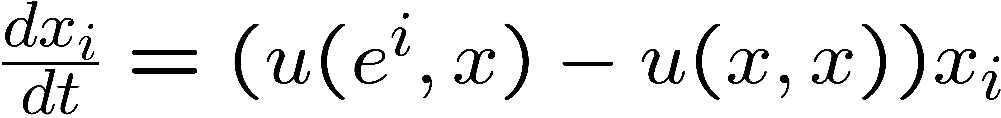
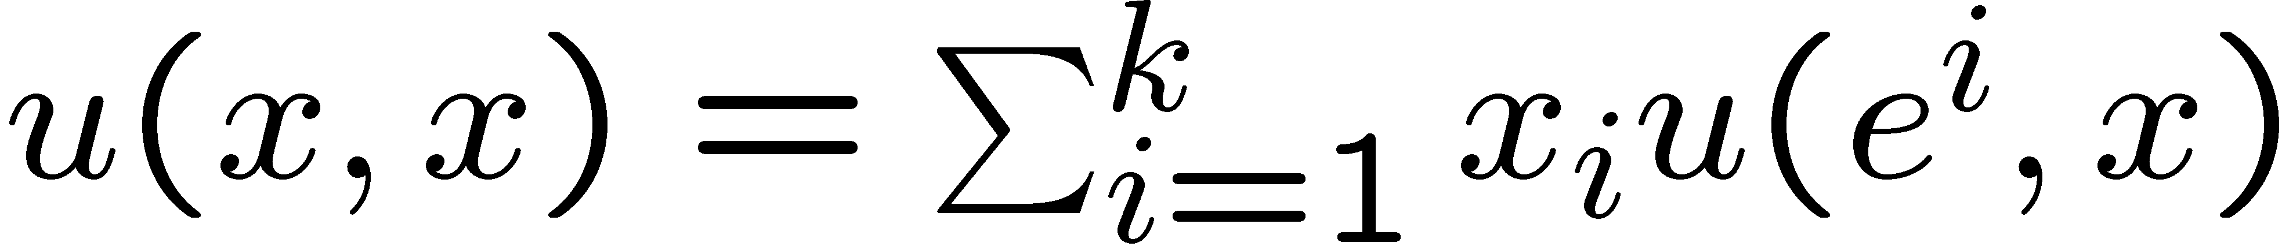
Replicator Dynamics: Model
x_{i} – population share of pure strategy i.
e^{i} – pure strategy i.
u(e^{i}, x) – expected payoff (fitness) of strategy i at a random match when the population is in state x=(x₁, …, x_{n}).
u(x, x) – population expected payoff (fitness) is the expected payoff to an individual drawn at random from the population:

Slide 53
Stability Concepts
Lyapunov Stability: a state x is “stable” or “Lyapunov stable” if no small perturbation of the state induces a movement away from x.
  no push away from x
Asymptotical Stability: a state x is “asymptotical stable” if it is “Lyapunov stable” and all sufficiently small perturbations of the state induce a movement back toward x.
  an ESS is asymptotical stable

Slide 54
Normalization of 2x2 Symmetric Game
General 2 x 2 Symmetric (Payoff Matrix) |  | P2
 |  | L | R
P1 | L | a11 | a12
 | R | a21 | a22
a1=a11-a21, a2=a22-a12
a1 | 0
0 | a2
This local shift in payoff produces a new game which has the same set of NEPs as the original game.
does not change a player’s pure and mixed best-reply correspondences.
does not change weak and strict dominance orderings.

Slide 55
NE, ESS in Symmetric 2x2 Game
 | L | R
L | a1 | 0
R | 0 | a2
mixed strategy: x=λL+(1- λ)R
with λ =a2/(a1+a2)
a2
Prisoner’s Dilemma Game
NE: (R,R)
ESS: (R,R)
Coordination Game
NE: (R,R), (L,L), (x,x)
ESS: (R,R), (L,L)
I
II
Hawk-dove Game
NE: (L,R), (R,L), (x,x)
ESS: (x,x)
III
IV
a1
Prisoner’s Dilemma Game
NE: (L,L)
ESS: (L,L)
Replicator Dynamics

Slide 56
NE, ESS, Replicator Dynamics in Symmetric 2x2 Game
x₁ – probability of playing “L”; x – mixed strategy defined before
a2
Prisoner’s Dilemma Game
NE: (R,R)
ESS: (R,R)
Replicator Dynamics → ESS=NE
Coordination Game
NE: (R,R), (L,L), (x,x)
ESS: (R,R), (L,L)
Replicator Dynamics → ESS
x₁
I
II
0
1
0
a2/(a1+a2)
1
x₁
a1
III
IV
x₁
0
1
x₁
0
a2/(a1+a2)
1
Hawk-dove Game
NE: (L,R), (R,L), (x,x)
ESS: (x,x)
Replicator Dynamics → ESS
Prisoner’s Dilemma Game
NE: (L,L)
ESS: (L,L)
Replicator Dynamics → ESS=NE

Slide 57
Rock-Scissors-Paper (RSP) Game
Unique NE strategy x=(1/3, 1/3, 1/3) is NOT ESS !
How about the Replicator Dynamics?
RSP Game (Payoff Matrix) |  | P2
 |  | Rock | Scissors | Paper
P1 | Rock | 0, 0 | 1, -1 | -1, 1
 | Scissors | -1, 1 | 0, 0 | 1, -1
 | Paper | 1, -1 | -1, 1 | 0, 0

Slide 58
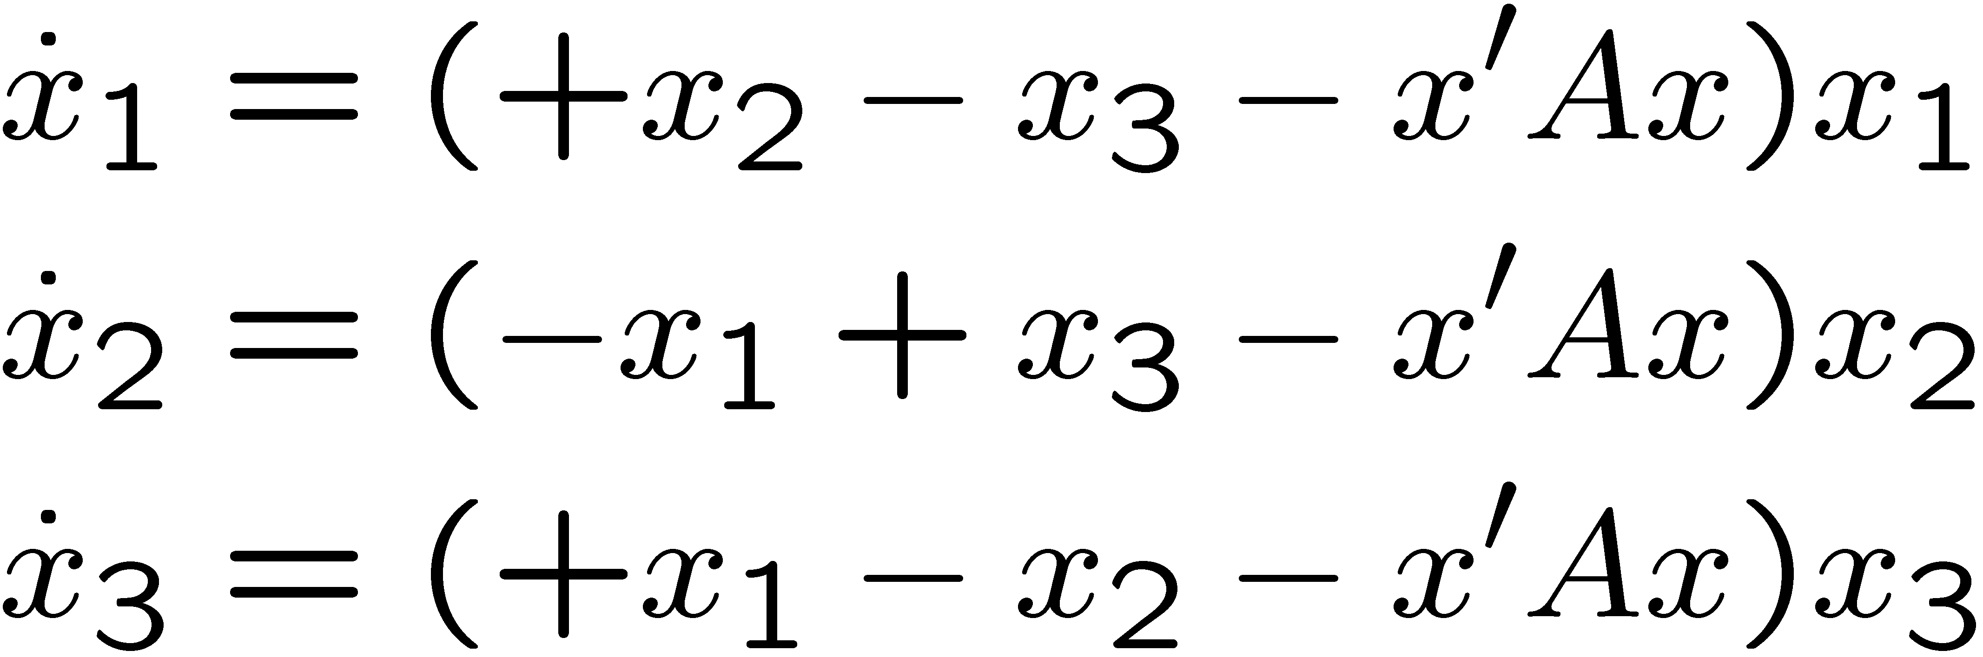
Example: Rock-Scissors-Paper (RSP) Game
RSP Game |  | P2
 |  | R | S | P
P1 | R | 0, 0 | 1, -1 | -1, 1
 | S | -1, 1 | 0, 0 | 1, -1
 | P | 1, -1 | -1, 1 | 0, 0
A is the payoff matrix of one player
0 | 1 | -1
-1 | 0 | 1
1 | -1 | 0
Replicator Dynamics:

Slide 59

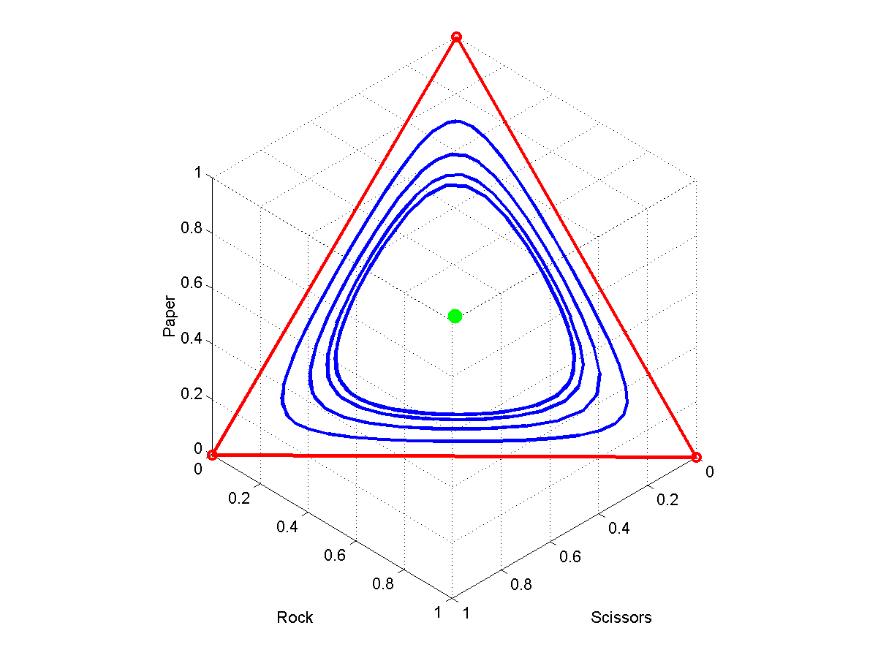
Rock-Scissors-Paper (RSP) Game
NE strategy x=(1/3, 1/3, 1/3), but not ESS
NE strategy is Lyapunov stable, but not asymptotically stable
Replicator Dynamics:
Start from any initial state, the system moves forever along a closed curve!
Paper
(x₃)
Rock (x₁)
Scissors (x₂)

Slide 60
Evolutionary Game Theory and Computer Networking
“An evolutionary game perspective to ALOHA with power control”.
E. Altman, N. Bonneau, M. Debbah, and G. Caire. Proceedings of the 19th International Teletraffic Congress, 2005.
“An evolutionary game-theoretic approach to congestion control”.
D.S. Menasche, D.R. Figueiredo, E. de Souza e Silva. Performance Evaluation 62 (2005)

