Slide 1

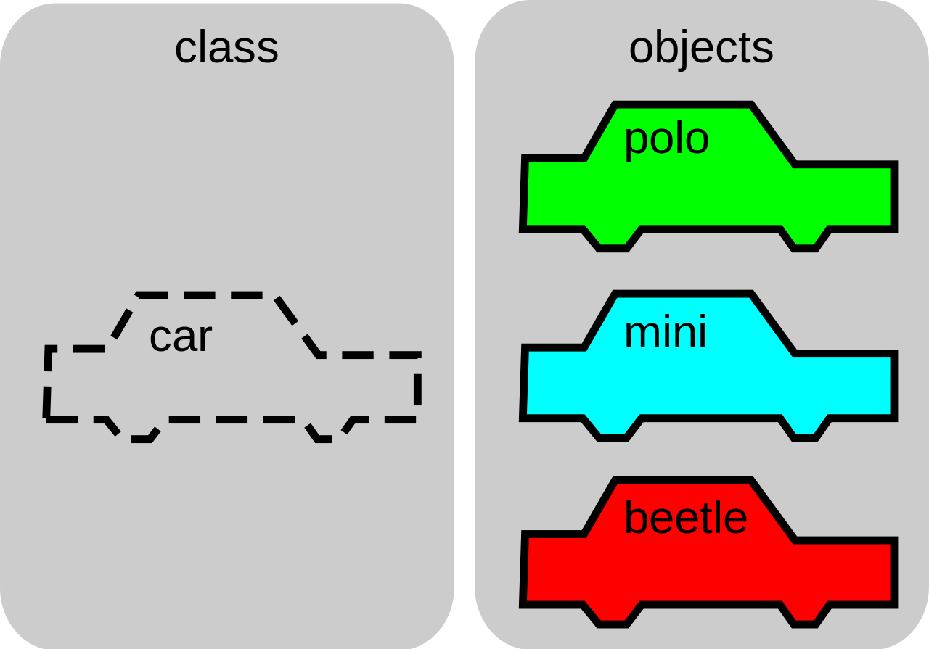


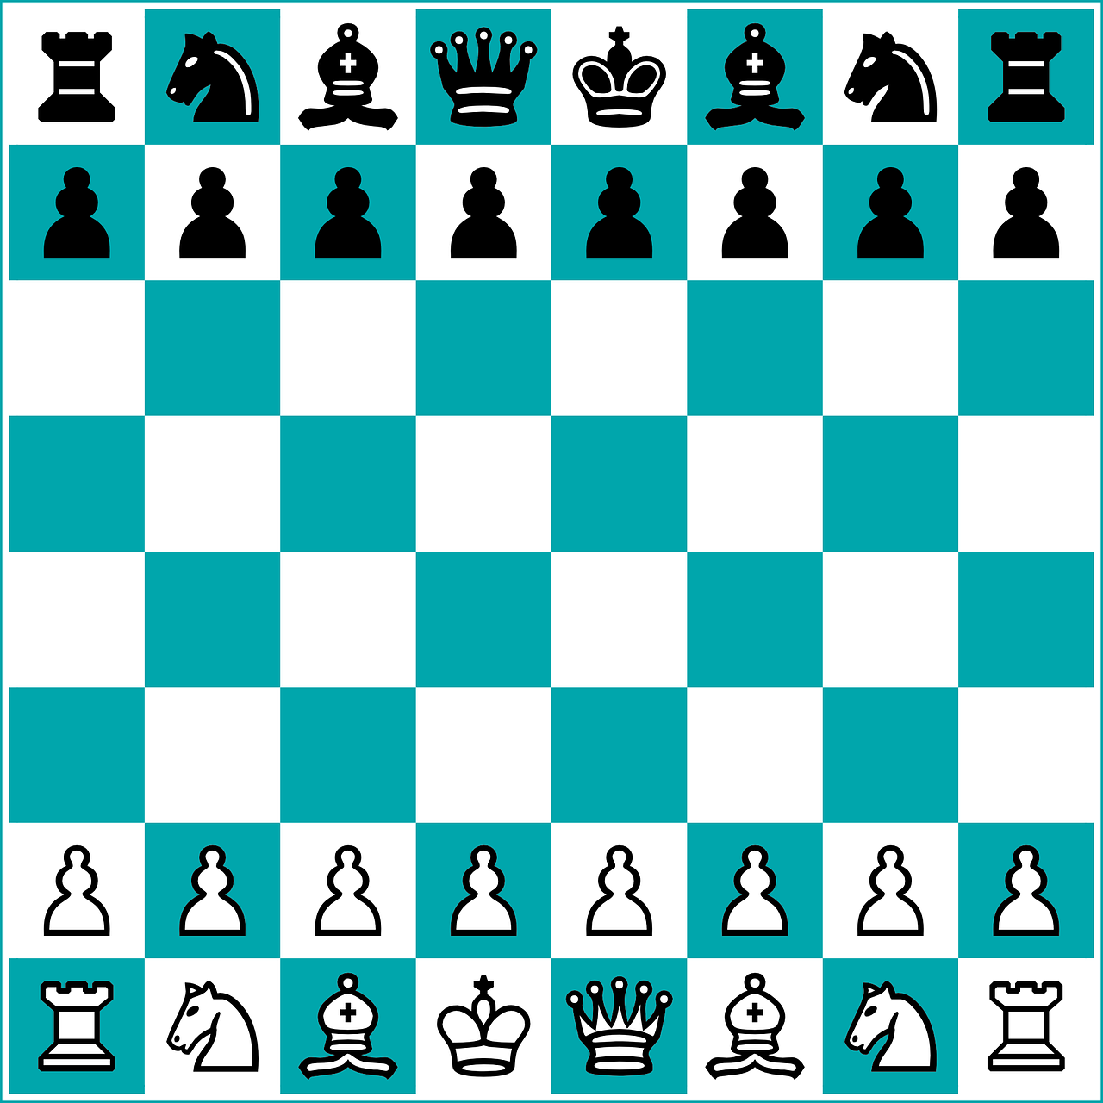

Jian Pan 5728309
Xiaohan Yu 5718303
Chess Game

Slide 2
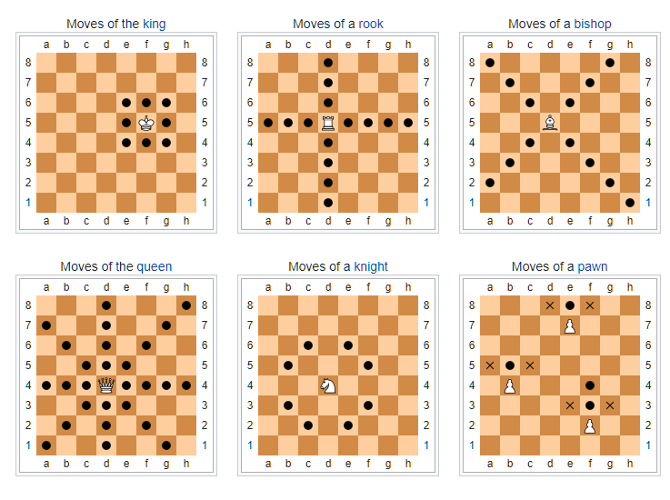
Chess Game
Source: wiki, https://en.wikipedia.org/wiki/Chess

Slide 3
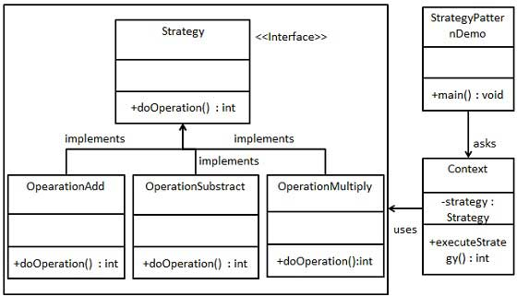
Strategy Pattern
In Strategy pattern, we create objects which represent various strategies and a context object whose behavior varies as per its strategy object. The strategy object changes the executing algorithm of the context object.
the Strategy pattern allows an algorithm to be chosen at runtime by containment. The concrete algorithms are implemented by separate classes or functions which are passed to the strategy as a parameter to its constructor or to a setter method. Which algorithm is chosen for this parameter can vary dynamically based on the program's state or inputs

Slide 4
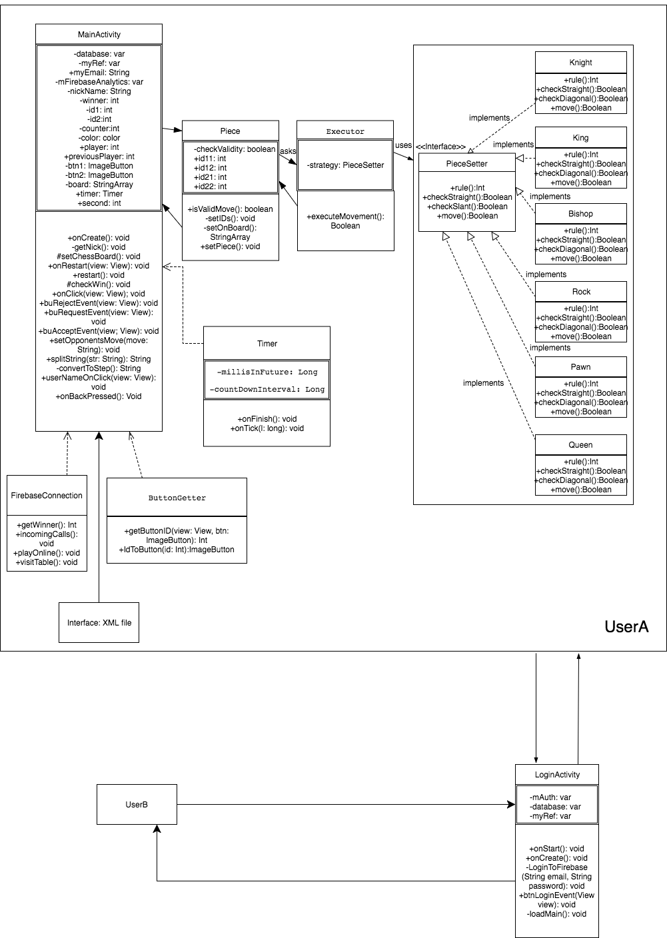
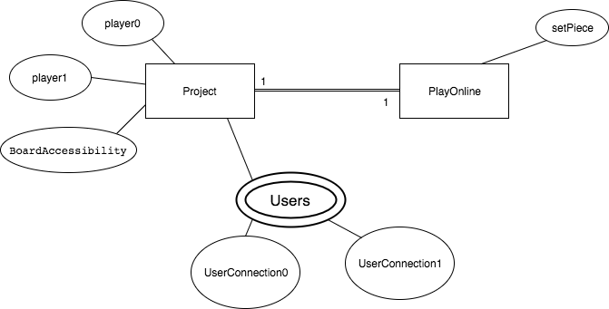
UML & DB Diagram

Slide 5
Extra content
About AI and other platform application

