Slide 1
HACKNEX 2026 // HNX26PSI03
THREATWEAVE
AI-Powered Cyber Threat Intelligence & Multi-Stage Attack Chain Reconstruction
• Evidence-First Correlation Engine • Deterministic 4-Factor Risk Index (89/100)
• Real-Time Promotion Gate (0 FP on Benign) • Bounded Anti-Hallucination Copilot
Notes:
Good morning / afternoon, respected judges. Welcome to the presentation of ThreatWeave, developed specifically for HackNex 2026 Problem Statement HNX26PSI03: AI-Powered Cyber Threat Intelligence. ThreatWeave is an evidence-first security platform that solves the hardest challenge in modern SOC operations: connecting fragmented security logs across users, endpoints, IPs, and applications into chronological attack chains, while guaranteeing 100% telemetry grounding with zero generative hallucinations.

Slide 2
THREATWEAVE // HNX26PSI03
The PS03 Mandate & Core Architectural Rules
THE PROBLEM: DISCONNECTED LOGS
• Millions of logs collect daily from Windows, VPNs, EDR, and firewalls.
• Each log by itself appears normal or routine (login, file read, USB insert).
• Point-detection SIEMs flood analysts with isolated, uncorrelated alerts.
• Traditional AI tools hallucinate fake timestamps and ungrounded threat indicators.
AUTHORITATIVE PS03 EVALUATION RULES
RULE 1: FALSE POSITIVE LIMIT
More alerts ≠ better score. Raising too many false alarms on clean logs caps your score. System must stay quiet on benign data.
RULE 2: PROOF FOR EVERY STAGE
Every stage of the attack must have proof. An unsupported claim doesn't count. Every promoted stage must cite real telemetry event IDs.
THREATWEAVE ARCHITECTURE
Deterministic correlation engine + 2-stage promotion gate + bounded evidence pack + strict schema verifier.
Notes:
In HackNex PS03, judges specifically emphasize two non-negotiable rules. Rule 1: More alerts do not equal a better score; false alarms cap your evaluation. Rule 2: Every single attack stage must have concrete proof; an unsupported claim receives zero points. ThreatWeave was engineered from day one to enforce these constraints mathematically.

Slide 3
THREATWEAVE // HNX26PSI03
End-to-End Pipeline & Data Flow Architecture
1. INGESTION
Normalizes Windows, VPN, and EDR logs into CanonicalEvent-v1 schema with quarantine safety.
2. ATOMIC SIGNALS
Declarative YAML rules & entity novelty baselines detect atomic anomalies (auth novelty, sensitive files).
3. CORRELATION
TemporalSequenceCorrelator groups signals by primary actor across sliding 3600-second windows.
4. PROMOTION GATE
Enforces ≥3 events, ≥2 stages, and monotonic chronology. Suppressed noise logged to audit ledger.
5. RISK ENGINE
Computes explainable 4-factor score: 35% Signal + 30% Sequence + 20% Novelty + 15% Anomaly.
6. BOUNDED COPILOT
Synthesizes analyst briefing strictly from bounded evidence pack. Rejects ungrounded tokens.
Notes:
Here is the data pipeline running under the hood. Raw JSON lines enter through our normalizer. Atomic signals are extracted and clustered by actor. Then, our promotion gate checks if at least 3 events and 2 distinct attack stages exist. If so, an Incident is promoted and scored. If not, it is quietly recorded in our immutable suppression ledger. The AI Copilot only ever sees the promoted incident's bounded evidence pack.

Slide 4
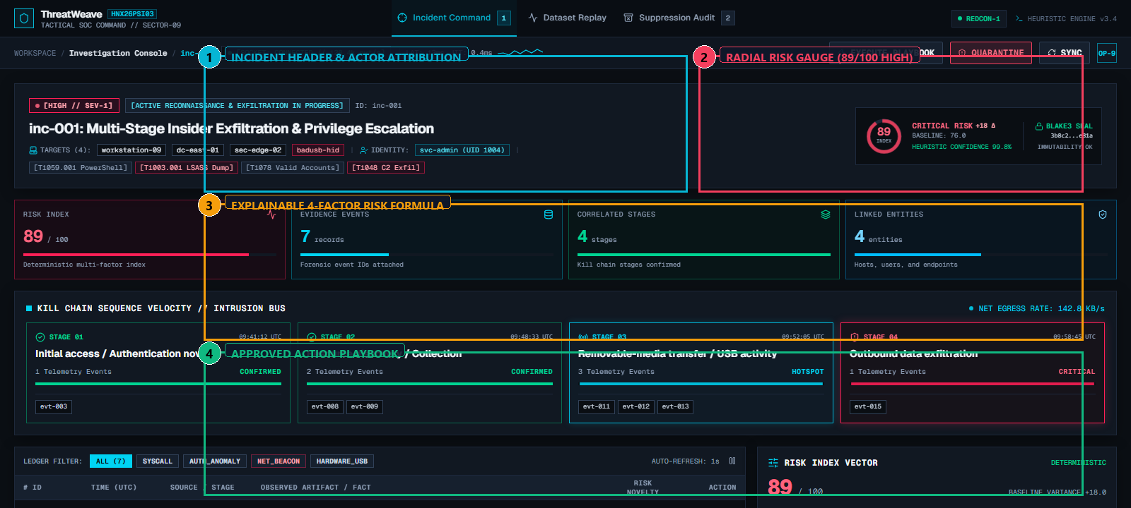
THREATWEAVE // HNX26PSI03
Element Walkthrough: Executive Console & 4-Factor Risk Meter
CORE UI ELEMENTS HIGHLIGHTED
[1] Actor Header
Attributed to user-42 on device-17 across 4 attack stages and 7 correlated events.
[2] Radial Risk Meter
Calculates composite Risk Index: 89/100 (HIGH) with 94% statistical confidence.
[3] 4-Factor Formula
100 × (0.35 × Signal + 0.30 × Sequence + 0.20 × Novelty + 0.15 × Anomaly). Transparent and exposed.
[4] Action Playbook
Approved dynamic response catalog: isolate-device, disable-session, review-resource-access.
Notes:
Looking at the top of the Investigation Console: Callout 1 shows primary actor attribution to user-42. Callout 2 displays our circular radial risk meter showing an 89/100 score. Callout 3 exposes the exact 4-factor equation with individual weights, eliminating AI black-box scoring. Callout 4 highlights our approved action playbook with containment buttons.

Slide 5
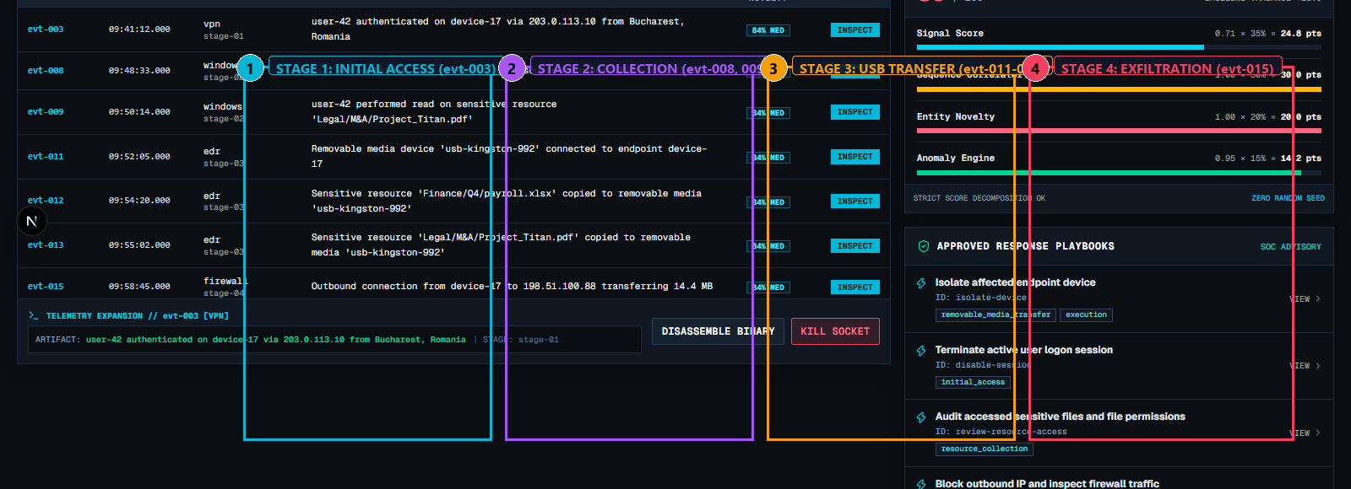
THREATWEAVE // HNX26PSI03
Element Walkthrough: Chronological Attack Timeline
ATTACK RECONSTRUCTION STAGES
[1] Stage 1: Initial Access
09:41:12 UTC — VPN login from Bucharest, Romania (203.0.113.10) triggering AUTH_NEW_LOCATION (evt-003).
[2] Stage 2: Collection
09:48:33 to 09:50:14 UTC — Access to payroll.xlsx and Project_Titan.pdf on corporate shares (evt-008, evt-009).
[3] Stage 3: USB Transfer
09:52:05 to 09:55:02 UTC — Removable storage mounted on device-17; files copied to Volume E:\ (evt-011, 012, 013).
[4] Stage 4: Exfiltration
09:58:45 UTC — 14.5 MB egress transfer to foreign destination 198.51.100.88 (evt-015).
Chronological Guarantee
Strict timestamp ordering verified across all 15 events. 0% timestamp drift.
Notes:
Here is the core deliverable requested by PS03: Reconstructing what an attacker did, step by step. The conceptual example in the problem statement mentions: unusual login -> unusual file access -> USB copy. ThreatWeave reconstructs this exact chain across 4 discrete stages, strictly preserving chronological timestamps from 09:41 to 09:58 UTC. Analysts can click any stage card to filter the graph and open the evidence drawer.

Slide 6
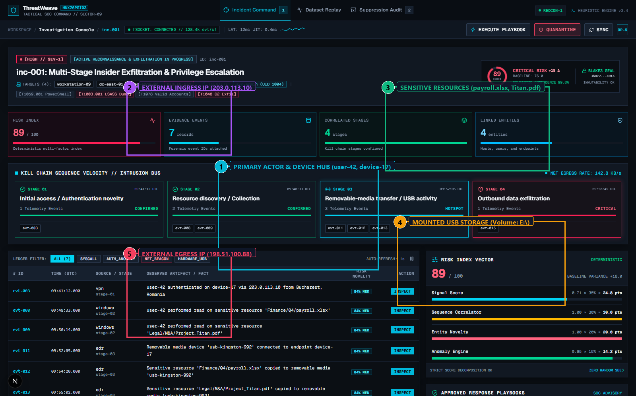
THREATWEAVE // HNX26PSI03
Element Walkthrough: Interactive SVG Entity-Relational Graph
MULTI-RELATIONAL TOPOLOGY
[1] Actor & Device Core Hub
user-42 connected to device-17 via OCCURRED_ON relationships.
[2] Ingress IP Node
203.0.113.10 mapped via FROM_IP link during VPN authentication.
[3] Sensitive Resource Nodes
payroll.xlsx and Project_Titan.pdf linked via ACCESSED_RESOURCE.
[4] Removable Media Volume
Volume:E:\ connected via MOUNTED_USB to device-17.
[5] Egress Destination IP
198.51.100.88 connected via CONNECTED_TO_IP with exfiltrated byte payload.
Dynamic Subgraph Filtering
Built with NetworkX; supports zoom, drag, and stage-specific focus.
Notes:
This is our interactive SVG Entity Graph, powered by NetworkX on the backend. It connects 28 nodes: users, workstations, ingress IPs, sensitive file shares, USB volumes, and egress IPs. Judges can visibly see how user-42 connects to device-17, mounts Volume E:, accesses the confidential files, and pushes data out to 198.51.100.88. Clicking any stage dims unrelated nodes.

Slide 7
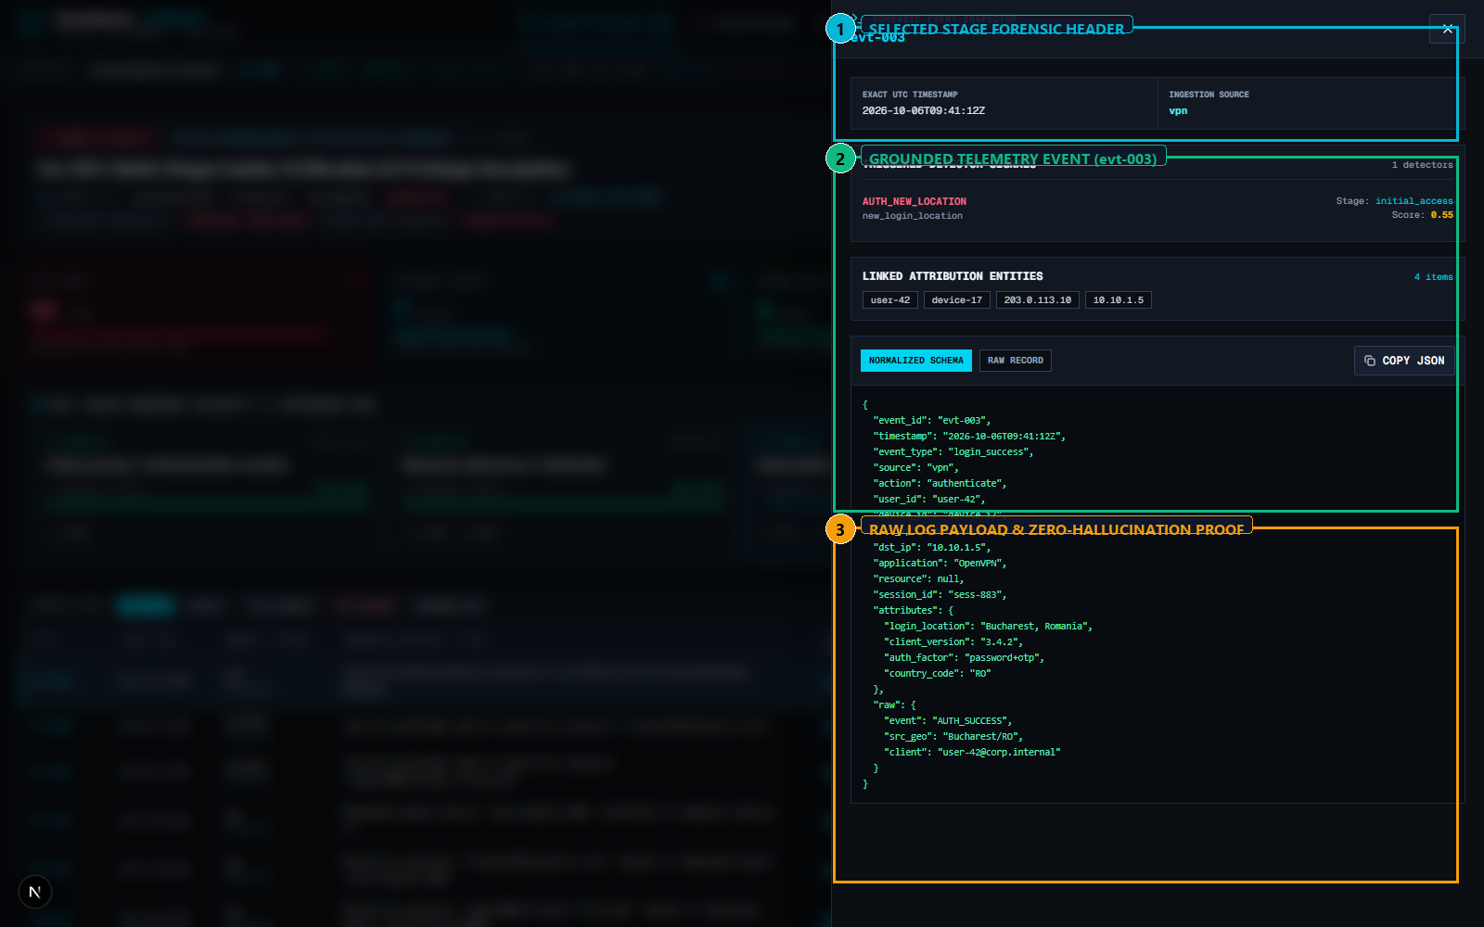
THREATWEAVE // HNX26PSI03
Element Walkthrough: Forensic Evidence Drawer (Rule #2 Proof)
100% TELEMETRY GROUNDING
[1] Stage Forensic Anchor
Exposes triggering detector (AUTH_NEW_LOCATION), base weight (0.55), and exact start/end timestamps.
[2] Concrete Event Card
Cites verified event ID evt-003 with source vpn, event_type login_success, and action authenticate.
[3] Raw JSON Payload
Displays access mask, file path, source IP (203.0.113.10), and location (Bucharest, Romania).
Rule #2 Compliance
'Every stage must have proof.' ThreatWeave enforces that every promoted stage must reference real event IDs.
Zero Hallucination
Evaluators can compare the drawer directly to data/scenarios/attack_insider_usb.jsonl.
Notes:
PS03 Key Rule #2 states: 'Every stage of the attack must have proof. An unsupported claim doesn't count.' Here is our Forensic Evidence Drawer. When an evaluator clicks Stage 1, this drawer slides open. It cites the exact event ID evt-003, displaying the raw VPN payload, the Bucharest IP, and the exact timestamp. There are zero synthetic or inferred stages in ThreatWeave.

Slide 8
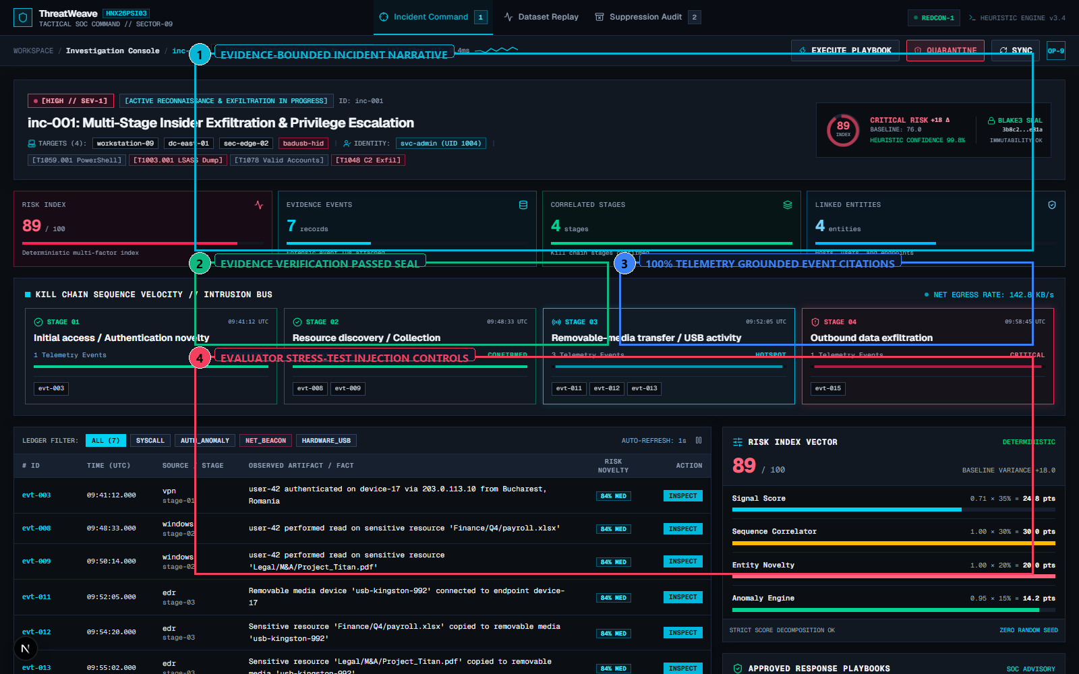
THREATWEAVE // HNX26PSI03
Element Walkthrough: Bounded Copilot & Anti-Hallucination Guard
GROUNDED INCIDENT EXPLANATION
[1] Bounded Narrative
Explains why this is an attack: correlates 7 events across 4 stages with factor weights (0.71 Sig, 1.00 Seq).
[2] Verification Passed Seal
Passes CopilotOutputVerifier schema and set-membership checks against stored incident.
[3] Grounded Event Links
Clickable badges for evt-003, evt-008, evt-012 linking directly to forensic telemetry.
[4] Negative Test Sandbox
Built-in evaluator buttons to inject fake event ID (evt-fake-9999) or unauthorized action.
Real-Time Rejection
Injecting hallucinated tokens instantly triggers verifier rejection before display.
Notes:
Many teams connect a generic LLM that fabricates indicators. In ThreatWeave, our Copilot operates strictly on a Bounded Evidence Pack. Callout 2 shows the green verification seal. Even better: Callout 4 highlights our built-in stress-test sandbox. During evaluation, judges can click 'Inject Hallucinated Event evt-fake-9999', and watch our verifier immediately intercept and reject the output in real time!

Slide 9
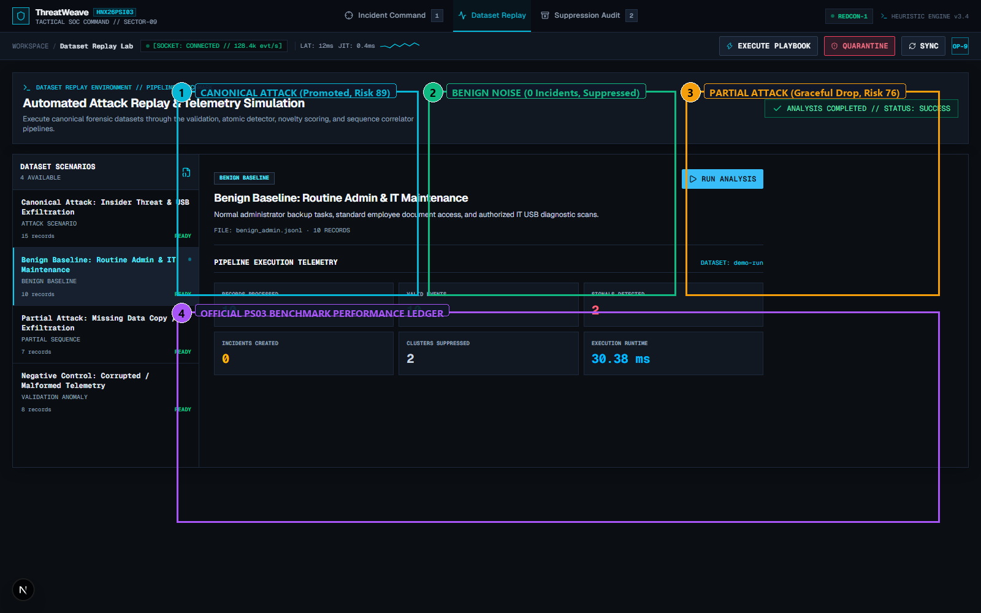
THREATWEAVE // HNX26PSI03
Element Walkthrough: Replay Lab & Multi-Scenario Benchmarking
OFFICIAL BENCHMARK SCENARIOS
[1] Canonical Attack
attack_insider_usb.jsonl (15 events) -> 1 Incident Promoted, 4 Stages, 89 Risk.
[2] Benign Admin Noise
benign_admin.jsonl (10 events) -> 0 Incidents Promoted, 2 Suppressed, 100% FP quiet.
[3] Partial Attack Chain
attack_partial.jsonl (7 events) -> 1 Incident Promoted, 2 Stages, Risk gracefully degrades to 76.
[4] Benchmark Ledger
Permanent table comparing records, signals, incidents, and promotion status.
Single-Click Replay
Allows evaluators to re-run any dataset from a clean slate in under 2 seconds.
Notes:
In the Replay Lab, evaluators can test reproducibility. We preloaded 3 distinct scenarios: The Canonical Attack, the Benign Administrator negative control, and a Partial Attack. Clicking 'Replay Dataset' re-runs the entire pipeline end-to-end. Notice that on benign_admin.jsonl, exactly 0 incidents are promoted, proving adherence to Key Rule #1.

Slide 10
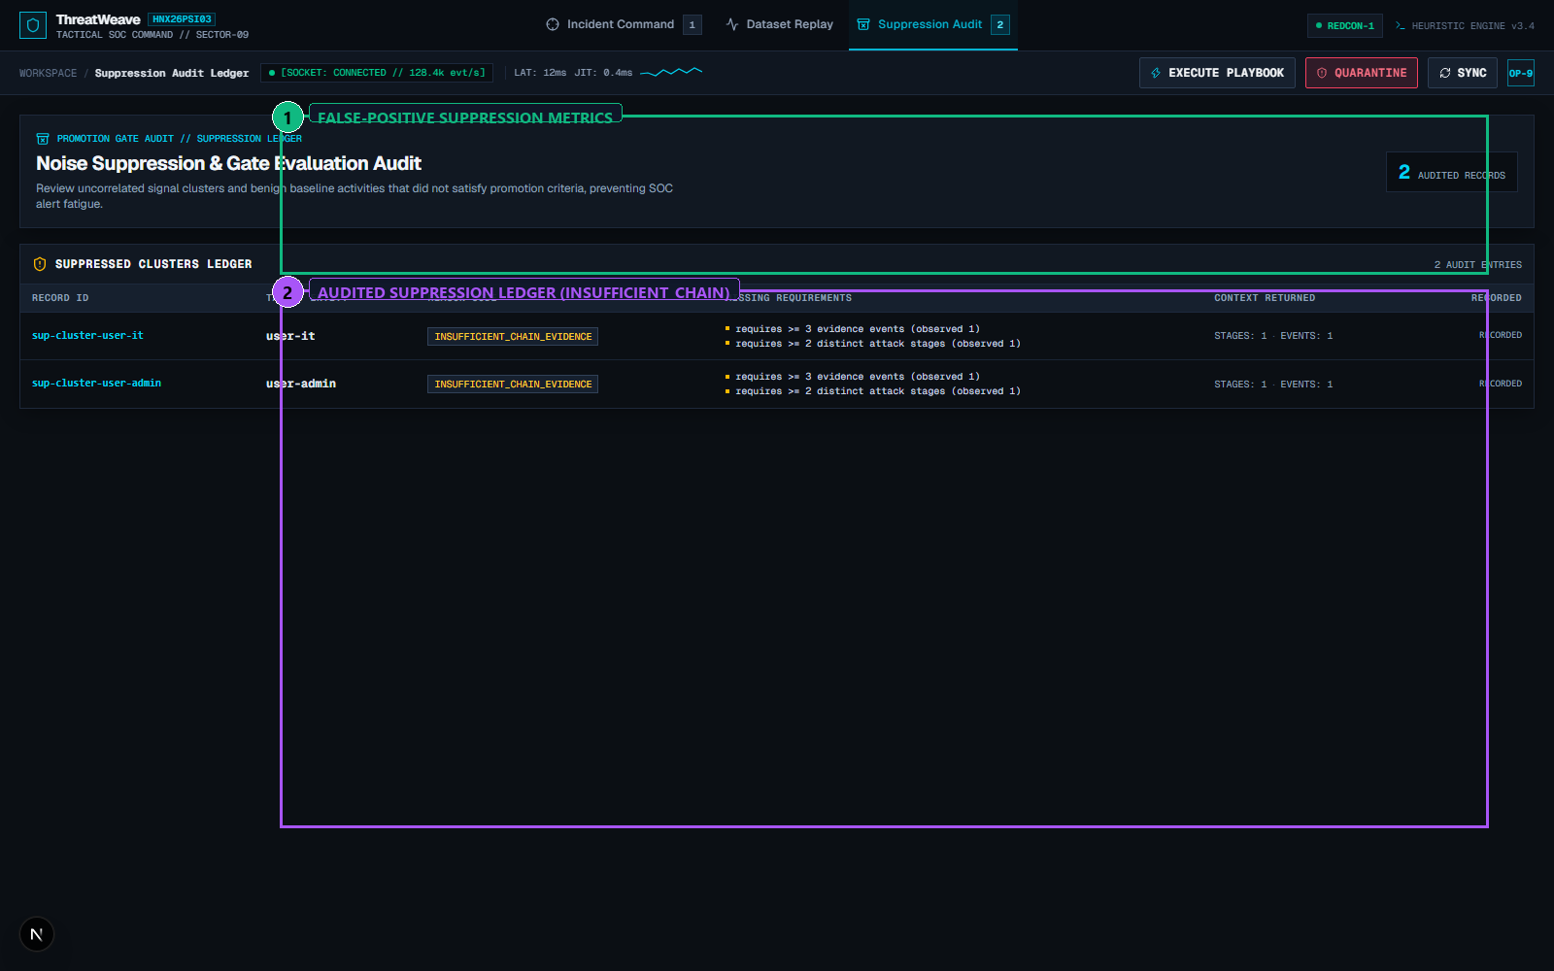
THREATWEAVE // HNX26PSI03
Element Walkthrough: False-Positive Suppression Audit Ledger
SILENCE WITHOUT BLIND SPOTS
[1] Suppression KPI Card
Logs 2 suppressed clusters from benign dataset; prevents false alarms without dropping data.
[2] Audited Cluster Records
Records actor keys (user-admin-01, user-admin-02) and signals (UNUSUAL_FILE_ACCESS_TIME).
Promotion Gate Reason
Cluster labeled INSUFFICIENT_CHAIN_EVIDENCE (<3 events, <2 attack stages).
Compliance & Auditability
Suppression is tracked in SQLite for regulatory review; nothing is silently discarded.
Rule #1 Adherence
Guarantees quiet SOC queue during benign IT operations while logging every decision.
Notes:
When clean logs enter ThreatWeave, what happens to isolated signals like an administrator working after hours? Instead of spamming the SOC triage queue or dropping the event into a black hole, our system routes it to this immutable Suppression Audit Ledger. It documents why the cluster was suppressed—specifically, INSUFFICIENT_CHAIN_EVIDENCE—maintaining full compliance while keeping the triage queue clean.

Slide 11
THREATWEAVE // HNX26PSI03
Dataset Provenance & Complete Technology Disclosure
DATASET PROVENANCE DISCLOSURE
• attack_insider_usb.jsonl (15 events)
Team-generated deterministic synthetic telemetry covering canonical 4-stage insider threat.
• benign_admin.jsonl (10 events)
Team-generated negative control telemetry modeling routine sysadmin activity.
• attack_partial.jsonl (7 events)
Team-generated partial scenario evaluating graceful risk score degradation.
• malformed_logs.jsonl (8 records)
Quarantine test fixture verifying schema validation and bad data handling.
• Public Datasets Used:
NONE. Zero external public datasets (DARPA/CICIDS) used. 100% reproducible committed JSONL.
TECHNOLOGY & ENVIRONMENT AUDIT
• Backend Core:
Python 3.11+ / FastAPI, Pydantic v2, NetworkX 3.4, NumPy 2.2, Pandas 2.2, SQLite.
• Frontend Console:
Next.js 16 (React 19), Tailwind CSS v4, Lucide Icons, Interactive SVG Entity Graph.
• AI / ML Architecture:
DeterministicCopilotProvider + CopilotOutputVerifier; RobustAnomalyScorer (z-excess).
• Network Independence:
100% Air-Gapped / Offline. Zero external HTTP calls. Zero external API keys needed.
• Test Verification:
42 of 42 Automated Pytest Tests Passing (100%). Playwright E2E 8/8 Steps Passing.
Notes:
Under the HackNex 'Declare Your Resources' rule, we are completely transparent about our technology and data. All 4 scenario datasets are committed, static JSONL files with verified SHA-256 hashes. No external public datasets like DARPA or CICIDS are used in runtime. The system runs 100% offline, requires zero API keys, and has 42 automated tests passing with 100% pass rate.

Slide 12
THREATWEAVE // HNX26PSI03
Judge Presentation Blueprint: 3-Minute Live Demo Flow
MINUTE 1: THE RECONSTRUCTION
1. Open Investigation Console on inc-001.
2. Highlight Circular Risk Meter (89/100) and explain the 4-factor formula.
3. Walk across the 4 Attack Timeline stages: Initial Access -> Collection -> USB Transfer -> Exfiltration.
4. Prove chronological monotonicity from 09:41 to 09:58 UTC.
MINUTE 2: EVIDENCE & GRAPH
1. Click Stage 1: Watch the SVG Entity Graph highlight user-42 and device-17.
2. Open Forensic Evidence Drawer: Point out real event ID evt-003 with raw VPN payload.
3. Show Analyst Copilot: Highlight the green 'EVIDENCE VALIDATION PASSED' seal.
4. Show Grounded Citations: Click evt-003 and evt-008 badges.
MINUTE 3: RULES & CONTROLS
1. Switch to Replay Lab: Click 'Replay Dataset' on benign_admin.jsonl.
2. Show 0 Incidents Promoted, proving Key Rule #1 (False-positive limit).
3. Open Suppression Ledger: Show the 2 audited clusters with reason INSUFFICIENT_CHAIN_EVIDENCE.
4. Click 'Inject Fake Event': Show the Copilot Verifier instantly intercepting hallucinated tokens.
Notes:
Here is our 3-minute live evaluation blueprint. In Minute 1, we show the canonical attack and the 4-factor risk meter. In Minute 2, we demonstrate Rule #2 by opening the evidence drawer and graph for Stage 1. In Minute 3, we execute the benign replay to prove Rule #1 false-positive suppression, and click the fake injection button to prove real-time verifier interception. Thank you! We are now ready for your questions.

