Slide 1
NCase
Test Case Generator

Slide 2
Unit Testing
Parametrized Testing
Tree Testing
Combinatorics
NCase
Pairwise Testing
C# Internal DSL
NUnit integration
Readable Syntax
XUnit integration
Modular Syntax

Slide 3
How do you currently
write a Test?

Slide 4
Usual Test
ARRANGE
ACT
ASSERT

Slide 5
How do you currently
write multiple Tests?

Slide 6
1st solution: Copy & Paste & Change
Difficult to maintain
No overview
Low “Test Case Coverage”

Slide 7
2nd solution: parametrized test framework
Requires refactoring
Various syntaxes with bad trade-off Scalability vs. Readability

Slide 8
Solution with
NCase

Slide 9
from Usual Test to NCase
Usual Test
NCase
ARRANGE
ACT
ASSERT

Slide 10
from One Test to Many Tests
NCase One Test
NCase Many Tests

Slide 11
from One Test to Many Tests
Many tests
NCase generates all possible combinations of
1 Title
1 Due Date
1 IsDone value

Slide 12
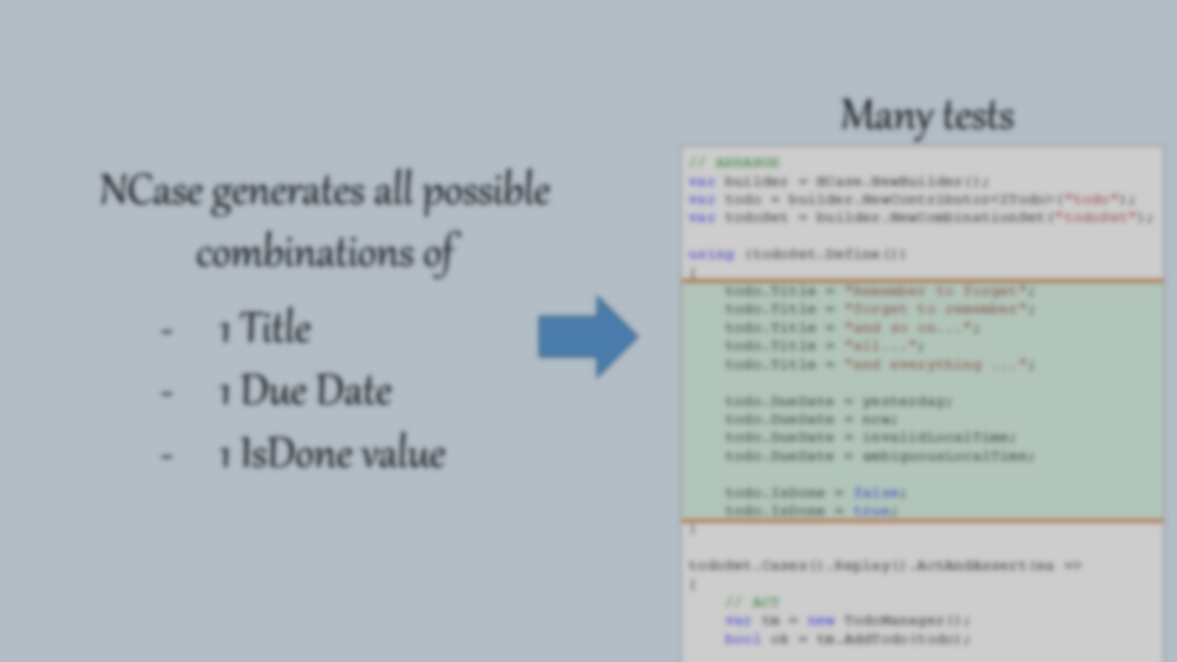
from One Test to Many Tests

Slide 13
How does
NCase
Work?

Slide 14
How does NCase work?
1
2
3

Slide 15
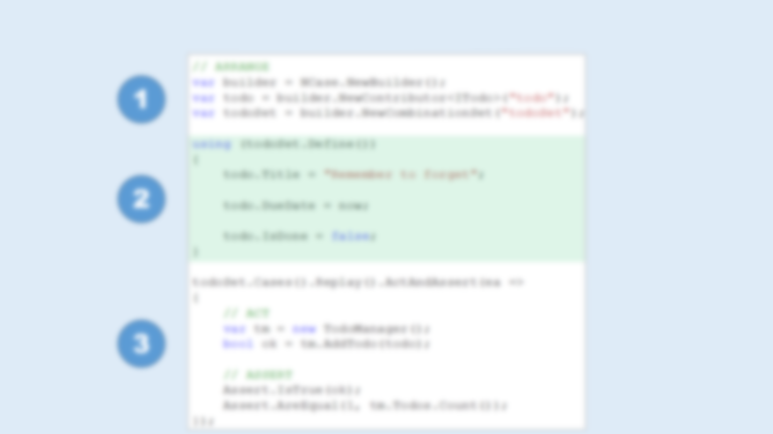
How does NCase work?
1
Create Sets and Contributors
2
Write Set Definitions
3
Generate Test Cases and Perform Tests

Slide 16
How does NCase work?
1
Create Sets and Contributors
Create Builder
builder owns all Sets and Contributors
Create Contributors
instances of any type, that you want to control
Create Sets (here CombinationSet)
defines a set of test cases

Slide 17
How does NCase work?
2
Write Set Definitions
Syntax specific to type of Set (DSL)
Records all Contributor Calls

Slide 18
How does NCase work?
Generates all test cases
Restores values in contributors
Calls Act and Asserts
3
Generate Test Cases and Perform Tests

Slide 19
Combination Set

Slide 20
Cartesian Product
Cartesian Product
set 1
set 2
set 3

Slide 21
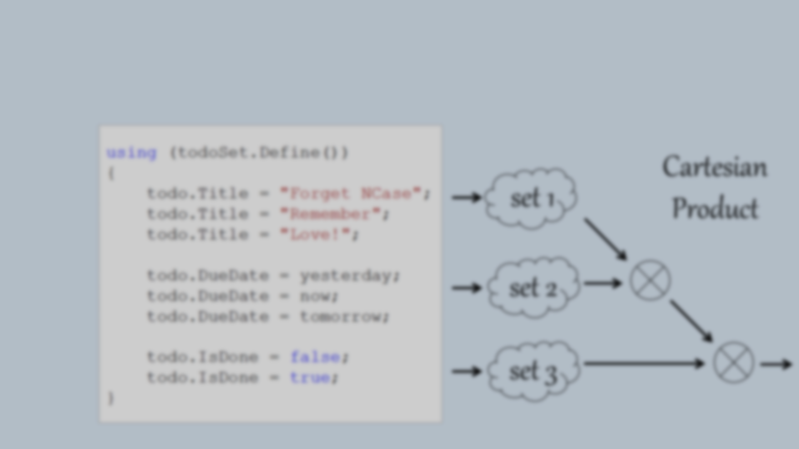
Cartesian Product

Slide 22
Pairwise Product
Pairwise Product
set 1
set 2
set 3

Slide 23
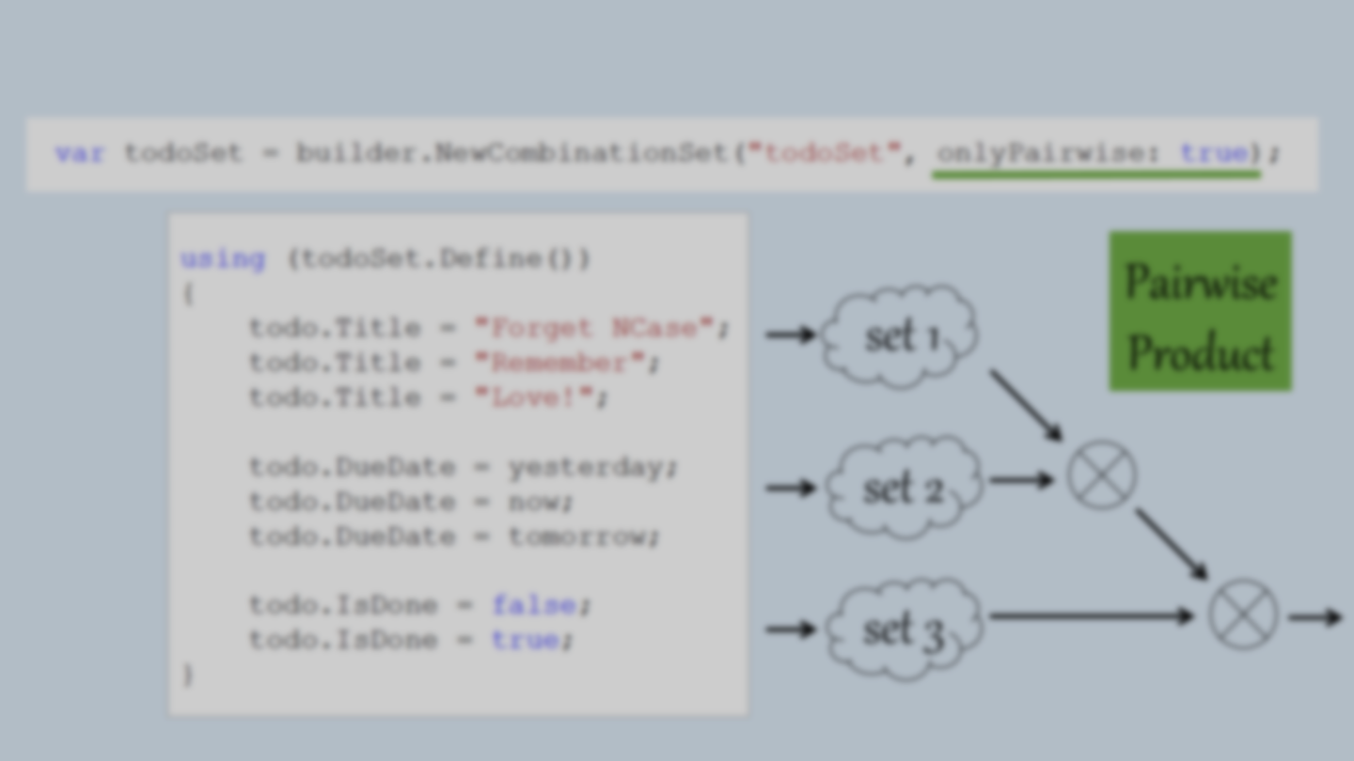
Pairwise Product

Slide 24
Combination Tree

Slide 25
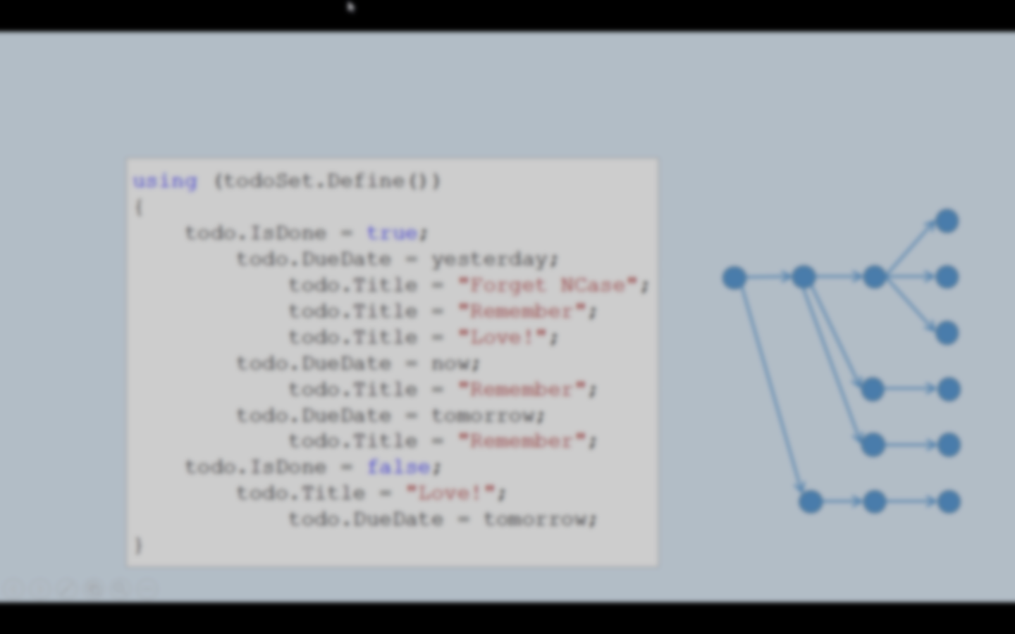
Combination Tree

Slide 26
Mix Contributors
You can mix contributors within definitions

Slide 27
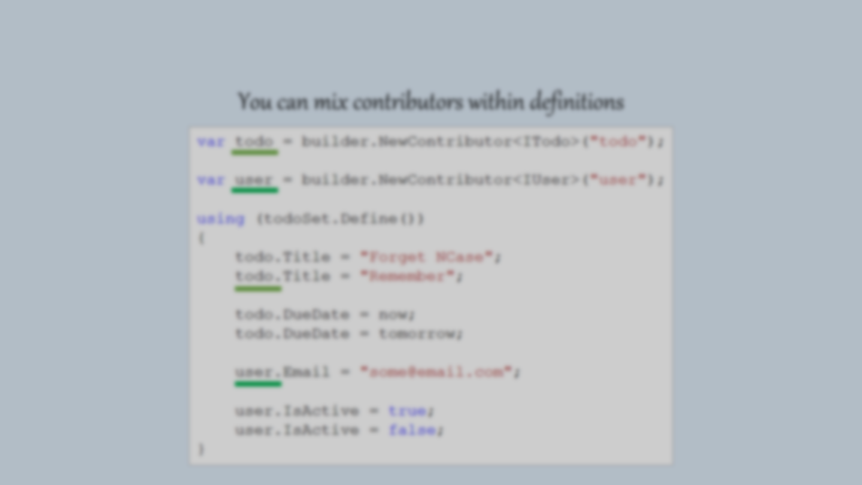
Mix Contributors
You can mix contributors within definitions. It simply works.

Slide 28
Reference other Definitions
You can reference definitions within definitions

Slide 29
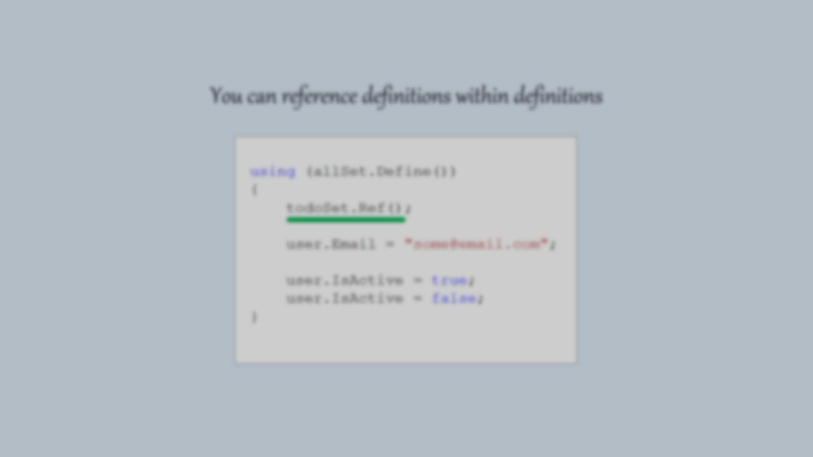
Reference other Definitions
You can inject reference to other definitions

Slide 30
Coming Features

Slide 31
Coming Features
Support recording of method calls
(currently only property calls are recorded)
Support class contributors (currently only interface contributors are supported)
Moq like Setup(…) and Verify(…)
Permutation Set permuting order of calls
Dedicated unit test runner currently integrates with NUnit, XUnit. Dedicated runner would improve usability within IDE

Slide 32
Unit Testing
Parametrized Testing
Tree Testing
Combinatorics
NCase
Pairwise Testing
C# Internal DSL
NUnit integration
Readable Syntax
XUnit integration
Modular Syntax
http://github.com/jeromerg/NCase

