Slide 1
NCase
Test Case Generator

Slide 2
Unit Testing
Parametrized Testing
Tree Testing
Combinatorics
NCase
Pairwise Testing
C# Internal DSL
NUnit integration
Readable Syntax
XUnit integration
Modular Syntax

Slide 3
How do you currently
write a Test?

Slide 4
Conventional test
ARRANGE
ACT
ASSERT

Slide 5
How do you currently
write multiple Tests?

Slide 6
1st solution: Copy & Paste & Change
Difficult to maintain
No overview
Low “Test Case Coverage”

Slide 7
2nd solution: parametrized test framework
Requires refactoring
Various syntaxes with bad trade-off Scalability vs. Readability

Slide 8
Solution with
NCase

Slide 9
from Usual Test to NCase
Usual Test
NCase
ARRANGE
ACT
ASSERT

Slide 10
from One Test to Many Tests
NCase One Test
NCase Many Tests

Slide 11
from One Test to Many Tests
Many tests
NCase generates all possible combinations of
1 Title
1 Due Date
1 IsDone value

Slide 12
How does
NCase
Work?

Slide 13
How does NCase work?
1
2
3

Slide 14
How does NCase work?
1
Create Sets and Contributors
2
Write Set Definitions
3
Generate Test Cases and Perform Tests

Slide 15
Create Sets and Contributors
1
Create a Builder
A Builder owns all Sets and Contributors
Create Contributors
instances of any type that you want to be controlled by Ncase
Create Sets (here CombinationSet)
defines a set of test cases

Slide 16
Write Set Definitions
Write the Set Definition
The Syntax is specific to the set type (DSL)
2
Record Contributor Calls

Slide 17
Generate Test Cases and Perform Tests
Generates all test cases
Restores values in contributors
Calls Act and Asserts
3

Slide 18
Combination Set

Slide 19
Cartesian Product
Cartesian Product
set 1
set 2
set 3

Slide 20
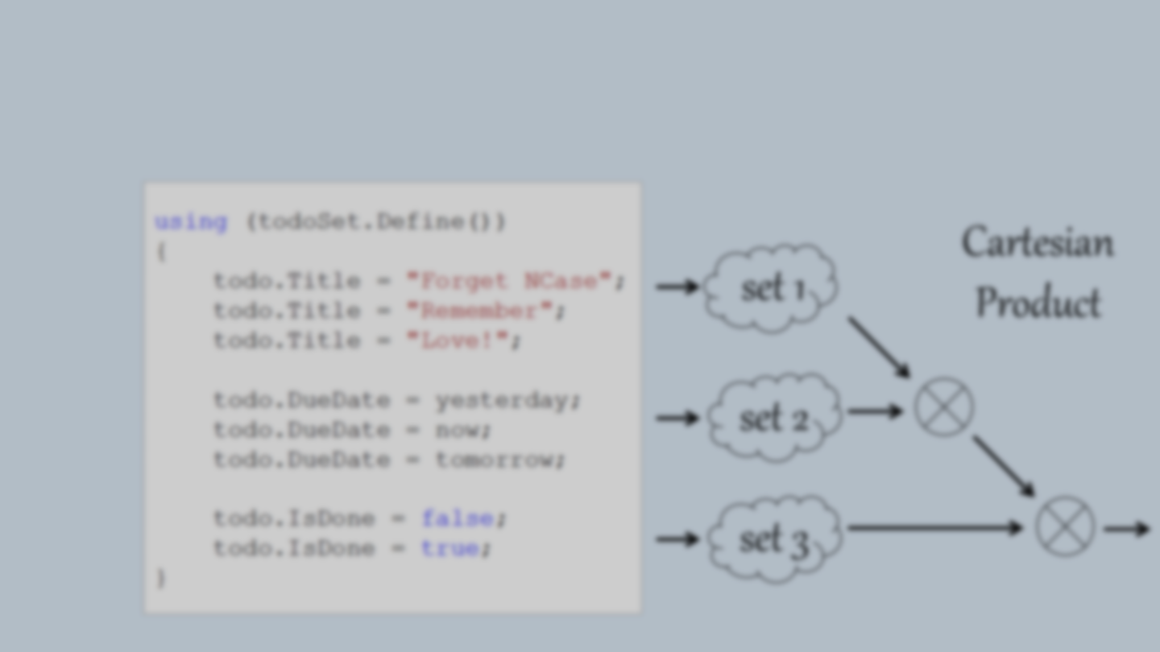
Cartesian Product

Slide 21
Pairwise Product
Pairwise Product
set 1
set 2
set 3

Slide 22
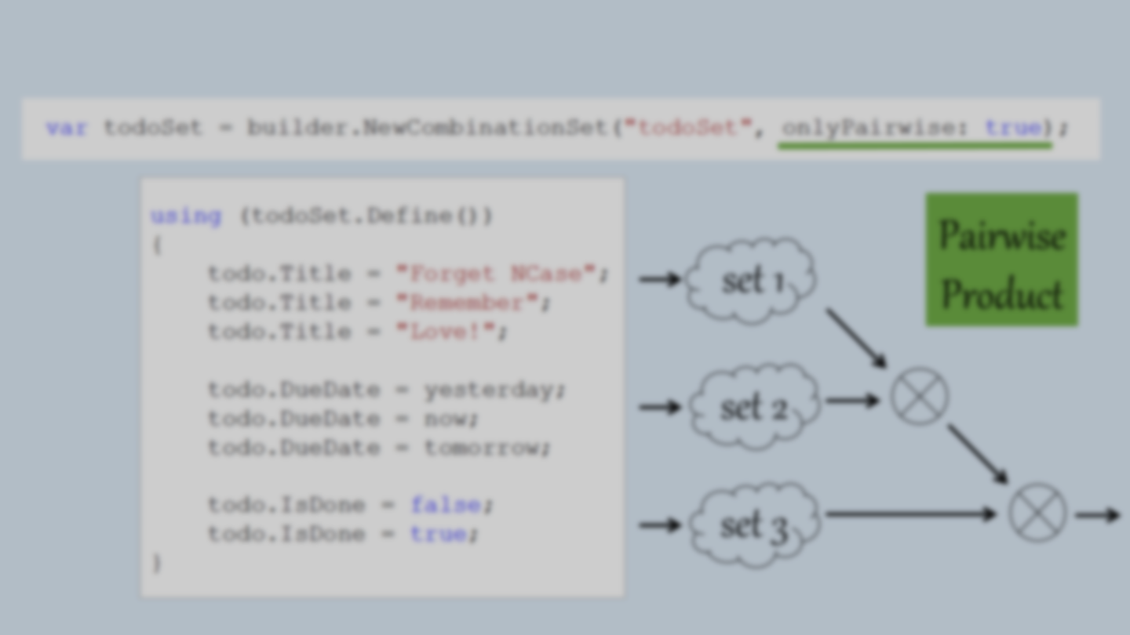
Pairwise Product

Slide 23
Combination Tree

Slide 24
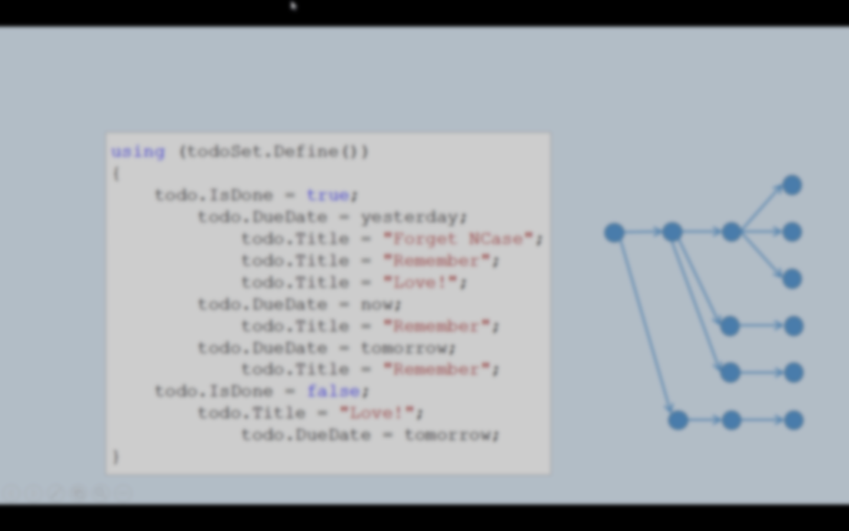
Combination Tree

Slide 25
Mix Contributors
You can mix contributors within definitions

Slide 26
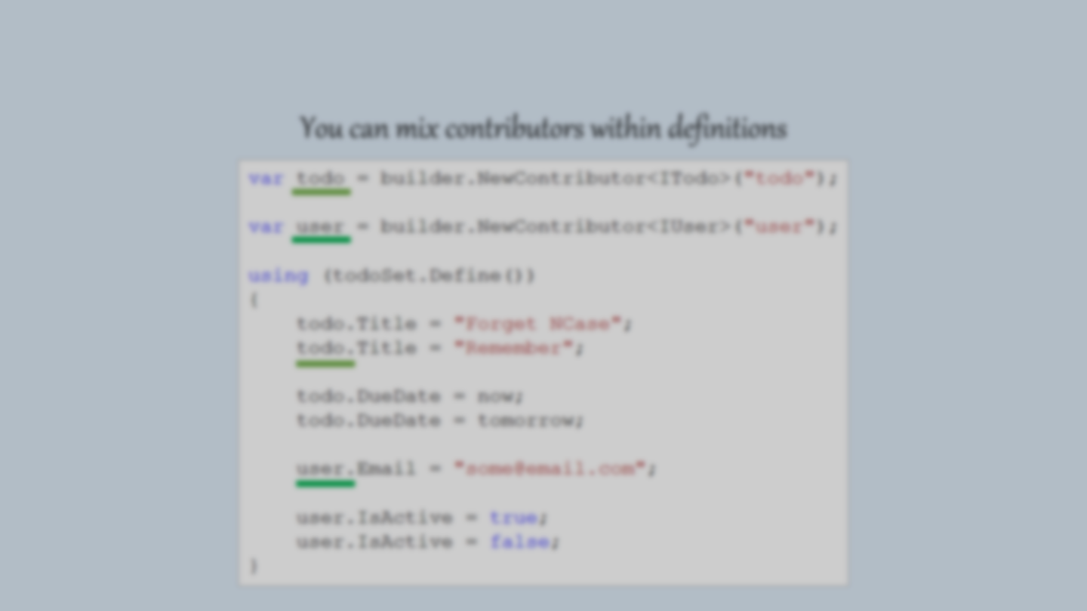
Mix Contributors
You can mix contributors within definitions. It simply works.

Slide 27
Reference other Definitions
You can reference definitions within definitions

Slide 28
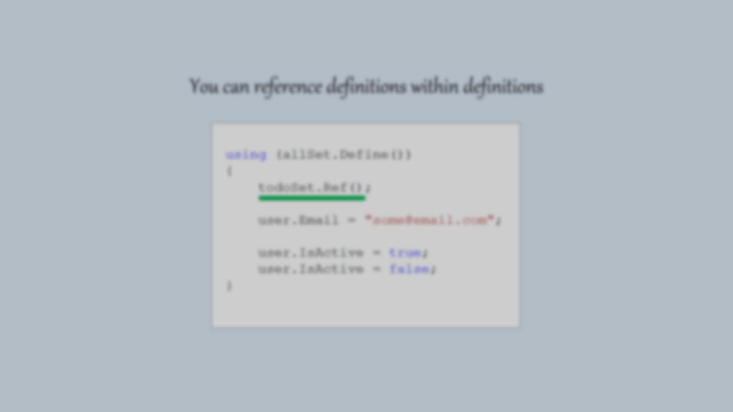
Reference other Definitions
You can inject reference to other definitions

Slide 29
Permutation Set
… Coming soon …

Slide 30
Unit Testing
Parametrized Testing
Tree Testing
Combinatorics
NCase
Pairwise Testing
C# Internal DSL
NUnit integration
Readable Syntax
XUnit integration
Modular Syntax
http://github.com/jeromerg/NCase

