Slide 1
A New Learning Algorithm for Stochastic Feedforward Neural Nets
Yichuan Tang, Ruslan Salakhutdinov –ICML2013
Repoter: Yunfei WANG
Nov.26, 2013

Slide 2
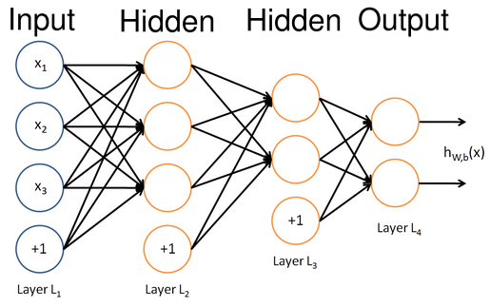
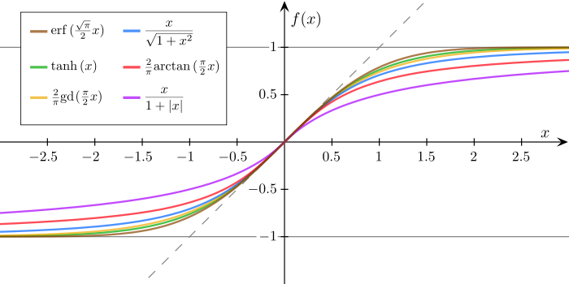
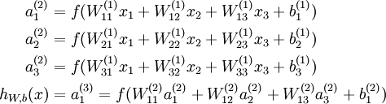

Multilayer Perceptrons(MLPs)
We assume that y has a Gaussian distribution with an x-dependent mean given by the output of MLPs

Slide 3
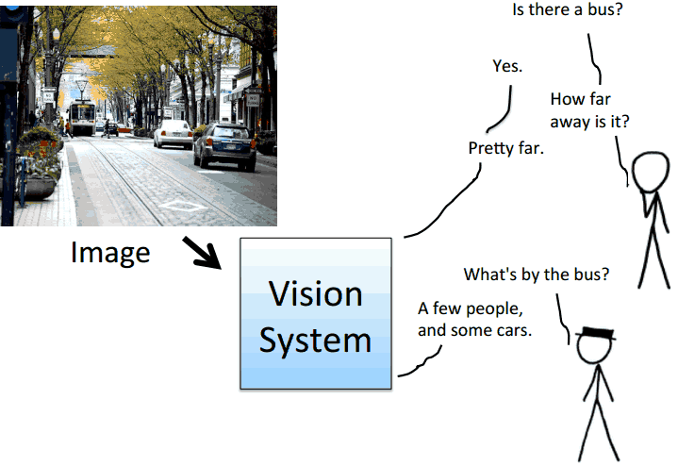
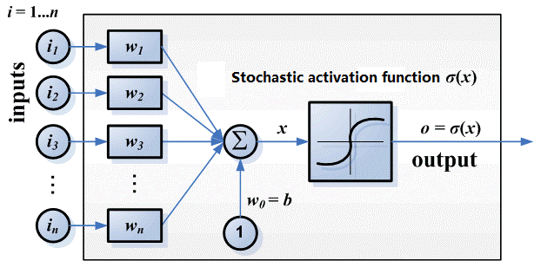
Sigmoid Belief Net (SBN)
One way to model the multi-modality is making the hidden variables stochastic.
Sigmoid Belief Net (SBN) is a stochastic feedforward neural network with binary hidden, input, and output variables.
Given the same X, different hidden configurations leads to different output values of Y .
For structured prediction problems, we are interested in modeling a conditional distribution p(Y|X) that is multimodal, namely learning one to many functions from X to Y.

Slide 4
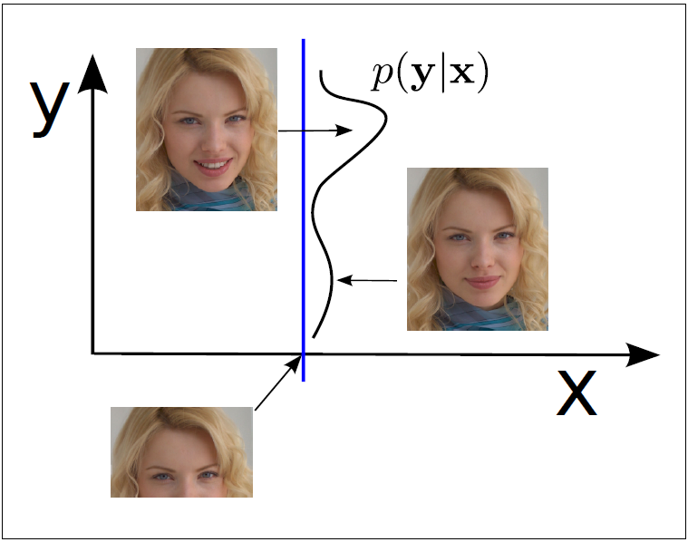
Motivation of SFNN
MLPs are popular models used for non-linear regression and classification tasks. MLPs model the conditional distribution of the predictor variables y given input variables x.
However, this predictive distribution is assumed to be unimodal.
For tasks such as structured prediction problems, the conditional distribution should be one-to-many mappings.
Using only discrete hidden units is suboptimal when modeling real-valued output y.
For a finite number of discrete hidden states, each one is a Gaussian
, where the mean
When x varies, only the probability of choosing a specific hidden state is changed via .
A smoother can be learned if is a deterministic function of x as well.

Slide 5
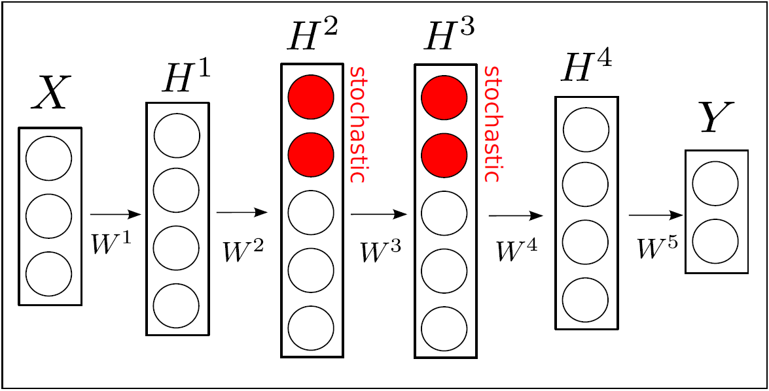
Stochastic Feedforward Neural Network
Highlights
To better model continuous data, SFNNs have hidden layers with both discrete stochastic and deterministic units.
Present a novel Monte Carlo variant of the Generalized Expectation Maximization algorithm for learning. Importance sampling is used for the E-step for inference,
Error backpropagation is used by the M-step to improve a variational lower bound on the data log-likelihood.
Turning part of the hidden variables in a MLP into stochastic nodes, Sigmoid Belief Nets induce a rich multimodal distribution in the output space.

Slide 6
Advantages of SFNN
We can draw exact samples from the model without resorting to Markov chain Monte Carlo.
Stochastic units form a distributed code to represent an exponential number of mixture components in output space.
As a directed model, learning does not need to deal with a global partition function.
Combination of stochastic and deterministic hidden units can be jointly trained using the backpropagation algorithm.

Slide 7
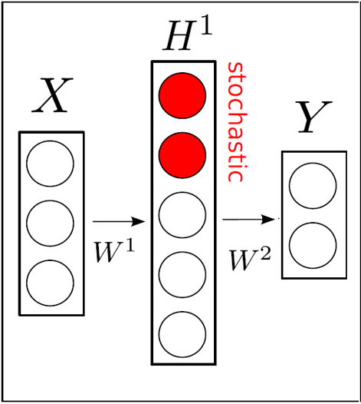


Formulation of SFNNs
SFNNs contain binary stochastic hidden variables
For simplicity, we can construct a SFNN with one hidden layer.
The conditional distribution is obtained by marginalizing out the latent stochastic hidden variables:
SFNN is a directed graphical model, the joint distribution can be factorized as:

Slide 8
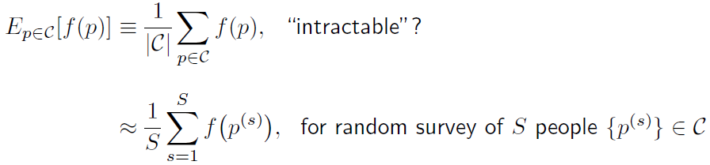
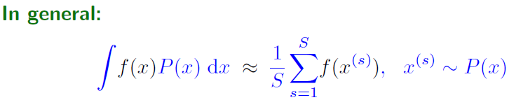
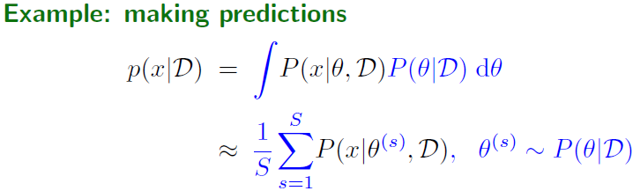
Monte Carlo
What is the average height f of people p in Cambridge C?

Slide 9

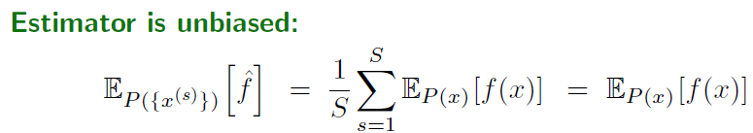
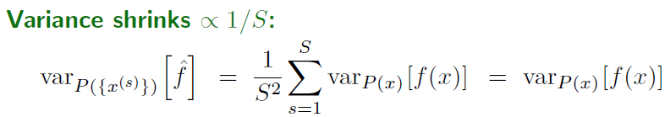
Properties of Monte Carlo

Slide 10

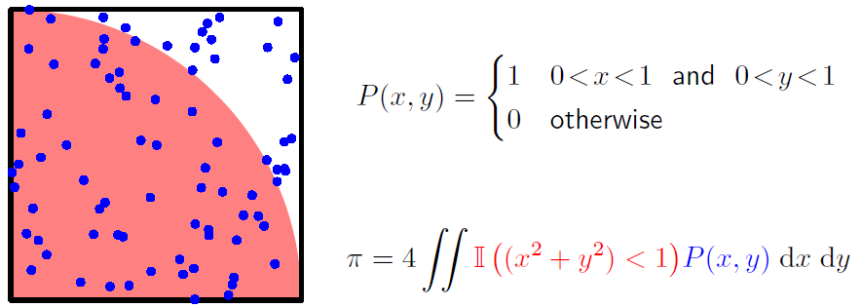
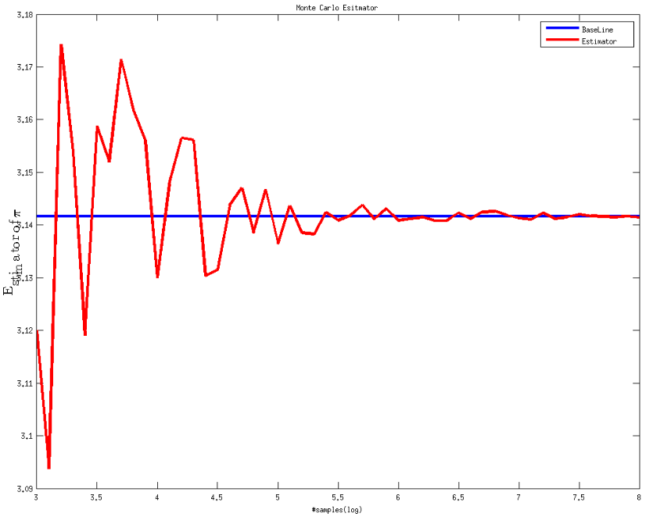
A dumb approximation of

Slide 11
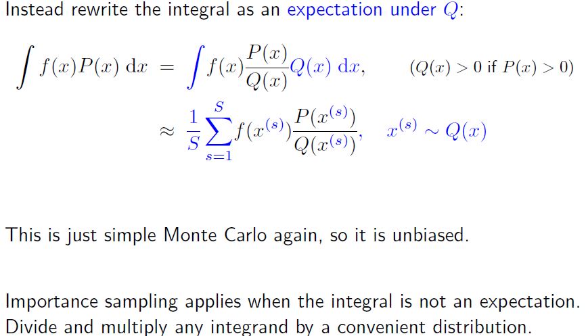
Importance sampling

Slide 12
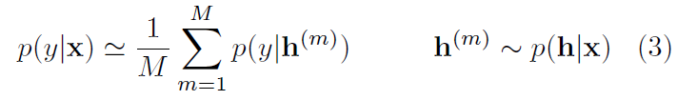

Formulation of SFNNs
Since is a vector of N Bernoulli random variables, has up to models
Computation costs come with modeling flexibility of SFNN. How can we obtain with components conditioned on x? Monte Carlo approximation with M samples for its estimation:
In SFNNs, we assume a conditional diagonal Gaussian distribution on the output space:

Slide 13
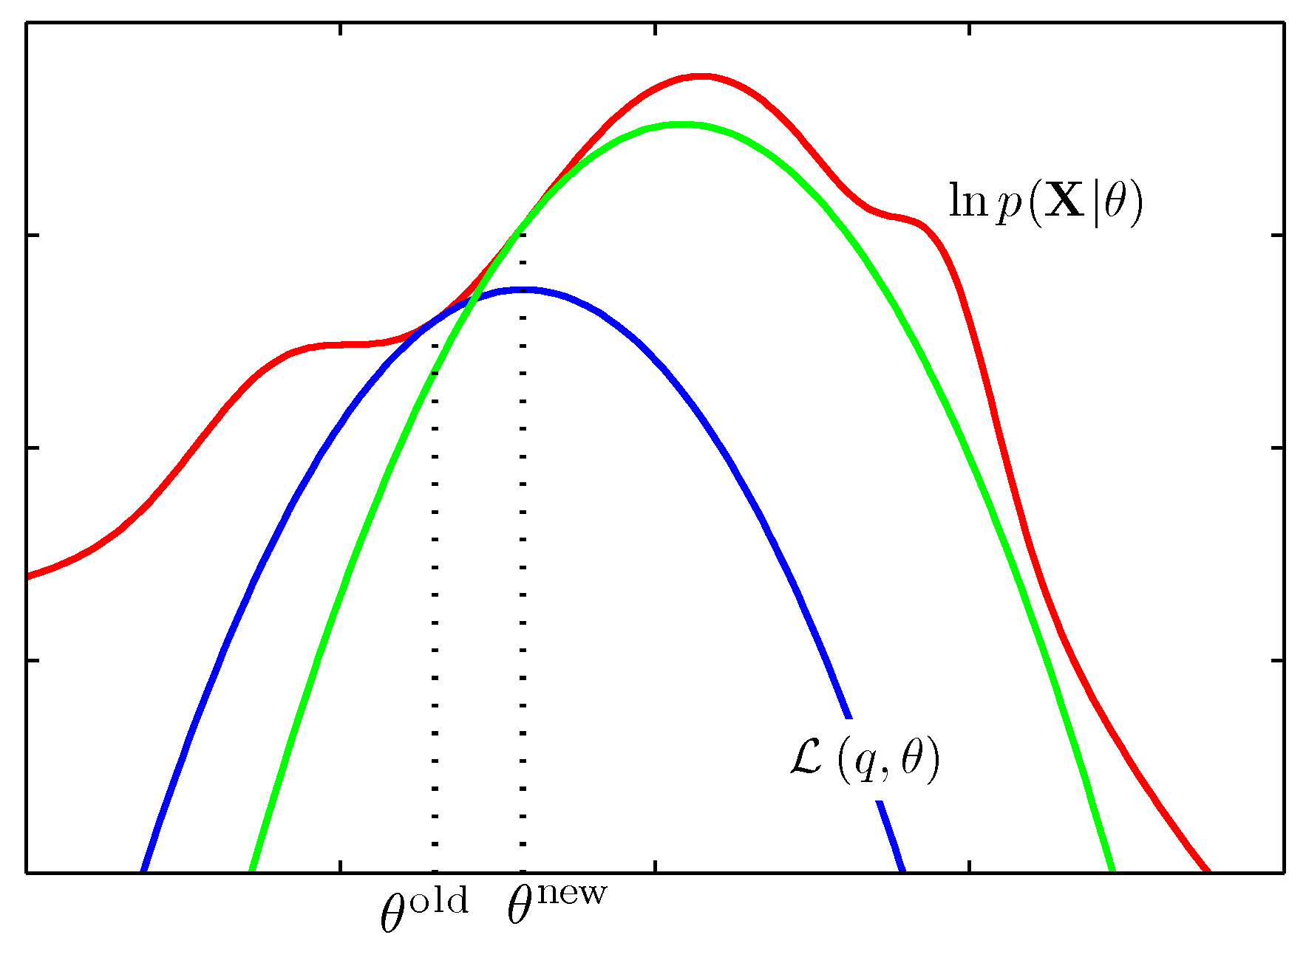
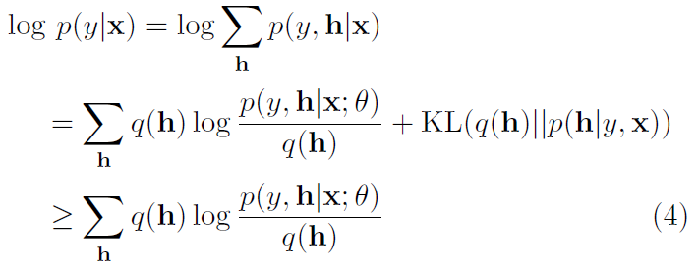
Learning procedure of SFNNs- E step
For any approximating distribution ,we can write down the following variational lower bound on the data log-likelihood:
For the tightest lower bound, need to be the exact

Slide 14
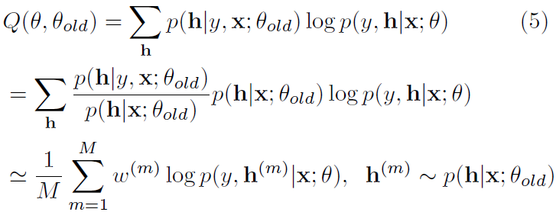


Learning procedure of SFNNs- M step
Let Q be the expected complete data log-likelihood, which is a lower bound on the log-likelihood. We wish to maximize the lower bound:
Using Bayes Theorem, importance weight can be rewritten as:
The denominator of can be approximated using Eq.3, therefore:

Slide 15


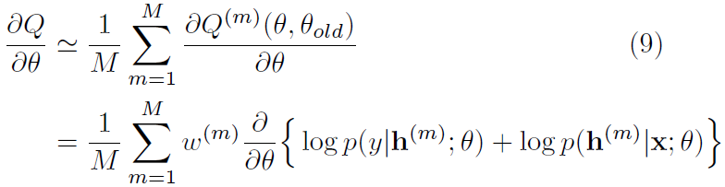
Learning procedure of SFNNs- M step
For convenience, we dene the partial objective of the m-th sample as
We can then approximate our objective function with M samples from the proposal:
For our generalized M-step, we seek to perform gradient ascent on Q:

Slide 16
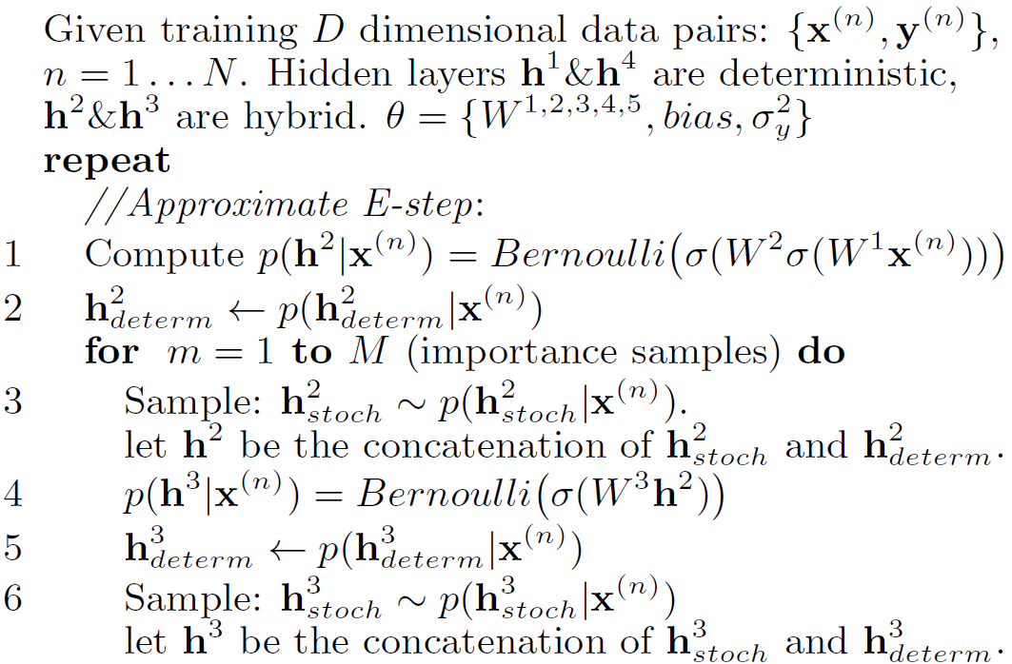
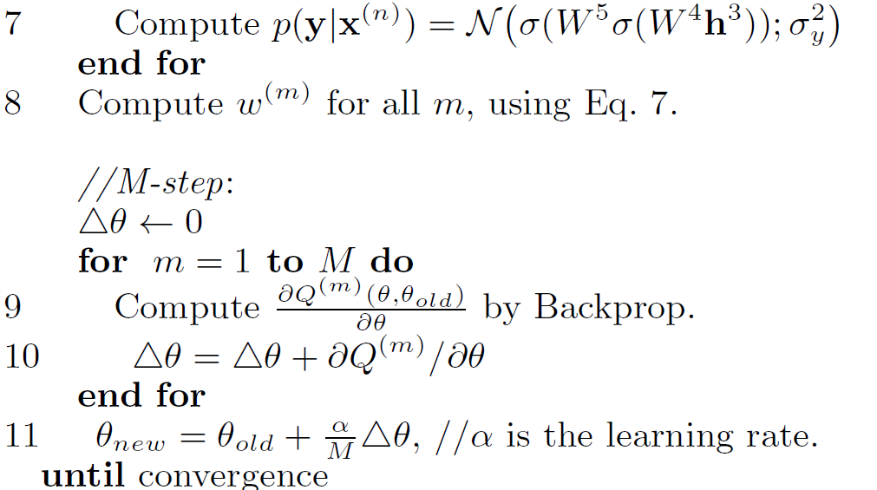
EM algorithm for SFNNs

