Slide 1
Regularization & Cross Modal
Reporter: Yunfei WANG
Date: March/04/2014
E-mail: yunfeiwang@hust.edu.cn

Slide 2
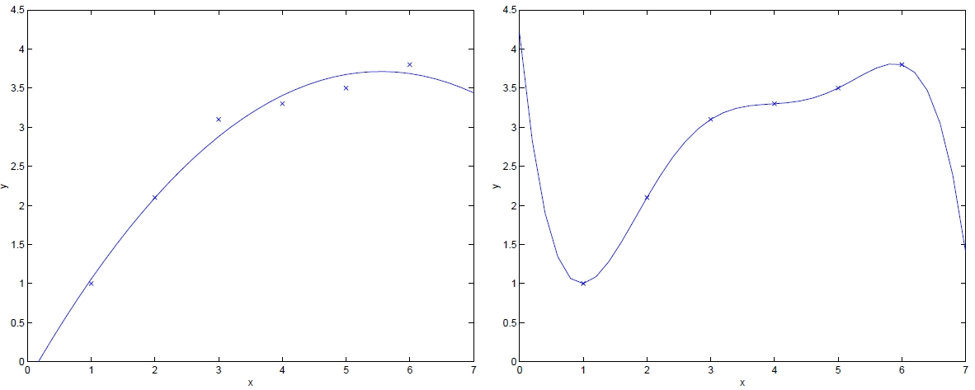
Ordinary Least Squares
Low Bias
Over-fitting!
High Variance
Shrinking or setting to zero some coefficients can improve prediction accuracy and lead to reasonable interpretation with several the most important features.

Slide 3
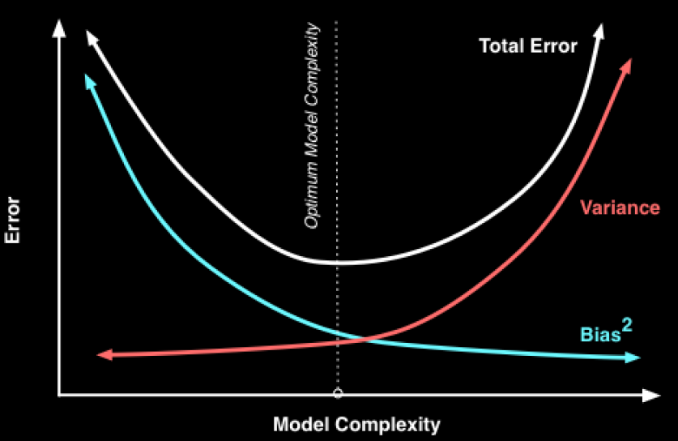
Model Complexity & Regularization
Regularization helps to control the complexity of models by limiting the scope of parameters
1)reduce the risk of over-fitting 2)improve the ability of generalization

Slide 4
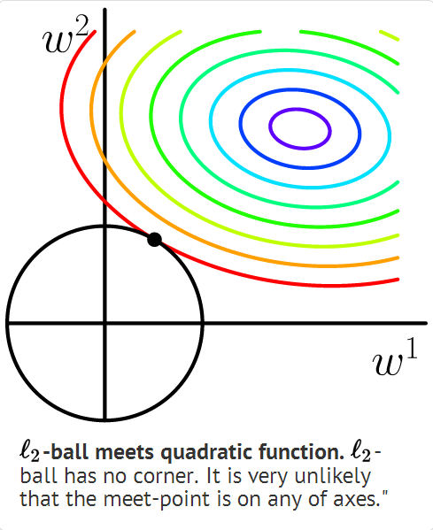
Ridge Regression
No feature selection
Perform badly in sparse high-dimensional space
http://freemind.pluskid.org/machine-learning/sparsity-and-some-basics-of-l1-regularization/

Slide 5
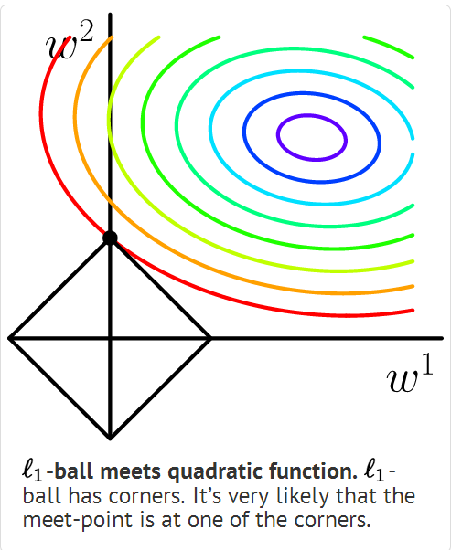
LASSO
Limitations:
In the p>n case, owing to the nature of convex optimization problem it can select at most n out of the p variables[2].
For a group of highly correlated variables, LASSO tend to select only arbitrary one of them[2,3].
In the case of n>p, LASSO is dominated by ridge regression if there are high correlations between variables[4].
http://freemind.pluskid.org/machine-learning/sparsity-and-some-basics-of-l1-regularization/

Slide 6
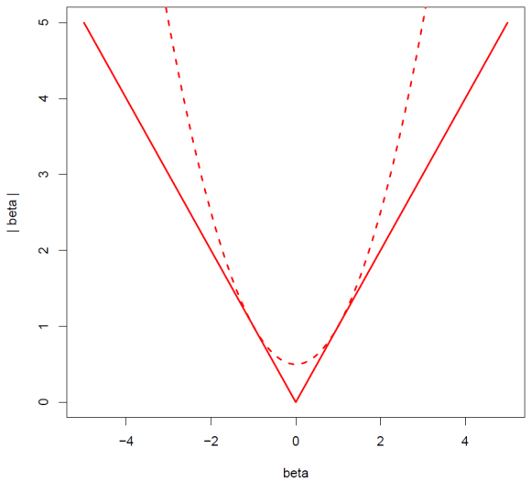
Parameters Estimation of LASSO
Approximation of the LASSO penalty[5]:

Slide 7
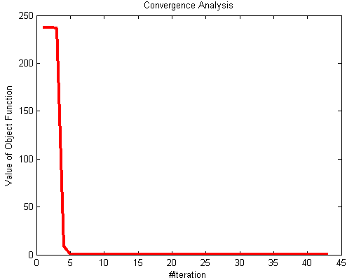
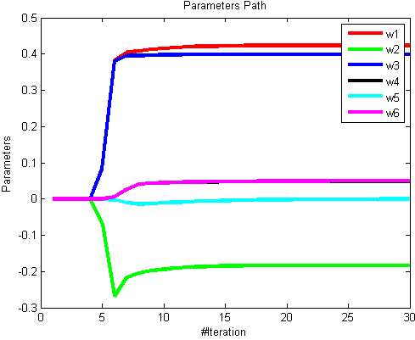
Parameters Estimation of LASSO
Loss function of LASSO regression:
Plug the approximation into the LASSO loss function:
Weighted rigid regression

Slide 8
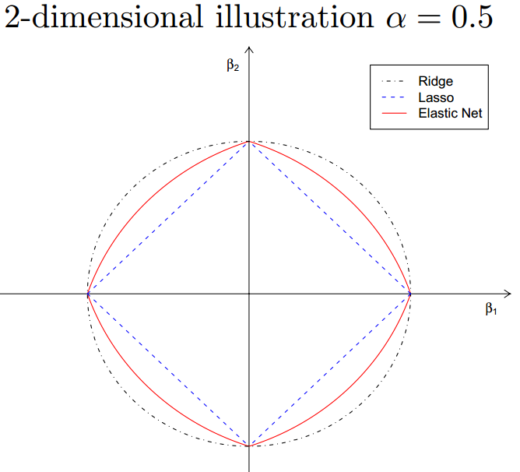
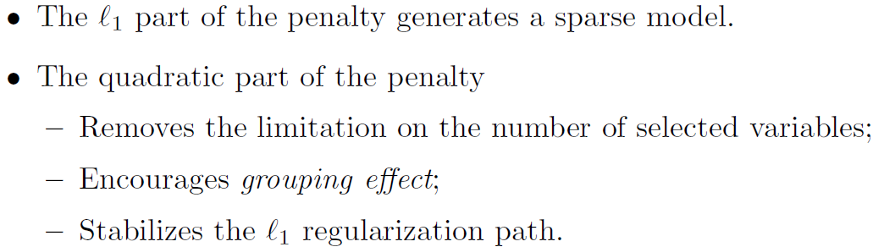
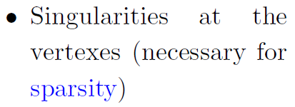
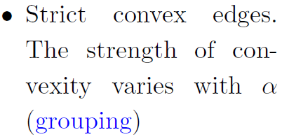
Elastic Net

Slide 9
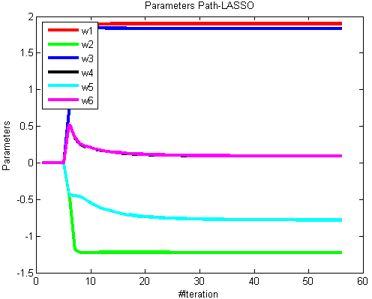
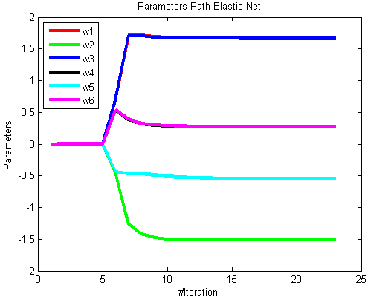

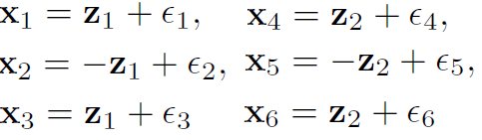

A simple illustration: elastic net vs. LASSO

Slide 10
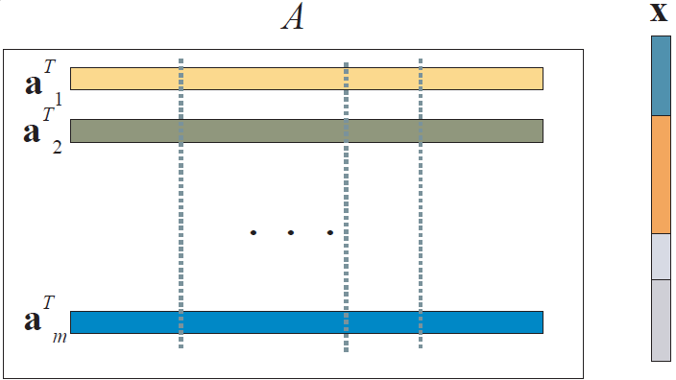
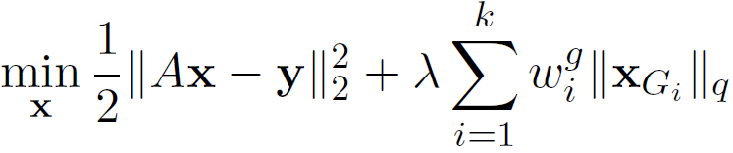
Group LASSO for Group Variable Selection
Features are grouped into four non-overlapping groups
General strategy for grouped variable selection is to use block L₁₋norm regularization. For variables with each block(group) L_{q} norm is applied and different blocks are combined by L₁ norm.[7]
SLEP Package: http://www.public.asu.edu/~jye02/Software/SLEP/

Slide 11
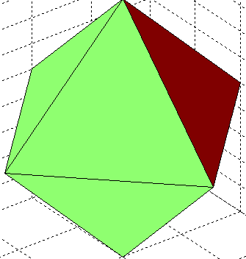
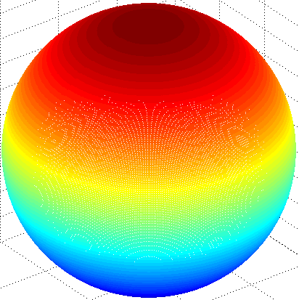
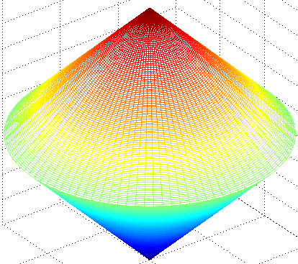
Comparison in 3D
L1-norm
L2-norm
Group LASSO

Slide 12
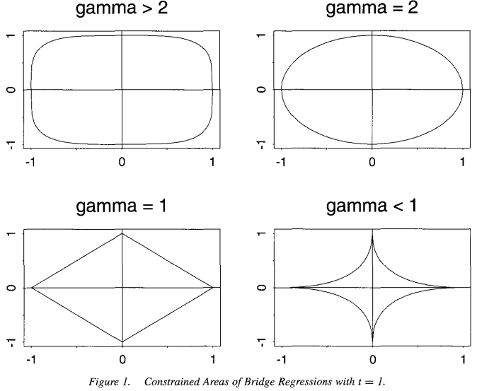
Bridge Regression

Slide 13
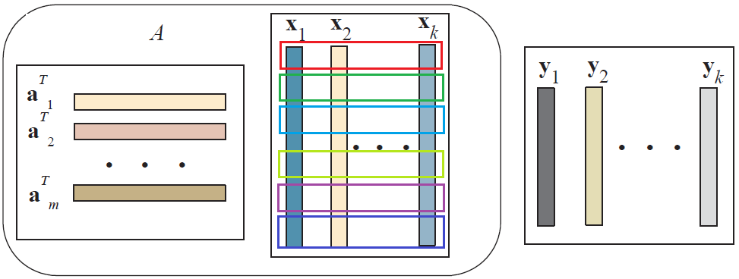
L₁/L_{q} -norm for Multi-task Feature Selection
Based on the assumption that all the tasks share the common set of features which is not realistic in many real-word applications. [13]
A subset of highly related outputs may share a common set of relevant inputs, whereas weakly related outputs are less likely to be affected by the same inputs.[13]

Slide 14
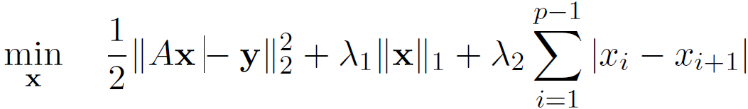
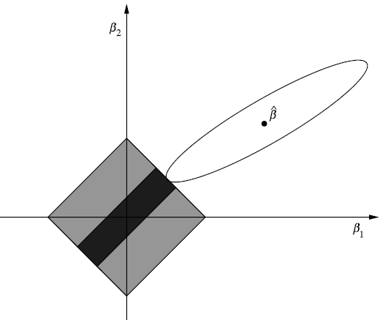
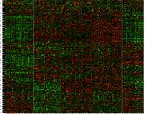
Fused Lasso
Successive difference
LASSO ignores ordering of the features[8].
Fused Lasso produces sparse and blocky solution[9], which is useful when features are ordered in some meaningful way or the number of features is much greater than the sample size[8].
Unordered features?[8]
Multidimentional scaling(MDS) or Hierarchical clustering
Heat map displays
 |  |  |  |  |  | …

Slide 15
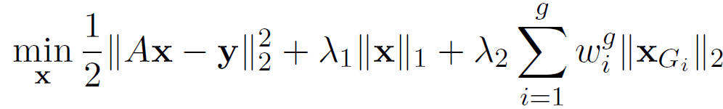
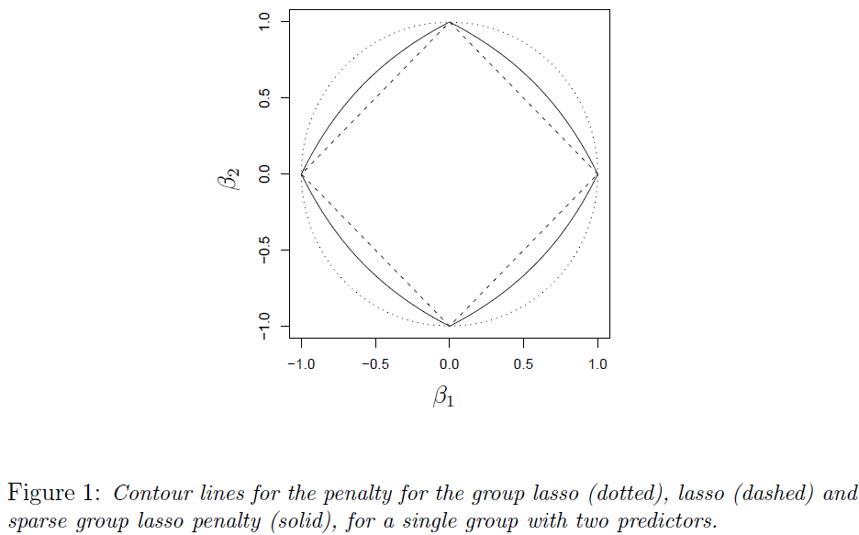
Sparse Group Lasso
G₁
G₂
Gɡ
1.0 | 0.01 | 0 | 0.003 | 0.002 | … | 1.2 | 0.015 | 0
Have the property of Elastic Net: highly correlated features can be selected simultaneously.
The group information here is more flexible than that in LASSO(correlation).
Sparse Group Lasso yields sparsity at both the group and individual feature levels, in order to select groups and features within a group.[10]

Slide 16
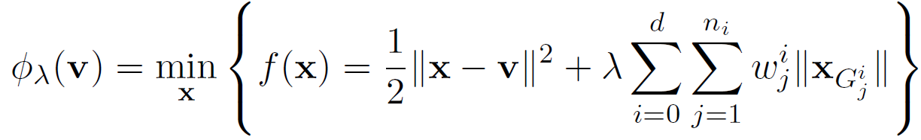
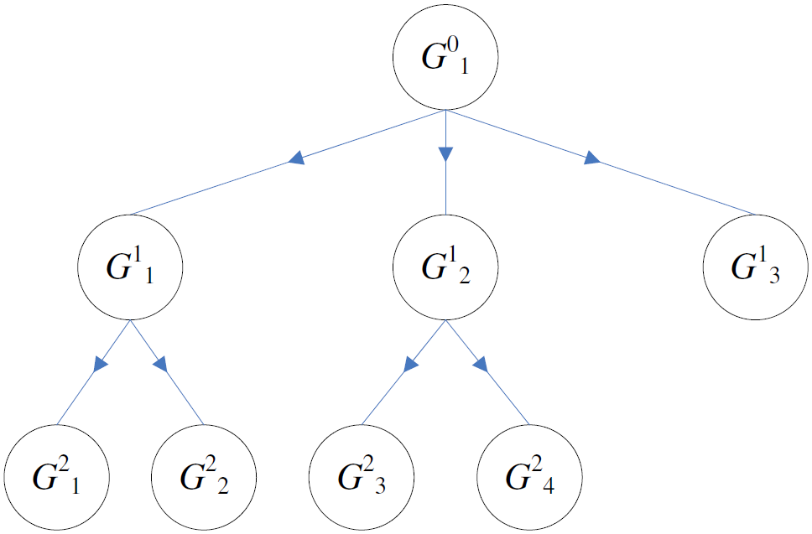
Tree Structured Group Lasso
Structure over features be express as a tree with leaf nodes as features and internal nodes as clusters of the features[11].
Based on group lasso
This tree structure may be available as prior knowledge, or can be learned from data using methods such as a hierarchical agglomerative clustering algorithm.[13]
We can see the true model parameters within the tree hierarchy in Figure 7 in [12].

Slide 17
Overlapped Group Lasso
G₁
Overlapping groups
Gɡ
1.0 | 0.01 | 0 | 0.003 | 0.002 | … | 1.2 | 0.015 | 0
G₂
Group Lasso and sparse group Lasso are only restricted to the non-overlapping groups of features;
Tree structured group Lasso is restricted to the tree structured groups with no overlapping in the same level.
In some applications, a more flexible overlapping group structure is desired.

Slide 18
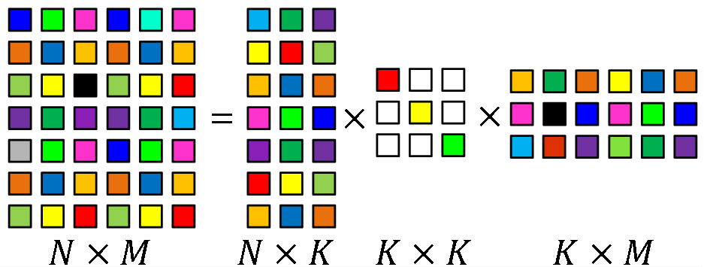
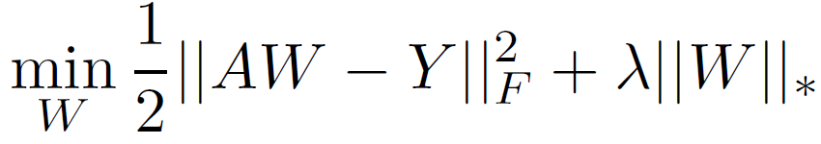
Trace Norm
Rank of X gives the number of basis functions and measures the correlation between them, so the selection of a joint subspace of low dimension is equivalent to choosing a low-rank parameter matrix.
Rank constraint is non-convex, so we replace it with trace norm just as replacing L0-norm with L1-norm.

Slide 19
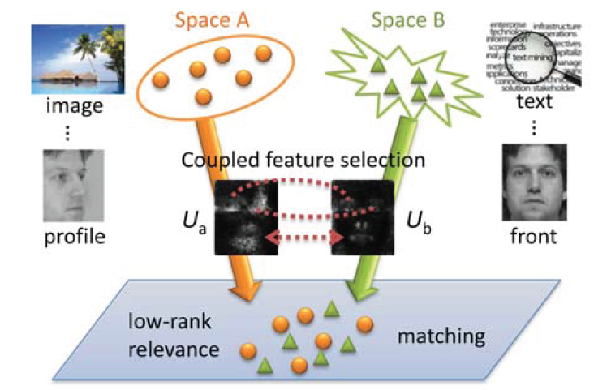
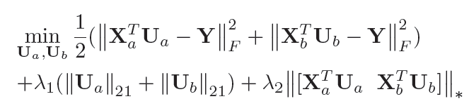
Overview of the Cross Modal Matching[14]
Coupled linear regression, learning projection matrices for mapping different modal data into a common space.
-norms play a role of feature
selection on two feature spaces
Trace norm enforce the relevance of projected data with connections.

Slide 20
References
[1]Efron, Bradley, et al. "Least angle regression." The Annals of statistics 32.2 (2004): 407-499.
[2] Zou, Hui, and Trevor Hastie. "Regularization and variable selection via the elastic net." Journal of the Royal Statistical Society: Series B (Statistical Methodology) 67.2 (2005): 301-320.
[3] Flexeder, Claudia. Generalized Lasso Regularization for Regression Models. Diss. Institut für Statistik, 2010.
[4] Tibshirani, Robert. "Regression shrinkage and selection via the lasso." Journal of the Royal Statistical Society. Series B (Methodological) (1996): 267-288.
[5] Fan, Jianqing, and Runze Li. "Variable selection via nonconcave penalized likelihood and its oracle properties." Journal of the American Statistical Association 96.456 (2001): 1348-1360.
[6] Fu, Wenjiang J. "Penalized regressions: the bridge versus the lasso." Journal of computational and graphical statistics 7.3 (1998): 397-416.
[7] Liu, Han, and Jian Zhang. On the l1− lq regularized regression. Technical Report, 2008.
[8] Tibshirani, Robert, et al. "Sparsity and smoothness via the fused lasso." Journal of the Royal Statistical Society: Series B (Statistical Methodology) 67.1 (2005): 91-108.
[9] Rinaldo, Alessandro. "Properties and refinements of the fused lasso." The Annals of Statistics 37.5B (2009): 2922-2952.
[10] Friedman, Jerome, Trevor Hastie, and Robert Tibshirani. "A note on the group lasso and a sparse group lasso." arXiv preprint arXiv:1001.0736 (2010).
[11] Liu, Jun, and Jieping Ye. "Moreau-Yosida Regularization for Grouped Tree Structure Learning." NIPS. Vol. 23. 2010.
[12] Zhao, Peng, Guilherme Rocha, and Bin Yu. "The composite absolute penalties family for grouped and hierarchical variable selection." The Annals of Statistics(2009): 3468-3497.
[13] Kim, Seyoung, and Eric P. Xing. "Tree-guided group lasso for multi-task regression with structured sparsity." Proceedings of the 27th International Conference on Machine Learning (ICML-10). 2010.
[14] Wang, Kaiye, et al. "Learning Coupled Feature Spaces for Cross-modal Matching."

