Slide 1
Ensemble Learning
Reporter: Yunfei WANG
Email: yunfeiwang@hust.edu.cn

Slide 2

What’s Ensemble Learning
Ensemble learning is the process by which multiple modes are strategically generated and combined to solve a particular with better performance.
Applications
Model selection
Tasks with missing features
Data fusion
Incremental learning

Slide 3
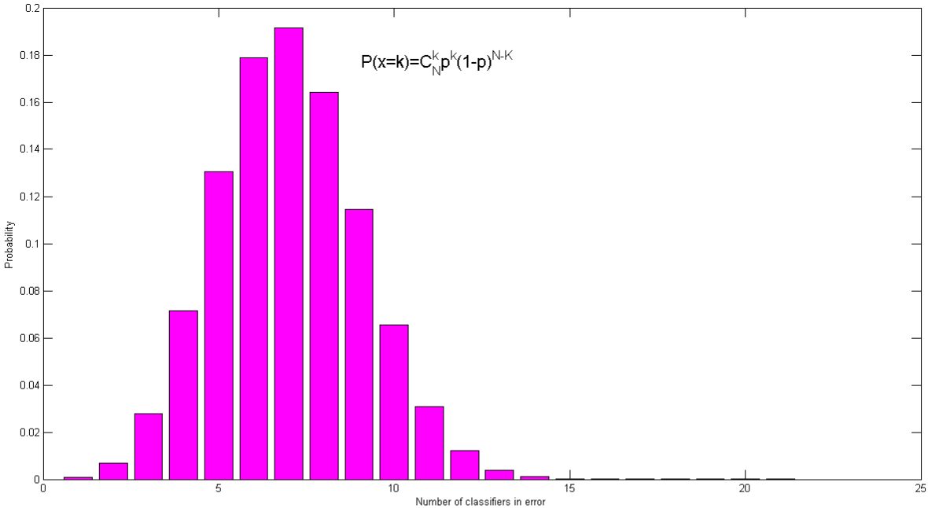
Why does Ensemble Learning works?
A necessary and sufficient condition for an ensemble to be more accurate than any of its individual members is if the classifiers are accurate(better than random guessing) and diverse(making uncorrelated errors).[5]
Hypothetical classifier with misclassification rate p=0.3
Under the majority voting strategy, it’s not likely for half of the classifiers make errors at the same time.

Slide 4
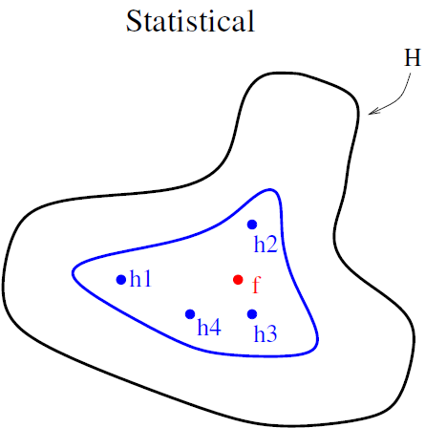
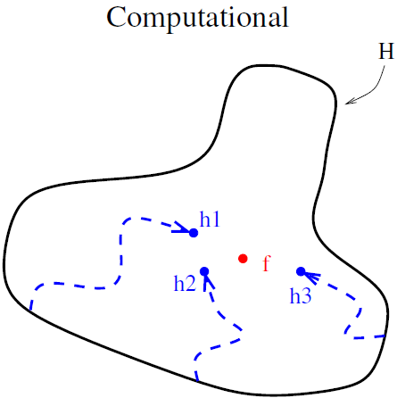
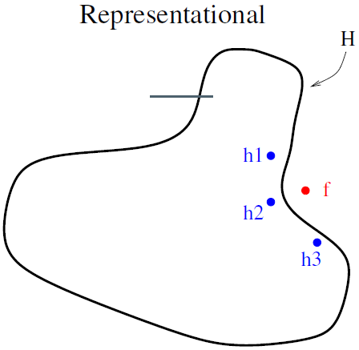
Why does Ensemble Learning works?[4,5]
Statistical Error
Optimization Error
Model Error
Combination of several hypothesizes produce an approximation closer to the true function.
For hypothesis that are complex and sensitive to training set, ensemble outputs a more accurate hypothesis.
Ensembles can produce an hypothesis outside the hypothesis set, expanding the representation abilities.

Slide 5
Diversity: Cornerstone of Ensemble Systems
Models making different errors are complementary, therefore the combination of them can reduce the total error.
How to achieve diversity?[1]
Sample training data subsets randomly with replacement;
Sample training data subsets randomly without replacement;
Set different parameters for the same type of different models;
Combine different type of models for diversity;
Different features contribute to diversity.

Slide 6
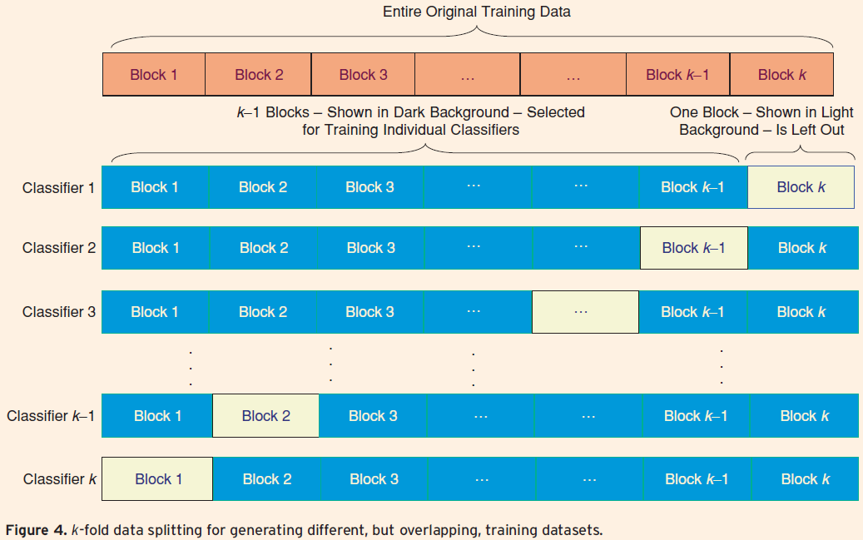
K-Folder Data Splitting

Slide 7
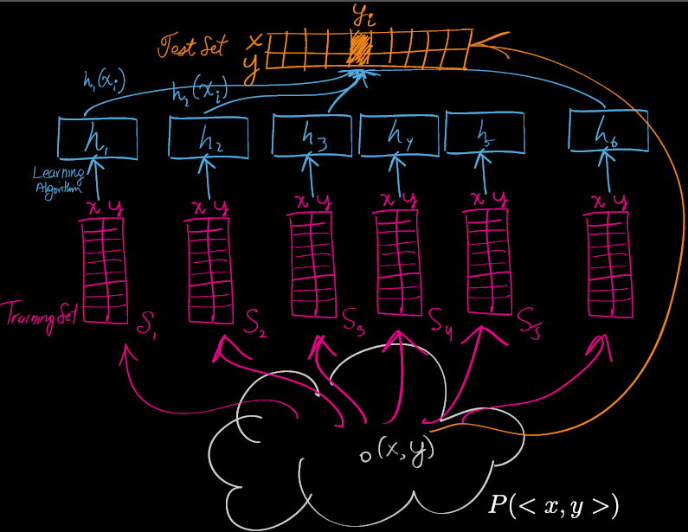
Bagging
Appealing when training data is limited!
Draw training data subsets randomly with replacement from the entire training data
Train a different model of the same type on each training data subset
Combine models by averaging for regression or voting for classification.
Large portions of samples(75%-100%) are drawn into each subset.
Unstable modes(Neural Networks/Decision Trees) can increase diversity for small perturbations in training set.

Slide 8
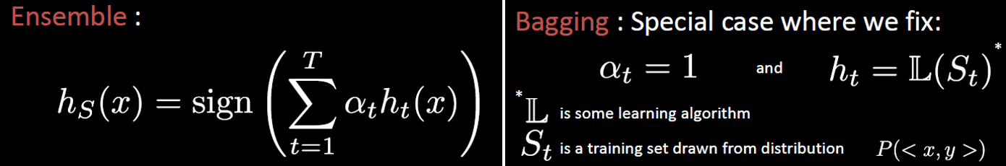
Bagging-Algorithm

Slide 9
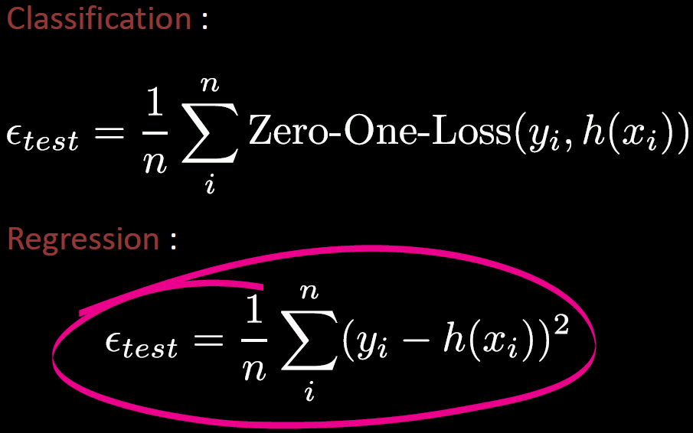
Generalization Error

Slide 10
Generalization Error Reformulation

Slide 11
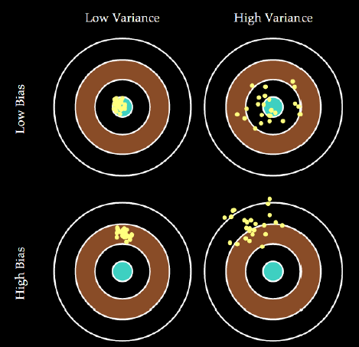
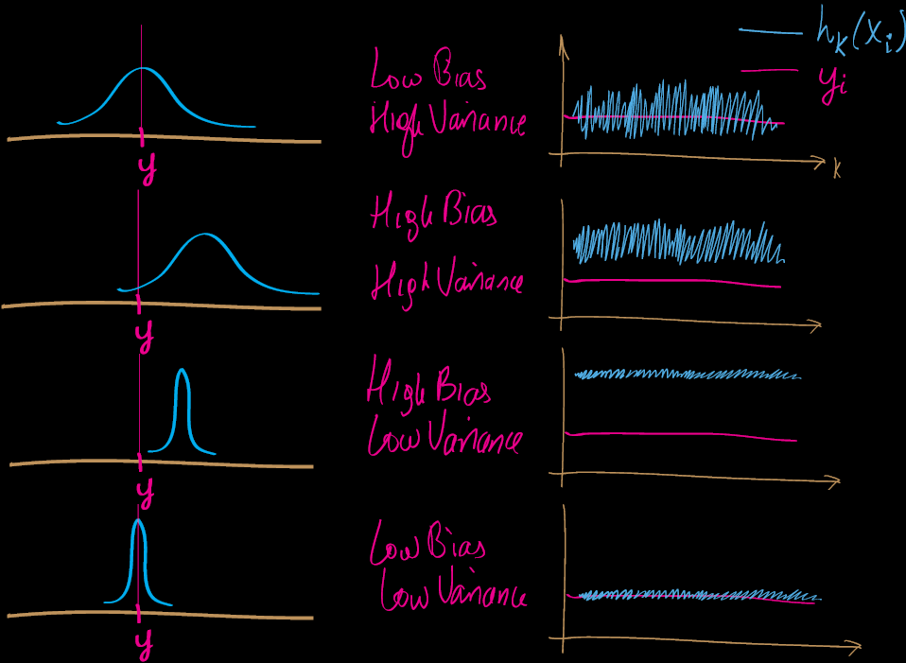
Bias versus Variance

Slide 12
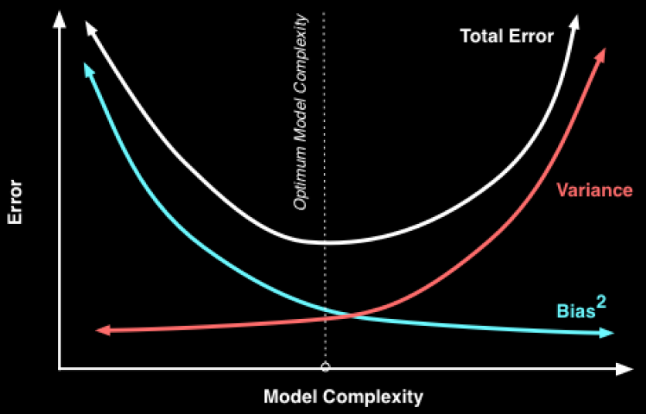
Bias versus Variance

Slide 13
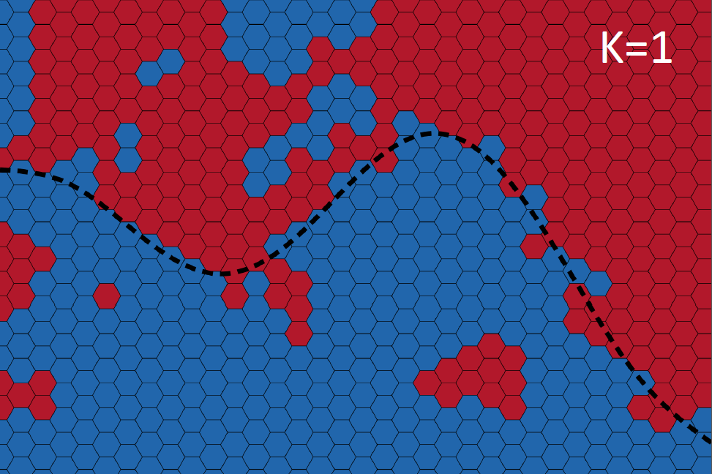
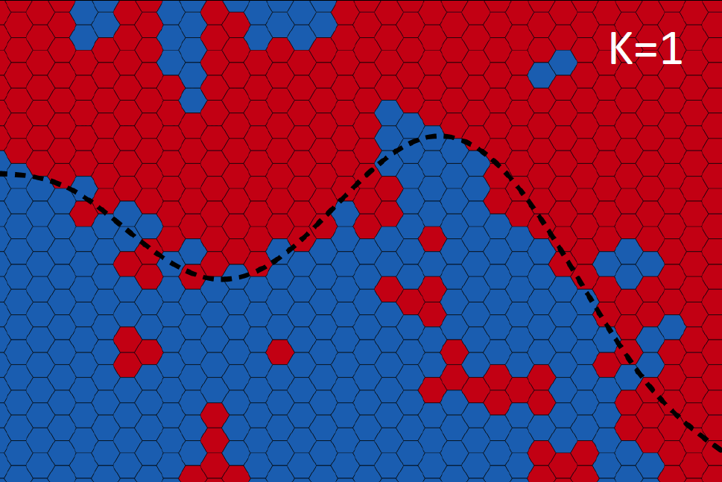
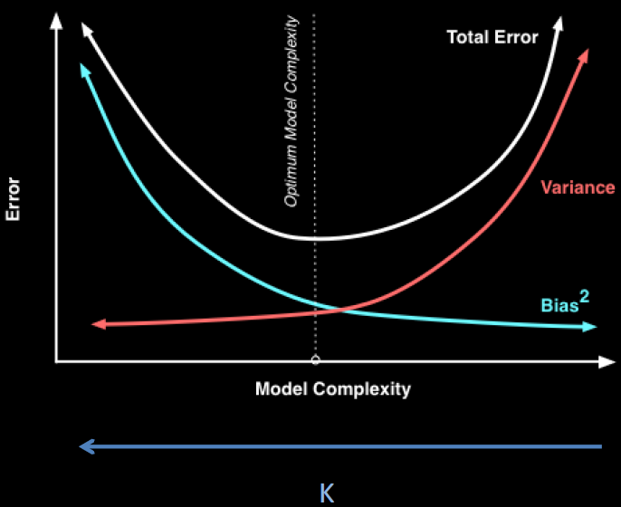
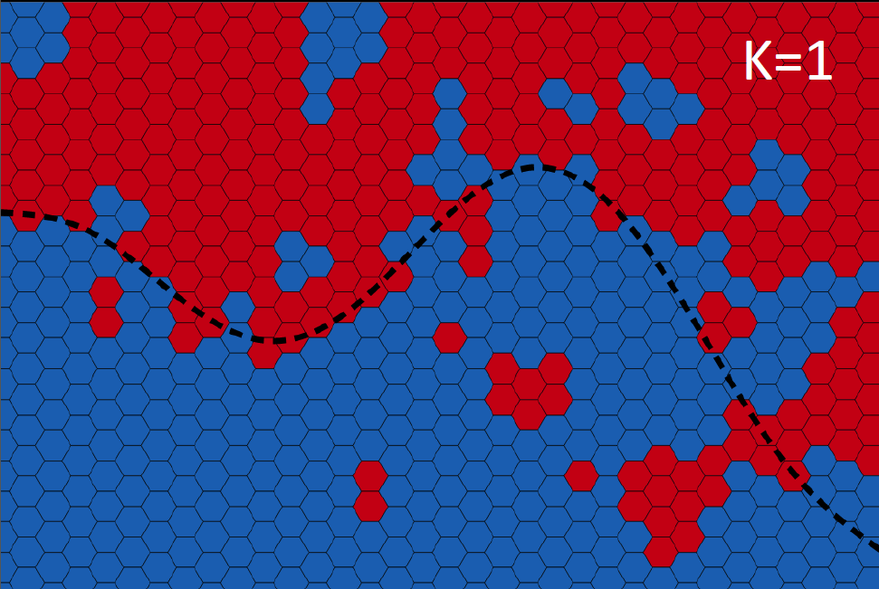
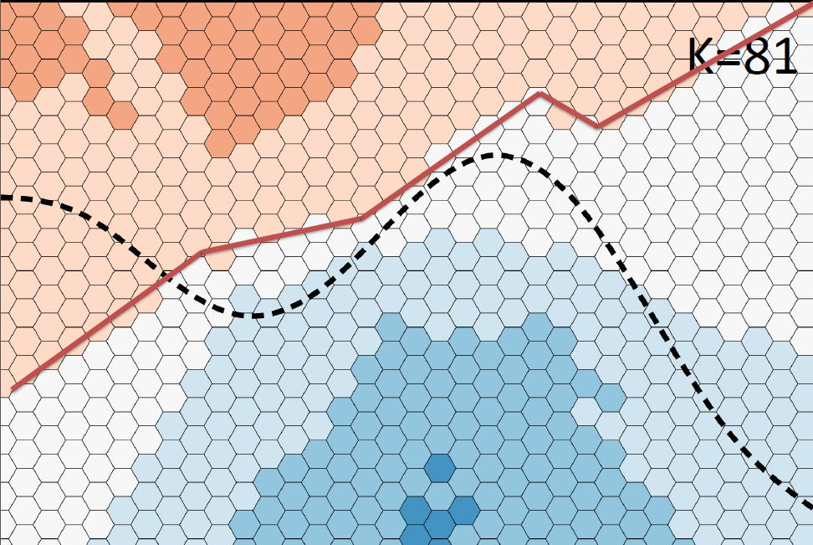
KNN and Model Complexity
K=1:sensitive to noises; K=81: stable

Slide 14
Generalization Error with Noise

Slide 15
Why does Bagging work?
Bagging has the approximately the same bias, but reduces variance of overall models![6]
The individual models with relatively smaller bias should be selected to maximize the variance-reducing effect of ensemble learning, since the variance can be removed by averaging. If greater weight is given to the models making better predictions, the error can be reduced further.[3]

Slide 16
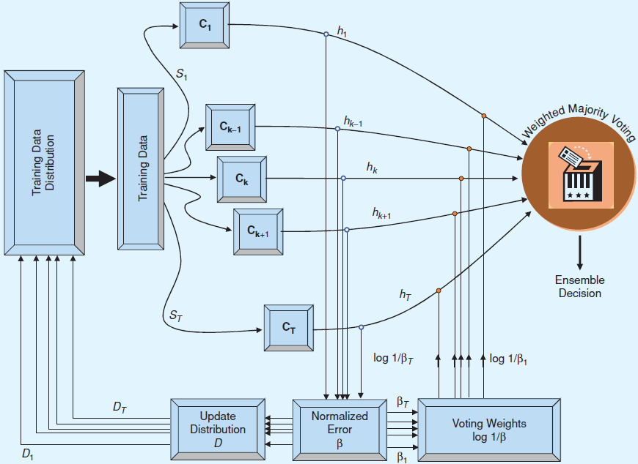
AdaBoost (Adaptive Boosting)
Update distribution for each training sample: Increase the weight of misclassified samples and decrease that of correctly classified ones.
Subsequent classifiers focus on misclassified samples via weighted misclassified penalty.
Weak classifiers are combined via weighted majority voting.
Sensitive to noisy data and outliers.
Less susceptible to the over-fitting problem.

Slide 17
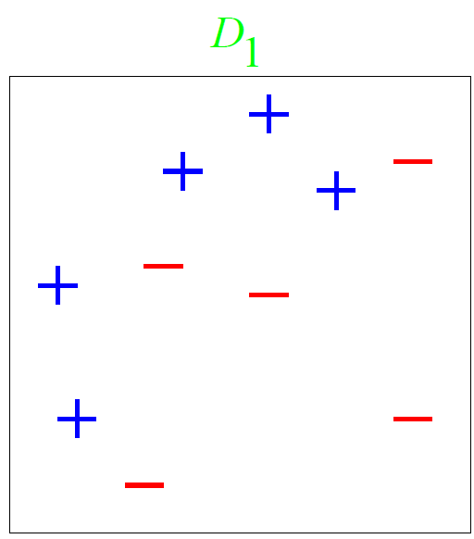
AdaBoost – Toy Example

Slide 18
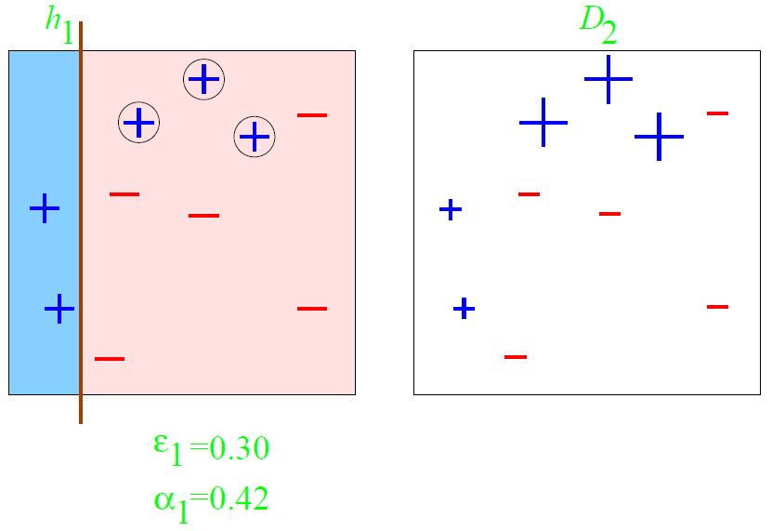
AdaBoost – Toy Example

Slide 19
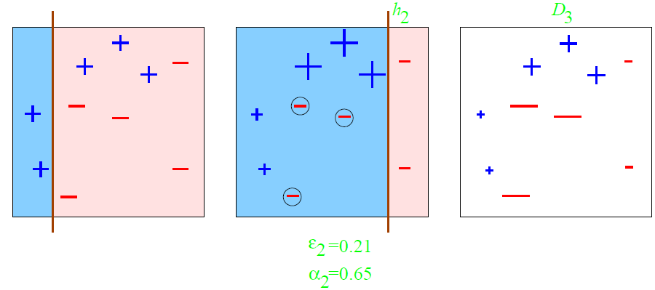
AdaBoost – Toy Example

Slide 20
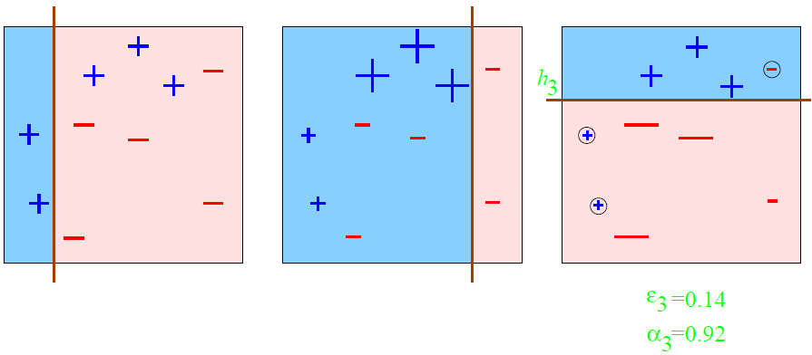
AdaBoost – Toy Example

Slide 21
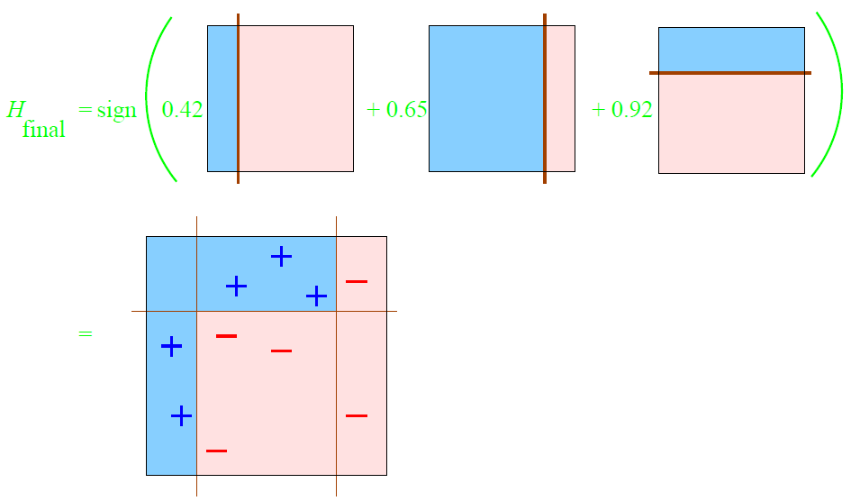
AdaBoost – Toy Example

Slide 22
Too Much or Too Little Data
Large volumes of data
Too little data
Partition the data into small subsets;
Training different classifiers with different partitions of data;
Combining their outputs with an appropriate combination rule
Drawing overlapping random subsets of the available data
Training a different classifier on different bootstrap samples
Creating an ensemble

Slide 23
Data Fusion
Heterogeneous Features
Feature 1
Feature 2
Feature 3
Feature 4
Model 1
Model 2
Model 3
Model 4
Data from different sources may provide complementary information.
Heterogeneous features cannot be used all together to train a single model.
A suitable combination of such information can lead to improved accuracy of decision compared to the one based on individual data sources.
Final Model

Slide 24
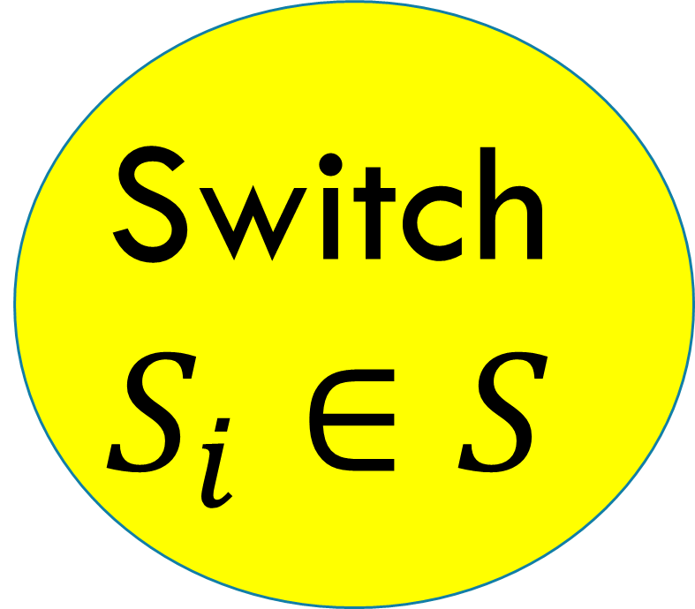
Ensemble Learning for Missing Features Problem
Sample with features S
Feature Subspace S₁
Model 1
Feature Subspace S₂
Model 2
Model Pool
Switch
$$S_{i}∈S$$
Feature Subspace S₃
Model 3
Ensemble Models’ Outputs
Feature Subspace S_{N}
Model N
Output
Percentage of features(15%-40%) used depend on redundancy of features and complexity of task( Larger feature subspace ->Stronger but fewer individual models).[2]

Slide 25
References
[1] Polikar, Robi. "Ensemble based systems in decision making." Circuits and Systems Magazine, IEEE 6.3 (2006): 21-45.
[2]Krause, Stefan, and Robi Polikar. "An ensemble of classifiers approach for the missing feature problem." Neural Networks, 2003.
[3] Sewell, Martin. "Ensemble learning." RN 11.02 (2008). Proceedings of the International Joint Conference on. Vol. 1. IEEE, 2003.
[4] http://lovebingkuai.diandian.com/post/2013-04-28/40050551522
[5] Dietterich, Thomas G. "Ensemble methods in machine learning." Multiple classifier systems. Springer Berlin Heidelberg, 2000. 1-15.
[6] Meir, Ron, and Gunnar Rätsch. "An introduction to boosting and leveraging."Advanced lectures on machine learning. Springer Berlin Heidelberg, 2003. 118-183.
[7] Schapire, Robert E., et al. "Boosting the margin: A new explanation for the effectiveness of voting methods." The annals of statistics 26.5 (1998): 1651-1686.

