Slide 1
SMART PARKING
Team name : Proj_224789_Team_2
Team members :
HARSHITHA SHIVANI T(113321243014)
ITHA VAISHNAVI SANJUKTHA(113321243015)
JEROMEY A(113321243016)
KAMIREDDY BHAVANI(113321243017)
RAVURU VARSHITHA REDDY(113321243041)
PHASE2: INNOVATION
Consider incorporating predictive maintenance algorithms to anticipate maintenance needs based on sensor data.

Slide 2
Smart parking innovation refers to the use of advanced technology and data-driven solutions to improve the efficiency, convenience, and sustainability of parking systems. This innovation is driven by the increasing urbanization and the growing challenges associated with finding parking spaces in crowded cities. Here are some key innovations and technologies in the realm of smart parking: 1. Sensors and IOT Devices: Smart parking systems often use sensors and Internet of Things (IoT) devices to monitor parking space occupancy in real-time. These sensors can be embedded in parking spots or attached to lampposts, and they provide data that helps drivers find available parking spaces quickly. 2. Mobile Apps: Many cities and parking facilities offer mobile apps that provide real-time information about parking availability. These apps can guide drivers to open parking spots, reserve spaces in advance, and even pay for parking electronically. 3. Data Analytics: Advanced analytics are used to process and analyze parking data, helping cities and parking operators make informed decisions about pricing, enforcement, and optimizing parking space usage. 4. Automated Payment Systems: Smart parking systems often include automated payment options, such as mobile payment apps, contactless payment methods, or license plate recognition for ticketless entry and exit. 5. Dynamic Pricing: Some smart parking systems implement dynamic pricing, where the cost of parking changes based on demand and availability. This can help reduce congestion during peak times and encourage off-peak usage.

Slide 3
6. Parking Guidance Systems: These systems use real-time data to direct drivers to available parking spaces. This can be achieved through digital signs, mobile apps, or in-car navigation systems. 7. Reservable Parking: Drivers can reserve parking spaces in advance through mobile apps or online platforms, ensuring they have a spot when they arrive at their destination. 8. Electric Vehicle Charging Integration: Many smart parking facilities now offer electric vehicle (EV) charging stations. These can be reserved and paid for through mobile apps, making it convenient for EV owners. 9. Environmental Sustainability: Smart parking solutions can contribute to environmental sustainability by reducing the time spent circling for parking, which results in lower emissions. They can also encourage the use of public transportation by providing information on park-and-ride options. 10. Security and Safety: Smart parking systems can enhance security through surveillance cameras and real-time monitoring, which can help deter crime and ensure the safety of parkers. 11. Accessibility Features: Innovations in smart parking often include features to make parking facilities more accessible for people with disabilities, such as designated accessible spots and guidance for accessible parking spaces. 12. Data Sharing and Integration: Data from smart parking systems can be integrated with other urban infrastructure systems, such as traffic management and public transportation, to improve overall mobility and urban planning. Smart parking innovations aim to make urban mobility more efficient, reduce congestion, and improve the overall parking experience for both drivers and cities. These innovations can also contribute to reducing the environmental impact of transportation and help cities better manage their parking resources.

Slide 4
DEFINING OBJECTIVES :
Before designing an IOT sensor system, it is essential to define the project’s objectives . Objectives includes Real-time Parking Information , Increased Revenue, Sustainability , Improved Safety , Reducing Maintenance Costs .Based on these objectives , the sensors specifications and network architecture are designed to make this project a success.

Slide 5
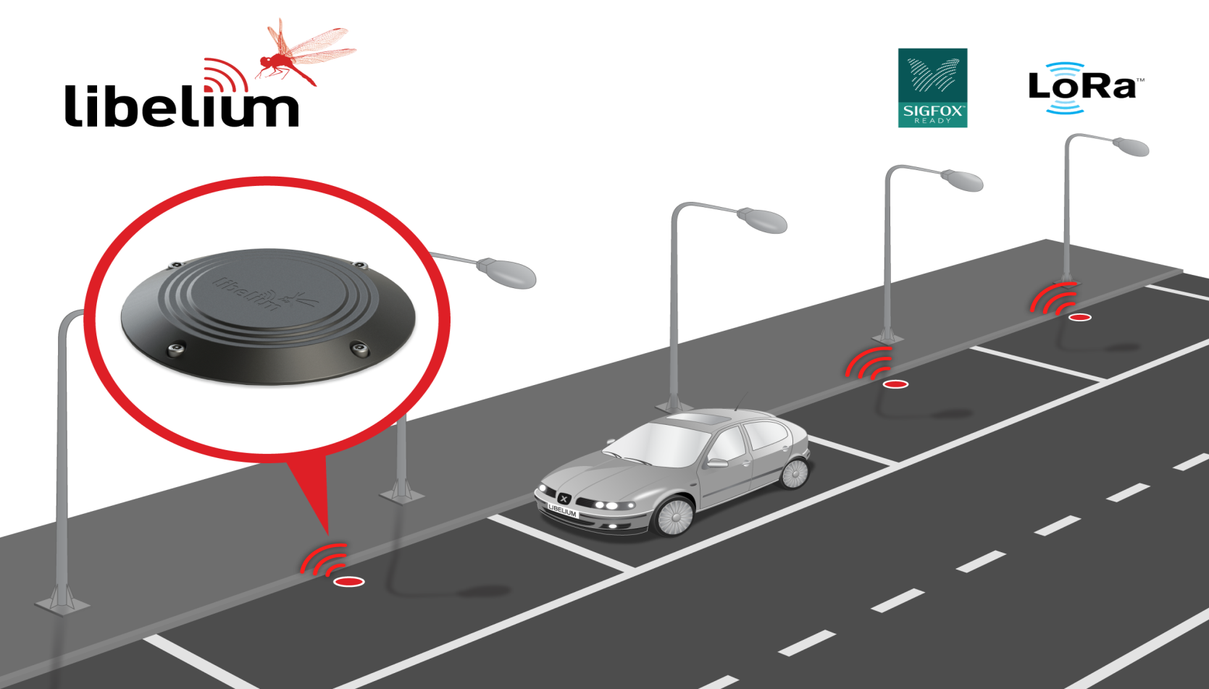
SENSOR DESIGN:

Slide 6
DESIGNING THE IOT SENSOR SYSTEM :
Real-Time Monitoring
Optimized Routes
Integration with Navigation Apps
Receive up-to-date information on parking availability through our smart status platform
Find the most convenient parking spots based on real-time data to reduce time and fuel consumption.
Seamlessly integrate our platform with popular navigation apps for a seamless parking experience

Slide 7
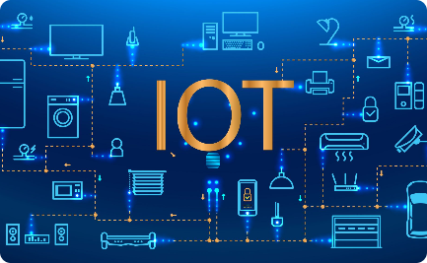


Integrating the System Using IoT Technologies and Python :
IoT Connectivity
Python Integration
Advanced Analytics
Utilize cutting-edge IoT technologies to connect sensors and devices for accurate parking data.
Leverage the power of Python to develop a scalable and robust smart parking system.
Analyze data collected from the system to gain valuable insights and optimize parking management

Slide 8

Enhancing Public Smart Parking with IoT Sensors
Enhancing Public Smart Parking with IoT Sensors :
1
Seamless Integration
Integrate IoT sensors seamlessly into existing parking infrastructure for hassle-free implementation.
Occupancy Detection
2
Accurately detect parking space occupancy to provide real-time availability information to motorists.
3
Dynamic Pricing
Implement dynamic pricing models based on demand and availability for optimized parking utilization.

Slide 9

Real-Time Information About Smart Parking
Real-Time Information About Smart Parking :
Mobile App Integration
Notification Alerts
Access real-time parking information through our user-friendly mobile application.
Receive instant notifications about available parking spaces and time-sensitive offers.
Live Updates
Stay informed with real-time updates on parking status, including occupancy and estimated parking time.

Slide 10
Detecting Malfunctions and Controlling Smart Parking with IoT Sensors
Detecting Malfunctions and Controlling Smart Parking with IoT Sensors
Maintenance Monitoring
Automated Controls
Error Handling
Enable automated control mechanisms to manage parking spaces, such as barrier systems and slot reservation.
Implement proactive error handling protocols for swift resolution of technical issues in the system.
Continuous monitoring of sensors and devices to detect malfunctions and ensure optimal performance.

Slide 11
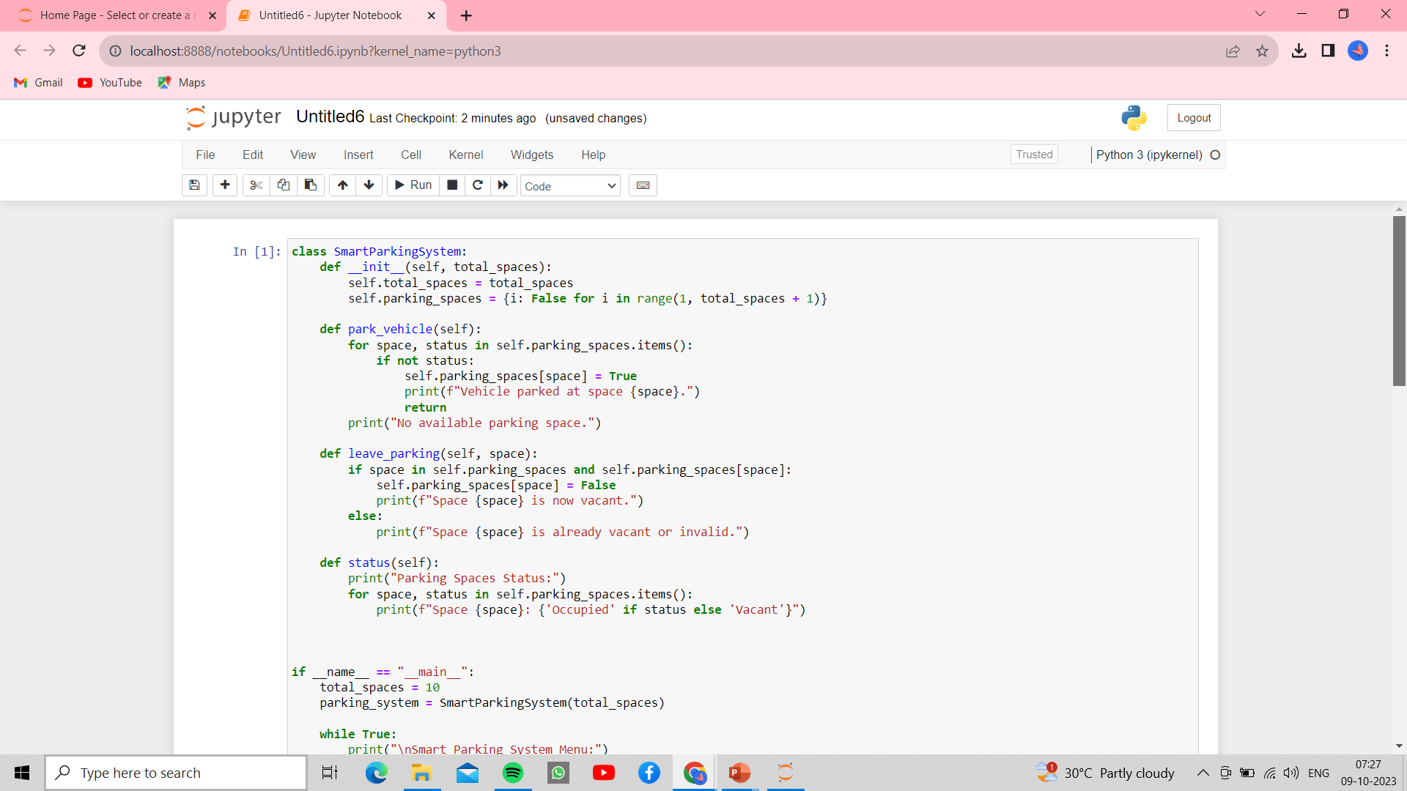
Program for Smart Parking:

Slide 12
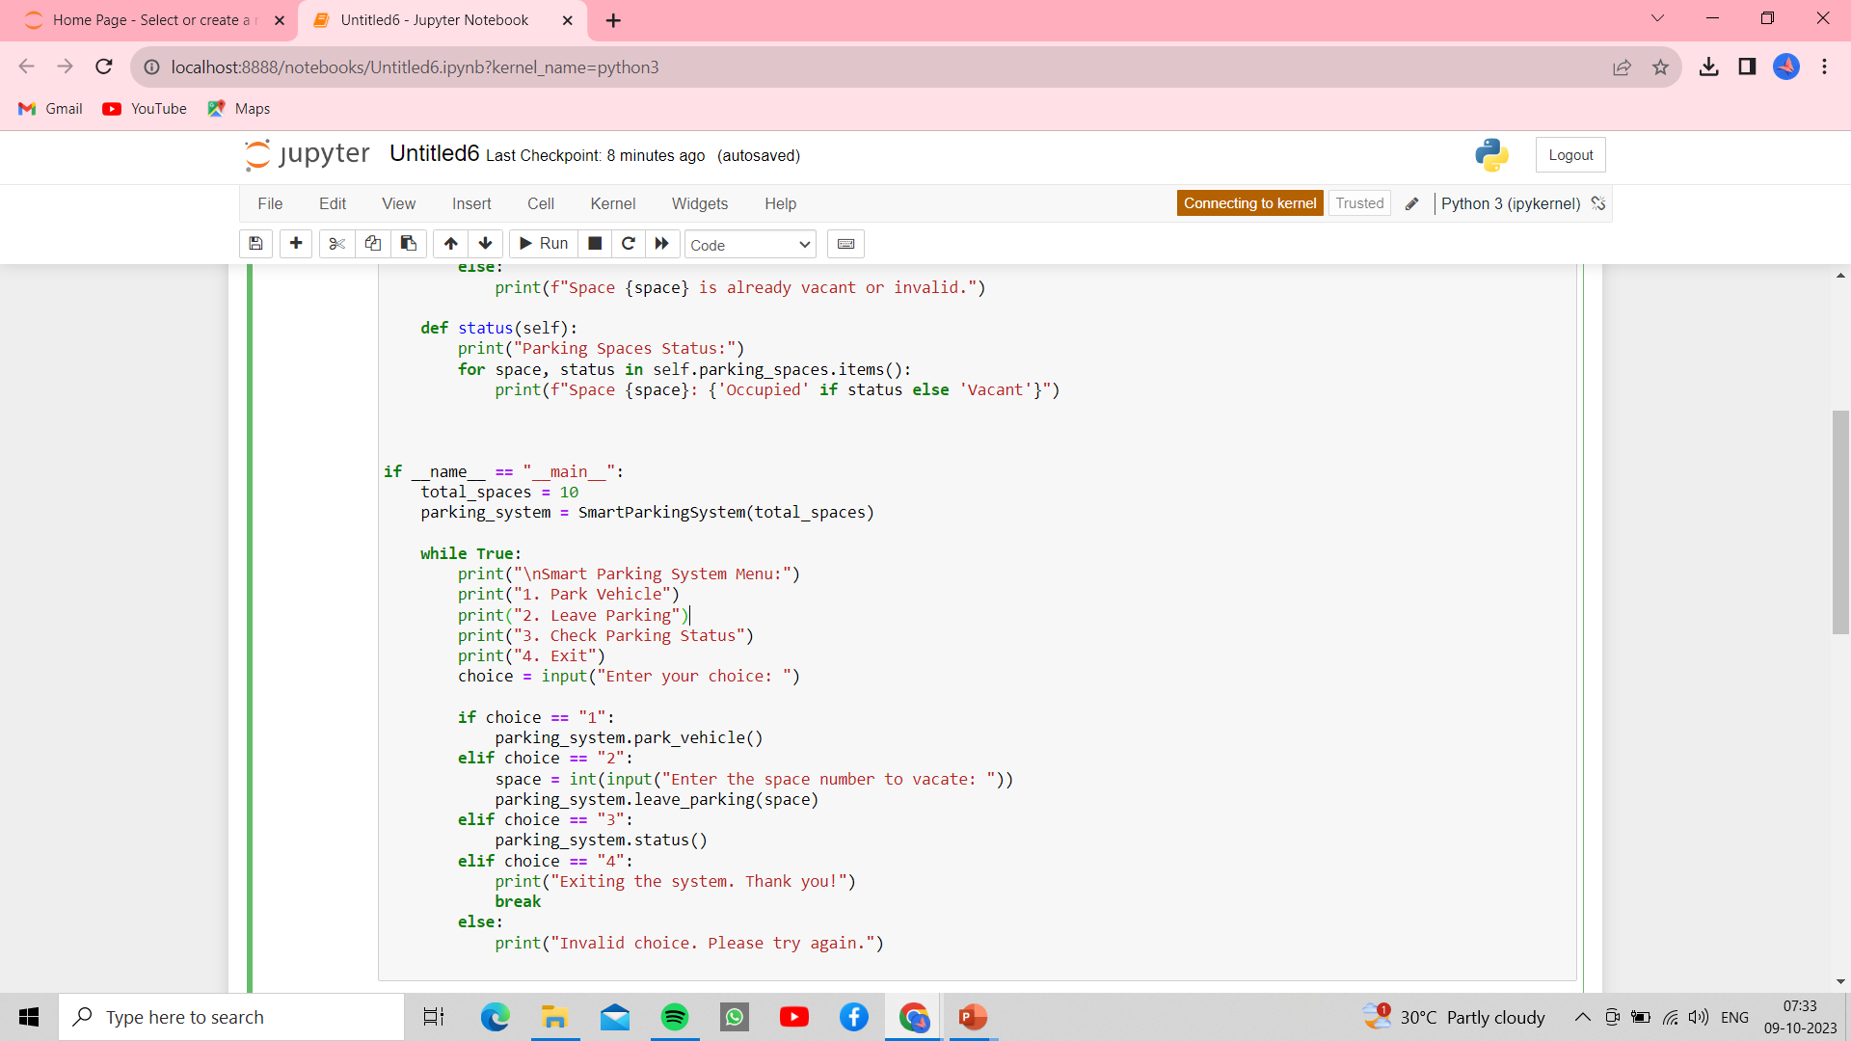
Program for Smart Parking (Continued):

Slide 13

Sample Output for Smart Parking:

Slide 14
Conclusion :
Smart parking powered by IoT sensors and advanced technologies is revolutionizing the way we park and enhancing the overall parking experience for motorists.

