Slide 1
Health Insight Agent
A Multi-Agent LLM Architecture for Personal Longitudinal Health Data Interpretation
Jerome Zhang · MSAI High-Risk Project · Spring 2026

Slide 2
The Problem
Personal health data is fragmented
Existing LLM approaches use single-shot prompting
• Wearables capture biometrics (HRV, sleep, body battery)
• Food apps track nutrition (macros, micros)
• Training journals log resistance work
…but no system unifies them into actionable insights
• Dump everything into one prompt
• Ask the LLM to figure it out
• Generic, ungrounded outputs
• Hidden cross-domain disagreements
Health Insight Agent · Slide 2 / 8

Slide 3
Research Question
Does a multi-agent LLM architecture produce more grounded, domain-specific health insights than single-shot LLM prompting on identical longitudinal personal health data?
Approach
Build both. Compare side-by-side. Measure what differs.
Health Insight Agent · Slide 3 / 8

Slide 4
Method — Architecture
7-Day Personal Health Data (Macros + Workouts + Garmin biometrics) │ ┌──────────────────────┼──────────────────────┐ ▼ ▼ ▼ ┌─────────┐ ┌──────────┐ ┌──────────┐ │Nutrition│ │ Training │ │ Recovery │ Stage 1 │ Agent │ │ Agent │ │ Agent │ (parallel) └─────┬───┘ └─────┬────┘ └─────┬────┘ │ │ │ └─────────────────────┼─────────────────────┘ ▼ ┌──────────────┐ │ Orchestrator │ Stage 2 │ Agent │ └──────┬───────┘ ▼ 3-5 Cross-Domain Insights
Single-shot mode
1 LLM call. All data. Direct prompt → output.
Multi-agent mode
4 LLM calls. 3 specialists in parallel + 1 orchestrator.
Health Insight Agent · Slide 4 / 8

Slide 5
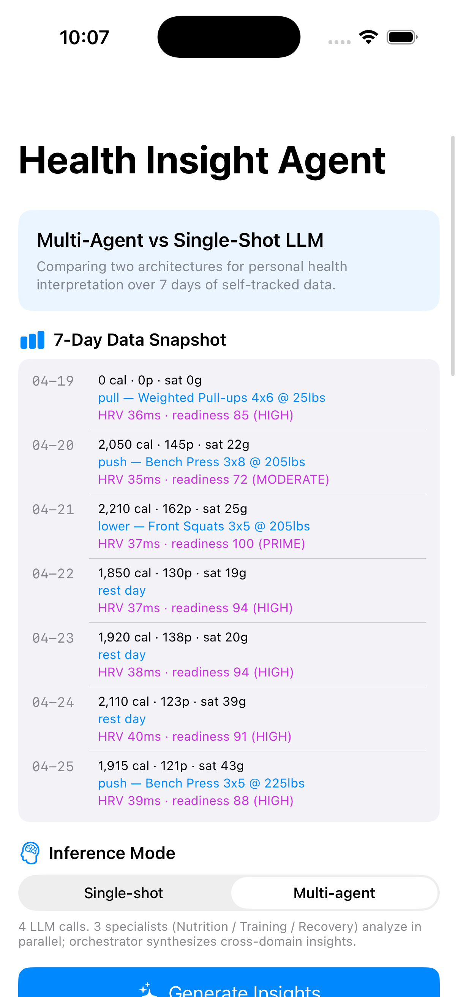
Implementation
Platform
Native iOS app · SwiftUI · iOS 17+
LLM
GPT-4o-mini via OpenAI Chat Completions API
Networking
Pure URLSession, no SDK
Data
7 days of self-tracked data (Apr 19–25, 2026)
Domains
Macros (food log) · Workouts (split + main lift) · Garmin (HRV, body battery, training readiness)
Health Insight Agent · Slide 5 / 8

Slide 6
Results
n=5 generations per mode · GPT-4o-mini · temp 0.4 · identical 7-day dataset
Metric | Single-Shot | Multi-Agent
Grounding rate | 100% | 100%
Cross-domain integration rate | 76% (range 40–100%) | 100% (no variance)
Total tokens (mean) | 1352 | 3603 (2.66×)
Wall-clock latency (mean) | 9.80s | 13.90s (1.42×)
LLM calls / generation | 1 | 4
Headline finding
Both architectures hit 100% grounding (no hallucinated values). Multi-agent's win is consistency on cross-domain integration — it never dropped below 100%, while single-shot had one run at 40%. Cost: 2.66× tokens, 1.42× latency.
Health Insight Agent · Slide 6 / 8

Slide 7
Future Directions
Scale up
Evaluate on public datasets (LifeSnaps, MyHeart Counts) across many users.
1
Clinical validation
Pair LLM outputs with clinician annotation for correctness, not just grounding.
2
Adaptive routing
Dynamically choose which specialists to invoke based on user query.
3
On-device inference
Swap GPT-4o-mini for Apple's Foundation Models framework — privacy-preserving deployment.
4
Persistent memory
Cross-session insight tracking ("did you act on last week's recommendation?").
5
Health Insight Agent · Slide 7 / 8

Slide 8
Thank You
Jerome Zhang · MSAI High-Risk Project · Spring 2026
Code & report: https://github.com/jeromez0/health-insight-agent
Questions?

