Slide 1


ISUZU MOTORS EUROPE
Parts support for scheduled PMS
Phase 1 covers the N75 fleet. Oil and fuel filters form the core service pack, with the air filter as the primary attach. Genuine parts are proposed first, unless a genuine SPA or a BVP offers the lower price.
18 August 2026 · complementary to the ITUK PMS pack
P700

Slide 2
PARTS SUPPORT · SCHEDULED PMS
Contents
01
Where this sits
The same N75 scope and 40,000 km interval as the ITUK pack, with ISZE figures applied to it.
02
The one percent
A one percent uplift across all PMS parts sold to dealers: 182 units, approximately EUR 4,207.
03
Coverage
The air filter is the largest gap. The fuel filter is approximately two thirds covered. The method follows.
04
Price route
A BVP where genuine demand is low, or an SPA where genuine can be brought in at a lower price.
05
Urea, brakes, clutch
The urea filter kit is retained. Brakes remain condition-based across both pad numbers. The clutch is supplied as a kit for manual transmissions only.
2

Slide 3
PARTS SUPPORT · SCHEDULED PMS
The actions we will take
Phase 1 covers the N75 fleet on the 40,000 km interval, scheduled PMS only. No additional visits are to be generated.
Filter pack
BVP
SPA
Clutch kit
Oil, fuel and air
Where genuine is quiet
Where price is the barrier
Manual transmissions only
All three filters go out as one set on the scheduled service. Oil and fuel are already established; the air filter is the one most often left off. Selling the three together is the primary action.
A BVP equivalent exists for the oil, fuel and air filter. It is used where genuine demand is low, or where the BVP wins on price.
No BVP exists for the R90 brake pad, so an SPA on genuine is the only lever. Brakes stay condition-based and are supplied when the repair requires them.
No broad campaign. Kit 5876102320 on identified manual units, until transmission data is available.
3

Slide 4
PARTS SUPPORT · SCHEDULED PMS
One percent uplift on all PMS parts
ITUK to dealer, calendar 2025
A one percent uplift on the parts the network already moves. No change to the mix.
+1%
This is not a volume campaign and not additional services. It is better capture of the scheduled work that already takes place.
on the mix of PMS parts already sold today
Delivered through three actions: the complete filter pack on every scheduled service, BVP where genuine is quiet, and SPA where price is the barrier.
4

Slide 5
PARTS SUPPORT · SCHEDULED PMS
How the cover percentages are built
Cover % = units sold in calendar 2025 / units the service schedule expects
1. The car park
2. How often
3. Expected units
9,359 N75
1.25 services / year
11,699 filters
N75 units in operation, DVLA 2024, covering both engine generations. This is not the 22,389 complete UK parc.
Planning basis: 50,000 km per year against a 40,000 km filter interval. 50,000 ÷ 40,000 = 1.25.
9,359 × 1.25. The same expected quantity applies to oil, fuel and air. This is the denominator.
Worked example
Sold 2025
Expected
Cover
Oil, ITUK to dealer
5,335
11,699
45.6%
Oil, ISZE to ITUK
4,691
11,699
40.1%
Fuel, ITUK to dealer
7,415
11,699
63.4%
Air, ITUK to dealer
2,284
11,699
19.5%
The same method applies to both layers. Scope is the 37 N75 part numbers in the ITUK pack. Pad coverage uses 0.5 events per year rather than 1.25. The one percent figure is one percent of actual 2025 mix, not of expected services. Air uses the same 1.25 as oil and fuel; on a 0.5 air interval it would read 39 percent.
5

Slide 6
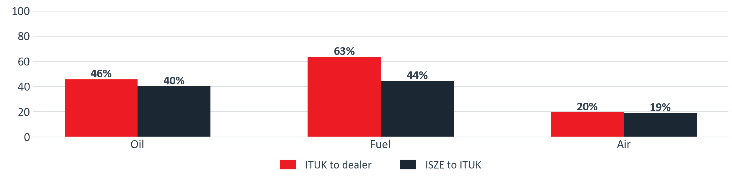


PARTS SUPPORT · SCHEDULED PMS
N75 filter coverage, calendar 2025
Quantity sold divided by the quantity expected under the IML service schedule. N75 units in operation: 9,359 (DVLA 2024), at 1.25 services per year. Expected oil, fuel and air filters: 11,699. Scope is the 37 N75 part numbers in the ITUK pack.
Expected
ITUK to dealer
Cover
ISZE to ITUK
Cover
Oil filter
11,699
5,335
45.6%
4,691
40.1%
Fuel filter
11,699
7,415
63.4%
5,161
44.1%
Air filter
11,699
2,284
19.5%
2,204
18.8%
6

Slide 7
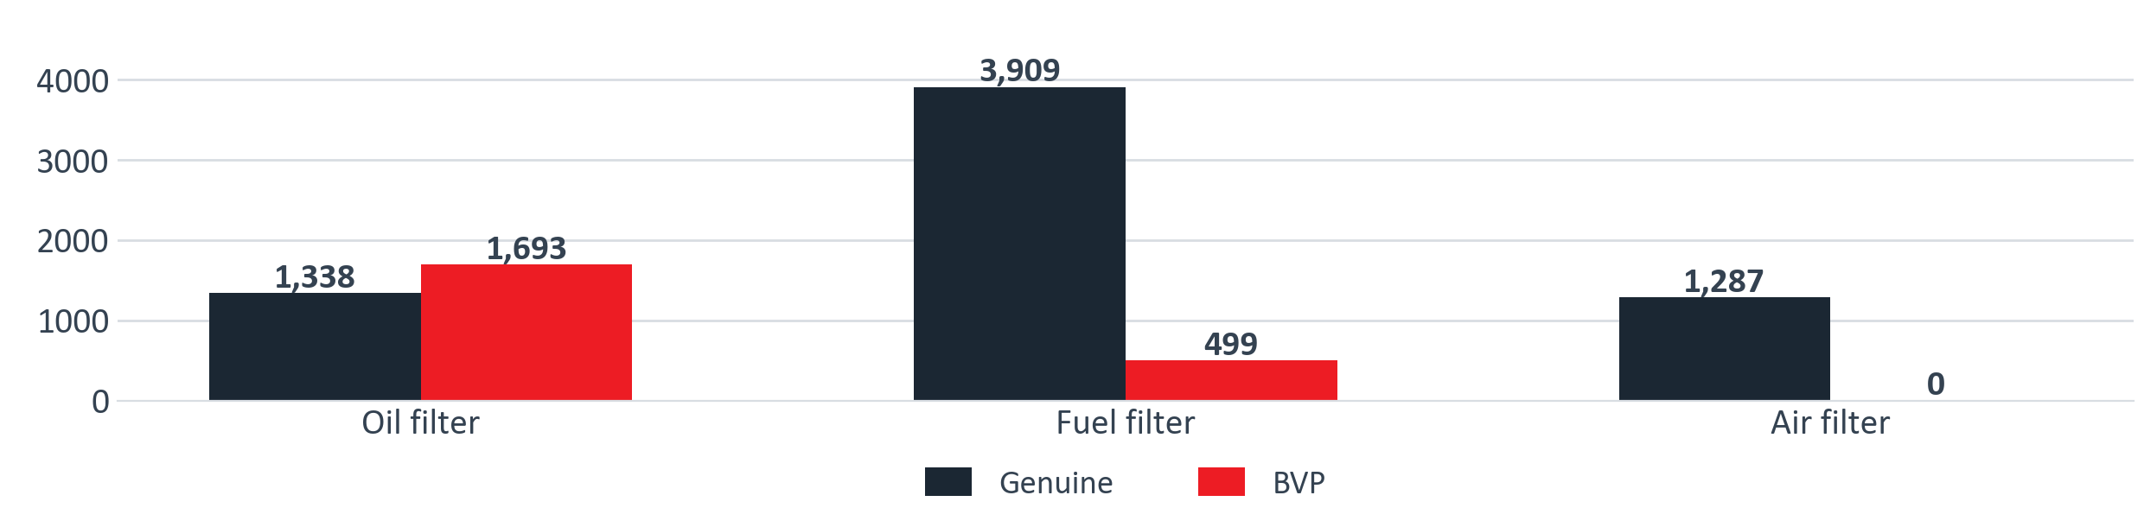
PARTS SUPPORT · SCHEDULED PMS
ITUK filter sales, genuine and BVP
ITUK's own figures, year-to-date demand across both N75 model slides. The oil BVP already outsells genuine. The fuel BVP is one part number. The air BVP has never sold.
Genuine
BVP
Total
BVP share
Oil filter
1,338
1,693
3,031
55.9%
Fuel filter
3,909
499
4,408
11.3%
Air filter
1,287
0
1,287
0.0%
Source: ITUK PMS Project pack, 18 August 2026, slides 15 and 16. Year-to-date demand, NPR75 4HK1 and NPR88 4JZ1.
7

Slide 8
PARTS SUPPORT · SCHEDULED PMS
Price route: the lower of genuine or BVP
A BVP applies where genuine demand is low, unless an SPA on genuine achieves a lower price. Across the set, genuine is proposed first unless it is already cheaper than the BVP.
Fuel
Genuine demand is established.
Retain genuine. A BVP equivalent is available if required.
1
Air
Genuine coverage is 20 percent.
BVP 5876102500, or an SPA on genuine where that is lower.
2
Oil
The BVP is already supplied.
Remains in the set. Not a separate campaign.
3
Pad
No BVP available.
SPA on genuine only, and only where the repair requires the pad.
4
8

Slide 9
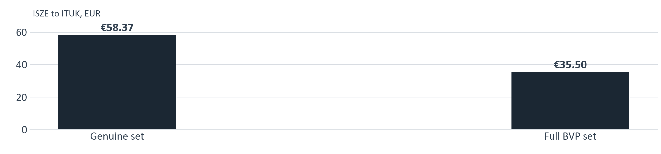

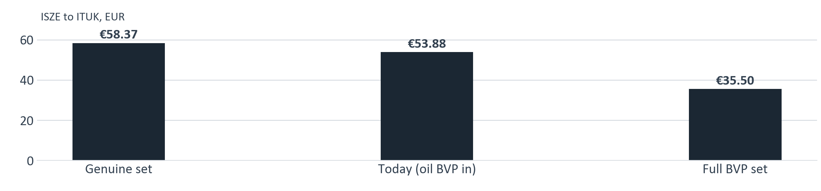
PARTS SUPPORT · SCHEDULED PMS
One scheduled service, three filters
The genuine set is proposed first. A BVP applies only where genuine is not taken up, or is not the lower price. The air BVP is 44 percent below genuine.
Oil
Fuel
Air
Set
Genuine PN
8983282070
8975425400
8981772710
3 part numbers
ISZE to ITUK EUR
14.45
12.56
31.36
58.37
BVP PN
1876102890
1876102860
5876102500
if required
BVP ISZE to ITUK EUR
9.96
8.05
17.49
35.50
8

Slide 10
PARTS SUPPORT · SCHEDULED PMS
Urea filter kit is retained
ITUK requested that this item be retained, and that is confirmed. It sits outside the 37 N75 part numbers and is treated as a separate line. The item is the DEF pump filter kit, not bulk fluid.
Genuine 8983507161
BVP 1876102341
Current kit
If genuine is not taken up
Genuine remains the first choice for this item.
Use the BVP where genuine is not taken up, unless a genuine SPA achieves a lower price.
Genuine 8983507161
BVP 1876102341
ITUK to dealer qty
541
34
ISZE to ITUK qty
506
46
ISZE to ITUK EUR
70.53
30.72
Prices shown are ISZE to ITUK, PR00 IE40, valid 13 March 2026.
10

Slide 11
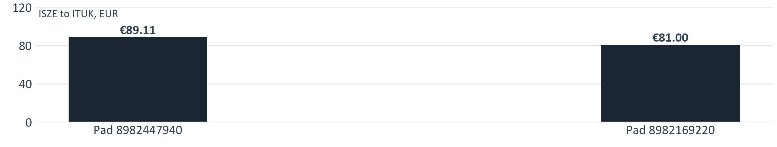


PARTS SUPPORT · SCHEDULED PMS
Brakes remain condition-based
No promotional trigger. Where the pad is required for the repair, no BVP exists and an SPA applies. Both N75 pad numbers are included.
ITUK to dealer
ISZE to ITUK
Inspect interval
Pad 8982447940 + 8982169220
2,900
2,730
20,000 km / 12 months
Disc rear 8981919560
487
521
—
Disc front 8982488951
393
520
—
The rotors fit N75 NPR and carry over to P700. They sell steadily and come only from ISZE, but they are not on the ITUK PMS list. Proposal: add them to the R90 brake pack.
Brake pad inspection every 20,000 km or 12 months, from the IMG N-series maintenance schedule (NPR75 / 4HK1). No schedule sets a pad replacement interval: brakes are condition-based. No BVP exists for the R90 pad; SPA on genuine only.
11

Slide 12
PARTS SUPPORT · SCHEDULED PMS
Clutch supplied as a kit, manual transmissions only
No broad campaign; VIN and manual transmission only. Applied on identified manual units until transmission data is available. Disc 8981649181 is not to be included.
BVP kit 5876102320
Genuine three pieces
Single part number
If the workshop requires individual pieces
ITUK to dealer 63 units. ISZE to ITUK 78 units at EUR 194.69.
8981649171 + 8970388314 + 1313100120, ISZE to ITUK EUR 282.08. The kit is 31 percent lower.
Piece
PN
ITUK to dealer
ISZE to ITUK
Disc
8981649171
50
47
Pressure plate
8970388314
9
54
Release bearing
1313100120
38
21
12

Slide 13
Thank you
Questions and next steps
P700

