Slide 1
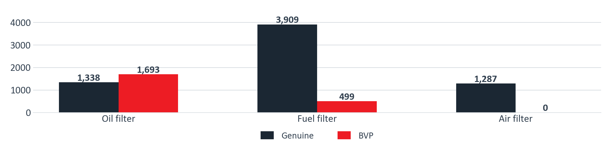

PARTS SUPPORT · SCHEDULED PMS
ITUK filter sales, genuine and BVP
ITUK's own figures, year-to-date demand across both N75 model slides. The oil BVP already outsells genuine. The fuel BVP is one part number. The air BVP has never sold.
Genuine
BVP
Total
BVP share
Oil filter
1,338
1,693
3,031
55.9%
Fuel filter
3,909
499
4,408
11.3%
Air filter
1,287
0
1,287
0.0%
Source: ITUK PMS Project pack, 18 August 2026, slides 15 and 16. Year-to-date demand, NPR75 4HK1 and NPR88 4JZ1.

