Slide 1
Managed Dealer Inventory - TVS (MDI) Project
ISUZU TRUCK UK LTD

Slide 2
What ITUK needs from MDI
1
2
3
4
Customer experience
Inventory quality
Dealer performance
Management visibility
Improve parts availability and reduce lost sales from stockouts.
Reduce excess stock, improve mix and lower carrying cost.
Improve ordering discipline, recommendation adoption and stock turns.
Give ITUK consistent KPIs and exception reporting across the dealer network.
What a successful POC looks like
Availability
Cashflow
Adoption
Control
Improving stock coverage without adding unnecessary inventory.
Reducing excess / non-moving inventory and improving stock turns.
Dealers using and trusting recommended orders consistently.
ITUK able to see performance and act on exceptions.

Slide 3
MDI – Anticipated Work Flow
TVS Receive Data From Dealer
TVS Generate Demand Forecast
TVS Send Recommended Stock Order to Dealer
Update Customer Dashboards
Send Exception Report to ITUK
Collaborate to Improve System
Dealer Accepts, Rejects or Modifies Recommended Order

Slide 4
Dealer DMS Mix

Slide 5
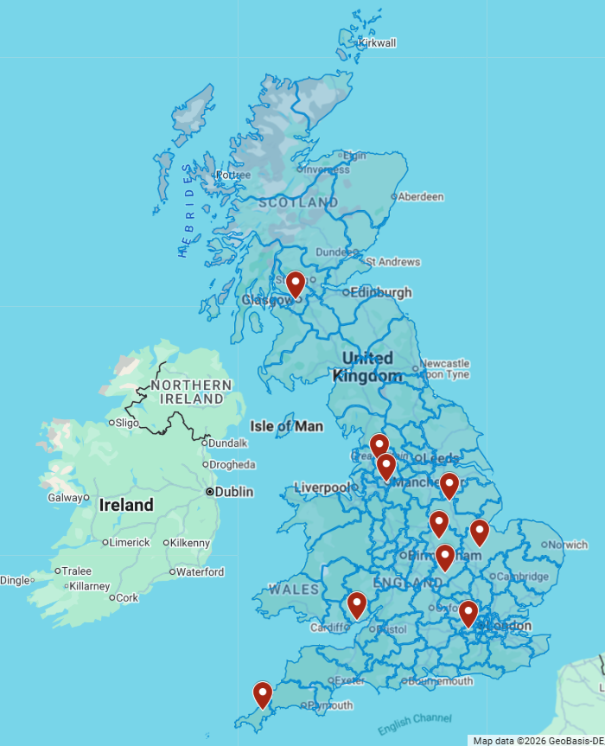
PoC Dealers
Dealer Account | Dealer | Post Code | Parts Manager
P9041 | COMMERCIAL MOTORS (WALES) LTD | NP19 4RF | Craig Little
P9364 | SW COMMERCIALS LTD | TR4 9DH | Charlie Heide
P9042 | CORDWALLIS COMMERCIALS (HEATHROW) | TW14 8ND | James Finnegan
P9344 | RH Commercial Vehicles Ltd (Northampton) | NN7 4AW | Tom Judd
P9345 | RH Commercial Vehicles Ltd (Tuxford) | NG22 0NH | Jervel Foster
P9346 | RH Commercial Vehicles Ltd (Leicester) | LE7 4UZ | Tom Judd
P9347 | RH Commercial Vehicles Ltd(Peterborough) | PE1 5UP | Tom Judd
P9181 | JDS TRUCKS LIMITED - BLACKBURN | BB1 3BB | Rebecca Hirst
P9182 | JDS TRUCKS LIMITED - MANCHESTER | M50 2UW | Rebecca Hirst
P9163 | MOTUS COMMERCIALS-GLASGOW | G51 4SX | Gerry Doolan

Slide 6
TVS Proposal – Operating Model
Phase 1 proves the process; Phases 2 and 3 progressively automate the dealer workflow.
1
PoC / manual process
2
Automated order file
3
Dealer auto-accept
Dealer sends a daily stock file. TVS manually processes the data, generates a recommended order and returns it to the dealer.
Recommended order files are automated from TVS systems into the Isuzu dealer management workflow.
A DMS button allows the dealer to accept the recommended order with minimal manual handling.
CURRENT TVS PROPOSAL
FUTURE MODEL – SUBJECT TO TECHNICAL / COMMERCIAL AGREEMENT
Daily Phase 1 Workflow
1
2
3
4
5
Dealer file
TVS processing
Recommended order
Dealer action
ITUK oversight
Daily stock file
Demand / forecast logic
Returned to dealer
Review and place order
Exceptions and KPIs

Slide 7
Latest TVS commercials – 24 July 2026
The PoC is now low-cost and site-based; the full-network Phase 1 cost is unchanged from the original annual quote.
10-DEALER POC
FULL PHASE 1 – 60 DEALERS
£2,370
£91
£5,460 / month
total for 3 months
per dealer / month
£65,520 / year
Equivalent to £79 per dealer / month
TVS proposes onboarding the remaining 50 dealers over the 3 months following the PoC.
ITUK view: Acceptable cost to test process reliability, dealer adoption and data quality.
Commercial points still to close
1
No automatic rollout
2
200-line assumption
3
Phase 2 pricing
Move beyond 10 dealers only after a formal ITUK PoC review and approval.
Confirm £91 is a fixed site fee and does not increase if a dealer file exceeds 200 lines.
Automation should reduce the manual workload; the revised monthly fee is still to be agreed for phase 2.

Slide 8
Latest TVS commercials – 24 July 2026
TVS has now defined the daily service level. ITUK still needs business KPIs to prove that MDI improves dealer inventory.
TVS committed service levels
KPIs ITUK need to agree before PoC go-live to phase 1 (60 Dealers)
90%
OTIF* target for generating and sending the recommended order
Recommendation acceptance
Off-the-shelf fill rate
Are dealers using the TVS suggested order?
Is availability improving for regular demand?
09:00
Stock turns / months of stock
Aged / no-sale stock
Dealer daily file must be received by TVS
Is stock becoming leaner and more productive?
Is non-moving inventory reducing?
VOR / emergency / lost sales
Dealer data compliance
12:00
Recommended order returned to the dealer
Are urgent requirements and missed demand reducing?
Are files complete, accurate and on time?
15:00
Any failure to provide the order highlighted to ITUK
PoC reporting point challenged by ITUK to TVS
TVS currently proposes Power BI only when 60 dealers are onboarded; the PoC would receive a confirmation email. ITUK have requested a simple weekly KPI pack during the 3-month trial.
*OTIF - On Time In Full.
On time - returned to the dealer by the agreed time, which is 12:00 noon.
In full - complete, not missing the required recommendation output.
90% OTIF KPI means TVS is committing to successfully sending the recommended order back on time and complete in at least 90% of cases.

Slide 9
Commercial context for IML – TVS vs PartsEye
The alternatives are not identical, but the cost gap explains why ITUK is testing a lower-risk local route.
TVS – local MDI proposal
PartsEye – IML global route
£2,370
10-dealer / 3-month POC
$5,000 / month
ITUK platform fee
£65,520 p.a.
Phase 1 at 60 dealers
+ $200 / dealer / month
Minimum 50 licences → $15,000 / month / $180,000 p.a. at 50 dealers
Low-cost, controlled UK PoC before any full-network commitment.
Manual process initially; Phase 2 automation dependent on TVS / ITUK / Keyloop scoping.
Dedicated TVS demand, planning and forecasting support.
Reporting during the PoC still needs strengthening.
One-time implementation fee is absorbed by IML under the global contract.
Broader global platform, DMS / ERP integration, reporting and standardisation.
IML model requires a larger licence commitment and materially higher ongoing cost.
Original ITUK trial model contemplated a limited dealer trial before full operation.

Slide 10
Proposed Working Timeline
Late Aug
Agree direction and approve / decline POC
September
Finalise commercial terms, KPIs and dealer data template
Oct–Dec
Run 10-dealer, 3-month PoC
January 2027
Formal PoC review and go / no-go decision
Jan–Mar 2027
If approved, staged onboarding of remaining dealers
Phase 2
Automation timing and revised fee after Keyloop scoping

