Slide 1
i-FORS Project (Previously GSCM)
Isuzu Forecasting & Order Replenishment System
Director briefing ahead of discussions with Isuzu Motors Limited, Japan
ISUZU TRUCK UK LTD

Slide 2
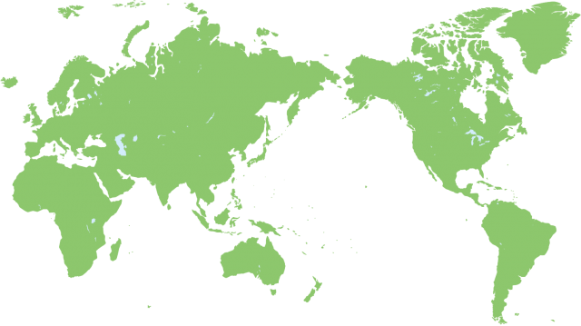
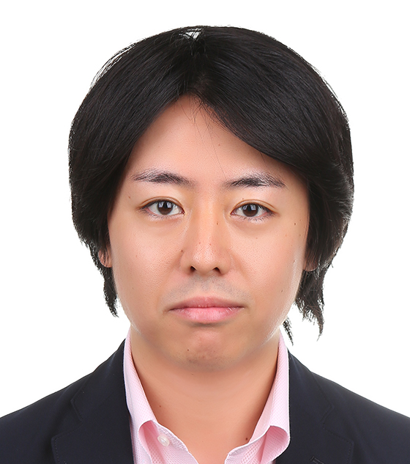


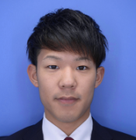
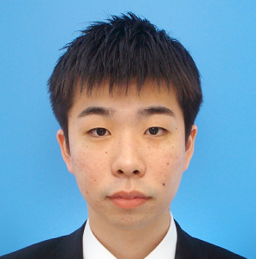
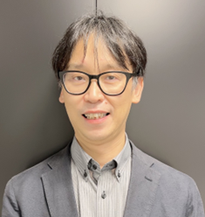

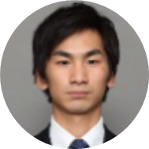
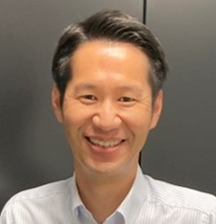
Members (i-FORS Group-N85)
Kenta Taniguchi
Group Leader
ITUK
Nao Masaki
Team Leader
IMA/IIF
Ryosuke Yokota
Nariko Kikuyama
IIF
IIF
IMIT
IMIT
IPC
Kaito Hisamoto
IEA
IMA
IMSB
ITUK/IEA/IIF
/South America
Takaharu Inoue
Concurrent NP2
Keiya Otsuki
Haruka Ichimura
IMA-based
IMSB/IPC
Naoaki Tashiro
IMA
Concurrent NPC

Slide 3
i-FORS Project
The i-FORS Project is an Isuzu Motors Ltd led initiative to centralise demand forecasting and parts ordering globally.
IML (Japan) takes over:
  Demand forecasting
  Order quantity calculation
ITUK retains:
  Commercial ownership (sales, pricing, inventory ownership, execution)
Why the project exists
IML’s view:
Forecasting is inconsistent across markets
Leads to:
  Excess inventory
  Non-moving / dead stock
  Variable service levels

Slide 4
Expected Benefits (As of October 2024)
Fill rate >95% (Refer slide 6)
Inventory -30% & M.O.S to 5 (Refer slide 5)
Reduced obsolescence
Improved customer satisfaction

Slide 5
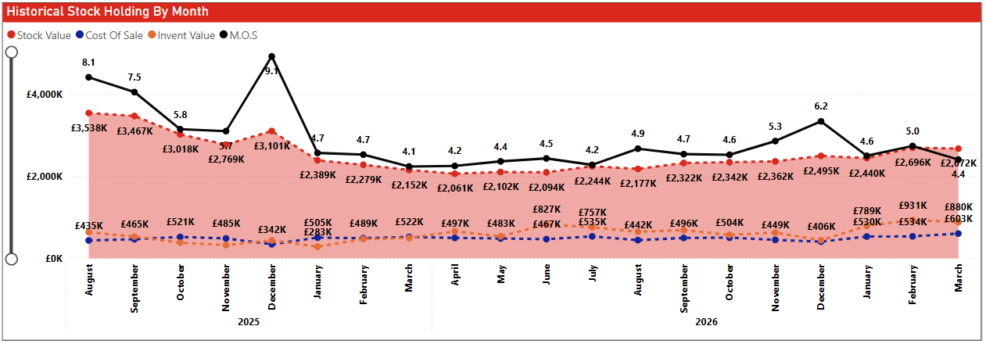
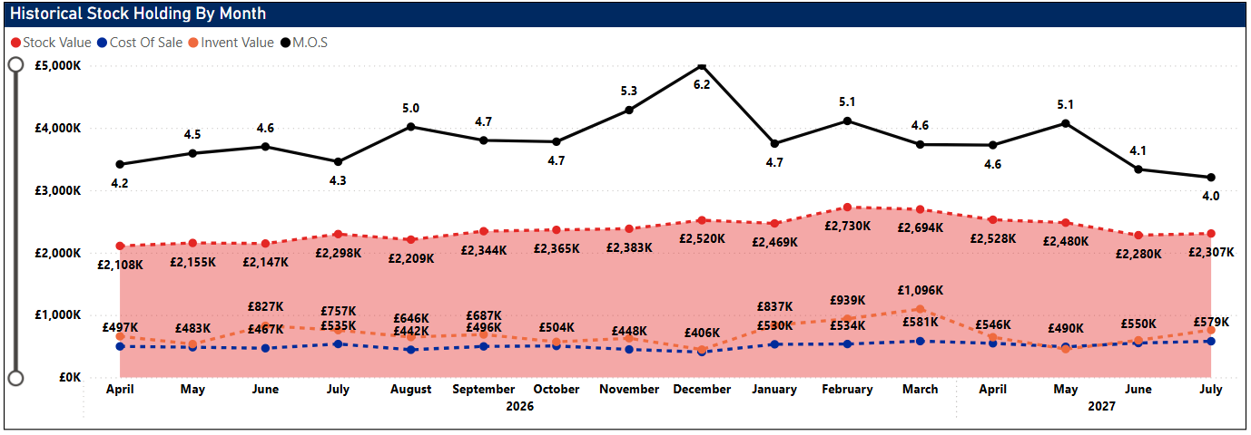
ITUK Parts Stock & M.O.S. – Current Result

Slide 6
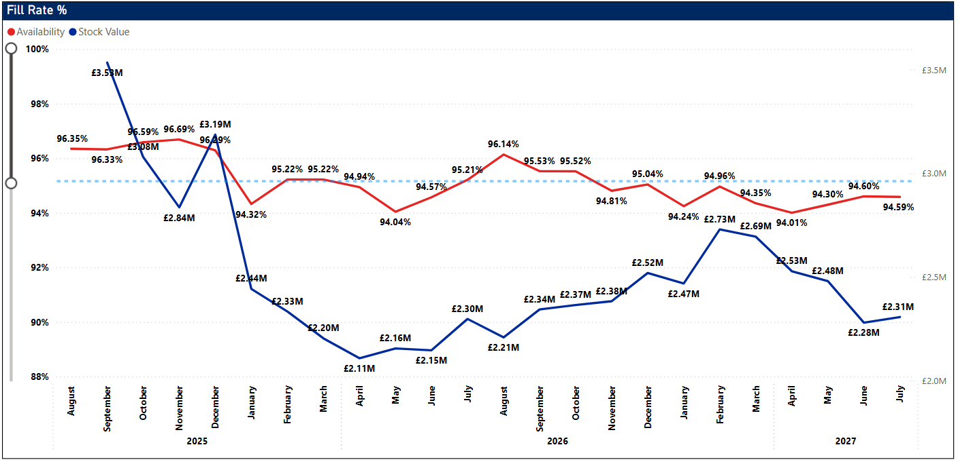
Fill Rate

Slide 7
How it works
Key point:
It is not currently a fully automated system – still collaborative ITUK\IML
But core logic is centralised in Japan
Weekly cycle:
ITUK uploads data
Sales
Stock Orders
Backorders
i-FORS system:
  Runs forecasting
  Calculates recommended order quantities
Weekly joint review
(ITUK + IML)
ITUK places final orders
Key capability shift
Today (ITUK)
Forecasting done locally (Pentana / Experience)
Orders often:
  Lower Part Number count
  Higher quantities
i-FORS approach
Orders:
  More Part Numbers
  Lower quantities per part number
  → Broader coverage, less overstock risk
Strategic shift:
From “bulk stocking” → to “precision stocking”

Slide 8
Schedule
 |  | 2024 | 2025 |  |  |  |  |  |  |  |  |  |  |  | 2026
 |  | Dec | Jan. | Feb. | Mar. | Apr | May | Jun. | Jul. | Aug. | Sep. | Oct | Nov. | Dec | Jan. | Feb. | Mar. | Apr | May | Jun. | Jul. | Aug. | Sep. | Oct. | Nov. | Dec.
Master schedule
Business Preparation | ISZJ
 | ITUK
System Preparation | ISZJ
 | ITUK
★P700
★SOP
Jan 2027~
★1st meeting
★ Agreement for PoC
PoC
ITUK new DMS development
★Decision for new DMS
★Weekly MTG
★Review PoC
Automatic I/F integration ★
Data check
Study “Buy Back” scheme
for ITUK and ISZE
Discussion and building Operations
for PoC (Monthly MTG)
Operations
test
Discussion and building
“Buy Back” scheme
Requirements definition
for additional program
Study “Buy Back” scheme
in UK
Check FTP
availability
Global SCM System
Phase 4 and Phase 5
Check
ITUK’s data
Check details of
“Informatica”
Global SCM System
Phase 6
Confirm
data transition for PoC
System
test
Requirements definition
for new DMS
Check “Informatica”
availability
Implementation data transition system
to new DMS
Data creation
with the format
RFQ
Additional program development
with Neon

Slide 9
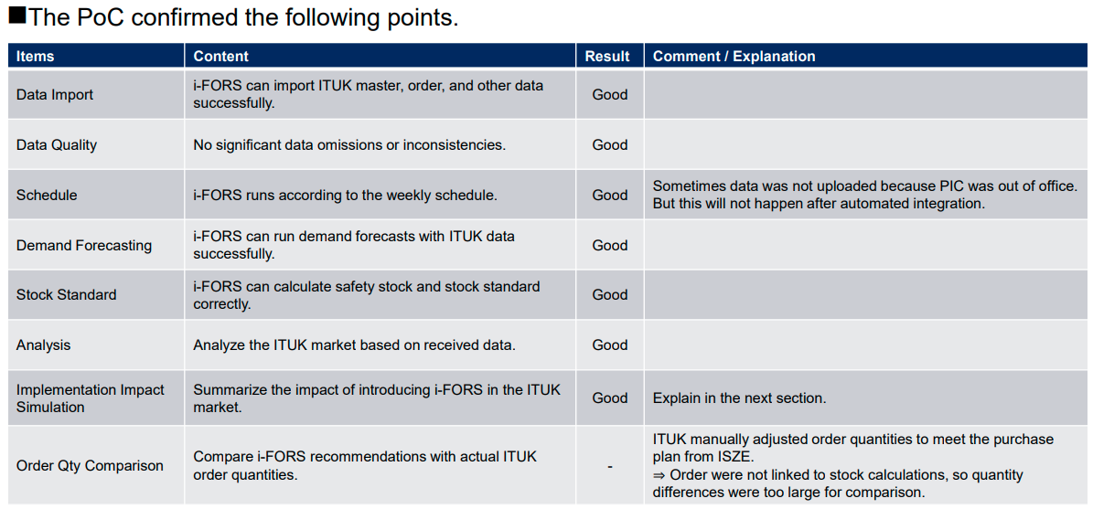
PoC Confirmations

Slide 10
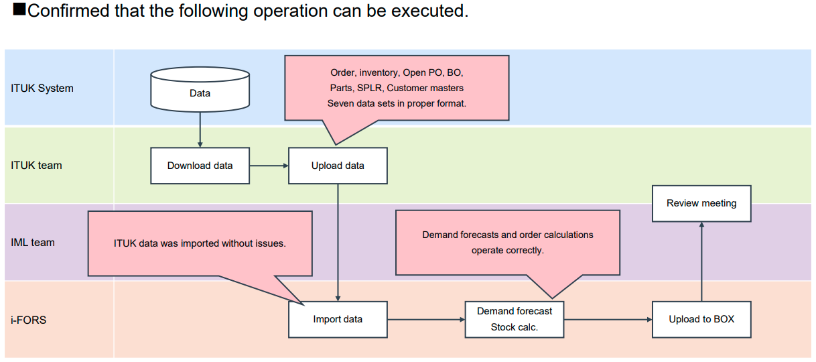
PoC Confirmations (Feasibility)

Slide 11
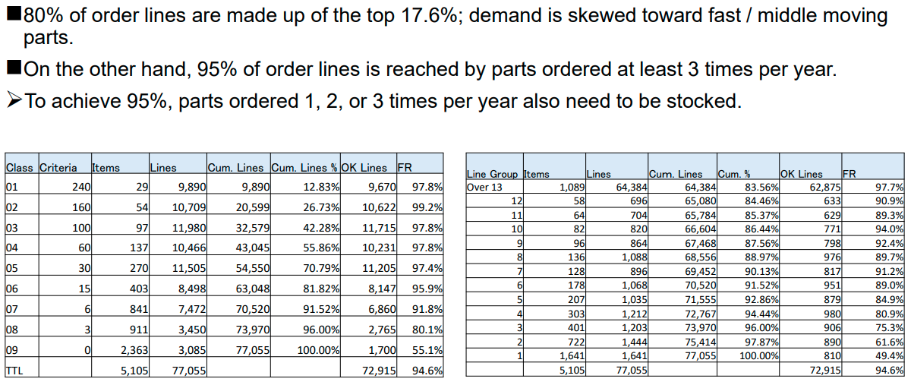
PoC Confirmations (Analysis)

Slide 12
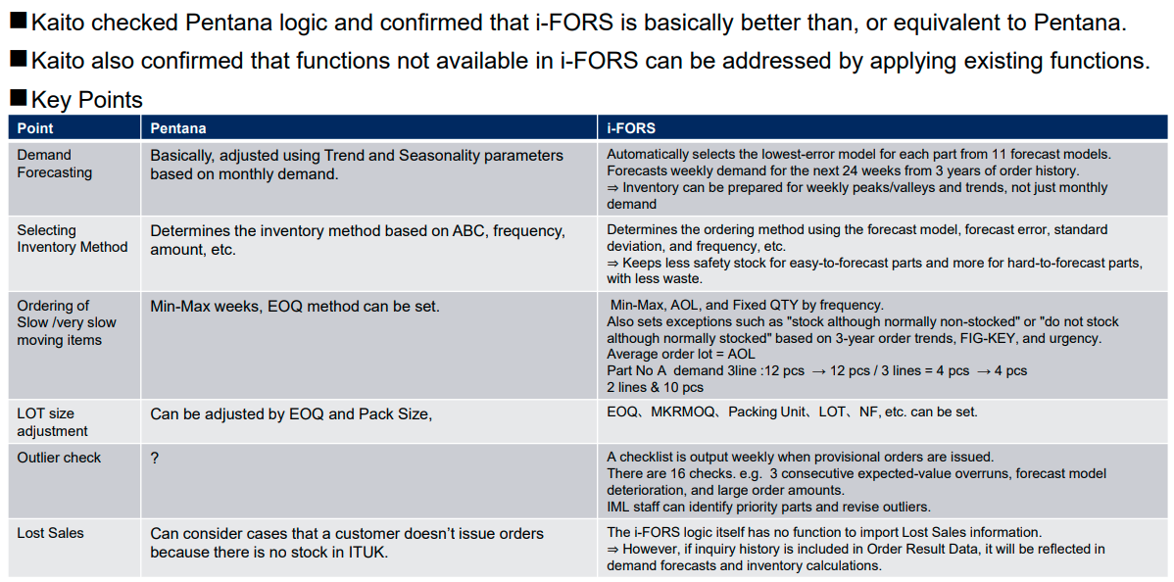
Logic Comparison

Slide 13
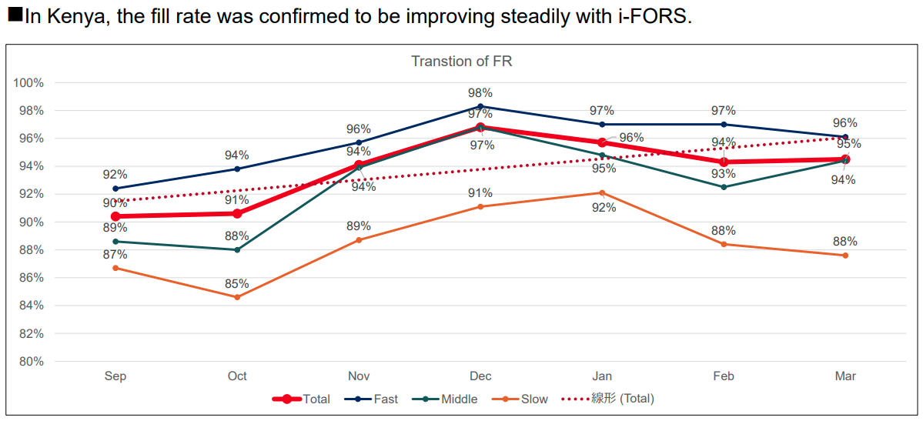
Progress in Kenya

Slide 14
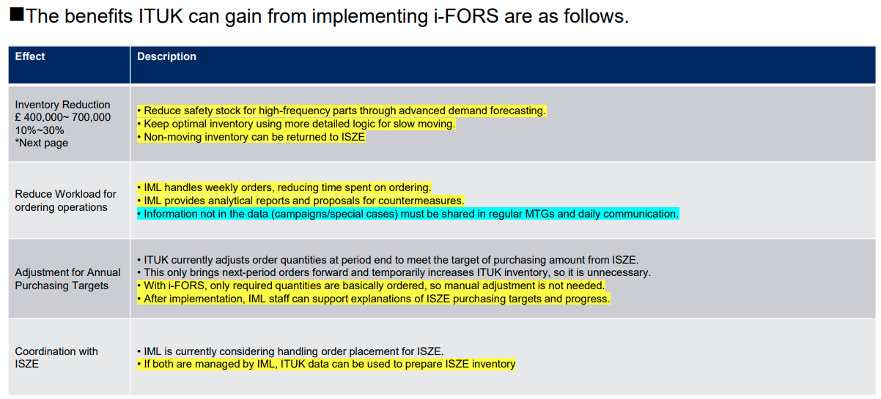
Benefits of Implementing i-FORS in ITUK

Slide 15
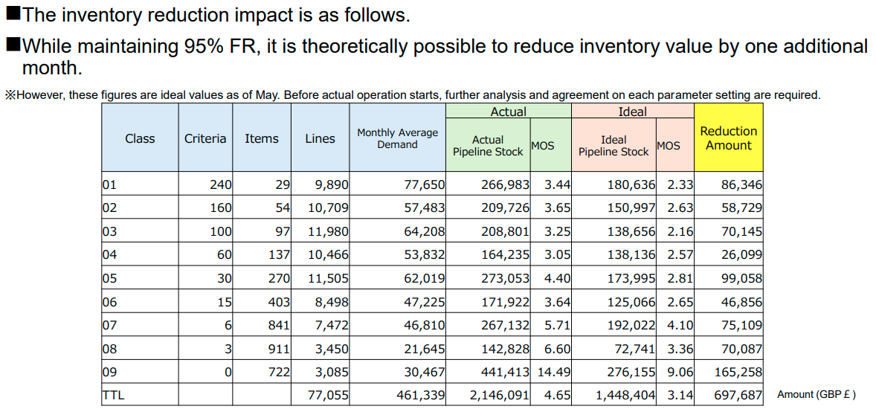
Inventory Reduction Simulation

Slide 16
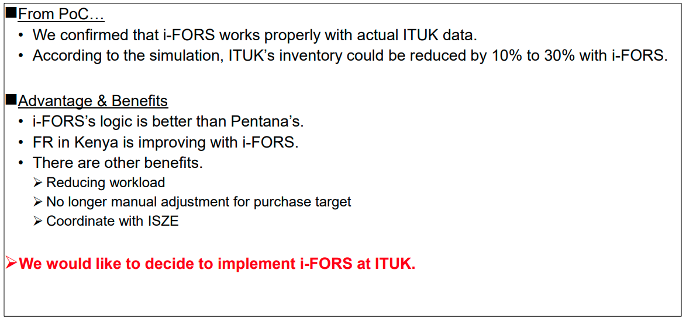
Summary of Meeting – IML Team 26/07/2026

Slide 17
Commercial \ Risk \ Questions
ITUK position:
This does NOT increase purchases from ISZE
Only way to increase purchases is to increase ITUK sales
This is cost optimisation, not revenue growth
Could even reduce short-term purchase volumes
Questions
Safety net
  What happens if system fails or supply delays?
  Escalation / VOR / emergency process?
Commercial model
  What is the ongoing cost (outsourcing fee)?
  ROI saving?
Control & governance
  How much override authority does ITUK retain?
  Who owns final decisions?
Dead stock / returns
  Clear policy before go-live?
  Financial responsibility?
System dependency
  How does this align with Keyloop migration?
Key risks / concerns
Loss of control
Forecasting outsourced to Japan
Dependency on central system
System dependency / integration
Requires:
  Interface (Pentana → Keyloop transition risk)

