Slide 1

ISZE · BELGIUM · IBX
Benelux Sales Review
& FY2027 Target
Isuzu Benelux · August 2026

Slide 2
IBX MEETING
Agenda
— FY2027 YTD (Apr–Jul) Sales Review
— Parts Performance — category movers
— Parts Performance — Brake parts
— Parts Performance — Injectors
— Parts Performance — Fuel system
— Parts Performance — Body parts
— Parts Performance — where volume grew
— GPS Capture
— Service-Parts Coverage
— IDS 2026 — Dealer Standard
— Fleet & FY2027 Target
— SPA — status
— R&M — market discussion
— Data request: part-level Sales-to-Dealer
2

Slide 3
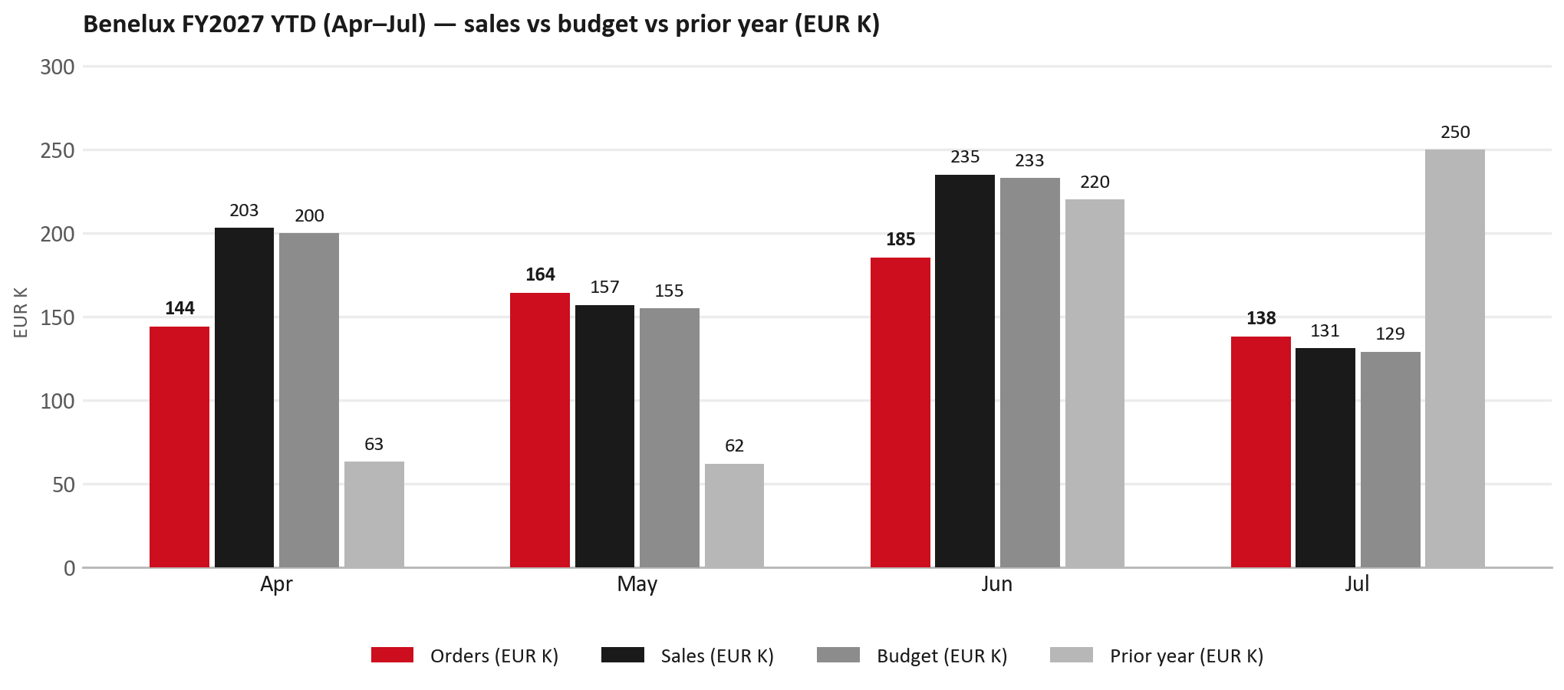
POWER BI — OFFICIAL CUT
FY2027 YTD (Apr–Jul): EUR 726K, +1% vs budget
TAKEAWAYS
— Sales EUR 726K against a EUR 717K budget — +1%, and +22% on last year's EUR 595K.
— Order intake EUR 631K against EUR 726K billed (orders ~87% of shipments).
— By month vs budget: Apr +1%, May +1%, Jun +1%, Jul +2%.
— Jul softened (-48% YoY) — holiday timing / stock build can explain a quiet month after a strong spring.
3

Slide 4
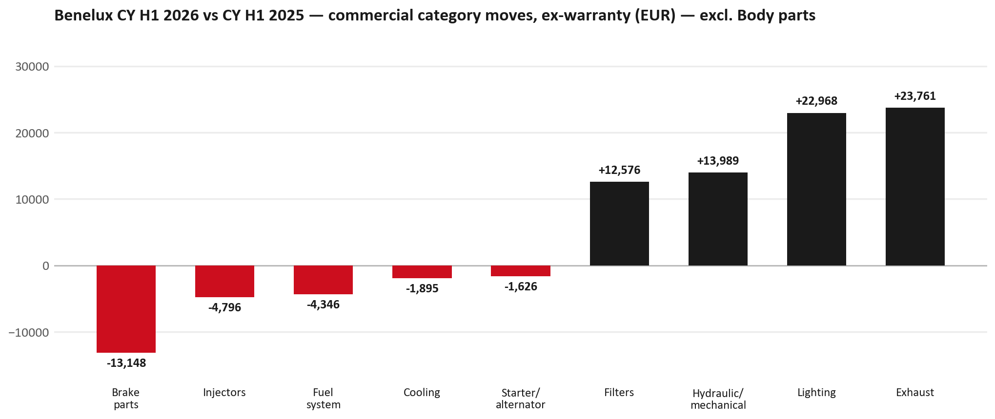
PARTS PERFORMANCE
Parts Performance — CY H1 2026 vs CY H1 2025 (commercial, ex-warranty)
TAKEAWAYS
— Commercial parts billing (warranty/campaign excluded) EUR 1,029K against EUR 828K a year earlier — +24.3% (CY H1 2026 vs CY H1 2025, Jan–Jun).
— Body parts EUR 102K (+36%) is excluded from the chart scale — covered on the Body deep-dive slide.
— Largest PN drops (all categories): 5878316930 (SHOE KIT; BRAKE,RR) EUR -13K, 62 fewer pcs; 8974725274 (RAIL; ROOF) EUR -4K, 34 fewer pcs; 8977988670 (TRANSFER ASM) EUR -4K, 2 fewer pcs.
— Largest PN gains (all categories): 8978461152 (GLASS; WINDSHIELD) EUR 18K, 79 more pcs; 8981776324 (DPD ASM) EUR 8K, 6 more pcs; 8975554500 (FILTER; BLOWER UNIT) [TF*,UC*] EUR 7K, 407 more pcs.
4

Slide 5
PARTS PERFORMANCE — BRAKE PARTS
Brake parts — CY H1 2026 vs CY H1 2025 (commercial, ex-warranty)
— EUR 42,206 (CY H1 2025) to EUR 29,058 (CY H1 2026), down EUR 13,148 (-31%).
— Largest part numbers driving the decline (by EUR):
— 5878316930 (SHOE KIT; BRAKE,RR): EUR 12,755 to EUR 0, 62 fewer pieces.
— 5876102280 (LINING KIT; RR BRAKE · NPR,NQR,NNR): EUR 3,276 to EUR 0, 57 fewer pieces.
— 8981246634 (ROTOR; DISC BRK,FRT): EUR 1,335 to EUR 375, 11 fewer pieces.
— 8982324811 (HYDRAULIC UNIT; ANTI LOCK BRK): EUR 858 to EUR 0, 1 fewer pieces.
Questions for us to work through together
— Is pad and rotor pricing competitive against what the dealers can buy locally?
— Is any of this stock timing on your side rather than end demand?
— Are dealers still quoting these part numbers, or have they dropped off the workshop menu?
5

Slide 6
PARTS PERFORMANCE — INJECTORS
Injectors — CY H1 2026 vs CY H1 2025 (commercial, ex-warranty)
— EUR 10,591 (CY H1 2025) to EUR 5,795 (CY H1 2026), down EUR 4,796 (-45%).
— Largest part numbers driving the decline (by EUR):
— 8984890190 (NOZZLE ASM; INJ): EUR 3,865 to EUR 1,887, 12 fewer pieces.
— 8983320591 (NOZZLE ASM; INJ): EUR 1,321 to EUR 0, 7 fewer pieces.
— 8973865576 (PUMP ASM; INJ): EUR 886 to EUR 0, 1 fewer pieces.
— 8982601090 (NOZZLE ASM; INJ): EUR 2,710 to EUR 1,909, 6 fewer pieces.
Questions for us to work through together
— Is this fewer failures, or repairs moving out of the network?
— Is the exchange/reman route competing with new parts here?
— Are dealers still quoting these part numbers, or have they dropped off the workshop menu?
6

Slide 7
PARTS PERFORMANCE — FUEL SYSTEM
Fuel system — CY H1 2026 vs CY H1 2025 (commercial, ex-warranty)
— EUR 9,894 (CY H1 2025) to EUR 5,548 (CY H1 2026), down EUR 4,346 (-44%).
— Largest part numbers driving the decline (by EUR):
— 8941449334 (SEDIMENTER; FUEL): EUR 2,530 to EUR 0, 51 fewer pieces.
— 8981530463 (TANK; FUEL): EUR 1,645 to EUR 0, 8 fewer pieces.
— 8984890171 (PUMP ASM; FUEL,SUPPLY): EUR 3,409 to EUR 2,032, 2 fewer pieces.
— 8972745350 (TANK; FUEL): EUR 1,212 to EUR 0, 7 fewer pieces.
Questions for us to work through together
— Is this pricing against what the dealers can buy locally?
— Is any of this stock timing on your side rather than end demand?
— What would make the biggest difference to keep this business with us?
7

Slide 8
PARTS PERFORMANCE — BODY PARTS
Body parts — CY H1 2026 vs CY H1 2025 (commercial, ex-warranty)
— EUR 286,109 (CY H1 2025) to EUR 388,275 (CY H1 2026), up EUR 102,166 (+36%).
— Largest part numbers driving the increase (by EUR):
— 8978461152 (GLASS; WINDSHIELD): EUR 697 to EUR 18,240, +79 pcs.
— 8975595830 (PANEL; SIDE GATE): EUR 2,154 to EUR 6,389, +19 pcs.
— 7552172691 (BUMPER ASM; FRT): EUR 753 to EUR 4,765, +26 pcs.
— 8983410105 (BUMPER ASM; FRT): EUR 1,387 to EUR 4,581, +29 pcs.
— Largest Body declines: 8974725274 (RAIL; ROOF) EUR -4K, 34 fewer pcs; 8974725284 (RAIL; ROOF) EUR -4K, 33 fewer pcs.
Questions for us to work through together
— Is this collision / glass volume from a few fleet events, or a sustained workshop pattern?
— Are windshields and bumpers staying with the network, or is bodywork leaking to IAM?
— Which models drive the glass and bumper PNs — and is stock aligned?
8

Slide 9
PARTS PERFORMANCE — GROWTH
Where volume grew — CY H1 2026 vs CY H1 2025 (commercial, ex-warranty)
Part | Description | Model | CY H1 2025 | CY H1 2026 | Δ EUR
8978461152 | GLASS; WINDSHIELD | — | EUR 697 | EUR 18,240 | EUR 17,542
8981776324 | DPD ASM | — | EUR 4,136 | EUR 11,992 | EUR 7,856
8975554500 | FILTER; BLOWER UNIT | TF*,UC* | EUR 9,783 | EUR 16,468 | EUR 6,684
7552348280 | STEERING UNIT | — | EUR 2,123 | EUR 8,352 | EUR 6,229
8983320764 | DPD ASM | — | EUR 2,283 | EUR 6,849 | EUR 4,566
8975359391 | DPD ASM | — | EUR 4,694 | EUR 9,218 | EUR 4,524
— Body parts +36%, Exhaust +70%, Lighting +29% — where the commercial volume went.
— Claim-matched PNs (187 distinct) and campaign/recall text matches are already excluded from this growth list. Residual warranty on unmapped PNs can remain.
— PNs ranked by largest EUR increase (prior-period sales > 0). Worth agreeing which of these are repeatable and which were one-off.
9

Slide 10
GPS
GPS Capture: 76.1%
— GPS measures your actual parts purchases against the full potential of your fleet.
— Benelux today: 76.1% (FY2026 purchases against the CY2025 fleet potential).
— Fleet potential: EUR 2,745K on 10,760 vehicles.
— Denominator widened vs Belgium-only file: Poland UIO10 (Łukasz / SAMAR 2025): +1,167 UIO (base was 9,593 / EUR 2,454K). NL/LUX still 0 in carpark.
— Q1 FY2027 IBX order mix ~39% SOR / ~39% VOR by € — VOR urgency pricing lifts billed amount.
10

Slide 11
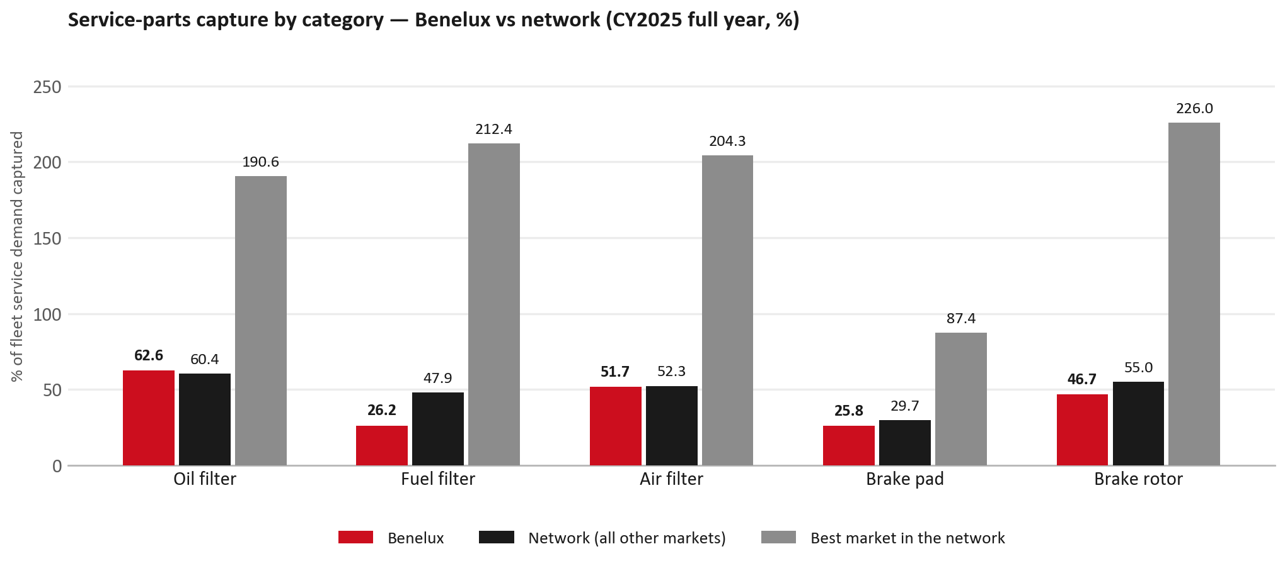
SERVICE-PARTS COVERAGE
Service-parts coverage: fuel filter is the clear gap
TAKEAWAYS
— Fuel filter 26.2% against 47.9% for the rest of the network.
— Brake rotor 46.7% against 55.0% for the rest of the network.
— Every market here is measured on the same fleet-and-interval model, so the comparison is like-for-like even where the underlying interval assumption is debatable.
— Worth agreeing which category we tackle first, and what the joint action is.
11

Slide 12
IDS 2026 — DEALER STANDARD
IDS 2026: Benelux averages 78.6%, above the 74.8% network benchmark
Dealer | Total % | Global rank
Pashuysen | 95.7% | #23
Sud Motor Huy | 92.9% | #47
Sud Motor Marche | 92.9% | #48
Benelux country average | 78.6% | —
Network average (all IDS 2026) | 74.8% | —
Delfosse | 60.7% | #460
Degroote | 57.1% | #466
Fayt | 55.4% | #472
— 34 dealers assessed across Premises, Organisation, Service, Parts and Vehicle Sales.
— The country average sits 3.8 points above the network.
— The spread is the point: 40 points between the strongest and weakest dealer.
— Dealer-by-dealer detail and individual feedback are available as a separate pack — worth agreeing which dealers to visit, and when.
12

Slide 13
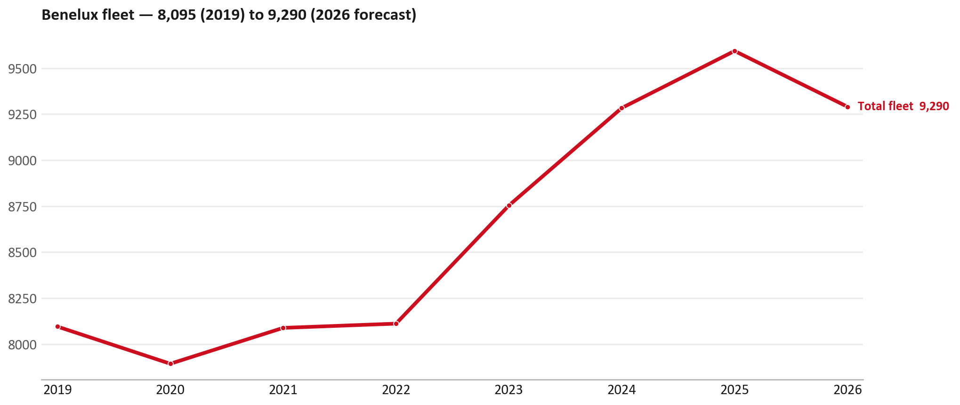
FLEET & FY2027 TARGET
The fleet is expected to decline in 2026
WHAT THIS MEANS FOR FY2027
— Fleet size (calendar year): 9,593 vehicles in 2025 → 9,290 working estimate for end-2026 (-3.2%).
— The chart is calendar years 2019–2026 only. 2026 is a working year-end estimate, not a fiscal-year figure.
— End-2026 mix: LCV / D-Max 9,154; CV — LD 136.
— The FY2027 extended target (ISZE→DB) applies a 5% price adjustment and 1.8% stretch — locked at EUR 2,340,134 from GPS Extended Target V3.1 (Dashboard column I).
— So the target is built from a slightly smaller fleet — not from an assumed growth story.
13

Slide 14
FLEET & FY2027 TARGET
How the FY2027 extended target is built
ISZE → DB extended target (V3.1 Dashboard column I)
Step | Amount
Business Plan / actual FY27 base | EUR 2,296,577
Market potential (max spend FY27) | EUR 2,419,787
Stretch (+1.8% of max spend) | EUR 43,556
FY2027 EXTENDED TARGET (locked) | EUR 2,340,134
— Extended target = BP + stretch; stretch default is 1.8% (network rule from GPS Extended Target V3.1).
— Figure locked from V3.1 Dashboard col I BELGIUM: EUR 2,340,134.
14

Slide 15
FY2027 TARGET
What the FY2027 target reflects
1
Your fleet
2
The price move
— The working fleet movement used in the target is -3.2%.
— ISZE is applying a 5% price adjustment for FY2027, consistent with every ISZE market this year.
— It is built into the per-vehicle rate above, not added separately on top.
What it means for your target
 | Value
FY2027 extended target (V3.1 col I) | EUR 2,340,134
vs BP FY27 (EUR 2,296,577) | +1.9%
Stretch included | +1.8%
— As in previous cycles we would expect an incentive to sit alongside this adjustment — that approval is still pending on our side.
— Until the incentive is confirmed, treat the FY2027 target as the working bridge (fleet × price × additional growth), not a locked commercial commitment.
15

Slide 16
SPA
SPA
1
IBX proposal
2
ISZE review
3
Counter-proposal
4
Final approval
— Isuzu Benelux submits a proposed parts list.
— ISZE reviews the proposal against network data and fit.
— ISZE returns a counter-proposal where needed.
— Signed off by ISZE management.
Purpose: higher turnover for both sides.
16

Slide 17
R&M
R&M — let's align on the market
M
Market
S
Servicing & R&M
— How is the market moving for you right now?
— How much of your volume is fleet business rather than retail?
— Where do you see the biggest hurdles this year?
— Where are your real strengths in this segment?
— Do you offer an R&M or service-plan product today?
— What share of the parc do you retain for servicing after year three?
— Does R&M business come bundled with fleet tenders — roughly what share?
— What would it take to bring more out-of-network servicing back?
17

Slide 18
ASK
Part-level Sales-to-Dealer Data
1
Already halfway there
2
Sharper insight
3
Shared benefit
— You already report Sales-to-Dealer monthly. The ask is the same data at part-number level.
— Part-by-part visibility separates a stock movement from a lost job — and tells us where the volume actually went.
— Better availability on your fast movers, a sharper target for us, and a factual basis for the SPA — same data, both sides gain.
Requested from 01/01/2025, part number level, monthly.
18

Slide 19
Moving the World – for You

