Slide 1

ISZE · GERMANY · ISD
Germany Sales Review
& FY2027 Target
Isuzu Sales Deutschland · August 2026

Slide 2
ISD MEETING
Agenda
— Parts Performance — category movers
— Parts Performance — Brake parts
— Parts Performance — Exhaust
— Parts Performance — Injectors
— Parts Performance — where volume grew
— New Business — validation queue
— Sales-to-Dealer Outlook
— GPS Capture
— Service-Parts Coverage
— Fleet & FY2027 Target
— SPA — status
— R&M — market discussion
— Data request: part-level Sales-to-Dealer
— Next steps
2

Slide 3
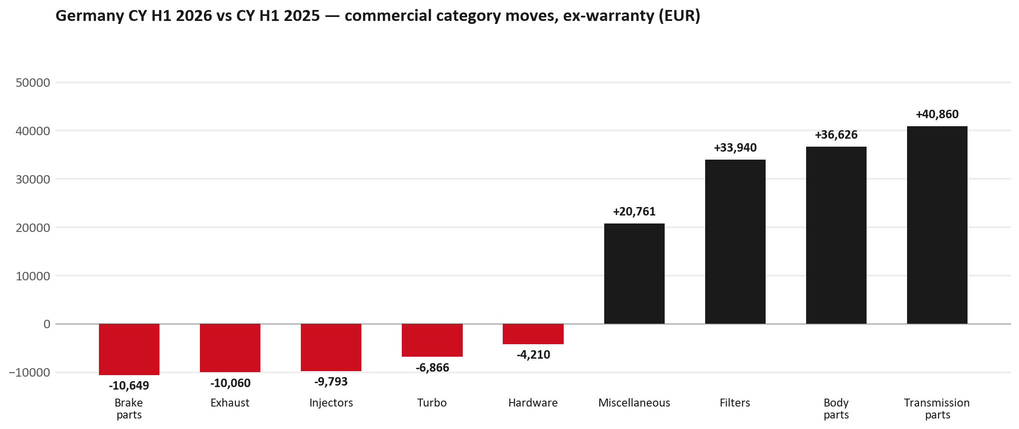
PARTS PERFORMANCE
Parts Performance — CY H1 2026 vs CY H1 2025 (commercial, ex-warranty)
TAKEAWAYS
— Commercial parts billing (warranty/campaign excluded) EUR 908K against EUR 728K a year earlier — +24.7% (CY H1 2026 vs CY H1 2025, Jan–Jun).
— Largest PN drops: 8981776324 (DPD ASM) EUR -10K, 10 fewer pcs; 8981402660 (FILTER; ACL) [TFR,TFS,UCR,UCS] EUR -8K, 500 fewer pcs; 8983320591 (NOZZLE ASM; INJ) EUR -8K, 54 fewer pcs.
— Largest PN gains: 8981596930 (ELEMENT KIT; FUEL FI) [N*R,NPS,QKR,TF*,UC*] EUR 15K, 1,100 more pcs; 8978461152 (GLASS; WINDSHIELD) EUR 14K, 61 more pcs; 8984890171 (PUMP ASM; FUEL,SUPPL) EUR 10K, 13 more pcs.
— Credit notes of EUR 30K stay on the net bridge (net EUR 1,280K); not in the movers.
3

Slide 4
PARTS PERFORMANCE — BRAKE PARTS
Brake parts — CY H1 2026 vs CY H1 2025 (commercial, ex-warranty)
— EUR 56,031 (CY H1 2025) to EUR 45,382 (CY H1 2026), down EUR 10,649 (-19%).
— Largest part numbers driving the decline (by EUR):
— 8984893170 (CALIPER; FRT DISC BRK): EUR 3,891 to EUR 0, 42 fewer pieces.
— 8975546600 (PAD KIT; CALIPER,DISC BRK,FRT · TF*): EUR 3,881 to EUR 0, 60 fewer pieces.
— 8984893180 (CALIPER; FRT DISC BRK): EUR 2,844 to EUR 0, 32 fewer pieces.
— 8980499580 (SUPPORT; FRT DISC BRK): EUR 2,018 to EUR 0, 30 fewer pieces.
Questions for us to work through together
— Is pad and rotor pricing competitive against what the dealers can buy locally?
— Is any of this stock timing on your side rather than end demand?
— Are dealers still quoting these part numbers, or have they dropped off the workshop menu?
4

Slide 5
PARTS PERFORMANCE — EXHAUST
Exhaust — CY H1 2026 vs CY H1 2025 (commercial, ex-warranty)
— EUR 72,758 (CY H1 2025) to EUR 62,699 (CY H1 2026), down EUR 10,060 (-14%).
— Largest part numbers driving the decline (by EUR):
— 8981776324 (DPD ASM): EUR 9,554 to EUR 0, 10 fewer pieces.
— 8981405904 (SILENCER ASM; EXH): EUR 6,439 to EUR 0, 45 fewer pieces.
— 8975360781 (VALVE; EGR): EUR 1,748 to EUR 0, 8 fewer pieces.
— 8975340171 (COOLER; EGR): EUR 1,598 to EUR 0, 6 fewer pieces.
Questions for us to work through together
— Is this pricing against what the dealers can buy locally?
— Is any of this stock timing on your side rather than end demand?
— What would make the biggest difference to keep this business with us?
5

Slide 6
PARTS PERFORMANCE — INJECTORS
Injectors — CY H1 2026 vs CY H1 2025 (commercial, ex-warranty)
— EUR 18,124 (CY H1 2025) to EUR 8,331 (CY H1 2026), down EUR 9,793 (-54%).
— Largest part numbers driving the decline (by EUR):
— 8983320591 (NOZZLE ASM; INJ): EUR 7,594 to EUR 0, 54 fewer pieces.
— 8982601090 (NOZZLE ASM; INJ): EUR 5,092 to EUR 0, 30 fewer pieces.
— 8982383181 (NOZZLE ASM; INJ): EUR 1,064 to EUR 0, 5 fewer pieces.
— 8976798670 (GASKET; INJ NOZZLE): EUR 155 to EUR 0, 76 fewer pieces.
Questions for us to work through together
— Is this fewer failures, or repairs moving out of the network?
— Is the exchange/reman route competing with new parts here?
— Are dealers still quoting these part numbers, or have they dropped off the workshop menu?
6

Slide 7
PARTS PERFORMANCE — GROWTH
Where volume grew — CY H1 2026 vs CY H1 2025 (commercial, ex-warranty)
Part | Description | Model | CY H1 2025 | CY H1 2026 | Δ EUR
8981596930 | ELEMENT KIT; FUEL FILTER | N*R,NPS,QKR,TF*, | EUR 14,872 | EUR 30,140 | EUR 15,268
8978461152 | GLASS; WINDSHIELD | — | EUR 535 | EUR 14,313 | EUR 13,779
8984890171 | PUMP ASM; FUEL,SUPPLY | — | EUR 2,463 | EUR 12,187 | EUR 9,724
8983860446 | GATE ASM; RR | — | EUR 5,415 | EUR 9,790 | EUR 4,375
8984890190 | NOZZLE ASM; INJ | — | EUR 2,794 | EUR 6,850 | EUR 4,056
8983929813 | BRACKET; AXLE CASE | — | EUR 364 | EUR 3,722 | EUR 3,358
— Transmission parts +79%, Body parts +20%, Filters +141% — where the commercial volume went.
— Claim-matched PNs (209 distinct) and campaign/recall text matches are already excluded from this growth list. Residual warranty on unmapped PNs can remain.
— PNs ranked by largest EUR increase (prior-period sales > 0). Worth agreeing which of these are repeatable and which were one-off.
7

Slide 8
PARTS PERFORMANCE
New Business — validation queue (CY H1 2026)
Part | Description | Current sales | Review
7553149600 | DRIVE ASM; FINAL,FRT | EUR 28,349 | Validate
8982705240 | ELEMENT; OIL FILTER | EUR 15,645 | Validate
8974995480 | FILTER; ACL | EUR 10,735 | Validate
8981472452 | SHAFT ASM; FRT DRIVE | EUR 9,929 | Validate
8975554500 | FILTER; BLOWER UNIT | EUR 9,798 | Validate
8974807976 | RADIO CONTROL ASM; STEREO,AM-F | EUR 8,888 | Warranty / campaign
— These lines had no prior-period sales, so they are kept out of the incremental-growth table.
— A first sale can be a new model, a supersession, timing, or a warranty campaign. It is not treated as a commercial win until that cause is confirmed.
8

Slide 9
SALES-TO-DEALER
Sales-to-Dealer outlook — FY2027
— FY2026 Sales-to-Dealer is EUR 4,072,917 (working estimate).
— The working fleet movement into FY2027 is -2.1%.
— Applying fleet movement, the 5% price adjustment and 1.8% additional growth gives a FY2027 Sales-to-Dealer target of EUR 4,261,921.
— The discussion is held in Sales-to-Dealer amounts; ISZE billing remains an internal reconciliation measure.
9

Slide 10
GPS
GPS Capture: 65.9%
— GPS measures your actual parts purchases against the full potential of your fleet.
— Germany today: 65.9% (FY2026 purchases against the CY2025 fleet potential).
— Fleet potential: EUR 3,808K on 13,780 vehicles.
— Real, sustained headroom above 65.9% — the service-parts and SPA discussion are both direct levers on it.
10

Slide 11
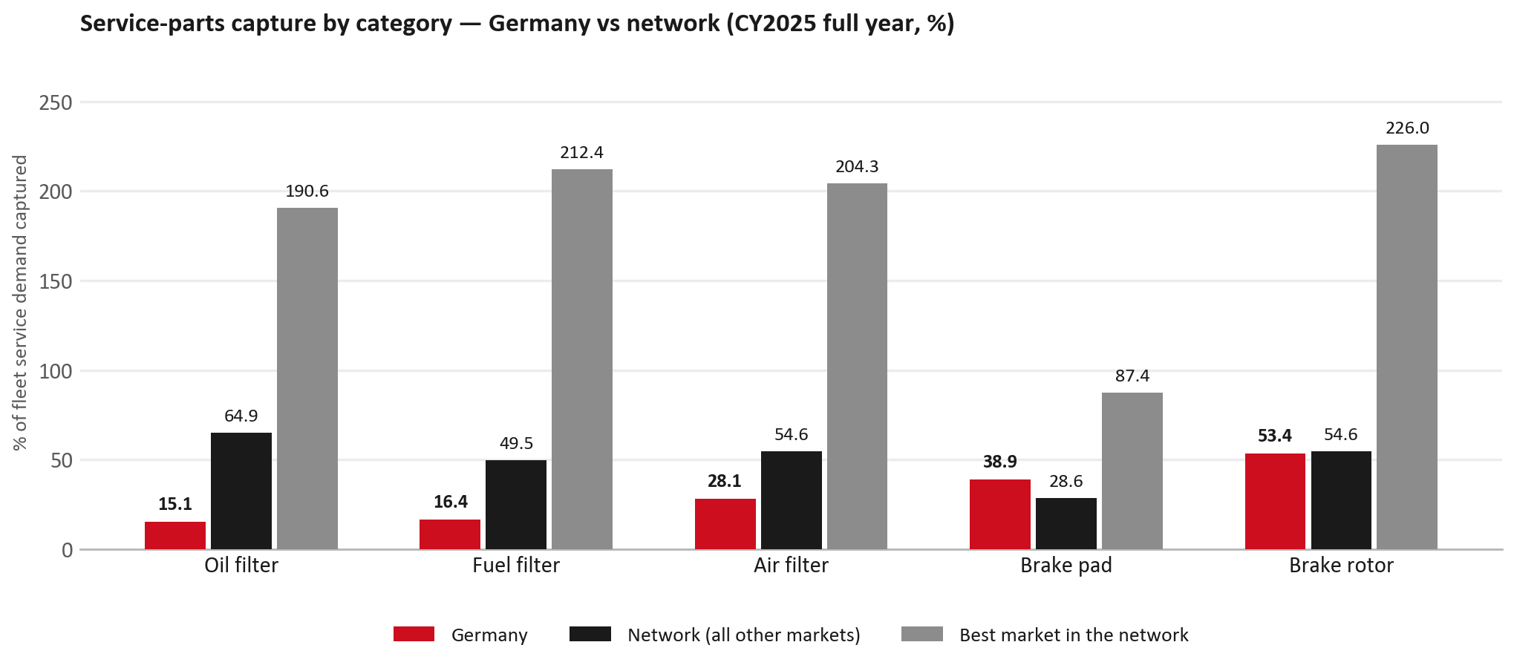
SERVICE-PARTS COVERAGE
Service-parts coverage: oil filter is the clear gap
TAKEAWAYS
— Oil filter 15.1% against 64.9% for the rest of the network.
— Fuel filter 16.4% against 49.5% for the rest of the network.
— Every market here is measured on the same fleet-and-interval model, so the comparison is like-for-like even where the underlying interval assumption is debatable.
— Worth agreeing which category we tackle first, and what the joint action is.
11

Slide 12
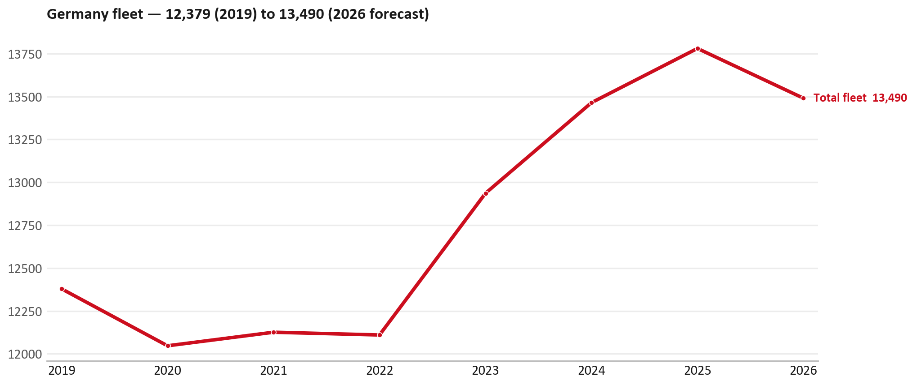
FLEET & FY2027 TARGET
The fleet is expected to decline in 2026
WHAT THIS MEANS FOR FY2027
— Fleet size (calendar year): 13,780 vehicles in 2025 → 13,490 working estimate for end-2026 (-2.1%).
— The chart is calendar years 2019–2026 only. 2026 is a working year-end estimate, not a fiscal-year figure.
— End-2026 mix: LCV / D-Max 12,443; CV — LD 1,016; CV — MD 31.
— The FY2027 Sales-to-Dealer target starts from that fleet change, then applies a 5% price adjustment and 1.8% additional growth.
— So the target is built from a slightly smaller fleet — not from an assumed growth story.
12

Slide 13
FLEET & FY2027 TARGET
How the FY2027 target is built
Sales-to-Dealer amount bridge
Step | Amount
FY2026 Sales-to-Dealer (working estimate) | EUR 4,072,917
After fleet movement (-2.1%) | EUR 3,987,203
After price adjustment (+5%) | EUR 4,186,563
FY2027 target after additional growth (+1.8%) | EUR 4,261,921
— The FY2027 target is +4.6% versus the FY2026 Sales-to-Dealer base.
— The FY2026 base is a working estimate (ISZE billing ÷ 0.65): the KPI Dashboard has no usable Sales-to-Dealer row for this market.
13

Slide 14
FY2027 TARGET
What the FY2027 target reflects
1
Your fleet
2
The price move
— The working fleet movement used in the target is -2.1%.
— ISZE is applying a 5% price adjustment for FY2027, consistent with every ISZE market this year.
— It is built into the per-vehicle rate above, not added separately on top.
What it means for your target
 | Value
FY2027 Sales-to-Dealer target | EUR 4,261,921
vs FY2026 Sales-to-Dealer (EUR 4,072,917) | +4.6%
— As in previous cycles we would expect an incentive to sit alongside this adjustment — that approval is still pending on our side.
— Until the incentive is confirmed, treat the FY2027 target as the working bridge (fleet × price × additional growth), not a locked commercial commitment.
14

Slide 15
SPA
SPA
1
ISD proposal
2
ISZE review
3
Counter-proposal
4
Final approval
— Isuzu Sales Deutschland submits a proposed parts list.
— ISZE reviews the proposal against network data and fit.
— ISZE returns a counter-proposal where needed.
— Signed off by ISZE management.
Purpose: higher turnover for both sides.
15

Slide 16
R&M
R&M — let's align on the market
M
Market
S
Servicing & R&M
— How is the market moving for you right now?
— How much of your volume is fleet business rather than retail?
— Where do you see the biggest hurdles this year?
— Where are your real strengths in this segment?
— Do you offer an R&M or service-plan product today?
— What share of the parc do you retain for servicing after year three?
— Does R&M business come bundled with fleet tenders — roughly what share?
— What would it take to bring more out-of-network servicing back?
16

Slide 17
ASK
Part-level Sales-to-Dealer Data
1
The starting point
2
Sharper insight
3
Shared benefit
— We have no Sales-to-Dealer figures from you for FY2026. The ask is monthly Sales-to-Dealer, at part-number level.
— Part-by-part visibility separates a stock movement from a lost job — and tells us where the volume actually went.
— Better availability on your fast movers, a sharper target for us, and a factual basis for the SPA — same data, both sides gain.
Requested from 01/01/2025, part number level, monthly.
17

Slide 18
SUMMARY
Next steps
— Confirm FY2027 Sales-to-Dealer target: EUR 4,261,921 (+4.6% vs FY2026 Sales-to-Dealer).
— Confirm the incentive alongside the price adjustment once approved on our side.
— Brake parts / Exhaust / Injectors: agree which category we tackle first, and what the joint action is.
— Agree part-level Sales-to-Dealer data sharing, effective 01/01/2025.
— SPA: ISD proposal, ISZE review and counter-proposal cycle to follow.
18

Slide 19
Moving the World – for You

