Slide 1

ISZE · GREECE · PETROS
Greece Sales Review
& FY2027 Target
Petros Petropoulos · August 2026

Slide 2
PETROS MEETING
Agenda
— FY2027 YTD (Apr–Jul) Sales Review
— Parts Performance — category movers
— Parts Performance — Brake parts
— Parts Performance — Engine parts
— Parts Performance — Body parts
— Parts Performance — where volume grew
— New Business — validation queue
— Service-Parts Coverage
— IDS 2026 — Dealer Standard
— Fleet & FY2027 Target
— SPA — status
— R&M — market discussion
— Data request: part-level Sales-to-Dealer
— Next steps
2

Slide 3
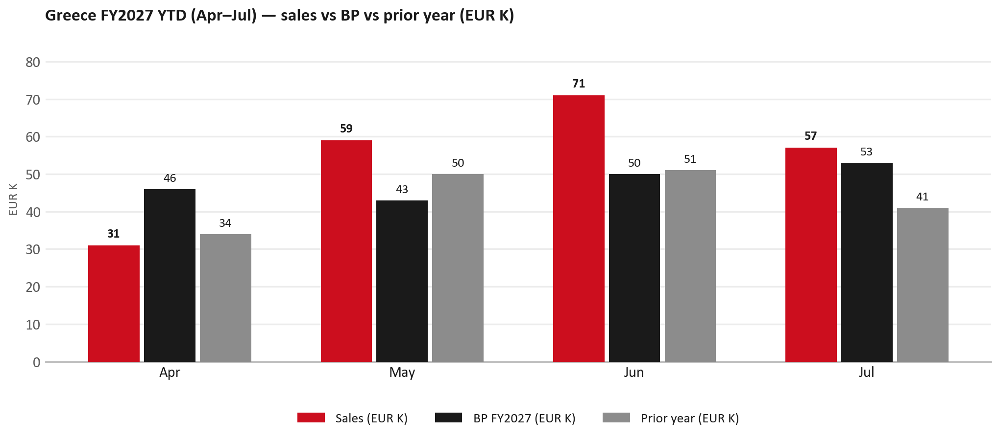
POWER BI — OFFICIAL CUT
FY2027 YTD (Apr–Jul): EUR 218K, +13% vs BP
TAKEAWAYS
— Sales EUR 218K against BP EUR 192K — +13%, and +24% on last year's EUR 176K.
— By month vs BP: Apr -32%, May +36%, Jun +41%, Jul +8%.
— Worth walking through the shape of the period together.
3

Slide 4
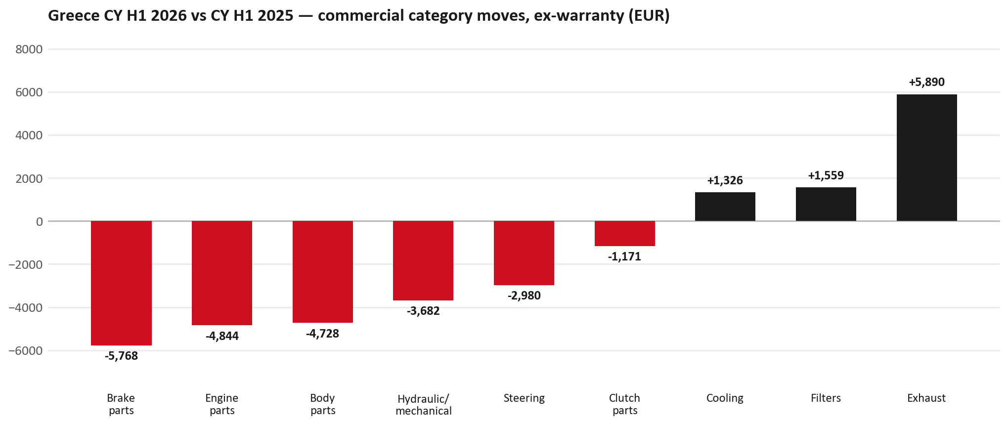
PARTS PERFORMANCE
Parts Performance — CY H1 2026 vs CY H1 2025 (commercial, ex-warranty)
TAKEAWAYS
— Commercial parts billing (warranty/campaign excluded) EUR 183K against EUR 213K a year earlier — -14.0% (CY H1 2026 vs CY H1 2025, Jan–Jun).
— Largest PN drops (all categories): 8976607440 (TRANSMISSION ASM; MA) EUR -4K, 1 fewer pcs; 8980139111 (VALVE; EGR) EUR -4K, 36 fewer pcs; 8972660360 (TRANSFER ASM) EUR -2K, 1 fewer pcs.
— Largest PN gains (all categories): 8982705240 (ELEMENT; OIL FILTER) [NHR,NLR,NMR,TF*,UC*] EUR 2K, 96 more pcs; 8975554500 (FILTER; BLOWER UNIT) [TF*,UC*] EUR 2K, 126 more pcs; 7552622990 (PANEL; ENG HOOD) EUR 2K, 8 more pcs.
— Within Exhaust (EUR 6K, +62%): 8983682091 (PIPE; EXH) EUR 8K, 6 more pcs; 8980845954 (DPD ASM) EUR 2K, 1 more pcs; 8981521221 (COOLER; EGR) EUR 1K, 3 more pcs.
4

Slide 5
PARTS PERFORMANCE — BRAKE PARTS
Brake parts — CY H1 2026 vs CY H1 2025 (commercial, ex-warranty)
— EUR 12,155 (CY H1 2025) to EUR 6,387 (CY H1 2026), down EUR 5,768 (-47%).
— Largest part numbers driving the decline (by EUR):
— 5876150610 (PAD KIT; CALIPER,DISC BRK,FRT · TF*): EUR 2,026 to EUR 0, 45 fewer pieces.
— 8980180360 (SHOE KIT; BRK,RR): EUR 1,245 to EUR 222, 23 fewer pieces.
— 5876150600 (PAD KIT; CALIPER,DISC BRK,FRT · TF*): EUR 849 to EUR 0, 16 fewer pieces.
— 8975546610 (PAD KIT; CALIPER,DISC BRK,FRT · TF*): EUR 755 to EUR 0, 9 fewer pieces.
Questions for us to work through together
— Is pad and rotor pricing competitive against what the dealers can buy locally?
— Is any of this stock timing on your side rather than end demand?
— Are dealers still quoting these part numbers, or have they dropped off the workshop menu?
5

Slide 6
PARTS PERFORMANCE — ENGINE PARTS
Engine parts — CY H1 2026 vs CY H1 2025 (commercial, ex-warranty)
— EUR 6,374 (CY H1 2025) to EUR 1,530 (CY H1 2026), down EUR 4,844 (-76%).
— Largest part numbers driving the decline (by EUR):
— 8981706190 (HEAD ASM; CYL): EUR 1,176 to EUR 0, 1 fewer pieces.
— 8978775550 (CAMERA ASM): EUR 1,088 to EUR 0, 1 fewer pieces.
— 8983360671 (VALVE; EVRV): EUR 885 to EUR 190, 9 fewer pieces.
— 8981162600 (VALVE; EVRV): EUR 893 to EUR 453, 10 fewer pieces.
Questions for us to work through together
— Is this pricing against what the dealers can buy locally?
— Is any of this stock timing on your side rather than end demand?
— What would make the biggest difference to keep this business with us?
6

Slide 7
PARTS PERFORMANCE — BODY PARTS
Body parts — CY H1 2026 vs CY H1 2025 (commercial, ex-warranty)
— EUR 42,243 (CY H1 2025) to EUR 37,515 (CY H1 2026), down EUR 4,728 (-11%).
— Largest part numbers driving the decline (by EUR):
— 8975509392 (BUMPER ASM; FRT): EUR 2,569 to EUR 1,384, 8 fewer pieces.
— 8981532774 (BUMPER; RR): EUR 1,176 to EUR 0, 5 fewer pieces.
— 8978461152 (GLASS; WINDSHIELD): EUR 882 to EUR 0, 4 fewer pieces.
— 8979089293 (BACK ASM; SEAT): EUR 764 to EUR 0, 1 fewer pieces.
Questions for us to work through together
— Is this pricing against what the dealers can buy locally?
— Is any of this stock timing on your side rather than end demand?
— What would make the biggest difference to keep this business with us?
7

Slide 8
PARTS PERFORMANCE — GROWTH
Where volume grew — CY H1 2026 vs CY H1 2025 (commercial, ex-warranty)
Part | Description | Model | CY H1 2025 | CY H1 2026 | Δ EUR
8982705240 | ELEMENT; OIL FILTER | NHR,NLR,NMR,TF*, | EUR 5,411 | EUR 7,756 | EUR 2,345
8975554500 | FILTER; BLOWER UNIT | TF*,UC* | EUR 4,355 | EUR 6,541 | EUR 2,186
7552622990 | PANEL; ENG HOOD | — | EUR 186 | EUR 1,830 | EUR 1,644
8975534311 | RADIATOR ASM | — | EUR 326 | EUR 1,658 | EUR 1,332
7552070251 | GRILLE; INNER,RAD | — | EUR 73 | EUR 1,312 | EUR 1,239
8978249035 | LAMP ASM; HEAD | — | EUR 351 | EUR 1,352 | EUR 1,001
— Exhaust +62%, Filters +8%, Cooling +31% — where the commercial volume went.
— Claim-matched PNs (71 distinct) and campaign/recall text matches are already excluded from this growth list. Residual warranty on unmapped PNs can remain.
— PNs ranked by largest EUR increase (prior-period sales > 0). Worth agreeing which of these are repeatable and which were one-off.
8

Slide 9
PARTS PERFORMANCE
New Business — validation queue (CY H1 2026)
Part | Description | Current sales | Review
8975359391 | DPD ASM | EUR 13,788 | Warranty / campaign
8983682091 | PIPE; EXH | EUR 8,087 | Validate
8978406900 | FRAME ASM | EUR 3,419 | Validate
5876150022 | FILTER; ACL | EUR 3,038 | Validate
7552172691 | BUMPER ASM; FRT | EUR 2,544 | Validate
8974985741 | TURBOCHARGER ASM | EUR 1,750 | Warranty / campaign
— These lines had no prior-period sales, so they are kept out of the incremental-growth table.
— A first sale can be a new model, a supersession, timing, or a warranty campaign. It is not treated as a commercial win until that cause is confirmed.
9

Slide 10
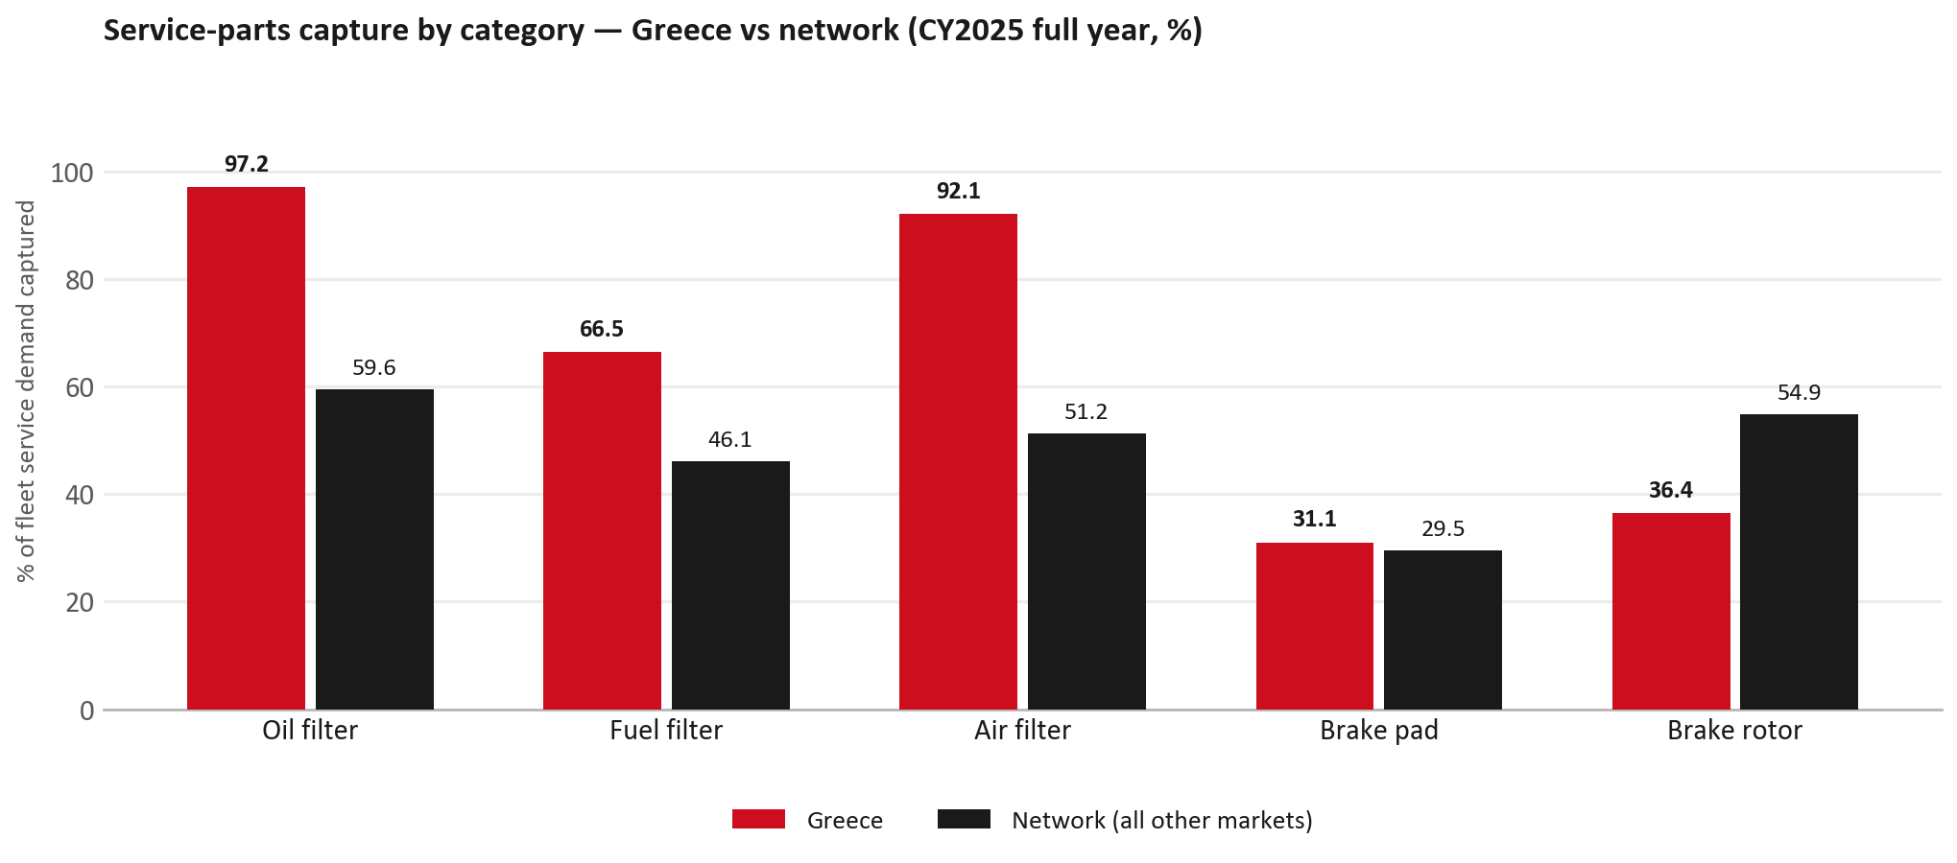
SERVICE-PARTS COVERAGE
Service-parts coverage: brake rotor is the clear gap
TAKEAWAYS
— Brake rotor 36.4% against 54.9% for the rest of the network.
— Brake pad 31.1% against 29.5% for the rest of the network.
— Every market here is measured on the same fleet-and-interval model, so the comparison is like-for-like even where the underlying interval assumption is debatable.
— Worth agreeing which category we tackle first, and what the joint action is.
10

Slide 11
IDS 2026 — DEALER STANDARD
IDS 2026: Greece averages 73.9%, below the 79.4% network benchmark
Dealer | Total % | Global rank
Sofia France Auto | 91.8% | #69
Nik. J. Theocarakis Sa | 86.1% | #167
Mpenteniti Pinelopi & Co. G.P | 85.0% | #184
Greece country average | 73.9% | —
Network average (all IDS 2026) | 79.4% | —
Basdelis G. A. Ike | 62.1% | #454
Theodorou Ike | 61.8% | #455
Chaniotis A. Ae | 57.1% | #467
— 34 dealers assessed across Premises, Organisation, Service, Parts and Vehicle Sales.
— The country average sits 5.5 points below the network — both averages are taken on assessed dealers only.
— The spread is the point: 35 points between the strongest and weakest assessed dealer.
— Dealer-by-dealer detail and individual feedback are available as a separate pack — worth agreeing which dealers to visit, and when.
11

Slide 12
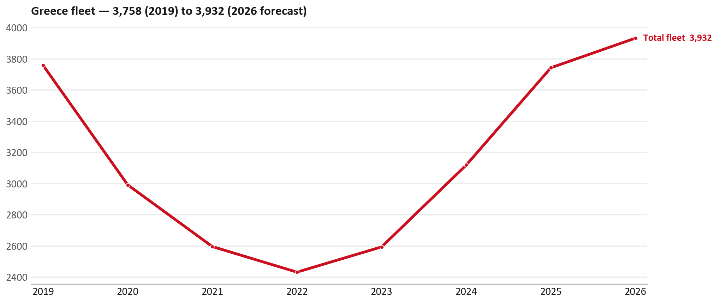
FLEET & FY2027 TARGET
The fleet is expected to grow in 2026
WHAT THIS MEANS FOR FY2027
— Fleet size (calendar year): 3,742 vehicles in 2025 → 3,932 working estimate for end-2026 (+5.1%).
— The chart is calendar years 2019–2026 only. 2026 is a working year-end estimate, not a fiscal-year figure.
— End-2026 mix: LCV / D-Max 3,879; CV — LD 53.
— The FY2027 extended target (ISZE→DB) applies a 5% price adjustment and 1.8% stretch — locked at EUR 592,795 from GPS Extended Target V3.1 (Dashboard column I).
— The target reflects the working fleet outlook without extending the chart beyond 2026.
12

Slide 13
FLEET & FY2027 TARGET
How the FY2027 extended target is built
ISZE → DB extended target (V3.1 Dashboard column I)
Step | Amount
Business Plan / actual FY27 base | EUR 574,400
Market potential (max spend FY27) | EUR 1,021,924
Stretch (+1.8% of max spend) | EUR 18,395
FY2027 EXTENDED TARGET (locked) | EUR 592,795
— Extended target = BP + stretch; stretch default is 1.8% (network rule from GPS Extended Target V3.1).
— Figure locked from GPS Extended Target FY27 V3.1, Dashboard column I (GREECE): EUR 592,795.
13

Slide 14
FY2027 TARGET
What the FY2027 target reflects
1
The FY2027 business plan
2
The price move
— The target starts from the FY2027 Business Plan for this market, EUR 574,400.
— Your fleet outlook (+5.1%) sets the market potential the stretch is measured against.
— ISZE is applying a 5% price adjustment for FY2027, consistent with every ISZE market this year.
— It is built into the per-vehicle rate above, not added separately on top.
What it means for your target
 | Value
FY2027 extended target (V3.1 col I) | EUR 592,795
vs BP FY27 (EUR 574,400) | +3.2%
Stretch included | +1.8%
— As in previous cycles we would expect an incentive to sit alongside this adjustment — that approval is still pending on our side.
— Until the incentive is confirmed, treat the FY2027 extended target as the working figure (BP + stretch), not a locked commercial commitment.
14

Slide 15
SPA
SPA
1
PETROS proposal
2
ISZE review
3
Counter-proposal
4
Final approval
— Petros Petropoulos submits a proposed parts list.
— ISZE reviews the proposal against network data and fit.
— ISZE returns a counter-proposal where needed.
— Signed off by ISZE management.
Purpose: higher turnover for both sides.
15

Slide 16
R&M
R&M — let's align on the market
M
Market
S
Servicing & R&M
— How is the market moving for you right now?
— How much of your volume is fleet business rather than retail?
— Where do you see the biggest hurdles this year?
— Where are your real strengths in this segment?
— Do you offer an R&M or service-plan product today?
— What share of the parc do you retain for servicing after year three?
— Does R&M business come bundled with fleet tenders — roughly what share?
— What would it take to bring more out-of-network servicing back?
16

Slide 17
ASK
Part-level Sales-to-Dealer Data
1
The starting point
2
Sharper insight
3
Shared benefit
— We have no Sales-to-Dealer figures from you for FY2026. The ask is monthly Sales-to-Dealer, at part-number level.
— Part-by-part visibility separates a stock movement from a lost job — and tells us where the volume actually went.
— Better availability on your fast movers, a sharper target for us, and a factual basis for the SPA — same data, both sides gain.
Requested from 01/01/2025, part number level, monthly.
17

Slide 18
SUMMARY
Next steps
— Confirm FY2027 extended target: EUR 592,795 (V3.1 Dashboard column I, +1.8% stretch).
— Confirm the incentive alongside the price adjustment once approved on our side.
— Brake parts / Engine parts / Body parts: agree which category we tackle first, and what the joint action is.
— Agree part-level Sales-to-Dealer data sharing, effective 01/01/2025.
— SPA: PETROS proposal, ISZE review and counter-proposal cycle to follow.
— IDS 2026: agree dealer visit dates, starting with the lower-scoring dealers.
18

Slide 19
Moving the World – for You

Slide 20
GREECE · PETROS PETROPOULOS
Deep dive — detail behind the Mode A story
— Extra detail for meeting prep — pick which slides to share with Petros Petropoulos.
— Mode A ends on the previous closing slide.
— Label in all charts: “Genuine with BVP alternative” (not “genuine contested”).
20

Slide 21
AGENDA
Deep-dive agenda
— GPS — fiscal year (headline vs excl. warranty; max two lines)
— FY2025 → FY2026 wallet mix (Genuine / Genuine with BVP alternative / BVP)
— Where the money went — outside the service-parts basket (FY)
— Service parts: CY capture vs network + FY billing (capture % is CY-only by design)
— Brake pads — BVP share of total brake pad sales (FY)
— AIM exposure
— Warranty — two lenses
— How to use this in the meeting
21

Slide 22
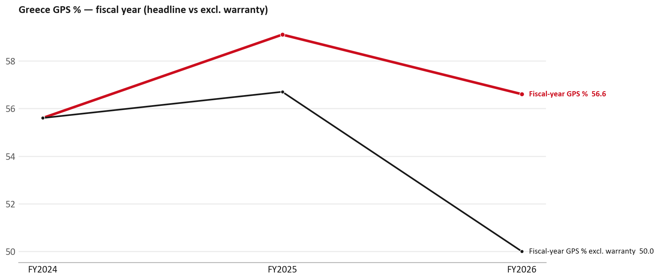
GPS
GPS: fiscal year headline vs after warranty
TAKEAWAYS
— Red = fiscal-year GPS (frozen CY2025 wallet). FY25 59.1% → FY26 56.6%.
— Black = the same GPS after removing warranty parts (€). FY26 ≈ 50.0% (warranty EUR 70,926 ≈ 16% of FY26 billing).
— Both lines divide by the same wallet (EUR 779,500), so the gap between them is warranty and nothing else.
— LIVE SOURCE BUG: Greece's billing sits under payer 66, which gps_billing_fy_ALLCUSTOMERS.csv labels 'RSA'. The warranty file uses 'RSA' for Norway. Joining the two on that name merges Greece into Norway. Confirmed by Jerome 17-07-2026. Never join those files on the name.
22

Slide 23
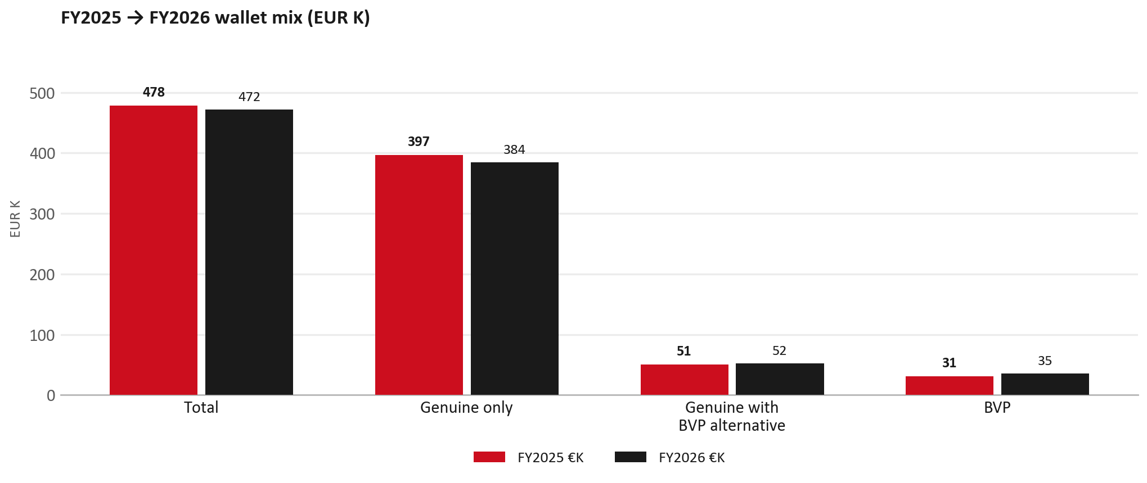
WALLET MIX
FY2025 → FY2026 wallet mix
— Total EUR 478,134 → EUR 471,586 (-1.4%).
— Genuine only EUR -12,197.
— Genuine with BVP alternative EUR 1,286; BVP EUR 4,362 (7.5% of FY26 wallet).
— Display label locked: Genuine with BVP alternative.
23

Slide 24
WALLET MIX
FY wallet mix — detail
 | FY2025 | FY2026 | Δ
Total | EUR 478,134 | EUR 471,586 | EUR -6,548
Genuine only | EUR 396,607 | EUR 384,410 | EUR -12,197
Genuine with BVP alternative | EUR 50,668 | EUR 51,954 | EUR 1,286
BVP | EUR 30,859 | EUR 35,222 | EUR 4,362
BVP % of wallet | 6.5% | 7.5% | +1.0 pp
24

Slide 25
DRIVERS
Where the genuine drop sits (FY2025 → FY2026)
— Genuine-only sales moved EUR -12,197 from FY2025 to FY2026.
— Of that, the routine service basket (filters, pads, rotors) moved EUR -2,144 on genuine-only; BVP in that basket moved EUR 6,325.
— So about 82% of the genuine-only drop sits outside routine service parts.
— Meeting line: check high-value assemblies / sensors before blaming the filter or pad menu.
25

Slide 26
DRIVERS
Largest part-number drops (FY24→FY25) — outside service filters
Part | Description | Δ EUR
8982181430 | WHEEL; DISC,AL | -10,053
8983550720 | partikel sensor | -5,526
8980139111 | VALVE; EGR | -4,263
8981901180 | DRIVE ASM; FINAL,RR | -2,572
8973865576 | PUMP ASM; INJ | -2,519
8981454531 | OVERHAUL KIT; SUPPLY PUMP | -2,049
8981520891 | CONTROL UNIT; ENG | -1,754
— Check warranty / campaign coding before calling competitive leakage.
26

Slide 27

SERVICE PARTS
Service-parts capture vs network (calendar year)
TAKEAWAYS
— Capture % is calendar-year (full CY2025). Fleet demand is modelled on calendar years — there is no matching fiscal-year capture %.
— Oil filter 97.2% vs network 59.6%; Fuel filter 66.5% vs network 46.1%; Air filter 92.1% vs network 51.2%.
— Next slide: fiscal-year € billing in the same 5 categories.
— Primary lens = total capture (not genuine-only).
27

Slide 28
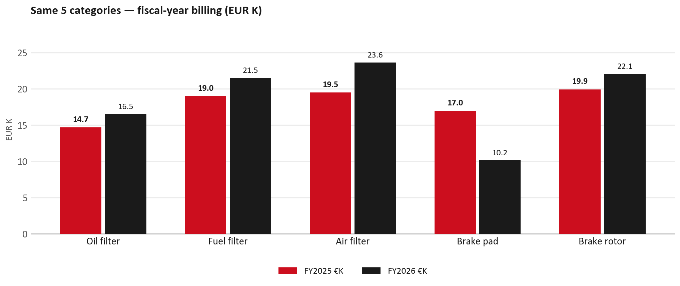
SERVICE PARTS · FY
Service-parts billing by fiscal year (same 5 lines)
TAKEAWAYS
— This is Sales-to-Petros Petropoulos € in fiscal years — not capture % of fleet demand.
— Use both lenses — do not mix % capture with € billing.
— Primary = total sales in the basket.
28

Slide 29
BRAKES
Brake pads — BVP share of total brake pad sales (FY)
 | FY2025 | FY2026
Genuine pad sales (€) | EUR 13,861 | EUR 8,346
BVP pad sales (€) | EUR 3,122 | EUR 1,815
Genuine qty | 193 | 139
BVP qty | 53 | 43
BVP share of pad sales (€) | 18% | 18%
— BVP share = BVP € ÷ all brake-pad € billed (genuine + BVP). Not a PMS capture %.
— Wallet-level BVP is still only ~7.5% of FY26 — do not generalise a pad story to the whole wallet.
29

Slide 30
AIM
AIM exposure
Year | High-risk € | High-risk % | Quadrant
2023 | EUR 3,420 | 0.8% | Priority target (low GPS - low capture)
2024 | EUR 3,253 | 0.7% | Wallet gap (low GPS - high capture)
2025 | EUR 3,308 | 0.6% | Wallet gap (low GPS - high capture)
— High-risk € is catalogue AIM exposure, not proven walk-out.
— Open on jobs not bought through the distributor — not a street IAM war alone.
30

Slide 31
WARRANTY
Warranty — two real lenses
1
CY2025 claim-price parts
2
Fiscal GPS expense
— EUR 56,159 (claim-price basis).
— Calendar-year claim price basis.
— CV EUR 1,450 + LCV EUR 54,708.
— FY24 EUR 0 · FY25 EUR 19,030 · FY26 EUR 70,926.
— Source row: Greece.
— Ex-warranty GPS = (net − warranty) ÷ frozen CY25 wallet.
— Both numbers are real — never mix them on one slide without labels.
31

Slide 32
BRIDGE
How to use this in the meeting
If they say… | You know…
BVP is eating genuine | Wallet BVP ~7.5%. Check pads as a local exception only.
GPS looks fine / too high | FY26 headline 56.6%; excl. warranty ≈ 50.0%.
Service parts are fine | CY2025 capture vs network (previous slides) + FY billing lens.
32

Slide 33
Moving the World – for You

