Slide 1

IML · ITUK · ISZE
Operational kick-off, 18 August 2026
Targeted actions: BVP availability, SPA where required, and a complete filter set for scheduled PMS.

Slide 2
GOAL
Goal and three actions
The goal is one additional percentage point on all ITUK PMS parts at ITUK sales to dealers.
368 additional units / about EUR 7,530 valued
That is 1 percent of calendar 2025 ITUK sales to dealers on the ITUK parts list (36,843 units / EUR 752,982 valued), at the same mix. The euro figure is valued at the ISZE average selling price to ITUK. It is not a dealer invoice.
1
Offer BVP where genuine volume is low.
2
Use a Special Price Agreement only if price remains the barrier.
3
Complete the filter set when attach is the barrier.
2

Slide 3
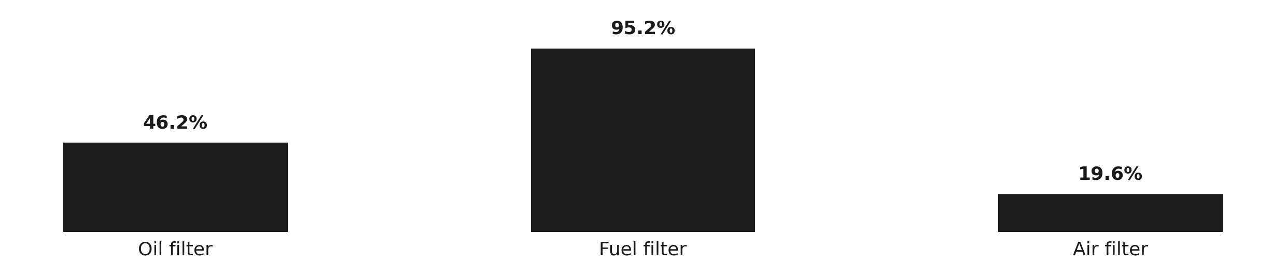
COVERAGE
N75 filter coverage, calendar 2025
How much of the expected N75 service volume was sold, ITUK to dealers and ISZE to ITUK.
Category
Expected
ITUK to dealer
%
ISZE to ITUK
%
Oil filter
11,699
5,404
46.2%
4,673
39.9%
Fuel filter
11,699
11,139
95.2%
11,021
94.2%
Air filter
11,699
2,289
19.6%
2,226
19.0%
Fuel is already at the N75 service level. Air is not.
3

Slide 4
PARTS
Part numbers and 2025 quantity
The primary quantity column is ITUK to dealer. ISZE to ITUK is shown beside it. List prices are ISZE list euro. Cover percentages are N75 only, ISZE then dealer. The oil filter is set contents.
GENUINE
BVP
Item
Cover N75
PN
ITUK to dealer
ISZE to ITUK
List EUR
PN
ITUK to dealer
ISZE to ITUK
List EUR
Oil filter
39.9% / 46.2%
8983282070
348
371
14.45
1876102890
2,161
2,909
9.96
Fuel filter
94.2% / 95.2%
8975425400
3,605
2,005
12.56
1876102860
0
0
8.05
Air filter
19.0% / 19.6%
8981772710
1,513
1,403
31.36
5876102500
0
0
17.49
4

Slide 5
BVP
BVP where genuine volume is low
The request is to offer BVP for the fuel and air filters on the scheduled PMS set. Genuine remains first. BVP is the alternative when genuine volume stays low.
GENUINE
BVP
Part
PN
ISZE to ITUK
Projected to dealers
PN
ISZE to ITUK
Projected to dealers
Fuel
8975425400
EUR 12.56
EUR 17.58
1876102860
EUR 8.05
EUR 11.27
Air
8981772710
EUR 31.36
EUR 43.90
5876102500
EUR 17.49
EUR 24.49
Projected ITUK price to dealers. Genuine versus BVP. Same 1.40 step as the aftermarket slide.
Fuel, genuine
EUR 17.58
Fuel, BVP
EUR 11.27
Air, genuine
EUR 43.90
Air, BVP
EUR 24.49
ITUK to dealer cover against expected N75 volume. Fuel is already at the service level. Air is the hole. Oil BVP is already supplied.
Oil filter
46.2%
Fuel filter
95.2%
Air filter
19.6%
5

Slide 6
SPA
Special Price Agreement
If price remains the barrier after BVP, a targeted discount may be used where it increases PMS take-up.
- The request concerns fuel and air filters, and genuine lines where volume is low.
- A Special Price Agreement is requested only if the BVP alternative is not sufficient for scheduled PMS.
- If ITUK and ISZE cannot agree the required discount, IML can assist as a last resort.
6

Slide 7
FILTER SET
Parts required for one scheduled PMS (N75)
One scheduled service is oil, fuel, and air. Offer the genuine set first. Use BVP only if the genuine set does not take. Air is the attach hole.
ISZE to ITUK
EUR 58.37
Oil
Fuel
Air, attach hole
EUR 14.45
EUR 12.56
EUR 31.36
Projected ITUK to dealers (x 1.40)
EUR 81.72
Oil
Fuel
Air, attach hole
EUR 20.23
EUR 17.58
EUR 43.90
Part
ISZE to ITUK
Projected ITUK to dealers
Why it is in the set
Oil filter
EUR 14.45
EUR 20.23
Set contents
Fuel filter
EUR 12.56
EUR 17.58
Already at the service level
Air filter
EUR 31.36
EUR 43.90
Attach hole. Complete the set.
Today, oil BVP is already in the set: EUR 53.88 to ITUK, and EUR 75.43 projected to dealers. The BVP set is a last resort only: EUR 35.50 to ITUK, and EUR 49.70 projected to dealers.
7

Slide 8
DRAFT · BRAKES
DRAFT
Brake pad and discs
The scheduled wear item is the pad. Discs are the aftermarket hole. There is no BVP twin for the R90 pad. A Special Price Agreement is the commercial route.
Pad 8982447940. Cover is about 51 percent (2,367 ITUK to dealer / 2,282 ISZE to ITUK, against 9,359 vehicles at 0.5 events).
ISZE to ITUK
EUR 89.11
Projected ITUK to dealers
EUR 124.75
Aftermarket workshop
EUR 46.12
Read the last two bars. Same step: projected ITUK price to dealers versus what a workshop pays for the aftermarket pad.
Pad cover against expected N75 events
Cover
about 51%
Discs that are selling. Not on the ITUK PMS list.
Axle
PN
ITUK to dealer
ISZE to ITUK
Cover
Rear
8981919560
487
521
about 10%
Front
8982488951
393
520
about 8%
Cover uses 0.25 axle-sets per year (200,000 km, two pad lives). These discs fit N75 NPR and carry over to P700.
8

Slide 9
DRAFT · CLUTCH
DRAFT
Clutch kit, manual vehicles only
Until a transmission file exists, the planning assumption is that 47 percent of the N75 parc is manual.
BVP kit 5876102320
Genuine piece sum
ISZE to ITUK EUR 194.69. Projected ITUK to dealers about EUR 273.
ISZE to ITUK EUR 282.08. About EUR 395 projected to dealers.
63 ITUK to dealer. 78 ISZE to ITUK.
8981649171 + 8970388314 + 1313100120. Do not mix 8981649181.
Piece
PN
ITUK to dealer
ISZE to ITUK
Disc
8981649171
50
47
Pressure plate
8970388314
9
54
Release bearing
1313100120
38
21
BVP kit, ISZE to ITUK
EUR 194.69
BVP kit, projected to dealers
about EUR 273
Genuine pieces, ISZE to ITUK
EUR 282.08
Genuine pieces, projected to dealers
about EUR 395
9

Slide 10
DRAFT · UREA
DRAFT
Urea filter kit
Urea is not in the ITUK parts list of 56 part numbers. It is a separate line. The item on the parts file is the DEF pump filter kit, not bulk fluid.
Genuine 8983507161
BVP 1876102341
FILTER KIT; PUMP ASM,DEF DCM S. ITUK to dealer 541. ISZE to ITUK 506. ISZE to ITUK EUR 70.53. Projected ITUK to dealers about EUR 99 (x 1.40).
Same kit, BVP number. ITUK to dealer 34. ISZE to ITUK 46. ISZE to ITUK EUR 30.72. Projected ITUK to dealers about EUR 43 (x 1.40).
No AdBlue fluid part number was found on the ITUK dealer file for calendar 2025. Earlier kit numbers also appear: 8983507160 (132 to dealers) and 1876102340 (77 to dealers, 59 ISZE to ITUK).
10

Slide 11
DRAFT · AFTERMARKET
DRAFT
The pad is well above aftermarket at the dealer step
Filters are close. The clutch is not the problem.
We compare the projected ITUK price to dealers with what a workshop pays for the aftermarket part. Same step.
Part
ISZE to ITUK
Projected ITUK to dealers
Aftermarket workshop
Read
Oil filter
EUR 14.45
EUR 20.23
EUR 15.10
Above
Fuel filter
EUR 12.56
EUR 17.58
EUR 14.45
Above
Air filter
EUR 31.36
EUR 43.90
EUR 47.05
In line
Brake pad
EUR 89.11
EUR 124.75
EUR 46.12
Well above
Clutch disc
EUR 84.47
EUR 118.26
EUR 284
Below
Above
In line
Well above
Oil and fuel sit above aftermarket at the dealer step, and close.
Air is in line with aftermarket at the same step.
The pad is well above aftermarket. That is the line to discuss.
ISZE to ITUK is shown so the buy-in is visible. The read uses only projected ITUK to dealers versus aftermarket. Projected is ISZE to ITUK times 1.40.
11

Slide 12
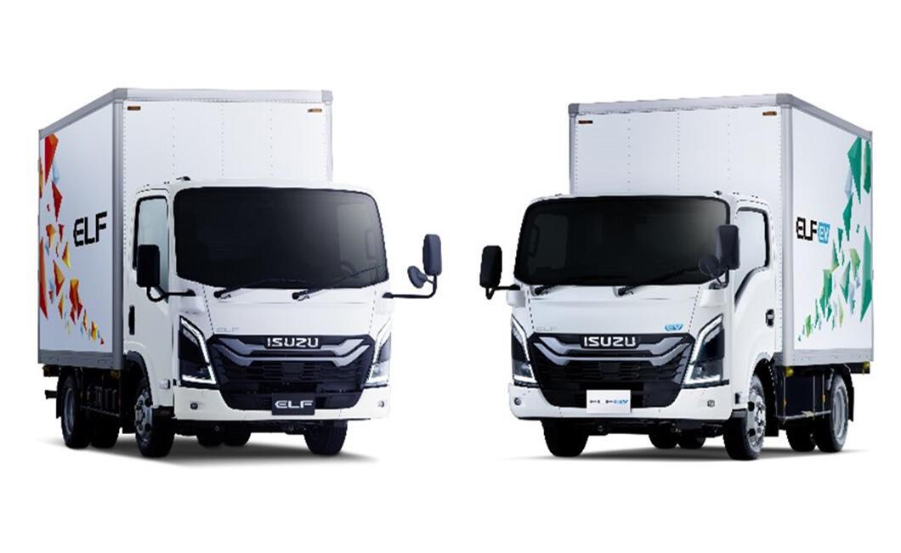
October. N75 first.
P700

