Slide 1

ISZE · VEHICLE PARTS · DRAFT
How we proceed on PMS
from the parts side
Draft · complements the ITUK operating model · N75 · 18 August 2026

Slide 2
OPENING
Your model stays the head story
Uptime is the customer story. Parts attaches the right set on a visit that already happens.
ITUK already said
What parts Europe adds
N75 events. Oil + fuel + air on the job. Inspect brakes. Conversion and fill, not discount as the KPI. N35 later. Connected later.
Cover %. Filter pack. BVP promotion from August. SPA we price now. Clutch stays in at 47% manuals. If ISZE and ITUK cannot close the discount, IML can join.
2

Slide 3
PATH
How we got here
March to August is one programme. This week we have both halves.
Mar
Apr
Jun
Jul
13 Aug
Kick-off. Frequencies and target items. VIN format not available. UIO, CBU and R&M instead.
UK visit. N75 first. Air and brake as headlines. Oil and fuel as the 40,000 km pack. Parc 9,359.
EU conference. SPA discussion. Sales prices requested so a SPA can be priced.
Japan hour locked. ISZE to take the parts lead on Tuesday.
Your pack plus three ISZE options. You asked for this draft in Japan.
3

Slide 4
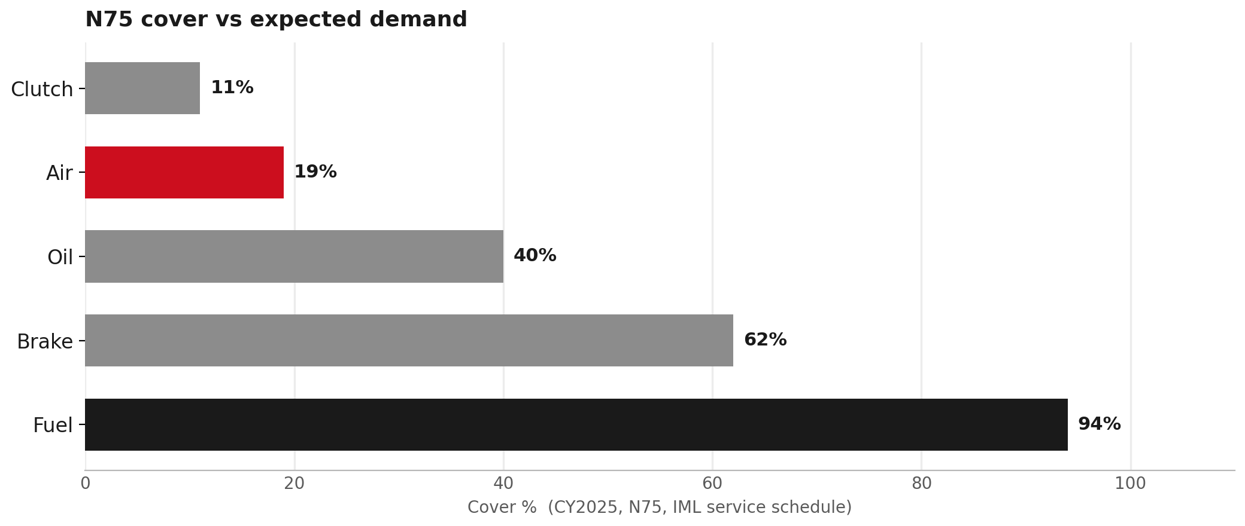
WHERE THE MISS IS
N75 cover % · clutch stays in
AIR THE MISS
CLUTCH 47% MANUALS
BRAKE CONVERT
19%
11%
62%
2,226 / 11,699 expected
243 / 2,199 expected
2,902 / 4,680 expected
What this means
- Air is the miss. Put it on the same visit as oil and fuel.
- Fuel is already 94%. Keep it in the pack.
- Brake: inspect and convert. R90 pad 8982447940 is orderable.
- Oil stays in the pack. Not the campaign KPI.
- Clutch stays in at 47% manuals for this round.
4

Slide 5
CY2025 ISZE TO ITUK
N75 lines · cover %, qty, list price
Same IML schedule as the cover bars. Qty is what we billed. List is ISZE list EUR.
Item | Cover | Genuine PN | 2025 qty | List EUR | BVP PN | 2025 qty | List EUR
Oil | 40% | 8983282070 | 371 | 14.45 | 1876102890 | 2,909 | 9.96
Fuel | 94% | 8975425400 | 2,005 | 12.56 | 1876102860 | 0 | 8.05
Air | 19% | 8981772710 | 1,403 | 31.36 | 5876102500 | 0 | 17.49
Brake pad | 62% | 8982447940 | 2,282 | 89.11 | no twin | - | -
Clutch disc 4HK1 | 11% family | 8981649171 | 47 | 84.47 | see kit mix | - | -
Clutch PP 4HK1 | 11% family | 8970388314 | 54 | 120.75 | 5876101040 | 14 | 89.22
Oil BVP already outsells genuine (2,909 vs 371). Fuel BVP and air BVP did not move in 2025. Brake pad 8982447940 is orderable. Clutch % uses 47% manuals (expected 2,199 kits).
5

Slide 6
FILTER PACK AT ISZE LIST
One 40,000 km visit, in euros
This is the pack on the job card. Not a discount number. Three ways to price the same three filters.
Genuine pack EUR 58.37
Oil BVP today EUR 53.88
If ITUK orders BVP EUR 35.50
Oil 8983282070 at 14.45. Fuel 8975425400 at 12.56. Air 8981772710 at 31.36. Fuel already attaches. Air is the miss on this set.
Oil 1876102890 at 9.96 (already selling). Fuel genuine 12.56. Air genuine 31.36. August move: keep promoting the oil BVP that already moves.
Oil 9.96 + fuel 1876102860 at 8.05 (qty 0) + air 5876102500 at 17.49 (qty 0). 39% below genuine. Only if they stock the zeros.
Brake on the same visit: pad 8982447940 list 89.11 EUR (2,282 billed in 2025). If genuine still needs more discount after BVP, that is the SPA. If ITUK and ISZE cannot close it, IML can join.
6

Slide 7
PARTS EUROPE
Three levers · BVP this month, SPA now
We do not wait for October to start pricing.
1 BVP · August
2 SPA · now
3 Filter pack
Where a twin exists, promote it now. Live oil BVP 1876102890 already moves. Catalogue twins with zero UK sales only go on the poster if ITUK orders them.
Genuine air and brake, and clutch if we keep it in. We price with ITUK now, not after Japan. If the level is not enough, IML can join.
One N75 kit: oil + fuel + air. Fuel 94%, air 19%. That is how air rides on an event that already exists. R90 pad 8982447940 on the brake side.
7

Slide 8
DISCOUNT LADDER
How we get the price down
BVP first. Then SPA with ITUK. If we cannot agree the level, IML joins and we share it three ways.
Need more price on this job? Walk the ladder. Do not start with a three-party SPA.
BVP twin exists
Genuine needs SPA
Promote BVP. That is the August move. No extra SPA until the twin is on the shelf.
ISZE prices it with ITUK now. Dealer quotes the set on the event.
If ITUK and ISZE cannot close the level: IML joins. Three wallets, one conversion.
ISZE
ITUK
IML
Europe parts. SPA wallet + pack BOM
UK distributor. Dealer price + stock
If still short. Third share of the discount
8

Slide 9
TIMELINE
How we proceed
Mark this up in Japan. Lock the ladder on Tuesday. BVP already this month.
August
Tue 18 Aug
September
October
Nov to Dec
Promote live BVP. Start SPA numbers with ITUK.
Lock pack, SPA lines, BVP order or leave, IML-join rule, clutch on 47%.
Pack BOM, SPA paper, R90 pad order, bulletin, stock rule.
N75 uptime campaign. Pack on the visit. Brake convert. Clutch in the model.
Air attach %, brake accept, clutch kits vs 2,199, pack fill. Then N35.
Not this round: N35 as the launch, connected / odometer, oil as the headline KPI.
9

Slide 10
TUESDAY
Five answers so the hour can close
If we leave with these, September has a job.
1
BVP now. Promote live oil BVP from August. Zero-sales twins (air 5876102500, fuel 1876102860): order, or leave off the poster?
2
SPA now. Which genuine air / brake / clutch lines do we price with ITUK this month?
3
IML join rule. If ITUK and ISZE cannot agree the SPA level, IML can share the discount. Yes?
4
Pack. One N75 kit (oil + fuel + air) on existing events. R90 pad 8982447940 is orderable.
5
Clutch. Keep it in at 47% manuals (expected 2,199). VIN later only refines the %.
10

Slide 11
Moving the World – for You

