Slide 1

ISZE · CYPRUS · CYPRUS
Cyprus Sales Review
& FY2027 Target
Loutsios & Sons · August 2026

Slide 2
CYPRUS MEETING
Agenda
— Parts Performance — category movers
— Parts Performance — Body parts
— Parts Performance — Air conditioning
— Parts Performance — Filters
— Parts Performance — where volume grew
— New Business — validation queue
— Service-Parts Coverage
— IDS 2026 — Dealer Standard
— Fleet & FY2027 Target
— SPA — status
— R&M — market discussion
— Data request: part-level Sales-to-Dealer
— Next steps
2

Slide 3
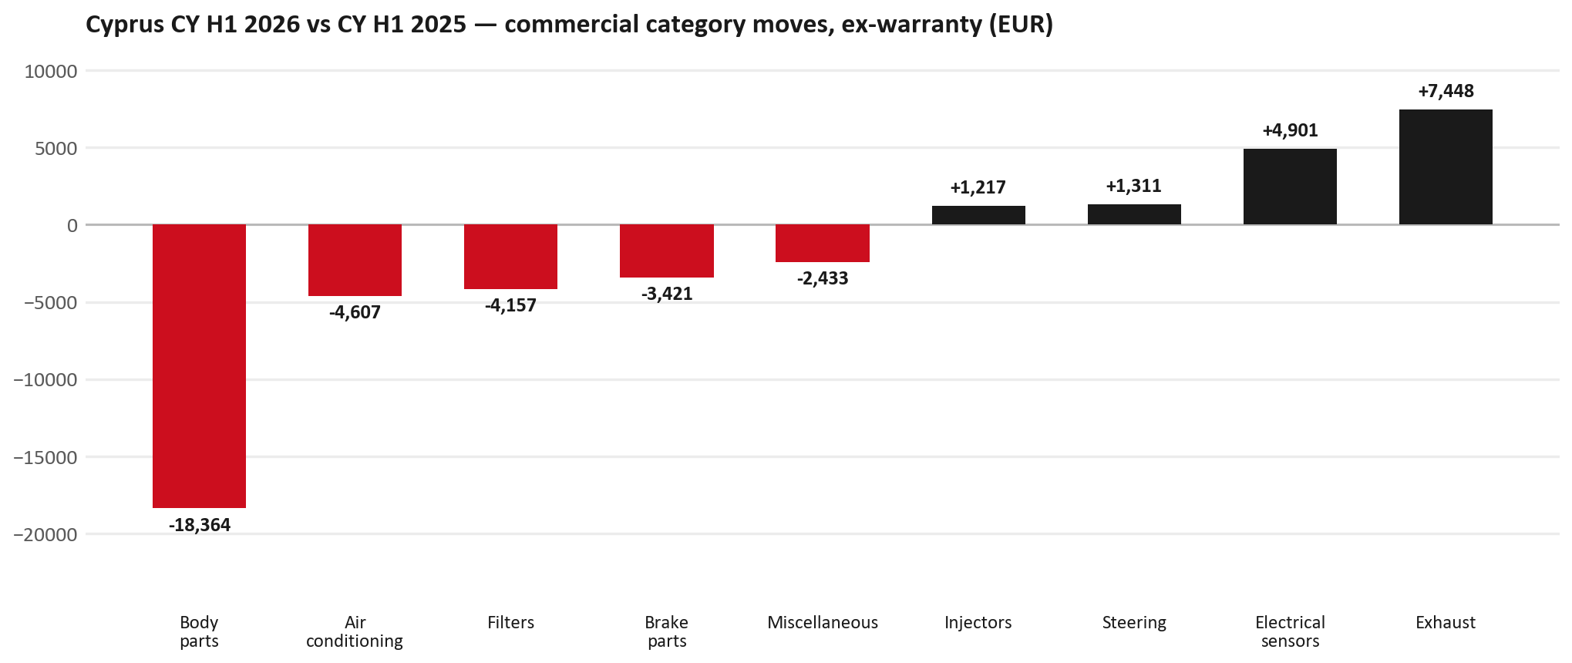
PARTS PERFORMANCE
Parts Performance — CY H1 2026 vs CY H1 2025 (commercial, ex-warranty)
TAKEAWAYS
— Commercial parts billing (warranty/campaign excluded) EUR 152K against EUR 173K a year earlier — -12.2% (CY H1 2026 vs CY H1 2025, Jan–Jun).
— Largest PN drops (all categories): 8974725284 (RAIL; ROOF) EUR -8K, 64 fewer pcs; 8974725274 (RAIL; ROOF) EUR -8K, 63 fewer pcs; 5876150170 (ELEMENT KIT; FUEL FI) [N*R,NPS,QKR,TF*,UC*] EUR -2K, 290 fewer pcs.
— Largest PN gains (all categories): 8972666501 (DISPLAY; MULTI) EUR 3K, 2 more pcs; 8975554500 (FILTER; BLOWER UNIT) [TF*,UC*] EUR 2K, 153 more pcs; 5876150610 (PAD KIT; CALIPER,DIS) [TF*] EUR 1K, 20 more pcs.
— Within Exhaust (EUR 7K, +375%): 8983682091 (PIPE; EXH) EUR 1K, 1 more pcs; 8982688122 (PUMP ASM; DEF,DCM SP) EUR 1K, 1 more pcs; 8980139111 (VALVE; EGR) EUR 1K, 7 more pcs.
3

Slide 4
PARTS PERFORMANCE — BODY PARTS
Body parts — CY H1 2026 vs CY H1 2025 (commercial, ex-warranty)
— EUR 47,674 (CY H1 2025) to EUR 29,311 (CY H1 2026), down EUR 18,364 (-39%).
— Largest part numbers driving the decline (by EUR):
— 8974725284 (RAIL; ROOF): EUR 8,915 to EUR 879, 64 fewer pieces.
— 8974725274 (RAIL; ROOF): EUR 9,543 to EUR 1,632, 63 fewer pieces.
— 8974725301 (RAIL; ROOF): EUR 1,305 to EUR 206, 48 fewer pieces.
— 8974725321 (RAIL; ROOF): EUR 1,374 to EUR 321, 46 fewer pieces.
Questions for us to work through together
— Is this pricing against what the dealers can buy locally?
— Is any of this stock timing on your side rather than end demand?
— What would make the biggest difference to keep this business with us?
4

Slide 5
PARTS PERFORMANCE — AIR CONDITIONING
Air conditioning — CY H1 2026 vs CY H1 2025 (commercial, ex-warranty)
— EUR 16,613 (CY H1 2025) to EUR 12,006 (CY H1 2026), down EUR 4,607 (-28%).
— Largest part numbers driving the decline (by EUR):
— 5876150180 (FILTER; BLOWER UNIT · TF*,UC*): EUR 2,361 to EUR 805, 100 fewer pieces.
— 8974995480 (FILTER; ACL · TFR,TFS,UCR,UCS): EUR 2,147 to EUR 635, 70 fewer pieces.
— 5876150021 (FILTER; ACL · TFR,TFS,UCR,UCS): EUR 1,248 to EUR 0, 100 fewer pieces.
— 5876150521 (FILTER; ACL · TFR,TFS,UCR,UCS): EUR 1,502 to EUR 742, 50 fewer pieces.
Questions for us to work through together
— Is the seasonal pattern different this year, or is this a real shift?
— Are cabin filters and A/C service being sold as a package?
5

Slide 6
PARTS PERFORMANCE — FILTERS
Filters — CY H1 2026 vs CY H1 2025 (commercial, ex-warranty)
— EUR 15,913 (CY H1 2025) to EUR 11,756 (CY H1 2026), down EUR 4,157 (-26%).
— Largest part numbers driving the decline (by EUR):
— 5876150170 (ELEMENT KIT; FUEL FILTER · N*R,NPS,QKR,TF*,UC*): EUR 3,675 to EUR 1,752, 290 fewer pieces.
— 8980959830 (ELEMENT KIT; FUEL FILTER · N*R,NPS): EUR 655 to EUR 0, 20 fewer pieces.
— 5876150050 (ELEMENT; OIL FILTER · TFR,TFS,UCR,UCS): EUR 643 to EUR 0, 110 fewer pieces.
— 8975425400 (ELEMENT; FUEL FILTER · FV*,FT*,FS*,FR*,N*R,N*S): EUR 1,051 to EUR 628, 50 fewer pieces.
Questions for us to work through together
— Are dealers stocking filters, or ordering line-by-line against each job?
— How much servicing do you estimate is happening outside the franchised network?
— Would a service-pack offer on oil and fuel filters be workable for your dealers?
6

Slide 7
PARTS PERFORMANCE — GROWTH
Where volume grew — CY H1 2026 vs CY H1 2025 (commercial, ex-warranty)
Part | Description | Model | CY H1 2025 | CY H1 2026 | Δ EUR
8972666501 | DISPLAY; MULTI | — | EUR 1,405 | EUR 4,215 | EUR 2,810
8975554500 | FILTER; BLOWER UNIT | TF*,UC* | EUR 2,959 | EUR 5,447 | EUR 2,489
5876150610 | PAD KIT; CALIPER,DISC BRK,FR | TF* | EUR 1,167 | EUR 2,303 | EUR 1,136
8980548130 | NUT; LICENSE PLATE | — | EUR 336 | EUR 1,176 | EUR 840
7552422500 | CONTROL UNIT | — | EUR 729 | EUR 1,458 | EUR 729
8983314120 | SENSOR; PRESSURE,DPD | — | EUR 212 | EUR 843 | EUR 631
— Exhaust +375%, Electrical sensors +40%, Steering +26% — where the commercial volume went.
— Claim-matched PNs (70 distinct) and campaign/recall text matches are already excluded from this growth list. Residual warranty on unmapped PNs can remain.
— PNs ranked by largest EUR increase (prior-period sales > 0). Worth agreeing which of these are repeatable and which were one-off.
7

Slide 8
PARTS PERFORMANCE
New Business — validation queue (CY H1 2026)
Part | Description | Current sales | Review
8975359391 | DPD ASM | EUR 6,942 | Warranty / campaign
8972666511 | DISPLAY; MULTI | EUR 1,668 | Validate
8972666502 | DISPLAY; MULTI | EUR 1,399 | Validate
7552689700 | PUMP; WATER | EUR 1,287 | Warranty / campaign
8983682091 | PIPE; EXH | EUR 1,277 | Validate
8978461162 | GLASS; WINDSHIELD | EUR 1,246 | Validate
— These lines had no prior-period sales, so they are kept out of the incremental-growth table.
— A first sale can be a new model, a supersession, timing, or a warranty campaign. It is not treated as a commercial win until that cause is confirmed.
8

Slide 9
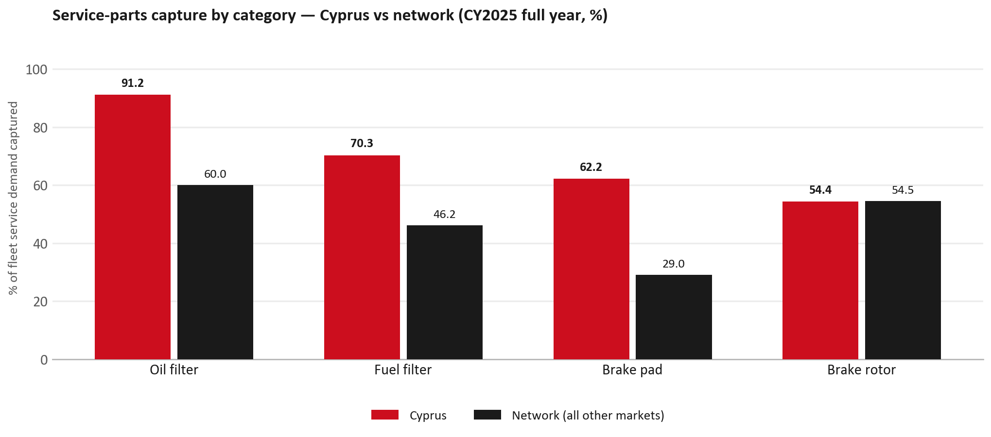
SERVICE-PARTS COVERAGE
Service-parts coverage: brake rotor is the clear gap
TAKEAWAYS
— Brake rotor 54.4% against 54.5% for the rest of the network.
— Fuel filter 70.3% against 46.2% for the rest of the network.
— Every market here is measured on the same fleet-and-interval model, so the comparison is like-for-like even where the underlying interval assumption is debatable.
— Air filter is not shown: the modelled demand base for that category does not hold for this market, so the rate is not quotable.
9

Slide 10
IDS 2026 — DEALER STANDARD
IDS 2026: Cyprus averages 75.0%, below the 79.4% network benchmark
Dealer | Total % | Global rank
A. Loutsios And Sons Ltd | 75.0% | #340
Cyprus country average | 75.0% | —
Network average (all IDS 2026) | 79.4% | —
A. Loutsios And Sons Ltd | 75.0% | #340
— 1 dealers assessed across Premises, Organisation, Service, Parts and Vehicle Sales.
— The country average sits 4.4 points below the network — both averages are taken on assessed dealers only.
— The spread is the point: 0 points between the strongest and weakest assessed dealer.
— Dealer-by-dealer detail and individual feedback are available as a separate pack — worth agreeing which dealers to visit, and when.
10

Slide 11
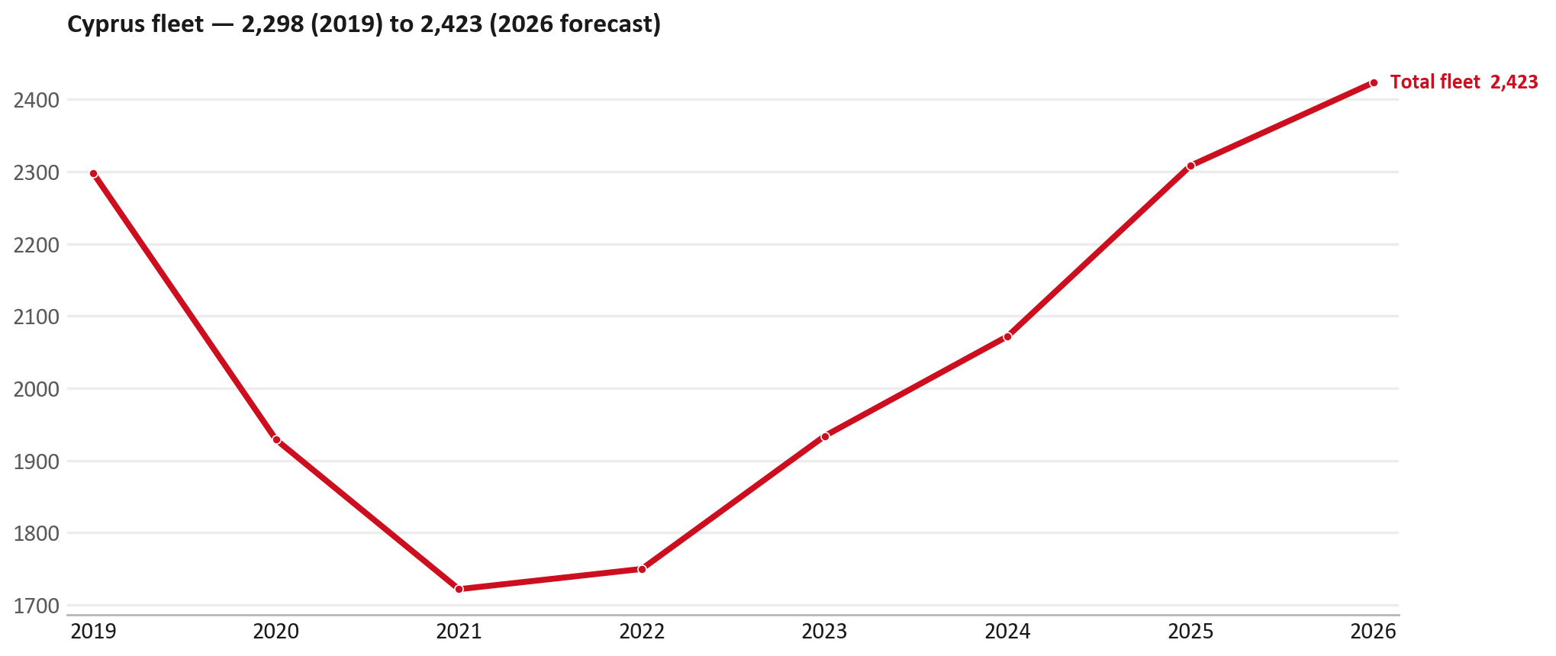
FLEET & FY2027 TARGET
The fleet is expected to grow in 2026
WHAT THIS MEANS FOR FY2027
— Fleet size (calendar year): 2,308 vehicles in 2025 → 2,423 working estimate for end-2026 (+5.0%).
— The chart is calendar years 2019–2026 only. 2026 is a working year-end estimate, not a fiscal-year figure.
— End-2026 mix: LCV / D-Max 2,206; CV — LD 212; CV — MD 5.
— The FY2027 extended target (ISZE→DB) applies a 5% price adjustment and 1.8% stretch — locked at EUR 552,822 from GPS Extended Target V3.1 (Dashboard column I).
— The target reflects the working fleet outlook without extending the chart beyond 2026.
11

Slide 12
FLEET & FY2027 TARGET
How the FY2027 extended target is built
ISZE → DB extended target (V3.1 Dashboard column I)
Step | Amount
Business Plan / actual FY27 base | EUR 539,600
Market potential (max spend FY27) | EUR 734,562
Stretch (+1.8% of max spend) | EUR 13,222
FY2027 EXTENDED TARGET (locked) | EUR 552,822
— Extended target = BP + stretch; stretch default is 1.8% (network rule from GPS Extended Target V3.1).
— Figure locked from GPS Extended Target FY27 V3.1, Dashboard column I (CYPRUS): EUR 552,822.
12

Slide 13
FY2027 TARGET
What the FY2027 target reflects
1
The FY2027 business plan
2
The price move
— The target starts from the FY2027 Business Plan for this market, EUR 539,600.
— Your fleet outlook (+5.0%) sets the market potential the stretch is measured against.
— ISZE is applying a 5% price adjustment for FY2027, consistent with every ISZE market this year.
— It is built into the per-vehicle rate above, not added separately on top.
What it means for your target
 | Value
FY2027 extended target (V3.1 col I) | EUR 552,822
vs BP FY27 (EUR 539,600) | +2.5%
Stretch included | +1.8%
— As in previous cycles we would expect an incentive to sit alongside this adjustment — that approval is still pending on our side.
— Until the incentive is confirmed, treat the FY2027 extended target as the working figure (BP + stretch), not a locked commercial commitment.
13

Slide 14
SPA
SPA
1
CYPRUS proposal
2
ISZE review
3
Counter-proposal
4
Final approval
— Loutsios & Sons submits a proposed parts list.
— ISZE reviews the proposal against network data and fit.
— ISZE returns a counter-proposal where needed.
— Signed off by ISZE management.
Purpose: higher turnover for both sides.
14

Slide 15
R&M
R&M — let's align on the market
M
Market
S
Servicing & R&M
— How is the market moving for you right now?
— How much of your volume is fleet business rather than retail?
— Where do you see the biggest hurdles this year?
— Where are your real strengths in this segment?
— Do you offer an R&M or service-plan product today?
— What share of the parc do you retain for servicing after year three?
— Does R&M business come bundled with fleet tenders — roughly what share?
— What would it take to bring more out-of-network servicing back?
15

Slide 16
ASK
Part-level Sales-to-Dealer Data
1
The starting point
2
Sharper insight
3
Shared benefit
— We have no Sales-to-Dealer figures from you for FY2026. The ask is monthly Sales-to-Dealer, at part-number level.
— Part-by-part visibility separates a stock movement from a lost job — and tells us where the volume actually went.
— Better availability on your fast movers, a sharper target for us, and a factual basis for the SPA — same data, both sides gain.
Requested from 01/01/2025, part number level, monthly.
16

Slide 17
SUMMARY
Next steps
— Confirm FY2027 extended target: EUR 552,822 (V3.1 Dashboard column I, +1.8% stretch).
— Confirm the incentive alongside the price adjustment once approved on our side.
— Body parts / Air conditioning / Filters: agree which category we tackle first, and what the joint action is.
— Agree part-level Sales-to-Dealer data sharing, effective 01/01/2025.
— SPA: CYPRUS proposal, ISZE review and counter-proposal cycle to follow.
— IDS 2026: agree dealer visit dates, starting with the lower-scoring dealers.
17

Slide 18
Moving the World – for You

