Slide 1

ISZE · FINLAND · FINLAND
Finland Sales Review
& FY2027 Target
Nordic Automotive Trading · August 2026

Slide 2
FINLAND MEETING
Agenda
— Parts Performance — category movers
— Parts Performance — Exhaust
— Parts Performance — Transmission parts
— Parts Performance — Brake parts
— Parts Performance — where volume grew
— New Business — validation queue
— Service-Parts Coverage
— Fleet & FY2027 Target
— SPA — status
— R&M — market discussion
— Data request: part-level Sales-to-Dealer
— Next steps
2

Slide 3
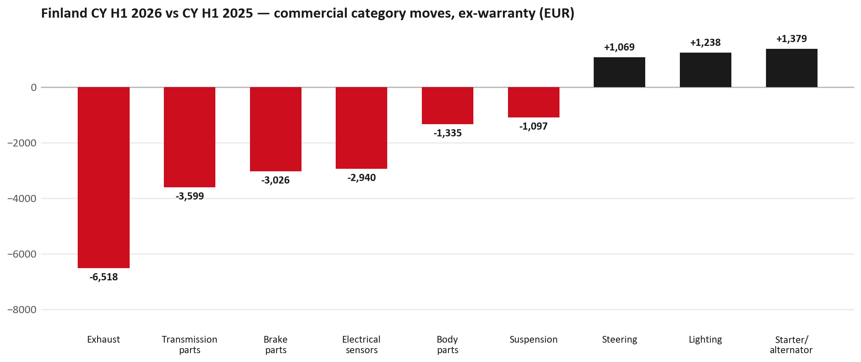
PARTS PERFORMANCE
Parts Performance — CY H1 2026 vs CY H1 2025 (commercial, ex-warranty)
TAKEAWAYS
— Commercial parts billing (warranty/campaign excluded) EUR 79K against EUR 91K a year earlier — -13.4% (CY H1 2026 vs CY H1 2025, Jan–Jun).
— Largest PN drops (all categories): 8980139111 (VALVE; EGR) EUR -4K, 25 fewer pcs; 8983682091 (PIPE; EXH) EUR -3K, 2 fewer pcs; 8981901180 (DRIVE ASM; FINAL,RR) EUR -3K, 2 fewer pcs.
— Largest PN gains (all categories): 8982602580 (SENSOR; PRESSURE,DPD) EUR 1K, 9 more pcs; 8981596930 (ELEMENT KIT; FUEL FI) [N*R,NPS,QKR,TF*,UC*] EUR 1K, 36 more pcs; 8981045589 (PANEL; SIDE GATE) EUR 0K, 2 more pcs.
— Within Starter / alternator (EUR 1K, +5059%): 8983092631 (STARTER ASM) EUR 1K, 2 more pcs; 8982476891 (GENERATOR ASM) EUR 0K, 1 more pcs; 8981836550 (STARTER ASM) EUR 0K, 1 more pcs.
3

Slide 4
PARTS PERFORMANCE — EXHAUST
Exhaust — CY H1 2026 vs CY H1 2025 (commercial, ex-warranty)
— EUR 10,706 (CY H1 2025) to EUR 4,188 (CY H1 2026), down EUR 6,518 (-61%).
— Largest part numbers driving the decline (by EUR):
— 8980139111 (VALVE; EGR): EUR 4,652 to EUR 1,045, 25 fewer pieces.
— 8983682091 (PIPE; EXH): EUR 2,623 to EUR 0, 2 fewer pieces.
— 8975359391 (DPD ASM): EUR 2,194 to EUR 0, 1 fewer pieces.
— 8983314120 (SENSOR; PRESSURE,DPD): EUR 396 to EUR 0, 2 fewer pieces.
Questions for us to work through together
— Is this pricing against what the dealers can buy locally?
— Is any of this stock timing on your side rather than end demand?
— What would make the biggest difference to keep this business with us?
4

Slide 5
PARTS PERFORMANCE — TRANSMISSION PARTS
Transmission parts — CY H1 2026 vs CY H1 2025 (commercial, ex-warranty)
— EUR 7,152 (CY H1 2025) to EUR 3,553 (CY H1 2026), down EUR 3,599 (-50%).
— Largest part numbers driving the decline (by EUR):
— 8981901180 (DRIVE ASM; FINAL,RR): EUR 2,577 to EUR 0, 2 fewer pieces.
— 8980842808 (CASE; FRT AXLE): EUR 615 to EUR 0, 2 fewer pieces.
— 1884057500 (T/AXLEOIL): EUR 508 to EUR 0, 16 fewer pieces.
— 8979487611 (SHAFT ASM; PROP,FRT): EUR 498 to EUR 0, 2 fewer pieces.
Questions for us to work through together
— Is this a mix shift towards assemblies, or fewer component-level repairs?
— Any availability problems on the fast-moving lines?
5

Slide 6
PARTS PERFORMANCE — BRAKE PARTS
Brake parts — CY H1 2026 vs CY H1 2025 (commercial, ex-warranty)
— EUR 4,789 (CY H1 2025) to EUR 1,763 (CY H1 2026), down EUR 3,026 (-63%).
— Largest part numbers driving the decline (by EUR):
— 8976526220 (PAD KIT; CALIPER,DISC BRK,FRT): EUR 773 to EUR 0, 12 fewer pieces.
— 8983767530 (ROTOR; DISC BRK,FRT): EUR 635 to EUR 0, 8 fewer pieces.
— 8978279610 (PAD KIT; DISC BRK,W/O SHIM & CLIP): EUR 903 to EUR 411, 7 fewer pieces.
— 8979488071 (ROTOR; DISC BRK,FRT): EUR 326 to EUR 0, 6 fewer pieces.
Questions for us to work through together
— Is pad and rotor pricing competitive against what the dealers can buy locally?
— Is any of this stock timing on your side rather than end demand?
— Are dealers still quoting these part numbers, or have they dropped off the workshop menu?
6

Slide 7
PARTS PERFORMANCE — GROWTH
Where volume grew — CY H1 2026 vs CY H1 2025 (commercial, ex-warranty)
Part | Description | Model | CY H1 2025 | CY H1 2026 | Δ EUR
8982602580 | SENSOR; PRESSURE,DPD | — | EUR 102 | EUR 1,026 | EUR 924
8981596930 | ELEMENT KIT; FUEL FILTER | N*R,NPS,QKR,TF*, | EUR 946 | EUR 1,449 | EUR 502
8981045589 | PANEL; SIDE GATE | — | EUR 243 | EUR 728 | EUR 485
8981402660 | FILTER; ACL | TFR,TFS,UCR,UCS | EUR 670 | EUR 1,151 | EUR 481
8981394280 | FILTER; BLOWER UNIT | TF*,UC* | EUR 1,252 | EUR 1,713 | EUR 461
8981408531 | ACTUATOR; AXLE | — | EUR 237 | EUR 689 | EUR 452
— Starter / alternator +5059%, Lighting +20%, Steering +112% — where the commercial volume went.
— Claim-matched PNs (95 distinct) and campaign/recall text matches are already excluded from this growth list. Residual warranty on unmapped PNs can remain.
— PNs ranked by largest EUR increase (prior-period sales > 0). Worth agreeing which of these are repeatable and which were one-off.
7

Slide 8
PARTS PERFORMANCE
New Business — validation queue (CY H1 2026)
Part | Description | Current sales | Review
8982059351 | PANEL; SIDE GATE | EUR 2,035 | Validate
8975536750 | BODY ASM; REAR | EUR 1,552 | Validate
8981405894 | SILENCER ASM; EXH | EUR 1,169 | Validate
7551890430 | HARNESS; BUMPER | EUR 1,132 | Warranty / campaign
8977993743 | LAMP ASM; HEAD | EUR 1,000 | Validate
8983320621 | PUMP ASM; FUEL,SUPPLY | EUR 992 | Validate
— These lines had no prior-period sales, so they are kept out of the incremental-growth table.
— A first sale can be a new model, a supersession, timing, or a warranty campaign. It is not treated as a commercial win until that cause is confirmed.
8

Slide 9
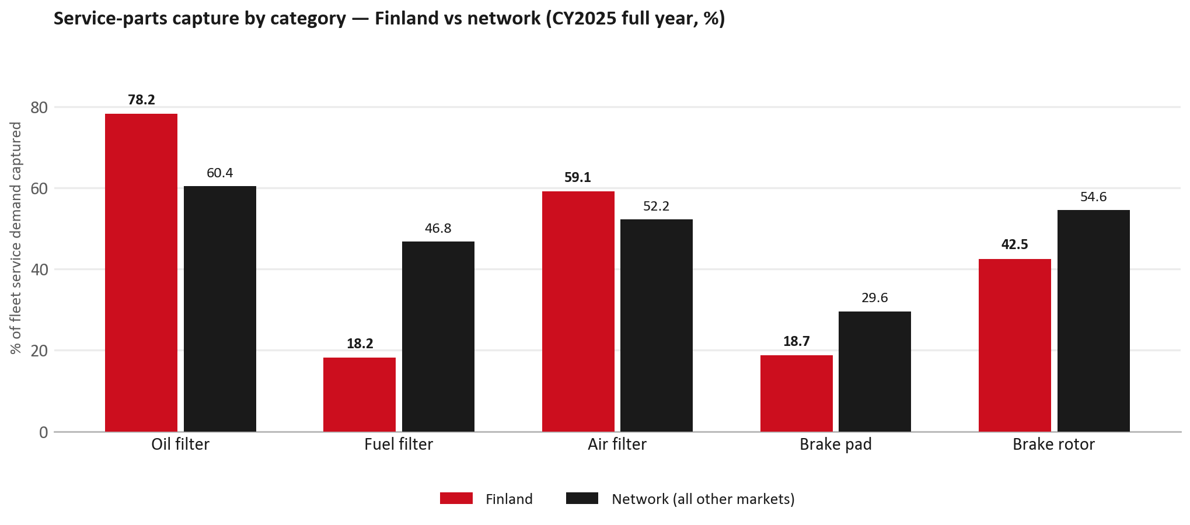
SERVICE-PARTS COVERAGE
Service-parts coverage: fuel filter is the clear gap
TAKEAWAYS
— Fuel filter 18.2% against 46.8% for the rest of the network.
— Brake rotor 42.5% against 54.6% for the rest of the network.
— Every market here is measured on the same fleet-and-interval model, so the comparison is like-for-like even where the underlying interval assumption is debatable.
— Worth agreeing which category we tackle first, and what the joint action is.
9

Slide 10
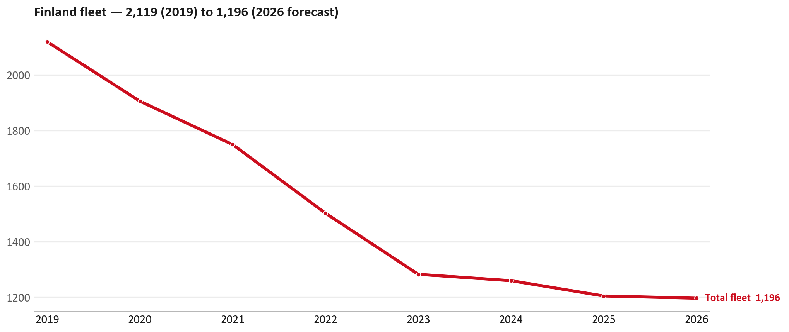
FLEET & FY2027 TARGET
The fleet is expected to decline in 2026
WHAT THIS MEANS FOR FY2027
— Fleet size (calendar year): 1,204 vehicles in 2025 → 1,196 working estimate for end-2026 (-0.7%).
— The chart is calendar years 2019–2026 only. 2026 is a working year-end estimate, not a fiscal-year figure.
— End-2026 mix: LCV / D-Max 1,196; CV — LD 0.
— The FY2027 extended target (ISZE→DB) applies a 5% price adjustment and 1.8% stretch — locked at EUR 365,728 from GPS Extended Target V3.1 (Dashboard column I).
— So the target is built from a slightly smaller fleet — not from an assumed growth story.
10

Slide 11
FLEET & FY2027 TARGET
How the FY2027 extended target is built
ISZE → DB extended target (V3.1 Dashboard column I)
Step | Amount
Business Plan / actual FY27 base | EUR 360,300
Market potential (max spend FY27) | EUR 301,550
Stretch (+1.8% of max spend) | EUR 5,428
FY2027 EXTENDED TARGET (locked) | EUR 365,728
— Extended target = BP + stretch; stretch default is 1.8% (network rule from GPS Extended Target V3.1).
— Figure locked from GPS Extended Target FY27 V3.1, Dashboard column I (FINLAND): EUR 365,728.
11

Slide 12
FY2027 TARGET
What the FY2027 target reflects
1
The FY2027 business plan
2
The price move
— The target starts from the FY2027 Business Plan for this market, EUR 360,300.
— Your fleet outlook (-0.7%) sets the market potential the stretch is measured against.
— ISZE is applying a 5% price adjustment for FY2027, consistent with every ISZE market this year.
— It is built into the per-vehicle rate above, not added separately on top.
What it means for your target
 | Value
FY2027 extended target (V3.1 col I) | EUR 365,728
vs BP FY27 (EUR 360,300) | +1.5%
Stretch included | +1.8%
— As in previous cycles we would expect an incentive to sit alongside this adjustment — that approval is still pending on our side.
— Until the incentive is confirmed, treat the FY2027 extended target as the working figure (BP + stretch), not a locked commercial commitment.
12

Slide 13
SPA
SPA
1
FINLAND proposal
2
ISZE review
3
Counter-proposal
4
Final approval
— Nordic Automotive Trading submits a proposed parts list.
— ISZE reviews the proposal against network data and fit.
— ISZE returns a counter-proposal where needed.
— Signed off by ISZE management.
Purpose: higher turnover for both sides.
13

Slide 14
R&M
R&M — let's align on the market
M
Market
S
Servicing & R&M
— How is the market moving for you right now?
— How much of your volume is fleet business rather than retail?
— Where do you see the biggest hurdles this year?
— Where are your real strengths in this segment?
— Do you offer an R&M or service-plan product today?
— What share of the parc do you retain for servicing after year three?
— Does R&M business come bundled with fleet tenders — roughly what share?
— What would it take to bring more out-of-network servicing back?
14

Slide 15
ASK
Part-level Sales-to-Dealer Data
1
The starting point
2
Sharper insight
3
Shared benefit
— We have no Sales-to-Dealer figures from you for FY2026. The ask is monthly Sales-to-Dealer, at part-number level.
— Part-by-part visibility separates a stock movement from a lost job — and tells us where the volume actually went.
— Better availability on your fast movers, a sharper target for us, and a factual basis for the SPA — same data, both sides gain.
Requested from 01/01/2025, part number level, monthly.
15

Slide 16
SUMMARY
Next steps
— Confirm FY2027 extended target: EUR 365,728 (V3.1 Dashboard column I, +1.8% stretch).
— Confirm the incentive alongside the price adjustment once approved on our side.
— Exhaust / Transmission parts / Brake parts: agree which category we tackle first, and what the joint action is.
— Agree part-level Sales-to-Dealer data sharing, effective 01/01/2025.
— SPA: FINLAND proposal, ISZE review and counter-proposal cycle to follow.
16

Slide 17
Moving the World – for You

Slide 18
FINLAND · NORDIC AUTOMOTIVE TRADING
Deep dive — detail behind the Mode A story
— Extra detail for meeting prep — pick which slides to share with Nordic Automotive Trading.
— Mode A ends on the previous closing slide.
— Label in all charts: “Genuine with BVP alternative” (not “genuine contested”).
18

Slide 19
AGENDA
Deep-dive agenda
— GPS — fiscal year (headline vs excl. warranty; max two lines)
— FY2025 → FY2026 wallet mix (Genuine / Genuine with BVP alternative / BVP)
— Where the money went — outside the service-parts basket (FY)
— Service parts: CY capture vs network + FY billing (capture % is CY-only by design)
— Brake pads — BVP share of total brake pad sales (FY)
— AIM exposure
— Warranty — two lenses
— How to use this in the meeting
19

Slide 20
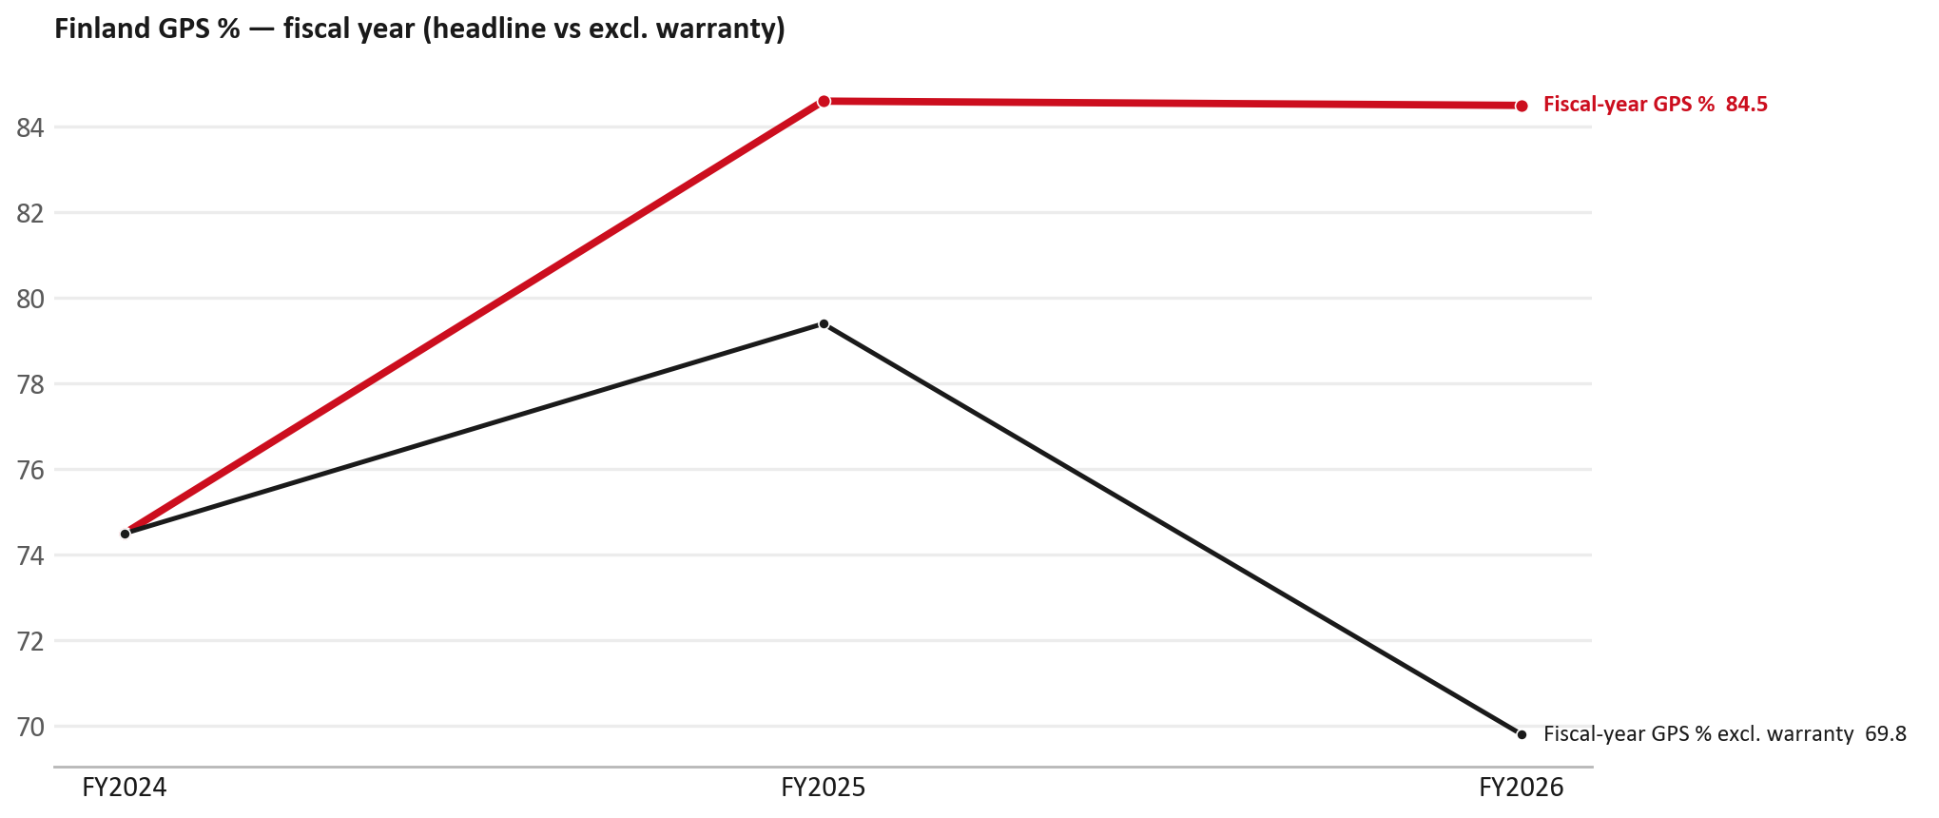
GPS
GPS: fiscal year headline vs after warranty
TAKEAWAYS
— Red = fiscal-year GPS (frozen CY2025 wallet). FY25 84.6% → FY26 84.5%.
— Black = the same GPS after removing warranty parts (€). FY26 ≈ 69.8% (warranty EUR 59,704 ≈ 22% of FY26 billing).
— Both lines divide by the same wallet (EUR 314,750), so the gap between them is warranty and nothing else.
20

Slide 21
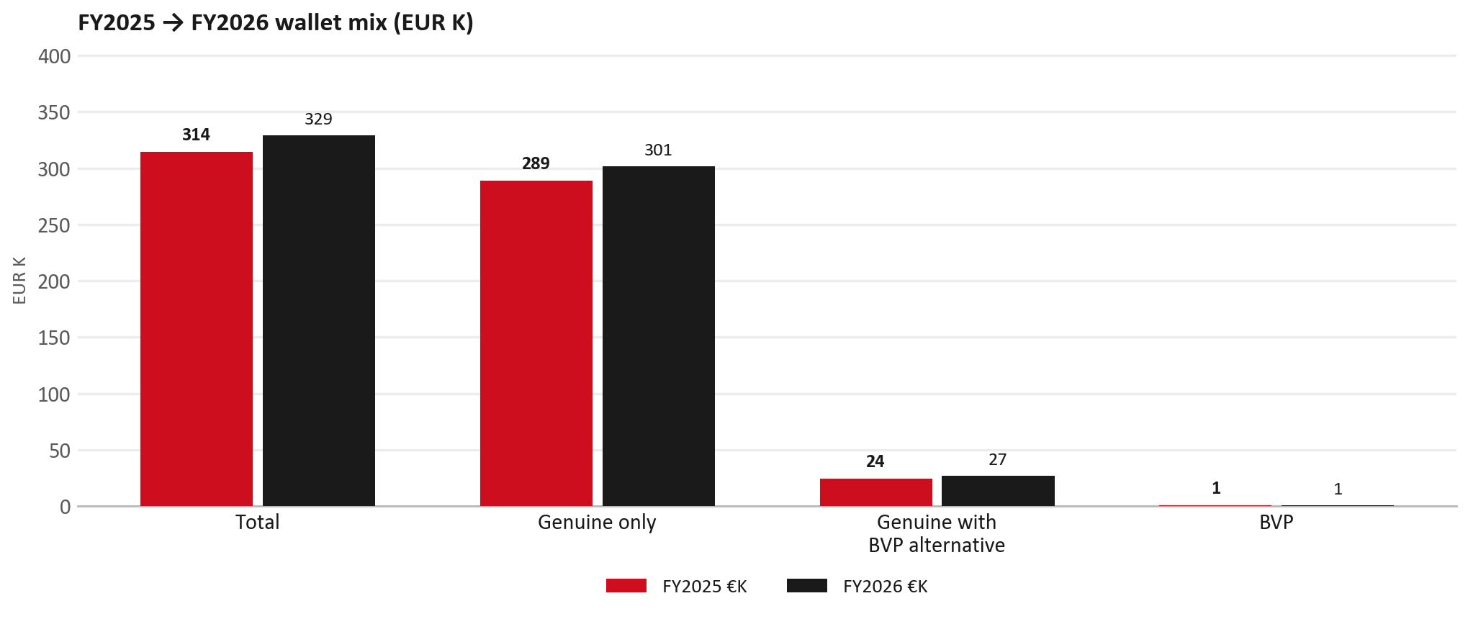
WALLET MIX
FY2025 → FY2026 wallet mix
— Total EUR 314,111 → EUR 328,901 (+4.7%).
— Genuine only EUR 12,561.
— Genuine with BVP alternative EUR 2,446; BVP EUR -217 (0.2% of FY26 wallet).
— Display label locked: Genuine with BVP alternative.
21

Slide 22
WALLET MIX
FY wallet mix — detail
 | FY2025 | FY2026 | Δ
Total | EUR 314,111 | EUR 328,901 | EUR 14,790
Genuine only | EUR 288,900 | EUR 301,461 | EUR 12,561
Genuine with BVP alternative | EUR 24,366 | EUR 26,812 | EUR 2,446
BVP | EUR 845 | EUR 628 | EUR -217
BVP % of wallet | 0.3% | 0.2% | -0.1 pp
22

Slide 23
DRIVERS
Where the genuine drop sits (FY2025 → FY2026)
— Genuine-only sales moved EUR 12,561 from FY2025 to FY2026.
— Of that, the routine service basket (filters, pads, rotors) moved EUR 4,768 on genuine-only; BVP in that basket moved EUR 157.
— Genuine-only did not fall on this FY cut — check category movers and H1 for pressure points.
— Meeting line: check high-value assemblies / sensors before blaming the filter or pad menu.
23

Slide 24
DRIVERS
Largest part-number drops (FY24→FY25) — outside service filters
Part | Description | Δ EUR
8977998750 | STEERING UNIT | -6,436
8983550720 | partikel sensor | -6,368
8981472452 | SHAFT ASM; FRT DRIVE | -5,303
8979487180 | SHAFT ASM; PROP,RR | -2,691
8983320764 | DPD ASM | -2,112
8981405904 | SILENCER ASM; EXH | -2,009
8981532774 | BUMPER; RR | -1,841
— Check warranty / campaign coding before calling competitive leakage.
24

Slide 25
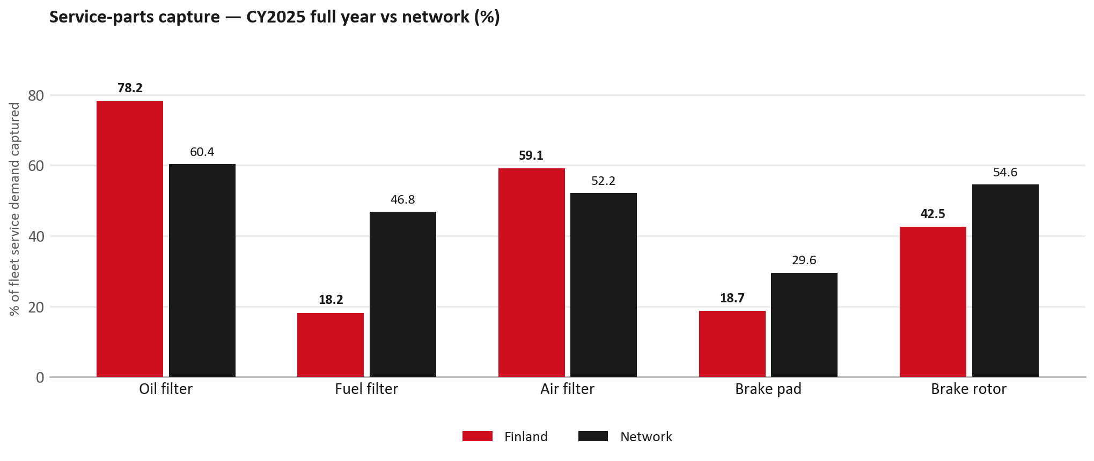
SERVICE PARTS
Service-parts capture vs network (calendar year)
TAKEAWAYS
— Capture % is calendar-year (full CY2025). Fleet demand is modelled on calendar years — there is no matching fiscal-year capture %.
— Oil filter 78.2% vs network 60.4%; Fuel filter 18.2% vs network 46.8%; Air filter 59.1% vs network 52.2%.
— Next slide: fiscal-year € billing in the same 5 categories.
— Primary lens = total capture (not genuine-only).
25

Slide 26
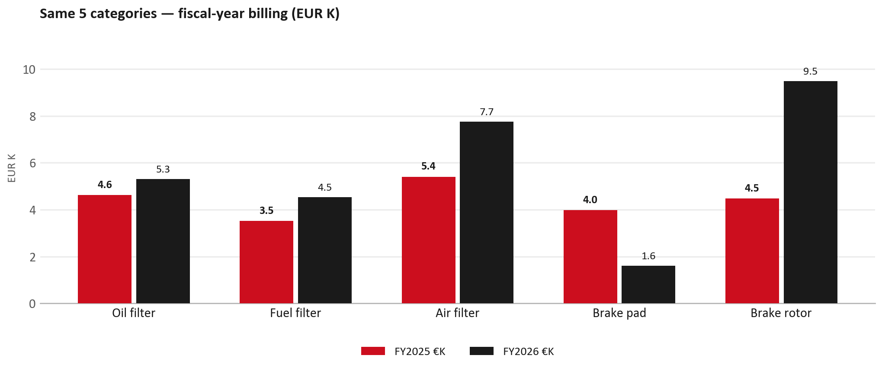
SERVICE PARTS · FY
Service-parts billing by fiscal year (same 5 lines)
TAKEAWAYS
— This is Sales-to-Nordic Automotive Trading € in fiscal years — not capture % of fleet demand.
— Use both lenses — do not mix % capture with € billing.
— Primary = total sales in the basket.
26

Slide 27
BRAKES
Brake pads — BVP share of total brake pad sales (FY)
 | FY2025 | FY2026
Genuine pad sales (€) | EUR 3,625 | EUR 1,612
BVP pad sales (€) | EUR 350 | EUR 0
Genuine qty | 50 | 23
BVP qty | 6 | 0
BVP share of pad sales (€) | 9% | 0%
— BVP share = BVP € ÷ all brake-pad € billed (genuine + BVP). Not a PMS capture %.
— Nordic Automotive Trading pad sales are genuine-only in this cut (~EUR 2K FY26) — no BVP pad lines billed.
— Wallet-level BVP is still only ~0.2% of FY26 — do not generalise a pad story to the whole wallet.
27

Slide 28
AIM
AIM exposure
Year | High-risk € | High-risk % | Quadrant
2023 | EUR 6,166 | 2.9% | Attach gap (high GPS - low capture)
2024 | EUR 2,291 | 0.8% | Attach gap (high GPS - low capture)
2025 | EUR 3,635 | 1.3% | Attach gap (high GPS - low capture)
— High-risk € is catalogue AIM exposure, not proven walk-out.
— Open on jobs not bought through the distributor — not a street IAM war alone.
28

Slide 29
WARRANTY
Warranty — two real lenses
1
CY2025 claim-price parts
2
Fiscal GPS expense
— EUR 48,676 (claim-price basis).
— Calendar-year claim price basis.
— LCV warranty.
— FY24 EUR 0 · FY25 EUR 16,257 · FY26 EUR 59,704.
— Source row: Nordic FI.
— Ex-warranty GPS = (net − warranty) ÷ frozen CY25 wallet.
— Both numbers are real — never mix them on one slide without labels.
29

Slide 30
BRIDGE
How to use this in the meeting
If they say… | You know…
BVP is eating genuine | Wallet BVP ~0.2%. Check pads as a local exception only.
GPS looks fine / too high | FY26 headline 84.5%; excl. warranty ≈ 69.8%.
Service parts are fine | CY2025 capture vs network (previous slides) + FY billing lens.
30

Slide 31
Moving the World – for You

