Slide 1

ISZE · SWEDEN · SWEDEN
Sweden Sales Review
& FY2027 Target
Isuzu Sverige · August 2026

Slide 2
SWEDEN MEETING
Agenda
— Parts Performance — category movers
— Parts Performance — Exhaust
— Parts Performance — Mirrors
— Parts Performance — where volume grew
— New Business — validation queue
— Service-Parts Coverage
— Fleet & FY2027 Target
— SPA — status
— R&M — market discussion
— Data request: part-level Sales-to-Dealer
— Next steps
2

Slide 3
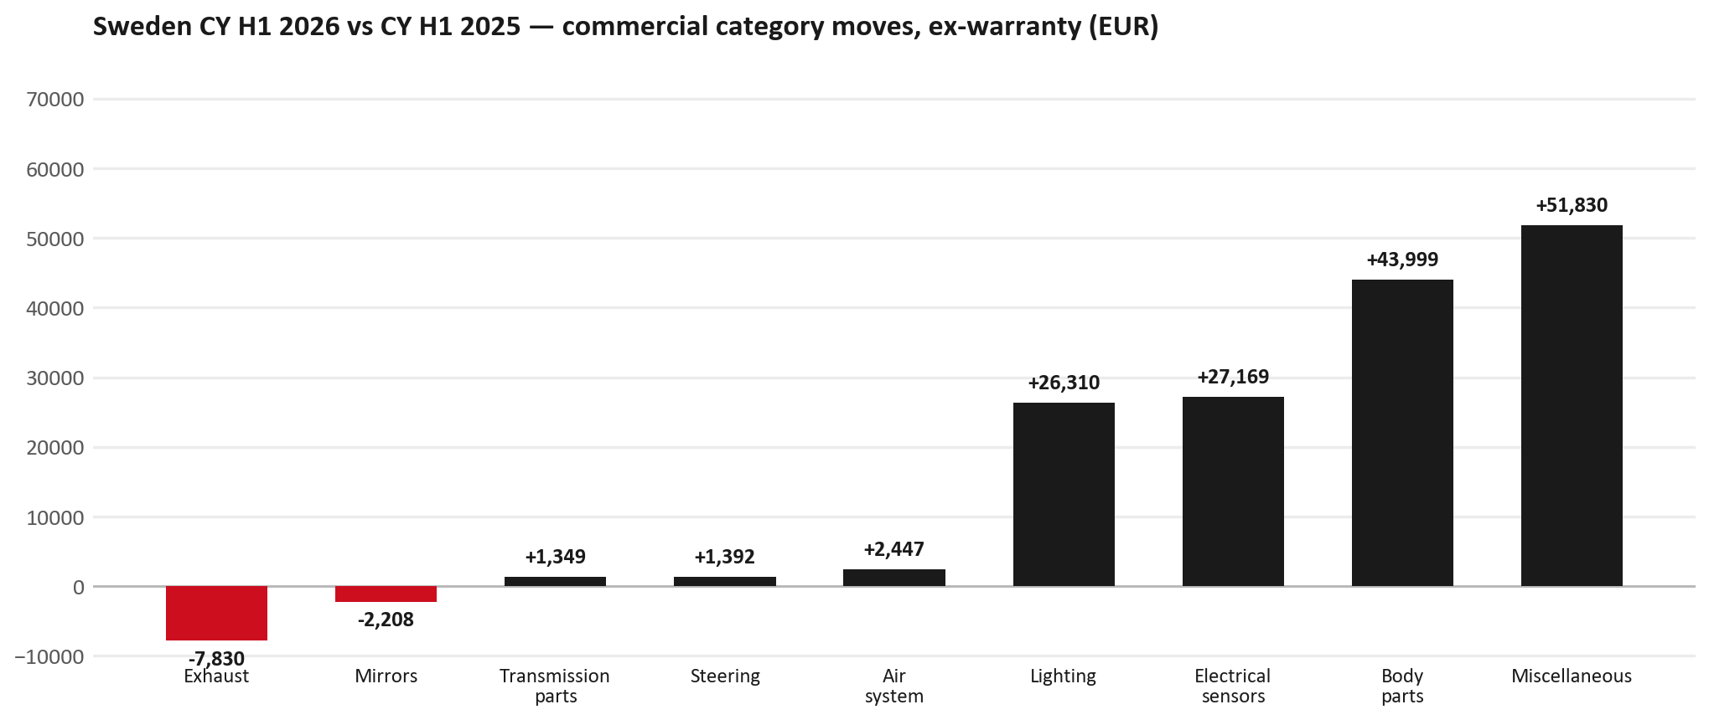
PARTS PERFORMANCE
Parts Performance — CY H1 2026 vs CY H1 2025 (commercial, ex-warranty)
TAKEAWAYS
— Commercial parts billing (warranty/campaign excluded) EUR 549K against EUR 370K a year earlier — +48.4% (CY H1 2026 vs CY H1 2025, Jan–Jun).
— Largest PN drops (all categories): 8983952370 (DRIVE ASM; FINAL,RR) EUR -8K, 6 fewer pcs; 8975536860 (BODY ASM; REAR) EUR -4K, 3 fewer pcs; 8983953042 (FRAME ASM) EUR -3K, 1 fewer pcs.
— Largest PN gains (all categories): 8974995480 (FILTER; ACL) [TFR,TFS,UCR,UCS] EUR 7K, 255 more pcs; 5874123812 (INTERFACE MX2-T) EUR 5K, 5 more pcs; 8975554500 (FILTER; BLOWER UNIT) [TF*,UC*] EUR 5K, 40 more pcs.
— Within Miscellaneous (EUR 52K, +203%): 7552816560 (BATTERY ASM; HIGH VO) EUR 39K, 1 more pcs; 5874123812 (INTERFACE MX2-T) EUR 5K, 5 more pcs; 8972660360 (TRANSFER ASM) EUR 2K, 1 more pcs.
3

Slide 4
PARTS PERFORMANCE — EXHAUST
Exhaust — CY H1 2026 vs CY H1 2025 (commercial, ex-warranty)
— EUR 14,504 (CY H1 2025) to EUR 6,673 (CY H1 2026), down EUR 7,830 (-54%).
— Largest part numbers driving the decline (by EUR):
— 8983320764 (DPD ASM): EUR 4,395 to EUR 2,198, 1 fewer pieces.
— 8983511791 (PIPE; EXH): EUR 1,863 to EUR 0, 5 fewer pieces.
— 8981405904 (SILENCER ASM; EXH): EUR 1,573 to EUR 0, 11 fewer pieces.
— 8980139111 (VALVE; EGR): EUR 1,458 to EUR 0, 10 fewer pieces.
Questions for us to work through together
— Is this pricing against what the dealers can buy locally?
— Is any of this stock timing on your side rather than end demand?
— What would make the biggest difference to keep this business with us?
4

Slide 5
PARTS PERFORMANCE — MIRRORS
Mirrors — CY H1 2026 vs CY H1 2025 (commercial, ex-warranty)
— EUR 5,505 (CY H1 2025) to EUR 3,297 (CY H1 2026), down EUR 2,208 (-40%).
— Largest part numbers driving the decline (by EUR):
— 8984813531 (MIRROR ASM; DOOR): EUR 939 to EUR 0, 7 fewer pieces.
— 7551828420 (MIRROR ASM; DOOR): EUR 650 to EUR 126, 4 fewer pieces.
— 8983288527 (MIRROR ASM; DOOR): EUR 505 to EUR 0, 4 fewer pieces.
— 7551828430 (MIRROR ASM; DOOR): EUR 521 to EUR 126, 3 fewer pieces.
Questions for us to work through together
— Is this pricing against what the dealers can buy locally?
— Is any of this stock timing on your side rather than end demand?
— What would make the biggest difference to keep this business with us?
5

Slide 6
PARTS PERFORMANCE — GROWTH
Where volume grew — CY H1 2026 vs CY H1 2025 (commercial, ex-warranty)
Part | Description | Model | CY H1 2025 | CY H1 2026 | Δ EUR
8974995480 | FILTER; ACL | TFR,TFS,UCR,UCS | EUR 7,517 | EUR 14,527 | EUR 7,010
5874123812 | INTERFACE MX2-T | — | EUR 8,022 | EUR 13,137 | EUR 5,115
8975554500 | FILTER; BLOWER UNIT | TF*,UC* | EUR 15,796 | EUR 20,691 | EUR 4,895
7552172691 | BUMPER ASM; FRT | — | EUR 708 | EUR 5,391 | EUR 4,683
8977993753 | LAMP ASM; HEAD | — | EUR 3,624 | EUR 7,900 | EUR 4,276
8975509392 | BUMPER ASM; FRT | — | EUR 11,601 | EUR 15,104 | EUR 3,504
— Miscellaneous +203%, Body parts +34%, Electrical sensors +157% — where the commercial volume went.
— Claim-matched PNs (154 distinct) and campaign/recall text matches are already excluded from this growth list. Residual warranty on unmapped PNs can remain.
— PNs ranked by largest EUR increase (prior-period sales > 0). Worth agreeing which of these are repeatable and which were one-off.
6

Slide 7
PARTS PERFORMANCE
New Business — validation queue (CY H1 2026)
Part | Description | Current sales | Review
7552816560 | BATTERY ASM; HIGH VOLTAGE | EUR 38,794 | Validate
8972746690 | TANK ASM; DEF | EUR 8,829 | Warranty / campaign
8978461152 | GLASS; WINDSHIELD | EUR 7,174 | Warranty / campaign
8978249025 | LAMP ASM; HEAD | EUR 4,646 | Validate
7552689700 | PUMP; WATER | EUR 4,550 | Validate
5884026751 | COMPRESSION GAUGE | EUR 4,003 | Validate
— These lines had no prior-period sales, so they are kept out of the incremental-growth table.
— A first sale can be a new model, a supersession, timing, or a warranty campaign. It is not treated as a commercial win until that cause is confirmed.
7

Slide 8
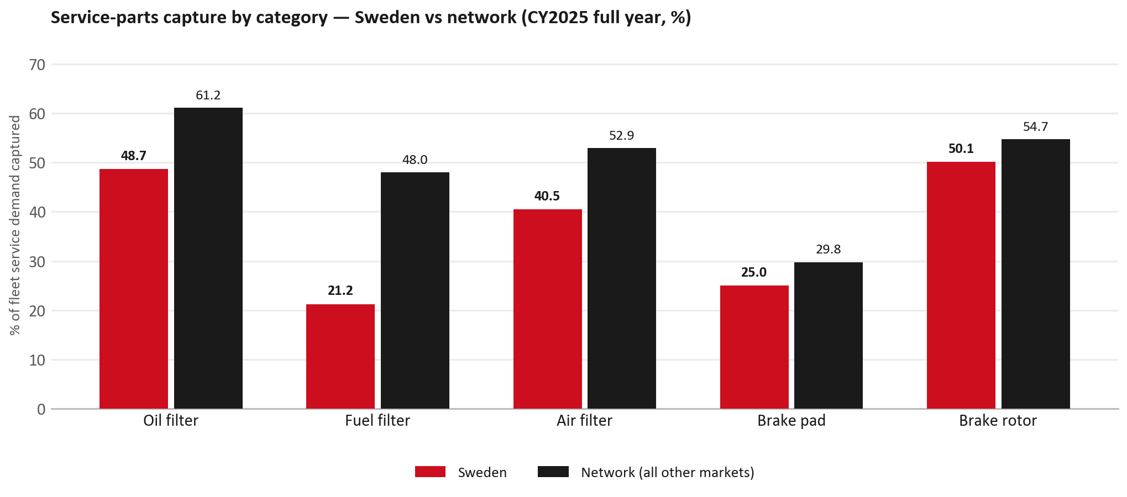
SERVICE-PARTS COVERAGE
Service-parts coverage sits below the network on every routine category
TAKEAWAYS
— Fuel filter 21.2% against 48.0% for the rest of the network.
— Oil filter 48.7% against 61.2% for the rest of the network.
— Every market here is measured on the same fleet-and-interval model, so the comparison is like-for-like even where the underlying interval assumption is debatable.
— Worth agreeing which category we tackle first, and what the joint action is.
8

Slide 9
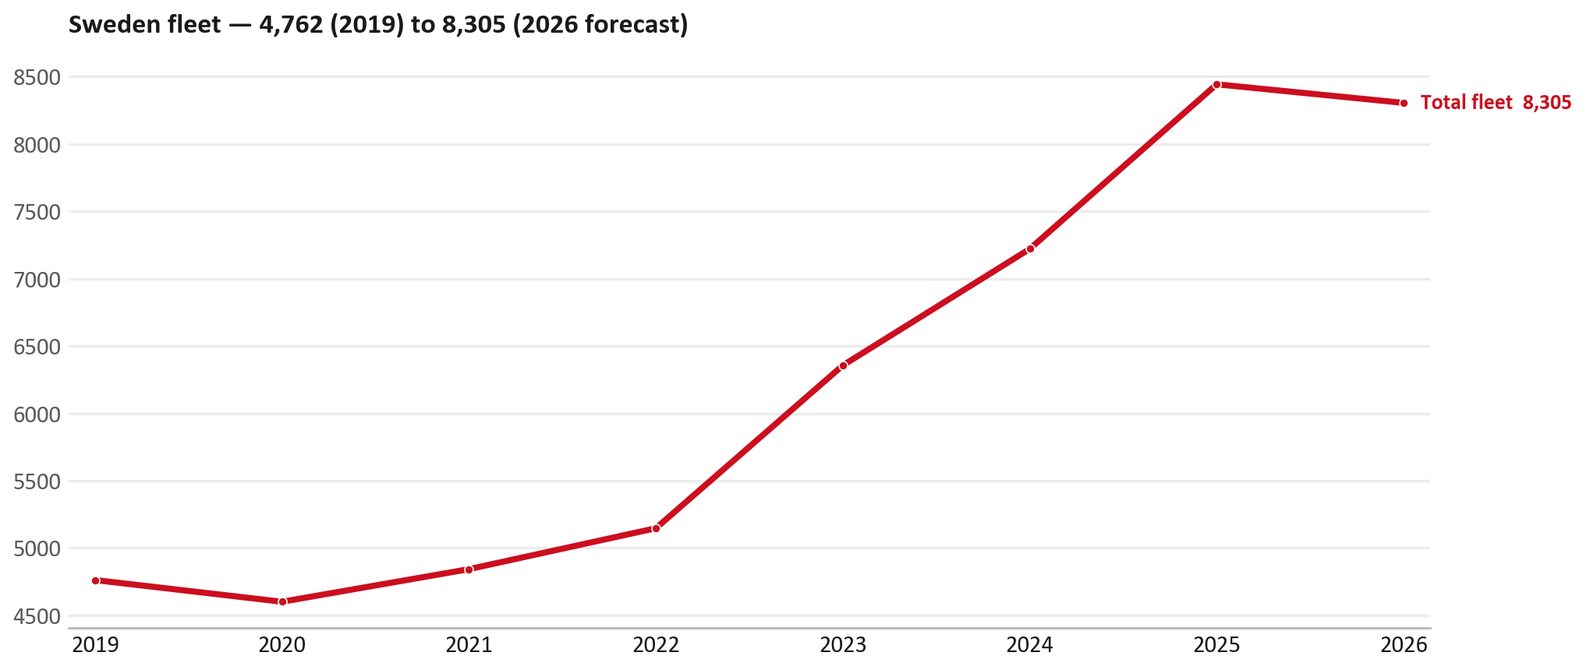
FLEET & FY2027 TARGET
The fleet is expected to decline in 2026
WHAT THIS MEANS FOR FY2027
— Fleet size (calendar year): 8,443 vehicles in 2025 → 8,305 working estimate for end-2026 (-1.6%).
— The chart is calendar years 2019–2026 only. 2026 is a working year-end estimate, not a fiscal-year figure.
— End-2026 mix: LCV / D-Max 8,305; CV — LD 0.
— The FY2027 extended target (ISZE→DB) applies a 5% price adjustment and 1.8% stretch — locked at EUR 1,502,024 from GPS Extended Target V3.1 (Dashboard column I).
— So the target is built from a slightly smaller fleet — not from an assumed growth story.
9

Slide 10
FLEET & FY2027 TARGET
How the FY2027 extended target is built
ISZE → DB extended target (V3.1 Dashboard column I)
Step | Amount
Business Plan / actual FY27 base | EUR 1,464,302
Market potential (max spend FY27) | EUR 2,095,636
Stretch (+1.8% of max spend) | EUR 37,721
FY2027 EXTENDED TARGET (locked) | EUR 1,502,024
— Extended target = BP + stretch; stretch default is 1.8% (network rule from GPS Extended Target V3.1).
— Figure locked from GPS Extended Target FY27 V3.1, Dashboard column I (SWEDEN): EUR 1,502,024.
10

Slide 11
FY2027 TARGET
What the FY2027 target reflects
1
The FY2027 business plan
2
The price move
— The target starts from the FY2027 Business Plan for this market, EUR 1,464,302.
— Your fleet outlook (-1.6%) sets the market potential the stretch is measured against.
— ISZE is applying a 5% price adjustment for FY2027, consistent with every ISZE market this year.
— It is built into the per-vehicle rate above, not added separately on top.
What it means for your target
 | Value
FY2027 extended target (V3.1 col I) | EUR 1,502,024
vs BP FY27 (EUR 1,464,302) | +2.6%
Stretch included | +1.8%
— As in previous cycles we would expect an incentive to sit alongside this adjustment — that approval is still pending on our side.
— Until the incentive is confirmed, treat the FY2027 extended target as the working figure (BP + stretch), not a locked commercial commitment.
11

Slide 12
SPA
SPA
1
SWEDEN proposal
2
ISZE review
3
Counter-proposal
4
Final approval
— Isuzu Sverige submits a proposed parts list.
— ISZE reviews the proposal against network data and fit.
— ISZE returns a counter-proposal where needed.
— Signed off by ISZE management.
Purpose: higher turnover for both sides.
12

Slide 13
R&M
R&M — let's align on the market
M
Market
S
Servicing & R&M
— How is the market moving for you right now?
— How much of your volume is fleet business rather than retail?
— Where do you see the biggest hurdles this year?
— Where are your real strengths in this segment?
— Do you offer an R&M or service-plan product today?
— What share of the parc do you retain for servicing after year three?
— Does R&M business come bundled with fleet tenders — roughly what share?
— What would it take to bring more out-of-network servicing back?
13

Slide 14
ASK
Part-level Sales-to-Dealer Data
1
Already halfway there
2
Sharper insight
3
Shared benefit
— You already report Sales-to-Dealer monthly. The ask is the same data at part-number level.
— Part-by-part visibility separates a stock movement from a lost job — and tells us where the volume actually went.
— Better availability on your fast movers, a sharper target for us, and a factual basis for the SPA — same data, both sides gain.
Requested from 01/01/2025, part number level, monthly.
14

Slide 15
SUMMARY
Next steps
— Confirm FY2027 extended target: EUR 1,502,024 (V3.1 Dashboard column I, +1.8% stretch).
— Confirm the incentive alongside the price adjustment once approved on our side.
— Exhaust / Mirrors: agree which category we tackle first, and what the joint action is.
— Agree part-level Sales-to-Dealer data sharing, effective 01/01/2025.
— SPA: SWEDEN proposal, ISZE review and counter-proposal cycle to follow.
15

Slide 16
Moving the World – for You

Slide 17
SWEDEN · ISUZU SVERIGE
Deep dive — detail behind the Mode A story
— Extra detail for meeting prep — pick which slides to share with Isuzu Sverige.
— Mode A ends on the previous closing slide.
— Label in all charts: “Genuine with BVP alternative” (not “genuine contested”).
17

Slide 18
AGENDA
Deep-dive agenda
— GPS — fiscal year (headline vs excl. warranty; max two lines)
— FY2025 → FY2026 wallet mix (Genuine / Genuine with BVP alternative / BVP)
— Where the money went — outside the service-parts basket (FY)
— Service parts: CY capture vs network + FY billing (capture % is CY-only by design)
— Brake pads — BVP share of total brake pad sales (FY)
— AIM exposure
— Warranty — two lenses
— How to use this in the meeting
18

Slide 19
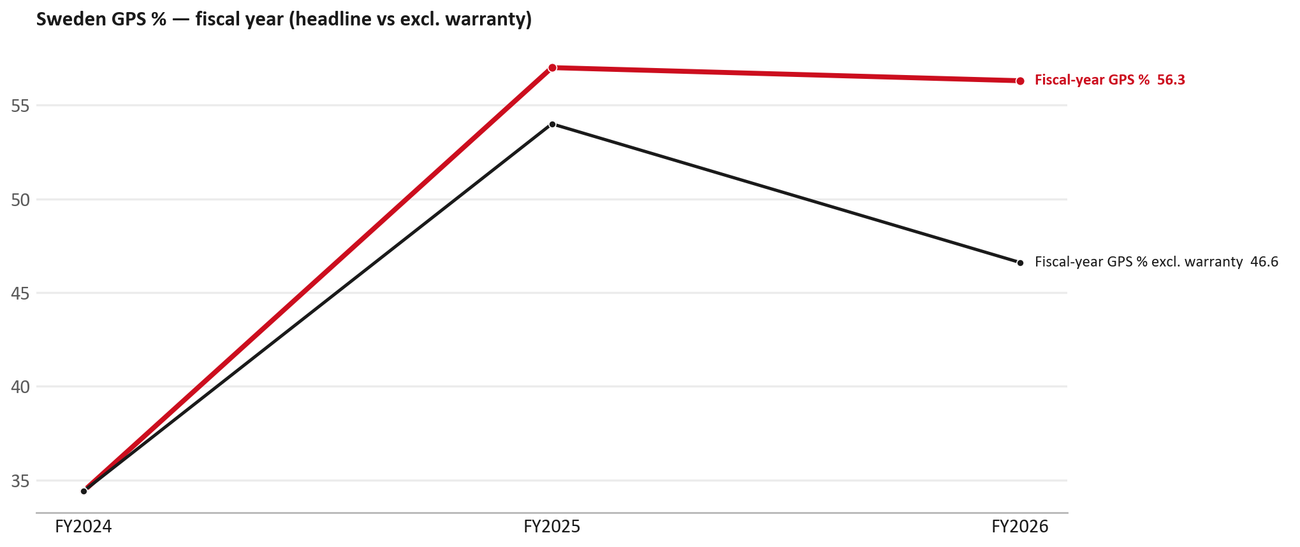
GPS
GPS: fiscal year headline vs after warranty
TAKEAWAYS
— Red = fiscal-year GPS (frozen CY2025 wallet). FY25 57.0% → FY26 56.3%.
— Black = the same GPS after removing warranty parts (€). FY26 ≈ 46.6% (warranty EUR 303,689 ≈ 25% of FY26 billing).
— Both lines divide by the same wallet (EUR 2,135,105), so the gap between them is warranty and nothing else.
19

Slide 20
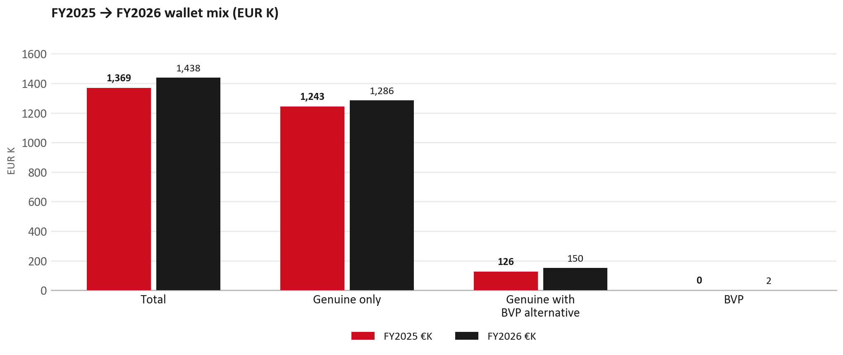
WALLET MIX
FY2025 → FY2026 wallet mix
— Total EUR 1,368,714 → EUR 1,438,426 (+5.1%).
— Genuine only EUR 43,773.
— Genuine with BVP alternative EUR 24,192; BVP EUR 1,747 (0.1% of FY26 wallet).
— Display label locked: Genuine with BVP alternative.
20

Slide 21
WALLET MIX
FY wallet mix — detail
 | FY2025 | FY2026 | Δ
Total | EUR 1,368,714 | EUR 1,438,426 | EUR 69,712
Genuine only | EUR 1,242,596 | EUR 1,286,369 | EUR 43,773
Genuine with BVP alternative | EUR 126,118 | EUR 150,310 | EUR 24,192
BVP | EUR 0 | EUR 1,747 | EUR 1,747
BVP % of wallet | 0.0% | 0.1% | +0.1 pp
21

Slide 22
DRIVERS
Where the genuine drop sits (FY2025 → FY2026)
— Genuine-only sales moved EUR 43,773 from FY2025 to FY2026.
— Of that, the routine service basket (filters, pads, rotors) moved EUR 32,328 on genuine-only; BVP in that basket moved EUR 1,747.
— Genuine-only did not fall on this FY cut — check category movers and H1 for pressure points.
— Meeting line: check high-value assemblies / sensors before blaming the filter or pad menu.
22

Slide 23
DRIVERS
Largest part-number drops (FY24→FY25) — outside service filters
Part | Description | Δ EUR
8977998750 | STEERING UNIT | -18,332
8983550720 | partikel sensor | -15,778
8975293230 | ENGINE ASM | -11,250
8975359390 | DPD ASM | -4,512
5874123812 | INTERFACE MX2-T | -3,213
8982330912 | LAMP ASM; RR COMB | -3,199
8980139111 | VALVE; EGR | -3,059
— Check warranty / campaign coding before calling competitive leakage.
23

Slide 24
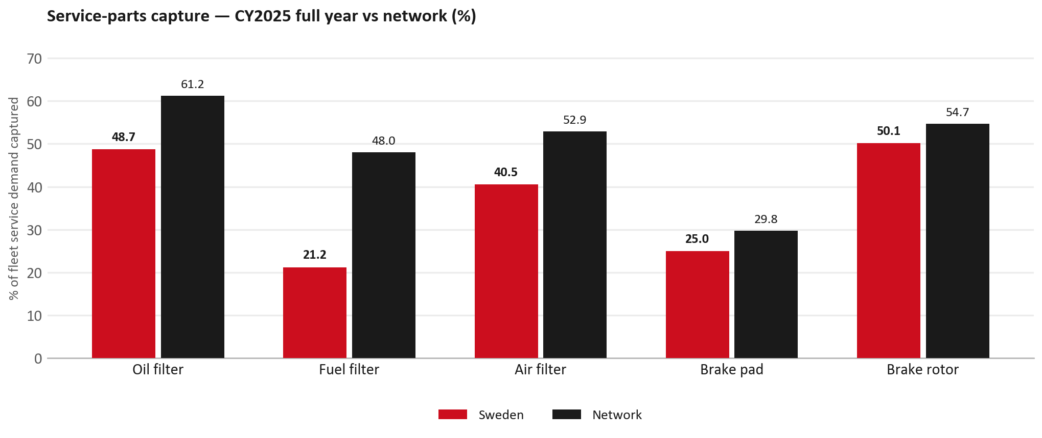
SERVICE PARTS
Service-parts capture vs network (calendar year)
TAKEAWAYS
— Capture % is calendar-year (full CY2025). Fleet demand is modelled on calendar years — there is no matching fiscal-year capture %.
— Oil filter 48.7% vs network 61.2%; Fuel filter 21.2% vs network 48.0%; Air filter 40.5% vs network 52.9%.
— Next slide: fiscal-year € billing in the same 5 categories.
— Primary lens = total capture (not genuine-only).
24

Slide 25
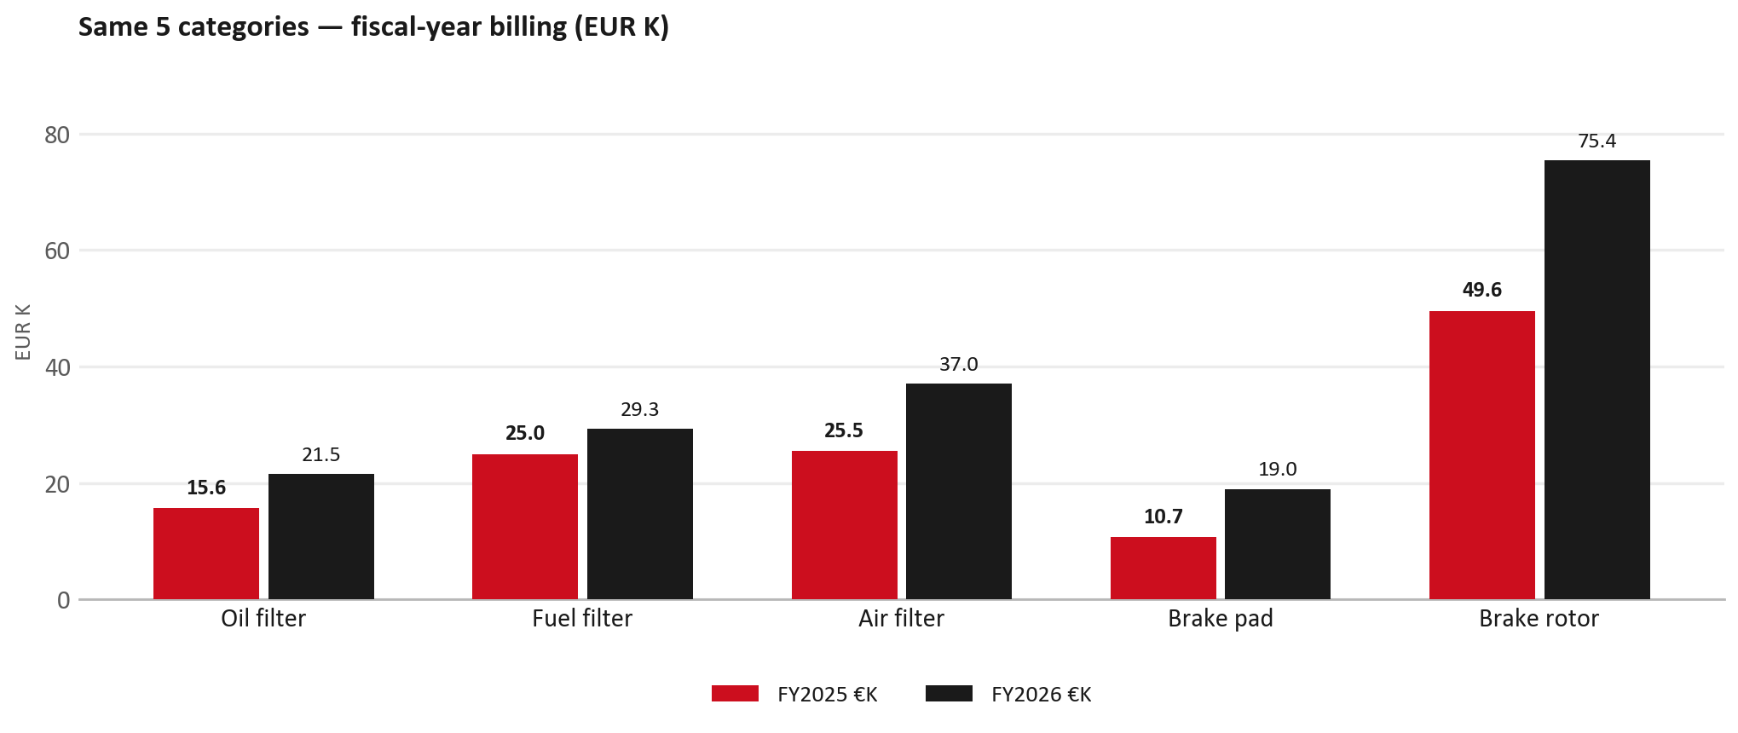
SERVICE PARTS · FY
Service-parts billing by fiscal year (same 5 lines)
TAKEAWAYS
— This is Sales-to-Isuzu Sverige € in fiscal years — not capture % of fleet demand.
— Use both lenses — do not mix % capture with € billing.
— Primary = total sales in the basket.
25

Slide 26
BRAKES
Brake pads — BVP share of total brake pad sales (FY)
 | FY2025 | FY2026
Genuine pad sales (€) | EUR 10,691 | EUR 18,992
BVP pad sales (€) | EUR 0 | EUR 0
Genuine qty | 183 | 312
BVP qty | 0 | 0
BVP share of pad sales (€) | 0% | 0%
— BVP share = BVP € ÷ all brake-pad € billed (genuine + BVP). Not a PMS capture %.
— Isuzu Sverige pad sales are genuine-only in this cut (~EUR 19K FY26) — no BVP pad lines billed.
— Wallet-level BVP is still only ~0.1% of FY26 — do not generalise a pad story to the whole wallet.
26

Slide 27
AIM
AIM exposure
Year | High-risk € | High-risk % | Quadrant
2023 | EUR 11,791 | 1.7% | Priority target (low GPS - low capture)
2024 | EUR 14,429 | 1.3% | Priority target (low GPS - low capture)
2025 | EUR 10,725 | 0.8% | Priority target (low GPS - low capture)
— High-risk € is catalogue AIM exposure, not proven walk-out.
— Open on jobs not bought through the distributor — not a street IAM war alone.
27

Slide 28
WARRANTY
Warranty — two real lenses
1
CY2025 claim-price parts
2
Fiscal GPS expense
— EUR 189,618 (claim-price basis).
— Calendar-year claim price basis.
— LCV warranty.
— FY24 EUR 68 · FY25 EUR 63,980 · FY26 EUR 303,689.
— Source row: Sverige.
— Ex-warranty GPS = (net − warranty) ÷ frozen CY25 wallet.
— Both numbers are real — never mix them on one slide without labels.
28

Slide 29
BRIDGE
How to use this in the meeting
If they say… | You know…
BVP is eating genuine | Wallet BVP ~0.1%. Check pads as a local exception only.
GPS looks fine / too high | FY26 headline 56.3%; excl. warranty ≈ 46.6%.
Service parts are fine | CY2025 capture vs network (previous slides) + FY billing lens.
29

Slide 30
Moving the World – for You

