Slide 1

ISZE · SWEDEN · SWEDEN
Sweden Sales Review
& FY2027 Target
Isuzu Sverige · August 2026

Slide 2
SWEDEN MEETING
Agenda
— Parts Performance — category movers
— Parts Performance — Exhaust
— Parts Performance — Mirrors
— Parts Performance — where volume grew
— New Business — validation queue
— Service-Parts Coverage
— Fleet & FY2027 Target
— SPA — status
— R&M — market discussion
— Data request: part-level Sales-to-Dealer
— Next steps
2

Slide 3
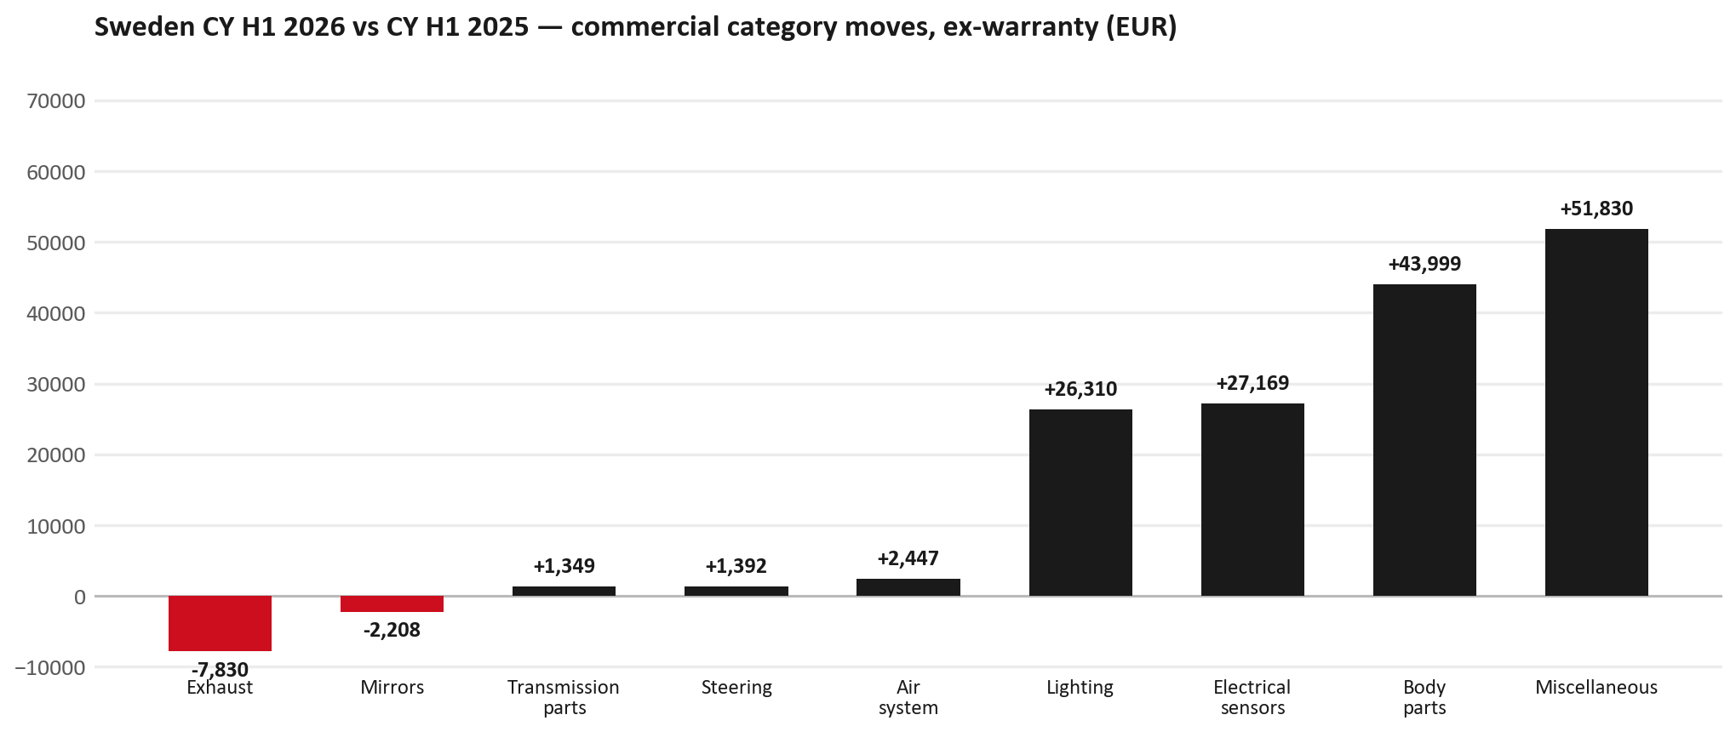
PARTS PERFORMANCE
Parts Performance — CY H1 2026 vs CY H1 2025 (commercial, ex-warranty)
TAKEAWAYS
— Commercial parts billing (warranty/campaign excluded) EUR 549K against EUR 370K a year earlier — +48.4% (CY H1 2026 vs CY H1 2025, Jan–Jun).
— Largest PN drops (all categories): 8983952370 (DRIVE ASM; FINAL,RR) EUR -8K, 6 fewer pcs; 8975536860 (BODY ASM; REAR) EUR -4K, 3 fewer pcs; 8983953042 (FRAME ASM) EUR -3K, 1 fewer pcs.
— Largest PN gains (all categories): 8974995480 (FILTER; ACL) [TFR,TFS,UCR,UCS] EUR 7K, 255 more pcs; 5874123812 (INTERFACE MX2-T) EUR 5K, 5 more pcs; 8975554500 (FILTER; BLOWER UNIT) [TF*,UC*] EUR 5K, 40 more pcs.
— Within Miscellaneous (EUR 52K, +203%): 7552816560 (BATTERY ASM; HIGH VO) EUR 39K, 1 more pcs; 5874123812 (INTERFACE MX2-T) EUR 5K, 5 more pcs; 8972660360 (TRANSFER ASM) EUR 2K, 1 more pcs.
3

Slide 4
PARTS PERFORMANCE — EXHAUST
Exhaust — CY H1 2026 vs CY H1 2025 (commercial, ex-warranty)
— EUR 14,504 (CY H1 2025) to EUR 6,673 (CY H1 2026), down EUR 7,830 (-54%).
— Largest part numbers driving the decline (by EUR):
— 8983320764 (DPD ASM): EUR 4,395 to EUR 2,198, 1 fewer pieces.
— 8983511791 (PIPE; EXH): EUR 1,863 to EUR 0, 5 fewer pieces.
— 8981405904 (SILENCER ASM; EXH): EUR 1,573 to EUR 0, 11 fewer pieces.
— 8980139111 (VALVE; EGR): EUR 1,458 to EUR 0, 10 fewer pieces.
Questions for us to work through together
— Is this pricing against what the dealers can buy locally?
— Is any of this stock timing on your side rather than end demand?
— What would make the biggest difference to keep this business with us?
4

Slide 5
PARTS PERFORMANCE — MIRRORS
Mirrors — CY H1 2026 vs CY H1 2025 (commercial, ex-warranty)
— EUR 5,505 (CY H1 2025) to EUR 3,297 (CY H1 2026), down EUR 2,208 (-40%).
— Largest part numbers driving the decline (by EUR):
— 8984813531 (MIRROR ASM; DOOR): EUR 939 to EUR 0, 7 fewer pieces.
— 7551828420 (MIRROR ASM; DOOR): EUR 650 to EUR 126, 4 fewer pieces.
— 8983288527 (MIRROR ASM; DOOR): EUR 505 to EUR 0, 4 fewer pieces.
— 7551828430 (MIRROR ASM; DOOR): EUR 521 to EUR 126, 3 fewer pieces.
Questions for us to work through together
— Is this pricing against what the dealers can buy locally?
— Is any of this stock timing on your side rather than end demand?
— What would make the biggest difference to keep this business with us?
5

Slide 6
PARTS PERFORMANCE — GROWTH
Where volume grew — CY H1 2026 vs CY H1 2025 (commercial, ex-warranty)
Part | Description | Model | CY H1 2025 | CY H1 2026 | Δ EUR
8974995480 | FILTER; ACL | TFR,TFS,UCR,UCS | EUR 7,517 | EUR 14,527 | EUR 7,010
5874123812 | INTERFACE MX2-T | — | EUR 8,022 | EUR 13,137 | EUR 5,115
8975554500 | FILTER; BLOWER UNIT | TF*,UC* | EUR 15,796 | EUR 20,691 | EUR 4,895
7552172691 | BUMPER ASM; FRT | — | EUR 708 | EUR 5,391 | EUR 4,683
8977993753 | LAMP ASM; HEAD | — | EUR 3,624 | EUR 7,900 | EUR 4,276
8975509392 | BUMPER ASM; FRT | — | EUR 11,601 | EUR 15,104 | EUR 3,504
— Miscellaneous +203%, Body parts +34%, Electrical sensors +157% — where the commercial volume went.
— Claim-matched PNs (154 distinct) and campaign/recall text matches are already excluded from this growth list. Residual warranty on unmapped PNs can remain.
— PNs ranked by largest EUR increase (prior-period sales > 0). Worth agreeing which of these are repeatable and which were one-off.
6

Slide 7
PARTS PERFORMANCE
New Business — validation queue (CY H1 2026)
Part | Description | Current sales | Review
7552816560 | BATTERY ASM; HIGH VOLTAGE | EUR 38,794 | Validate
8972746690 | TANK ASM; DEF | EUR 8,829 | Warranty / campaign
8978461152 | GLASS; WINDSHIELD | EUR 7,174 | Warranty / campaign
8978249025 | LAMP ASM; HEAD | EUR 4,646 | Validate
7552689700 | PUMP; WATER | EUR 4,550 | Validate
5884026751 | COMPRESSION GAUGE | EUR 4,003 | Validate
— These lines had no prior-period sales, so they are kept out of the incremental-growth table.
— A first sale can be a new model, a supersession, timing, or a warranty campaign. It is not treated as a commercial win until that cause is confirmed.
7

Slide 8
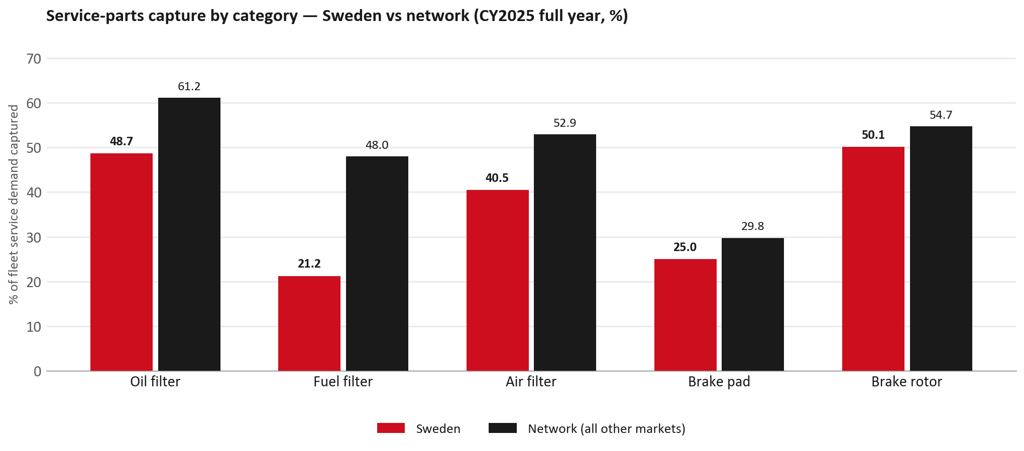
SERVICE-PARTS COVERAGE
Service-parts coverage sits below the network on every routine category
TAKEAWAYS
— Fuel filter 21.2% against 48.0% for the rest of the network.
— Oil filter 48.7% against 61.2% for the rest of the network.
— Every market here is measured on the same fleet-and-interval model, so the comparison is like-for-like even where the underlying interval assumption is debatable.
— Worth agreeing which category we tackle first, and what the joint action is.
8

Slide 9
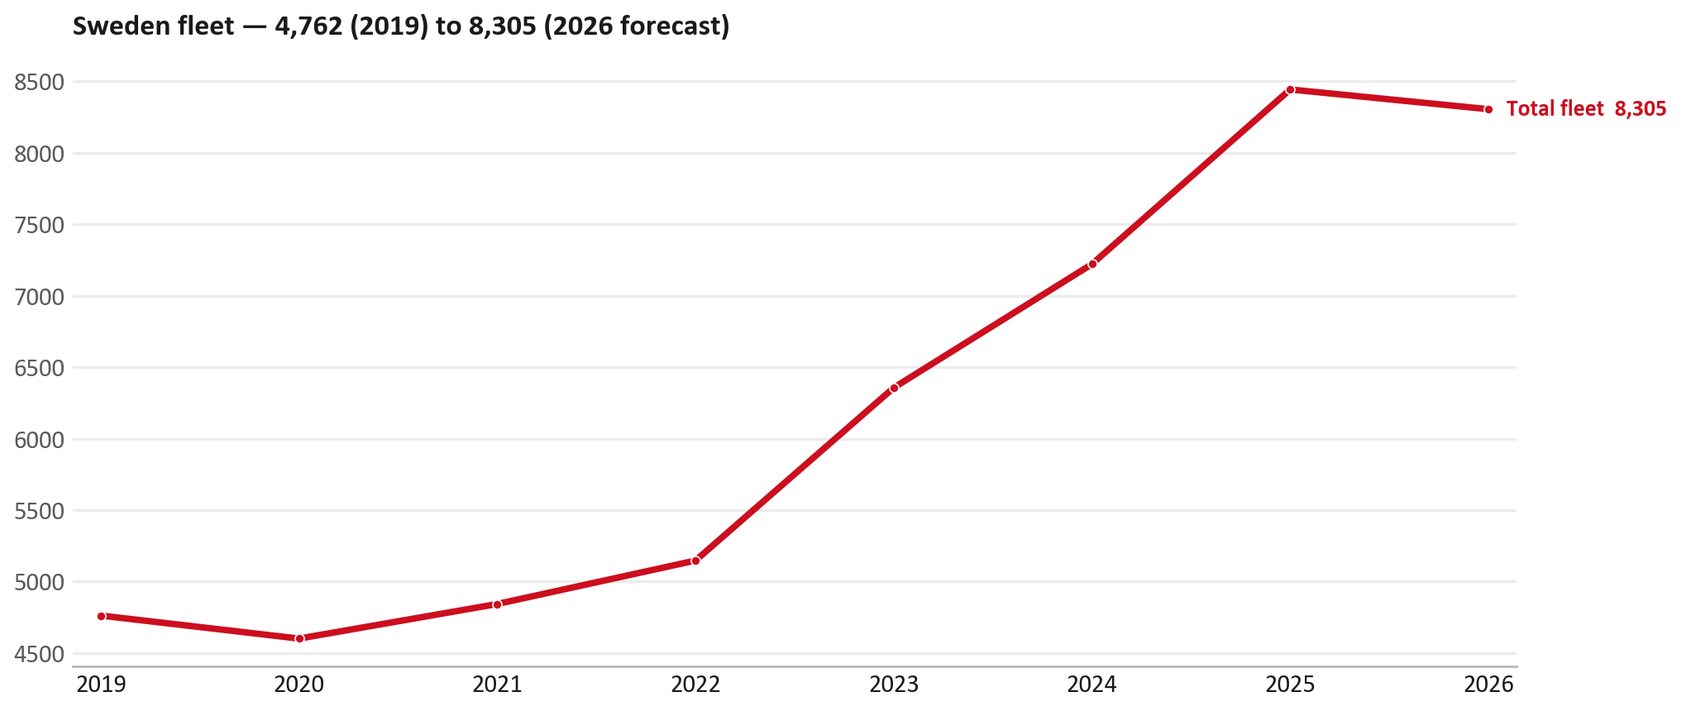
FLEET & FY2027 TARGET
The fleet is expected to decline in 2026
WHAT THIS MEANS FOR FY2027
— Fleet size (calendar year): 8,443 vehicles in 2025 → 8,305 working estimate for end-2026 (-1.6%).
— The chart is calendar years 2019–2026 only. 2026 is a working year-end estimate, not a fiscal-year figure.
— End-2026 mix: LCV / D-Max 8,305; CV — LD 0.
— The FY2027 extended target (ISZE→DB) applies a 5% price adjustment and 1.8% stretch — locked at EUR 1,502,024 from GPS Extended Target V3.1 (Dashboard column I).
— So the target is built from a slightly smaller fleet — not from an assumed growth story.
9

Slide 10
FLEET & FY2027 TARGET
How the FY2027 extended target is built
ISZE → DB extended target (V3.1 Dashboard column I)
Step | Amount
Business Plan / actual FY27 base | EUR 1,464,302
Market potential (max spend FY27) | EUR 2,095,636
Stretch (+1.8% of max spend) | EUR 37,721
FY2027 EXTENDED TARGET (locked) | EUR 1,502,024
— Extended target = BP + stretch; stretch default is 1.8% (network rule from GPS Extended Target V3.1).
— Figure locked from GPS Extended Target FY27 V3.1, Dashboard column I (SWEDEN): EUR 1,502,024.
10

Slide 11
FY2027 TARGET
What the FY2027 target reflects
1
The FY2027 business plan
2
The price move
— The target starts from the FY2027 Business Plan for this market, EUR 1,464,302.
— Your fleet outlook (-1.6%) sets the market potential the stretch is measured against.
— ISZE is applying a 5% price adjustment for FY2027, consistent with every ISZE market this year.
— It is built into the per-vehicle rate above, not added separately on top.
What it means for your target
 | Value
FY2027 extended target (V3.1 col I) | EUR 1,502,024
vs BP FY27 (EUR 1,464,302) | +2.6%
Stretch included | +1.8%
— As in previous cycles we would expect an incentive to sit alongside this adjustment — that approval is still pending on our side.
— Until the incentive is confirmed, treat the FY2027 extended target as the working figure (BP + stretch), not a locked commercial commitment.
11

Slide 12
SPA
SPA
1
SWEDEN proposal
2
ISZE review
3
Counter-proposal
4
Final approval
— Isuzu Sverige submits a proposed parts list.
— ISZE reviews the proposal against network data and fit.
— ISZE returns a counter-proposal where needed.
— Signed off by ISZE management.
Purpose: higher turnover for both sides.
12

Slide 13
R&M
R&M — let's align on the market
M
Market
S
Servicing & R&M
— How is the market moving for you right now?
— How much of your volume is fleet business rather than retail?
— Where do you see the biggest hurdles this year?
— Where are your real strengths in this segment?
— Do you offer an R&M or service-plan product today?
— What share of the parc do you retain for servicing after year three?
— Does R&M business come bundled with fleet tenders — roughly what share?
— What would it take to bring more out-of-network servicing back?
13

Slide 14
ASK
Part-level Sales-to-Dealer Data
1
Already halfway there
2
Sharper insight
3
Shared benefit
— You already report Sales-to-Dealer monthly. The ask is the same data at part-number level.
— Part-by-part visibility separates a stock movement from a lost job — and tells us where the volume actually went.
— Better availability on your fast movers, a sharper target for us, and a factual basis for the SPA — same data, both sides gain.
Requested from 01/01/2025, part number level, monthly.
14

Slide 15
SUMMARY
Next steps
— Confirm FY2027 extended target: EUR 1,502,024 (V3.1 Dashboard column I, +1.8% stretch).
— Confirm the incentive alongside the price adjustment once approved on our side.
— Exhaust / Mirrors: agree which category we tackle first, and what the joint action is.
— Agree part-level Sales-to-Dealer data sharing, effective 01/01/2025.
— SPA: SWEDEN proposal, ISZE review and counter-proposal cycle to follow.
15

Slide 16
Moving the World – for You

