Slide 1

ISZE · HUNGARY · HUNGARY
Hungary Sales Review
& FY2027 Target
AutoWallis Distribution · August 2026

Slide 2
HUNGARY MEETING
Agenda
— Parts Performance — category movers
— Parts Performance — Brake parts
— Parts Performance — Steering
— Parts Performance — Turbo
— Parts Performance — where volume grew
— New Business — validation queue
— FY2027 Extended Target — ISZE to HUNGARY
— GPS Capture
— Service-Parts Coverage
— IDS 2026 — Dealer Standard
— Fleet & FY2027 Target
— SPA — status
— R&M — market discussion
— Data request: part-level Sales-to-Dealer
— Next steps
2

Slide 3
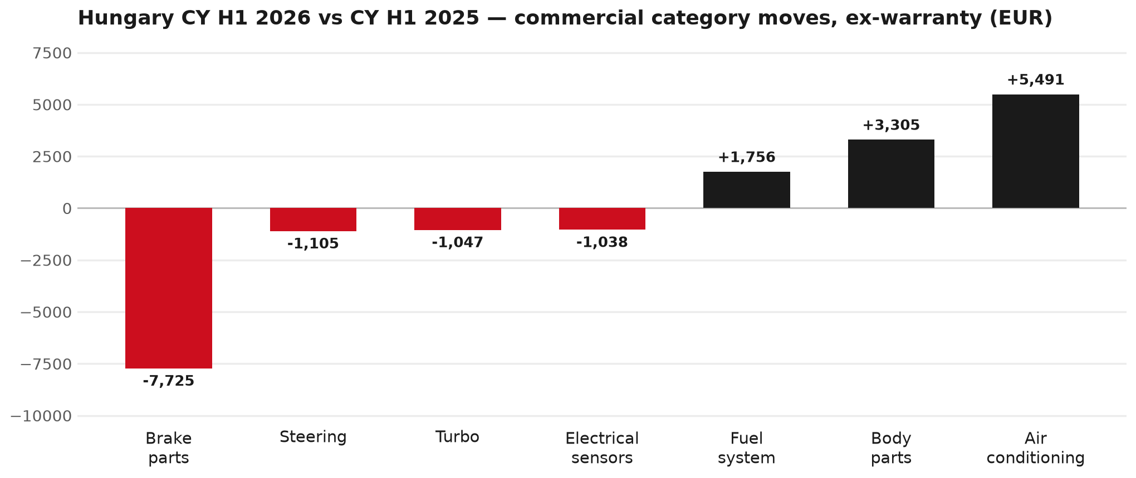
PARTS PERFORMANCE
Parts Performance — CY H1 2026 vs CY H1 2025 (commercial, ex-warranty)
TAKEAWAYS
— Commercial parts billing (warranty/campaign excluded) EUR 123K against EUR 122K a year earlier — +0.3% (CY H1 2026 vs CY H1 2025, Jan–Jun).
— Largest PN drops (all categories): 8983767550 (ROTOR; DISC BRK,FRT) EUR -6K, 79 fewer pcs; 8977993753 (LAMP ASM; HEAD) EUR -3K, 9 fewer pcs; 8975546610 (PAD KIT; CALIPER,DIS) [TF*] EUR -2K, 21 fewer pcs.
— Largest PN gains (all categories): 8974995480 (FILTER; ACL) [TFR,TFS,UCR,UCS] EUR 3K, 154 more pcs; 1884057520 (T AXLE OIL 20L) EUR 2K, 14 more pcs; 8975595830 (PANEL; SIDE GATE) EUR 2K, 8 more pcs.
— Within Air conditioning (EUR 5K, +37%): 8974995480 (FILTER; ACL) [TFR,TFS,UCR,UCS] EUR 3K, 154 more pcs; 8975554500 (FILTER; BLOWER UNIT) [TF*,UC*] EUR 1K, 51 more pcs; 8981569021 (CONTROL SUB ASM; HTR) EUR 0K.
3

Slide 4
PARTS PERFORMANCE — BRAKE PARTS
Brake parts — CY H1 2026 vs CY H1 2025 (commercial, ex-warranty)
— EUR 18,443 (CY H1 2025) to EUR 10,718 (CY H1 2026), down EUR 7,725 (-42%).
— Largest part numbers driving the decline (by EUR):
— 8983767550 (ROTOR; DISC BRK,FRT): EUR 11,764 to EUR 5,544, 79 fewer pieces.
— 8975546610 (PAD KIT; CALIPER,DISC BRK,FRT · TF*): EUR 2,500 to EUR 742, 21 fewer pieces.
— 8978279610 (PAD KIT; DISC BRK,W/O SHIM & CLIP): EUR 2,015 to EUR 1,311, 10 fewer pieces.
— 8976526220 (PAD KIT; CALIPER,DISC BRK,FRT): EUR 644 to EUR 0, 10 fewer pieces.
Questions for us to work through together
— Is pad and rotor pricing competitive against what the dealers can buy locally?
— Is any of this stock timing on your side rather than end demand?
— Are dealers still quoting these part numbers, or have they dropped off the workshop menu?
4

Slide 5
PARTS PERFORMANCE — STEERING
Steering — CY H1 2026 vs CY H1 2025 (commercial, ex-warranty)
— EUR 2,096 (CY H1 2025) to EUR 991 (CY H1 2026), down EUR 1,105 (-53%).
— Largest part numbers driving the decline (by EUR):
— 8979461321 (STEERING UNIT): EUR 624 to EUR 0, 1 fewer pieces.
— 8979461642 (PUMP ASM; OIL,P/S): EUR 465 to EUR 0, 2 fewer pieces.
— 7552338510 (KNUCKLE; FRT AXLE): EUR 257 to EUR 0, 1 fewer pieces.
— 8983039040 (KNUCKLE; FRT AXLE): EUR 186 to EUR 0, 1 fewer pieces.
Questions for us to work through together
— Is this pricing against what the dealers can buy locally?
— Is any of this stock timing on your side rather than end demand?
— What would make the biggest difference to keep this business with us?
5

Slide 6
PARTS PERFORMANCE — TURBO
Turbo — CY H1 2026 vs CY H1 2025 (commercial, ex-warranty)
— EUR 1,059 (CY H1 2025) to EUR 12 (CY H1 2026), down EUR 1,047 (-99%).
— Largest part numbers driving the decline (by EUR):
— 8974985741 (TURBOCHARGER ASM): EUR 857 to EUR 0, 1 fewer pieces.
— 8975334720 (PIPE; OIL RETURN,TURBOCHARGER): EUR 119 to EUR 0, 2 fewer pieces.
— 8981993530 (SENSOR; TURBOCHARGER): EUR 48 to EUR 0, 1 fewer pieces.
— 8982480882 (GASKET; TURBOCHARGER TO EXH MANIF): EUR 20 to EUR 0, 5 fewer pieces.
Questions for us to work through together
— Is this fewer turbo failures, or jobs moving to independents?
— Is reman / exchange competing with new units on price or lead time?
— Any availability problems on the fast-moving turbo lines?
6

Slide 7
PARTS PERFORMANCE — GROWTH
Where volume grew — CY H1 2026 vs CY H1 2025 (commercial, ex-warranty)
Part | Description | Model | CY H1 2025 | CY H1 2026 | Δ EUR
8974995480 | FILTER; ACL | TFR,TFS,UCR,UCS | EUR 5,153 | EUR 8,390 | EUR 3,237
1884057520 | T AXLE OIL 20L | — | EUR 1,703 | EUR 3,801 | EUR 2,098
8975595830 | PANEL; SIDE GATE | — | EUR 430 | EUR 2,130 | EUR 1,700
8983320160 | VALVE; EGR | — | EUR 220 | EUR 1,397 | EUR 1,178
8978249035 | LAMP ASM; HEAD | — | EUR 338 | EUR 1,313 | EUR 975
5876150530 | ELEMENT; OIL FILTER | NHR,NLR,NMR,TF*, | EUR 51 | EUR 857 | EUR 806
— Air conditioning +37%, Body parts +12%, Fuel system +553% — where the commercial volume went.
— Claim-matched PNs (87 distinct) and campaign/recall text matches are already excluded from this growth list. Residual warranty on unmapped PNs can remain.
— PNs ranked by largest EUR increase (prior-period sales > 0). Worth agreeing which of these are repeatable and which were one-off.
7

Slide 8
PARTS PERFORMANCE
New Business — validation queue (CY H1 2026)
Part | Description | Current sales | Review
8984890171 | PUMP ASM; FUEL,SUPPLY | EUR 1,955 | Validate
7552689700 | PUMP; WATER | EUR 1,751 | Warranty / campaign
8978725102 | PANEL; SIDE OUTER | EUR 1,422 | Validate
8983842610 | COMPRESSOR ASM; A/C | EUR 1,195 | Validate
8980803191 | GUARD ASM; RR | EUR 1,185 | Validate
5876150610 | PAD KIT; CALIPER,DISC BRK,FRT | EUR 1,152 | Validate
— These lines had no prior-period sales, so they are kept out of the incremental-growth table.
— A first sale can be a new model, a supersession, timing, or a warranty campaign. It is not treated as a commercial win until that cause is confirmed.
8

Slide 9
FY2027 EXTENDED TARGET
FY2027 Extended Target: EUR 366,166
— FY2026 ISZE billing was EUR 346,246. The FY2027 base plan is EUR 349,600, plus a 1.8% stretch (EUR 16,566) — EUR 366,166 in total, +5.8% versus FY2026.
— That stretch lifts your GPS share of fleet potential from 38.0% to 39.8%.
— This is the ISZE→AutoWallis commercial target — separate from what you sell on to your own dealers.
— ISZE management has submitted a financial incentive tied to reaching this stretch target for FY2027 — not yet approved by Japan. We'll confirm as soon as that's through.
9

Slide 10
GPS
GPS Capture: 37.1%
— GPS measures your actual parts purchases against the full potential of your fleet.
— Hungary today: 37.1% (FY2026 purchases against the CY2025 fleet potential).
— Fleet potential: EUR 934K on 3,734 vehicles.
— Real, sustained headroom above 37.1% — the service-parts and SPA discussion are both direct levers on it.
10

Slide 11
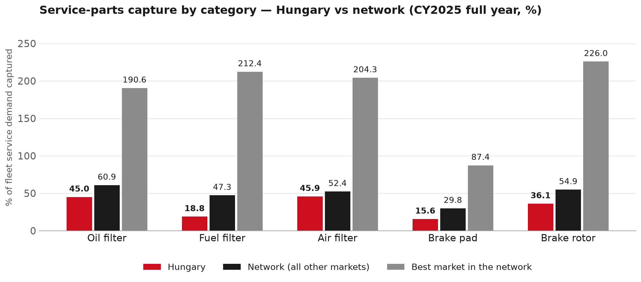
SERVICE-PARTS COVERAGE
Service-parts coverage sits below the network on every routine category
TAKEAWAYS
— Fuel filter 18.8% against 47.3% for the rest of the network.
— Brake rotor 36.1% against 54.9% for the rest of the network.
— Every market here is measured on the same fleet-and-interval model, so the comparison is like-for-like even where the underlying interval assumption is debatable.
— Worth agreeing which category we tackle first, and what the joint action is.
11

Slide 12
IDS 2026 — DEALER STANDARD
IDS 2026: Hungary 86.2% vs 74.8% network
Dealer | Total % | Global rank
Zakar | 99.3% | #3
Csősz | 96.4% | #18
Tipp-Autó | 95.0% | #27
Hungary country average | 86.2% | —
Network average (all IDS 2026) | 74.8% | —
Autó Caro | 74.3% | #358
Marsal | 69.3% | #409
Bonus Kft. | 66.8% | #425
— 19 dealers assessed across Premises, Organisation, Service, Parts and Vehicle Sales.
— The country average sits 11.4 points above the network.
— The spread is the point: 32 points between the strongest and weakest dealer.
— Dealer-by-dealer detail and individual feedback are available as a separate pack — worth agreeing which dealers to visit, and when.
12

Slide 13
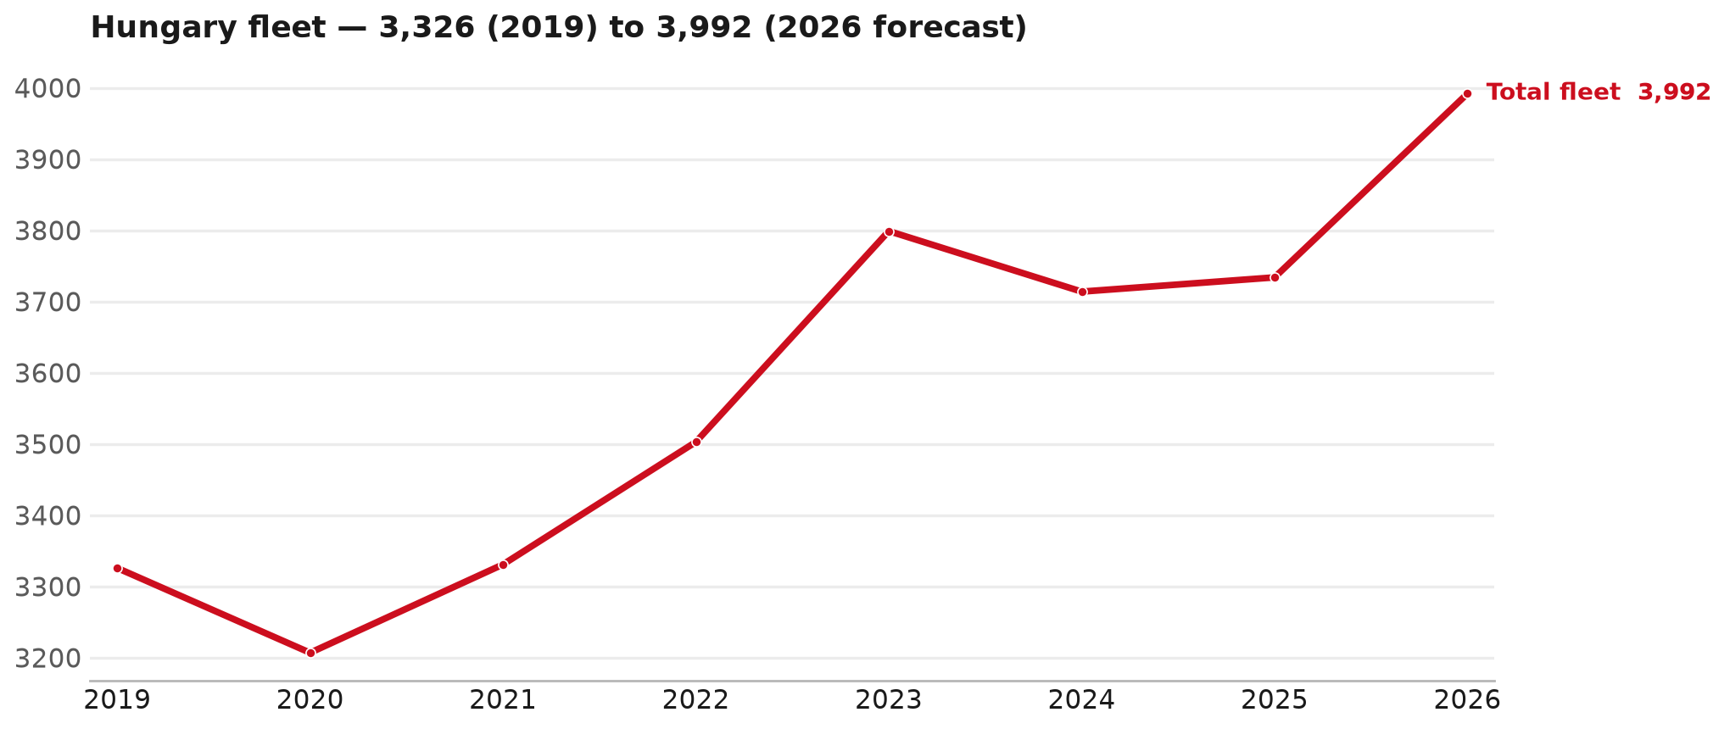
FLEET & FY2027 TARGET
The fleet is expected to grow in 2026
WHAT THIS MEANS FOR FY2027
— Fleet size (calendar year): 3,734 vehicles in 2025 → 3,992 working estimate for end-2026 (+6.9%).
— The chart is calendar years 2019–2026 only. 2026 is a working year-end estimate, not a fiscal-year figure.
— End-2026 mix: LCV / D-Max 3,992; CV — LD 0.
— That fleet growth feeds the FY2027 Extended Target's max-spend potential (EUR 920,328), which the base plan plus stretch is measured against.
— The target reflects the working fleet outlook without extending the chart beyond 2026.
13

Slide 14
FLEET & FY2027 TARGET
How the FY2027 target is built
ISZE → AutoWallis Extended Target bridge
Step | Amount
FY2026 ISZE billing (actual) | EUR 346,246
FY2027 base plan (BP FY27, reviewed with ISZE) | EUR 349,600
After stretch (+1.8% of EUR 920,328 fleet potential) | EUR 366,166
— The Extended Target is +5.8% versus FY2026 ISZE billing.
— This bridge is the ISZE→AutoWallis commercial track — a separate figure from what you sell on to your own dealers, which this deck does not target this cycle.
— ISZE management has submitted a financial incentive tied to reaching the stretch portion of this target — not yet approved by Japan.
14

Slide 15
FY2027 TARGET
What the FY2027 target reflects
1
Your fleet potential
2
The stretch ask
— Max spend for FY2027 is EUR 920,328 — 3,992 units × the FY27 ISZE-net rate (FY26 rate +5%).
— ISZE is asking for a 1.8% stretch on top of the base plan — EUR 16,566.
— That lifts your GPS share from 38.0% to 39.8% of fleet potential.
What it means for your target
 | Value
FY2027 Extended Target | EUR 366,166
vs FY2026 ISZE billing (EUR 346,246) | +5.8%
— ISZE management has submitted a financial incentive tied to reaching this stretch target for FY2027 — not yet approved by Japan. We'll confirm as soon as that's through.
— Until the incentive is confirmed, treat the Extended Target as the working bridge (base plan + stretch), not a locked commercial commitment.
15

Slide 16
SPA
SPA
1
HUNGARY proposal
2
ISZE review
3
Counter-proposal
4
Final approval
— AutoWallis Distribution submits a proposed parts list.
— ISZE reviews the proposal against network data and fit.
— ISZE returns a counter-proposal where needed.
— Signed off by ISZE management.
Purpose: higher turnover for both sides.
16

Slide 17
R&M
R&M — let's align on the market
M
Market
S
Servicing & R&M
— How is the market moving for you right now?
— How much of your volume is fleet business rather than retail?
— Where do you see the biggest hurdles this year?
— Where are your real strengths in this segment?
— Do you offer an R&M or service-plan product today?
— What share of the parc do you retain for servicing after year three?
— Does R&M business come bundled with fleet tenders — roughly what share?
— What would it take to bring more out-of-network servicing back?
17

Slide 18
ASK
Part-level Sales-to-Dealer Data
1
The starting point
2
Sharper insight
3
Shared benefit
— We have no Sales-to-Dealer figures from you for FY2026. The ask is monthly Sales-to-Dealer, at part-number level.
— Part-by-part visibility separates a stock movement from a lost job — and tells us where the volume actually went.
— Better availability on your fast movers, a sharper target for us, and a factual basis for the SPA — same data, both sides gain.
Requested from 01/01/2025, part number level, monthly.
18

Slide 19
SUMMARY
Next steps
— Align on the FY2027 Extended Target (base plan + stretch) — working figure EUR 366,166 (+5.8% vs FY2026 ISZE billing).
— Confirm the incentive tied to the stretch target once approved by Japan.
— Brake parts / Steering / Turbo: agree which category we tackle first, and what the joint action is.
— Agree part-level Sales-to-Dealer data sharing, effective 01/01/2025.
— SPA: HUNGARY proposal, ISZE review and counter-proposal cycle to follow.
— IDS 2026: agree dealer visit dates, starting with the lower-scoring dealers.
19

Slide 20
HUNGARY · AUTOWALLIS DISTRIBUTION
Deep dive — detail behind the Mode A story
— Extra detail for meeting prep — pick which slides to share with AutoWallis Distribution.
— This is the internal file. The client-safe deck without this section is ISZE_HUNGARY_Sales_Review_FY2027_ModeA_only.pptx — send that one, not this one.
— Label in all charts: “Genuine with BVP alternative” (not “genuine contested”).
20

Slide 21
AGENDA
Deep-dive agenda
— GPS — fiscal year (headline vs excl. warranty; max two lines)
— FY2025 → FY2026 wallet mix (Genuine / Genuine with BVP alternative / BVP)
— Where the money went — outside the service-parts basket (FY)
— Service parts: CY capture vs network + FY billing (capture % is CY-only by design)
— Brake pads — BVP share of total brake pad sales (FY)
— AIM exposure
— Warranty — two lenses
— How to use this in the meeting
21

Slide 22
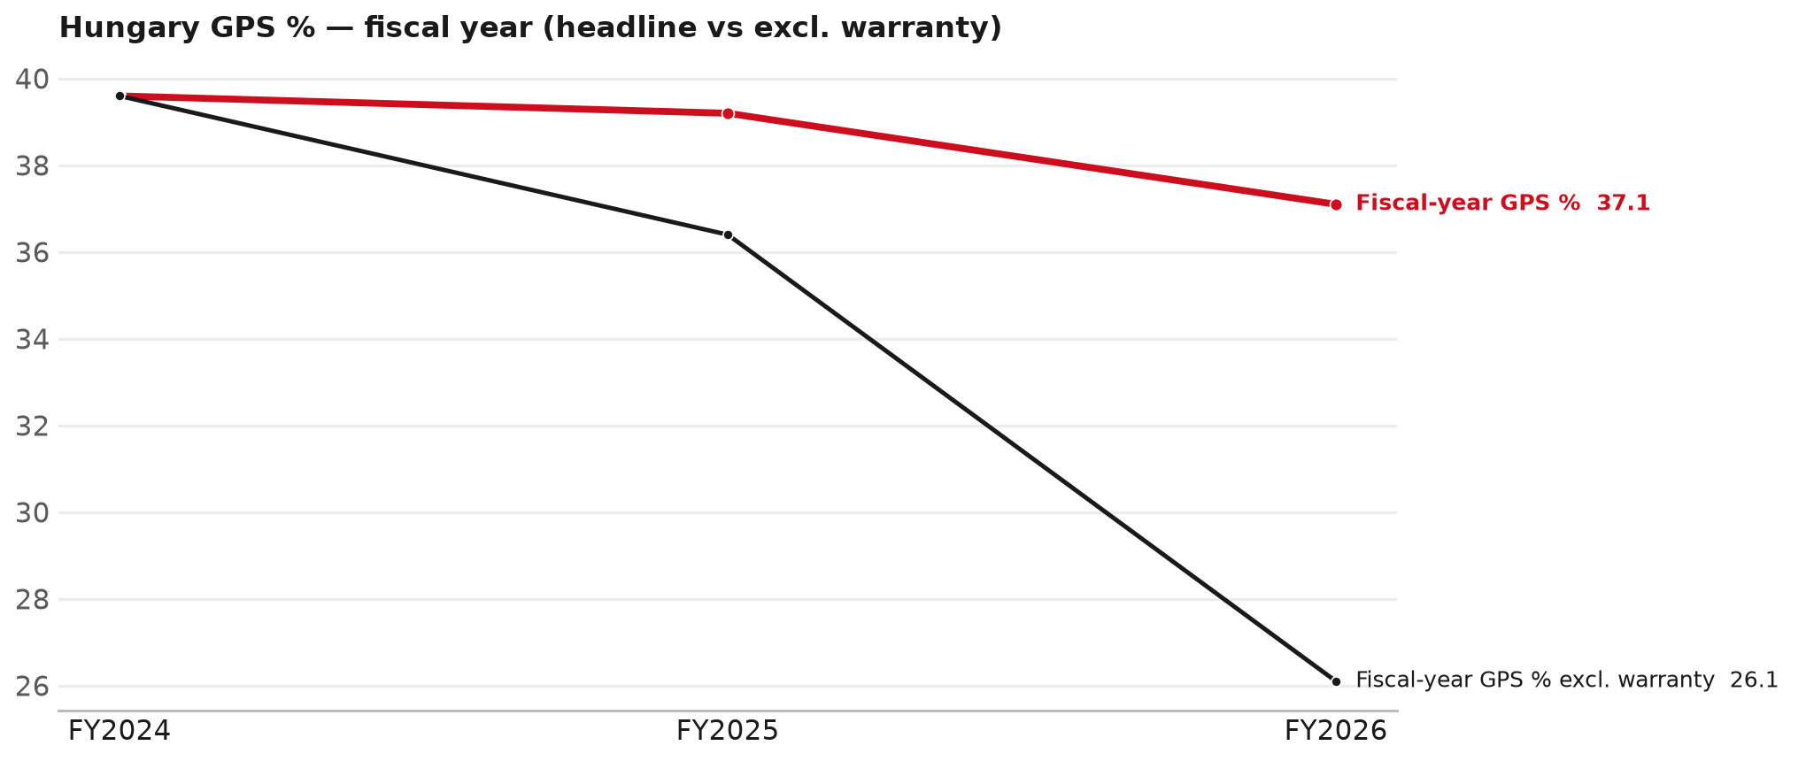
GPS
GPS: fiscal year headline vs after warranty
TAKEAWAYS
— Red = fiscal-year GPS (frozen CY2025 wallet). FY25 39.2% → FY26 37.1%.
— Black = fiscal GPS after removing warranty parts (€). FY26 ≈ 26.1% (warranty EUR 102,418 ≈ 30% of FY26 billing).
— Fleet 3,734 → 3,645 (working year-end estimate under the FY2027 target).
22

Slide 23
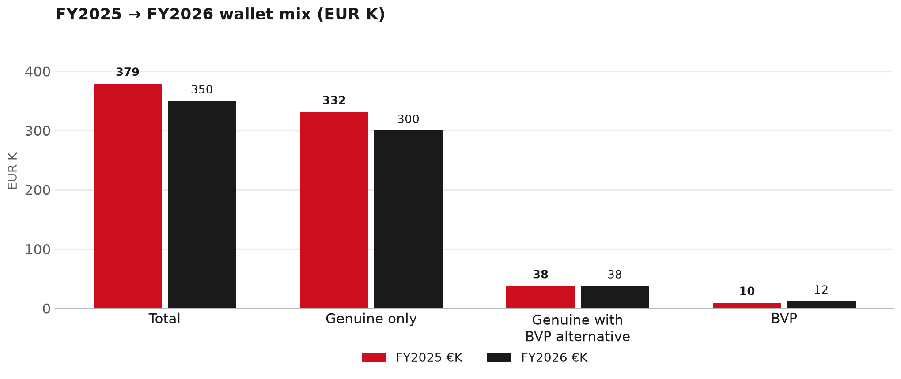
WALLET MIX
FY2025 → FY2026 wallet mix
— Total EUR 379,407 → EUR 349,882 (-7.8%).
— Genuine only EUR -31,719.
— Genuine with BVP alternative EUR -226; BVP EUR 2,420 (3.5% of FY26 wallet).
— Display label locked: Genuine with BVP alternative.
23

Slide 24
WALLET MIX
FY wallet mix — detail
 | FY2025 | FY2026 | Δ
Total | EUR 379,407 | EUR 349,882 | EUR -29,525
Genuine only | EUR 331,753 | EUR 300,034 | EUR -31,719
Genuine with BVP alternative | EUR 37,959 | EUR 37,733 | EUR -226
BVP | EUR 9,694 | EUR 12,115 | EUR 2,420
BVP % of wallet | 2.6% | 3.5% | +0.9 pp
24

Slide 25
DRIVERS
Where the genuine drop sits (FY2025 → FY2026)
— Genuine-only sales moved EUR -31,719 from FY2025 to FY2026.
— Of that, the routine service basket (filters, pads, rotors) moved EUR 7,633 on genuine-only; BVP in that basket moved EUR 3,835.
— So about 124% of the genuine-only drop sits outside routine service parts.
— Meeting line: check high-value assemblies / sensors before blaming the filter or pad menu.
25

Slide 26
DRIVERS
Largest part-number drops (FY24→FY25) — outside service filters
Part | Description | Δ EUR
8977998750 | STEERING UNIT | -11,031
8983550720 | partikel sensor | -9,198
8976492820 | TRANSFER ASM | -7,900
8980803191 | GUARD ASM; RR | -4,592
8982404570 | DRIVE ASM; FINAL,RR | -3,876
8981974530 | DRIVE ASM; FINAL,RR | -3,719
8981470623 | TRANSMISSION ASM; MANUAL | -3,504
— Check warranty / campaign coding before calling competitive leakage.
26

Slide 27
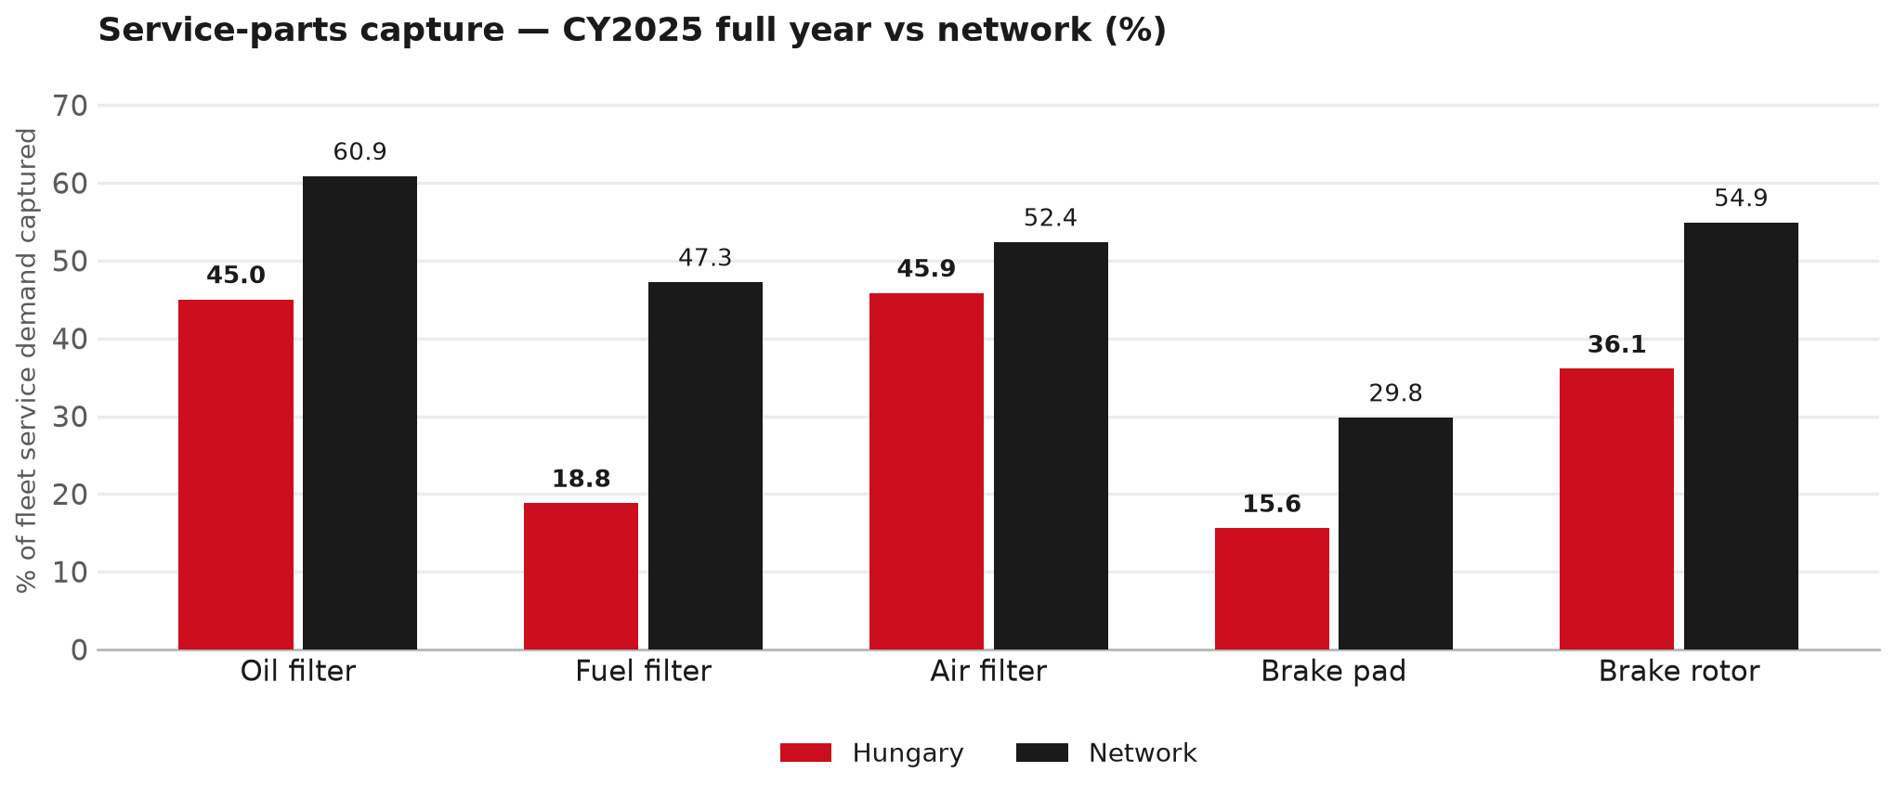
SERVICE PARTS
Service-parts capture vs network (calendar year)
TAKEAWAYS
— Capture % is calendar-year (full CY2025). Fleet demand is modelled on calendar years — there is no matching fiscal-year capture %.
— Oil filter 45.0% vs network 60.9%; Fuel filter 18.8% vs network 47.3%; Air filter 45.9% vs network 52.4%.
— Next slide: fiscal-year € billing in the same five categories.
— Primary lens = total capture (not genuine-only).
27

Slide 28
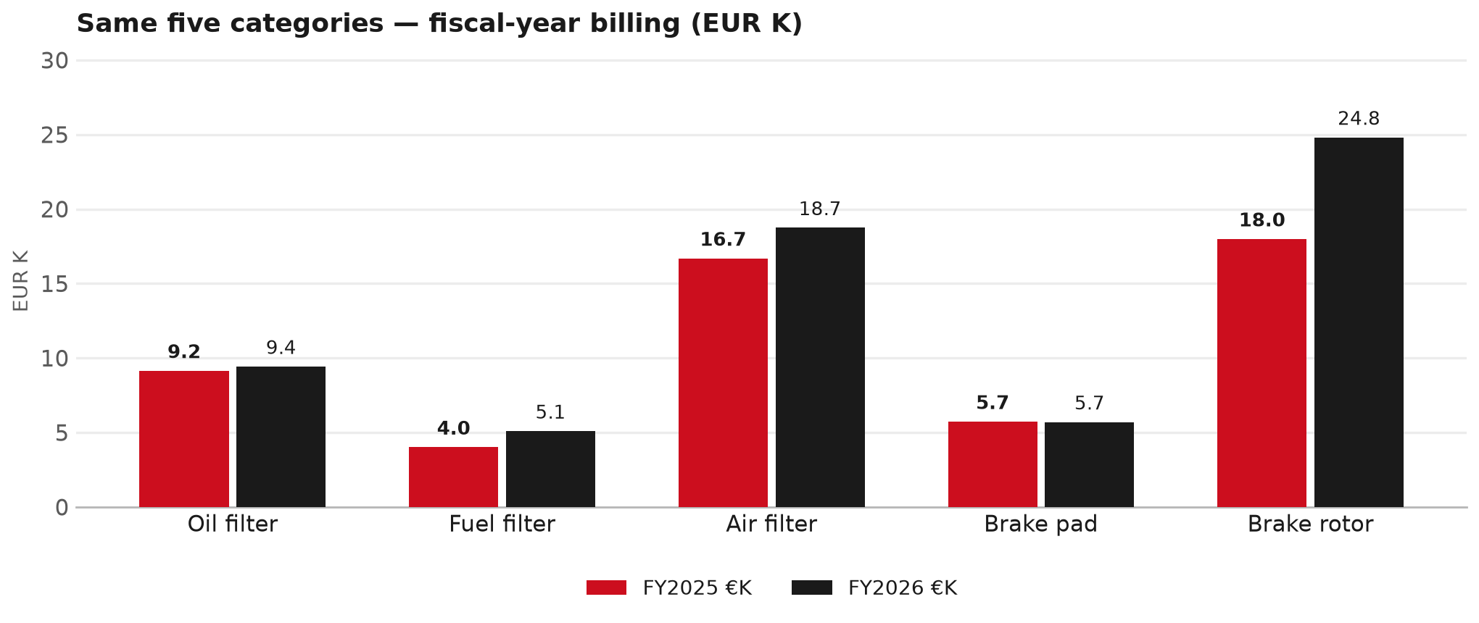
SERVICE PARTS · FY
Service-parts billing by fiscal year (same five lines)
TAKEAWAYS
— This is Sales-to-AutoWallis Distribution € in fiscal years — not capture % of fleet demand.
— Use both lenses — do not mix % capture with € billing.
— Primary = total sales in the basket.
28

Slide 29
BRAKES
Brake pads — BVP share of total brake pad sales (FY)
 | FY2025 | FY2026
Genuine qty | 0 | 0
BVP qty | 0 | 0
BVP share of total brake pad sales (€) | 0% | 11%
— BVP share = BVP € ÷ all brake-pad € billed (genuine + BVP). Not a PMS capture %.
— Wallet-level BVP is still only ~3.5% of FY26 — do not generalise a pad story to the whole wallet.
29

Slide 30
AIM
AIM exposure
Year | High-risk € | High-risk % | Quadrant
2023 | EUR 12,757 | 3.8% | Priority target (low GPS - low capture)
2024 | EUR 10,343 | 2.6% | Priority target (low GPS - low capture)
2025 | EUR 7,043 | 2.1% | Priority target (low GPS - low capture)
— High-risk € is catalogue AIM exposure, not proven walk-out.
— Open on jobs not bought through the distributor — not a street IAM war alone.
30

Slide 31
WARRANTY
Warranty — two real lenses
1
CY2025 claim-price parts
2
Fiscal GPS expense
— EUR 77,434 (claim-price basis).
— Calendar-year claim price basis.
— LCV warranty.
— FY24 EUR 225 · FY25 EUR 25,886 · FY26 EUR 102,418.
— Source row: AutoWallis.
— Ex-warranty GPS = (net − warranty) ÷ frozen CY25 wallet.
— Both numbers are real — never mix them on one slide without labels.
31

Slide 32
BRIDGE
How to use this in the meeting
If they say… | You know…
BVP is eating genuine | Wallet BVP ~3.5%. Check pads as a local exception only.
GPS looks fine / too high | FY26 headline 37.1%; excl. warranty ≈ 26.1%.
Service parts are fine | CY2025 capture vs network (previous slides) + FY billing lens.
32

Slide 33
Moving the World – for You

