Slide 1

ISZE · PORTUGAL · PORTUGAL
Portugal Sales Review
& FY2027 Target
I-Motors · August 2026

Slide 2
PORTUGAL MEETING
Agenda
— Q1 FY2027 Sales Review
— Parts Performance — category movers
— Parts Performance — Clutch parts
— Parts Performance — Steering
— Parts Performance — Air system
— Parts Performance — where volume grew
— New Business — validation queue
— Sales-to-Dealer Outlook
— GPS Capture
— Service-Parts Coverage
— Fleet & FY2027 Target
— SPA — status
— R&M — market discussion
— Data request: part-level Sales-to-Dealer
— Next steps
2

Slide 3
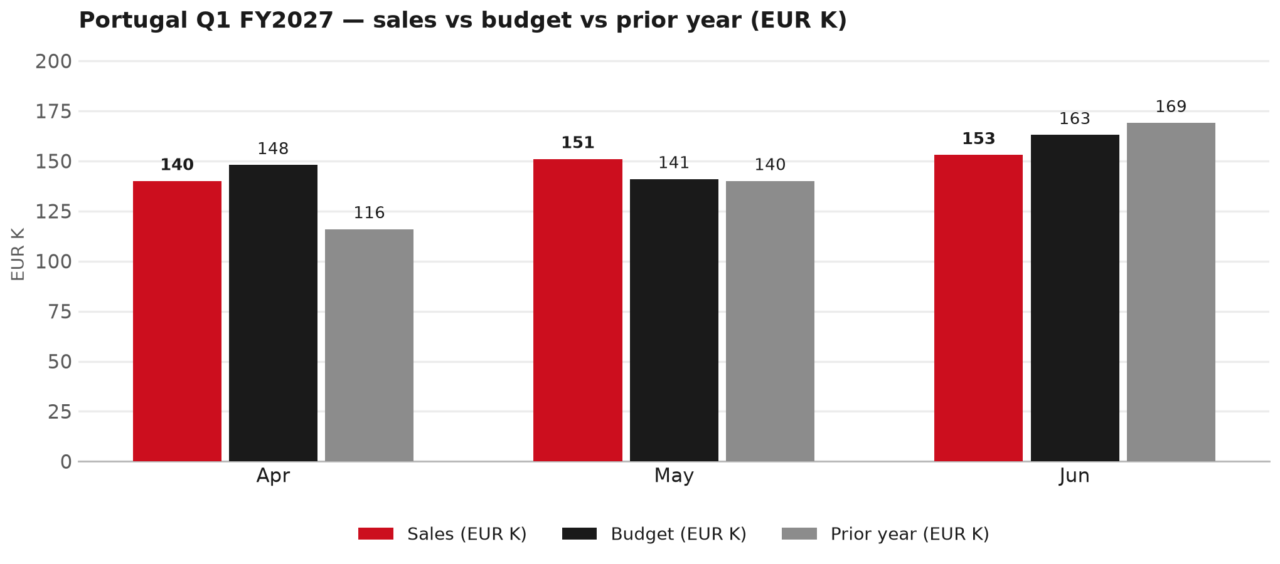
POWER BI — OFFICIAL CUT
Q1 FY2027: EUR 444K, -2% vs budget
TAKEAWAYS
— Sales EUR 444K against budget EUR 452K — -2%, and +4% on last year's EUR 425K.
— The beat is entirely May: EUR 151K against EUR 141K. Apr -5% and Jun -6% are below budget.
— Worth walking through the shape of the period together.
3

Slide 4
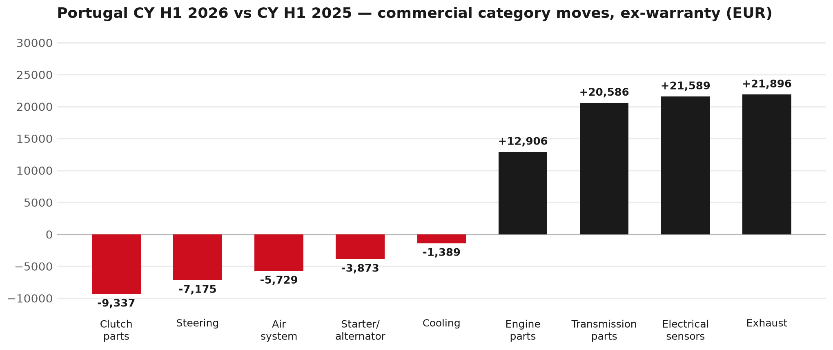
PARTS PERFORMANCE
Parts Performance — CY H1 2026 vs CY H1 2025 (commercial, ex-warranty)
TAKEAWAYS
— Commercial parts billing (warranty/campaign excluded) EUR 772K against EUR 640K a year earlier — +20.5% (CY H1 2026 vs CY H1 2025, Jan–Jun).
— Largest PN drops (all categories): 8982447940 (PAD KIT; CALIPER,DIS) EUR -6K, 72 fewer pcs; 5873113841 (ENGINE ASM; PARTIAL) EUR -4K, 1 fewer pcs; 8983682091 (PIPE; EXH) EUR -4K, 3 fewer pcs.
— Largest PN gains (all categories): 8975359391 (DPD ASM) EUR 9K, 4 more pcs; 8976607440 (TRANSMISSION ASM; MA) EUR 8K, 2 more pcs; 8980921340 (GEAR SET; FINAL DRIV) EUR 6K, 11 more pcs.
— Within Exhaust (EUR 22K, +57%): 8975359391 (DPD ASM) EUR 9K, 4 more pcs; 8983023941 (SENSOR; DEF DCM EXH ) EUR 4K, 14 more pcs; 8982127181 (COOLER ASM; EGR) EUR 3K, 13 more pcs.
4

Slide 5
PARTS PERFORMANCE — CLUTCH PARTS
Clutch parts — CY H1 2026 vs CY H1 2025 (commercial, ex-warranty)
— EUR 36,848 (CY H1 2025) to EUR 27,511 (CY H1 2026), down EUR 9,337 (-25%).
— Largest part numbers driving the decline (by EUR):
— 5876102060 (CLUTCH KIT · N*R,NLS): EUR 5,091 to EUR 1,311, 23 fewer pieces.
— 8978293170 (DISC; CLUTCH): EUR 2,882 to EUR 493, 24 fewer pieces.
— 5876100910 (PLATE ASM; PRESSURE,CLU · NLR,NMR,NNR,NPR,NQR,NPS): EUR 3,379 to EUR 1,607, 23 fewer pieces.
— 8982831940 (PLATE ASM; PRESSURE,CLU): EUR 2,023 to EUR 637, 20 fewer pieces.
Questions for us to work through together
— Is clutch pricing a barrier against local competition for you?
— What would make the biggest difference to keep this business with us?
— Worth a joint look at the specific part numbers together?
5

Slide 6
PARTS PERFORMANCE — STEERING
Steering — CY H1 2026 vs CY H1 2025 (commercial, ex-warranty)
— EUR 26,698 (CY H1 2025) to EUR 19,523 (CY H1 2026), down EUR 7,175 (-27%).
— Largest part numbers driving the decline (by EUR):
— 8983948772 (STEERING UNIT): EUR 4,545 to EUR 2,000, 5 fewer pieces.
— 8978243002 (PUMP ASM; OIL,P/S): EUR 4,737 to EUR 2,250, 10 fewer pieces.
— 8981017801 (STEERING UNIT): EUR 2,314 to EUR 0, 3 fewer pieces.
— 8982519482 (STEERING UNIT): EUR 1,407 to EUR 0, 2 fewer pieces.
Questions for us to work through together
— Is this pricing against what the dealers can buy locally?
— Is any of this stock timing on your side rather than end demand?
— What would make the biggest difference to keep this business with us?
6

Slide 7
PARTS PERFORMANCE — AIR SYSTEM
Air system — CY H1 2026 vs CY H1 2025 (commercial, ex-warranty)
— EUR 17,998 (CY H1 2025) to EUR 12,270 (CY H1 2026), down EUR 5,729 (-32%).
— Largest part numbers driving the decline (by EUR):
— 5876102500 (ELEMENT; AIR CLEANER · N*R,NPS): EUR 5,189 to EUR 3,045, 122 fewer pieces.
— 8974719842 (AIR BAG UNIT): EUR 1,628 to EUR 0, 5 fewer pieces.
— 8983322301 (AIR BAG UNIT): EUR 706 to EUR 0, 2 fewer pieces.
— 8983964240 (GUIDE ASM; AIR): EUR 1,016 to EUR 340, 12 fewer pieces.
Questions for us to work through together
— Is this pricing against what the dealers can buy locally?
— Is any of this stock timing on your side rather than end demand?
— What would make the biggest difference to keep this business with us?
7

Slide 8
PARTS PERFORMANCE — GROWTH
Where volume grew — CY H1 2026 vs CY H1 2025 (commercial, ex-warranty)
Part | Description | CY H1 2025 | CY H1 2026 | Δ EUR
8975359391 | DPD ASM | EUR 2,216 | EUR 10,812 | EUR 8,597
8976607440 | TRANSMISSION ASM; MANUAL | EUR 3,934 | EUR 11,826 | EUR 7,892
8980921340 | GEAR SET; FINAL DRIVE,RR | EUR 3,436 | EUR 9,270 | EUR 5,833
8984890190 | NOZZLE ASM; INJ | EUR 638 | EUR 5,513 | EUR 4,876
8970471004 | CAGE ASM; DIFF,FINAL DRIVE | EUR 1,155 | EUR 4,522 | EUR 3,366
8982127181 | COOLER ASM; EGR | EUR 1,375 | EUR 4,602 | EUR 3,227
— Exhaust +57%, Electrical sensors +64%, Transmission parts +36% — where the commercial volume went.
— Claim-matched PNs (158 distinct) and campaign/recall text matches are already excluded from this growth list. Residual warranty on unmapped PNs can remain.
— PNs ranked by largest EUR increase (prior-period sales > 0). Worth agreeing which of these are repeatable and which were one-off.
8

Slide 9
PARTS PERFORMANCE
New Business — validation queue (CY H1 2026)
Part | Description | Current sales | Review
8983759890 | ENGINE ASM | EUR 10,268 | Validate
8982050610 | FILTER ASM | EUR 7,567 | Validate
7552933240 | METER COMPL; CLUSTER | EUR 5,585 | Validate
7552933280 | METER COMPL; CLUSTER | EUR 5,357 | Validate
7552283740 | TRANSFER ASM | EUR 4,439 | Validate
8983023941 | SENSOR; DEF DCM EXH NOX | EUR 3,874 | Validate
— These lines had no prior-period sales, so they are kept out of the incremental-growth table.
— A first sale can be a new model, a supersession, timing, or a warranty campaign. It is not treated as a commercial win until that cause is confirmed.
9

Slide 10
SALES-TO-DEALER
Sales-to-Dealer outlook — FY2027
— FY2026 Sales-to-Dealer is EUR 2,803,598 (working estimate).
— The working fleet movement into FY2027 is +7.2%.
— Applying fleet movement, the 5% price adjustment and 1.8% additional growth gives a FY2027 Sales-to-Dealer target of EUR 3,213,790.
— The discussion is held in Sales-to-Dealer amounts; ISZE billing remains an internal reconciliation measure.
10

Slide 11
GPS
GPS Capture: 86.0%
— GPS measures your actual parts purchases against the full potential of your fleet.
— Portugal today: 86.0% (FY2026 purchases against the CY2025 fleet potential).
— Fleet potential: EUR 2,005K on 8,019 vehicles.
— Real, sustained headroom above 86.0% — the service-parts and SPA discussion are both direct levers on it.
11

Slide 12
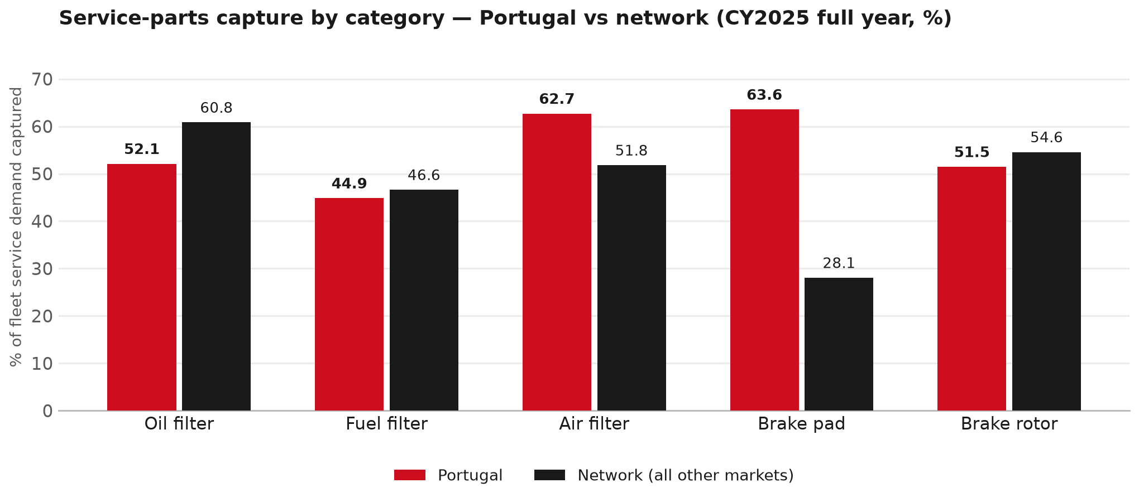
SERVICE-PARTS COVERAGE
Service-parts coverage: oil filter is the clear gap
TAKEAWAYS
— Oil filter 52.1% against 60.8% for the rest of the network.
— Brake rotor 51.5% against 54.6% for the rest of the network.
— Every market here is measured on the same fleet-and-interval model, so the comparison is like-for-like even where the underlying interval assumption is debatable.
— Worth agreeing which category we tackle first, and what the joint action is.
12

Slide 13
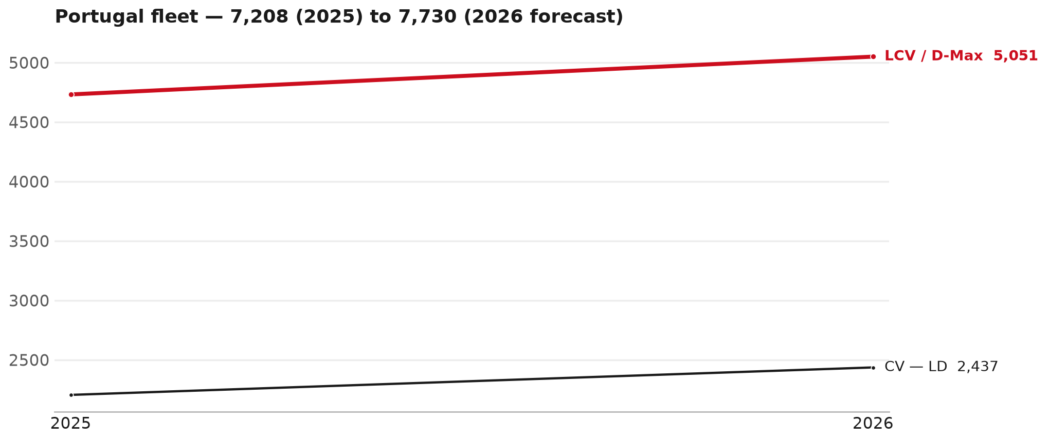
FLEET & FY2027 TARGET
The fleet is expected to grow in 2026
WHAT THIS MEANS FOR FY2027
— Fleet size (calendar year): 7,208 vehicles in 2025 → 7,730 working estimate for end-2026 (+7.2%).
— The chart is calendar years 2019–2026 only. 2026 is a working year-end estimate, not a fiscal-year figure.
— Smaller segments not plotted (<5% of fleet): F-Series 242.
— The FY2027 Sales-to-Dealer target starts from that fleet change, then applies a 5% price adjustment and 1.8% additional growth.
— The target reflects the working fleet outlook without extending the chart beyond 2026.
13

Slide 14
FLEET & FY2027 TARGET
How the FY2027 target is built
Sales-to-Dealer amount bridge
Step | Amount
FY2026 Sales-to-Dealer (working estimate) | EUR 2,803,598
After fleet movement (+7.2%) | EUR 3,006,633
After price adjustment (+5%) | EUR 3,156,965
FY2027 target after additional growth (+1.8%) | EUR 3,213,790
— The FY2027 target is +14.6% versus the FY2026 Sales-to-Dealer base.
— The FY2026 base is a working estimate (ISZE billing ÷ 0.65): the KPI Dashboard has no usable Sales-to-Dealer row for this market.
14

Slide 15
FY2027 TARGET
What the FY2027 target reflects
1
Your fleet
2
The price move
— The working fleet movement used in the target is +7.2%.
— ISZE is applying a 5% price adjustment for FY2027, consistent with every ISZE market this year.
— It is built into the per-vehicle rate above, not added separately on top.
What it means for your target
 | Value
FY2027 Sales-to-Dealer target | EUR 3,213,790
vs FY2026 Sales-to-Dealer (EUR 2,803,598) | +14.6%
— As in previous cycles we would expect an incentive to sit alongside this adjustment — that approval is still pending on our side.
— Until the incentive is confirmed, treat the FY2027 target as the working bridge (fleet × price × additional growth), not a locked commercial commitment.
15

Slide 16
SPA
SPA
1
PORTUGAL proposal
2
ISZE review
3
Counter-proposal
4
Final approval
— I-Motors submits a proposed parts list.
— ISZE reviews the proposal against network data and fit.
— ISZE returns a counter-proposal where needed.
— Signed off by ISZE management.
Purpose: higher turnover for both sides.
16

Slide 17
R&M
R&M — let's align on the market
M
Market
S
Servicing & R&M
— How is the market moving for you right now?
— How much of your volume is fleet business rather than retail?
— Where do you see the biggest hurdles this year?
— Where are your real strengths in this segment?
— Do you offer an R&M or service-plan product today?
— What share of the parc do you retain for servicing after year three?
— Does R&M business come bundled with fleet tenders — roughly what share?
— What would it take to bring more out-of-network servicing back?
17

Slide 18
ASK
Part-level Sales-to-Dealer Data
1
The starting point
2
Sharper insight
3
Shared benefit
— We have no Sales-to-Dealer figures from you for FY2026. The ask is monthly Sales-to-Dealer, at part-number level.
— Part-by-part visibility separates a stock movement from a lost job — and tells us where the volume actually went.
— Better availability on your fast movers, a sharper target for us, and a factual basis for the SPA — same data, both sides gain.
Requested from 01/01/2025, part number level, monthly.
18

Slide 19
SUMMARY
Next steps
— Confirm FY2027 Sales-to-Dealer target: EUR 3,213,790 (+14.6% vs FY2026 Sales-to-Dealer).
— Confirm the incentive alongside the price adjustment once approved on our side.
— Clutch parts / Steering / Air system: agree which category we tackle first, and what the joint action is.
— Agree part-level Sales-to-Dealer data sharing, effective 01/01/2025.
— SPA: PORTUGAL proposal, ISZE review and counter-proposal cycle to follow.
19

Slide 20
Moving the World – for You

Slide 21
PORTUGAL · I-MOTORS
Deep dive — detail behind the Mode A story
— Extra detail for meeting prep — pick which slides to share with I-Motors.
— Mode A ends on the previous closing slide.
— Label in all charts: “Genuine with BVP alternative” (not “genuine contested”).
21

Slide 22
AGENDA
Deep-dive agenda
— GPS — published fiscal-year figure
— FY2025 → FY2026 wallet mix (Genuine / Genuine with BVP alternative / BVP)
— Where the money went — outside the service-parts basket (FY)
— Service parts: CY capture vs network + FY billing (capture % is CY-only by design)
— Brake pads — BVP share of total brake pad sales (FY)
— AIM exposure
— Warranty — two lenses
— How to use this in the meeting
22

Slide 23
GPS
GPS Capture: 86.0%
— GPS measures actual parts purchases against the full potential of the fleet.
— Portugal today: 86.0% (FY2026 purchases against the CY2025 fleet potential).
— Fleet potential: EUR 2,004,750 on 8,019 vehicles.
— This is the published GPS figure. Do not mix it with a mixed-rate fleet wallet.
23

Slide 24
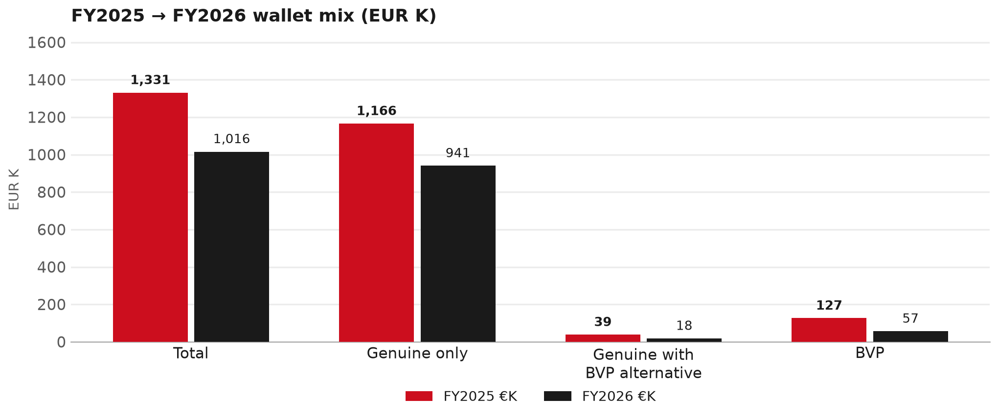
WALLET MIX
FY2025 → FY2026 wallet mix
— Total EUR 1,331,023 → EUR 1,015,839 (-23.7%).
— Genuine only EUR -225,203.
— Genuine with BVP alternative EUR -20,139; BVP EUR -69,842 (5.6% of FY26 wallet).
— Display label locked: Genuine with BVP alternative.
24

Slide 25
WALLET MIX
FY wallet mix — detail
 | FY2025 | FY2026 | Δ
Total | EUR 1,331,023 | EUR 1,015,839 | EUR -315,184
Genuine only | EUR 1,165,766 | EUR 940,563 | EUR -225,203
Genuine with BVP alternative | EUR 38,618 | EUR 18,479 | EUR -20,139
BVP | EUR 126,639 | EUR 56,797 | EUR -69,842
BVP % of wallet | 9.5% | 5.6% | -3.9 pp
25

Slide 26
DRIVERS
Where the genuine drop sits (FY2025 → FY2026)
— Genuine-only sales moved EUR -225,203 from FY2025 to FY2026.
— Of that, the routine service basket (filters, pads, rotors) moved EUR -36,678 on genuine-only; BVP in that basket moved EUR -34,939.
— So about 84% of the genuine-only drop sits outside routine service parts.
— Meeting line: check high-value assemblies / sensors before blaming the filter or pad menu.
26

Slide 27
DRIVERS
Largest part-number drops (FY24→FY25) — outside service filters
Part | Description | Δ EUR
8983528480 | SENSOR; NOX | -27,509
8983320763 | DPD ASM | -20,096
8983550720 | partikel sensor | -16,274
REBATE | Rebate Material | -14,000
8983320591 | NOZZLE ASM; INJ | -13,910
8982049420 | FILTER ASM | -11,599
5873114080 | ENGINE ASM; PARTIAL | -6,436
— Check warranty / campaign coding before calling competitive leakage.
27

Slide 28
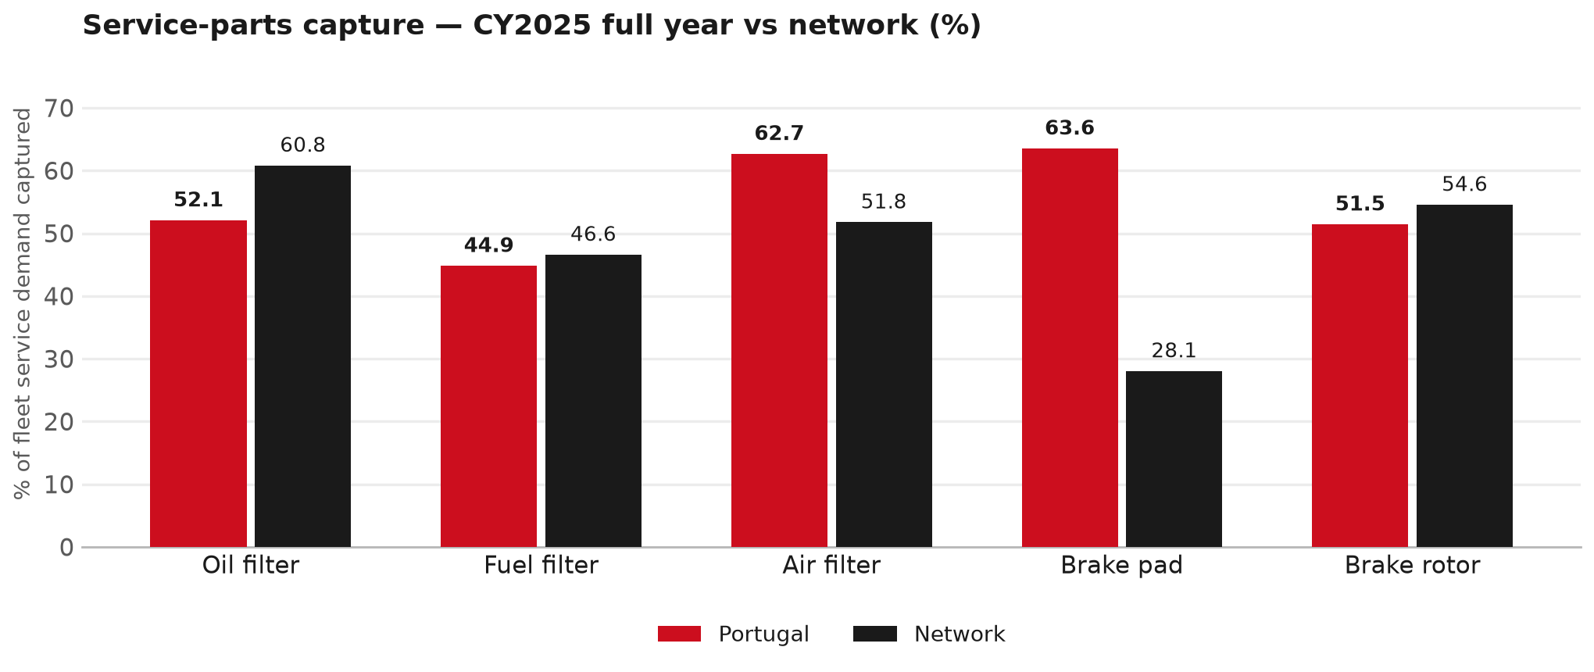
SERVICE PARTS
Service-parts capture vs network (calendar year)
TAKEAWAYS
— Capture % is calendar-year (full CY2025). Fleet demand is modelled on calendar years — there is no matching fiscal-year capture %.
— Oil filter 52.1% vs network 60.8%; Fuel filter 44.9% vs network 46.6%; Air filter 62.7% vs network 51.8%.
— Next slide: fiscal-year € billing in the same 5 categories.
— Primary lens = total capture (not genuine-only).
28

Slide 29
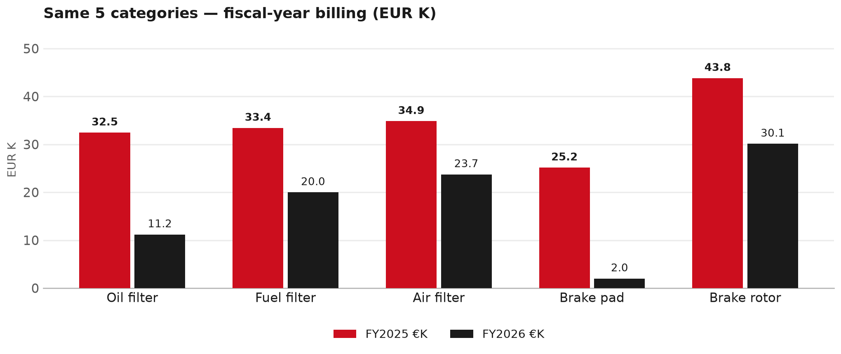
SERVICE PARTS · FY
Service-parts billing by fiscal year (same 5 lines)
TAKEAWAYS
— This is Sales-to-I-Motors € in fiscal years — not capture % of fleet demand.
— Use both lenses — do not mix % capture with € billing.
— Primary = total sales in the basket.
29

Slide 30
BRAKES
Brake pads — BVP share of total brake pad sales (FY)
 | FY2025 | FY2026
Genuine pad sales (€) | EUR 20,834 | EUR 2,011
BVP pad sales (€) | EUR 4,325 | EUR 0
Genuine qty | 271 | 24
BVP qty | 80 | 0
BVP share of pad sales (€) | 17% | 0%
— BVP share = BVP € ÷ all brake-pad € billed (genuine + BVP). Not a PMS capture %.
— I-Motors pad sales are genuine-only in this cut (~EUR 2K FY26) — no BVP pad lines billed.
— Wallet-level BVP is still only ~5.6% of FY26 — do not generalise a pad story to the whole wallet.
30

Slide 31
AIM
AIM exposure
Year | High-risk € | High-risk % | Quadrant
2023 | EUR 11,015 | 0.8% | Defend (high GPS - high capture)
2024 | EUR 14,542 | 0.9% | Defend (high GPS - high capture)
2025 | EUR 11,743 | 0.7% | Defend (high GPS - high capture)
— High-risk € is catalogue AIM exposure, not proven walk-out.
— Open on jobs not bought through the distributor — not only independent-parts competition.
31

Slide 32
WARRANTY
Warranty — two real lenses
1
CY2025 claim-price parts
2
Fiscal GPS expense
— EUR 130,588 (claim-price basis).
— Calendar-year claim price basis.
— CV EUR 28,836 is a lower bound (52% of part cells priced); LCV EUR 101,752 is clean.
— FY24 EUR 75 · FY25 EUR 43,679 · FY26 EUR 191,206.
— Source row: Imotors.
— Ex-warranty GPS = (net − warranty) ÷ frozen CY25 wallet.
— Both numbers are real — never mix them on one slide without labels.
32

Slide 33
BRIDGE
How to use this in the meeting
If they say… | You know…
BVP is eating genuine | Wallet BVP ~5.6%. Check pads as a local exception only.
GPS looks fine / too high | FY26 headline 86.0%; excl. warranty ≈ None%.
Service parts are fine | CY2025 capture vs network (previous slides) + FY billing lens.
33

Slide 34
Moving the World – for You

