Slide 1

ISZE · ICELAND · ICELAND
Iceland Sales Review
& FY2027 Target
BL ehf. · August 2026

Slide 2
ICELAND MEETING
Agenda
— Parts Performance — category movers
— Parts Performance — Transmission parts
— Parts Performance — Air conditioning
— Parts Performance — where volume grew
— New Business — validation queue
— Sales-to-Dealer Outlook
— GPS Capture
— Service-Parts Coverage
— Fleet & FY2027 Target
— SPA — status
— R&M — market discussion
— Data request: part-level Sales-to-Dealer
— Next steps
2

Slide 3
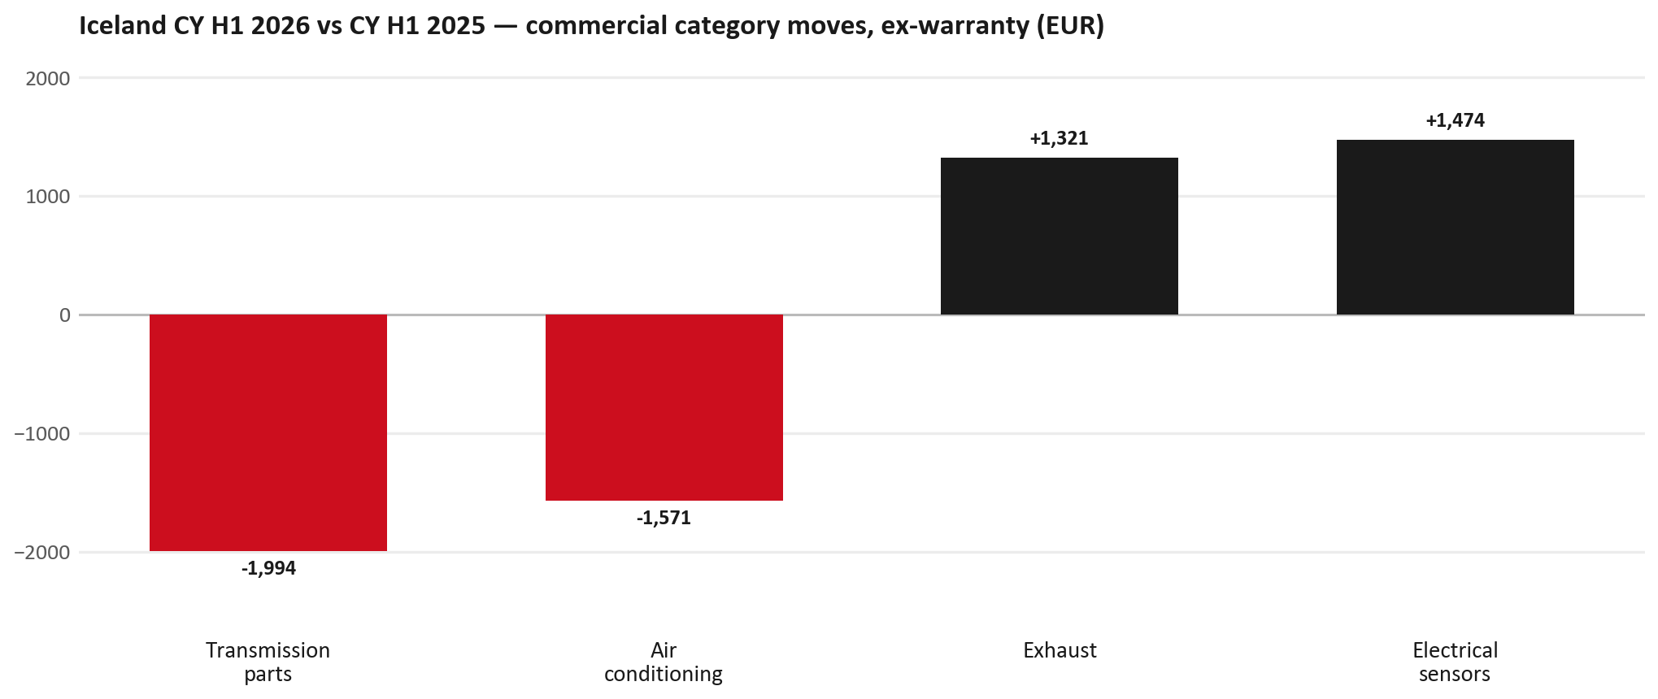
PARTS PERFORMANCE
Parts Performance — CY H1 2026 vs CY H1 2025 (commercial, ex-warranty)
TAKEAWAYS
— Commercial parts billing (warranty/campaign excluded) EUR 38K against EUR 38K a year earlier — -0.1% (CY H1 2026 vs CY H1 2025, Jan–Jun).
— Largest PN drops: 8983952370 (DRIVE ASM; FINAL,RR) EUR -1K, 1 fewer pcs; 8974926118 (HARNESS; CABLE,ENG R) EUR -1K, 1 fewer pcs; 8980088940 (MOTOR ASM; FAN,BLOWE) EUR -1K, 11 fewer pcs.
— Largest PN gains: 8983767550 (ROTOR; DISC BRK,FRT) EUR 1K, 14 more pcs; 8978279610 (PAD KIT; DISC BRK,W/) EUR 1K, 9 more pcs; 8983937793 (SUPPORT; RR BUMPER) EUR 0K, 3 more pcs.
— About EUR 4K of claim-matched PN billing was stripped so this chart is aftermarket demand, not warranty.
3

Slide 4
PARTS PERFORMANCE — TRANSMISSION PARTS
Transmission parts — CY H1 2026 vs CY H1 2025 (commercial, ex-warranty)
— EUR 3,371 (CY H1 2025) to EUR 1,377 (CY H1 2026), down EUR 1,994 (-59%).
— Largest part numbers driving the decline (by EUR):
— 8983952370 (DRIVE ASM; FINAL,RR): EUR 1,243 to EUR 0, 1 fewer pieces.
— 8973679590 (ACTUATOR; TRANSFER,2-4 SHIFT): EUR 827 to EUR 237, 5 fewer pieces.
— 8942588190 (BEARING; HUB INNER,FRT AXLE · TF*,UBS,UC*): EUR 191 to EUR 48, 6 fewer pieces.
— 8942270410 (BEARING; HUB OUTER,FRT AXLE · TF*,UBS,UC*): EUR 174 to EUR 44, 6 fewer pieces.
Questions for us to work through together
— Is this a mix shift towards assemblies, or fewer component-level repairs?
— Any availability problems on the fast-moving lines?
4

Slide 5
PARTS PERFORMANCE — AIR CONDITIONING
Air conditioning — CY H1 2026 vs CY H1 2025 (commercial, ex-warranty)
— EUR 4,651 (CY H1 2025) to EUR 3,080 (CY H1 2026), down EUR 1,571 (-34%).
— Largest part numbers driving the decline (by EUR):
— 8980088940 (MOTOR ASM; FAN,BLOWER UNIT): EUR 890 to EUR 78, 11 fewer pieces.
— 8981402660 (FILTER; ACL · TFR,TFS,UCR,UCS): EUR 310 to EUR 0, 14 fewer pieces.
— 8975488420 (FILTER; BLOWER UNIT · TF*,UC*): EUR 232 to EUR 0, 14 fewer pieces.
— 8980084420 (FILTER; EVAPORATOR): EUR 182 to EUR 0, 8 fewer pieces.
Questions for us to work through together
— Is the seasonal pattern different this year, or is this a real shift?
— Are cabin filters and A/C service being sold as a package?
5

Slide 6
PARTS PERFORMANCE — GROWTH
Where volume grew — CY H1 2026 vs CY H1 2025 (commercial, ex-warranty)
Part | Description | Model | CY H1 2025 | CY H1 2026 | Δ EUR
8983767550 | ROTOR; DISC BRK,FRT | — | EUR 470 | EUR 1,569 | EUR 1,099
8978279610 | PAD KIT; DISC BRK,W/O SHIM & | — | EUR 206 | EUR 817 | EUR 611
8983937793 | SUPPORT; RR BUMPER | — | EUR 103 | EUR 412 | EUR 309
8980094180 | SENSOR; MAP | — | EUR 305 | EUR 610 | EUR 304
8975546610 | PAD KIT; CALIPER,DISC BRK,FR | TF* | EUR 248 | EUR 489 | EUR 241
8980115041 | PIPE; OIL,TURBOCHARGER FEED | — | EUR 104 | EUR 301 | EUR 196
— Electrical sensors +56%, Exhaust +125% — where the commercial volume went.
— Claim-matched PNs (28 distinct) and campaign/recall text matches are already excluded from this growth list. Residual warranty on unmapped PNs can remain.
— PNs ranked by largest EUR increase (prior-period sales > 0). Worth agreeing which of these are repeatable and which were one-off.
6

Slide 7
PARTS PERFORMANCE
New Business — validation queue (CY H1 2026)
Part | Description | Current sales | Review
8983682091 | PIPE; EXH | EUR 1,310 | Validate
7552392890 | CAMERA ASM | EUR 1,001 | Warranty / campaign
8981454531 | OVERHAUL KIT; SUPPLY PUMP | EUR 776 | Validate
8982601090 | NOZZLE ASM; INJ | EUR 756 | Validate
8983860446 | GATE ASM; RR | EUR 648 | Validate
8978248633 | LAMP ASM; RR COMB | EUR 626 | Validate
— These lines had no prior-period sales, so they are kept out of the incremental-growth table.
— A first sale can be a new model, a supersession, timing, or a warranty campaign. It is not treated as a commercial win until that cause is confirmed.
7

Slide 8
SALES-TO-DEALER
Sales-to-Dealer outlook — FY2027
— FY2026 Sales-to-Dealer is EUR 195,849 (reported KPI).
— The working fleet movement into FY2027 is -1.2%.
— Applying fleet movement, the 5% price adjustment and 1.8% additional growth gives a FY2027 Sales-to-Dealer target of EUR 206,765.
— The discussion is held in Sales-to-Dealer amounts; ISZE billing remains an internal reconciliation measure.
8

Slide 9
GPS
GPS Capture: 82.6%
— GPS measures your actual parts purchases against the full potential of your fleet.
— Iceland today: 82.6% (FY2026 purchases against the CY2025 fleet potential).
— Fleet potential: EUR 102K on 406 vehicles.
— Real, sustained headroom above 82.6% — the service-parts and SPA discussion are both direct levers on it.
9

Slide 10
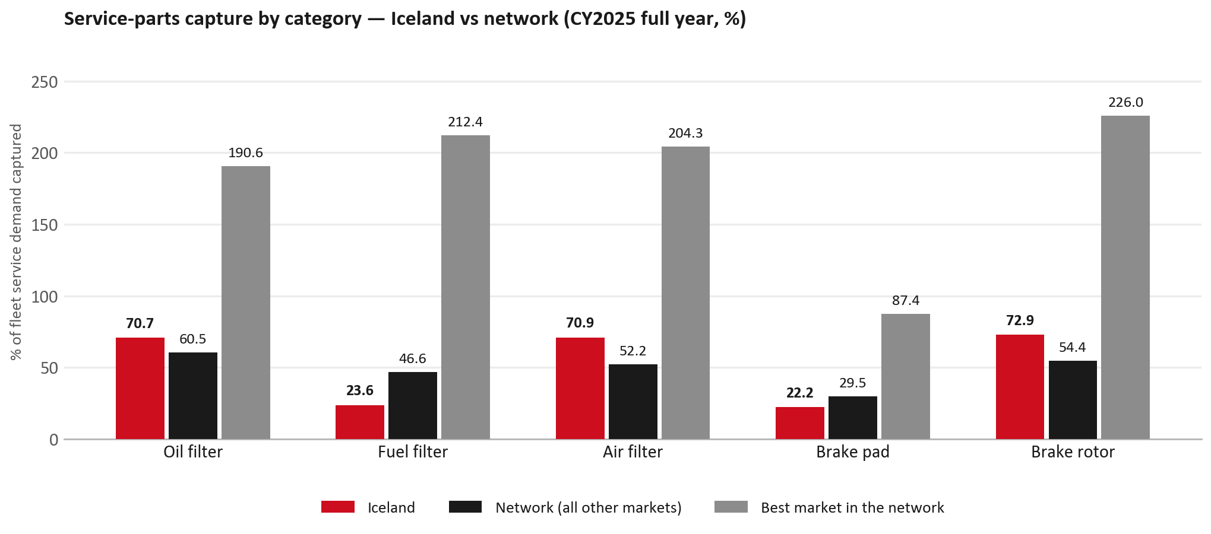
SERVICE-PARTS COVERAGE
Service-parts coverage: fuel filter is the clear gap
TAKEAWAYS
— Fuel filter 23.6% against 46.6% for the rest of the network.
— Brake pad 22.2% against 29.5% for the rest of the network.
— Every market here is measured on the same fleet-and-interval model, so the comparison is like-for-like even where the underlying interval assumption is debatable.
— Worth agreeing which category we tackle first, and what the joint action is.
10

Slide 11
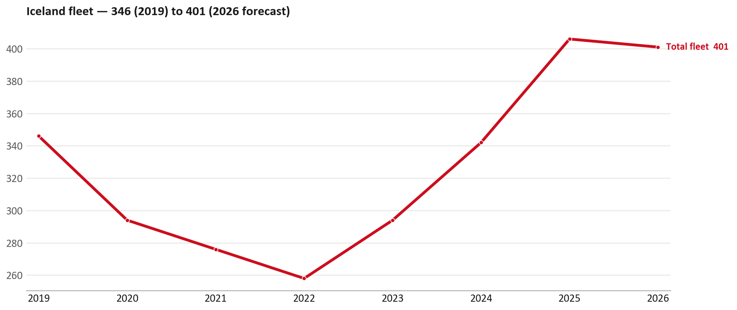
FLEET & FY2027 TARGET
The fleet is expected to decline in 2026
WHAT THIS MEANS FOR FY2027
— Fleet size (calendar year): 406 vehicles in 2025 → 401 working estimate for end-2026 (-1.2%).
— The chart is calendar years 2019–2026 only. 2026 is a working year-end estimate, not a fiscal-year figure.
— End-2026 mix: LCV / D-Max 401; CV — LD 0; CV — MD 0.
— The FY2027 Sales-to-Dealer target starts from that fleet change, then applies a 5% price adjustment and 1.8% additional growth.
— So the target is built from a slightly smaller fleet — not from an assumed growth story.
11

Slide 12
FLEET & FY2027 TARGET
How the FY2027 target is built
Sales-to-Dealer amount bridge
Step | Amount
FY2026 Sales-to-Dealer (reported KPI) | EUR 195,849
After fleet movement (-1.2%) | EUR 193,437
After price adjustment (+5%) | EUR 203,109
FY2027 target after additional growth (+1.8%) | EUR 206,765
— The FY2027 target is +5.6% versus the FY2026 Sales-to-Dealer base.
— The FY2026 base is the reported Sales-to-Dealer KPI.
12

Slide 13
FY2027 TARGET
What the FY2027 target reflects
1
Your fleet
2
The price move
— The working fleet movement used in the target is -1.2%.
— ISZE is applying a 5% price adjustment for FY2027, consistent with every ISZE market this year.
— It is built into the per-vehicle rate above, not added separately on top.
What it means for your target
 | Value
FY2027 Sales-to-Dealer target | EUR 206,765
vs FY2026 Sales-to-Dealer (EUR 195,849) | +5.6%
— As in previous cycles we would expect an incentive to sit alongside this adjustment — that approval is still pending on our side.
— Until the incentive is confirmed, treat the FY2027 target as the working bridge (fleet × price × additional growth), not a locked commercial commitment.
13

Slide 14
SPA
SPA
1
ICELAND proposal
2
ISZE review
3
Counter-proposal
4
Final approval
— BL ehf. submits a proposed parts list.
— ISZE reviews the proposal against network data and fit.
— ISZE returns a counter-proposal where needed.
— Signed off by ISZE management.
Purpose: higher turnover for both sides.
14

Slide 15
R&M
R&M — let's align on the market
M
Market
S
Servicing & R&M
— How is the market moving for you right now?
— How much of your volume is fleet business rather than retail?
— Where do you see the biggest hurdles this year?
— Where are your real strengths in this segment?
— Do you offer an R&M or service-plan product today?
— What share of the parc do you retain for servicing after year three?
— Does R&M business come bundled with fleet tenders — roughly what share?
— What would it take to bring more out-of-network servicing back?
15

Slide 16
ASK
Part-level Sales-to-Dealer Data
1
Already halfway there
2
Sharper insight
3
Shared benefit
— You already report Sales-to-Dealer monthly. The ask is the same data at part-number level.
— Part-by-part visibility separates a stock movement from a lost job — and tells us where the volume actually went.
— Better availability on your fast movers, a sharper target for us, and a factual basis for the SPA — same data, both sides gain.
Requested from 01/01/2025, part number level, monthly.
16

Slide 17
SUMMARY
Next steps
— Align on the FY2027 Sales-to-Dealer bridge (fleet, price, additional growth) — working figure EUR 206,765 (+5.6% vs FY2026 base).
— Confirm the incentive alongside the price adjustment; lock the target once that approval is through.
— Transmission parts / Air conditioning: agree which category we tackle first, and what the joint action is.
— Agree part-level Sales-to-Dealer data sharing, effective 01/01/2025.
— SPA: ICELAND proposal, ISZE review and counter-proposal cycle to follow.
17

Slide 18
Moving the World – for You

Slide 19
ICELAND · BL EHF.
Deep dive — detail behind the Mode A story
— Extra detail for meeting prep — pick which slides to share with BL ehf..
— Mode A ends on the previous closing slide.
— Label in all charts: “Genuine with BVP alternative” (not “genuine contested”).
19

Slide 20
AGENDA
Deep-dive agenda
— GPS — fiscal year (headline vs excl. warranty; max two lines)
— FY2025 → FY2026 wallet mix (Genuine / Genuine with BVP alternative / BVP)
— Where the money went — outside the service-parts basket (FY)
— Service parts: CY capture vs network + FY billing (capture % is CY-only by design)
— Brake pads — BVP share of total brake pad sales (FY)
— AIM exposure
— Warranty — two lenses
— How to use this in the meeting
20

Slide 21
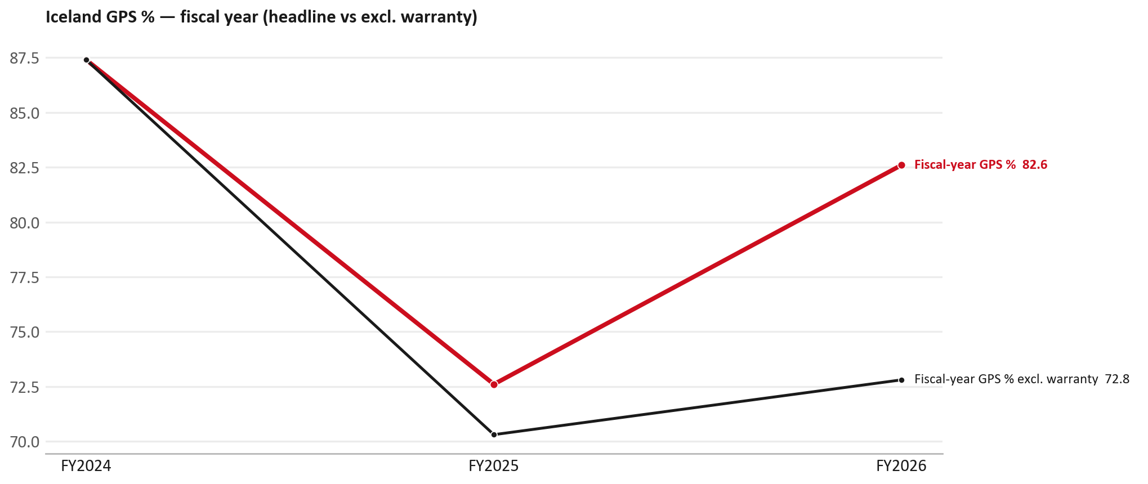
GPS
GPS: fiscal year headline vs after warranty
TAKEAWAYS
— Red = fiscal-year GPS (frozen CY2025 wallet). FY25 72.6% → FY26 82.6%.
— Black = fiscal GPS after removing warranty parts (€). FY26 ≈ 72.8% (warranty EUR 9,865 ≈ 12% of FY26 billing).
— Fleet 406 → 401 (working year-end estimate under the FY2027 target).
21

Slide 22
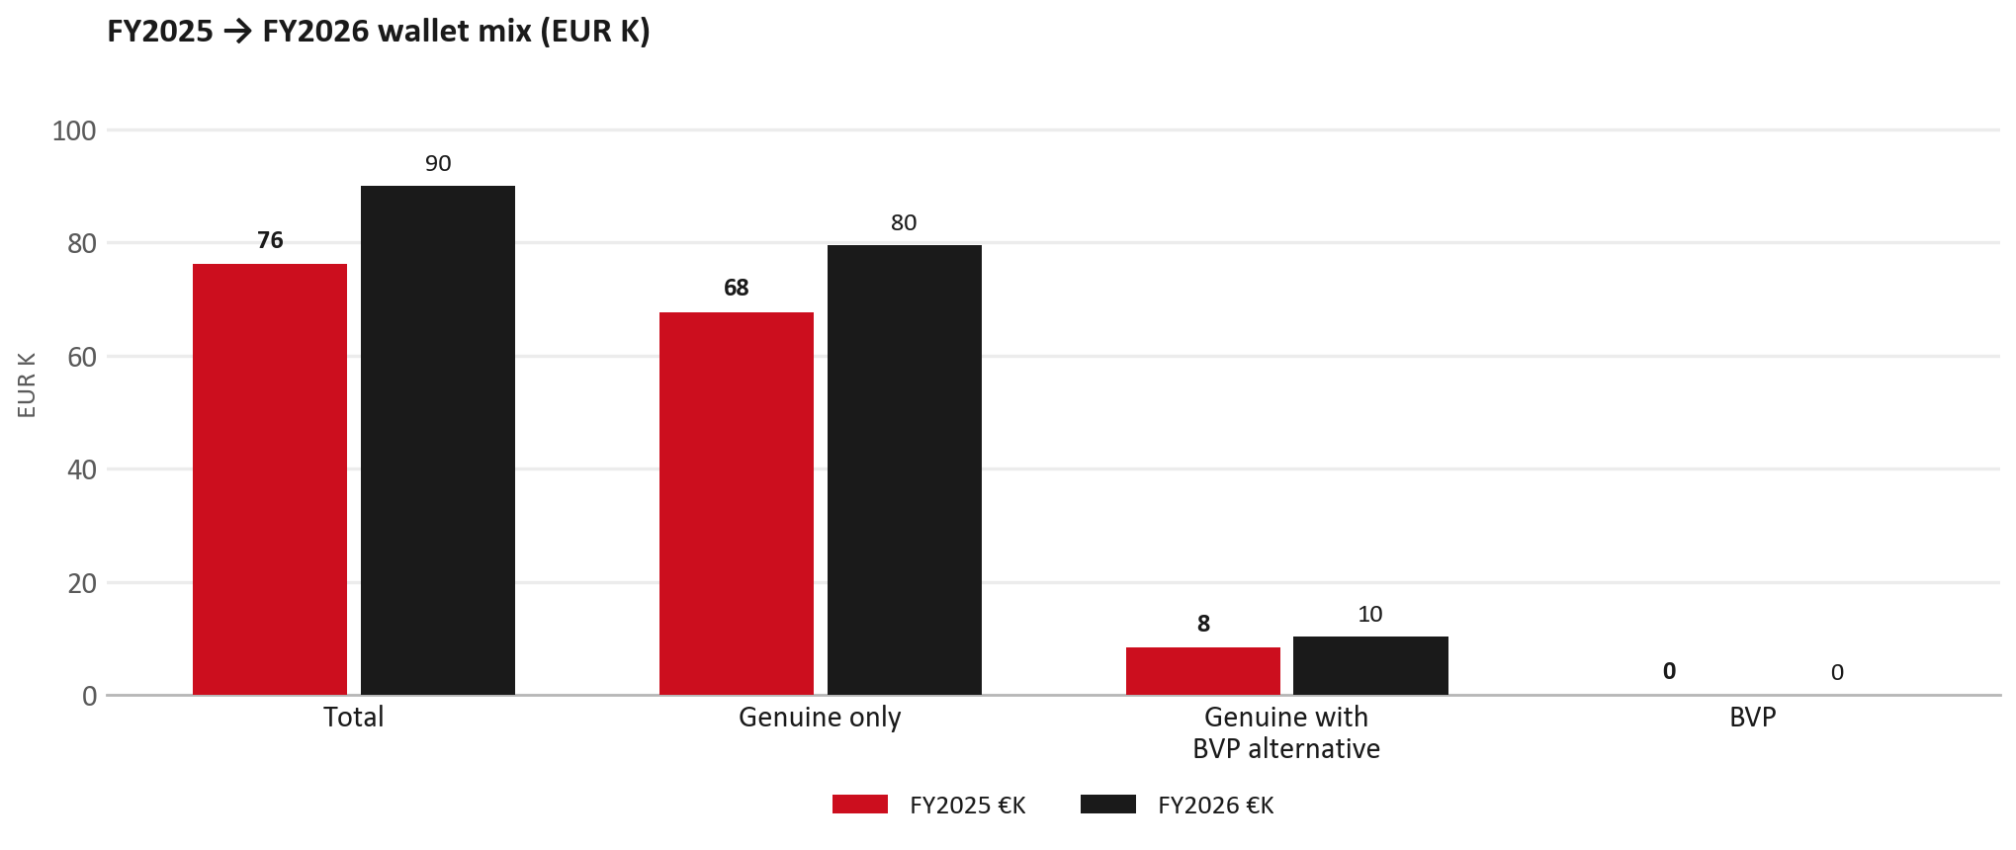
WALLET MIX
FY2025 → FY2026 wallet mix
— Total EUR 76,214 → EUR 89,959 (+18.0%).
— Genuine only EUR 11,823.
— Genuine with BVP alternative EUR 1,922; BVP EUR 0 (0.0% of FY26 wallet).
— Display label locked: Genuine with BVP alternative.
22

Slide 23
WALLET MIX
FY wallet mix — detail
 | FY2025 | FY2026 | Δ
Total | EUR 76,214 | EUR 89,959 | EUR 13,745
Genuine only | EUR 67,741 | EUR 79,564 | EUR 11,823
Genuine with BVP alternative | EUR 8,473 | EUR 10,395 | EUR 1,922
BVP | EUR 0 | EUR 0 | EUR 0
BVP % of wallet | 0.0% | 0.0% | +0.0 pp
23

Slide 24
DRIVERS
Where the genuine drop sits (FY2025 → FY2026)
— Genuine-only sales moved EUR 11,823 from FY2025 to FY2026.
— Of that, the routine service basket (filters, pads, rotors) moved EUR 3,336 on genuine-only; BVP in that basket moved EUR 0.
— Genuine-only did not fall on this FY cut — check category movers and H1 for pressure points.
— Meeting line: check high-value assemblies / sensors before blaming the filter or pad menu.
24

Slide 25
DRIVERS
Largest part-number drops (FY24→FY25) — outside service filters
Part | Description | Δ EUR
8981776324 | DPD ASM | -1,335
8983550720 | partikel sensor | -1,168
8980139111 | VALVE; EGR | -1,105
8974925378 | HARNESS; CABLE,ENG ROOM | -894
8984877702 | DISPLAY; MULTI | -830
8979468160 | SPRING ASM; LEAF,RR | -556
8973873711 | FENDER; FRT | -503
— Check warranty / campaign coding before calling competitive leakage.
25

Slide 26
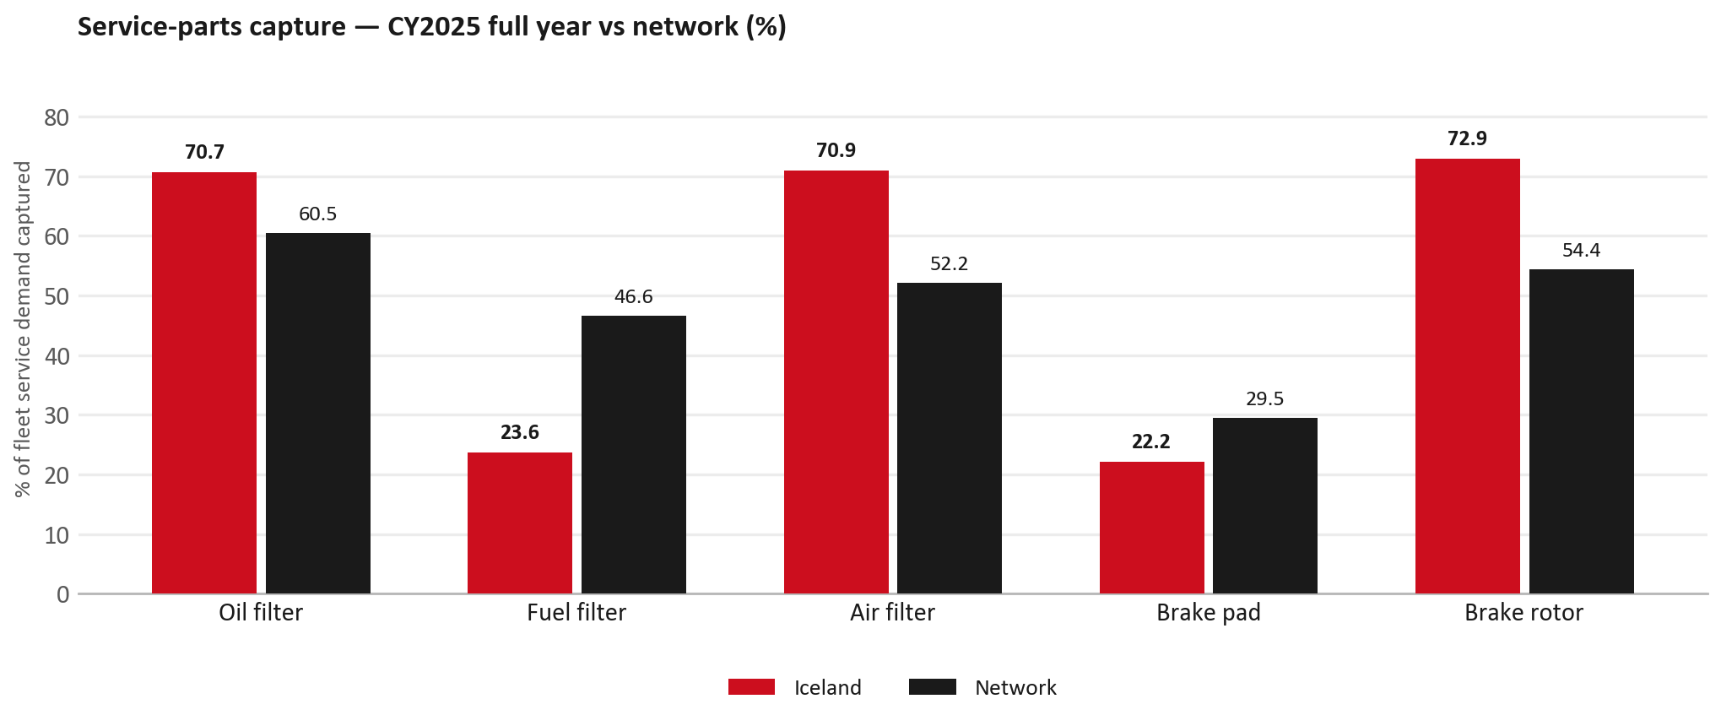
SERVICE PARTS
Service-parts capture vs network (calendar year)
TAKEAWAYS
— Capture % is calendar-year (full CY2025). Fleet demand is modelled on calendar years — there is no matching fiscal-year capture %.
— Oil filter 70.7% vs network 60.5%; Fuel filter 23.6% vs network 46.6%; Air filter 70.9% vs network 52.2%.
— Next slide: fiscal-year € billing in the same five categories.
— Primary lens = total capture (not genuine-only).
26

Slide 27
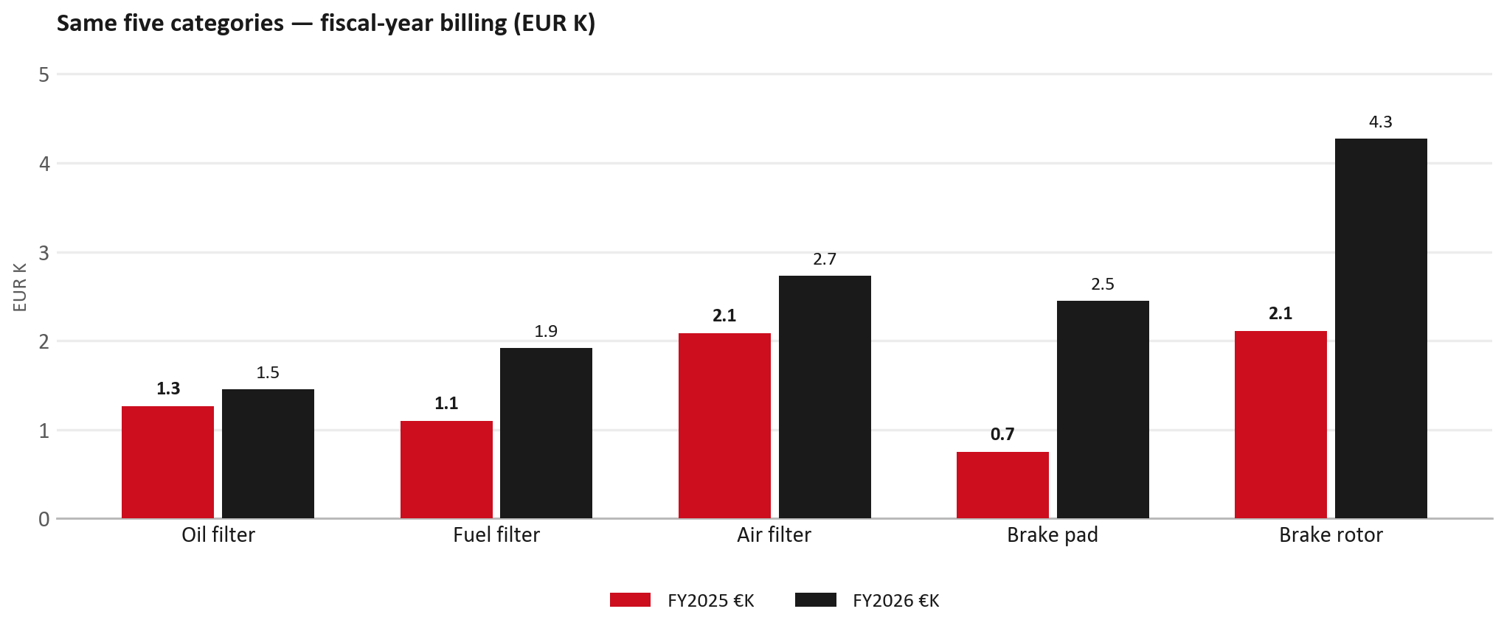
SERVICE PARTS · FY
Service-parts billing by fiscal year (same five lines)
TAKEAWAYS
— This is Sales-to-BL ehf. € in fiscal years — not capture % of fleet demand.
— Use both lenses — do not mix % capture with € billing.
— Primary = total sales in the basket.
27

Slide 28
BRAKES
Brake pads — BVP share of total brake pad sales (FY)
 | FY2025 | FY2026
Genuine qty | 0 | 0
BVP qty | 0 | 0
BVP share of total brake pad sales (€) | 0% | 0%
— BVP share = BVP € ÷ all brake-pad € billed (genuine + BVP). Not a PMS capture %.
— Wallet-level BVP is still only ~0.0% of FY26 — do not generalise a pad story to the whole wallet.
28

Slide 29
AIM
AIM exposure
Year | High-risk € | High-risk % | Quadrant
2023 | EUR 130 | 0.2% | Attach gap (high GPS - low capture)
2024 | EUR 767 | 1.0% | Attach gap (high GPS - low capture)
2025 | EUR 435 | 0.5% | Defend (high GPS - high capture)
— High-risk € is catalogue AIM exposure, not proven walk-out.
— Open on jobs not bought through the distributor — not a street IAM war alone.
29

Slide 30
WARRANTY
Warranty — two real lenses
1
CY2025 claim-price parts
2
Fiscal GPS expense
— EUR 7,035 (claim-price basis).
— Calendar-year claim price basis.
— LCV warranty.
— FY24 EUR 0 · FY25 EUR 2,345 · FY26 EUR 9,865.
— Source row: BL Iceland.
— Ex-warranty GPS = (net − warranty) ÷ frozen CY25 wallet.
— Both numbers are real — never mix them on one slide without labels.
30

Slide 31
BRIDGE
How to use this in the meeting
If they say… | You know…
BVP is eating genuine | Wallet BVP ~0.0%. Check pads as a local exception only.
GPS looks fine / too high | FY26 headline 82.6%; excl. warranty ≈ 72.8%.
Service parts are fine | CY2025 capture vs network (previous slides) + FY billing lens.
31

Slide 32
Moving the World – for You

