Slide 1

ISZE · UNITED KINGDOM · IUK
UK Sales Review
& FY2027 Target
I.M. Parts & Service · August 2026

Slide 2
IUK MEETING
Agenda
— Q1 FY2027 Sales Review
— Parts Performance — category movers
— Parts Performance — Body parts
— Parts Performance — Exhaust
— Parts Performance — Filters
— Parts Performance — where volume grew
— New Business — validation queue
— Sales-to-Dealer Outlook
— GPS Capture
— Service-Parts Coverage
— IDS 2026 — Dealer Standard
— Fleet & FY2027 Target
— SPA — status
— R&M — market discussion
— Data request: part-level Sales-to-Dealer
— Next steps
2

Slide 3
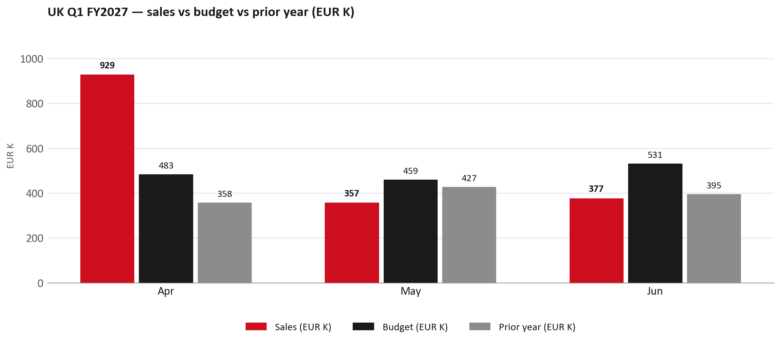
Q1 FY2027 SALES REVIEW
Q1 FY2027: EUR 1,663K, +13% vs budget
TAKEAWAYS
— Sales EUR 1,663K against a EUR 1,473K budget — +13%, and +41% on last year's EUR 1,180K.
— The beat is entirely Apr: EUR 929K against EUR 483K. May -22% and Jun -29% are both below budget.
— Order intake for the quarter was EUR 939K against EUR 1,663K billed — orders ran at about 56% of shipments.
— Worth walking through the shape of the quarter together, and what the order book looks like from here.
3

Slide 4
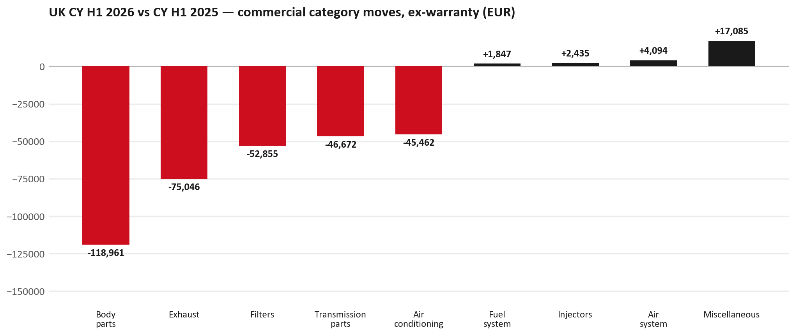
PARTS PERFORMANCE
Parts Performance — CY H1 2026 vs CY H1 2025 (commercial, ex-warranty)
TAKEAWAYS
— Commercial parts billing (warranty/campaign excluded) EUR 991K against EUR 1,464K a year earlier — -32.3% (CY H1 2026 vs CY H1 2025, Jan–Jun).
— Largest PN drops: 8981405904 (SILENCER ASM; EXH) EUR -47K, 350 fewer pcs; 8981596930 (ELEMENT KIT; FUEL FI) [N*R,NPS,QKR,TF*,UC*] EUR -34K, 2,650 fewer pcs; 8974995480 (FILTER; ACL) [TFR,TFS,UCR,UCS] EUR -22K, 1,048 fewer pcs.
— Largest PN gains: 8978248643 (LAMP ASM; RR COMB) EUR 6K, 39 more pcs; 7552259810 (WHEEL; DISC) EUR 6K, 49 more pcs; 8978461162 (GLASS; WINDSHIELD) EUR 5K, 24 more pcs.
— Credit notes of EUR 97K stay on the net bridge (net EUR 2,138K); not in the movers.
4

Slide 5
PARTS PERFORMANCE — BODY PARTS
Body parts — CY H1 2026 vs CY H1 2025 (commercial, ex-warranty)
— EUR 377,481 (CY H1 2025) to EUR 258,519 (CY H1 2026), down EUR 118,961 (-32%).
— Largest part numbers driving the decline (by EUR):
— 8979071454 (RAIL; ROOF): EUR 13,575 to EUR 0, 108 fewer pieces.
— 8979071464 (RAIL; ROOF): EUR 13,453 to EUR 0, 107 fewer pieces.
— 7552070680 (EMBLEM; RAD GRILLE): EUR 10,880 to EUR 0, 250 fewer pieces.
— 8981045609 (PANEL; SIDE GATE): EUR 8,742 to EUR 2,179, 28 fewer pieces.
Questions for us to work through together
— Is this pricing against what the dealers can buy locally?
— Is any of this stock timing on your side rather than end demand?
— What would make the biggest difference to keep this business with us?
5

Slide 6
PARTS PERFORMANCE — EXHAUST
Exhaust — CY H1 2026 vs CY H1 2025 (commercial, ex-warranty)
— EUR 108,243 (CY H1 2025) to EUR 33,197 (CY H1 2026), down EUR 75,046 (-69%).
— Largest part numbers driving the decline (by EUR):
— 8981405904 (SILENCER ASM; EXH): EUR 47,075 to EUR 0, 350 fewer pieces.
— 8981776324 (DPD ASM): EUR 11,294 to EUR 0, 9 fewer pieces.
— 8981405894 (SILENCER ASM; EXH): EUR 15,602 to EUR 6,759, 62 fewer pieces.
— 8981647861 (VALVE; EGR): EUR 13,497 to EUR 7,453, 55 fewer pieces.
Questions for us to work through together
— Is this pricing against what the dealers can buy locally?
— Is any of this stock timing on your side rather than end demand?
— What would make the biggest difference to keep this business with us?
6

Slide 7
PARTS PERFORMANCE — FILTERS
Filters — CY H1 2026 vs CY H1 2025 (commercial, ex-warranty)
— EUR 83,611 (CY H1 2025) to EUR 30,756 (CY H1 2026), down EUR 52,855 (-63%).
— Largest part numbers driving the decline (by EUR):
— 8981596930 (ELEMENT KIT; FUEL FILTER · N*R,NPS,QKR,TF*,UC*): EUR 44,695 to EUR 10,854, 2,650 fewer pieces.
— 8982705240 (ELEMENT; OIL FILTER · NHR,NLR,NMR,TF*,UC*): EUR 30,615 to EUR 14,130, 3,500 fewer pieces.
— 5876150531 (ELEMENT; OIL FILTER): EUR 3,947 to EUR 0, 900 fewer pieces.
— 8981650710 (ELEMENT; OIL FILTER · TFR,TFS,UCR,UCS): EUR 1,878 to EUR 188, 270 fewer pieces.
Questions for us to work through together
— Are dealers stocking filters, or ordering line-by-line against each job?
— How much servicing do you estimate is happening outside the franchised network?
— Would a service-pack offer on oil and fuel filters be workable for your dealers?
7

Slide 8
PARTS PERFORMANCE — GROWTH
Where volume grew — CY H1 2026 vs CY H1 2025 (commercial, ex-warranty)
Part | Description | CY H1 2025 | CY H1 2026 | Δ EUR
8978248643 | LAMP ASM; RR COMB | EUR 1,275 | EUR 6,992 | EUR 5,717
7552259810 | WHEEL; DISC | EUR 725 | EUR 6,350 | EUR 5,625
8978461162 | GLASS; WINDSHIELD | EUR 373 | EUR 5,102 | EUR 4,729
8978248653 | LAMP ASM; RR COMB | EUR 348 | EUR 4,473 | EUR 4,125
8978209330 | DOOR ASM; FRT,WO/TRIM | EUR 865 | EUR 3,649 | EUR 2,784
8983303281 | BUMPER ASM; FRT | EUR 3,582 | EUR 5,859 | EUR 2,276
— Miscellaneous +24%, Air system +45%, Injectors +48% — where the commercial volume went.
— Claim-matched PNs (519 distinct) and campaign/recall text matches are already excluded from this growth list. Residual warranty on unmapped PNs can remain.
— PNs ranked by largest EUR increase (prior-period sales > 0). Worth agreeing which of these are repeatable and which were one-off.
8

Slide 9
PARTS PERFORMANCE
New Business — validation queue (CY H1 2026)
Part | Description | Current sales | Review
8975359391 | DPD ASM | EUR 66,746 | Warranty / campaign
7552816560 | BATTERY ASM; HIGH VOLTAGE | EUR 37,785 | Validate
7552689700 | PUMP; WATER | EUR 30,858 | Warranty / campaign
8972666512 | DISPLAY; MULTI | EUR 7,793 | Validate
7552348300 | STEERING UNIT | EUR 6,361 | Validate
8975264511 | HYDRAULIC UNIT; ANTI LOCK BRK | EUR 5,598 | Warranty / campaign
— These lines had no prior-period sales, so they are kept out of the incremental-growth table.
— A first sale can be a new model, a supersession, timing, or a warranty campaign. It is not treated as a commercial win until that cause is confirmed.
9

Slide 10
SALES-TO-DEALER
Sales-to-Dealer outlook — FY2027
— FY2026 Sales-to-Dealer is EUR 21,418,279 (reported KPI).
— The working fleet movement into FY2027 is -6.0%.
— Applying fleet movement, the 5% price adjustment and 1.8% additional growth gives a FY2027 Sales-to-Dealer target of EUR 21,525,140.
— The discussion is held in Sales-to-Dealer amounts; ISZE billing remains an internal reconciliation measure.
10

Slide 11
GPS
GPS Capture: 47.3%
— GPS measures your actual parts purchases against the full potential of your fleet.
— UK today: 47.3% (FY2026 purchases against the CY2025 fleet potential).
— Fleet potential: EUR 11,946K on 47,783 vehicles.
— Real, sustained headroom above 47.3% — the service-parts and SPA discussion are both direct levers on it.
11

Slide 12
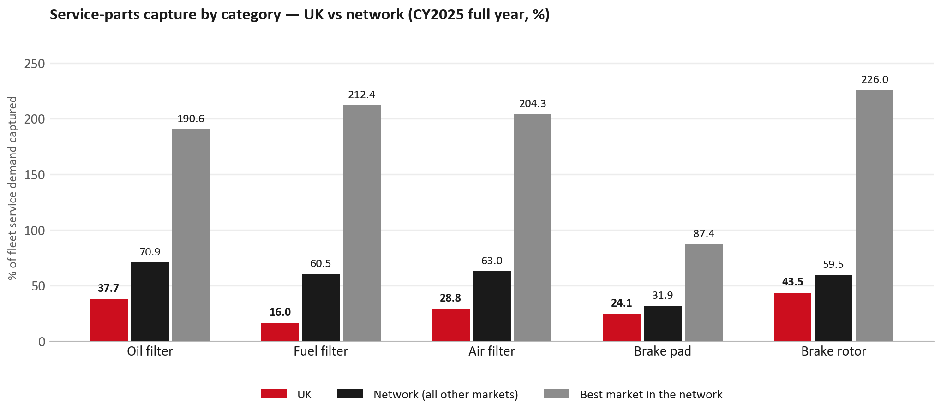
SERVICE-PARTS COVERAGE
Service-parts coverage sits below the network on every routine category
TAKEAWAYS
— Fuel filter 16.0% against 60.5% for the rest of the network.
— Air filter 28.8% against 63.0% for the rest of the network.
— Every market here is measured on the same fleet-and-interval model, so the comparison is like-for-like even where the underlying interval assumption is debatable.
— Worth agreeing which category we tackle first, and what the joint action is.
12

Slide 13
IDS 2026 — DEALER STANDARD
IDS 2026: UK averages 81.7%, above the 74.8% network benchmark
Dealer | Total % | Global rank
Adam Purves Isuzu | 100.0% | #1
Office Good Limited T/As Livingstonr Motor Group (Hull Isuzu) | 98.6% | #6
Eakin Brothers Ltd | 96.8% | #17
UK country average | 81.7% | —
Network average (all IDS 2026) | 74.8% | —
Fussellwadman | 65.7% | #434
York Van Centre Ltd | 59.0% | #463
Pentraeth Automotive Ltd | 47.5% | #474
— 43 dealers assessed across Premises, Organisation, Service, Parts and Vehicle Sales.
— The country average sits 6.9 points above the network.
— The spread is the point: 52 points between the strongest and weakest dealer.
— Dealer-by-dealer detail and individual feedback are available as a separate pack — worth agreeing which dealers to visit, and when.
13

Slide 14
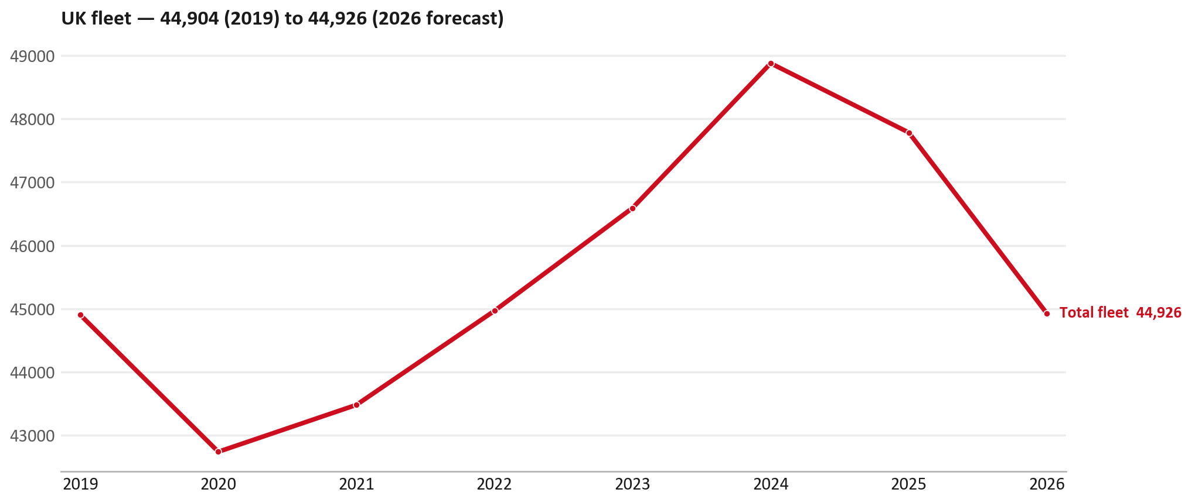
FLEET & FY2027 TARGET
The fleet is expected to decline in 2026
WHAT THIS MEANS FOR FY2027
— Fleet size (calendar year): 47,783 vehicles in 2025 → 44,926 working estimate for end-2026 (-6.0%).
— The chart is calendar years 2019–2026 only. 2026 is a working year-end estimate, not a fiscal-year figure.
— End-2026 mix: LCV / D-Max 44,926.
— The FY2027 Sales-to-Dealer target starts from that fleet change, then applies a 5% price adjustment and 1.8% additional growth.
— So the target is built from a slightly smaller fleet — not from an assumed growth story.
14

Slide 15
FLEET & FY2027 TARGET
How the FY2027 target is built
Sales-to-Dealer amount bridge
Step | Amount
FY2026 Sales-to-Dealer (reported KPI) | EUR 21,418,279
After fleet movement (-6.0%) | EUR 20,137,656
After price adjustment (+5%) | EUR 21,144,538
FY2027 target after additional growth (+1.8%) | EUR 21,525,140
— The FY2027 target is +0.5% versus the FY2026 Sales-to-Dealer base.
— The FY2026 base is the reported Sales-to-Dealer KPI.
15

Slide 16
FY2027 TARGET
What the FY2027 target reflects
1
Your fleet
2
The price move
— The working fleet movement used in the target is -6.0%.
— ISZE is applying a 5% price adjustment for FY2027, consistent with every ISZE market this year.
— It is built into the per-vehicle rate above, not added separately on top.
What it means for your target
 | Value
FY2027 Sales-to-Dealer target | EUR 21,525,140
vs FY2026 Sales-to-Dealer (EUR 21,418,279) | +0.5%
— As in previous cycles we would expect an incentive to sit alongside this adjustment — that approval is still pending on our side.
— Until the incentive is confirmed, treat the FY2027 target as the working bridge (fleet × price × additional growth), not a locked commercial commitment.
16

Slide 17
SPA
SPA
1
IUK proposal
2
ISZE review
3
Counter-proposal
4
Final approval
— I.M. Parts & Service submits a proposed parts list.
— ISZE reviews the proposal against network data and fit.
— ISZE returns a counter-proposal where needed.
— Signed off by ISZE management.
Purpose: higher turnover for both sides.
17

Slide 18
R&M
R&M — let's align on the market
M
Market
S
Servicing & R&M
— How is the market moving for you right now?
— How much of your volume is fleet business rather than retail?
— Where do you see the biggest hurdles this year?
— Where are your real strengths in this segment?
— Do you offer an R&M or service-plan product today?
— What share of the parc do you retain for servicing after year three?
— Does R&M business come bundled with fleet tenders — roughly what share?
— What would it take to bring more out-of-network servicing back?
18

Slide 19
ASK
Part-level Sales-to-Dealer Data
1
Already halfway there
2
Sharper insight
3
Shared benefit
— You already report Sales-to-Dealer monthly. The ask is the same data at part-number level.
— Part-by-part visibility separates a stock movement from a lost job — and tells us where the volume actually went.
— Better availability on your fast movers, a sharper target for us, and a factual basis for the SPA — same data, both sides gain.
Requested from 01/01/2025, part number level, monthly.
19

Slide 20
SUMMARY
Next steps
— Confirm FY2027 Sales-to-Dealer target: EUR 21,525,140 (+0.5% vs FY2026 Sales-to-Dealer).
— Confirm the incentive alongside the price adjustment once approved on our side.
— Body parts / Exhaust / Filters: agree which category we tackle first, and what the joint action is.
— Agree part-level Sales-to-Dealer data sharing, effective 01/01/2025.
— SPA: IUK proposal, ISZE review and counter-proposal cycle to follow.
— IDS 2026: agree dealer visit dates, starting with the lower-scoring dealers.
— Q2 outlook: review the order book against the Q1 shipment pattern.
20

Slide 21
Moving the World – for You

