Slide 1

ISZE · GREECE · PETROS
Greece Sales Review
& FY2027 Target
Petros Petropoulos · August 2026

Slide 2
PETROS MEETING
Agenda
— Parts Performance — category movers
— Parts Performance — Brake parts
— Parts Performance — Engine parts
— Parts Performance — Hydraulic / mechanical
— Parts Performance — where volume grew
— New Business — validation queue
— Sales-to-Dealer Outlook
— GPS Capture
— Service-Parts Coverage
— IDS 2026 — Dealer Standard
— Fleet & FY2027 Target
— SPA — status
— R&M — market discussion
— Data request: part-level Sales-to-Dealer
— Next steps
2

Slide 3
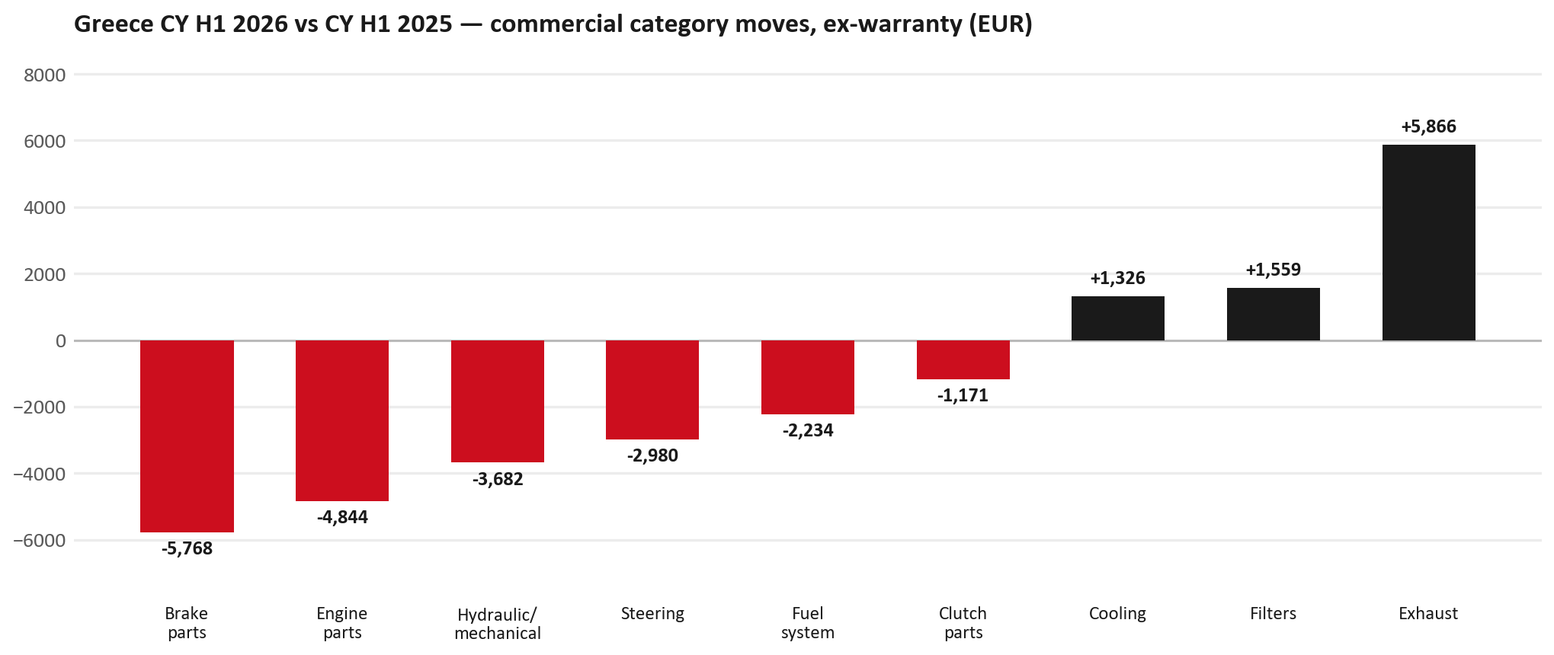
PARTS PERFORMANCE
Parts Performance — CY H1 2026 vs CY H1 2025 (commercial, ex-warranty)
TAKEAWAYS
— Commercial parts billing (warranty/campaign excluded) EUR 186K against EUR 213K a year earlier — -12.7% (CY H1 2026 vs CY H1 2025, Jan–Jun).
— Largest PN drops: 8976607440 (TRANSMISSION ASM; MA) EUR -4K, 1 fewer pcs; 8980139111 (VALVE; EGR) EUR -4K, 36 fewer pcs; 8972660360 (TRANSFER ASM) EUR -2K, 1 fewer pcs.
— Largest PN gains: 8982705240 (ELEMENT; OIL FILTER) [NHR,NLR,NMR,TF*,UC*] EUR 2K, 96 more pcs; 8975554500 (FILTER; BLOWER UNIT) [TF*,UC*] EUR 2K, 126 more pcs; 7552622990 (PANEL; ENG HOOD) EUR 2K, 8 more pcs.
— About EUR 53K of claim-matched PN billing was stripped so this chart is aftermarket demand, not warranty.
3

Slide 4
PARTS PERFORMANCE — BRAKE PARTS
Brake parts — CY H1 2026 vs CY H1 2025 (commercial, ex-warranty)
— EUR 12,155 (CY H1 2025) to EUR 6,387 (CY H1 2026), down EUR 5,768 (-47%).
— Largest part numbers driving the decline (by EUR):
— 5876150610 (PAD KIT; CALIPER,DISC BRK,FRT · TF*): EUR 2,026 to EUR 0, 45 fewer pieces.
— 8980180360 (SHOE KIT; BRK,RR): EUR 1,245 to EUR 222, 23 fewer pieces.
— 5876150600 (PAD KIT; CALIPER,DISC BRK,FRT · TF*): EUR 849 to EUR 0, 16 fewer pieces.
— 8975546610 (PAD KIT; CALIPER,DISC BRK,FRT · TF*): EUR 755 to EUR 0, 9 fewer pieces.
Questions for us to work through together
— Is pad and rotor pricing competitive against what the dealers can buy locally?
— Is any of this stock timing on your side rather than end demand?
— Are dealers still quoting these part numbers, or have they dropped off the workshop menu?
4

Slide 5
PARTS PERFORMANCE — ENGINE PARTS
Engine parts — CY H1 2026 vs CY H1 2025 (commercial, ex-warranty)
— EUR 6,374 (CY H1 2025) to EUR 1,530 (CY H1 2026), down EUR 4,844 (-76%).
— Largest part numbers driving the decline (by EUR):
— 8981706190 (HEAD ASM; CYL): EUR 1,176 to EUR 0, 1 fewer pieces.
— 8978775550 (CAMERA ASM): EUR 1,088 to EUR 0, 1 fewer pieces.
— 8983360671 (VALVE; EVRV): EUR 885 to EUR 190, 9 fewer pieces.
— 8981162600 (VALVE; EVRV): EUR 893 to EUR 453, 10 fewer pieces.
Questions for us to work through together
— Is this pricing against what the dealers can buy locally?
— Is any of this stock timing on your side rather than end demand?
— What would make the biggest difference to keep this business with us?
5

Slide 6
PARTS PERFORMANCE — HYDRAULIC / MECHANICAL
Hydraulic / mechanical — CY H1 2026 vs CY H1 2025 (commercial, ex-warranty)
— EUR 12,106 (CY H1 2025) to EUR 8,425 (CY H1 2026), down EUR 3,682 (-30%).
— Largest part numbers driving the decline (by EUR):
— 8981454531 (OVERHAUL KIT; SUPPLY PUMP): EUR 2,131 to EUR 1,474, 12 fewer pieces.
— 8981480632 (FLYWHEEL): EUR 516 to EUR 0, 2 fewer pieces.
— 8975274910 (WHEEL; DISC,AL): EUR 438 to EUR 0, 2 fewer pieces.
— 8973876741 (SHAFT ASM; FRT DRIVE): EUR 426 to EUR 0, 1 fewer pieces.
Questions for us to work through together
— Is this pricing against what the dealers can buy locally?
— Is any of this stock timing on your side rather than end demand?
— What would make the biggest difference to keep this business with us?
6

Slide 7
PARTS PERFORMANCE — GROWTH
Where volume grew — CY H1 2026 vs CY H1 2025 (commercial, ex-warranty)
Part | Description | Model | CY H1 2025 | CY H1 2026 | Δ EUR
8982705240 | ELEMENT; OIL FILTER | NHR,NLR,NMR,TF*, | EUR 5,411 | EUR 7,756 | EUR 2,345
8975554500 | FILTER; BLOWER UNIT | TF*,UC* | EUR 4,355 | EUR 6,541 | EUR 2,186
7552622990 | PANEL; ENG HOOD | — | EUR 186 | EUR 1,830 | EUR 1,644
8975534311 | RADIATOR ASM | — | EUR 326 | EUR 1,658 | EUR 1,332
7552070251 | GRILLE; INNER,RAD | — | EUR 73 | EUR 1,312 | EUR 1,239
8978249035 | LAMP ASM; HEAD | — | EUR 351 | EUR 1,352 | EUR 1,001
— Exhaust +62%, Filters +8%, Cooling +31% — where the commercial volume went.
— Claim-matched PNs (71 distinct) and campaign/recall text matches are already excluded from this growth list. Residual warranty on unmapped PNs can remain.
— PNs ranked by largest EUR increase (prior-period sales > 0). Worth agreeing which of these are repeatable and which were one-off.
7

Slide 8
PARTS PERFORMANCE
New Business — validation queue (CY H1 2026)
Part | Description | Current sales | Review
8975359391 | DPD ASM | EUR 13,788 | Warranty / campaign
8983682091 | PIPE; EXH | EUR 8,087 | Validate
8978406900 | FRAME ASM | EUR 6,738 | Validate
5876150022 | FILTER; ACL | EUR 3,038 | Validate
7552172691 | BUMPER ASM; FRT | EUR 2,544 | Validate
8974985741 | TURBOCHARGER ASM | EUR 1,750 | Warranty / campaign
— These lines had no prior-period sales, so they are kept out of the incremental-growth table.
— A first sale can be a new model, a supersession, timing, or a warranty campaign. It is not treated as a commercial win until that cause is confirmed.
8

Slide 9
SALES-TO-DEALER
Sales-to-Dealer outlook — FY2027
— FY2026 Sales-to-Dealer is EUR 708,667 (working estimate).
— The working fleet movement into FY2027 is +5.1%.
— Applying fleet movement, the 5% price adjustment and 1.8% additional growth gives a FY2027 Sales-to-Dealer target of EUR 795,956.
— The discussion is held in Sales-to-Dealer amounts; ISZE billing remains an internal reconciliation measure.
9

Slide 10
GPS
GPS Capture: 46.3%
— GPS measures your actual parts purchases against the full potential of your fleet.
— Greece today: 46.3% (FY2026 purchases against the CY2025 fleet potential).
— Fleet potential: EUR 954K on 3,742 vehicles.
— Real, sustained headroom above 46.3% — the service-parts and SPA discussion are both direct levers on it.
10

Slide 11
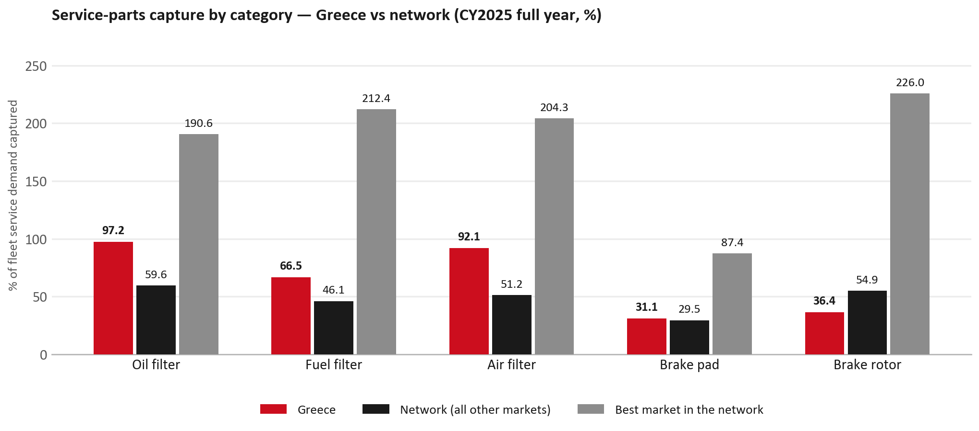
SERVICE-PARTS COVERAGE
Service-parts coverage: brake rotor is the clear gap
TAKEAWAYS
— Brake rotor 36.4% against 54.9% for the rest of the network.
— Brake pad 31.1% against 29.5% for the rest of the network.
— Every market here is measured on the same fleet-and-interval model, so the comparison is like-for-like even where the underlying interval assumption is debatable.
— Worth agreeing which category we tackle first, and what the joint action is.
11

Slide 12
IDS 2026 — DEALER STANDARD
IDS 2026: Greece averages 73.9%, below the 74.8% network benchmark
Dealer | Total % | Global rank
Sofia France Auto | 91.8% | #69
Nik. J. Theocarakis Sa | 86.1% | #167
Mpenteniti Pinelopi & Co. G.P | 85.0% | #184
Greece country average | 73.9% | —
Network average (all IDS 2026) | 74.8% | —
Basdelis G. A. Ike | 62.1% | #454
Theodorou Ike | 61.8% | #455
Chaniotis A. Ae | 57.1% | #467
— 34 dealers assessed across Premises, Organisation, Service, Parts and Vehicle Sales.
— The country average sits 0.9 points below the network.
— The spread is the point: 35 points between the strongest and weakest dealer.
— Dealer-by-dealer detail and individual feedback are available as a separate pack — worth agreeing which dealers to visit, and when.
12

Slide 13
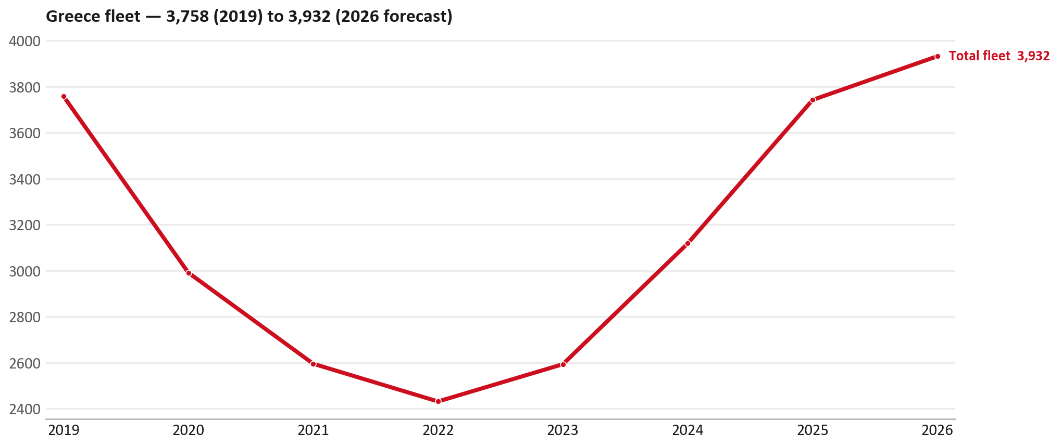
FLEET & FY2027 TARGET
The fleet is expected to grow in 2026
WHAT THIS MEANS FOR FY2027
— Fleet size (calendar year): 3,742 vehicles in 2025 → 3,932 working estimate for end-2026 (+5.1%).
— The chart is calendar years 2019–2026 only. 2026 is a working year-end estimate, not a fiscal-year figure.
— End-2026 mix: LCV / D-Max 3,879; CV — LD 53.
— The FY2027 Sales-to-Dealer target starts from that fleet change, then applies a 5% price adjustment and 1.8% additional growth.
— The target reflects the working fleet outlook without extending the chart beyond 2026.
13

Slide 14
FLEET & FY2027 TARGET
How the FY2027 target is built
Sales-to-Dealer amount bridge
Step | Amount
FY2026 Sales-to-Dealer (working estimate) | EUR 708,667
After fleet movement (+5.1%) | EUR 744,650
After price adjustment (+5%) | EUR 781,882
FY2027 target after additional growth (+1.8%) | EUR 795,956
— The FY2027 target is +12.3% versus the FY2026 Sales-to-Dealer base.
— The FY2026 base is a working estimate (ISZE billing ÷ 0.65): the KPI Dashboard has no usable Sales-to-Dealer row for this market.
14

Slide 15
FY2027 TARGET
What the FY2027 target reflects
1
Your fleet
2
The price move
— The working fleet movement used in the target is +5.1%.
— ISZE is applying a 5% price adjustment for FY2027, consistent with every ISZE market this year.
— It is built into the per-vehicle rate above, not added separately on top.
What it means for your target
 | Value
FY2027 Sales-to-Dealer target | EUR 795,956
vs FY2026 Sales-to-Dealer (EUR 708,667) | +12.3%
— As in previous cycles we would expect an incentive to sit alongside this adjustment — that approval is still pending on our side.
— Until the incentive is confirmed, treat the FY2027 target as the working bridge (fleet × price × additional growth), not a locked commercial commitment.
15

Slide 16
SPA
SPA
1
PETROS proposal
2
ISZE review
3
Counter-proposal
4
Final approval
— Petros Petropoulos submits a proposed parts list.
— ISZE reviews the proposal against network data and fit.
— ISZE returns a counter-proposal where needed.
— Signed off by ISZE management.
Purpose: higher turnover for both sides.
16

Slide 17
R&M
R&M — let's align on the market
M
Market
S
Servicing & R&M
— How is the market moving for you right now?
— How much of your volume is fleet business rather than retail?
— Where do you see the biggest hurdles this year?
— Where are your real strengths in this segment?
— Do you offer an R&M or service-plan product today?
— What share of the parc do you retain for servicing after year three?
— Does R&M business come bundled with fleet tenders — roughly what share?
— What would it take to bring more out-of-network servicing back?
17

Slide 18
ASK
Part-level Sales-to-Dealer Data
1
The starting point
2
Sharper insight
3
Shared benefit
— We have no Sales-to-Dealer figures from you for FY2026. The ask is monthly Sales-to-Dealer, at part-number level.
— Part-by-part visibility separates a stock movement from a lost job — and tells us where the volume actually went.
— Better availability on your fast movers, a sharper target for us, and a factual basis for the SPA — same data, both sides gain.
Requested from 01/01/2025, part number level, monthly.
18

Slide 19
SUMMARY
Next steps
— Align on the FY2027 Sales-to-Dealer bridge (fleet, price, additional growth) — working figure EUR 795,956 (+12.3% vs FY2026 base).
— Confirm the incentive alongside the price adjustment; lock the target once that approval is through.
— Brake parts / Engine parts / Hydraulic / mechanical: agree which category we tackle first, and what the joint action is.
— Agree part-level Sales-to-Dealer data sharing, effective 01/01/2025.
— SPA: PETROS proposal, ISZE review and counter-proposal cycle to follow.
— IDS 2026: agree dealer visit dates, starting with the lower-scoring dealers.
19

Slide 20
Moving the World – for You

