Slide 1

ISZE · ROMANIA · ROMANIA
Romania Sales Review
& FY2027 Target
Isuzu Rom Auto · August 2026

Slide 2
ROMANIA MEETING
Agenda
— Parts Performance — category movers
— Parts Performance — Hydraulic / mechanical
— Parts Performance — Brake parts
— Parts Performance — Lighting
— Parts Performance — where volume grew
— New Business — validation queue
— Sales-to-Dealer Outlook
— GPS Capture
— Service-Parts Coverage
— IDS 2026 — Dealer Standard
— Fleet & FY2027 Target
— SPA — status
— R&M — market discussion
— Data request: part-level Sales-to-Dealer
— Next steps
2

Slide 3
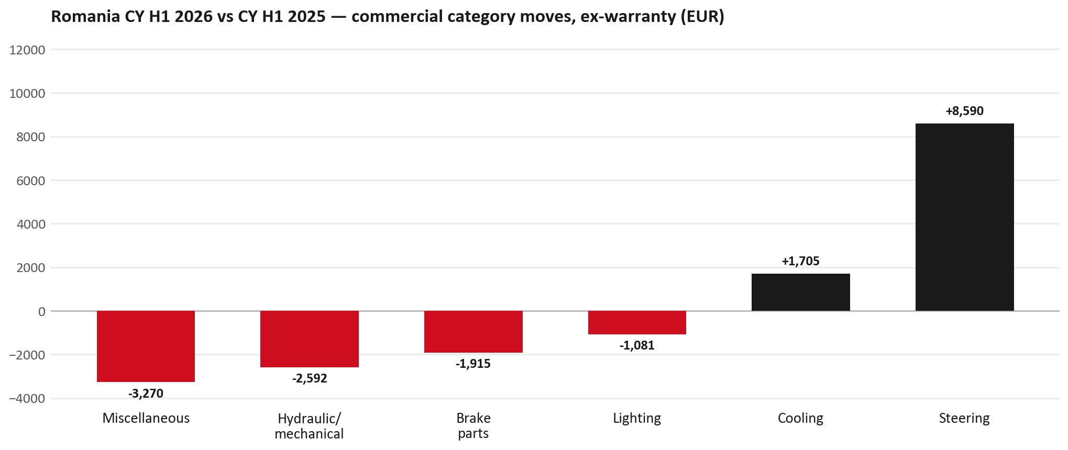
PARTS PERFORMANCE
Parts Performance — CY H1 2026 vs CY H1 2025 (commercial, ex-warranty)
TAKEAWAYS
— Commercial parts billing (warranty/campaign excluded) EUR 79K against EUR 80K a year earlier — -1.1% (CY H1 2026 vs CY H1 2025, Jan–Jun).
— Largest PN drops: 5874123812 (INTERFACE MX2-T) EUR -2K, 2 fewer pcs; 8981470623 (TRANSMISSION ASM; MA) EUR -2K, 1 fewer pcs; 8975056801 (PAD KIT; CALIPER,DIS) EUR -2K, 20 fewer pcs.
— Largest PN gains: 7552348290 (STEERING UNIT) EUR 8K, 4 more pcs; 8975488420 (FILTER; BLOWER UNIT) [TF*,UC*] EUR 1K, 60 more pcs; 8974995480 (FILTER; ACL) [TFR,TFS,UCR,UCS] EUR 1K, 30 more pcs.
— About EUR 6K of claim-matched PN billing was stripped so this chart is aftermarket demand, not warranty.
3

Slide 4
PARTS PERFORMANCE — HYDRAULIC / MECHANICAL
Hydraulic / mechanical — CY H1 2026 vs CY H1 2025 (commercial, ex-warranty)
— EUR 7,956 (CY H1 2025) to EUR 5,364 (CY H1 2026), down EUR 2,592 (-33%).
— Largest part numbers driving the decline (by EUR):
— 7552259810 (WHEEL; DISC): EUR 1,314 to EUR 0, 12 fewer pieces.
— 8981472452 (SHAFT ASM; FRT DRIVE): EUR 1,288 to EUR 0, 4 fewer pieces.
— 8981480632 (FLYWHEEL): EUR 516 to EUR 0, 2 fewer pieces.
— 8980058750 (JOINT ASM; BALL,LWR CONT ARM): EUR 313 to EUR 0, 10 fewer pieces.
Questions for us to work through together
— Is this pricing against what the dealers can buy locally?
— Is any of this stock timing on your side rather than end demand?
— What would make the biggest difference to keep this business with us?
4

Slide 5
PARTS PERFORMANCE — BRAKE PARTS
Brake parts — CY H1 2026 vs CY H1 2025 (commercial, ex-warranty)
— EUR 8,078 (CY H1 2025) to EUR 6,163 (CY H1 2026), down EUR 1,915 (-24%).
— Largest part numbers driving the decline (by EUR):
— 8975056801 (PAD KIT; CALIPER,DISC BRK,FRT): EUR 4,268 to EUR 2,564, 20 fewer pieces.
— 8980618131 (DRUM; BRK,RR): EUR 1,436 to EUR 1,179, 4 fewer pieces.
— 8978348260 (SHOE KIT; BRK,RR · TFR,TFS (RT,RG)): EUR 248 to EUR 0, 6 fewer pieces.
— 1476012180 (CYLINDER; WHEEL,RR BRK): EUR 196 to EUR 0, 1 fewer pieces.
Questions for us to work through together
— Is pad and rotor pricing competitive against what the dealers can buy locally?
— Is any of this stock timing on your side rather than end demand?
— Are dealers still quoting these part numbers, or have they dropped off the workshop menu?
5

Slide 6
PARTS PERFORMANCE — LIGHTING
Lighting — CY H1 2026 vs CY H1 2025 (commercial, ex-warranty)
— EUR 5,642 (CY H1 2025) to EUR 4,561 (CY H1 2026), down EUR 1,081 (-19%).
— Largest part numbers driving the decline (by EUR):
— 8978429890 (LAMP ASM; RR COMB): EUR 491 to EUR 0, 3 fewer pieces.
— 8983287885 (LAMP ASM; HEAD): EUR 476 to EUR 0, 4 fewer pieces.
— 8977950000 (LAMP UNIT; RR COMB): EUR 582 to EUR 119, 4 fewer pieces.
— 8978486410 (LAMP UNIT; RR COMB): EUR 446 to EUR 0, 3 fewer pieces.
Questions for us to work through together
— Is this availability, pricing, or genuinely fewer accident repairs?
— Are the bodyshops in your network sourcing lamps elsewhere?
6

Slide 7
PARTS PERFORMANCE — GROWTH
Where volume grew — CY H1 2026 vs CY H1 2025 (commercial, ex-warranty)
Part | Description | Model | CY H1 2025 | CY H1 2026 | Δ EUR
7552348290 | STEERING UNIT | — | EUR 2,043 | EUR 10,296 | EUR 8,253
8975488420 | FILTER; BLOWER UNIT | TF*,UC* | EUR 1,714 | EUR 2,725 | EUR 1,011
8974995480 | FILTER; ACL | TFR,TFS,UCR,UCS | EUR 4,371 | EUR 5,033 | EUR 662
7552070241 | GRILLE; INNER,RAD | — | EUR 304 | EUR 915 | EUR 611
8982705240 | ELEMENT; OIL FILTER | NHR,NLR,NMR,TF*, | EUR 1,527 | EUR 2,124 | EUR 597
8975391990 | ROD END ASM; OUTER | — | EUR 117 | EUR 712 | EUR 595
— Steering +272%, Cooling +172% — where the commercial volume went.
— Claim-matched PNs (24 distinct) and campaign/recall text matches are already excluded from this growth list. Residual warranty on unmapped PNs can remain.
— PNs ranked by largest EUR increase (prior-period sales > 0). Worth agreeing which of these are repeatable and which were one-off.
7

Slide 8
PARTS PERFORMANCE
New Business — validation queue (CY H1 2026)
Part | Description | Current sales | Review
8983682091 | PIPE; EXH | EUR 1,312 | Validate
5877030010 | ISUZU ATF WSI 4L | EUR 1,001 | Validate
8981532774 | BUMPER; RR | EUR 740 | Validate
8983989321 | PLATE ASM; PRESSURE,CLU | EUR 727 | Validate
8975435900 | DISC; CLUTCH | EUR 654 | Validate
8978248633 | LAMP ASM; RR COMB | EUR 651 | Validate
— These lines had no prior-period sales, so they are kept out of the incremental-growth table.
— A first sale can be a new model, a supersession, timing, or a warranty campaign. It is not treated as a commercial win until that cause is confirmed.
8

Slide 9
SALES-TO-DEALER
Sales-to-Dealer outlook — FY2027
— FY2026 Sales-to-Dealer is EUR 394,597 (reported KPI).
— The working fleet movement into FY2027 is +3.5%.
— Applying fleet movement, the 5% price adjustment and 1.8% additional growth gives a FY2027 Sales-to-Dealer target of EUR 436,750.
— The discussion is held in Sales-to-Dealer amounts; ISZE billing remains an internal reconciliation measure.
9

Slide 10
GPS
GPS Capture: 65.8%
— GPS measures your actual parts purchases against the full potential of your fleet.
— Romania today: 65.8% (FY2026 purchases against the CY2025 fleet potential).
— Fleet potential: EUR 268K on 1,071 vehicles.
— Real, sustained headroom above 65.8% — the service-parts and SPA discussion are both direct levers on it.
10

Slide 11
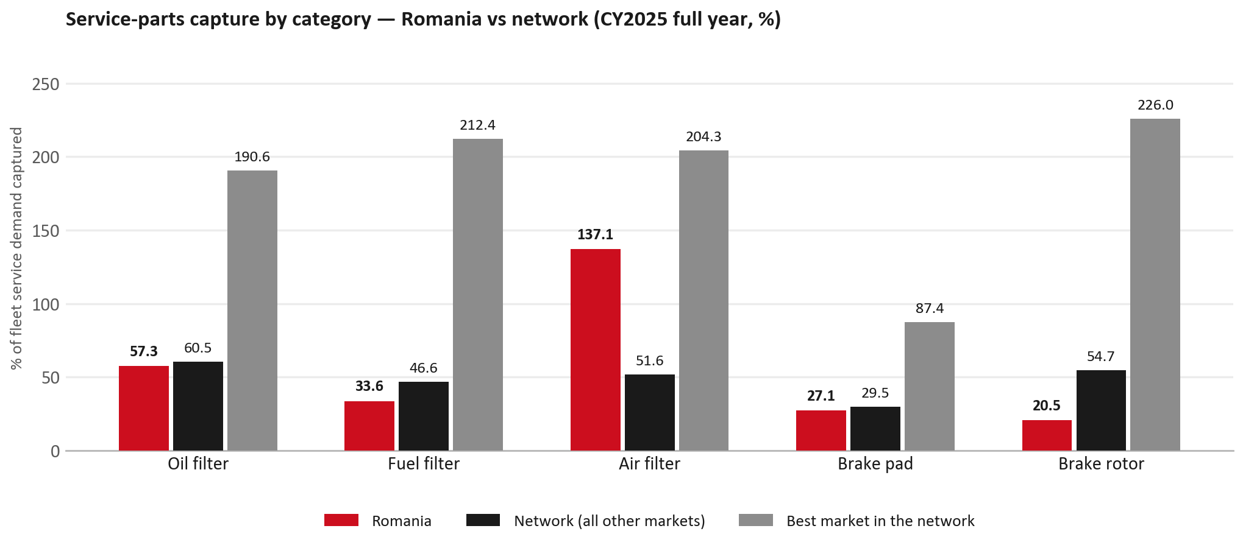
SERVICE-PARTS COVERAGE
Service-parts coverage: brake rotor is the clear gap
TAKEAWAYS
— Brake rotor 20.5% against 54.7% for the rest of the network.
— Fuel filter 33.6% against 46.6% for the rest of the network.
— Every market here is measured on the same fleet-and-interval model, so the comparison is like-for-like even where the underlying interval assumption is debatable.
— Worth agreeing which category we tackle first, and what the joint action is.
11

Slide 12
IDS 2026 — DEALER STANDARD
IDS 2026: Romania averages 79.6%, above the 74.8% network benchmark
Dealer | Total % | Global rank
Rodav | 92.5% | #61
Mit Motors | 89.6% | #103
Autocomo | 87.5% | #144
Romania country average | 79.6% | —
Network average (all IDS 2026) | 74.8% | —
Anvelo Center Oradea | 72.1% | #386
Marshal | 69.3% | #412
Simode Craiova | 54.6% | #473
— 15 dealers assessed across Premises, Organisation, Service, Parts and Vehicle Sales.
— The country average sits 4.8 points above the network.
— The spread is the point: 38 points between the strongest and weakest dealer.
— Dealer-by-dealer detail and individual feedback are available as a separate pack — worth agreeing which dealers to visit, and when.
12

Slide 13
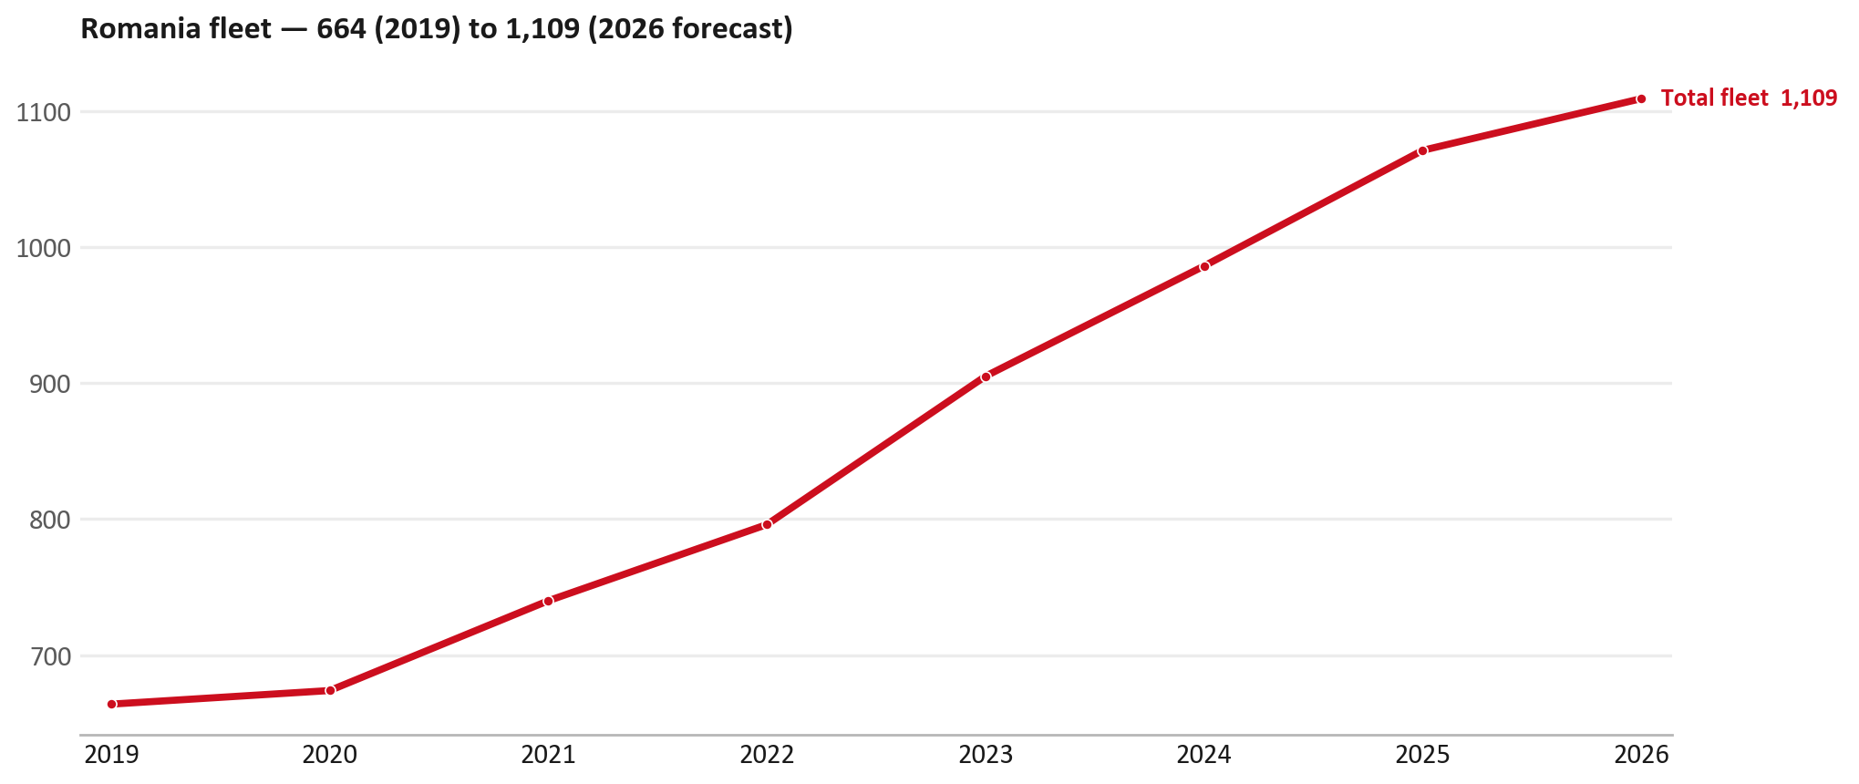
FLEET & FY2027 TARGET
The fleet is expected to grow in 2026
WHAT THIS MEANS FOR FY2027
— Fleet size (calendar year): 1,071 vehicles in 2025 → 1,109 working estimate for end-2026 (+3.5%).
— The chart is calendar years 2019–2026 only. 2026 is a working year-end estimate, not a fiscal-year figure.
— End-2026 mix: LCV / D-Max 1,109.
— The FY2027 Sales-to-Dealer target starts from that fleet change, then applies a 5% price adjustment and 1.8% additional growth.
— The target reflects the working fleet outlook without extending the chart beyond 2026.
13

Slide 14
FLEET & FY2027 TARGET
How the FY2027 target is built
Sales-to-Dealer amount bridge
Step | Amount
FY2026 Sales-to-Dealer (reported KPI) | EUR 394,597
After fleet movement (+3.5%) | EUR 408,598
After price adjustment (+5%) | EUR 429,028
FY2027 target after additional growth (+1.8%) | EUR 436,750
— The FY2027 target is +10.7% versus the FY2026 Sales-to-Dealer base.
— The FY2026 base is the reported Sales-to-Dealer KPI.
14

Slide 15
FY2027 TARGET
What the FY2027 target reflects
1
Your fleet
2
The price move
— The working fleet movement used in the target is +3.5%.
— ISZE is applying a 5% price adjustment for FY2027, consistent with every ISZE market this year.
— It is built into the per-vehicle rate above, not added separately on top.
What it means for your target
 | Value
FY2027 Sales-to-Dealer target | EUR 436,750
vs FY2026 Sales-to-Dealer (EUR 394,597) | +10.7%
— As in previous cycles we would expect an incentive to sit alongside this adjustment — that approval is still pending on our side.
— Until the incentive is confirmed, treat the FY2027 target as the working bridge (fleet × price × additional growth), not a locked commercial commitment.
15

Slide 16
SPA
SPA
1
ROMANIA proposal
2
ISZE review
3
Counter-proposal
4
Final approval
— Isuzu Rom Auto submits a proposed parts list.
— ISZE reviews the proposal against network data and fit.
— ISZE returns a counter-proposal where needed.
— Signed off by ISZE management.
Purpose: higher turnover for both sides.
16

Slide 17
R&M
R&M — let's align on the market
M
Market
S
Servicing & R&M
— How is the market moving for you right now?
— How much of your volume is fleet business rather than retail?
— Where do you see the biggest hurdles this year?
— Where are your real strengths in this segment?
— Do you offer an R&M or service-plan product today?
— What share of the parc do you retain for servicing after year three?
— Does R&M business come bundled with fleet tenders — roughly what share?
— What would it take to bring more out-of-network servicing back?
17

Slide 18
ASK
Part-level Sales-to-Dealer Data
1
Already halfway there
2
Sharper insight
3
Shared benefit
— You already report Sales-to-Dealer monthly. The ask is the same data at part-number level.
— Part-by-part visibility separates a stock movement from a lost job — and tells us where the volume actually went.
— Better availability on your fast movers, a sharper target for us, and a factual basis for the SPA — same data, both sides gain.
Requested from 01/01/2025, part number level, monthly.
18

Slide 19
SUMMARY
Next steps
— Align on the FY2027 Sales-to-Dealer bridge (fleet, price, additional growth) — working figure EUR 436,750 (+10.7% vs FY2026 base).
— Confirm the incentive alongside the price adjustment; lock the target once that approval is through.
— Hydraulic / mechanical / Brake parts / Lighting: agree which category we tackle first, and what the joint action is.
— Agree part-level Sales-to-Dealer data sharing, effective 01/01/2025.
— SPA: ROMANIA proposal, ISZE review and counter-proposal cycle to follow.
— IDS 2026: agree dealer visit dates, starting with the lower-scoring dealers.
19

Slide 20
Moving the World – for You

