Slide 1

ISZE · ISRAEL · UMI
UMI Sales Review
& FY2027 Target
Universal Motors Israel · August 2026

Slide 2
UMI MEETING
Agenda
— Parts Performance — category movers
— Parts Performance — where volume grew
— New Business — validation queue
— Sales-to-Dealer Outlook
— GPS Capture
— Service-Parts Coverage
— IDS 2026 — Dealer Standard
— Fleet & FY2027 Target
— SPA — status
— R&M — market discussion
— Data request: part-level Sales-to-Dealer
— Next steps
2

Slide 3
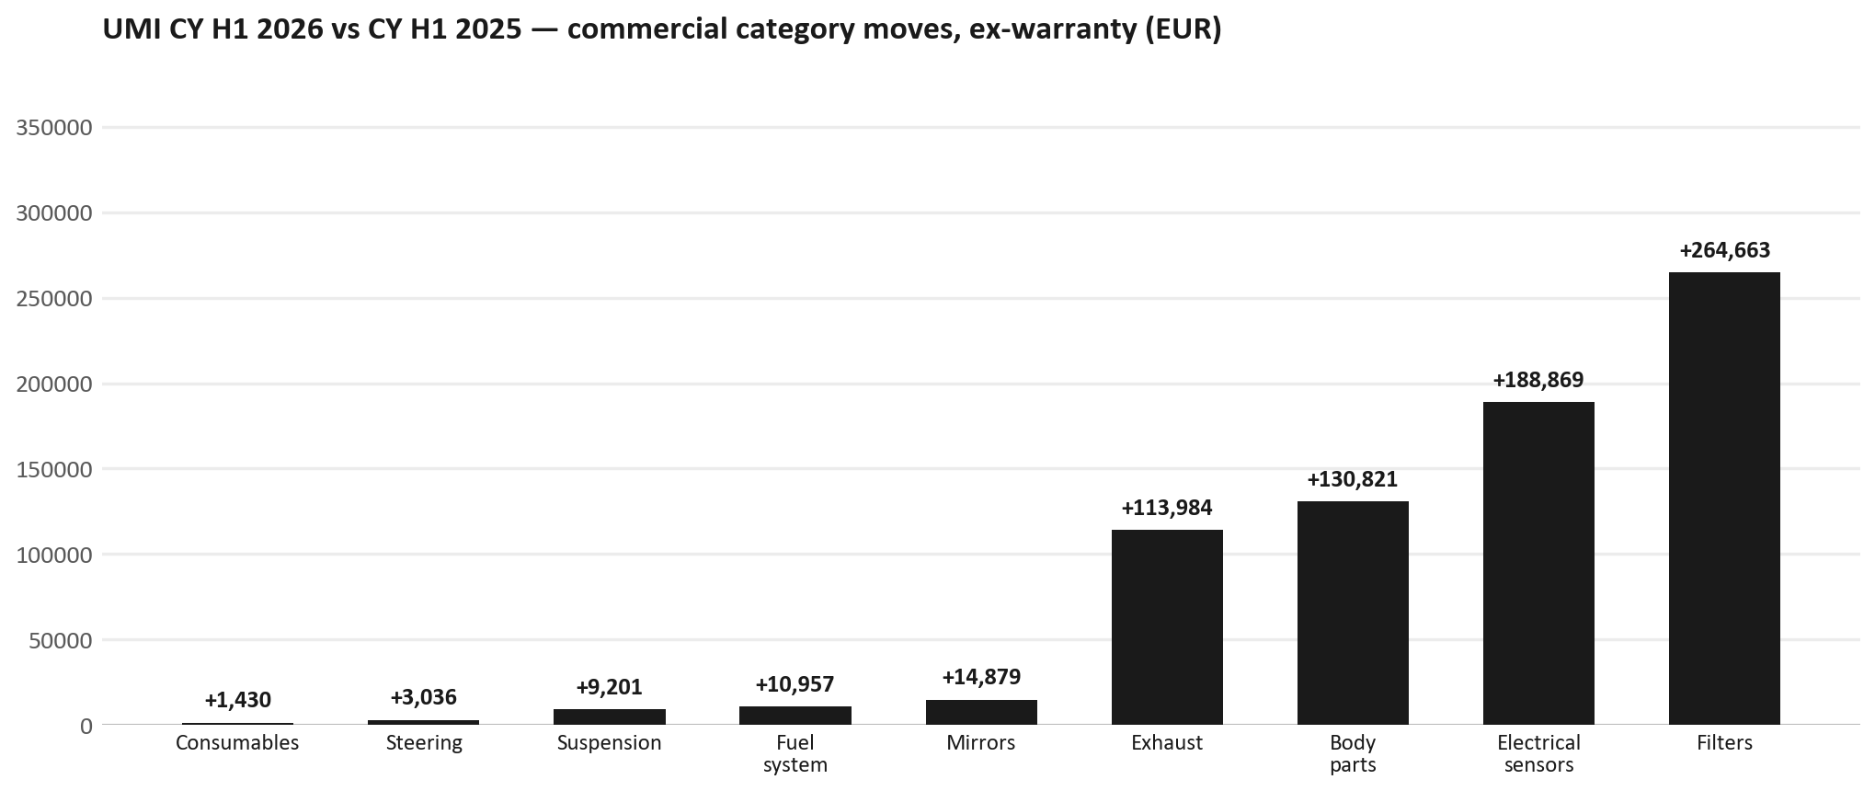
PARTS PERFORMANCE
Parts Performance — CY H1 2026 vs CY H1 2025 (commercial, ex-warranty)
TAKEAWAYS
— Commercial parts billing (warranty/campaign excluded) EUR 2,082K against EUR 498K a year earlier — +318.5% (CY H1 2026 vs CY H1 2025, Jan–Jun).
— Largest PN drops: 8975056801 (PAD KIT; CALIPER,DIS) EUR -10K, 140 fewer pcs; 1884057860 (GEAR OIL LSD) EUR -9K, 311 fewer pcs; 5876150050 (ELEMENT; OIL FILTER) [TFR,TFS,UCR,UCS] EUR -7K, 1,420 fewer pcs.
— Largest PN gains: 8982601090 (NOZZLE ASM; INJ) EUR 20K, 86 more pcs; 8978461132 (GLASS; WINDSHIELD) EUR 5K, 24 more pcs; 8978248633 (LAMP ASM; RR COMB) EUR 4K, 29 more pcs.
— Credit notes of EUR 137K stay on the net bridge (net EUR 2,512K); not in the movers.
3

Slide 4
PARTS PERFORMANCE — GROWTH
Where volume grew — CY H1 2026 vs CY H1 2025 (commercial, ex-warranty)
Part | Description | CY H1 2025 | CY H1 2026 | Δ EUR
8982601090 | NOZZLE ASM; INJ | EUR 4,954 | EUR 24,935 | EUR 19,982
8978461132 | GLASS; WINDSHIELD | EUR 1,379 | EUR 5,916 | EUR 4,537
8978248633 | LAMP ASM; RR COMB | EUR 1,368 | EUR 5,467 | EUR 4,099
7552172681 | BUMPER ASM; FRT | EUR 748 | EUR 4,711 | EUR 3,963
8983313592 | TURBOCHARGER ASM | EUR 7,671 | EUR 11,014 | EUR 3,343
7552070241 | GRILLE; INNER,RAD | EUR 1,368 | EUR 3,587 | EUR 2,219
— Filters +1169%, Electrical sensors +773%, Body parts +136% — where the commercial volume went.
— Claim-matched PNs (720 distinct) and campaign/recall text matches are already excluded from this growth list. Residual warranty on unmapped PNs can remain.
— PNs ranked by largest EUR increase (prior-period sales > 0). Worth agreeing which of these are repeatable and which were one-off.
4

Slide 5
PARTS PERFORMANCE
New Business — validation queue (CY H1 2026)
Part | Description | Current sales | Review
8982878080 | FILTER ASM | EUR 117,547 | Validate
8983528481 | SENSOR; NOX | EUR 108,290 | Validate
550047337 | Rim R4L15W40 CK4_3*5L | EUR 70,984 | Validate
5876102320 | CLUTCH KIT | EUR 40,712 | Validate
8982447940 | PAD KIT; CALIPER,DISC BRK,FRT | EUR 39,103 | Validate
8982984040 | ELEMENT; OIL FILTER | EUR 37,552 | Validate
— These lines had no prior-period sales, so they are kept out of the incremental-growth table.
— A first sale can be a new model, a supersession, timing, or a warranty campaign. It is not treated as a commercial win until that cause is confirmed.
5

Slide 6
SALES-TO-DEALER
Sales-to-Dealer outlook — FY2027
— FY2026 Sales-to-Dealer is EUR 3,863,026 (working estimate).
— The working fleet movement into FY2027 is -7.4%.
— Applying fleet movement, the 5% price adjustment and 1.8% additional growth gives a FY2027 Sales-to-Dealer target of EUR 3,821,648.
— The discussion is held in Sales-to-Dealer amounts; ISZE billing remains an internal reconciliation measure.
6

Slide 7
GPS
GPS Capture: 54.2%
— GPS measures your actual parts purchases against the full potential of your fleet.
— UMI today: 54.2% (FY2026 purchases against the CY2025 fleet potential).
— Fleet potential: EUR 4,636K on 18,542 vehicles.
— Real, sustained headroom above 54.2% — the service-parts and SPA discussion are both direct levers on it.
7

Slide 8
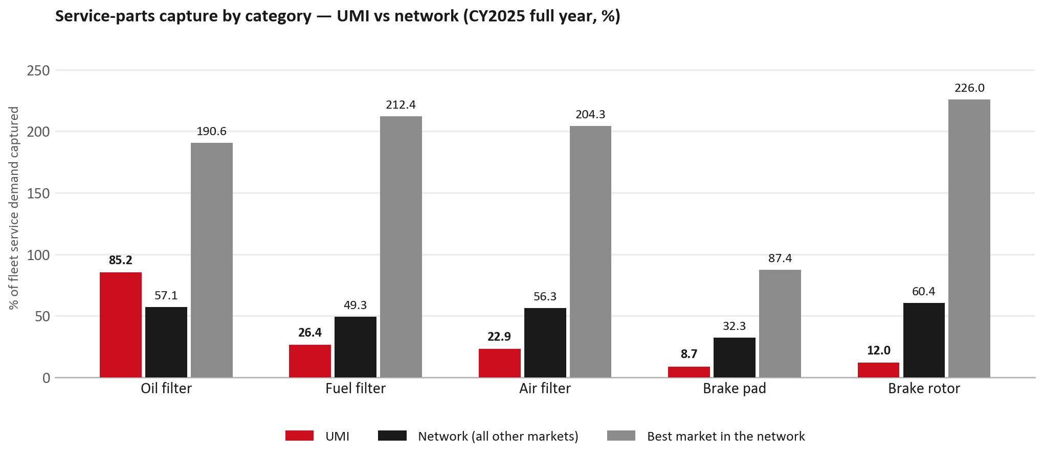
SERVICE-PARTS COVERAGE
Service-parts coverage: brake rotor is the clear gap
TAKEAWAYS
— Brake rotor 12.0% against 60.4% for the rest of the network.
— Air filter 22.9% against 56.3% for the rest of the network.
— Every market here is measured on the same fleet-and-interval model, so the comparison is like-for-like even where the underlying interval assumption is debatable.
— Worth agreeing which category we tackle first, and what the joint action is.
8

Slide 9
IDS 2026 — DEALER STANDARD
IDS 2026: UMI averages 60.9%, below the 74.8% network benchmark
Dealer | Total % | Global rank
Kfir Yaud | 69.6% | #406
Eden Garage Rishon | 68.6% | #415
Tel Hanan Haifa | 68.6% | #416
UMI country average | 60.9% | —
Network average (all IDS 2026) | 74.8% | —
Asayag Jerusalem | 44.3% | #476
Ram Raanana | 43.2% | #477
Zarfati Jerusalem | 39.3% | #479
— 29 dealers assessed across Premises, Organisation, Service, Parts and Vehicle Sales.
— The country average sits 13.9 points below the network.
— The spread is the point: 30 points between the strongest and weakest dealer.
— Dealer-by-dealer detail and individual feedback are available as a separate pack — worth agreeing which dealers to visit, and when.
9

Slide 10
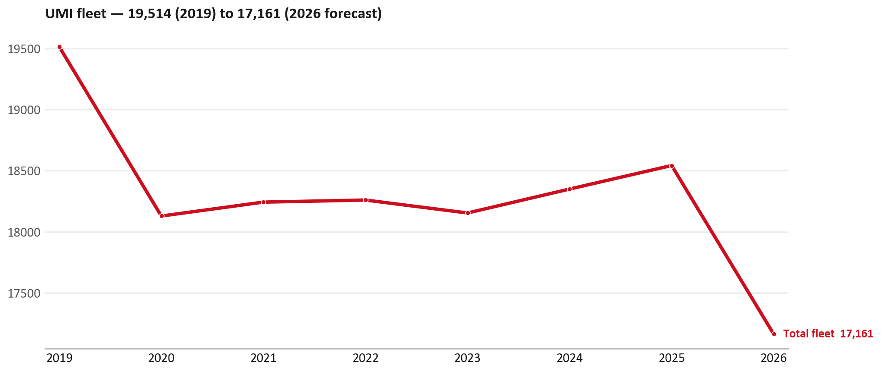
FLEET & FY2027 TARGET
The fleet is expected to decline in 2026
WHAT THIS MEANS FOR FY2027
— Fleet size (calendar year): 18,542 vehicles in 2025 → 17,161 working estimate for end-2026 (-7.4%).
— The chart is calendar years 2019–2026 only. 2026 is a working year-end estimate, not a fiscal-year figure.
— End-2026 mix: LCV / D-Max 17,161.
— The FY2027 Sales-to-Dealer target starts from that fleet change, then applies a 5% price adjustment and 1.8% additional growth.
— So the target is built from a slightly smaller fleet — not from an assumed growth story.
10

Slide 11
FLEET & FY2027 TARGET
How the FY2027 target is built
Sales-to-Dealer amount bridge
Step | Amount
FY2026 Sales-to-Dealer (working estimate) | EUR 3,863,026
After fleet movement (-7.4%) | EUR 3,575,309
After price adjustment (+5%) | EUR 3,754,075
FY2027 target after additional growth (+1.8%) | EUR 3,821,648
— The FY2027 target is -1.1% versus the FY2026 Sales-to-Dealer base.
— The FY2026 base is a working estimate (ISZE billing ÷ 0.65): the KPI Dashboard has no usable Sales-to-Dealer row for this market.
11

Slide 12
FY2027 TARGET
What the FY2027 target reflects
1
Your fleet
2
The price move
— The working fleet movement used in the target is -7.4%.
— ISZE is applying a 5% price adjustment for FY2027, consistent with every ISZE market this year.
— It is built into the per-vehicle rate above, not added separately on top.
What it means for your target
 | Value
FY2027 Sales-to-Dealer target | EUR 3,821,648
vs FY2026 Sales-to-Dealer (EUR 3,863,026) | -1.1%
— As in previous cycles we would expect an incentive to sit alongside this adjustment — that approval is still pending on our side.
— Until the incentive is confirmed, treat the FY2027 target as the working bridge (fleet × price × additional growth), not a locked commercial commitment.
12

Slide 13
SPA
SPA
1
UMI proposal
2
ISZE review
3
Counter-proposal
4
Final approval
— Universal Motors Israel submits a proposed parts list.
— ISZE reviews the proposal against network data and fit.
— ISZE returns a counter-proposal where needed.
— Signed off by ISZE management.
Purpose: higher turnover for both sides.
13

Slide 14
R&M
R&M — let's align on the market
M
Market
S
Servicing & R&M
— How is the market moving for you right now?
— How much of your volume is fleet business rather than retail?
— Where do you see the biggest hurdles this year?
— Where are your real strengths in this segment?
— Do you offer an R&M or service-plan product today?
— What share of the parc do you retain for servicing after year three?
— Does R&M business come bundled with fleet tenders — roughly what share?
— What would it take to bring more out-of-network servicing back?
14

Slide 15
ASK
Part-level Sales-to-Dealer Data
1
The starting point
2
Sharper insight
3
Shared benefit
— We have no Sales-to-Dealer figures from you for FY2026. The ask is monthly Sales-to-Dealer, at part-number level.
— Part-by-part visibility separates a stock movement from a lost job — and tells us where the volume actually went.
— Better availability on your fast movers, a sharper target for us, and a factual basis for the SPA — same data, both sides gain.
Requested from 01/01/2025, part number level, monthly.
15

Slide 16
SUMMARY
Next steps
— Align on the FY2027 Sales-to-Dealer bridge (fleet, price, additional growth) — working figure EUR 3,821,648 (-1.1% vs FY2026 base).
— Confirm the incentive alongside the price adjustment; lock the target once that approval is through.
— Agree part-level Sales-to-Dealer data sharing, effective 01/01/2025.
— SPA: UMI proposal, ISZE review and counter-proposal cycle to follow.
— IDS 2026: agree dealer visit dates, starting with the lower-scoring dealers.
16

Slide 17
Moving the World – for You

