Slide 1

ISZE · ISRAEL · UMI
UMI Sales Review
& FY2027 Target
Universal Motors Israel · August 2026

Slide 2
UMI MEETING
Agenda
— Parts Performance — category movers
— Parts Performance — Exhaust
— Parts Performance — Cooling
— Parts Performance — Lighting
— Parts Performance — where volume grew
— New Business — validation queue
— Sales-to-Dealer Outlook
— GPS Capture
— Service-Parts Coverage
— IDS 2026 — Dealer Standard
— Fleet & FY2027 Target
— SPA — status
— R&M — market discussion
— Data request: part-level Sales-to-Dealer
— Next steps
2

Slide 3
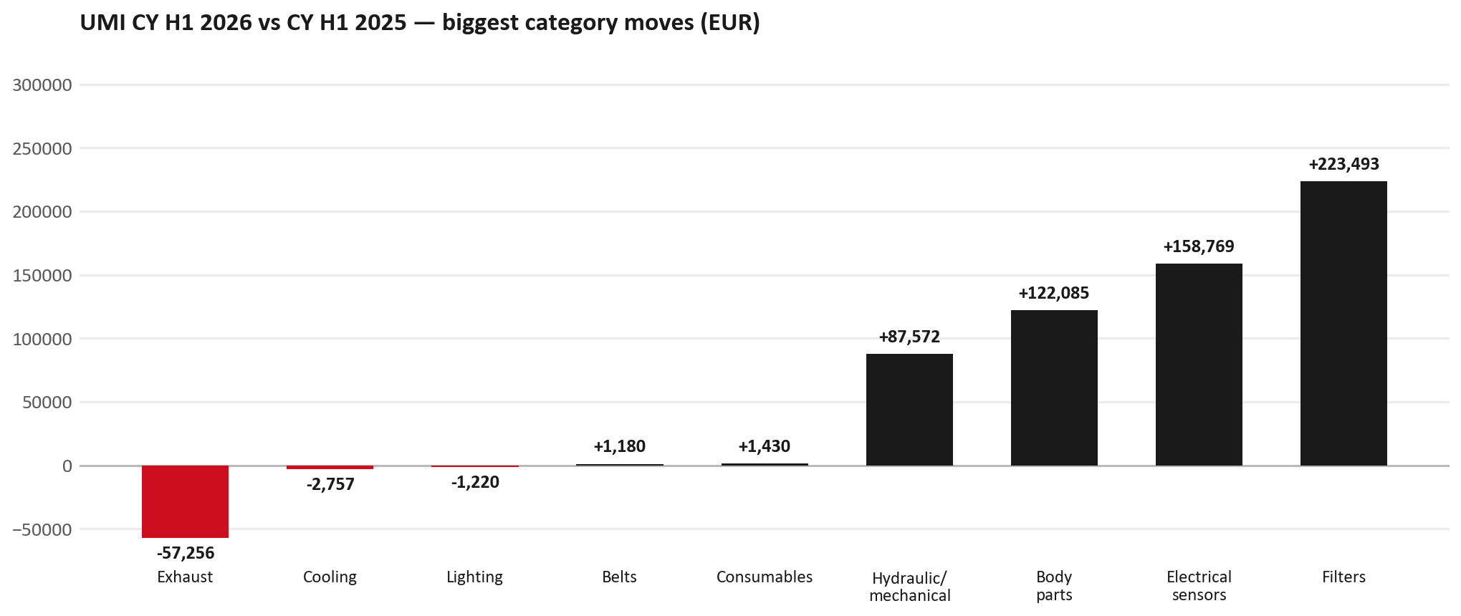
PARTS PERFORMANCE
Parts Performance — CY H1 2026 vs CY H1 2025
TAKEAWAYS
— Parts billing EUR 2,649K against EUR 1,386K a year earlier — +91.2%. After EUR 137K of credit notes the net figure is EUR 2,512K.
— Biggest declines: Exhaust EUR -57K; Cooling EUR -3K; Lighting EUR -1K.
— Growing: Filters +252%, Electrical sensors +95%, Body parts +91%.
— CY H1 2026 against CY H1 2025 (calendar Jan–Jun, Q1+Q2) — like-for-like half-year cut.
3

Slide 4
PARTS PERFORMANCE — EXHAUST
Exhaust — CY H1 2026 vs CY H1 2025
— EUR 204,992 (CY H1 2025) to EUR 147,736 (CY H1 2026), down EUR 57,256 (-28%).
— 8975359391 (DPD ASM): EUR 82,552 to EUR 0, 42 fewer pieces.
— 8983682091 (PIPE; EXH): EUR 38,591 to EUR 0, 33 fewer pieces.
— 8983320764 (DPD ASM): EUR 27,544 to EUR 0, 15 fewer pieces.
Questions for us to work through together
— Is this pricing against what the dealers can buy locally?
— Is any of this stock timing on your side rather than end demand?
— What would make the biggest difference to keep this business with us?
4

Slide 5
PARTS PERFORMANCE — COOLING
Cooling — CY H1 2026 vs CY H1 2025
— EUR 57,988 (CY H1 2025) to EUR 55,232 (CY H1 2026), down EUR 2,757 (-5%).
— 8984865960 (RADIATOR ASM): EUR 20,283 to EUR 5,087, 92 fewer pieces.
Questions for us to work through together
— Is this pricing against what the dealers can buy locally?
— Is any of this stock timing on your side rather than end demand?
— What would make the biggest difference to keep this business with us?
5

Slide 6
PARTS PERFORMANCE — LIGHTING
Lighting — CY H1 2026 vs CY H1 2025
— EUR 110,801 (CY H1 2025) to EUR 109,581 (CY H1 2026), down EUR 1,220 (-1%).
Questions for us to work through together
— Is this availability, pricing, or genuinely fewer accident repairs?
— Are the bodyshops in your network sourcing lamps elsewhere?
6

Slide 7
PARTS PERFORMANCE — GROWTH
Where volume grew — CY H1 2026 vs CY H1 2025
Part | Description | CY H1 2025 | CY H1 2026
7552348290 | STEERING UNIT | EUR 37,383 | EUR 110,876
8974985741 | TURBOCHARGER ASM | EUR 24,467 | EUR 48,464
8982601090 | NOZZLE ASM; INJ | EUR 4,954 | EUR 24,935
7552348310 | STEERING UNIT | EUR 5,980 | EUR 14,577
5876150530 | ELEMENT; OIL FILTER | EUR 171 | EUR 8,020
8983842670 | INJECTOR ASM; DEF DCM | EUR 10,363 | EUR 16,332
— Filters +252%, Electrical sensors +95%, Body parts +91% — where the volume went.
— Several of these are the kind of item that also moves on a campaign or claim. Israel CY2025 warranty parts (claim-price basis) were EUR 1,791K — separate from fiscal GPS warranty expense. Do not read this growth list as purely commercial without checking claims together.
— Worth agreeing which of these are repeatable and which were one-off.
7

Slide 8
PARTS PERFORMANCE
New Business — validation queue (CY H1 2026)
Part | Description | Current sales | Review
8982878080 | FILTER ASM | EUR 117,547 | Validate
8983528481 | SENSOR; NOX | EUR 108,290 | Validate
550047337 | Rim R4L15W40 CK4_3*5L | EUR 70,984 | Validate
5876102320 | CLUTCH KIT | EUR 40,712 | Validate
8982447940 | PAD KIT; CALIPER,DISC BRK,FRT | EUR 39,103 | Validate
8982984040 | ELEMENT; OIL FILTER | EUR 37,552 | Validate
— These lines had no prior-period sales, so they are kept out of the incremental-growth table.
— A first sale can be a new model, a supersession, timing, or a warranty campaign. It is not treated as a commercial win until that cause is confirmed.
8

Slide 9
SALES-TO-DEALER
Sales-to-Dealer outlook — FY2027
— FY2026 Sales-to-Dealer is EUR 3,863,026 (working estimate).
— The working fleet movement into FY2027 is -7.4%.
— Applying fleet movement, the 5% price adjustment and 1.8% additional growth gives a FY2027 Sales-to-Dealer target of EUR 3,821,648.
— The discussion is held in Sales-to-Dealer amounts; ISZE billing remains an internal reconciliation measure.
9

Slide 10
GPS
GPS Capture: 54.2%
— GPS measures your actual parts purchases against the full potential of your fleet.
— UMI today: 54.2% (FY2026 purchases against the CY2025 fleet potential).
— Fleet potential: EUR 4,636K on 18,542 vehicles.
— Real, sustained headroom above 54.2% — the service-parts and SPA discussion are both direct levers on it.
10

Slide 11
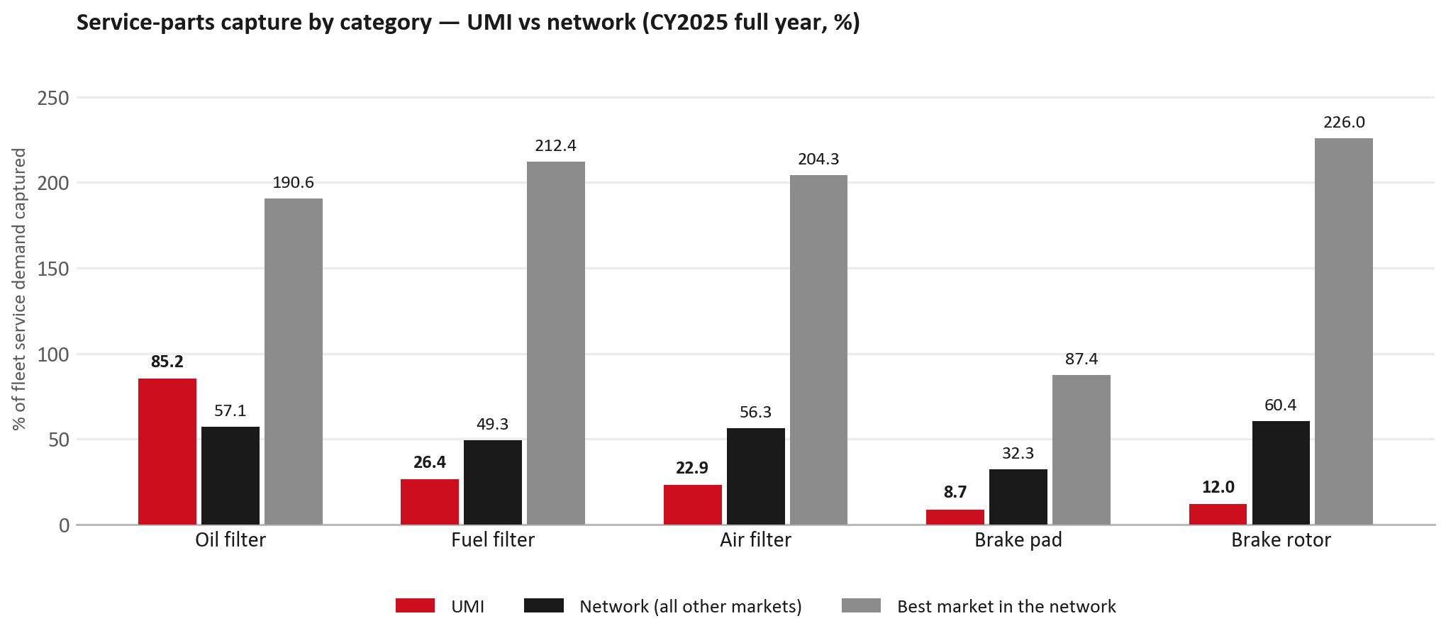
SERVICE-PARTS COVERAGE
Service-parts coverage: brake rotor is the clear gap
TAKEAWAYS
— Brake rotor 12.0% against 60.4% for the rest of the network.
— Air filter 22.9% against 56.3% for the rest of the network.
— Every market here is measured on the same fleet-and-interval model, so the comparison is like-for-like even where the underlying interval assumption is debatable.
— Worth agreeing which category we tackle first, and what the joint action is.
11

Slide 12
IDS 2026 — DEALER STANDARD
IDS 2026: UMI averages 60.9%, below the 74.8% network benchmark
Dealer | Total % | Global rank
Kfir Yaud | 69.6% | #406
Eden Garage Rishon | 68.6% | #415
Tel Hanan Haifa | 68.6% | #416
UMI country average | 60.9% | —
Network average (all IDS 2026) | 74.8% | —
Asayag Jerusalem | 44.3% | #476
Ram Raanana | 43.2% | #477
Zarfati Jerusalem | 39.3% | #479
— 29 dealers assessed across Premises, Organisation, Service, Parts and Vehicle Sales.
— The country average sits 13.9 points below the network.
— The spread is the point: 30 points between the strongest and weakest dealer.
— Dealer-by-dealer detail and individual feedback are available as a separate pack — worth agreeing which dealers to visit, and when.
12

Slide 13
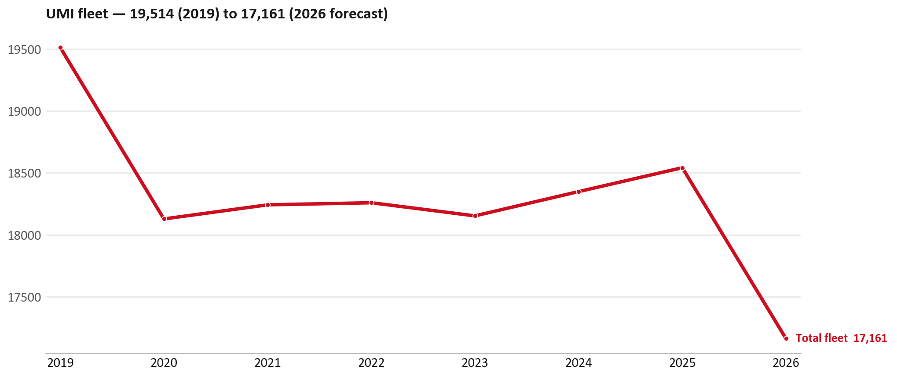
FLEET & FY2027 TARGET
The fleet is expected to decline in 2026
WHAT THIS MEANS FOR FY2027
— Fleet size (calendar year): 18,542 vehicles in 2025 → 17,161 working estimate for end-2026 (-7.4%).
— The chart is calendar years 2019–2026 only. 2026 is a working year-end estimate, not a fiscal-year figure.
— End-2026 mix: LCV / D-Max 17,161.
— The FY2027 Sales-to-Dealer target starts from that fleet change, then applies a 5% price adjustment and 1.8% additional growth.
— So the target is built from a slightly smaller fleet — not from an assumed growth story.
13

Slide 14
FLEET & FY2027 TARGET
How the FY2027 target is built
Sales-to-Dealer amount bridge
Step | Amount
FY2026 Sales-to-Dealer (working estimate) | EUR 3,863,026
After fleet movement (-7.4%) | EUR 3,575,309
After price adjustment (+5%) | EUR 3,754,075
FY2027 target after additional growth (+1.8%) | EUR 3,821,648
— The FY2027 target is -1.1% versus the FY2026 Sales-to-Dealer base.
— The FY2026 base is a working estimate (ISZE billing ÷ 0.65): the KPI Dashboard has no usable Sales-to-Dealer row for this market.
14

Slide 15
FY2027 TARGET
What the FY2027 target reflects
1
Your fleet
2
The price move
— The working fleet movement used in the target is -7.4%.
— ISZE is applying a 5% price adjustment for FY2027, consistent with every ISZE market this year.
— It is built into the per-vehicle rate above, not added separately on top.
What it means for your target
 | Value
FY2027 Sales-to-Dealer target | EUR 3,821,648
vs FY2026 Sales-to-Dealer (EUR 3,863,026) | -1.1%
— As in previous cycles we would expect an incentive to sit alongside this adjustment — that approval is still pending on our side.
— Until the incentive is confirmed, treat the FY2027 target as the working bridge (fleet × price × additional growth), not a locked commercial commitment.
15

Slide 16
SPA
SPA
1
UMI proposal
2
ISZE review
3
Counter-proposal
4
Final approval
— Universal Motors Israel submits a proposed parts list.
— ISZE reviews the proposal against network data and fit.
— ISZE returns a counter-proposal where needed.
— Signed off by ISZE management.
Purpose: higher turnover for both sides.
16

Slide 17
R&M
R&M — let's align on the market
M
Market
S
Servicing & R&M
— How is the market moving for you right now?
— How much of your volume is fleet business rather than retail?
— Where do you see the biggest hurdles this year?
— Where are your real strengths in this segment?
— Do you offer an R&M or service-plan product today?
— What share of the parc do you retain for servicing after year three?
— Does R&M business come bundled with fleet tenders — roughly what share?
— What would it take to bring more out-of-network servicing back?
17

Slide 18
ASK
Part-level Sales-to-Dealer Data
1
The starting point
2
Sharper insight
3
Shared benefit
— We have no Sales-to-Dealer figures from you for FY2026. The ask is monthly Sales-to-Dealer, at part-number level.
— Part-by-part visibility separates a stock movement from a lost job — and tells us where the volume actually went.
— Better availability on your fast movers, a sharper target for us, and a factual basis for the SPA — same data, both sides gain.
Requested from 01/01/2025, part number level, monthly.
18

Slide 19
SUMMARY
Next steps
— Align on the FY2027 Sales-to-Dealer bridge (fleet, price, additional growth) — working figure EUR 3,821,648 (-1.1% vs FY2026 base).
— Confirm the incentive alongside the price adjustment; lock the target once that approval is through.
— Exhaust / Cooling / Lighting: agree which category we tackle first, and what the joint action is.
— Agree part-level Sales-to-Dealer data sharing, effective 01/01/2025.
— SPA: UMI proposal, ISZE review and counter-proposal cycle to follow.
— IDS 2026: agree dealer visit dates, starting with the lower-scoring dealers.
19

Slide 20
Moving the World – for You

Slide 21
UMI · UNIVERSAL MOTORS ISRAEL
Deep dive — detail behind the Mode A story
— Extra detail for meeting prep — pick which slides to share with Universal Motors Israel.
— Mode A ends on the previous closing slide.
— Label in all charts: “Genuine with BVP alternative” (not “genuine contested”).
— UMI only — never blend UTI into these figures or IDS views.
21

Slide 22
AGENDA
Deep-dive agenda
— GPS — fiscal year (headline vs excl. warranty; max two lines)
— FY2025 → FY2026 wallet mix (Genuine / Genuine with BVP alternative / BVP)
— Where the money went — outside the service-parts basket (FY)
— Service parts: CY capture vs network + FY billing (capture % is CY-only by design)
— Brake pads — BVP share of total brake pad sales (FY)
— AIM exposure
— Warranty — two lenses
— How to use this in the meeting
22

Slide 23
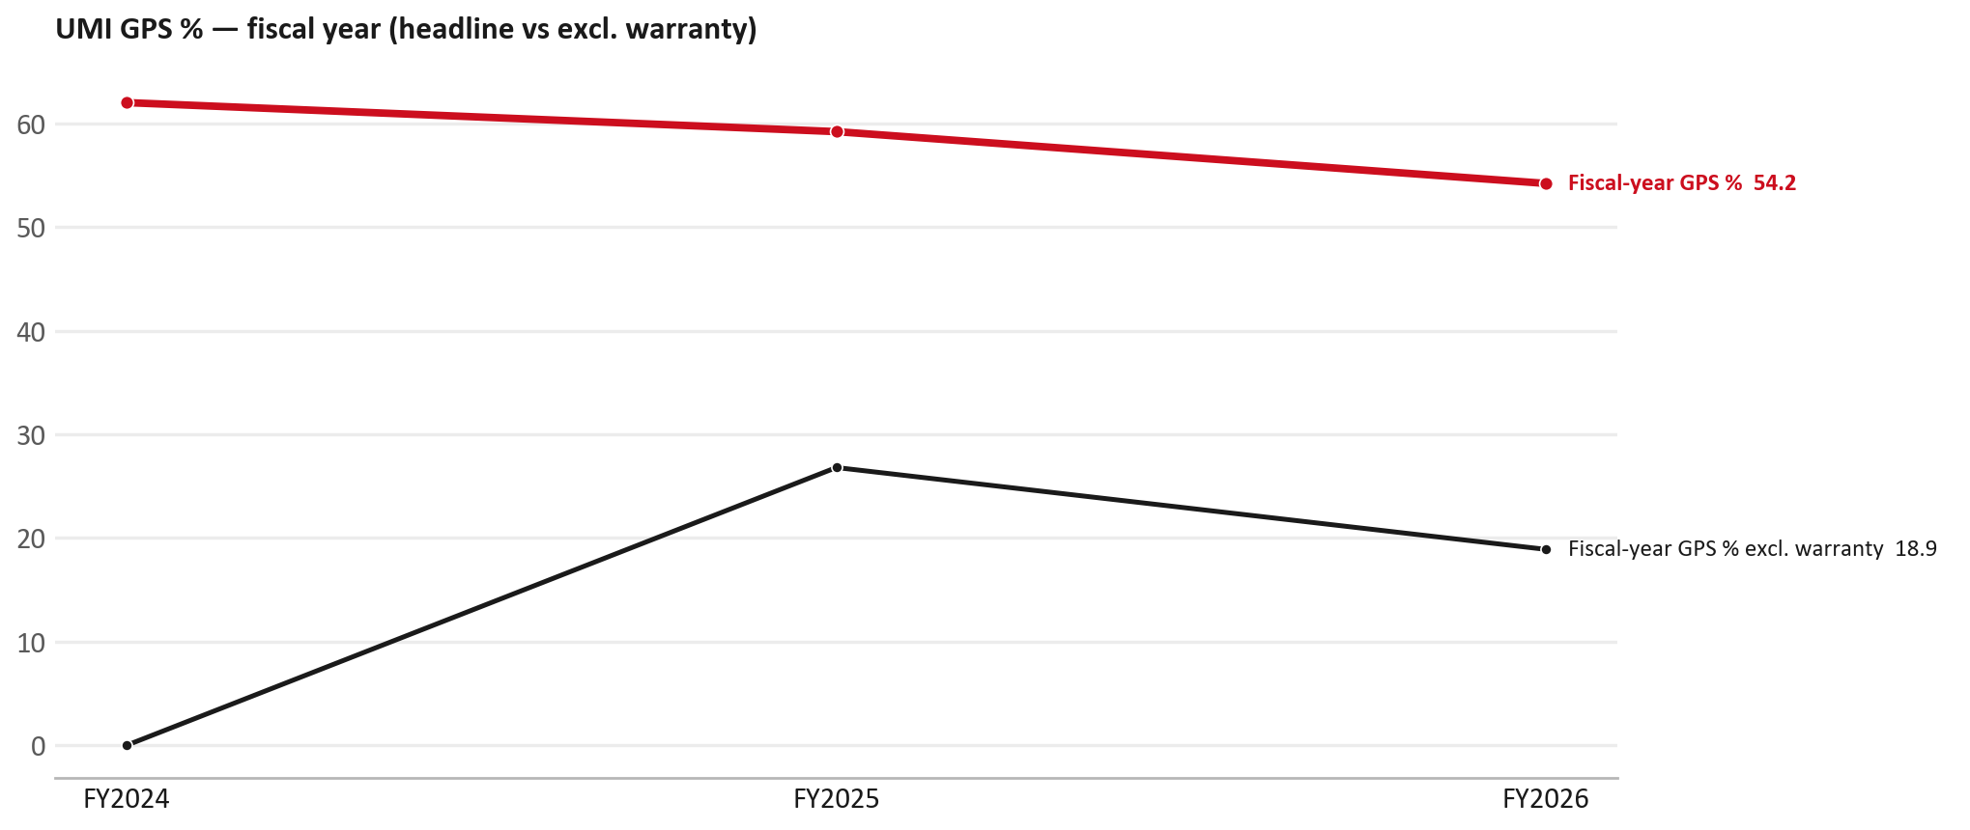
GPS
GPS: fiscal year headline vs after warranty
TAKEAWAYS
— Red = fiscal-year GPS (frozen CY2025 wallet). FY25 59.2% → FY26 54.2%.
— Black = fiscal GPS after removing warranty parts (€). FY26 ≈ 18.9% (warranty EUR 1,633,086 ≈ 65% of FY26 billing).
— Fleet 18,542 → 17,161 (working year-end estimate under the FY2027 target).
23

Slide 24
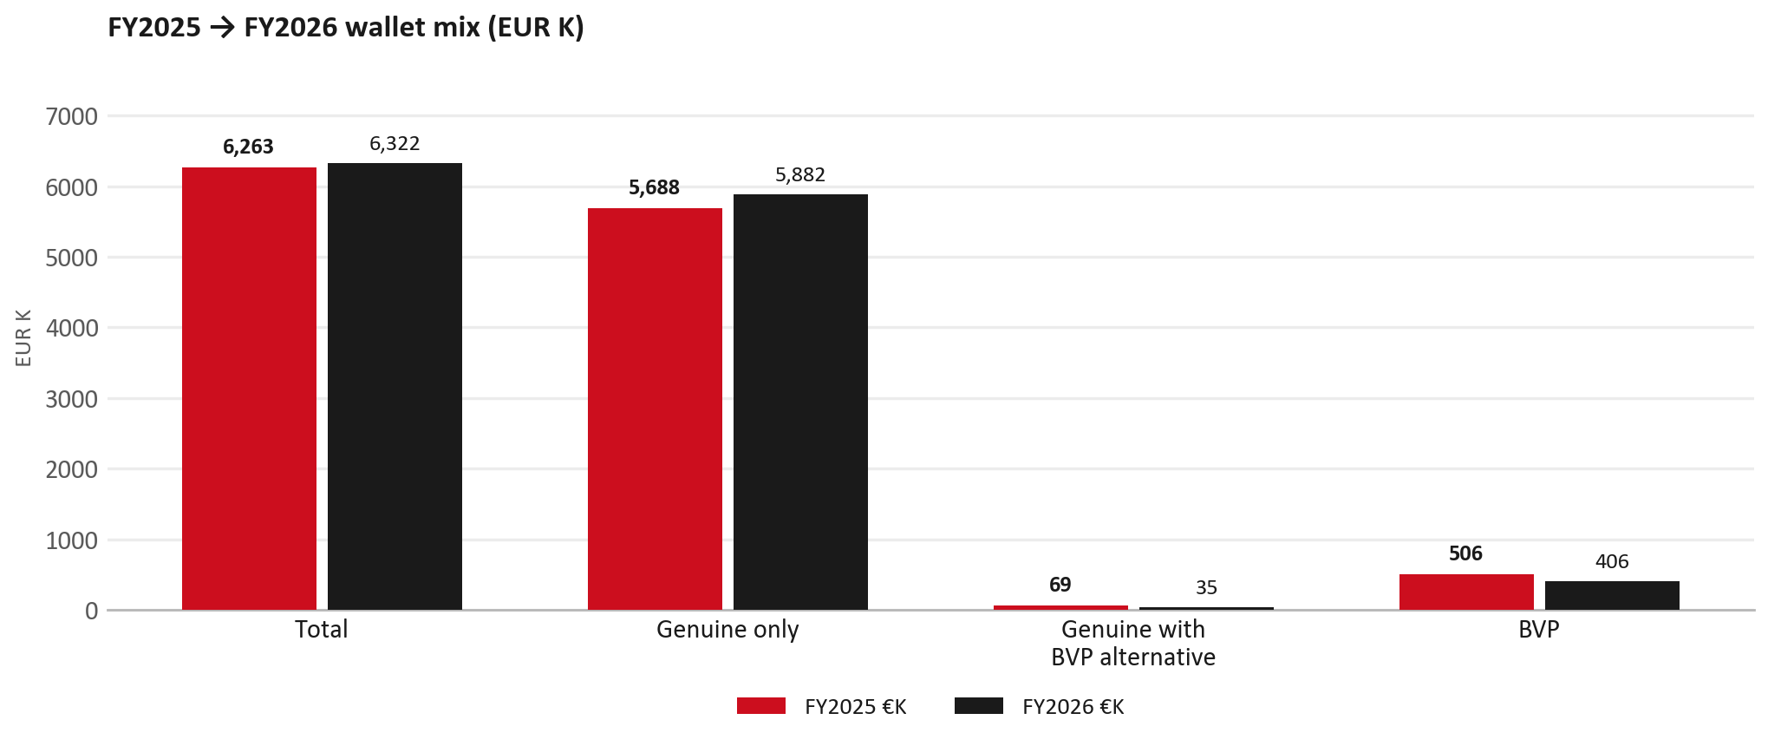
WALLET MIX
FY2025 → FY2026 wallet mix
— Total EUR 6,263,047 → EUR 6,322,218 (+0.9%).
— Genuine only EUR 194,105.
— Genuine with BVP alternative EUR -34,824; BVP EUR -100,110 (6.4% of FY26 wallet).
— Display label locked: Genuine with BVP alternative.
24

Slide 25
WALLET MIX
FY wallet mix — detail
 | FY2025 | FY2026 | Δ
Total | EUR 6,263,047 | EUR 6,322,218 | EUR 59,171
Genuine only | EUR 5,687,724 | EUR 5,881,829 | EUR 194,105
Genuine with BVP alternative | EUR 69,463 | EUR 34,638 | EUR -34,824
BVP | EUR 505,861 | EUR 405,751 | EUR -100,110
BVP % of wallet | 8.1% | 6.4% | -1.7 pp
25

Slide 26
DRIVERS
Where the genuine drop sits (FY2025 → FY2026)
— Genuine-only sales moved EUR 194,105 from FY2025 to FY2026.
— Of that, the routine service basket (filters, pads, rotors) moved EUR -3,606 on genuine-only; BVP in that basket moved EUR -31,193.
— Genuine-only did not fall on this FY cut — check category movers and H1 for pressure points.
— Meeting line: check high-value assemblies / sensors before blaming the filter or pad menu.
26

Slide 27
DRIVERS
Largest part-number drops (FY24→FY25) — outside service filters
Part | Description | Δ EUR
8982878080 | FILTER ASM | -328,202
8982049420 | FILTER ASM | -270,711
8981776324 | DPD ASM | -255,665
8975293230 | ENGINE ASM | -193,288
8983528480 | SENSOR; NOX | -173,207
8982601090 | NOZZLE ASM; INJ | -100,540
8983320763 | DPD ASM | -94,143
— Check warranty / campaign coding before calling competitive leakage.
27

Slide 28
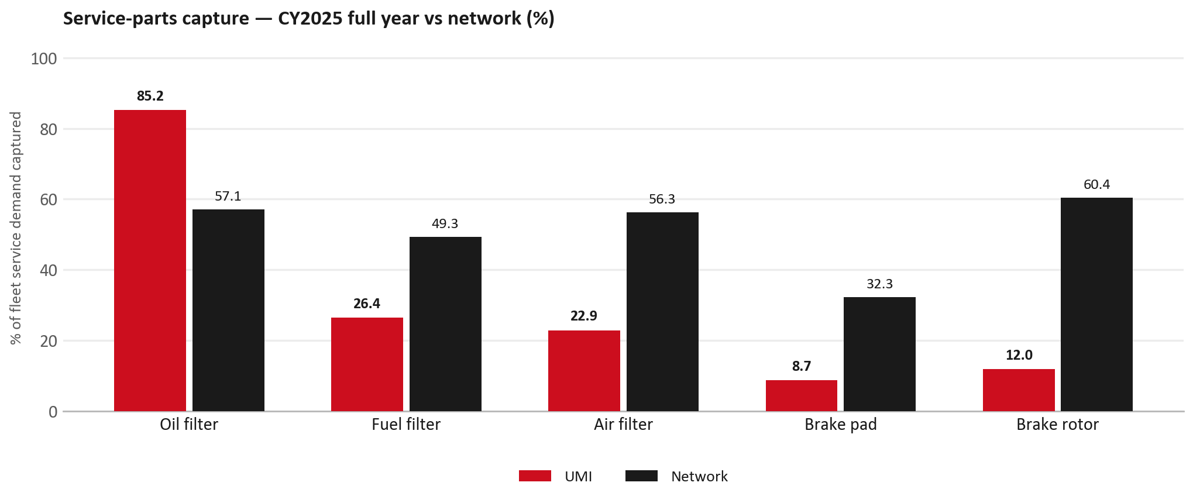
SERVICE PARTS
Service-parts capture vs network (calendar year)
TAKEAWAYS
— Capture % is calendar-year (full CY2025). Fleet demand is modelled on calendar years — there is no matching fiscal-year capture %.
— Oil filter 85.2% vs network 57.1%; Fuel filter 26.4% vs network 49.3%; Air filter 22.9% vs network 56.3%.
— Next slide: fiscal-year € billing in the same five categories.
— Primary lens = total capture (not genuine-only).
28

Slide 29
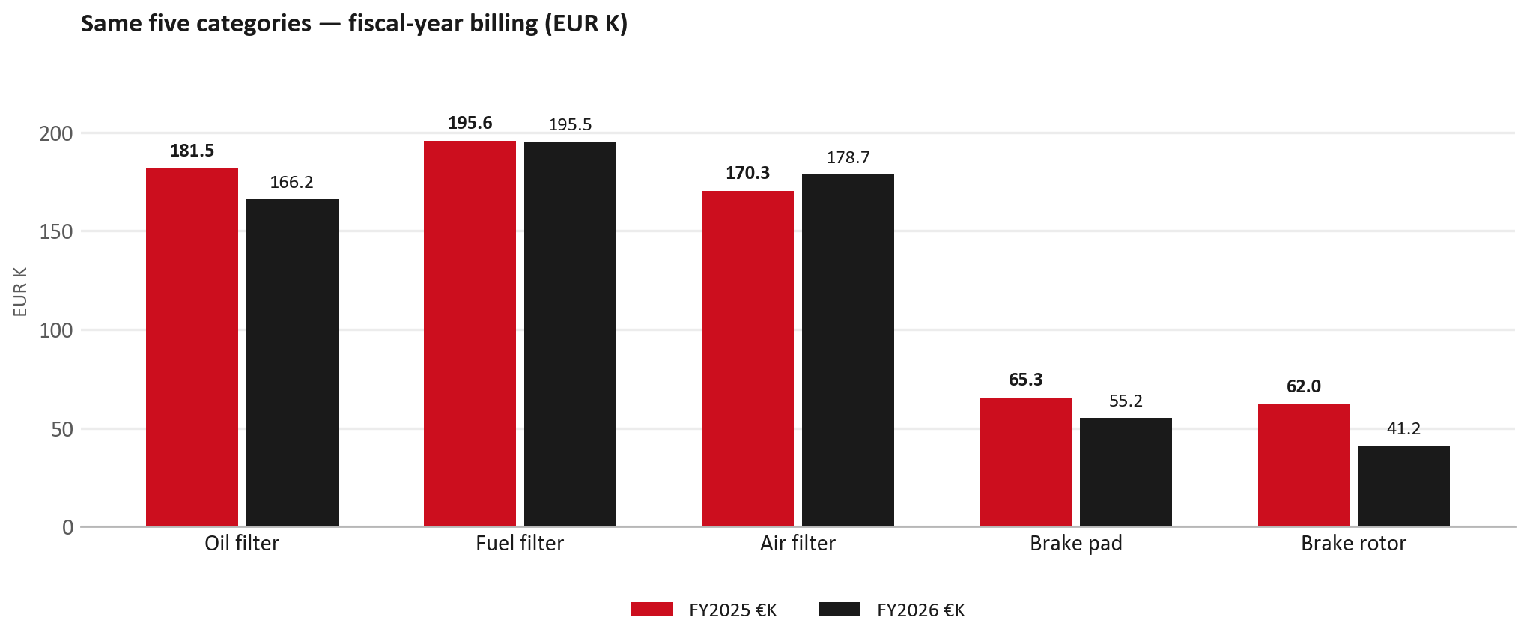
SERVICE PARTS · FY
Service-parts billing by fiscal year (same five lines)
TAKEAWAYS
— This is Sales-to-Universal Motors Israel € in fiscal years — not capture % of fleet demand.
— Use both lenses — do not mix % capture with € billing.
— Primary = total sales in the basket.
29

Slide 30
BRAKES
Brake pads — BVP share of total brake pad sales (FY)
 | FY2025 | FY2026
Genuine qty | 0 | 0
BVP qty | 0 | 0
BVP share of total brake pad sales (€) | 0% | 0%
— BVP share = BVP € ÷ all brake-pad € billed (genuine + BVP). Not a PMS capture %.
— Wallet-level BVP is still only ~6.4% of FY26 — do not generalise a pad story to the whole wallet.
30

Slide 31
AIM
AIM exposure
Year | High-risk € | High-risk % | Quadrant
2023 | EUR 12,441 | 0.4% | Attach gap (high GPS - low capture)
2024 | EUR 20,462 | 0.7% | Priority target (low GPS - low capture)
2025 | EUR 24,726 | 0.9% | Priority target (low GPS - low capture)
— High-risk € is catalogue AIM exposure, not proven walk-out.
— Open on jobs not bought through the distributor — not a street IAM war alone.
31

Slide 32
WARRANTY
Warranty — two real lenses
1
CY2025 claim-price parts
2
Fiscal GPS expense
— EUR 1,791,020 (claim-price basis).
— Calendar-year claim price basis.
— Dedicated UMI claim file; UMI only, never blended with UTI.
— FY24 EUR 2,902,813 · FY25 EUR 1,504,142 · FY26 EUR 1,633,086.
— Source row: UMI.
— Ex-warranty GPS = (net − warranty) ÷ frozen CY25 wallet.
— Both numbers are real — never mix them on one slide without labels.
32

Slide 33
BRIDGE
How to use this in the meeting
If they say… | You know…
BVP is eating genuine | Wallet BVP ~6.4%. Check pads as a local exception only.
GPS looks fine / too high | FY26 headline 54.2%; excl. warranty ≈ 18.9%.
Service parts are fine | CY2025 capture vs network (previous slides) + FY billing lens.
This is Israel network | UMI only — UTI did not sit in IDS Israel.
33

Slide 34
Moving the World – for You

