Slide 1

ISZE · VEHICLE PARTS & ACCESSORIES · MANAGEMENT PRESENTATION
We bill €35 million a year to our distributors.
Now we can see what it is made of.
AIM, our parts classification, shows what is selling, where it is selling and how each parts category can be priced. I am using it for sales analysis and price revisions.
October 2026 · For information, no decision requested
€35.0M = everything billed to our distributors, July 2025 – June 2026, the price revision base. €1.29M of it is rebate, transport and lubricant lines, which are not parts.
Notes:
I am telling management that I use AIM; I am not asking permission. The money first: we bill about €35 million a year to our distributors (the price revision base, July 2025 – June 2026, 15,872 part numbers). €1.29M of that is rebate, transport and lubricants, so the parts alone are about €33.7M. The question this presentation answers: what are those parts, and what can we do once we know?

Slide 2
ISZE · VEHICLE PARTS & ACCESSORIES
THE PROBLEM
42% of what we bill sat under one label: “Competitive parts”
Five of the seven top-level labels in the old price-list tree were commercial opinions. None named a product.
WHAT THIS MEANS
Old top level: share of what we billed
AIM top level: the ten largest of 22 families
The old top level mixed views on competition with product names. You could not ask “how are brakes selling?” from it.
AIM's top level names what the part is: 22 families, from brakes to lighting.
Purpose: one product view of everything we bill, so sales and prices can be read per product.
€14.6M, 42% of what we billed, sat under one label. Steering units, brake discs, brake pad kits, air filters and EGR components all read “Competitive parts”.
Base: €35.0M billed to distributors in the price revision book, July 2025 – June 2026 (15,872 part numbers), including €1.29M of rebate, transport and lubricant lines. Old top level: price-list classification. AIM: approved release of 7 October 2026.
2
Notes:
The old tree had 7 top-level labels. Five describe a commercial opinion (competitive, repair, accident, high value repair, comfort), not a product. 41.6% of what we billed (€14.57M) sat in 'Competitive parts'. Inside it, by AIM part type: Steering Unit €1.26M, Brake Rotor €1.15M, Brake Pad Kit €0.92M, Air Cleaner Filter €0.80M, EGR Component €0.67M. AIM has 22 families, 116 product groups and 239 part types on this basis; the old tree had 7 / 27 / 171.

Slide 3
ISZE · VEHICLE PARTS & ACCESSORIES
THE PROBLEM
€1.1M a year sat in families the parts have nothing to do with
The old rule read only the price-list text. It could not know that “ACL” means air cleaner.
WHAT THIS MEANS
PART
WHAT WE BILLED
OLD RULE FILED IT AS
AIM PLACES IT
Engine air cleaner elements
€672k
Air conditioning
Maintenance service › Air filter
A report on air filters, steering or bumpers was wrong by the amounts in this table before anyone looked at a price.
King pin kits
€150k
Hardware › Pin
Steering › Knuckle & king pin
Steering drag links
€125k
Linkage (hydraulic / mechanical)
Steering › Linkage
AIM reads five facts per part (page 5), so “FILTER; ACL” is an air cleaner element, not air conditioning.
Bumper bars
€99k
Suspension › Leaf spring
Accident & body › Bumper
Ball joints
€86k
Linkage (hydraulic / mechanical)
Suspension › Suspension arm
Purpose: get the family right first. Sales analysis and pricing follow from it.
Total €1.13M a year
Ask “how are our air filters selling?” and the old tree missed €0.67M of the €0.80M answer.
Old placements: classification audit of 20 September 2026, each confirmed against Isuzu's parts catalogue figures. Euro: price revision base, July 2025 – June 2026.
3
Notes:
Five classes where the price-list text names the system beyond argument and the old rule still filed the part somewhere physically unrelated. Euro on this basis: Engine air cleaner elements €672k (28 part numbers); King pin kits €150k (37 part numbers); Steering drag links €125k (18 part numbers); Front and rear bumper bars €99k (20 part numbers); Suspension ball joints €86k (11 part numbers). The old placements and their check against Isuzu catalogue figures (1-30 Air Cleaner, 4-10 Front Axle) are in the classification audit of 20 September 2026. Air cleaner elements under AIM today: €0.80M, of which FILTER; ACL lines €0.67M.

Slide 4
ISZE · VEHICLE PARTS & ACCESSORIES
THE PROBLEM
The old “Competitive” label found only half of the parts that face independent brands
Tested on 302 parts we checked against independent-brand prices. A pointer, not a measurement.
WHAT THIS MEANS
HOW OFTEN THE LABEL MATCHED THE EVIDENCE
THE OTHER WAY: A LABEL WITHOUT EVIDENCE
For a price revision the label points at the wrong parts about half the time, in both directions.
Parts with an independent-brand match, by old label
€1.26M
of steering units billed, filed under “Competitive parts”
25 of the 26 steering unit part numbers we billed carried that label. One part number, 7552348290, is 67% of the euro.
None of the 13 steering part numbers in our competitive price file has an independent-brand price. Prices exist for 31% of the euro under that label, so this is a pointer, not proof.
Raise a “repair part” and you may raise it where the customer already has a cheaper choice. Hold a “competitive part” and you may give margin away where nobody competes.
48%
of the 137 parts with a confirmed independent-brand alternative carried the “Competitive” label. The other 52% were filed as repair, accident, comfort or hardware.
Purpose: let price evidence, per product and per market, decide where we compete. AIM gives that evidence a product to attach to.
A label cannot tell us where we compete. Price evidence can, and it needs a real product to attach to. That is what AIM provides.
Classification audit, 17 September 2026: 302 parts checked against Autodoc, KS and Mekonomen prices, not a random sample. Steering: parts billed July 2025 – June 2026; competitive price file, 6 October 2026.
4
Notes:
Measured in the classification audit against our own independent-brand price scrapes (302 parts, not drawn at random, Competitive parts over-represented). Labelled Competitive: 66 of 119 had an independent-brand match (55.5%); labelled anything else: 71 of 183 (38.8%); lift 1.43. Turned round: of the 137 parts with a confirmed alternative, 48.2% sat in Competitive parts. Treat as direction, not measurement. Competition depends on the market, not on the part's name; AIM fixes the product and the competition check sits beside it per market. Steering units: 25 of 26 part numbers billed are under Competitive parts (€1.26M); 13 steering part numbers in the competitive price file, 0 with an independent-brand price. An independent-brand price exists for 30.7% of the euro under Competitive parts, so absence of a price is not proof of absence of competition.

Slide 5
ISZE · VEHICLE PARTS & ACCESSORIES
THE ANSWER
AIM gives every part a family, a product group and a part type
It reads five facts about each part together, not just its name.
WHAT THIS MEANS
FAMILY
€3.39M
Five facts, read together
Brakes
One part number now carries a family, a product group and a part type, each with its euro.
1
Part number links sales, prices and the catalogue
PRODUCT GROUP
€1.19M
2
Description what the price list calls the part
Pads & shoes
3
Catalogue figure where Isuzu draws it on the vehicle
PART TYPE
€0.93M
Five facts are read together. Where they disagree, the part goes to review instead of being guessed.
Brake pad kit
4
Customs code an independent check on the product
PART NUMBER 8982447940
€0.34M
5
Price separates a €11 element from a €154 housing
Front disc brake pad kit
+ Japan's code kept on every part (page 7)
Purpose: any question about sales or prices starts from a product and drills down to the part number.
Billed July 2025 – June 2026, price revision base.
98%
of what we bill has a family, group and part type
22 · 116 · 239
families · product groups · part types
7 Oct 2026
latest approved release, kept by Vehicle Parts Sales
Billed July 2025 – June 2026, price revision base. Coverage: share of billed euro with a family, product group and part type.
5
Notes:
AIM (our parts classification) gives three levels: family, product group, part type. Example path with billed euro: Brakes €3.39M > Pads & shoes €1.19M > Brake pad kit €0.93M > part 8982447940 (PAD KIT; CALIPER,DISC BRK,FRT) €0.34M. The five facts are read together; where they disagree the part goes to review instead of being guessed. Coverage on this basis: 98.15% of billed euro (99.36% of parts alone); 1,342 part numbers (€647k) still open, of which €217k is parts (the rest is the rebate line). Approved releases: 4 and 7 October 2026.

Slide 6
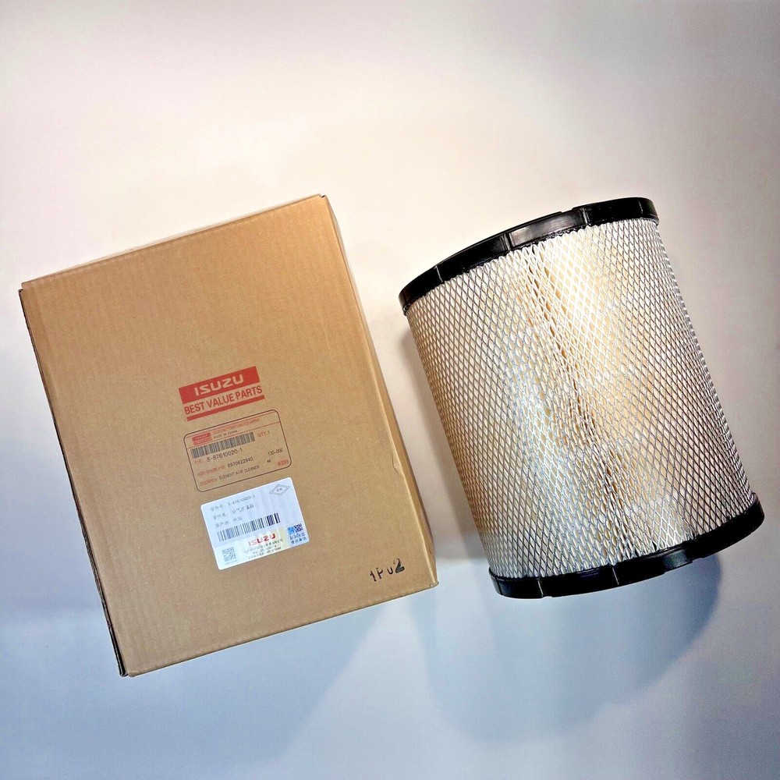
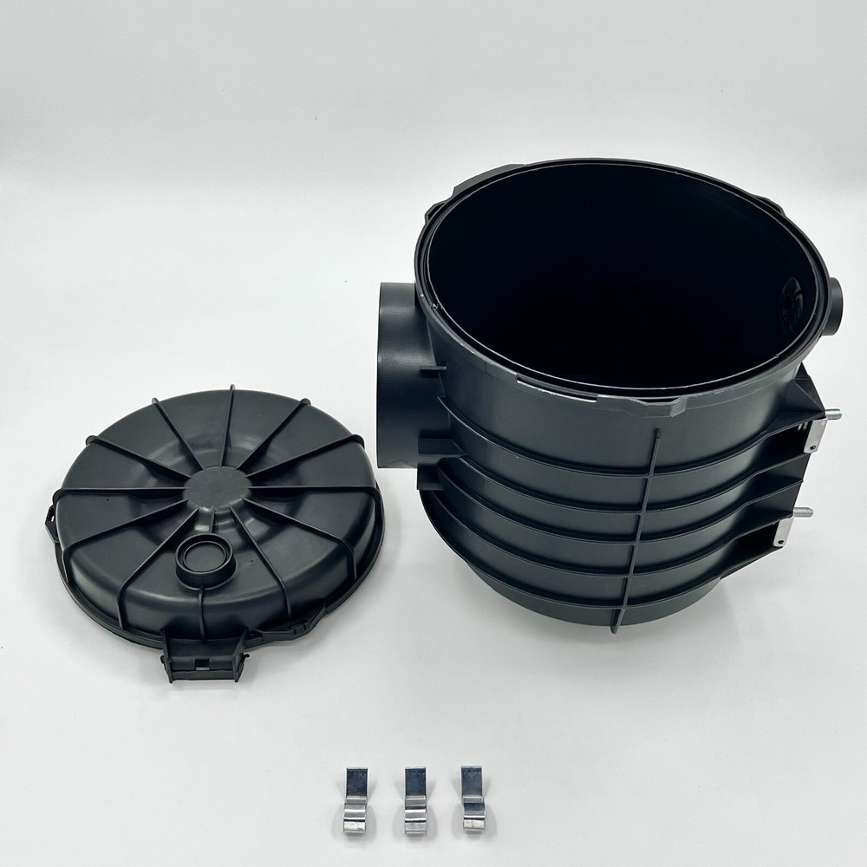
ISZE · VEHICLE PARTS & ACCESSORIES
PRECISION
An element and a housing share a family, not a price
AIM keeps them apart, so every price and sales comparison is like for like.
WHAT THIS MEANS
FILTER ELEMENTS
FILTER HOUSINGS AND ASSEMBLIES
Averaged together, a “filter” costs €13.64 per unit, a price that describes neither product.
€11.01
€154.47
average per unit
14×
average per unit
€2.79M billed
131 part numbers
€0.73M billed
59 part numbers
An element is bought at every service. A housing is bought after damage or failure. They belong in different parts of a sales review.
Product form only; not a specific part number.
Product form only; not a specific part number.
Replaced at every service. A routine purchase, bought again and again.
Replaced after damage or failure. A repair purchase, not a service one.
Purpose: compare distributors and years like for like.
Averaged together, a “filter” costs €13.64 per unit, a price that describes neither product.
Billed July 2025 – June 2026, price revision base, all filter part numbers marked element or housing / assembly in AIM. Photos: dealer and supplier listings, product form only.
6
Notes:
Filter elements: €2.79M billed, 253,009 units, 131 part numbers, €11.01 per unit. Housings and assemblies: €0.73M, 4,727 units, 59 part numbers, €154.47 per unit, 14.0 times the element. Blended: €13.64. The element photo is an Isuzu Best Value element in its box; the housing photo is a supplier listing. Both show product form only. These are the only photos in the presentation.

Slide 7
ISZE · VEHICLE PARTS & ACCESSORIES
JAPAN'S CODE
Japan's code stays on every part, but it cannot replace AIM
The code says where Japan files a part. AIM says what the part is. We need both.
WHAT THIS MEANS
One Japan code, many products
Code 275: 42% of what we bill, by AIM family
One product, many Japan codes
Different Japan codes on the same part type
One Japan code holds 42% of what we bill, across 197 part types. A sales chart by Japan code cannot separate brakes from body panels.
8
Japan codes for brake pad kits
11
Japan codes for air cleaner elements
Every AIM result can be translated back to Japan's own code, so a conversation with Japan can use their terms.
29
Japan codes for doors
Purpose: we analyse in AIM and talk to Japan in their code. Neither replaces the other.
How the code reinforces AIM
A bridge to Japan. Every AIM result translates back into Japan's own codes.
A completeness check. 89% of what we bill carries a Japan code. Of the other €3.9M: €1.3M is rebate, transport and lubricants, €1.2M is 4 steering unit part numbers, €1.4M other parts. Questions for Japan, not gaps in AIM.
Japan's catalogue code (ZKK) from Japan's parts-code file of 12 September 2025. Euro: price revision base, July 2025 – June 2026.
7
Notes:
ZKK is Japan's catalogue code: three characters, carried on 88.9% of billed euro (92.3% of parts alone). Code 275 alone holds €14.67M (41.9%) across 197 AIM part types. The other way round, one AIM part type sits under many codes: Air Cleaner Filter 11, Brake Pad Kit 8, Brake Rotor 5, Door 29. Without a Japan code: €3.88M, of which rebate, transport and lubricants €1.29M, 4 steering unit part numbers €1.16M, other parts €1.43M. Settled position on the Japan codes: 90_INBOX/SETTLED_POSITION_JP_CODES_2026-09-20.md.

Slide 8
ISZE · VEHICLE PARTS & ACCESSORIES
SALES ANALYSIS
Norway brings in €22 more per vehicle than Sweden. AIM traces it to two products
Similar light-commercial fleets: 7,929 vehicles in service in Norway, 8,443 in Sweden.
WHAT THIS MEANS
€209 against €187 per vehicle
Difference by family, Norway minus Sweden, € per vehicle
STEERING UNITS
€19.56 vs €2.09 per vehicle
Two similar fleets, two different parts bills: €209 against €187 per vehicle.
Norway bought 82, 81 of them one part number. Sweden bought 10. A repair pattern in Norway, or demand Sweden is not getting?
Steering units and brake pad kits explain most of it. Both are questions for the distributor, not conclusions.
BRAKE PAD KITS
€10.72 vs €4.64 per vehicle
Norway buys 14 kits per 100 vehicles a year, Sweden 6. Where do Swedish owners buy their brake pads?
Purpose: turn a gap between two distributors into a question about a named product.
Without families this is one number: Norway is 12% ahead. With AIM it is two concrete distributor conversations.
Parts billed July 2025 – June 2026, price revision base. Vehicles in service: 2025 estimates for both markets.
8
Notes:
Norway €1.66M on 7,929 vehicles = €209.4; Sweden €1.58M on 8,443 = €187.0. Steering: Norway 82 steering units (€155k, 2 part numbers; 81 of them part 7552348290) against Sweden 10 (€18k, 7 of them the same part number). Brake pad kits: Norway 1138 (€85k), Sweden 492 (€39k). Both fleets are light commercial vehicles; the 2025 fleet counts are estimates. These are questions to take to the two distributors, not conclusions.

Slide 9
ISZE · VEHICLE PARTS & ACCESSORIES
PRICE REVISIONS
The factory raised base prices 6.0% on average. By product group it ran from 0.6% to 10.3%
IML and IMIT base prices, September 2026 against September 2025, weighted on what we billed July 2025 – June 2026.
WHAT THIS MEANS
Steering gear +0.6%. One flat 6% would lift our price about ten times more than the factory cost moved.
Air and fuel filters +2.2% to +2.7%. A flat 6% makes the most frequent service parts dearer than the cost requires.
Brake pads and shoes +10.3%. Independent brands compete here. The pricing revision keeps the 29 brake pad kits at today's price.
Purpose: a price decision per product group instead of one network percentage.
Base-price move weighted on billed quantities, not a revenue or margin forecast. Worth €1.65M at last year's volumes. Product groups with at least €0.5M billed.
9
Notes:
Weighted base-price increase 5.96% on the price revision basis (priced lines €32.60M), worth €1.65M on last year's quantities. By AIM product group (groups with at least €0.5M billed): Steering Gear +0.55%; Air Filter +2.16%; Fuel Filter +2.72%; Filters (unspecified) +3.52%; Injection Pump +3.73%; Fuel Control +4.78%; Final Drive +5.00%; Lamps +5.10%; Oil Filter +5.12%; DEF System +5.96%; Turbo +6.03%; Discs & Drums +6.28%; Instruments +6.47%; Radiator +6.62%; Wheel Rim +6.78%; DPF/DPD +6.89%; Sensors +7.00%; HVAC Filters +7.04%; EGR +7.10%; Bumpers +7.27%; Panels +7.30%; Pads & Shoes +10.33%. This is a base-price move on billed quantities, not revenue, margin or demand response. Same basis as the price revision workbook (5.9616%, €1,652,140.71). What ISZE does with it is in the pricing revision presentation: our list rises 5.0% on average, each part follows its own factory increase, and the 29 brake pad kits stay at today's price (decided, pricing policy paper of 2 October 2026).

Slide 10
ISZE · VEHICLE PARTS & ACCESSORIES
WHAT I USE AIM FOR
Four things I use AIM for, and the evidence behind each
Each use is shown with real numbers earlier in this presentation.
1
Explain sales down to the part
2
Set price revisions per product group
3
Compare like with like
4
One language, with Japan's code kept
WHAT IT DOES
Compare distributors in euro per vehicle in service, by family and part type, and trace a gap to a named part number.
WHY IT MATTERS
A gap between two markets becomes a question to one distributor about one product, not an average to argue over.
SHOWN IN THIS PRESENTATION
Norway against Sweden: €22 per vehicle, traced to steering units and brake pad kits (page 8).
WHAT IT DOES
Read the factory increase and our own price decisions per family, product group and part type.
WHY IT MATTERS
The factory increase ran from +0.6% on steering gear to +10.3% on brake pads. One average hides where we compete and where we do not.
SHOWN IN THIS PRESENTATION
6.0% on average, 0.6% to 10.3% by product group (page 9).
WHAT IT DOES
Keep an element, a housing and a kit apart inside one family.
WHY IT MATTERS
A blended filter price of €13.64 describes neither a €11 element nor a €154 housing.
SHOWN IN THIS PRESENTATION
14 times the price between two products that used to share one average (page 6).
WHAT IT DOES
The same 22 families, 116 product groups and 239 part types for every distributor. Japan's catalogue code stays on every part.
WHY IT MATTERS
Distributor reviews, price revisions and talks with Japan refer to the same product.
SHOWN IN THIS PRESENTATION
89% of billed euro already linked to Japan's code (pages 5 and 7).
Next: link old and new part numbers, so a superseded part no longer looks like lost business.
Figures from pages 5 to 9. Billed July 2025 – June 2026, price revision base.
10
Notes:
Four uses, each tied to a page: 1 Norway against Sweden (page 8); 2 base-price increase by product group (page 9); 3 element against housing (page 6); 4 one structure for every market (22/116/239) and Japan's code kept on every part (pages 5 and 7). Next step: interchangeability, linking superseded part numbers to their replacements once the source file is supplied.

Slide 11
HOW I USE AIM FROM NOW ON
USE
AIM is the product language in my distributor sales reviews and in the price revisions.
From a label
to a product.
From a product
to a decision.
KEEP
Vehicle Parts Sales maintains it through approved, dated releases (latest 7 October 2026). Japan's code stays on every part.
CHECK
I take the two Nordic findings into the next distributor reviews and report what comes back.
AIM: one parts classification for sales analysis and price revisions. For information; no decision is requested.
11
Notes:
This slide informs; it does not ask. I use AIM as the product language for my sales reviews and price revisions; Vehicle Parts Sales keeps it current through approved, dated releases; and I take the two Nordic findings from page 8 (steering units in Norway, brake pad kits in Sweden) into the next distributor reviews and report back. No catalogue-wide automatic price change is implied.

