Slide 1

ISZE · IRELAND · IRELAND
Ireland Sales Review
& FY2027 Target
Isuzu Ireland · August 2026

Slide 2
IRELAND MEETING
Agenda
— Parts Performance — category movers
— Parts Performance — Filters
— Parts Performance — Electrical sensors
— Parts Performance — Injectors
— Parts Performance — where volume grew
— New Business — validation queue
— Sales-to-Dealer Outlook
— GPS Capture
— Fleet & FY2027 Target
— SPA — status
— R&M — market discussion
— Data request: part-level Sales-to-Dealer
— Next steps
2

Slide 3
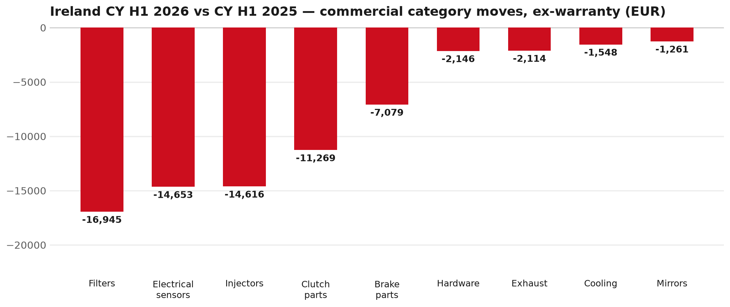
PARTS PERFORMANCE
Parts Performance — CY H1 2026 vs CY H1 2025 (commercial, ex-warranty)
TAKEAWAYS
— Commercial parts billing (warranty/campaign excluded) EUR 481K against EUR 586K a year earlier — -17.9% (CY H1 2026 vs CY H1 2025, Jan–Jun).
— Largest PN drops (all categories): 8983528481 (SENSOR; NOX) EUR -6K, 22 fewer pcs; 8976695331 (METER COMPL; CLUSTER) EUR -4K, 13 fewer pcs; 8982457540 (NOZZLE ASM; INJ) EUR -4K, 14 fewer pcs.
— Largest PN gains (all categories): 5874123812 (INTERFACE MX2-T) EUR 7K, 7 more pcs; 8982404570 (DRIVE ASM; FINAL,RR) EUR 3K, 2 more pcs; 8974985741 (TURBOCHARGER ASM) EUR 3K, 3 more pcs.
— About EUR 48K of claim-matched PN billing was stripped so this chart is aftermarket demand, not warranty.
3

Slide 4
PARTS PERFORMANCE — FILTERS
Filters — CY H1 2026 vs CY H1 2025 (commercial, ex-warranty)
— EUR 45,771 (CY H1 2025) to EUR 28,827 (CY H1 2026), down EUR 16,945 (-37%).
— Largest part numbers driving the decline (by EUR):
— 8980329082 (FILTER ASM): EUR 3,366 to EUR 0, 4 fewer pieces.
— 8983282070 (ELEMENT; OIL FILTER · FRR,FS*,FTR,FVR,NPS,N*R): EUR 4,666 to EUR 1,568, 212 fewer pieces.
— 8975425400 (ELEMENT; FUEL FILTER · FV*,FT*,FS*,FR*,N*R,N*S): EUR 3,649 to EUR 1,448, 173 fewer pieces.
— 5876102200 (ELEMENT KIT; FUEL FILTER · N*R,NPS): EUR 1,711 to EUR 250, 76 fewer pieces.
Questions for us to work through together
— Are dealers stocking filters, or ordering line-by-line against each job?
— How much servicing do you estimate is happening outside the franchised network?
— Would a service-pack offer on oil and fuel filters be workable for your dealers?
4

Slide 5
PARTS PERFORMANCE — ELECTRICAL SENSORS
Electrical sensors — CY H1 2026 vs CY H1 2025 (commercial, ex-warranty)
— EUR 68,893 (CY H1 2025) to EUR 54,240 (CY H1 2026), down EUR 14,653 (-21%).
— Largest part numbers driving the decline (by EUR):
— 8983528481 (SENSOR; NOX): EUR 16,129 to EUR 10,240, 22 fewer pieces.
— 8976695331 (METER COMPL; CLUSTER): EUR 4,616 to EUR 318, 13 fewer pieces.
— 8982201260 (SENSOR; SPEED): EUR 1,452 to EUR 0, 7 fewer pieces.
— 8976695321 (METER COMPL; CLUSTER): EUR 1,319 to EUR 0, 4 fewer pieces.
Questions for us to work through together
— Is this pricing against what the dealers can buy locally?
— Is any of this stock timing on your side rather than end demand?
— What would make the biggest difference to keep this business with us?
5

Slide 6
PARTS PERFORMANCE — INJECTORS
Injectors — CY H1 2026 vs CY H1 2025 (commercial, ex-warranty)
— EUR 17,244 (CY H1 2025) to EUR 2,628 (CY H1 2026), down EUR 14,616 (-85%).
— Largest part numbers driving the decline (by EUR):
— 8982457540 (NOZZLE ASM; INJ): EUR 4,285 to EUR 0, 14 fewer pieces.
— 8982318983 (INJECTOR ASM; DEF DCM): EUR 2,944 to EUR 0, 8 fewer pieces.
— 8980879851 (NOZZLE ASM; INJ): EUR 2,811 to EUR 0, 13 fewer pieces.
— 8982601090 (NOZZLE ASM; INJ): EUR 1,910 to EUR 0, 10 fewer pieces.
Questions for us to work through together
— Is this fewer failures, or repairs moving out of the network?
— Is the exchange/reman route competing with new parts here?
— Are dealers still quoting these part numbers, or have they dropped off the workshop menu?
6

Slide 7
PARTS PERFORMANCE — GROWTH
Where volume grew — CY H1 2026 vs CY H1 2025 (commercial, ex-warranty)
Part | Description | Model | CY H1 2025 | CY H1 2026 | Δ EUR
5874123812 | INTERFACE MX2-T | — | EUR 3,996 | EUR 11,408 | EUR 7,413
8982404570 | DRIVE ASM; FINAL,RR | — | EUR 1,289 | EUR 4,109 | EUR 2,820
8974985741 | TURBOCHARGER ASM | — | EUR 891 | EUR 3,510 | EUR 2,620
8980959830 | ELEMENT KIT; FUEL FILTER | N*R,NPS | EUR 4,480 | EUR 6,786 | EUR 2,306
5878324001 | KING PIN KIT | — | EUR 1,173 | EUR 2,853 | EUR 1,680
8983922341 | SPRING ASM; LEAF,RR | — | EUR 790 | EUR 2,448 | EUR 1,657
— Claim-matched PNs (67 distinct) and campaign/recall text matches are already excluded from this growth list. Residual warranty on unmapped PNs can remain.
— PNs ranked by largest EUR increase (prior-period sales > 0). Worth agreeing which of these are repeatable and which were one-off.
7

Slide 8
PARTS PERFORMANCE
New Business — validation queue (CY H1 2026)
Part | Description | Current sales | Review
8981580081 | HYDRAULIC UNIT; ANTI LOCK BRK | EUR 6,005 | Validate
8971345174 | FLYWHEEL | EUR 4,473 | Validate
8976882230 | HYDRAULIC UNIT; ANTI LOCK BRK | EUR 3,995 | Validate
7552392890 | CAMERA ASM | EUR 3,981 | Warranty / campaign
7552348280 | STEERING UNIT | EUR 3,968 | Warranty / campaign
8974842450 | TRANSMISSION ASM; MANUAL | EUR 3,966 | Validate
— These lines had no prior-period sales, so they are kept out of the incremental-growth table.
— A first sale can be a new model, a supersession, timing, or a warranty campaign. It is not treated as a commercial win until that cause is confirmed.
8

Slide 9
SALES-TO-DEALER
Sales-to-Dealer outlook — FY2027
— FY2026 Sales-to-Dealer is EUR 1,718,249 (working estimate).
— The working fleet movement into FY2027 is +18.4%.
— Applying fleet movement, the 5% price adjustment and 1.8% additional growth gives a FY2027 Sales-to-Dealer target of EUR 2,174,046.
— The discussion is held in Sales-to-Dealer amounts; ISZE billing remains an internal reconciliation measure.
9

Slide 10
GPS
GPS — amount view
— GPS compares actual parts purchases to the theoretical potential of the fleet.
— FY2026 purchases: EUR 1,103K.
— CY2025 fleet potential: EUR 956K (2,161 vehicles).
— Purchases sit above that theoretical potential — we discuss the amount and the per-vehicle rate, not a capture percentage.
10

Slide 11
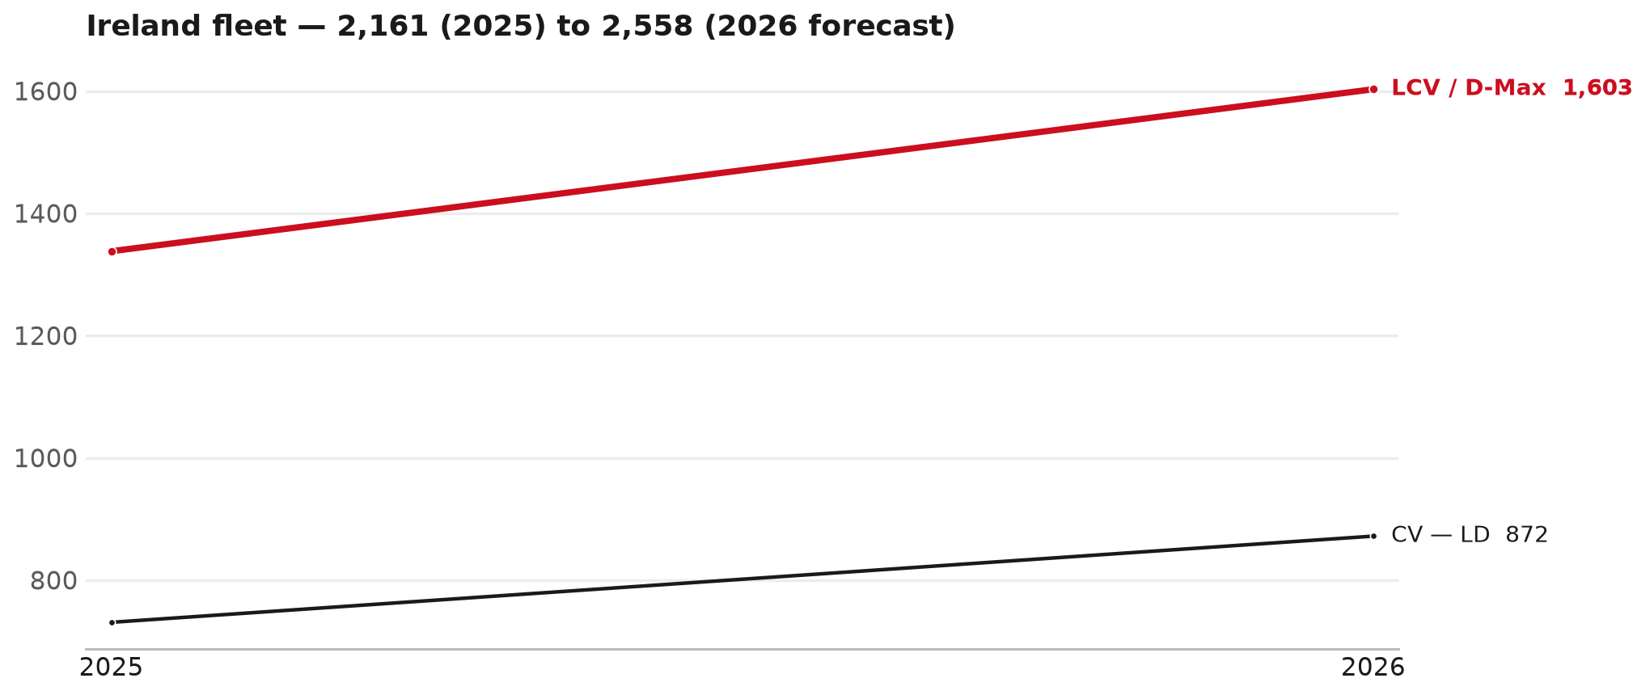
FLEET & FY2027 TARGET
The fleet is expected to grow in 2026
WHAT THIS MEANS FOR FY2027
— Fleet size (calendar year): 2,161 vehicles in 2025 → 2,558 working estimate for end-2026 (+18.4%).
— The chart is calendar years 2019–2026 only. 2026 is a working year-end estimate, not a fiscal-year figure.
— Smaller segments not plotted (<5% of fleet): F-Series 83.
— The FY2027 Sales-to-Dealer target starts from that fleet change, then applies a 5% price adjustment and 1.8% additional growth.
— The target reflects the working fleet outlook without extending the chart beyond 2026.
11

Slide 12
FLEET & FY2027 TARGET
How the FY2027 target is built
Sales-to-Dealer amount bridge
Step | Amount
FY2026 Sales-to-Dealer (working estimate) | EUR 1,718,249
After fleet movement (+18.4%) | EUR 2,033,910
After price adjustment (+5%) | EUR 2,135,606
FY2027 target after additional growth (+1.8%) | EUR 2,174,046
— The FY2027 target is +26.5% versus the FY2026 Sales-to-Dealer base.
— The FY2026 base is a working estimate (ISZE billing ÷ 0.65): the KPI Dashboard has no usable Sales-to-Dealer row for this market.
12

Slide 13
FY2027 TARGET
What the FY2027 target reflects
1
Your fleet
2
The price move
— The working fleet movement used in the target is +18.4%.
— ISZE is applying a 5% price adjustment for FY2027, consistent with every ISZE market this year.
— It is built into the per-vehicle rate above, not added separately on top.
What it means for your target
 | Value
FY2027 Sales-to-Dealer target | EUR 2,174,046
vs FY2026 Sales-to-Dealer (EUR 1,718,249) | +26.5%
— As in previous cycles we would expect an incentive to sit alongside this adjustment — that approval is still pending on our side.
— Until the incentive is confirmed, treat the FY2027 target as the working bridge (fleet × price × additional growth), not a locked commercial commitment.
13

Slide 14
SPA
SPA
1
IRELAND proposal
2
ISZE review
3
Counter-proposal
4
Final approval
— Isuzu Ireland submits a proposed parts list.
— ISZE reviews the proposal against network data and fit.
— ISZE returns a counter-proposal where needed.
— Signed off by ISZE management.
Purpose: higher turnover for both sides.
14

Slide 15
R&M
R&M — let's align on the market
M
Market
S
Servicing & R&M
— How is the market moving for you right now?
— How much of your volume is fleet business rather than retail?
— Where do you see the biggest hurdles this year?
— Where are your real strengths in this segment?
— Do you offer an R&M or service-plan product today?
— What share of the parc do you retain for servicing after year three?
— Does R&M business come bundled with fleet tenders — roughly what share?
— What would it take to bring more out-of-network servicing back?
15

Slide 16
ASK
Part-level Sales-to-Dealer Data
1
The starting point
2
Sharper insight
3
Shared benefit
— We have no Sales-to-Dealer figures from you for FY2026. The ask is monthly Sales-to-Dealer, at part-number level.
— Part-by-part visibility separates a stock movement from a lost job — and tells us where the volume actually went.
— Better availability on your fast movers, a sharper target for us, and a factual basis for the SPA — same data, both sides gain.
Requested from 01/01/2025, part number level, monthly.
16

Slide 17
SUMMARY
Next steps
— Confirm FY2027 Sales-to-Dealer target: EUR 2,174,046 (+26.5% vs FY2026 Sales-to-Dealer).
— Confirm the incentive alongside the price adjustment once approved on our side.
— Filters / Electrical sensors / Injectors: agree which category we tackle first, and what the joint action is.
— Agree part-level Sales-to-Dealer data sharing, effective 01/01/2025.
— SPA: IRELAND proposal, ISZE review and counter-proposal cycle to follow.
17

Slide 18
Moving the World – for You

