Slide 1

ISZE · BELGIUM · IBX
Benelux Sales Review
& FY2027 Target
Isuzu Benelux · August 2026

Slide 2
IBX MEETING
Agenda
— Parts Performance — category movers
— Parts Performance — Steering
— Parts Performance — Brake parts
— Parts Performance — Fuel system
— Parts Performance — where volume grew
— New Business — validation queue
— Sales-to-Dealer Outlook
— GPS Capture
— Service-Parts Coverage
— IDS 2026 — Dealer Standard
— Fleet & FY2027 Target
— SPA — status
— R&M — market discussion
— Data request: part-level Sales-to-Dealer
— Next steps
2

Slide 3
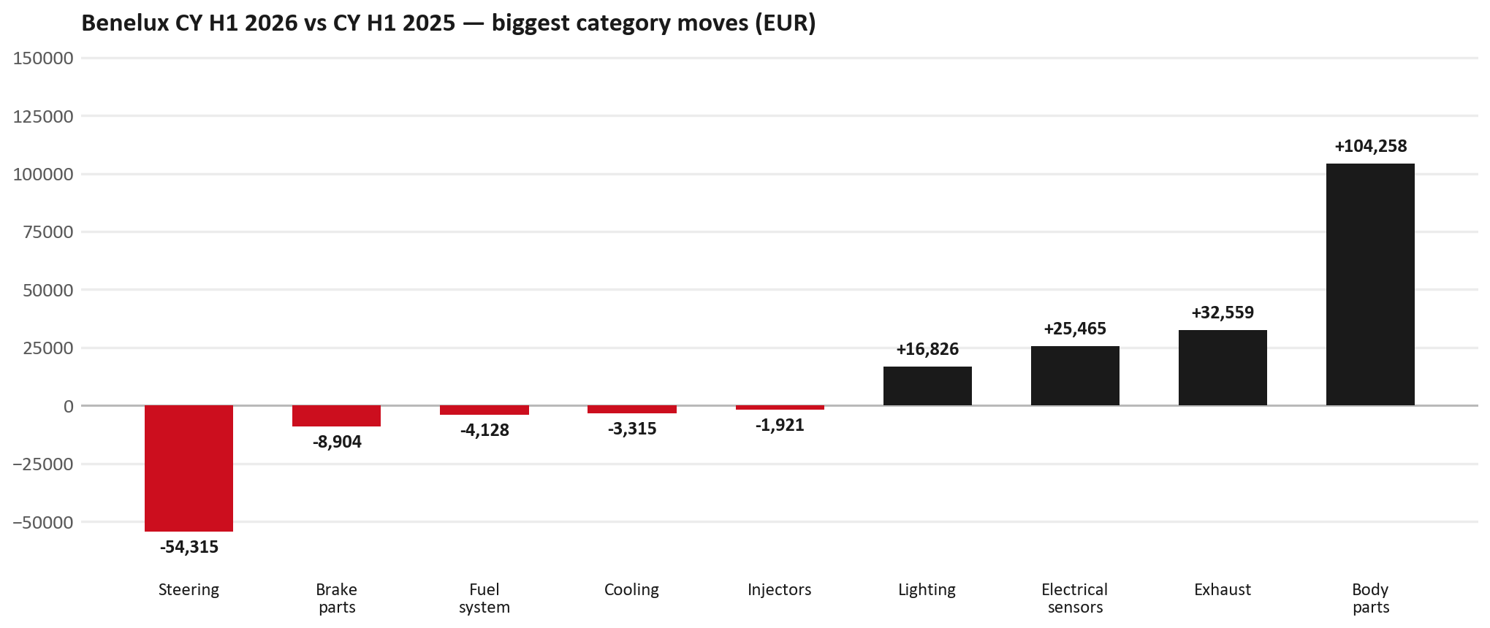
PARTS PERFORMANCE
Parts Performance — CY H1 2026 vs CY H1 2025
TAKEAWAYS
— Parts billing EUR 1,235K against EUR 1,057K a year earlier — +16.8%. After EUR 25K of credit notes the net figure is EUR 1,209K.
— Biggest declines: Steering EUR -54K; Brake parts EUR -9K; Fuel system EUR -4K.
— Growing: Body parts +36%, Exhaust +85%, Electrical sensors +38%.
— CY H1 2026 against CY H1 2025 (calendar Jan–Jun, Q1+Q2) — like-for-like half-year cut.
3

Slide 4
PARTS PERFORMANCE — STEERING
Steering — CY H1 2026 vs CY H1 2025
— EUR 96,368 (CY H1 2025) to EUR 42,053 (CY H1 2026), down EUR 54,315 (-56%).
— 7552348290 (STEERING UNIT): EUR 75,208 to EUR 16,010, 29 fewer pieces.
Questions for us to work through together
— Is this pricing against what the dealers can buy locally?
— Is any of this stock timing on your side rather than end demand?
— What would make the biggest difference to keep this business with us?
4

Slide 5
PARTS PERFORMANCE — BRAKE PARTS
Brake parts — CY H1 2026 vs CY H1 2025
— EUR 90,882 (CY H1 2025) to EUR 81,978 (CY H1 2026), down EUR 8,904 (-10%).
— 5878316930 (SHOE KIT; BRAKE,RR): EUR 12,755 to EUR 0, 62 fewer pieces.
— 8975546610 (PAD KIT; CALIPER,DISC BRK,FRT): EUR 9,648 to EUR 5,842, 44 fewer pieces.
— 5876102280 (LINING KIT; RR BRAKE): EUR 3,276 to EUR 0, 57 fewer pieces.
Questions for us to work through together
— Is pad and rotor pricing competitive against what the dealers can buy locally?
— Is any of this stock timing on your side rather than end demand?
— Are dealers still quoting these part numbers, or have they dropped off the workshop menu?
5

Slide 6
PARTS PERFORMANCE — FUEL SYSTEM
Fuel system — CY H1 2026 vs CY H1 2025
— EUR 9,894 (CY H1 2025) to EUR 5,766 (CY H1 2026), down EUR 4,128 (-42%).
Questions for us to work through together
— Is this pricing against what the dealers can buy locally?
— Is any of this stock timing on your side rather than end demand?
— What would make the biggest difference to keep this business with us?
6

Slide 7
PARTS PERFORMANCE — GROWTH
Where volume grew — CY H1 2026 vs CY H1 2025
Part | Description | CY H1 2025 | CY H1 2026
8978461152 | GLASS; WINDSHIELD | EUR 697 | EUR 18,240
8981776324 | DPD ASM | EUR 4,136 | EUR 11,992
8975554500 | FILTER; BLOWER UNIT | EUR 9,783 | EUR 16,468
7552348280 | STEERING UNIT | EUR 2,123 | EUR 8,352
8983682091 | PIPE; EXH | EUR 2,725 | EUR 7,917
8983320764 | DPD ASM | EUR 2,283 | EUR 6,849
— Body parts +36%, Exhaust +85%, Electrical sensors +38% — where the volume went.
— Several of these are the kind of item that also moves on a campaign or claim. Belgium CY2025 warranty parts (claim-price basis) were EUR 75K — separate from fiscal GPS warranty expense. Do not read this growth list as purely commercial without checking claims together.
— Worth agreeing which of these are repeatable and which were one-off.
7

Slide 8
PARTS PERFORMANCE
New Business — validation queue (CY H1 2026)
Part | Description | Current sales | Review
8978461162 | GLASS; WINDSHIELD | EUR 19,705 | Validate
7552283750 | TRANSFER ASM | EUR 8,010 | Validate
7552348310 | STEERING UNIT | EUR 4,918 | Validate
8978725102 | PANEL; SIDE OUTER | EUR 3,741 | Validate
8983042280 | TRANSMISSION ASM; AUTO | EUR 3,656 | Validate
8981596930 | ELEMENT KIT; FUEL FILTER | EUR 3,508 | Validate
— These lines had no prior-period sales, so they are kept out of the incremental-growth table.
— A first sale can be a new model, a supersession, timing, or a warranty campaign. It is not treated as a commercial win until that cause is confirmed.
8

Slide 9
SALES-TO-DEALER
Sales-to-Dealer outlook — FY2027
— FY2026 Sales-to-Dealer is EUR 6,834,272 (reported KPI).
— The working fleet movement into FY2027 is -3.2%.
— Applying fleet movement, the 5% price adjustment and 1.8% additional growth gives a FY2027 Sales-to-Dealer target of EUR 7,074,416.
— The discussion is held in Sales-to-Dealer amounts; ISZE billing remains an internal reconciliation measure.
9

Slide 10
GPS
GPS Capture: 85.2%
— GPS measures your actual parts purchases against the full potential of your fleet.
— Benelux today: 85.2% (FY2026 purchases against the CY2025 fleet potential).
— Fleet potential: EUR 2,454K on 9,593 vehicles.
— Real, sustained headroom above 85.2% — the service-parts and SPA discussion are both direct levers on it.
10

Slide 11
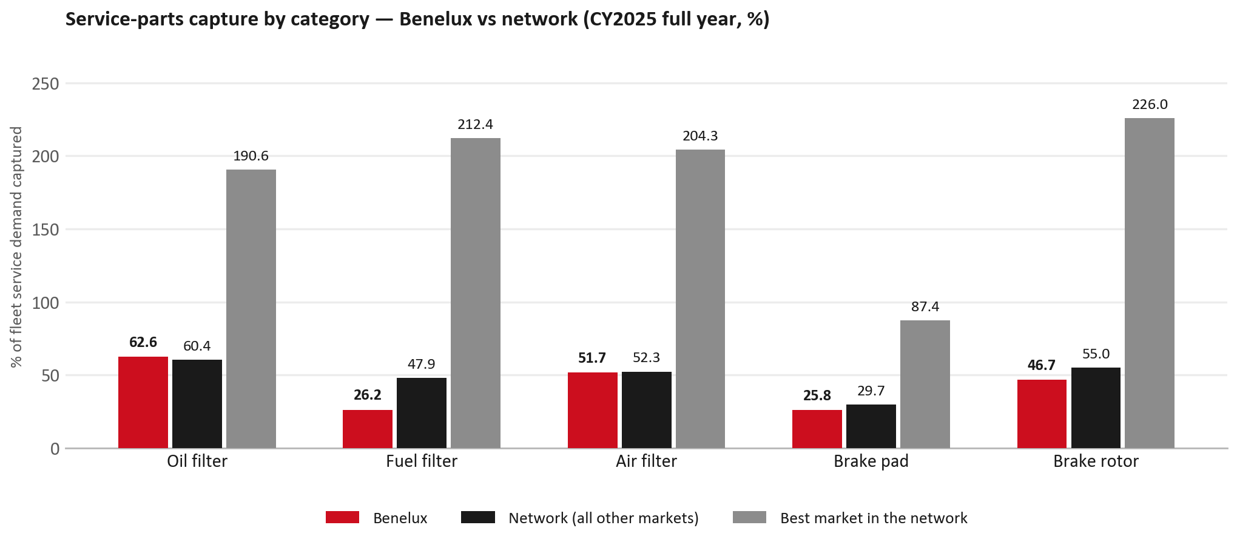
SERVICE-PARTS COVERAGE
Service-parts coverage: fuel filter is the clear gap
TAKEAWAYS
— Fuel filter 26.2% against 47.9% for the rest of the network.
— Brake rotor 46.7% against 55.0% for the rest of the network.
— Every market here is measured on the same fleet-and-interval model, so the comparison is like-for-like even where the underlying interval assumption is debatable.
— Worth agreeing which category we tackle first, and what the joint action is.
11

Slide 12
IDS 2026 — DEALER STANDARD
IDS 2026: Benelux averages 78.6%, above the 74.8% network benchmark
Dealer | Total % | Global rank
Pashuysen | 95.7% | #23
Sud Motor Huy | 92.9% | #47
Sud Motor Marche | 92.9% | #48
Benelux country average | 78.6% | —
Network average (all IDS 2026) | 74.8% | —
Delfosse | 60.7% | #460
Degroote | 57.1% | #466
Fayt | 55.4% | #472
— 34 dealers assessed across Premises, Organisation, Service, Parts and Vehicle Sales.
— The country average sits 3.8 points above the network.
— The spread is the point: 40 points between the strongest and weakest dealer.
— Dealer-by-dealer detail and individual feedback are available as a separate pack — worth agreeing which dealers to visit, and when.
12

Slide 13
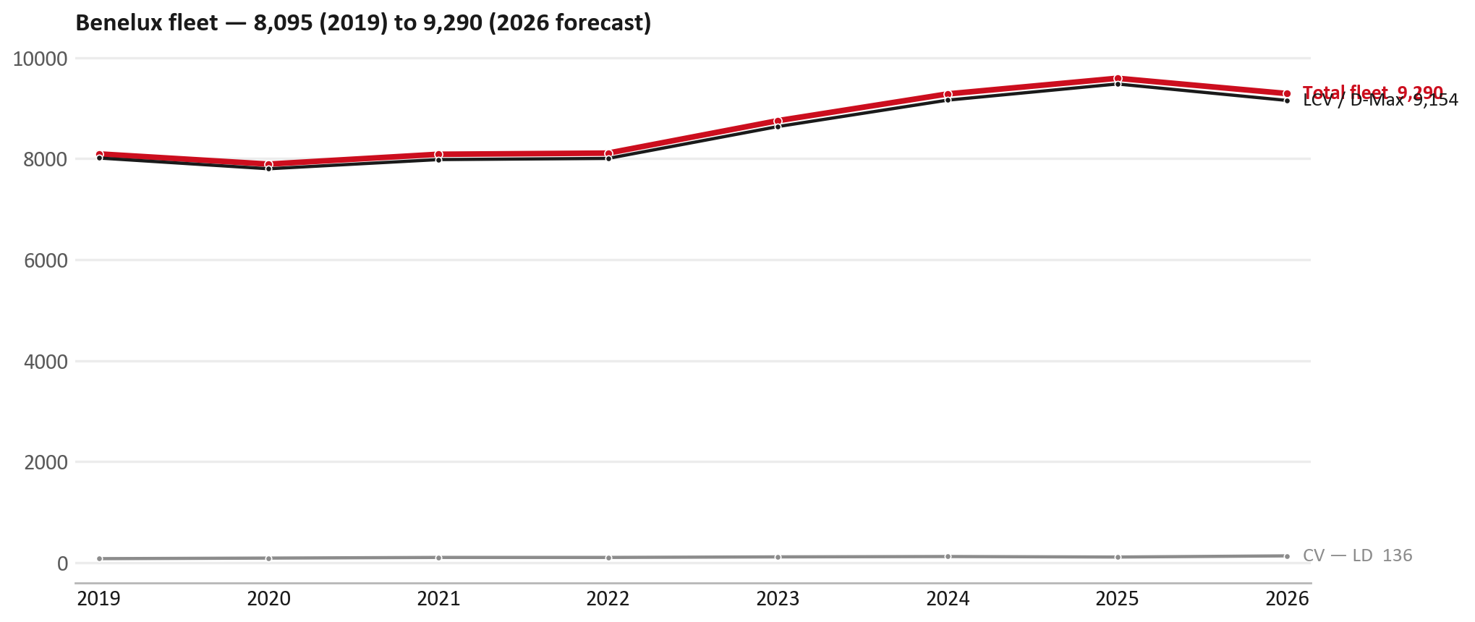
FLEET & FY2027 TARGET
The fleet is expected to decline in 2026
WHAT THIS MEANS FOR FY2027
— Fleet size (calendar year): 9,593 vehicles in 2025 → 9,290 working estimate for end-2026 (-3.2%).
— The chart is calendar years 2019–2026 only. 2026 is a working year-end estimate, not a fiscal-year figure.
— The FY2027 Sales-to-Dealer target starts from that fleet change, then applies a 5% price adjustment and 1.8% additional growth.
— So the target is built from a slightly smaller fleet — not from an assumed growth story.
13

Slide 14
FLEET & FY2027 TARGET
How the FY2027 target is built
Sales-to-Dealer amount bridge
Step | Amount
FY2026 Sales-to-Dealer (reported KPI) | EUR 6,834,272
After fleet movement (-3.2%) | EUR 6,618,408
After price adjustment (+5%) | EUR 6,949,328
FY2027 target after additional growth (+1.8%) | EUR 7,074,416
— The FY2027 target is +3.5% versus the FY2026 Sales-to-Dealer base.
— The FY2026 base is the reported Sales-to-Dealer KPI.
14

Slide 15
FY2027 TARGET
What the FY2027 target reflects
1
Your fleet
2
The price move
— The working fleet movement used in the target is -3.2%.
— ISZE is applying a 5% price adjustment for FY2027, consistent with every ISZE market this year.
— It is built into the per-vehicle rate above, not added separately on top.
What it means for your target
 | Value
FY2027 Sales-to-Dealer target | EUR 7,074,416
vs FY2026 Sales-to-Dealer (EUR 6,834,272) | +3.5%
— As in previous cycles we would expect an incentive to sit alongside this adjustment — that approval is still pending on our side.
— Until the incentive is confirmed, treat the FY2027 target as the working bridge (fleet × price × additional growth), not a locked commercial commitment.
15

Slide 16
SPA
SPA
1
IBX proposal
2
ISZE review
3
Counter-proposal
4
Final approval
— Isuzu Benelux submits a proposed parts list.
— ISZE reviews the proposal against network data and fit.
— ISZE returns a counter-proposal where needed.
— Signed off by ISZE management.
Purpose: higher turnover for both sides.
16

Slide 17
R&M
R&M — let's align on the market
M
Market
S
Servicing & R&M
— How is the market moving for you right now?
— How much of your volume is fleet business rather than retail?
— Where do you see the biggest hurdles this year?
— Where are your real strengths in this segment?
— Do you offer an R&M or service-plan product today?
— What share of the parc do you retain for servicing after year three?
— Does R&M business come bundled with fleet tenders — roughly what share?
— What would it take to bring more out-of-network servicing back?
17

Slide 18
ASK
Part-level Sales-to-Dealer Data
1
Already halfway there
2
Sharper insight
3
Shared benefit
— You already report Sales-to-Dealer monthly. The ask is the same data at part-number level.
— Part-by-part visibility separates a stock movement from a lost job — and tells us where the volume actually went.
— Better availability on your fast movers, a sharper target for us, and a factual basis for the SPA — same data, both sides gain.
Requested from 01/01/2025, part number level, monthly.
18

Slide 19
SUMMARY
Next steps
— Confirm FY2027 Sales-to-Dealer target: EUR 7,074,416 (+3.5% vs FY2026 Sales-to-Dealer).
— Confirm the incentive alongside the price adjustment once approved on our side.
— Steering / Brake parts / Fuel system: agree which category we tackle first, and what the joint action is.
— Agree part-level Sales-to-Dealer data sharing, effective 01/01/2025.
— SPA: IBX proposal, ISZE review and counter-proposal cycle to follow.
— IDS 2026: agree dealer visit dates, starting with the lower-scoring dealers.
19

Slide 20
Moving the World – for You

Slide 21
BENELUX · ISUZU BENELUX
Deep dive — detail behind the Mode A story
— Extra detail for meeting prep — pick which slides to share with Isuzu Benelux.
— Mode A ends on the previous closing slide.
— Label in all charts: “Genuine with BVP alternative” (not “genuine contested”).
— IBX GPS % can look high because billing covers BE/NL/PL/LUX while the wallet denominator is Belgium-only — say so when quoting %.
21

Slide 22
AGENDA
Deep-dive agenda
— GPS — calendar year and fiscal year on one chart (incl. warranty)
— FY2025 → FY2026 wallet mix (Genuine / Genuine with BVP alternative / BVP)
— Where the money went — outside the service-parts basket
— Service parts: calendar-year capture vs network + fiscal-year billing
— Brake pads — BVP share of total brake pad sales
— AIM exposure
— Warranty — two lenses
— How to use this in the meeting
22

Slide 23
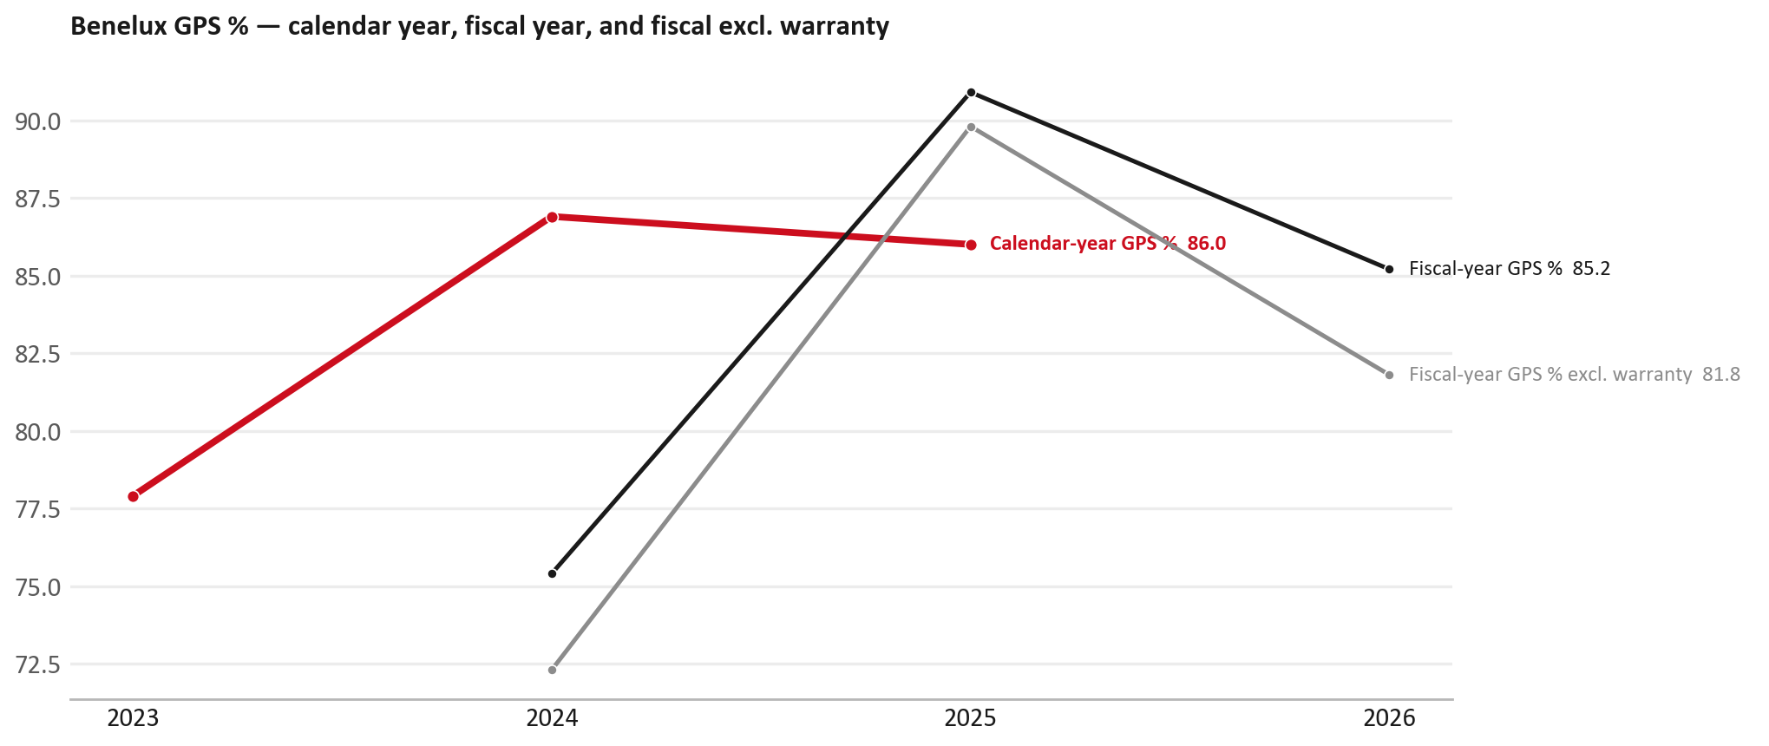
GPS
GPS: calendar year, fiscal year, and after warranty
TAKEAWAYS
— Red = calendar-year GPS. Recent peak 86.9%; CY2025 = 86.0%.
— Black = fiscal-year GPS (frozen CY2025 wallet). FY26 headline 85.2%.
— Grey = fiscal GPS after removing warranty parts (€). FY26 ≈ 81.8% (warranty EUR 83,007 ≈ 4% of FY26 billing).
— Fleet 9,593 → 9,290 (working CY2026 estimate).
— ISUZU BENELUX NV bills for BE/NL/PL/LUX but the FY27 max spend uses the BELGIUM UIO rows only. GPS 95-98% is therefore likely OVERSTATED — numerator covers a parc the denominator excludes. Do not present the % without stating that, or widen the denominator first (UIO rows NL 30/31/32, LUX 36/37/38, Poland 69).
23

Slide 24
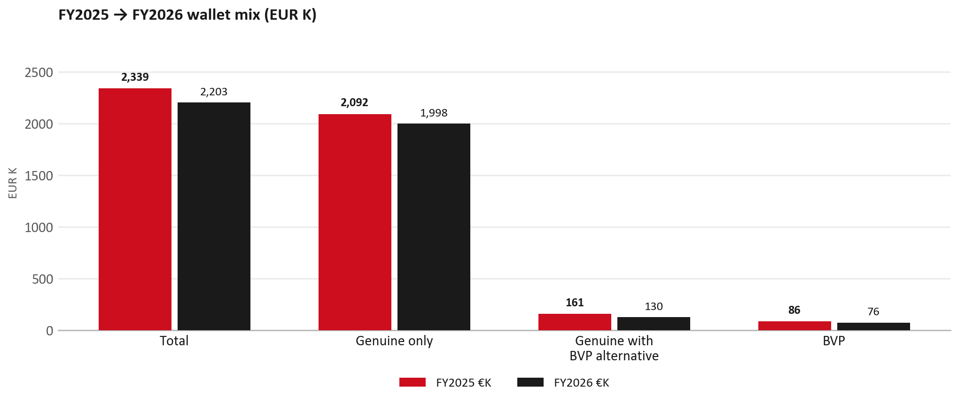
WALLET MIX
FY2025 → FY2026 wallet mix
— Total EUR 2,338,748 → EUR 2,203,112 (-5.8%).
— Genuine only EUR -94,412.
— Genuine with BVP alternative EUR -31,022; BVP EUR -10,202 (3.4% of FY26 wallet).
— Display label locked: Genuine with BVP alternative.
24

Slide 25
WALLET MIX
FY wallet mix — detail
 | FY2025 | FY2026 | Δ
Total | EUR 2,338,748 | EUR 2,203,112 | EUR -135,636
Genuine only | EUR 2,092,144 | EUR 1,997,733 | EUR -94,412
Genuine with BVP alternative | EUR 160,541 | EUR 129,519 | EUR -31,022
BVP | EUR 86,063 | EUR 75,861 | EUR -10,202
BVP % of wallet | 3.7% | 3.4% | -0.2 pp
25

Slide 26
DRIVERS
Where the genuine drop sits (calendar 2024 → 2025)
— Genuine-only sales moved EUR 78,321 from CY2024 to CY2025.
— Of that, the routine service basket (filters, pads, rotors) moved EUR -7,355 on genuine-only; BVP in that basket moved EUR -1,467.
— Meeting line: check high-value assemblies / sensors before blaming the filter or pad menu.
26

Slide 27
DRIVERS
Largest part-number drops (FY24→FY25) — outside service filters
Part | Description | Δ EUR
8977998750 | STEERING UNIT | -34,249
8981776324 | DPD ASM | -11,626
8975293230 | ENGINE ASM | -11,250
8983759930 | ENGINE ASM | -11,244
8983550720 | partikel sensor | -10,818
5876150180 | FILTER; BLOWER UNIT | -10,118
8980835411 | MOLDING; WINDSHIELD,LWR | -6,760
— Check warranty / campaign coding before calling competitive leakage.
27

Slide 28
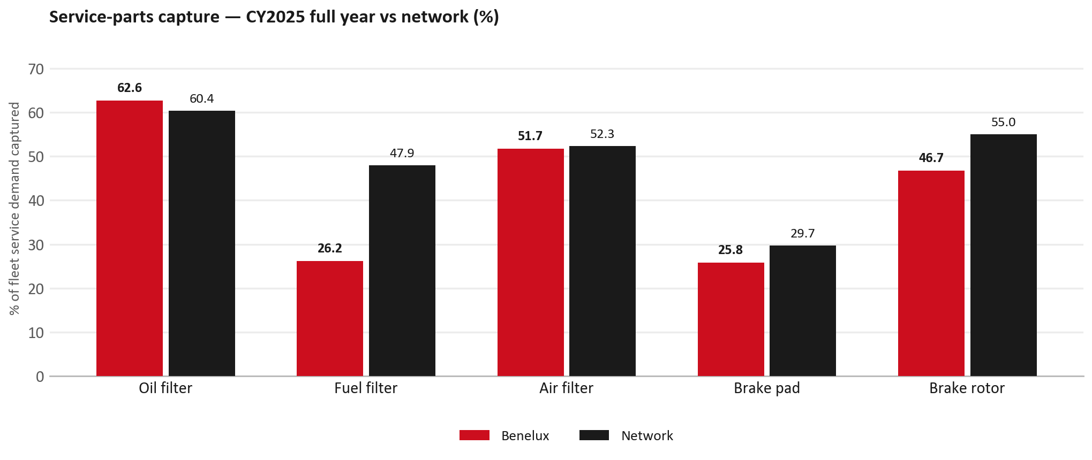
SERVICE PARTS
Service-parts capture vs network (calendar year)
TAKEAWAYS
— Capture % is calendar-year (full CY2025). Fleet demand is modelled on calendar years — there is no matching fiscal-year capture %.
— Oil filter 62.6% vs network 60.4%; Fuel filter 26.2% vs network 47.9%; Air filter 51.7% vs network 52.3%.
— Next slide: fiscal-year € billing in the same five categories.
— Primary lens = total capture (not genuine-only).
28

Slide 29
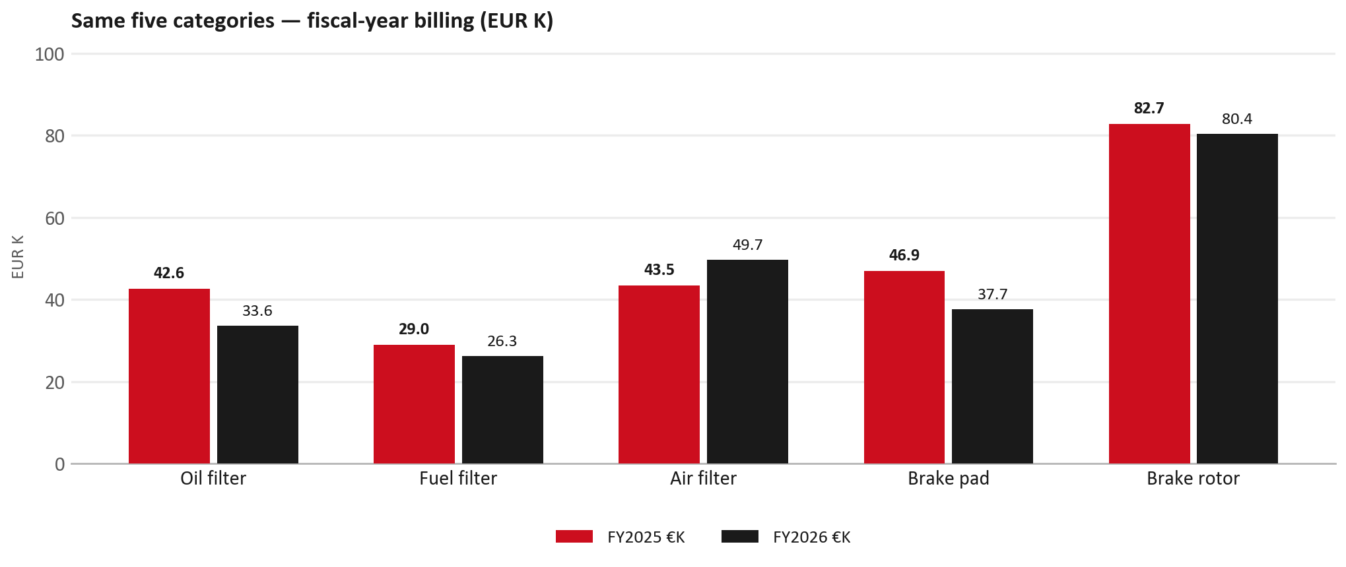
SERVICE PARTS · FY
Service-parts billing by fiscal year (same five lines)
TAKEAWAYS
— This is Sales-to-Isuzu Benelux € in fiscal years — not capture % of fleet demand.
— Use both lenses — do not mix % capture with € billing.
— Primary = total sales in the basket.
29

Slide 30
BRAKES
Brake pads — BVP share of total brake pad sales
 | 2024 | 2025
Genuine qty | 0 | 0
BVP qty | 0 | 0
BVP share of total brake pad sales (€) | 14% | 3%
— BVP share = BVP € ÷ all brake-pad € billed (genuine + BVP). Not a PMS capture %.
— Wallet-level BVP is still only ~3.4% of FY26 — do not generalise a pad story to the whole wallet.
30

Slide 31
AIM
AIM exposure
Year | High-risk € | High-risk % | Quadrant
2023 | EUR 29,155 | 1.7% | Defend (high GPS - high capture)
2024 | EUR 25,867 | 1.2% | Defend (high GPS - high capture)
2025 | EUR 25,745 | 1.2% | Attach gap (high GPS - low capture)
— High-risk € is catalogue AIM exposure, not proven walk-out.
— Open on jobs not bought through the distributor — not a street IAM war alone.
31

Slide 32
WARRANTY
Warranty — two real lenses
1
CY2025 claim-price parts
2
Fiscal GPS expense
— EUR 74,677 (claim-price basis).
— Calendar-year claim price basis.
— IBX Belgium only; no CV warranty rows in the source file.
— FY24 EUR 490 · FY25 EUR 25,359 · FY26 EUR 83,007.
— Source row: IBX.
— Ex-warranty GPS = (net − warranty) ÷ frozen CY25 wallet.
— Both numbers are real — never mix them on one slide without labels.
32

Slide 33
BRIDGE
How to use this in the meeting
If they say… | You know…
BVP is eating genuine | Wallet BVP ~3.4%. Check pads as a local exception only.
GPS looks fine / too high | FY26 headline 85.2%; excl. warranty ≈ 81.8%. IBX: Belgium-only denominator.
Service parts are fine | CY2025 capture vs network (previous slides) + FY billing lens.
33

Slide 34
Moving the World – for You

