Slide 1


ISUZU MOTORS EUROPE
Parts support for scheduled PMS
Phase 1 covers the N75 fleet. Oil and fuel filters form the core service pack, with the air filter as the primary attach. Genuine parts are proposed first, unless a genuine SPA or a BVP offers the lower price.
18 August 2026 · complementary to the ITUK PMS pack
P700

Slide 2
PARTS SUPPORT · SCHEDULED PMS
Contents
01
Where this sits
The same N75 scope and 40,000 km interval as the ITUK pack, with ISZE figures applied to it.
02
The one percent
A one percent uplift across all PMS parts sold to dealers: 182 units, approximately EUR 4,207.
03
Coverage
The air filter is the largest gap. The fuel filter is approximately two thirds covered. The method follows.
04
Price route
A BVP where genuine demand is low, or an SPA where genuine can be brought in at a lower price.
05
Urea, brakes, clutch
The urea filter kit is retained. Brakes remain condition-based across both pad numbers. The clutch is supplied as a kit for manual transmissions only.
2

Slide 3
PARTS SUPPORT · SCHEDULED PMS
The ITUK parts map, with ISZE figures applied
Phase 1 covers the N75 fleet on the 40,000 km interval, scheduled PMS only. No additional visits are to be generated.
Oil + fuel
Air filter
Brakes
Clutch
Core pack
Primary attach
Condition-based
VIN / manual
63%
20%
62%
47%
Oil and fuel filters are fitted at every scheduled service. On the ITUK N75 part number list, fuel filter coverage to dealers is 63 percent and oil 46 percent. The oil BVP is already established. Both remain in the core set.
To be included whenever the service menu requires it. Coverage is 20 percent, the largest gap on a visit that already takes place.
No volume campaign. Parts are supplied when the repair requires them. Both N75 pad numbers together reach 62 percent coverage. No BVP exists for the R90 pad; an SPA applies only where price is the barrier.
No broad campaign. Kit 5876102320, for manual transmissions only. A 47 percent planning share applies until transmission data is available.
3

Slide 4
PARTS SUPPORT · SCHEDULED PMS
One percent uplift on all PMS parts
ITUK to dealer, calendar 2025
Current mix retained. The 37 N75 part numbers in the ITUK pack, 18,211 units in the year.
+1%
This is not 117 additional complete services, and not filters alone. Brake parts represent 56 percent of the value.
182 extra units · about EUR 4,207 at ISZE to ITUK
Family
1% units
1% EUR
Fuel
74
461
Oil
53
439
Brake
29
2,354
Air
23
665
Clutch
3
288
4

Slide 5


PARTS SUPPORT · SCHEDULED PMS
N75 filter coverage, calendar 2025
Quantity sold divided by the quantity expected under the IML service schedule. N75 units in operation: 9,359 (DVLA 2024), at 1.25 services per year. Expected oil, fuel and air filters: 11,699. Scope is the 37 N75 part numbers in the ITUK pack.
Expected
ITUK to dealer
Cover
ISZE to ITUK
Cover
Oil filter
11,699
5,335
45.6%
4,691
40.1%
Fuel filter
11,699
7,415
63.4%
3,632
31.0%
Air filter
11,699
2,284
19.5%
2,204
18.8%
5

Slide 6
PARTS SUPPORT · SCHEDULED PMS
How the cover percentages are built
Cover % = units sold in calendar 2025 / units the service schedule expects
1. The car park
2. How often
3. Expected units
9,359 N75
1.25 services / year
11,699 filters
N75 units in operation, DVLA 2024, covering both engine generations. This is not the 22,389 complete UK parc.
Planning basis: 50,000 km per year against a 40,000 km filter interval. 50,000 ÷ 40,000 = 1.25.
9,359 × 1.25. The same expected quantity applies to oil, fuel and air. This is the denominator.
Worked example
Sold 2025
Expected
Cover
Oil, ITUK to dealer
5,335
11,699
45.6%
Oil, ISZE to ITUK
4,691
11,699
40.1%
Fuel, ITUK to dealer
7,415
11,699
63.4%
Air, ITUK to dealer
2,284
11,699
19.5%
The same method applies to both layers. Scope is the 37 N75 part numbers in the ITUK pack. Pad coverage uses 0.5 events per year rather than 1.25. The one percent figure is one percent of actual 2025 mix, not of expected services. Air uses the same 1.25 as oil and fuel; on a 0.5 air interval it would read 39 percent.
6

Slide 7
PARTS SUPPORT · SCHEDULED PMS
Price route: the lower of genuine or BVP
Agreed with ITUK on 17 August. A BVP applies where genuine demand is low, unless an SPA on genuine achieves a lower price. Across the set, genuine is proposed first unless it is already cheaper than the BVP.
Fuel
Genuine demand is established.
Retain genuine. A BVP equivalent is available if required.
1
Air
Genuine coverage is 20 percent.
BVP 5876102500, or an SPA on genuine where that is lower.
2
Oil
The BVP is already supplied.
Remains in the set. Not a separate campaign.
3
Pad
No BVP available.
SPA on genuine only, and only where the repair requires the pad.
4
7

Slide 8
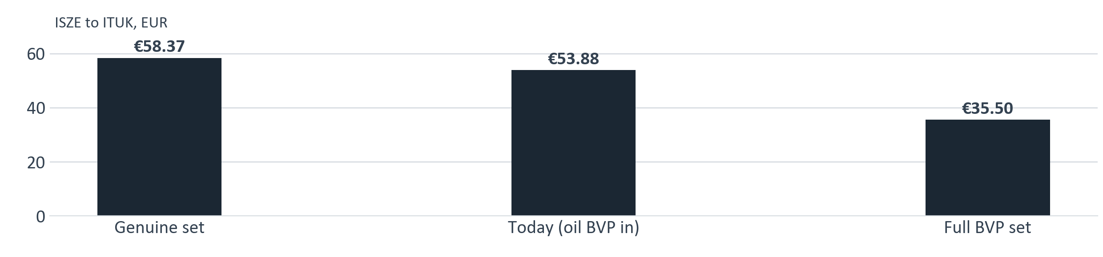

PARTS SUPPORT · SCHEDULED PMS
One scheduled service, three filters
The genuine set is proposed first. A BVP applies only where genuine is not taken up, or is not the lower price. The air BVP is 44 percent below genuine.
Oil
Fuel
Air
Set
Genuine PN
8983282070
8975425400
8981772710
3 part numbers
ISZE to ITUK EUR
14.45
12.56
31.36
58.37
BVP PN
1876102890
1876102860
5876102500
if required
BVP ISZE to ITUK EUR
9.96
8.05
17.49
35.50
8

Slide 9
PARTS SUPPORT · SCHEDULED PMS
Urea filter kit is retained
ITUK requested that this item be retained, and that is confirmed. It sits outside the 37 N75 part numbers and is treated as a separate line. The item is the DEF pump filter kit, not bulk fluid.
Genuine 8983507161
BVP 1876102341
Current kit
If genuine is not taken up
Genuine remains the first choice for this item.
Use the BVP where genuine is not taken up, unless a genuine SPA achieves a lower price.
Genuine 8983507161
BVP 1876102341
ITUK to dealer qty
541
34
ISZE to ITUK qty
506
46
ISZE to ITUK EUR
70.53
30.72
Prices shown are ISZE to ITUK, PR00 IE40, valid 13 March 2026.
9

Slide 10
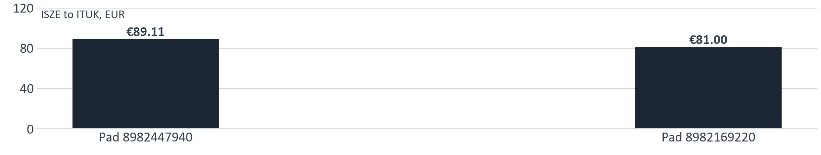


PARTS SUPPORT · SCHEDULED PMS
Brakes remain condition-based
No promotional trigger. Where the pad is required for the repair, no BVP exists and an SPA applies. Both N75 pad numbers are included.
ITUK to dealer
ISZE to ITUK
Cover
Pad 8982447940 + 8982169220
2,900
2,730
62% (0.5 / year)
Disc rear 8981919560
487
0
10% (0.25 axle-set)
Disc front 8982488951
393
0
8% (0.25 axle-set)
The rotors fit N75 NPR and carry over to P700. They are not on the ITUK PMS list, and ISZE has never supplied them: 880 rotors a year to dealers, none from ISZE.
No BVP exists for the R90 pad. SPA on genuine only, and only where the repair requires it.
10

Slide 11
PARTS SUPPORT · SCHEDULED PMS
Clutch supplied as a kit, manual transmissions only
No broad campaign; VIN and manual transmission only. A 47 percent planning share applies until transmission data is available. Disc 8981649181 is not to be included.
BVP kit 5876102320
Genuine three pieces
Single part number
If the workshop requires individual pieces
ITUK to dealer 63 units. ISZE to ITUK 78 units at EUR 194.69.
8981649171 + 8970388314 + 1313100120, ISZE to ITUK EUR 282.08. The kit is 31 percent lower.
Piece
PN
ITUK to dealer
ISZE to ITUK
Disc
8981649171
50
47
Pressure plate
8970388314
9
54
Release bearing
1313100120
38
21
11

Slide 12
October launch. N75 first.
Scheduled PMS only. Genuine parts are proposed first, with a BVP or an SPA where either offers the lower price. The urea filter kit is retained.
P700

