Slide 1

ISZE · DENMARK · DENMARK
Denmark Sales Review
& FY2027 Target
Isuzu Danmark · August 2026

Slide 2
DENMARK MEETING
Agenda
— Parts Performance — category movers
— Parts Performance — Brake parts
— Parts Performance — where volume grew
— New Business — validation queue
— Sales-to-Dealer Outlook
— GPS Capture
— Service-Parts Coverage
— IDS 2026 — Dealer Standard
— Fleet & FY2027 Target
— SPA — status
— R&M — market discussion
— Data request: part-level Sales-to-Dealer
— Next steps
2

Slide 3
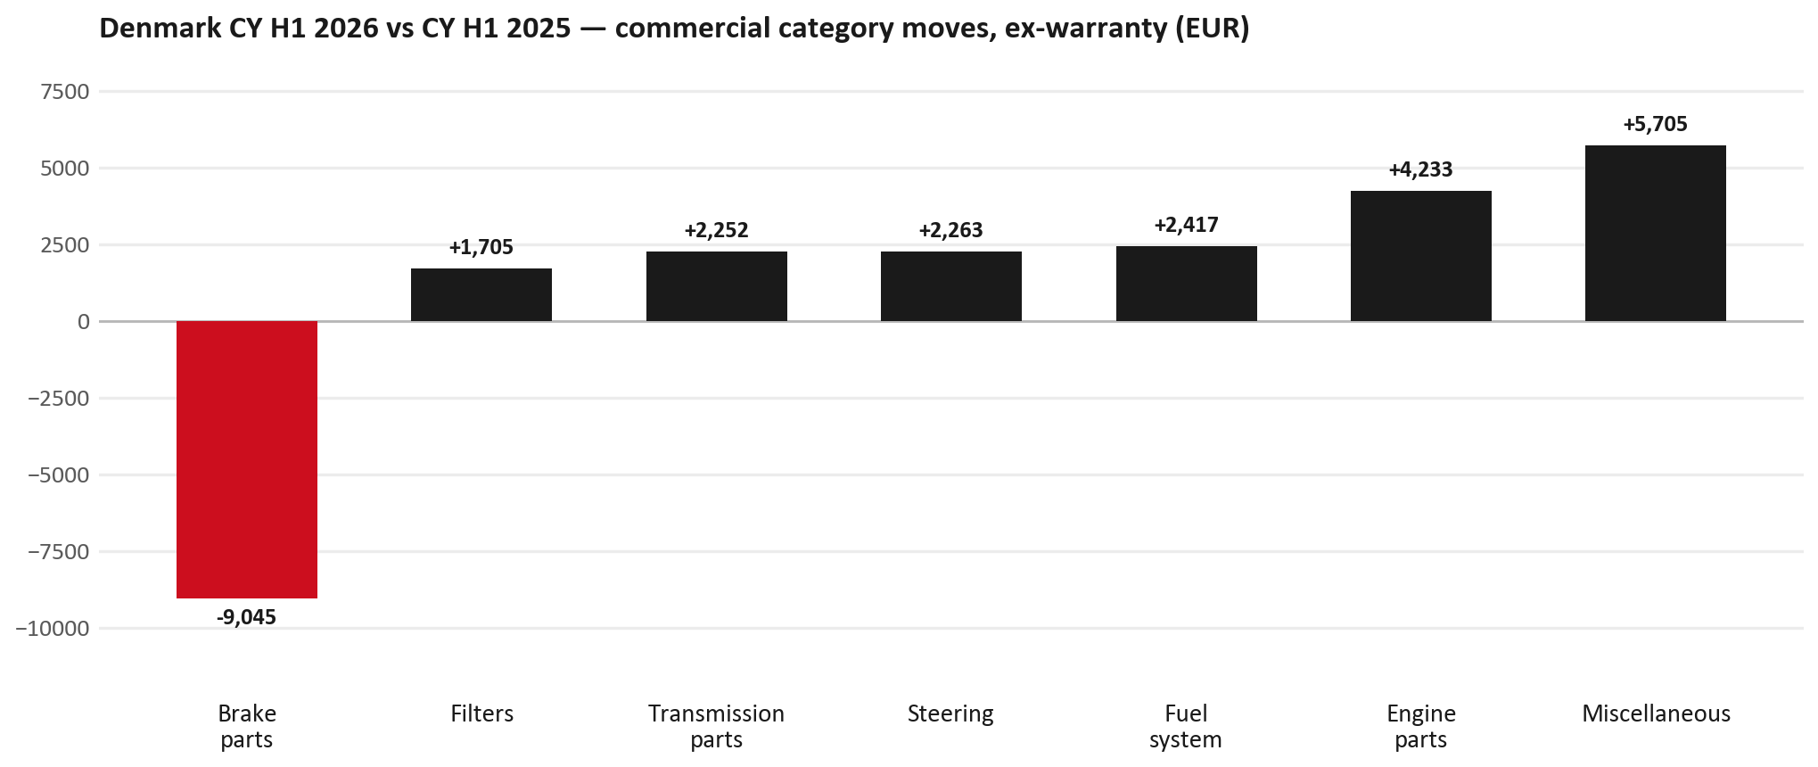
PARTS PERFORMANCE
Parts Performance — CY H1 2026 vs CY H1 2025 (commercial, ex-warranty)
TAKEAWAYS
— Commercial parts billing (warranty/campaign excluded) EUR 85K against EUR 61K a year earlier — +39.6% (CY H1 2026 vs CY H1 2025, Jan–Jun).
— Largest PN drops: 8983767550 (ROTOR; DISC BRK,FRT) EUR -5K, 62 fewer pcs; 8975546610 (PAD KIT; CALIPER,DIS) [TF*] EUR -3K, 41 fewer pcs; 8983682091 (PIPE; EXH) EUR -2K, 1 fewer pcs.
— Largest PN gains: 8983980531 (CAMERA; REAR) EUR 1K, 7 more pcs; 8972746690 (TANK ASM; DEF) EUR 1K, 1 more pcs; 8983282070 (ELEMENT; OIL FILTER) [FRR,FS*,FTR,FVR,NPS,N*R] EUR 1K, 72 more pcs.
— About EUR 9K of claim-matched PN billing was stripped so this chart is aftermarket demand, not warranty.
3

Slide 4
PARTS PERFORMANCE — BRAKE PARTS
Brake parts — CY H1 2026 vs CY H1 2025 (commercial, ex-warranty)
— EUR 14,607 (CY H1 2025) to EUR 5,562 (CY H1 2026), down EUR 9,045 (-62%).
— Largest part numbers driving the decline (by EUR):
— 8983767550 (ROTOR; DISC BRK,FRT): EUR 6,625 to EUR 1,583, 62 fewer pieces.
— 8975546610 (PAD KIT; CALIPER,DISC BRK,FRT · TF*): EUR 4,268 to EUR 834, 41 fewer pieces.
— 8983767530 (ROTOR; DISC BRK,FRT): EUR 1,076 to EUR 0, 12 fewer pieces.
— 8981246643 (ROTOR; DISC BRK,FRT): EUR 333 to EUR 0, 4 fewer pieces.
Questions for us to work through together
— Is pad and rotor pricing competitive against what the dealers can buy locally?
— Is any of this stock timing on your side rather than end demand?
— Are dealers still quoting these part numbers, or have they dropped off the workshop menu?
4

Slide 5
PARTS PERFORMANCE — GROWTH
Where volume grew — CY H1 2026 vs CY H1 2025 (commercial, ex-warranty)
Part | Description | Model | CY H1 2025 | CY H1 2026 | Δ EUR
8983980531 | CAMERA; REAR | — | EUR 190 | EUR 1,521 | EUR 1,331
8972746690 | TANK ASM; DEF | — | EUR 1,298 | EUR 2,600 | EUR 1,302
8983282070 | ELEMENT; OIL FILTER | FRR,FS*,FTR,FVR, | EUR 846 | EUR 1,918 | EUR 1,073
8983320160 | VALVE; EGR | — | EUR 527 | EUR 1,508 | EUR 981
8982330922 | LAMP ASM; RR COMB | — | EUR 565 | EUR 1,200 | EUR 635
8978279610 | PAD KIT; DISC BRK,W/O SHIM & | — | EUR 1,042 | EUR 1,649 | EUR 607
— Miscellaneous +191%, Engine parts +2232%, Fuel system +578% — where the commercial volume went.
— Claim-matched PNs (21 distinct) and campaign/recall text matches are already excluded from this growth list. Residual warranty on unmapped PNs can remain.
— PNs ranked by largest EUR increase (prior-period sales > 0). Worth agreeing which of these are repeatable and which were one-off.
5

Slide 6
PARTS PERFORMANCE
New Business — validation queue (CY H1 2026)
Part | Description | Current sales | Review
7551846320 | TRANSFER ASM | EUR 2,333 | Validate
7552348290 | STEERING UNIT | EUR 2,123 | Warranty / campaign
8983320621 | PUMP ASM; FUEL,SUPPLY | EUR 2,053 | Validate
8982599691 | TURBOCHARGER ASM | EUR 2,005 | Validate
8981901180 | DRIVE ASM; FINAL,RR | EUR 1,546 | Validate
8983929650 | SHAFT ASM; FRT DRIVE | EUR 1,311 | Warranty / campaign
— These lines had no prior-period sales, so they are kept out of the incremental-growth table.
— A first sale can be a new model, a supersession, timing, or a warranty campaign. It is not treated as a commercial win until that cause is confirmed.
6

Slide 7
SALES-TO-DEALER
Sales-to-Dealer outlook — FY2027
— FY2026 Sales-to-Dealer is EUR 572,864 (reported KPI).
— The working fleet movement into FY2027 is +1.8%.
— Applying fleet movement, the 5% price adjustment and 1.8% additional growth gives a FY2027 Sales-to-Dealer target of EUR 623,128.
— The discussion is held in Sales-to-Dealer amounts; ISZE billing remains an internal reconciliation measure.
7

Slide 8
GPS
GPS Capture: 71.0%
— GPS measures your actual parts purchases against the full potential of your fleet.
— Denmark today: 71.0% (FY2026 purchases against the CY2025 fleet potential).
— Fleet potential: EUR 213K on 851 vehicles.
— Real, sustained headroom above 71.0% — the service-parts and SPA discussion are both direct levers on it.
8

Slide 9
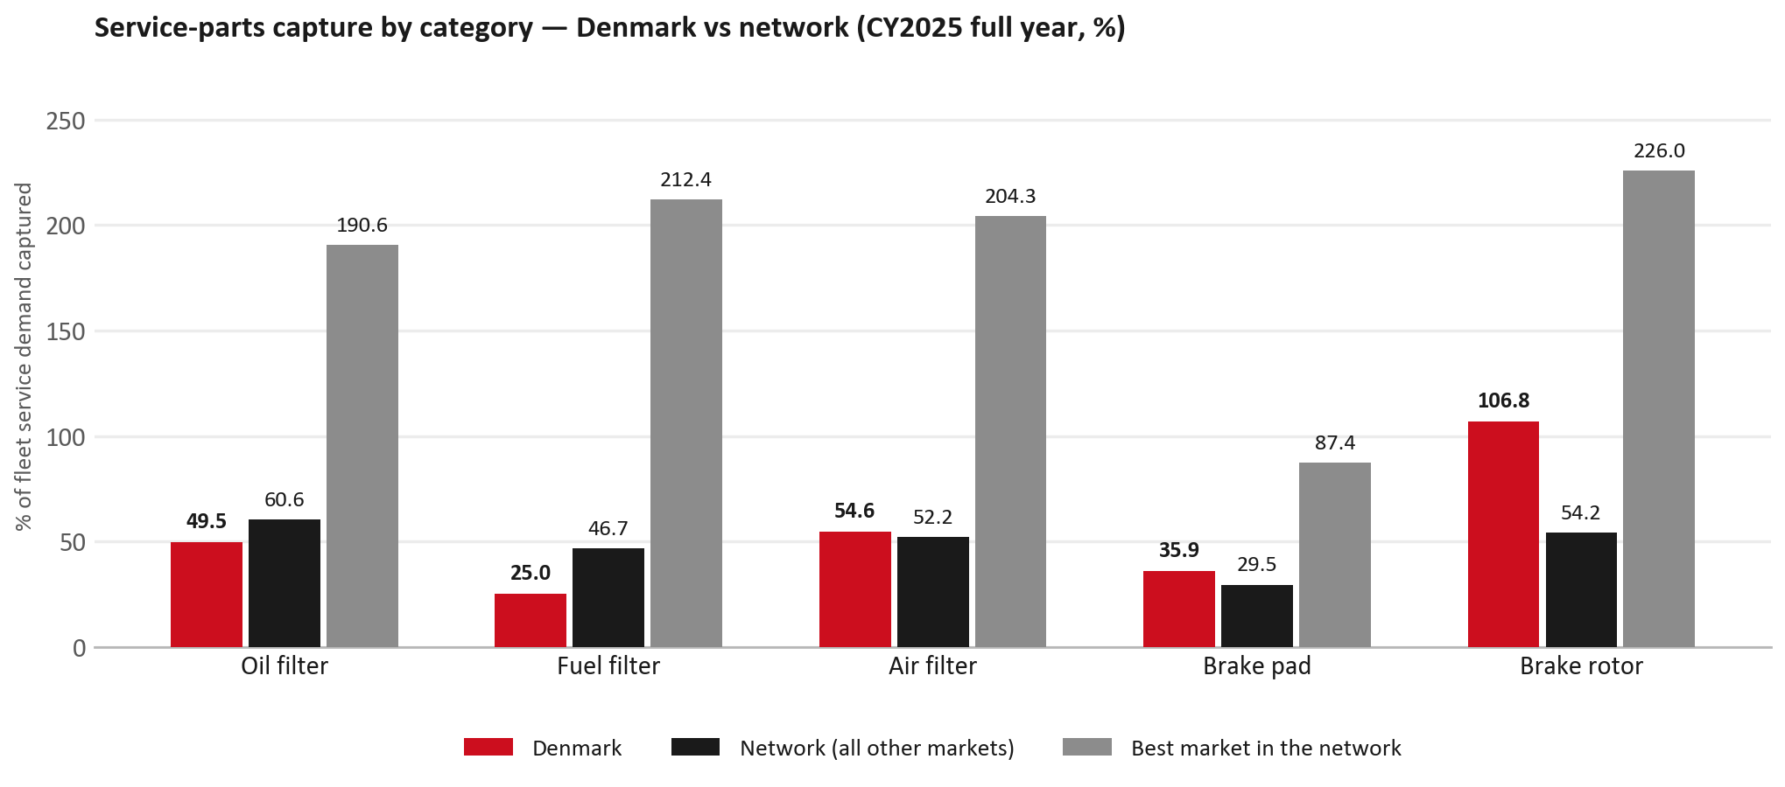
SERVICE-PARTS COVERAGE
Service-parts coverage: fuel filter is the clear gap
TAKEAWAYS
— Fuel filter 25.0% against 46.7% for the rest of the network.
— Oil filter 49.5% against 60.6% for the rest of the network.
— Every market here is measured on the same fleet-and-interval model, so the comparison is like-for-like even where the underlying interval assumption is debatable.
— Worth agreeing which category we tackle first, and what the joint action is.
9

Slide 10
IDS 2026 — DEALER STANDARD
IDS 2026: Denmark averages 75.7%, above the 74.8% network benchmark
Dealer | Total % | Global rank
Anders Hansen Automobiler | 97.5% | #11
Fyns-Bilsalg A/S | 86.1% | #164
Thybo Biler | 85.7% | #172
Denmark country average | 75.7% | —
Network average (all IDS 2026) | 74.8% | —
Pedersen Og Nielsen Aabenraa | 74.6% | #348
Varebil-Leasing Kolding | 66.4% | #430
Kjerulff A/S | 0.0% | #490
— 20 dealers assessed across Premises, Organisation, Service, Parts and Vehicle Sales.
— The country average sits 0.9 points above the network.
— The spread is the point: 98 points between the strongest and weakest dealer.
— Dealer-by-dealer detail and individual feedback are available as a separate pack — worth agreeing which dealers to visit, and when.
10

Slide 11
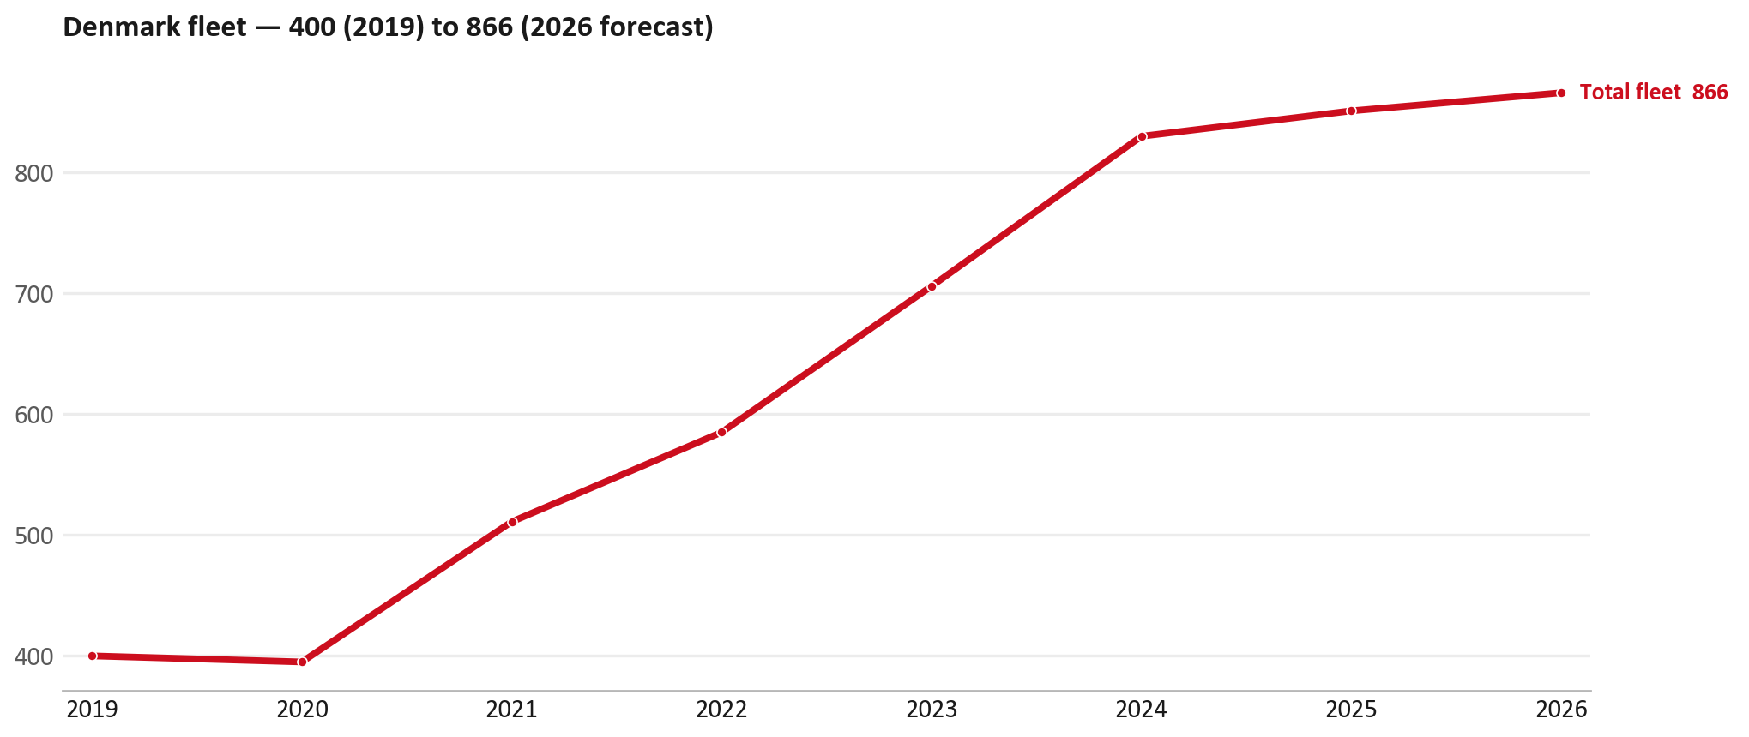
FLEET & FY2027 TARGET
The fleet is expected to grow in 2026
WHAT THIS MEANS FOR FY2027
— Fleet size (calendar year): 851 vehicles in 2025 → 866 working estimate for end-2026 (+1.8%).
— The chart is calendar years 2019–2026 only. 2026 is a working year-end estimate, not a fiscal-year figure.
— End-2026 mix: LCV / D-Max 865; CV — LD 1.
— The FY2027 Sales-to-Dealer target starts from that fleet change, then applies a 5% price adjustment and 1.8% additional growth.
— The target reflects the working fleet outlook without extending the chart beyond 2026.
11

Slide 12
FLEET & FY2027 TARGET
How the FY2027 target is built
Sales-to-Dealer amount bridge
Step | Amount
FY2026 Sales-to-Dealer (reported KPI) | EUR 572,864
After fleet movement (+1.8%) | EUR 582,961
After price adjustment (+5%) | EUR 612,110
FY2027 target after additional growth (+1.8%) | EUR 623,128
— The FY2027 target is +8.8% versus the FY2026 Sales-to-Dealer base.
— The FY2026 base is the reported Sales-to-Dealer KPI.
12

Slide 13
FY2027 TARGET
What the FY2027 target reflects
1
Your fleet
2
The price move
— The working fleet movement used in the target is +1.8%.
— ISZE is applying a 5% price adjustment for FY2027, consistent with every ISZE market this year.
— It is built into the per-vehicle rate above, not added separately on top.
What it means for your target
 | Value
FY2027 Sales-to-Dealer target | EUR 623,128
vs FY2026 Sales-to-Dealer (EUR 572,864) | +8.8%
— As in previous cycles we would expect an incentive to sit alongside this adjustment — that approval is still pending on our side.
— Until the incentive is confirmed, treat the FY2027 target as the working bridge (fleet × price × additional growth), not a locked commercial commitment.
13

Slide 14
SPA
SPA
1
DENMARK proposal
2
ISZE review
3
Counter-proposal
4
Final approval
— Isuzu Danmark submits a proposed parts list.
— ISZE reviews the proposal against network data and fit.
— ISZE returns a counter-proposal where needed.
— Signed off by ISZE management.
Purpose: higher turnover for both sides.
14

Slide 15
R&M
R&M — let's align on the market
M
Market
S
Servicing & R&M
— How is the market moving for you right now?
— How much of your volume is fleet business rather than retail?
— Where do you see the biggest hurdles this year?
— Where are your real strengths in this segment?
— Do you offer an R&M or service-plan product today?
— What share of the parc do you retain for servicing after year three?
— Does R&M business come bundled with fleet tenders — roughly what share?
— What would it take to bring more out-of-network servicing back?
15

Slide 16
ASK
Part-level Sales-to-Dealer Data
1
Already halfway there
2
Sharper insight
3
Shared benefit
— You already report Sales-to-Dealer monthly. The ask is the same data at part-number level.
— Part-by-part visibility separates a stock movement from a lost job — and tells us where the volume actually went.
— Better availability on your fast movers, a sharper target for us, and a factual basis for the SPA — same data, both sides gain.
Requested from 01/01/2025, part number level, monthly.
16

Slide 17
SUMMARY
Next steps
— Align on the FY2027 Sales-to-Dealer bridge (fleet, price, additional growth) — working figure EUR 623,128 (+8.8% vs FY2026 base).
— Confirm the incentive alongside the price adjustment; lock the target once that approval is through.
— Brake parts: agree which category we tackle first, and what the joint action is.
— Agree part-level Sales-to-Dealer data sharing, effective 01/01/2025.
— SPA: DENMARK proposal, ISZE review and counter-proposal cycle to follow.
— IDS 2026: agree dealer visit dates, starting with the lower-scoring dealers.
17

Slide 18
Moving the World – for You

