Slide 1

ISZE · MALTA · MALTA
Malta Sales Review
& FY2027 Target
GasanZammit Motors · August 2026

Slide 2
MALTA MEETING
Agenda
— Parts Performance — category movers
— Parts Performance — Body parts
— Parts Performance — Air conditioning
— Parts Performance — Electrical sensors
— Parts Performance — where volume grew
— New Business — validation queue
— Sales-to-Dealer Outlook
— GPS Capture
— Service-Parts Coverage
— IDS 2026 — Dealer Standard
— Fleet & FY2027 Target
— SPA — status
— R&M — market discussion
— Data request: part-level Sales-to-Dealer
— Next steps
2

Slide 3
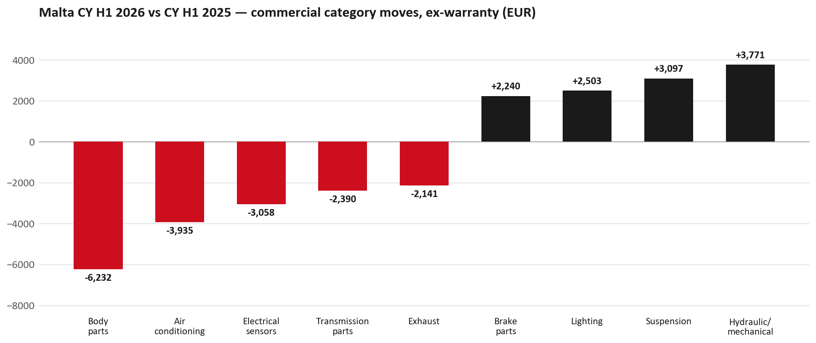
PARTS PERFORMANCE
Parts Performance — CY H1 2026 vs CY H1 2025 (commercial, ex-warranty)
TAKEAWAYS
— Commercial parts billing (warranty/campaign excluded) EUR 101K against EUR 101K a year earlier — +0.1% (CY H1 2026 vs CY H1 2025, Jan–Jun).
— Largest PN drops: 8983042280 (TRANSMISSION ASM; AU) EUR -3K, 1 fewer pcs; 8975536860 (BODY ASM; REAR) EUR -3K, 2 fewer pcs; 8983023390 (CONTROL UNIT; SRS) EUR -2K, 7 fewer pcs.
— Largest PN gains: 8983807440 (ABSORBER ASM; SHOCK,) [NQR] EUR 1K, 56 more pcs; 8971424521 (JOINT ASM; BALL,LWR ) EUR 1K, 43 more pcs; 8981532774 (BUMPER; RR) EUR 1K, 3 more pcs.
— About EUR 4K of claim-matched PN billing was stripped so this chart is aftermarket demand, not warranty.
3

Slide 4
PARTS PERFORMANCE — BODY PARTS
Body parts — CY H1 2026 vs CY H1 2025 (commercial, ex-warranty)
— EUR 30,941 (CY H1 2025) to EUR 24,709 (CY H1 2026), down EUR 6,232 (-20%).
— Largest part numbers driving the decline (by EUR):
— 8975509392 (BUMPER ASM; FRT): EUR 1,896 to EUR 118, 13 fewer pieces.
— 8971118074 (PANEL; ENG HOOD): EUR 1,207 to EUR 0, 1 fewer pieces.
— 8980320980 (PANEL ASM; FRT): EUR 607 to EUR 0, 3 fewer pieces.
— 8979078300 (STEP; BODY SIDE): EUR 732 to EUR 184, 3 fewer pieces.
Questions for us to work through together
— Is this pricing against what the dealers can buy locally?
— Is any of this stock timing on your side rather than end demand?
— What would make the biggest difference to keep this business with us?
4

Slide 5
PARTS PERFORMANCE — AIR CONDITIONING
Air conditioning — CY H1 2026 vs CY H1 2025 (commercial, ex-warranty)
— EUR 6,340 (CY H1 2025) to EUR 2,405 (CY H1 2026), down EUR 3,935 (-62%).
— Largest part numbers driving the decline (by EUR):
— 8974995480 (FILTER; ACL · TFR,TFS,UCR,UCS): EUR 1,503 to EUR 318, 55 fewer pieces.
— 8981394280 (FILTER; BLOWER UNIT · TF*,UC*): EUR 1,119 to EUR 0, 50 fewer pieces.
— 8981402660 (FILTER; ACL · TFR,TFS,UCR,UCS): EUR 1,116 to EUR 0, 50 fewer pieces.
— 8975435771 (COMPRESSOR ASM; A/C): EUR 540 to EUR 0, 1 fewer pieces.
Questions for us to work through together
— Is the seasonal pattern different this year, or is this a real shift?
— Are cabin filters and A/C service being sold as a package?
5

Slide 6
PARTS PERFORMANCE — ELECTRICAL SENSORS
Electrical sensors — CY H1 2026 vs CY H1 2025 (commercial, ex-warranty)
— EUR 9,600 (CY H1 2025) to EUR 6,541 (CY H1 2026), down EUR 3,058 (-32%).
— Largest part numbers driving the decline (by EUR):
— 8983023390 (CONTROL UNIT; SRS): EUR 2,346 to EUR 0, 7 fewer pieces.
— 8982437400 (SWITCH; COMB): EUR 994 to EUR 318, 8 fewer pieces.
— 8983712150 (SENSOR; SPD,RR WHEEL): EUR 587 to EUR 196, 2 fewer pieces.
— 8982437930 (SWITCH; COMB): EUR 808 to EUR 455, 5 fewer pieces.
Questions for us to work through together
— Is this pricing against what the dealers can buy locally?
— Is any of this stock timing on your side rather than end demand?
— What would make the biggest difference to keep this business with us?
6

Slide 7
PARTS PERFORMANCE — GROWTH
Where volume grew — CY H1 2026 vs CY H1 2025 (commercial, ex-warranty)
Part | Description | Model | CY H1 2025 | CY H1 2026 | Δ EUR
8983807440 | ABSORBER ASM; SHOCK,RR | NQR | EUR 189 | EUR 1,572 | EUR 1,382
8971424521 | JOINT ASM; BALL,LWR CONT ARM | — | EUR 41 | EUR 1,033 | EUR 992
8981532774 | BUMPER; RR | — | EUR 470 | EUR 1,189 | EUR 719
8983204550 | ABSORBER ASM; SHOCK,FRT | — | EUR 85 | EUR 630 | EUR 545
8982330902 | LAMP ASM; RR COMB | — | EUR 245 | EUR 788 | EUR 544
8981032020 | PANEL; DEFLECTOR | — | EUR 262 | EUR 804 | EUR 542
— Hydraulic / mechanical +144%, Suspension +128%, Lighting +27% — where the commercial volume went.
— Claim-matched PNs (37 distinct) and campaign/recall text matches are already excluded from this growth list. Residual warranty on unmapped PNs can remain.
— PNs ranked by largest EUR increase (prior-period sales > 0). Worth agreeing which of these are repeatable and which were one-off.
7

Slide 8
PARTS PERFORMANCE
New Business — validation queue (CY H1 2026)
Part | Description | Current sales | Review
8972746690 | TANK ASM; DEF | EUR 2,169 | Validate
8978775550 | CAMERA ASM | EUR 1,072 | Validate
5874123812 | INTERFACE MX2-T | EUR 1,069 | Validate
8982447940 | PAD KIT; CALIPER,DISC BRK,FRT | EUR 894 | Validate
8975425400 | ELEMENT; FUEL FILTER | EUR 820 | Validate
8979488071 | ROTOR; DISC BRK,FRT | EUR 814 | Validate
— These lines had no prior-period sales, so they are kept out of the incremental-growth table.
— A first sale can be a new model, a supersession, timing, or a warranty campaign. It is not treated as a commercial win until that cause is confirmed.
8

Slide 9
SALES-TO-DEALER
Sales-to-Dealer outlook — FY2027
— FY2026 Sales-to-Dealer is EUR 553,873 (reported KPI).
— The working fleet movement into FY2027 is -2.3%.
— Applying fleet movement, the 5% price adjustment and 1.8% additional growth gives a FY2027 Sales-to-Dealer target of EUR 578,373.
— The discussion is held in Sales-to-Dealer amounts; ISZE billing remains an internal reconciliation measure.
9

Slide 10
GPS
GPS Capture: 51.0%
— GPS measures your actual parts purchases against the full potential of your fleet.
— Malta today: 51.0% (FY2026 purchases against the CY2025 fleet potential).
— Fleet potential: EUR 379K on 1,040 vehicles.
— Real, sustained headroom above 51.0% — the service-parts and SPA discussion are both direct levers on it.
10

Slide 11
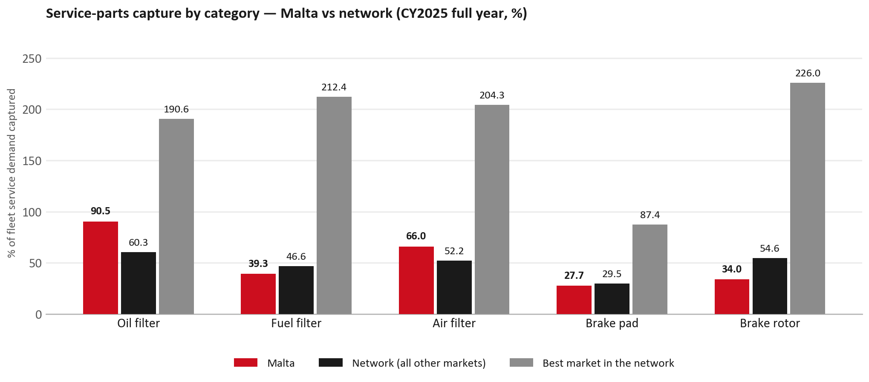
SERVICE-PARTS COVERAGE
Service-parts coverage: brake rotor is the clear gap
TAKEAWAYS
— Brake rotor 34.0% against 54.6% for the rest of the network.
— Fuel filter 39.3% against 46.6% for the rest of the network.
— Every market here is measured on the same fleet-and-interval model, so the comparison is like-for-like even where the underlying interval assumption is debatable.
— Worth agreeing which category we tackle first, and what the joint action is.
11

Slide 12
IDS 2026 — DEALER STANDARD
IDS 2026: Malta averages 89.3%, above the 74.8% network benchmark
Dealer | Total % | Global rank
Gasanzammit Motors Limited | 89.3% | #109
Malta country average | 89.3% | —
Network average (all IDS 2026) | 74.8% | —
Gasanzammit Motors Limited | 89.3% | #109
— 1 dealers assessed across Premises, Organisation, Service, Parts and Vehicle Sales.
— The country average sits 14.5 points above the network.
— The spread is the point: 0 points between the strongest and weakest dealer.
— Dealer-by-dealer detail and individual feedback are available as a separate pack — worth agreeing which dealers to visit, and when.
12

Slide 13
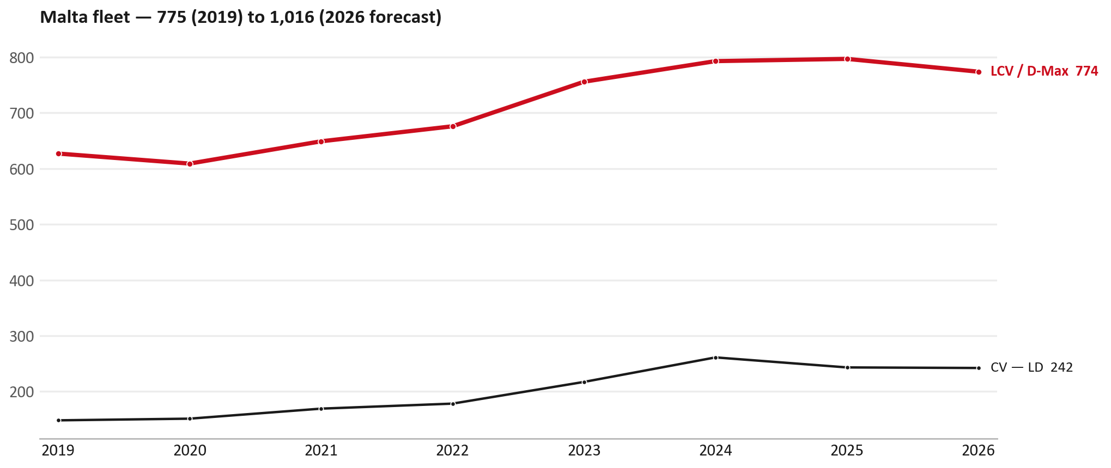
FLEET & FY2027 TARGET
The fleet is expected to decline in 2026
WHAT THIS MEANS FOR FY2027
— Fleet size (calendar year): 1,040 vehicles in 2025 → 1,016 working estimate for end-2026 (-2.3%).
— The chart is calendar years 2019–2026 only. 2026 is a working year-end estimate, not a fiscal-year figure.
— The FY2027 Sales-to-Dealer target starts from that fleet change, then applies a 5% price adjustment and 1.8% additional growth.
— So the target is built from a slightly smaller fleet — not from an assumed growth story.
13

Slide 14
FLEET & FY2027 TARGET
How the FY2027 target is built
Sales-to-Dealer amount bridge
Step | Amount
FY2026 Sales-to-Dealer (reported KPI) | EUR 553,873
After fleet movement (-2.3%) | EUR 541,091
After price adjustment (+5%) | EUR 568,146
FY2027 target after additional growth (+1.8%) | EUR 578,373
— The FY2027 target is +4.4% versus the FY2026 Sales-to-Dealer base.
— The FY2026 base is the reported Sales-to-Dealer KPI.
14

Slide 15
FY2027 TARGET
What the FY2027 target reflects
1
Your fleet
2
The price move
— The working fleet movement used in the target is -2.3%.
— ISZE is applying a 5% price adjustment for FY2027, consistent with every ISZE market this year.
— It is built into the per-vehicle rate above, not added separately on top.
What it means for your target
 | Value
FY2027 Sales-to-Dealer target | EUR 578,373
vs FY2026 Sales-to-Dealer (EUR 553,873) | +4.4%
— As in previous cycles we would expect an incentive to sit alongside this adjustment — that approval is still pending on our side.
— Until the incentive is confirmed, treat the FY2027 target as the working bridge (fleet × price × additional growth), not a locked commercial commitment.
15

Slide 16
SPA
SPA
1
MALTA proposal
2
ISZE review
3
Counter-proposal
4
Final approval
— GasanZammit Motors submits a proposed parts list.
— ISZE reviews the proposal against network data and fit.
— ISZE returns a counter-proposal where needed.
— Signed off by ISZE management.
Purpose: higher turnover for both sides.
16

Slide 17
R&M
R&M — let's align on the market
M
Market
S
Servicing & R&M
— How is the market moving for you right now?
— How much of your volume is fleet business rather than retail?
— Where do you see the biggest hurdles this year?
— Where are your real strengths in this segment?
— Do you offer an R&M or service-plan product today?
— What share of the parc do you retain for servicing after year three?
— Does R&M business come bundled with fleet tenders — roughly what share?
— What would it take to bring more out-of-network servicing back?
17

Slide 18
ASK
Part-level Sales-to-Dealer Data
1
Already halfway there
2
Sharper insight
3
Shared benefit
— You already report Sales-to-Dealer monthly. The ask is the same data at part-number level.
— Part-by-part visibility separates a stock movement from a lost job — and tells us where the volume actually went.
— Better availability on your fast movers, a sharper target for us, and a factual basis for the SPA — same data, both sides gain.
Requested from 01/01/2025, part number level, monthly.
18

Slide 19
SUMMARY
Next steps
— Align on the FY2027 Sales-to-Dealer bridge (fleet, price, additional growth) — working figure EUR 578,373 (+4.4% vs FY2026 base).
— Confirm the incentive alongside the price adjustment; lock the target once that approval is through.
— Body parts / Air conditioning / Electrical sensors: agree which category we tackle first, and what the joint action is.
— Agree part-level Sales-to-Dealer data sharing, effective 01/01/2025.
— SPA: MALTA proposal, ISZE review and counter-proposal cycle to follow.
— IDS 2026: agree dealer visit dates, starting with the lower-scoring dealers.
19

Slide 20
Moving the World – for You

Slide 21
MALTA · GASANZAMMIT MOTORS
Deep dive — detail behind the Mode A story
— Extra detail for meeting prep — pick which slides to share with GasanZammit Motors.
— Mode A ends on the previous closing slide.
— Label in all charts: “Genuine with BVP alternative” (not “genuine contested”).
21

Slide 22
AGENDA
Deep-dive agenda
— GPS — fiscal year (headline vs excl. warranty; max two lines)
— FY2025 → FY2026 wallet mix (Genuine / Genuine with BVP alternative / BVP)
— Where the money went — outside the service-parts basket (FY)
— Service parts: CY capture vs network + FY billing (capture % is CY-only by design)
— Brake pads — BVP share of total brake pad sales (FY)
— AIM exposure
— Warranty — two lenses
— How to use this in the meeting
22

Slide 23
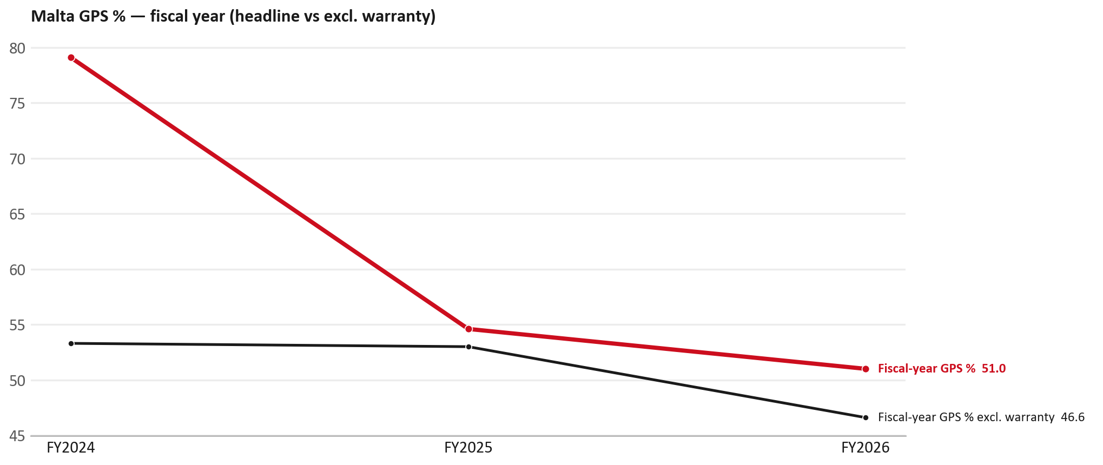
GPS
GPS: fiscal year headline vs after warranty
TAKEAWAYS
— Red = fiscal-year GPS (frozen CY2025 wallet). FY25 54.6% → FY26 51.0%.
— Black = fiscal GPS after removing warranty parts (€). FY26 ≈ 46.6% (warranty EUR 16,875 ≈ 9% of FY26 billing).
— Fleet 1,040 → 1,016 (working year-end estimate under the FY2027 target).
23

Slide 24
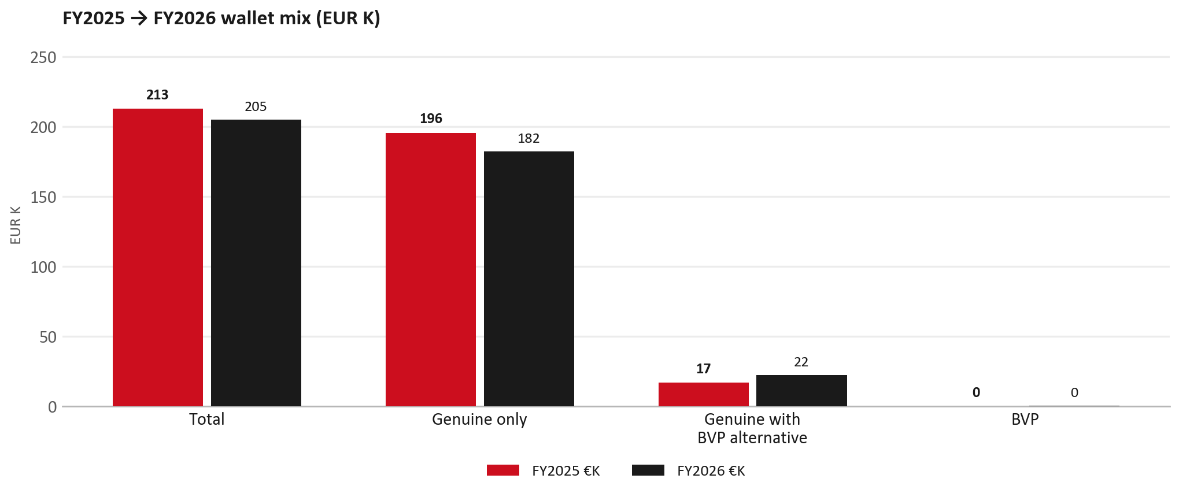
WALLET MIX
FY2025 → FY2026 wallet mix
— Total EUR 212,812 → EUR 205,187 (-3.6%).
— Genuine only EUR -13,364.
— Genuine with BVP alternative EUR 5,368; BVP EUR 371 (0.2% of FY26 wallet).
— Display label locked: Genuine with BVP alternative.
24

Slide 25
WALLET MIX
FY wallet mix — detail
 | FY2025 | FY2026 | Δ
Total | EUR 212,812 | EUR 205,187 | EUR -7,626
Genuine only | EUR 195,768 | EUR 182,404 | EUR -13,364
Genuine with BVP alternative | EUR 17,044 | EUR 22,412 | EUR 5,368
BVP | EUR 0 | EUR 371 | EUR 371
BVP % of wallet | 0.0% | 0.2% | +0.2 pp
25

Slide 26
DRIVERS
Where the genuine drop sits (FY2025 → FY2026)
— Genuine-only sales moved EUR -13,364 from FY2025 to FY2026.
— Of that, the routine service basket (filters, pads, rotors) moved EUR -1,946 on genuine-only; BVP in that basket moved EUR 42.
— So about 85% of the genuine-only drop sits outside routine service parts.
— Meeting line: check high-value assemblies / sensors before blaming the filter or pad menu.
26

Slide 27
DRIVERS
Largest part-number drops (FY24→FY25) — outside service filters
Part | Description | Δ EUR
8975293220 | ENGINE ASM | -25,100
8983320764 | DPD ASM | -2,782
8974725274 | RAIL; ROOF | -1,875
8974725284 | RAIL; ROOF | -1,875
5878323990 | KING PIN KIT | -1,598
8983550720 | partikel sensor | -1,415
8974922400 | DISPLAY; MULTI | -1,084
— Check warranty / campaign coding before calling competitive leakage.
27

Slide 28
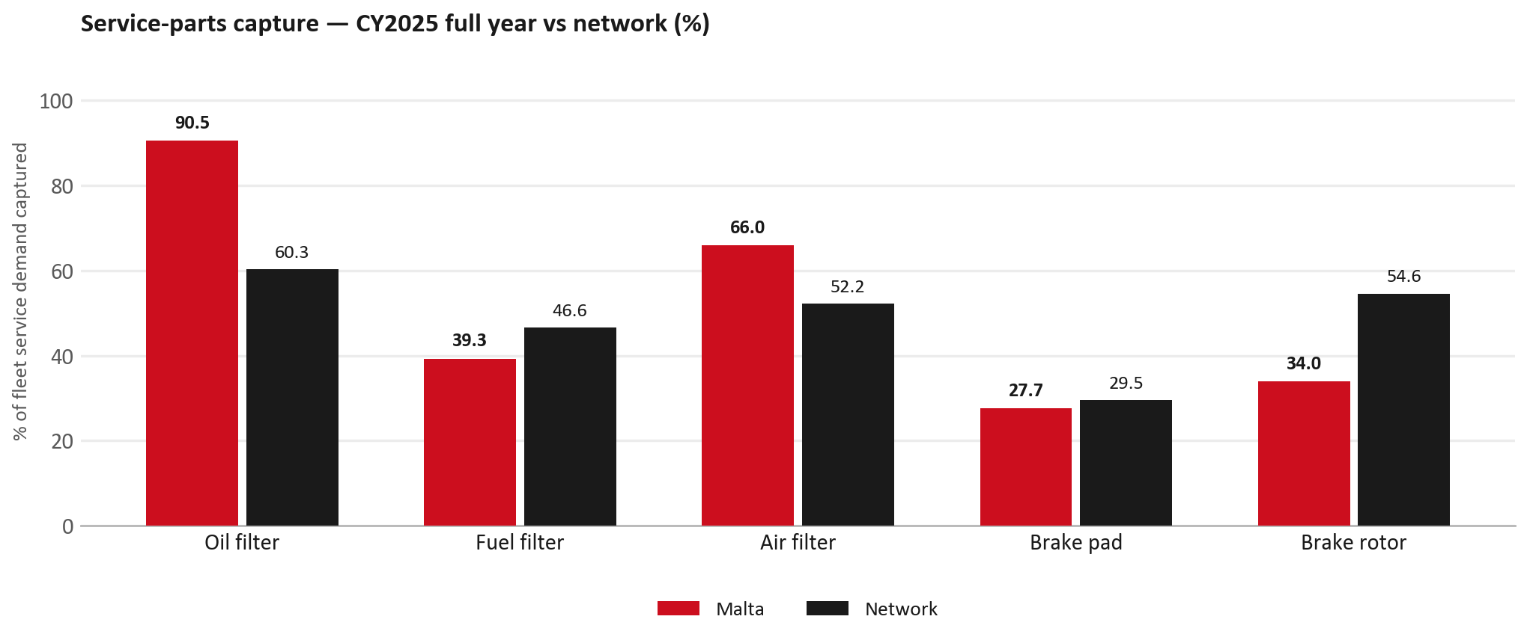
SERVICE PARTS
Service-parts capture vs network (calendar year)
TAKEAWAYS
— Capture % is calendar-year (full CY2025). Fleet demand is modelled on calendar years — there is no matching fiscal-year capture %.
— Oil filter 90.5% vs network 60.3%; Fuel filter 39.3% vs network 46.6%; Air filter 66.0% vs network 52.2%.
— Next slide: fiscal-year € billing in the same five categories.
— Primary lens = total capture (not genuine-only).
28

Slide 29
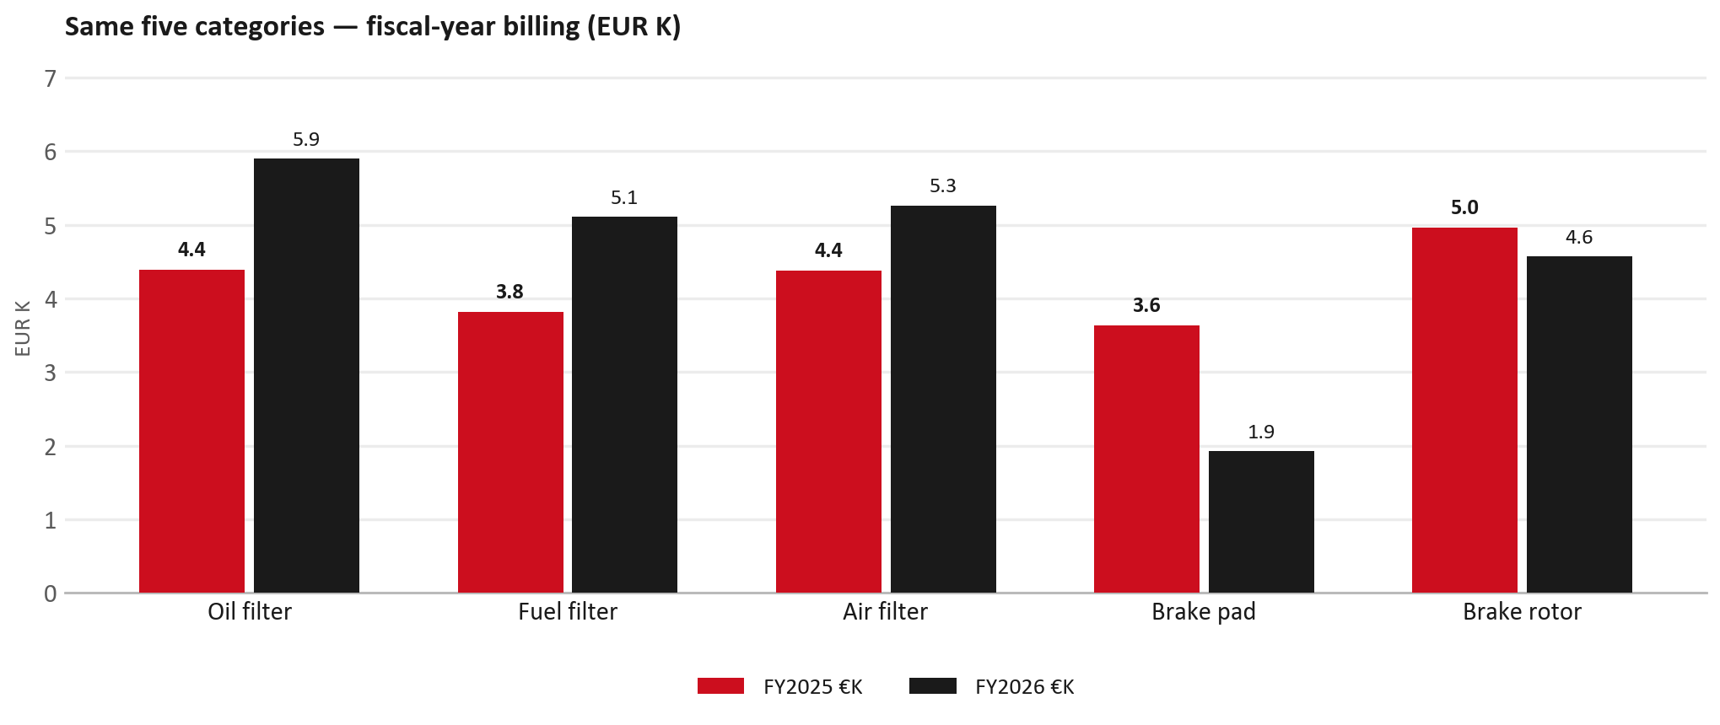
SERVICE PARTS · FY
Service-parts billing by fiscal year (same five lines)
TAKEAWAYS
— This is Sales-to-GasanZammit Motors € in fiscal years — not capture % of fleet demand.
— Use both lenses — do not mix % capture with € billing.
— Primary = total sales in the basket.
29

Slide 30
BRAKES
Brake pads — BVP share of total brake pad sales (FY)
 | FY2025 | FY2026
Genuine qty | 0 | 0
BVP qty | 0 | 0
BVP share of total brake pad sales (€) | 0% | 0%
— BVP share = BVP € ÷ all brake-pad € billed (genuine + BVP). Not a PMS capture %.
— Wallet-level BVP is still only ~0.2% of FY26 — do not generalise a pad story to the whole wallet.
30

Slide 31
AIM
AIM exposure
Year | High-risk € | High-risk % | Quadrant
2023 | EUR 1,925 | 1.0% | Defend (high GPS - high capture)
2024 | EUR 1,771 | 0.8% | Attach gap (high GPS - low capture)
2025 | EUR 2,991 | 1.5% | Defend (high GPS - high capture)
— High-risk € is catalogue AIM exposure, not proven walk-out.
— Open on jobs not bought through the distributor — not a street IAM war alone.
31

Slide 32
WARRANTY
Warranty — two real lenses
1
CY2025 claim-price parts
2
Fiscal GPS expense
— EUR 18,219 (claim-price basis).
— Calendar-year claim price basis.
— CV and LCV warranty.
— FY24 EUR 0 · FY25 EUR 6,073 · FY26 EUR 16,875.
— Source row: GasanZammit.
— Ex-warranty GPS = (net − warranty) ÷ frozen CY25 wallet.
— Both numbers are real — never mix them on one slide without labels.
32

Slide 33
BRIDGE
How to use this in the meeting
If they say… | You know…
BVP is eating genuine | Wallet BVP ~0.2%. Check pads as a local exception only.
GPS looks fine / too high | FY26 headline 51.0%; excl. warranty ≈ 46.6%.
Service parts are fine | CY2025 capture vs network (previous slides) + FY billing lens.
33

Slide 34
Moving the World – for You

